Slide 1

Welcome to English Corner
Professors
John and Marie Murdoch

Slide 2
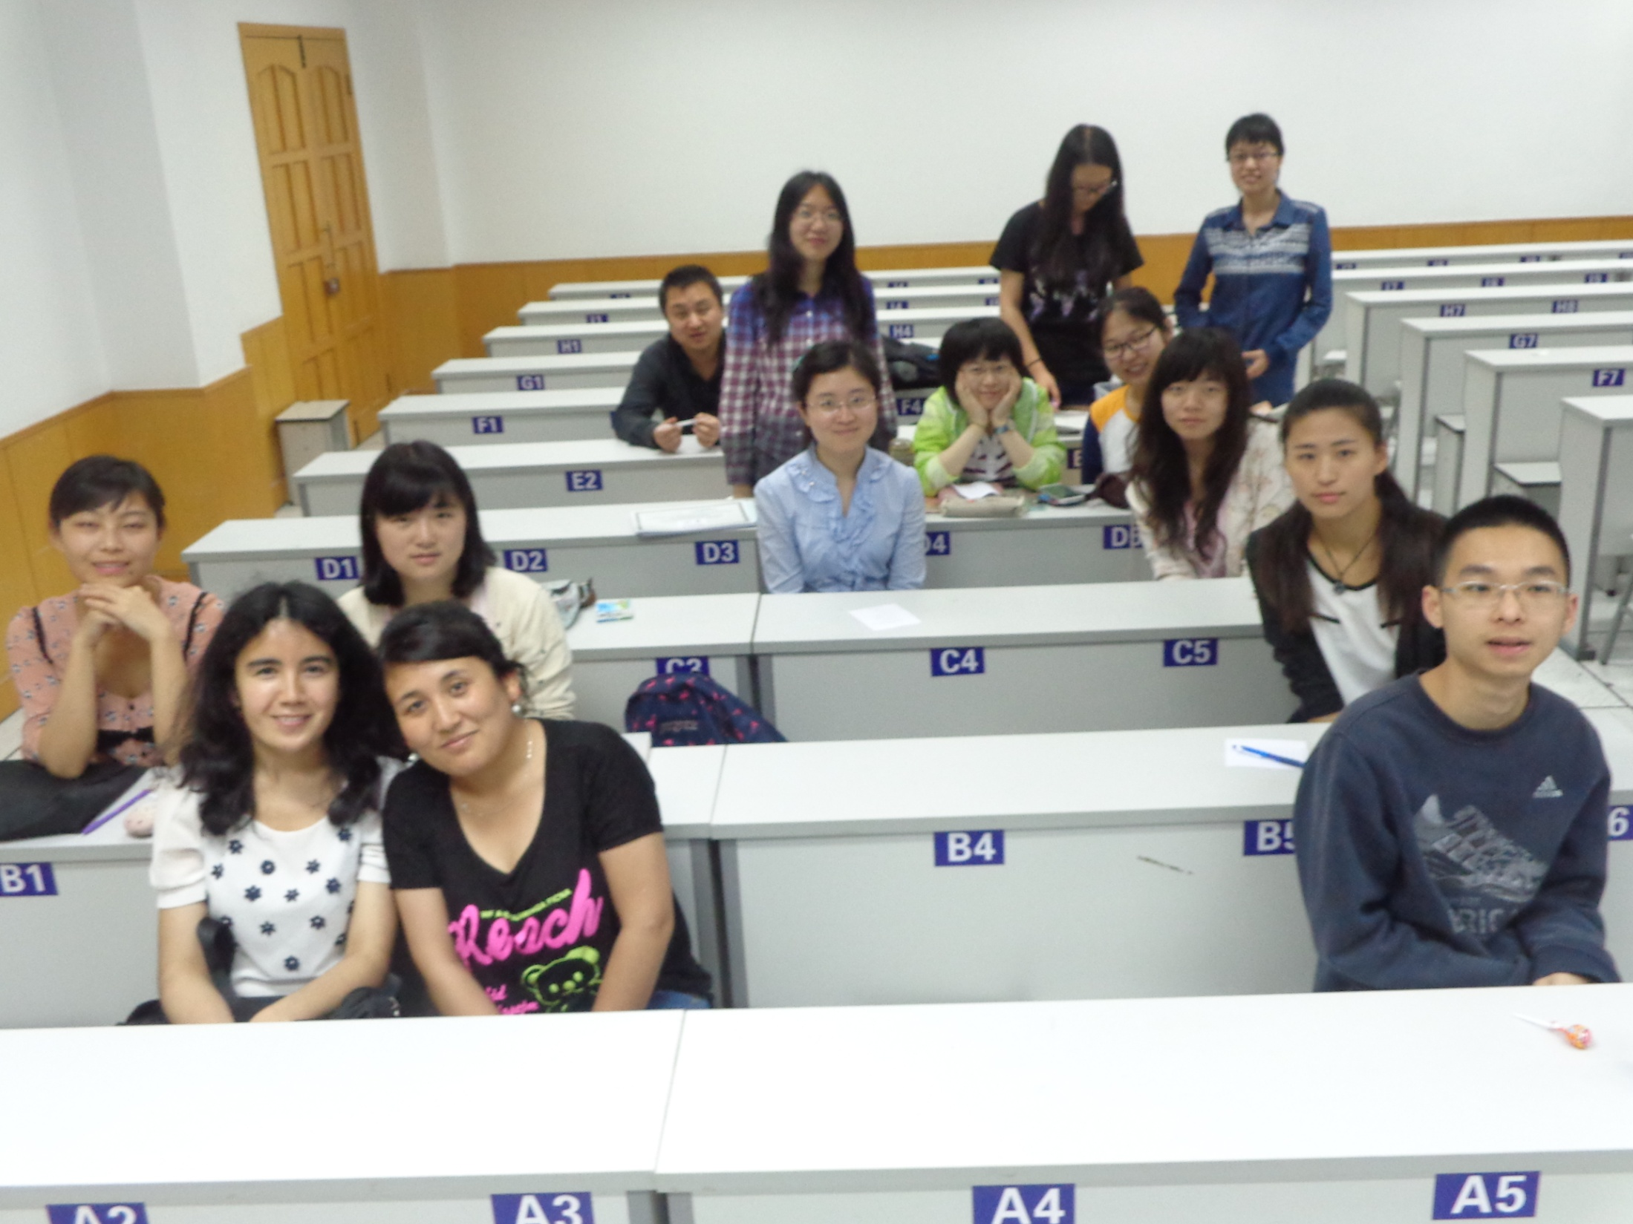
English Corner Friends

Slide 3
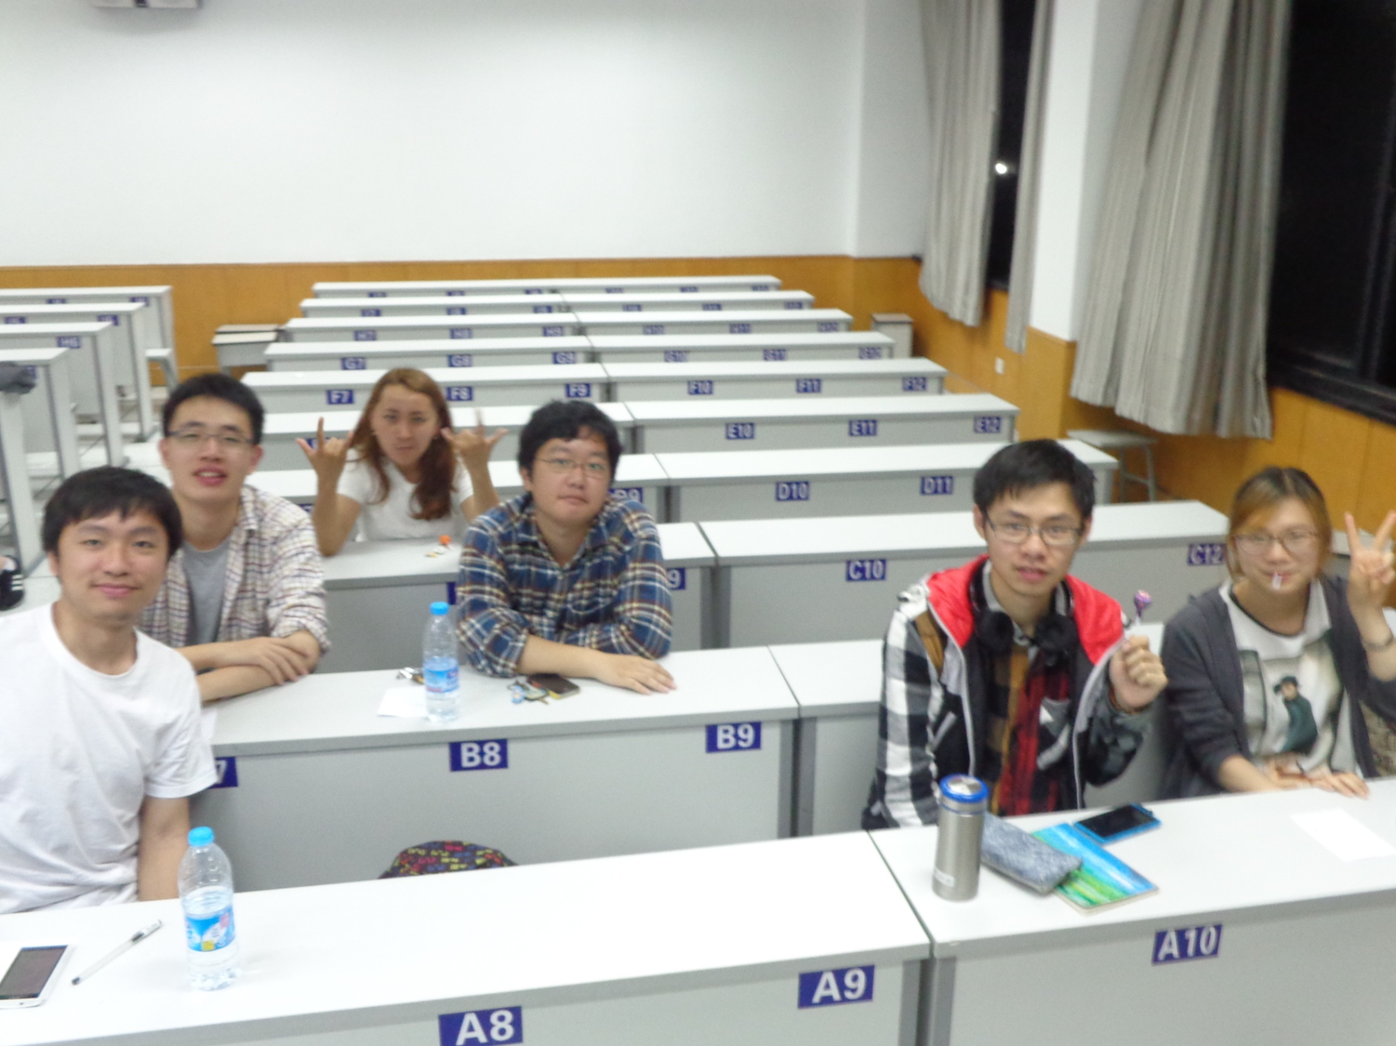
English Corner Friends

Slide 4
English Corner Guests
Ron and Kiem Anderson
From
Los Angeles, California

Slide 5
Introductions
Please stand and introduce yourself if this is your first English Corner.
What is your name?
Where are you from (hometown)?
Tell one thing you like to do in your free time?

Slide 6
English Corner’s Goals
To improve oral English skills—we speak only English.
To improve English listening skills.
To meet new friends.
To build social skills.
To learn about American and Chinese Cultures.
To share ideas and opinions.
Let’s have fun!

Slide 7


Next English Corner
June 5, 2014 7 PM
We will watch and discuss:
My Fair Lady”
Part 1
A British Musical
Bring a snack to share.

Slide 8

Let’s Sing
My Love

Slide 9
Your Discussion Topics
Instructions:
  Form in assigned groups so you can face each other.
  In discussing each topic: You will have a few minutes to discuss topic and determine some successful conclusions. Please select one person from each group to summarize the group’s discussion.
Topics: (1) Discuss the pros and cons of naming “Tofu” as China’s National Food. (2) If you do not like “Tofu,” which food would you choose to be China’s National Food.

Slide 10
Did anyone write a Limerick?
Limericks are short (sometimes serious; sometime silly) poems that are fun to recite.
A: What is a limerick, Mother?
A: It's a form of verse, said brother
B: In which lines one and two
B: Rhyme with five when it's through
A: And three and four rhyme with each other.

Slide 11
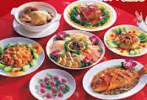

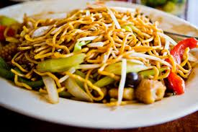
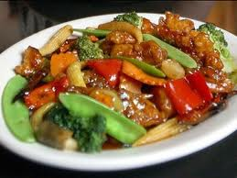
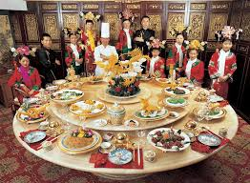
The Foods We Love to Eat
Oh how do you love tasty food,
You know the best you’ve ever chewed--
Delectable and scrumptious,
Delicious and luscious,
That leaves you in a savory mood!

Slide 12
Comparisons of Cultures
Fast Food
America
China
Burgers (beef / chicken)
Hotdogs
French Fries
Tacos (Mexican)
Soda Pop
Pizza
Ice Cream Cones, Malts, Ice Cream Sundays
Fried rice /Sweet & Sour pork or chicken
Chicken Nuggets
Fried Chicken

Slide 13

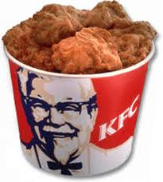








Fast Food Establishments
In recent years, reduced leisure time in China has led to a consumer shift away from traditional full-service restaurants toward fast-food establishments. Over the five years to 2012, revenue for the Fast-Food Restaurant industry in China grew at an annualized rate of 16.9% to $89.6 billion, says IBISWorld.

Slide 14
Choosing the favorite Fast Food Restaurant
Caucus Format
A caucus is a format for making a group decision.
Caucus rules:
  Divide into assigned groups.
  Appoint a spokesperson.
  From the list of fast food restaurants (select) the one that your group prefers. Your decision, must be based upon some rationale criteria e.g. quality, nutritional value, taste, cleanliness, etc.
  The spokesperson should be prepared to announce your groups choice and the reasons for the choice.
  Restaurants receiving the fewest votes will be dropped from the list and the process will be repeated until there is only one restaurant remaining or until one has the majority of the votes.

Slide 15
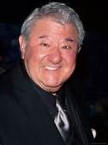
Food Humor
As a child my family’s menu consisted of two choices: take it or leave it!
(Buddy Hackett, American Comedian)

Slide 16

Break

Slide 17
Guest Presenter
Molen

Slide 18
Descriptionary
Instructions:
  Form in assigned groups.
  One person will have his/her back to the screen.
  When a word/phrase flashes on the screen, the person(s) facing the screen will describe the word/phrase. However, you cannot use the word or a form of it or use a synonym or an antonym of the word/phrase.
  When the person guesses the word correctly, then trade places and be prepared for the next word.

Slide 19
Chinglish
Translations
Form in assigned groups.
Rewrite translation into Standard English.
Be prepared to share your translation.

Slide 20
Questions
Questions for and from
the Professors.

Slide 21
What are some of the topics you would like to discuss in class and/or English Corners?

Slide 22
Vocabulary Builders
Instructions:
  Form groups of three or four people.
  Distribute the vocabulary card so each person in your group has one.
  Taking turns, each person then pronounces each word on his/her card.
  When everyone is finished, pass your card one person to the left and then each person pronounces the words on his/new card.
  Repeat the process until everyone has had a chance to pronounce the words on each card.
  Note: If someone needs help pronouncing a word, other group members should provide assistance.

Slide 23
Talking Cards
Please form groups of 3-5 people.
You will be given a number of playing cards.
In turn, starting with the person whose birthday is closest to today’s date, draw a card from the top of the deck and answer the corresponding question.
Then take turns answering questions, until you have use up all of your cards.
Please speak loudly enough for your group to hear and understand you.

Slide 24

Five Phases of Dating
Phase I – Meeting lots of people.
  Group parties/gatherings.
  Speed Dating and other group games.
Phase II – Making Friends
  Eating lunch or dinner together.
  Studying or going for a walk together.
  Sharing family stories and personal goals.
  Phase III – Formal Dating.
    Planned activities designed to help you know each other better.
    Should begin to be more personable, but set limits as to the time you spend alone with each other and limits to intimacy.

Slide 25

Five Phases of Dating
Phase IV Paring up/Going Steady
  Share your important beliefs and values.
  Introduce each other to your respective families.
  Begin to plan for the future—education, employment, home and family goals.
  Continue to practice limits regarding time alone together and sharing of intimacy.
Phase V Formal Engagement
  The marriage proposal.
  Approval of both sets of parents.
  Set a wedding date.
  Plan more intensely for your wedding and future life together.
  Continue to practice limits regarding time alone together and sharing of intimacy.

Slide 26
Describe your feelings about leaving your home and province for four years.
Try to describe your feelings as you return after successfully completing your B.S or B.A. degree in four years.
Try to describe the feelings of your parents as you return to your home as a college graduate.
Try your best to describe your first day on the job of your dreams.
Describe your future husband or wife.
What do you think your feelings will be when your first child leaves home to go to a school?
What do you think the purpose of life is?
Where do you think you will go when you or your parents die?
Why do you believe that?
Do you believe you came from some where else when you were born? Why do you believe that?
Suppose you move to Australia which has a different form of government. How will that change the way you act in your life, Why?
What about living in Australia would make you nervous?
What do you think you will do to adjust to that concern?

Slide 27

Speaking Activity
Divide into groups of two
Roll the dice and answer the number of the question your rolled.
If you have already answered that question roll the dice again.

Slide 28
What is something you have never done that you would like to try?
Talk about the importance of staying close to your family?
Describe a perfect first date?
Are your years at a university a good time to look for a husband or wife? Explain.
How old should people be before they consider marriage? Why?
Describe your future husband or wife.
How should parents discipline their child(ren)? Is spanking ok?
What do you think the purpose of life is?
Where do you think you will go when you or your parents die? Explain.
Do you believe you came from some where else before you were born? Explain.
Where do you think you will live after you have graduated from college?
What are your thoughts about smoking?

Slide 29
Talking Dice
Unfinished Sentences…

Slide 30
Unfinished Sentences:
Finish these sentences by adding your own words.
On Saturdays, I like to____________
If I had only 24 hours to live, I would__________
I feel best when people_____________
Secretly I wish_____________
If I could change the world, I would____ because_____
The most exciting thing I have done is_____
Right now the most important thing in my life is_____ because_________________
If I could be somewhere else now, I’d______________
I never worry about_____________________
I like people who________________
I find it difficult to_______________________
Studying is________________________________

Slide 31

ETHICAL DILEMMAS

Slide 32
Integrity
“Integrity without knowledge is weak and useless and knowledge without integrity is dangerous and dreadful.” (Samuel Johnson (1709-1784) English Poet, Critic and Writer)

Slide 33
VOCABULARY
ethics – the principles (rules) of conduct
governing an individual or a group, the
discipline dealing with what is good
and bad and moral duty and obligation
ethical – moral, conforming to accepted
rules and standards of conduct
moral – principles of right and wrong
behavior
dilemma – a situation involving a choice
between alternatives

Slide 34

expelled – kicked out of school,
suspended from school
0 tolerance – no exceptions, no second
chances
full ride – a scholarship which pays
tuition, books, room and board
Win Win – Solutions in which all parties are better off

Slide 35
ETHICAL DILEMMA
(VICE PRINCIPAL)
You are the vice principal in charge of discipline of a high school. It is your responsibility to see that all students follow the rules and are treated fairly and equally. It is the policy of your school that students caught with alcohol, drugs or weapons on campus will be expelled—0 tolerance.

Slide 36
Your daughter is a senior at the high school. She is an outstanding basketball and volleyball player and is a top academic student. She has applied to several universities and for scholarships that would pay virtually all of her costs at any of these colleges. She is almost certain to be accepted and to receive a full ride at all schools to which she has applied.

Slide 37
One evening, you are supervising a school dance. You need to speak to your daughter and can’t find her. You finally go into the darkened girls’ locker room and hear voices. One is your daughter’s voice and as you listen, you realize they are drinking alcohol. They do not see you.
What will you do?

Slide 38

Life is full of choices and decisions and many of them will present us with moral and ethical dilemmas. Some of these choices and decisions will challenge
the very principles,
standards and values
we were taught by
our family. When
faced with these
moral dilemmas,
what will you do?

Slide 39
Mystery Person
Conversation Game

Slide 40
Instructions
Write down the names of three famous people on the slip of paper that has been provided; names can be in English or Chinese. These people can be real or fictitious, but must be very well known.
Divide into assigned groups.
The first person has 30 seconds to describe their first mystery person without using his or her name.
Then group members have 30 seconds to guess the name of the famous person. The group member who first guesses correctly earns one point.
When time is up and if no one is successful, then the first person gives the answer.
Play continues by moving one person to the left until the time is up.
The winner is the person who has guessed the most correct answers.

