Slide 1

Welcome to English Corner
Professors
John and Marie Murdoch

Slide 3
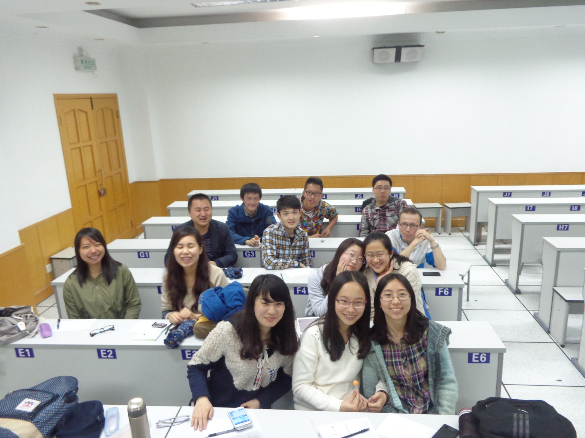
English Corner Friends

Slide 4
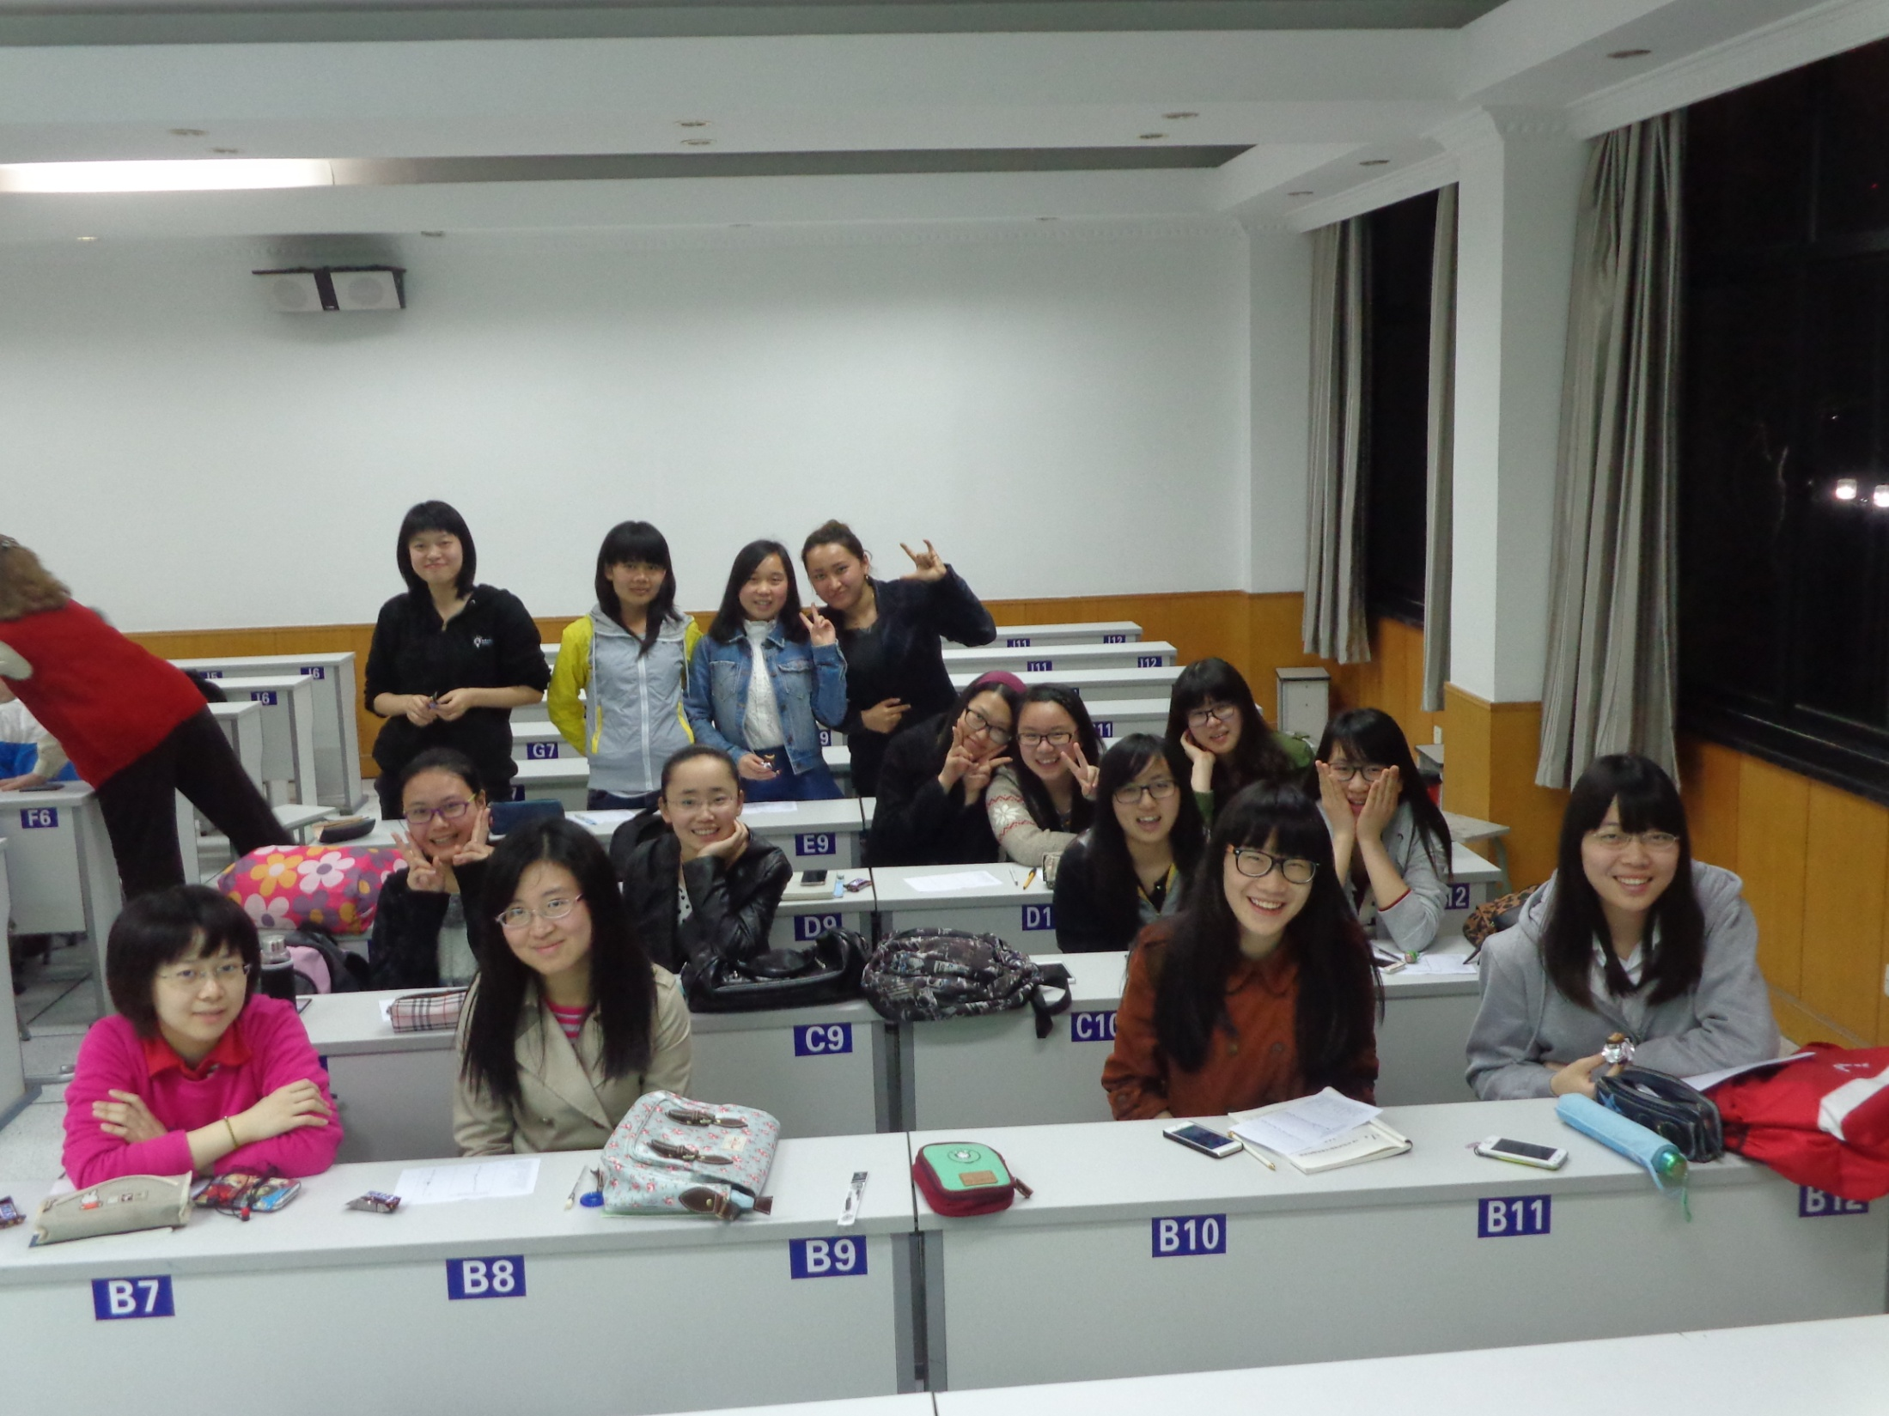
English Corner Friends

Slide 5
Introductions
Please stand and introduce yourself if this is your first English Corner.
What is your name?
Where are you from (hometown)?
Tell one thing you like to do in your free time?

Slide 6
English Corner’s Goals
To improve oral English skills—we speak only English.
To improve English listening skills.
To meet new friends.
To build social skills.
To learn about American and Chinese Cultures.
To share ideas and opinions.
Let’s have fun!

Slide 7
Next English Corner
May 15, 2014 7 PM
The next English Corner
will be in Room 218

Slide 8
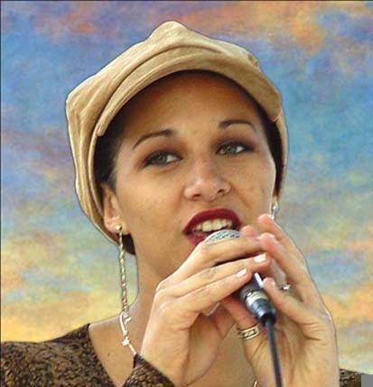
Let’s Sing
Happy
Mother’s
Day

Slide 9
Did anyone write a Limerick?
Limericks are short (sometimes serious; sometime silly) poems that are fun to recite.
A: What is a limerick, Mother?
A: It's a form of verse, said brother
B: In which lines one and two
B: Rhyme with five when it's through
A: And three and four rhyme with each other.

Slide 10
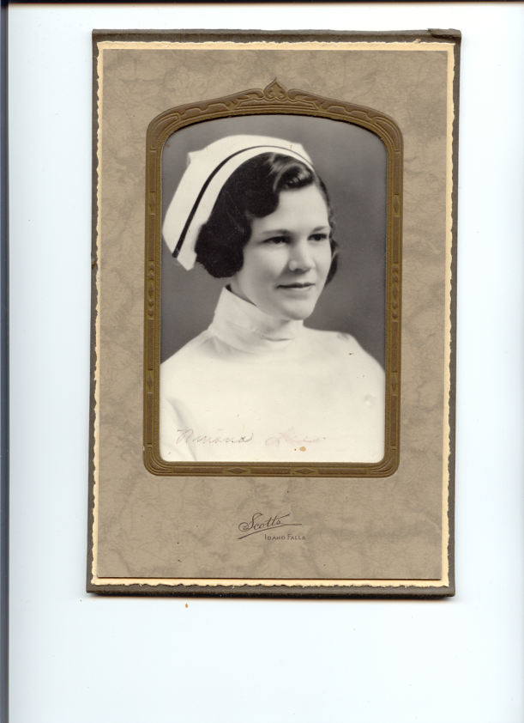
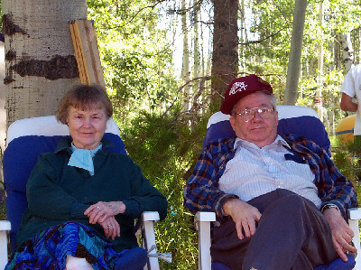
Mother
Oh Mother I do miss you so.
For everything—it’s you I owe.
You gave me courage
To attend college
And now it is my time to grow.

Slide 11
Your Discussion Topics
Instructions:
  Form groups so you can face each other.
  In discussing each topic: You will have a few minutes to discuss topic and determine some successful conclusions. Please select one person from each group to summarize the group’s discussion.
Topics: (1) What things would your mother like you to know? (2) What things would you like your mother to know? (3) Describe your mother.

Slide 12
What would your mother
Like you to know?

Slide 13
What would you like your
mother to know?

Slide 14
Describe your mother

Slide 15


Slide 16
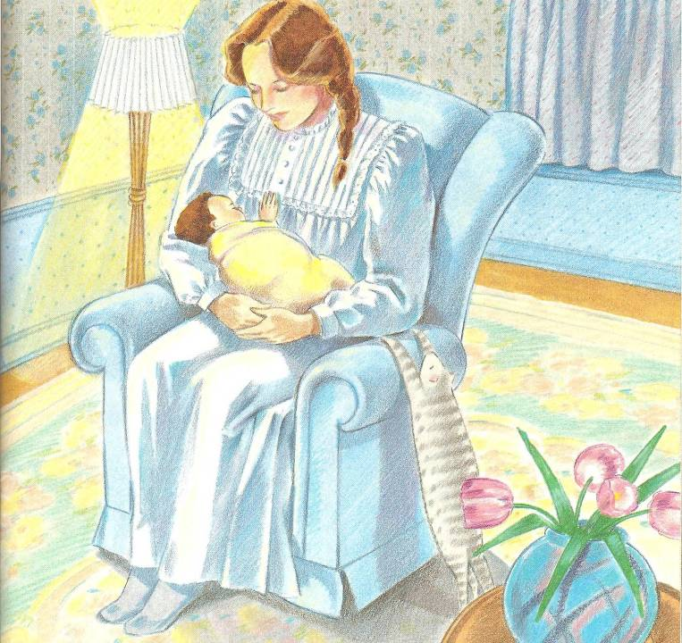
I’ll love you forever, I’ll like you for always,
As long as I’m living, my baby you’ll be.
2

Slide 17

3

Slide 18
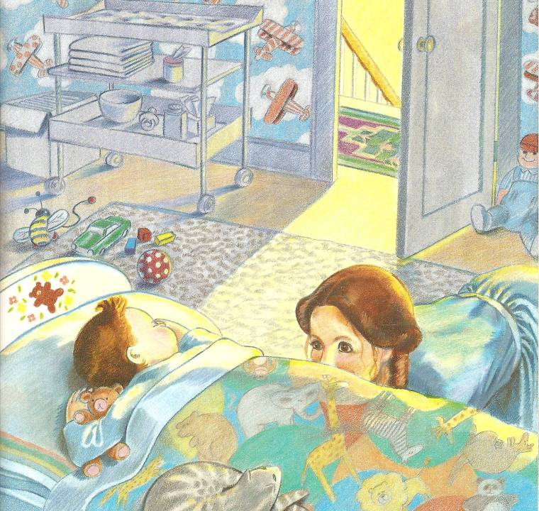
I’ll love you forever, I’ll like you for always,
As long as I’m living, my baby you’ll be.
4

Slide 19
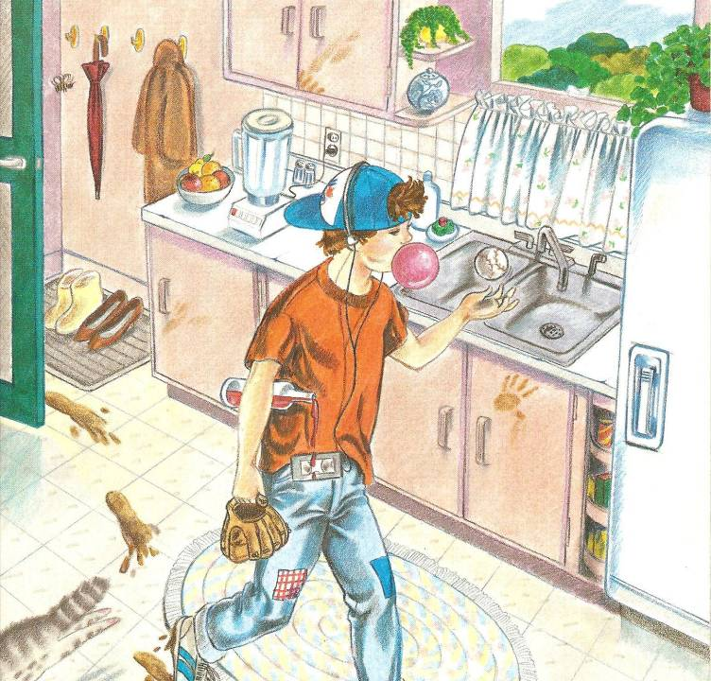
5

Slide 20
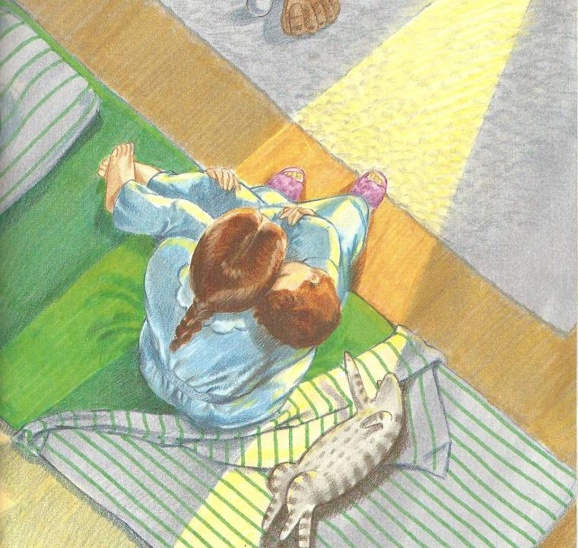
I’ll love you forever, I’ll like you for always,
As long as I’m living, my baby you’ll be.
6

Slide 21
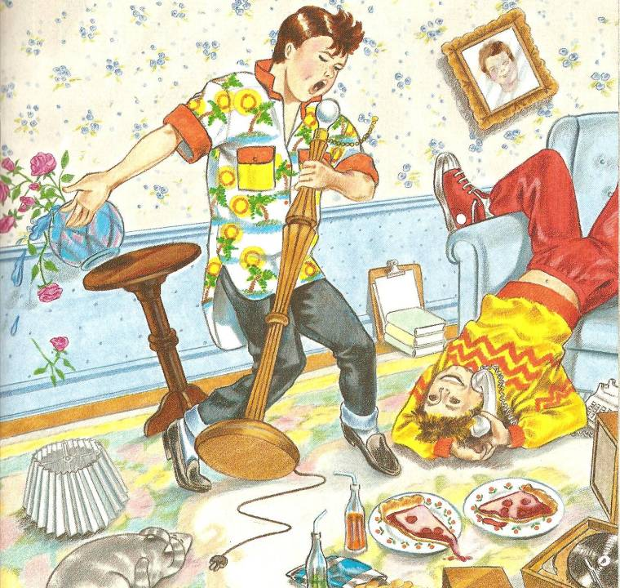
7

Slide 22
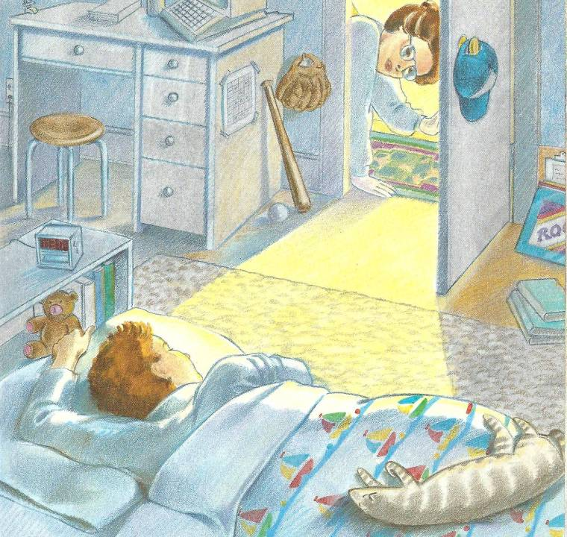
I’ll love you forever, I’ll like you for always,
As long as I’m living, my baby you’ll be.
8

Slide 23
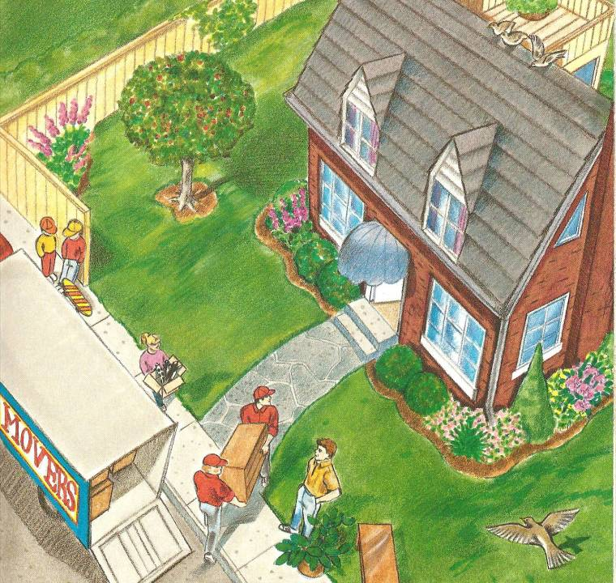
9

Slide 24
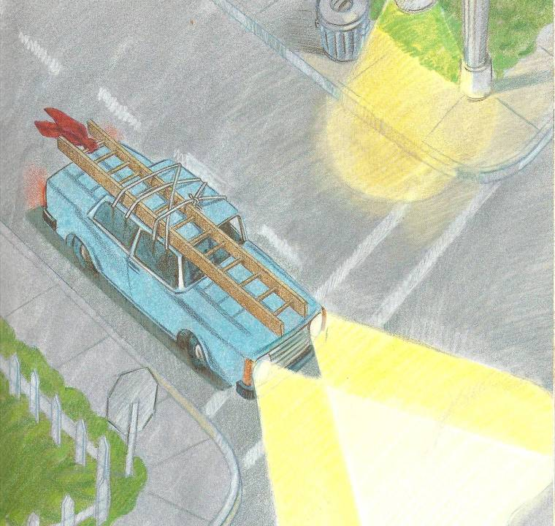
10

Slide 25
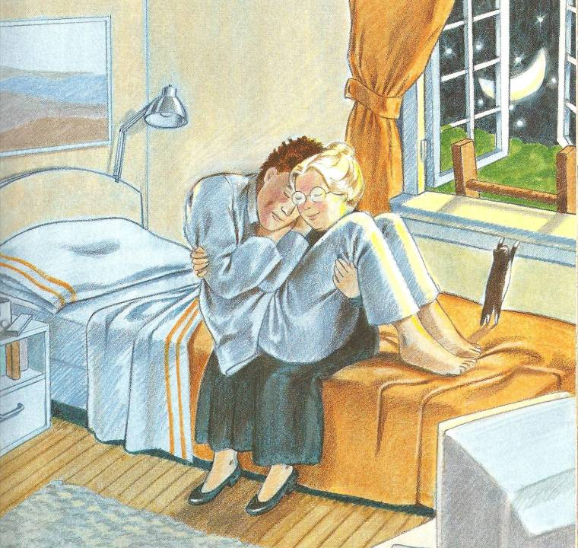
I’ll love you forever, I’ll like you for always,
As long as I’m living, my baby you’ll be.
11

Slide 26
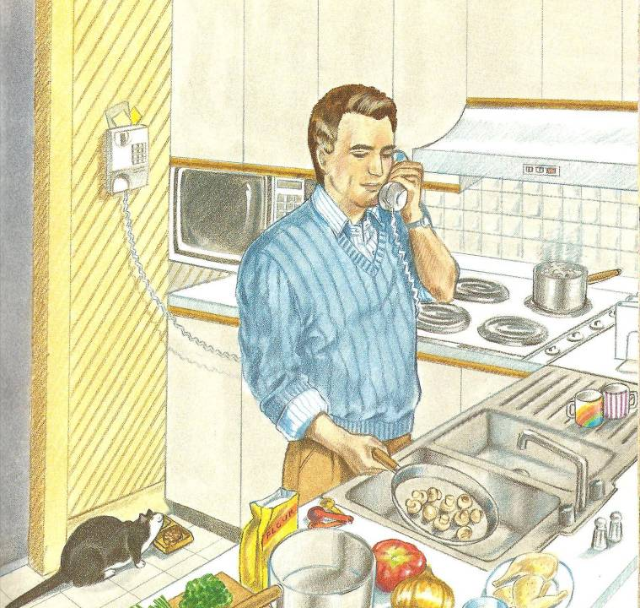
12

Slide 27
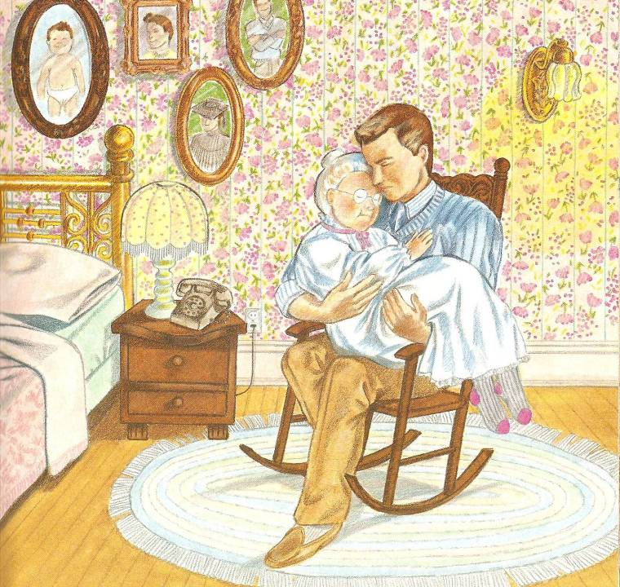
I’ll love you forever, I’ll like you for always,
As long as I’m living, my Mommy you’ll be.
13

Slide 28
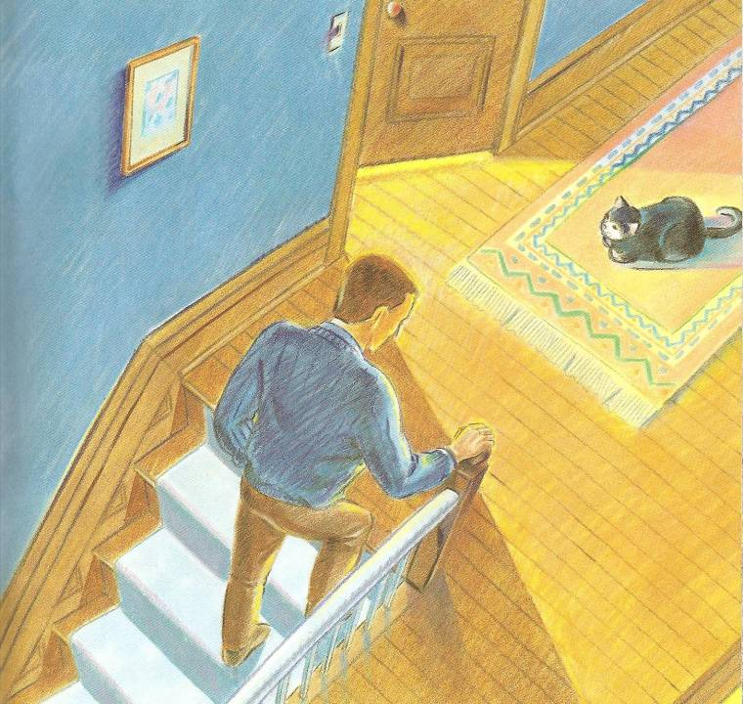
14

Slide 29
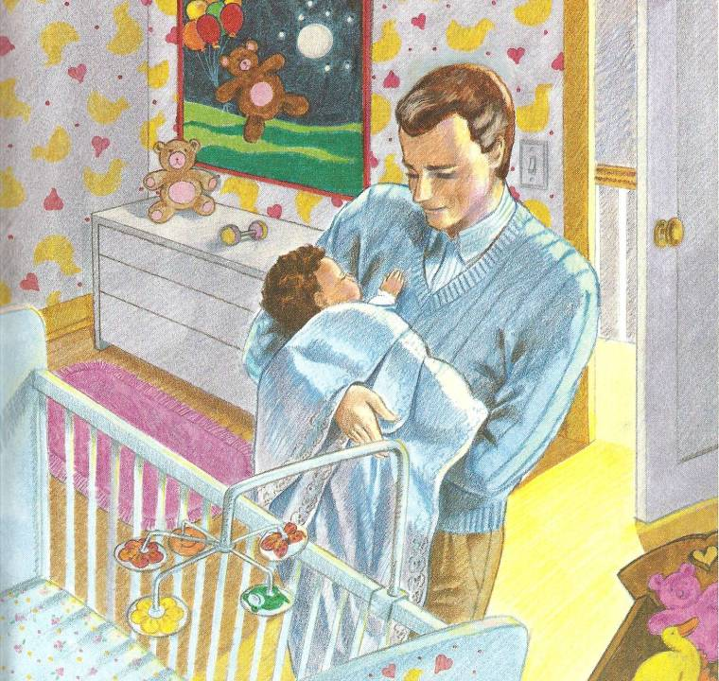
I’ll love you forever, I’ll like you for always,
As long as I’m living, my baby you’ll be.
15

Slide 30

Break

Slide 31
Mother’s Day Bingo
Mother | baby | nurse | nurture
dedication | helicopter mom | motherhood | counselor
chocolates | clean | embrace | endearments
disciplinarian | tiger mom | Mom | sacrifice
cook | teacher | protector | heart and soul
hug | laundry fairy | sleepless | kiss
homemaker | love | industrious | Mama
friend | decorator | sweetheart | roses
diapers | Grandmother | spouse | service
tenderness | budget | maternal | child

Slide 32
Questions
Questions for and from
the Professors.

Slide 33
Mother’s Day Descriptionary
Instructions:
  Form in assigned groups.
  One person will have his/her back to the screen.
  When a word/phrase flashes on the screen, the person(s) facing the screen will describe the word/phrase. However, you cannot use the word or a form of it or use a synonym or an antonym of the word/phrase.
  When the person guesses the word correctly, then trade places and be prepared for the next word.

Slide 34
diapers

Slide 35
baby formula

Slide 36
Helicopter Mom

Slide 37
laundry

Slide 38
industrious

Slide 39
Grandmother

Slide 40
protector

Slide 41
service

Slide 42
Tiger Mom

Slide 43
decorator

Slide 44
sleepless

Slide 45
Province

Slide 46
friend

Slide 47
teacher

Slide 48
kiss

Slide 49
cook

Slide 50
What are some of the topics you would like to discuss in class and/or English Corners?

Slide 51
Vocabulary Builders
Instructions:
  Form groups of three or four people.
  Distribute the vocabulary card so each person in your group has one.
  Taking turns, each person then pronounces each word on his/her card.
  When everyone is finished, pass your card one person to the left and then each person pronounces the words on his/new card.
  Repeat the process until everyone has had a chance to pronounce the words on each card.
  Note: If someone needs help pronouncing a word, other group members should provide assistance.

Slide 52
Talking Cards
Please form groups of 3-5 people.
You will be given a number of playing cards.
In turn, starting with the person whose birthday is closest to today’s date, draw a card from the top of the deck and answer the corresponding question.
Then take turns answering questions, until you have use up all of your cards.
Please speak loudly enough for your group to hear and understand you.

Slide 53

Five Phases of Dating
Phase I – Meeting lots of people.
  Group parties/gatherings.
  Speed Dating and other group games.
Phase II – Making Friends
  Eating lunch or dinner together.
  Studying or going for a walk together.
  Sharing family stories and personal goals.
  Phase III – Formal Dating.
    Planned activities designed to help you know each other better.
    Should begin to be more personable, but set limits as to the time you spend alone with each other and limits to intimacy.

Slide 54

Five Phases of Dating
Phase IV Paring up/Going Steady
  Share your important beliefs and values.
  Introduce each other to your respective families.
  Begin to plan for the future—education, employment, home and family goals.
  Continue to practice limits regarding time alone together and sharing of intimacy.
Phase V Formal Engagement
  The marriage proposal.
  Approval of both sets of parents.
  Set a wedding date.
  Plan more intensely for your wedding and future life together.
  Continue to practice limits regarding time alone together and sharing of intimacy.

Slide 55
Describe your feelings about leaving your home and province for four years.
Try to describe your feelings as you return after successfully completing your B.S or B.A. degree in four years.
Try to describe the feelings of your parents as you return to your home as a college graduate.
Try your best to describe your first day on the job of your dreams.
Describe your future husband or wife.
What do you think your feelings will be when your first child leaves home to go to a school?
What do you think the purpose of life is?
Where do you think you will go when you or your parents die?
Why do you believe that?
Do you believe you came from some where else when you were born? Why do you believe that?
Suppose you move to Australia which has a different form of government. How will that change the way you act in your life, Why?
What about living in Australia would make you nervous?
What do you think you will do to adjust to that concern?

Slide 56

Speaking Activity
Divide into groups of two
Roll the dice and answer the number of the question your rolled.
If you have already answered that question roll the dice again.

Slide 57
What is something you have never done that you would like to try?
Talk about the importance of staying close to your family?
Describe a perfect first date?
Are your years at a university a good time to look for a husband or wife? Explain.
How old should people be before they consider marriage? Why?
Describe your future husband or wife.
How should parents discipline their child(ren)? Is spanking ok?
What do you think the purpose of life is?
Where do you think you will go when you or your parents die? Explain.
Do you believe you came from some where else before you were born? Explain.
Where do you think you will live after you have graduated from college?
What are your thoughts about smoking?

Slide 58
Talking Dice
Unfinished Sentences…

Slide 59
Unfinished Sentences:
Finish these sentences by adding your own words.
On Saturdays, I like to____________
If I had only 24 hours to live, I would__________
I feel best when people_____________
Secretly I wish_____________
If I could change the world, I would____ because_____
The most exciting thing I have done is_____
Right now the most important thing in my life is_____ because_________________
If I could be somewhere else now, I’d______________
I never worry about_____________________
I like people who________________
I find it difficult to_______________________
Studying is________________________________

Slide 60

ETHICAL DILEMMAS

Slide 61
Integrity
“Integrity without knowledge is weak and useless and knowledge without integrity is dangerous and dreadful.” (Samuel Johnson (1709-1784) English Poet, Critic and Writer)

Slide 62
VOCABULARY
ethics – the principles (rules) of conduct
governing an individual or a group, the
discipline dealing with what is good
and bad and moral duty and obligation
ethical – moral, conforming to accepted
rules and standards of conduct
moral – principles of right and wrong
behavior
dilemma – a situation involving a choice
between alternatives

Slide 63

expelled – kicked out of school,
suspended from school
0 tolerance – no exceptions, no second
chances
full ride – a scholarship which pays
tuition, books, room and board
Win Win – Solutions in which all parties are better off

Slide 64
ETHICAL DILEMMA
(VICE PRINCIPAL)
You are the vice principal in charge of discipline of a high school. It is your responsibility to see that all students follow the rules and are treated fairly and equally. It is the policy of your school that students caught with alcohol, drugs or weapons on campus will be expelled—0 tolerance.

Slide 65
Your daughter is a senior at the high school. She is an outstanding basketball and volleyball player and is a top academic student. She has applied to several universities and for scholarships that would pay virtually all of her costs at any of these colleges. She is almost certain to be accepted and to receive a full ride at all schools to which she has applied.

Slide 66
One evening, you are supervising a school dance. You need to speak to your daughter and can’t find her. You finally go into the darkened girls’ locker room and hear voices. One is your daughter’s voice and as you listen, you realize they are drinking alcohol. They do not see you.
What will you do?

Slide 67

Life is full of choices and decisions and many of them will present us with moral and ethical dilemmas. Some of these choices and decisions will challenge
the very principles,
standards and values
we were taught by
our family. When
faced with these
moral dilemmas,
what will you do?

Slide 68
Mystery Person
Conversation Game

Slide 69
Instructions
Write down the names of three famous people on the slip of paper that has been provided; names can be in English or Chinese. These people can be real or fictitious, but must be very well known.
Divide into assigned groups.
The first person has 30 seconds to describe their first mystery person without using his or her name.
Then group members have 30 seconds to guess the name of the famous person. The group member who first guesses correctly earns one point.
When time is up and if no one is successful, then the first person gives the answer.
Play continues by moving one person to the left until the time is up.
The winner is the person who has guessed the most correct answers.

