Slide 1


Professors John & Marie Murdoch
Welcome to English Corner

Slide 2
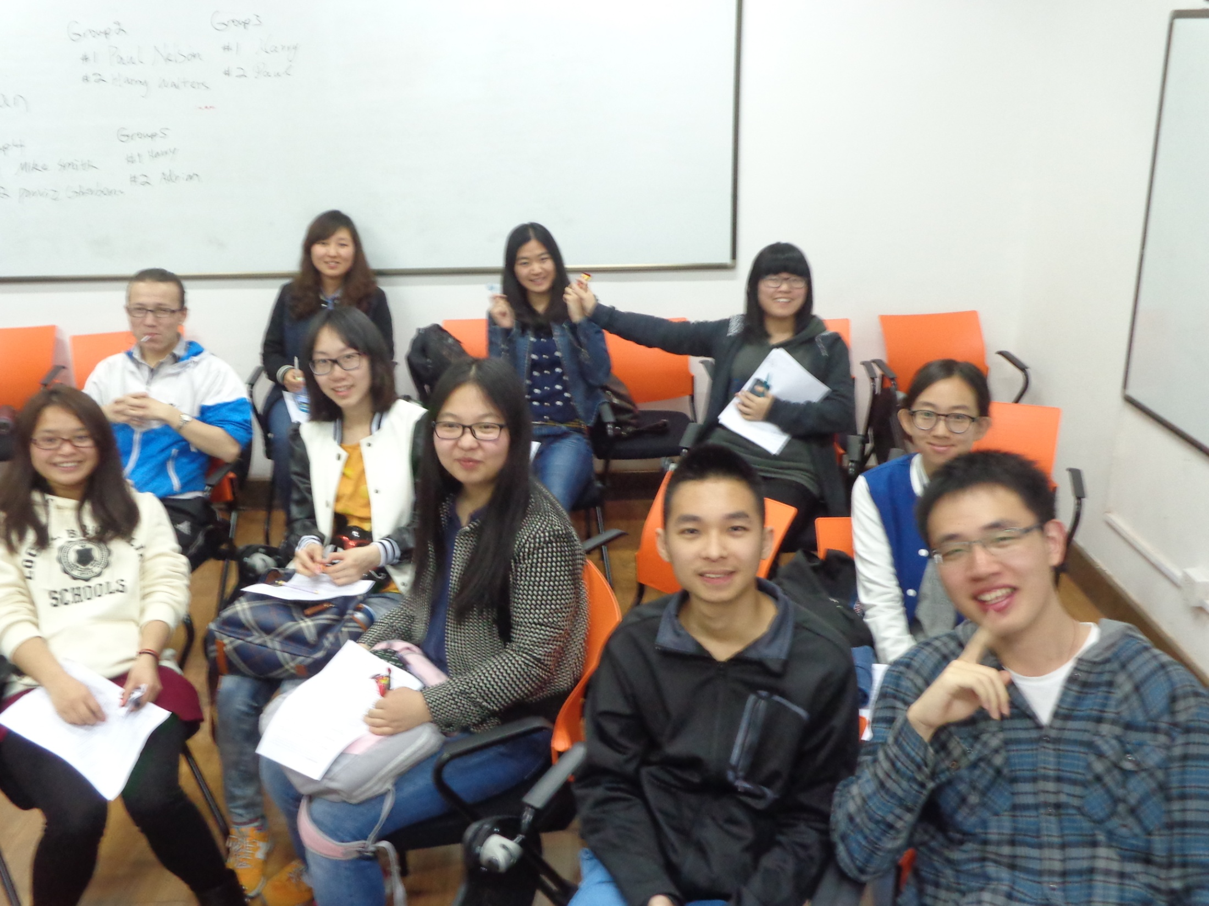
English Corner Friends

Slide 3
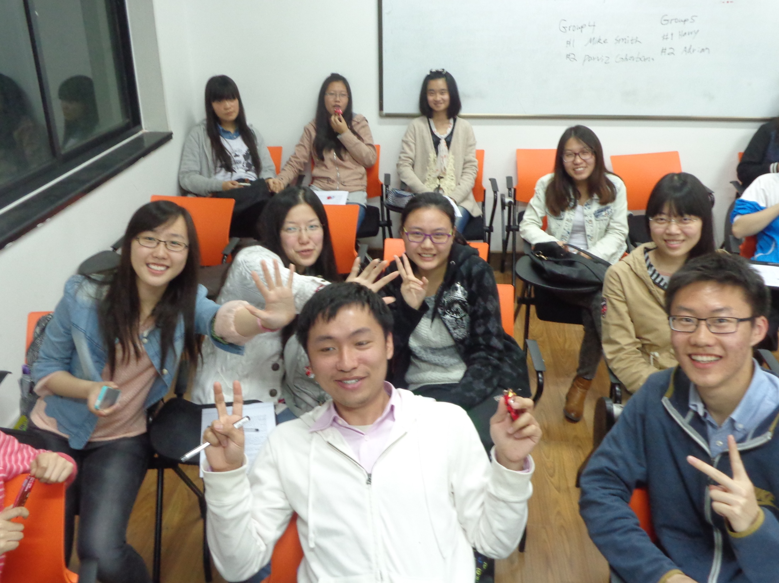
English Corner Friends

Slide 4
Introductions
Please stand and introduce yourself if this is your first English Corner.
What is your name?
Where are you from (hometown)?
Tell one thing you like to do in your free time?

Slide 5
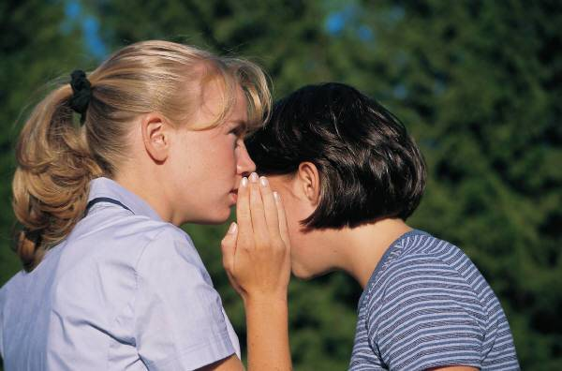
10 REASONS FOR SPEAKING ENGLISH

Slide 6
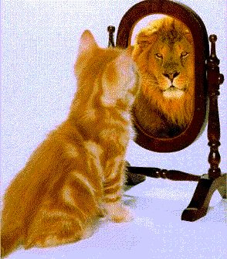
1. SELF ESTEEM

Slide 7
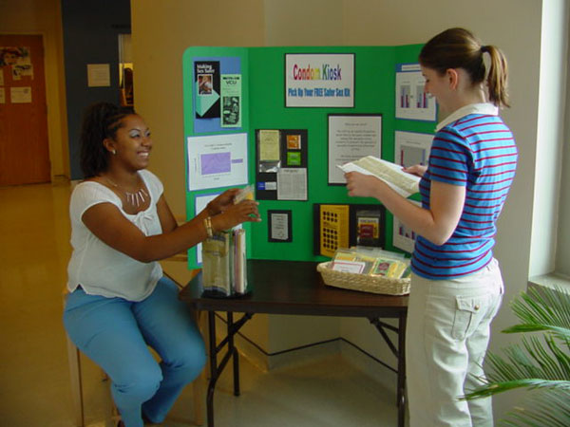
2. TEACHING OTHERS

Slide 8

SINGING SONGS -KARYOKE

Slide 9

KAREN
CARPENTER
“YESTERDAY
ONCE MORE”

Slide 10
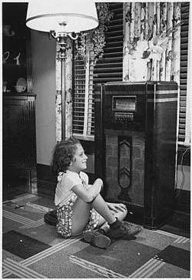
When I was young,
I’d listen to the
radio

Slide 11

Waiting for my
favorite songs.

Slide 12

When they played, I’d sing along;

Slide 13
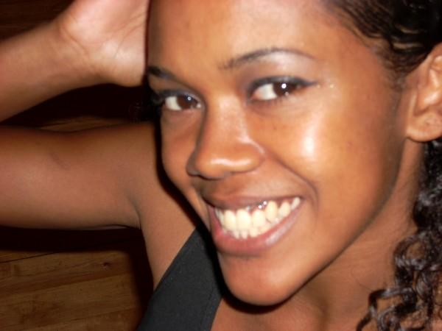
It made me smile.

Slide 14
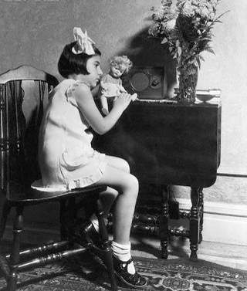
Those were such happy times
and not so long ago,

Slide 15

How I wondered where they’d gone.

Slide 16

But they’re back again,

Slide 17
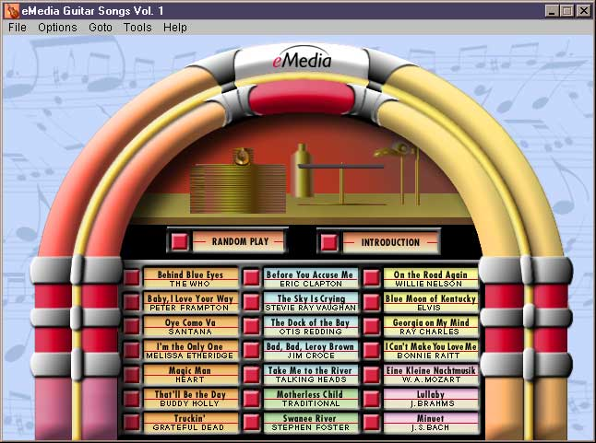
Just like a long lost friend,

Slide 18

All the songs I loved
so
well.

Slide 19

Every sha-la-la-la,
every whoa-oh-oh

Slide 20

Still shines.

Slide 21


Slide 22

Every shing-a-ling-a-ling
that they’re starting to sing

Slide 23

So fine.

Slide 24
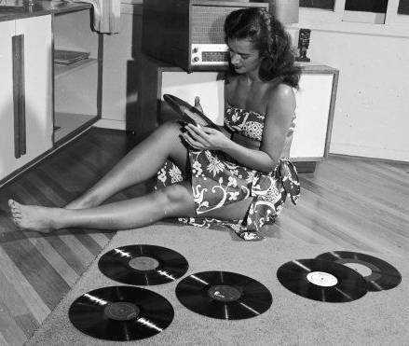

Slide 25
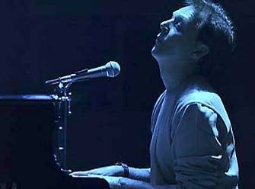
When they get to the part where he’s breaking her heart,

Slide 26

It can really make me cry.

Slide 27

Just like before,

Slide 28
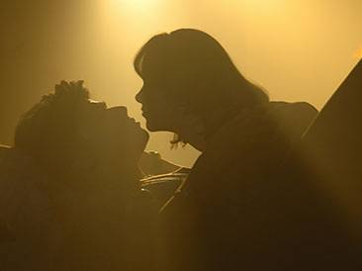
It’s yesterday once more.

Slide 29
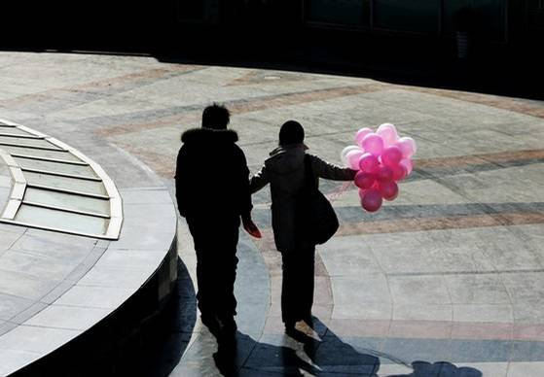

Slide 30
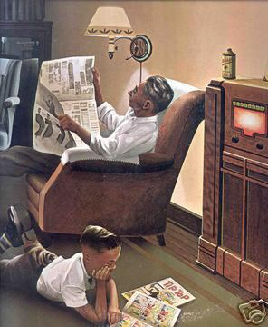
Looking back on how it was
in years gone by

Slide 31
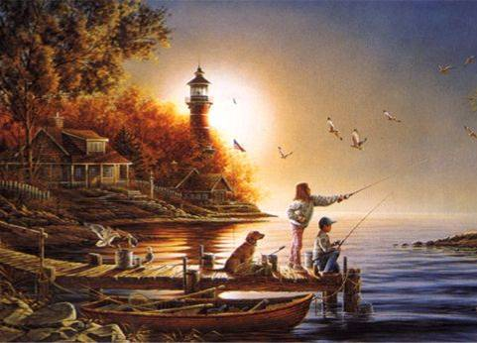
And the good times that I had,

Slide 32
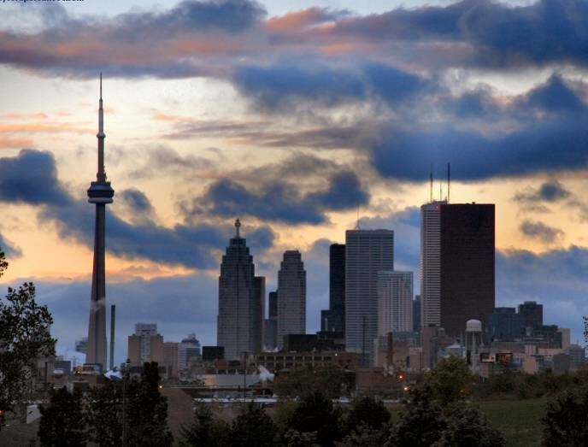
Makes today seem rather sad,

Slide 33

So much has changed.

Slide 34

It was songs of love that
I would sing to then

Slide 35

And I’d memorize each word.

Slide 36
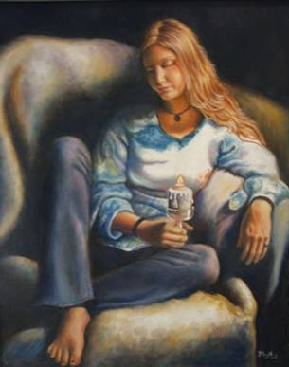
Those old melodies
still sound so good to me

Slide 37

As they melt the years away.

Slide 38

Every sha-la-la-la,
every whoa-oh-oh

Slide 39

Still shines.

Slide 40

All the oldies but goodies!

Slide 41

Every shing-a-ling-a-ling
that they’re starting to sing

Slide 42

So fine.

Slide 43


Slide 44
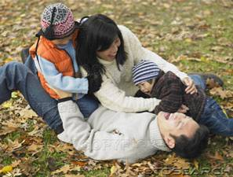
All my best memories come back clearly to me;

Slide 45

Some can even make me cry.

Slide 46
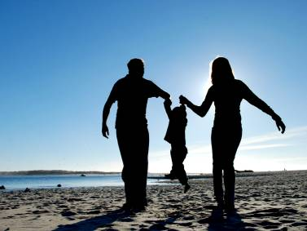
Just like before,

Slide 47

It’s yesterday once more.

Slide 48

Every sha-la-la-la,
every whoa-oh-oh

Slide 49

Still shines.

Slide 50


Slide 51

Every shing-a-ling-a-ling
that they’re starting to sing

Slide 52
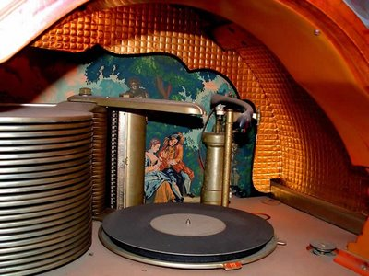
So fine.

Slide 53

Every sha-la-la-la,
every whoa-oh-oh

Slide 54

Still shines.
.

Slide 55

Karen Carpenter
Born: 03/02/50
Died: 02/04/83
Never let yesterday use up too much of today. Will Rogers
bjb/2007

Slide 56
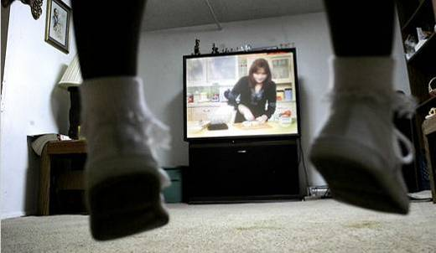

4. TALK TO:
THE T.V.
AND RADIO

Slide 57
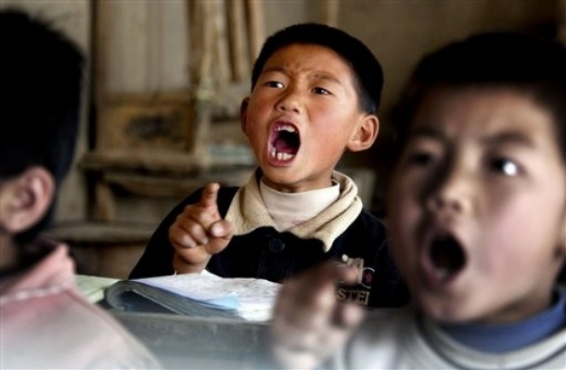
5. READ TEACHER’S POWERPOINTS

Slide 58

6. CALL ENGLISH SPEAKING FRIENDS

Slide 59
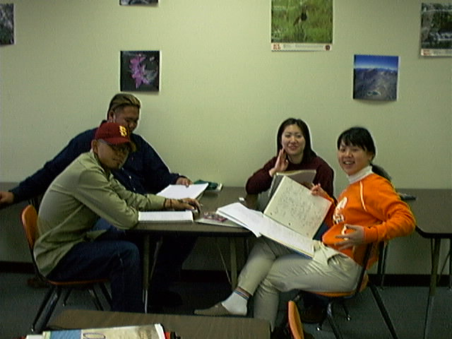
7. GROUP PARTICIPATION

Slide 60
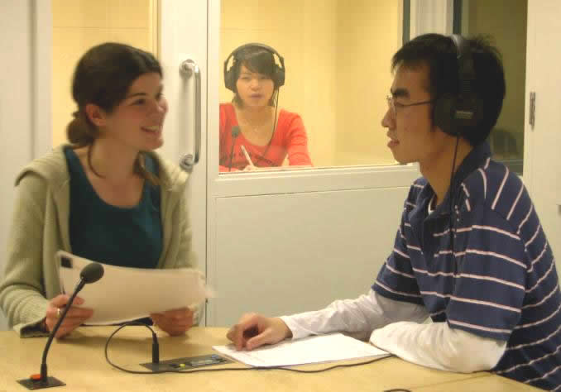
8. INTERPRETING FOR OTHERS

Slide 61


9. READ MORE—Mid-term Exam?!!

Slide 62
10. HELP Your ENGLISH TEACHERS!

Slide 63
English Corner’s Goals
To improve oral English skills—we speak only English.
To improve English listening skills.
To meet new friends.
To build social skills.
To learn about American and Chinese Cultures.
To share ideas and opinions.
Let’s have fun!

Slide 64
Next English Corner
April 24, 2014 7 PM
The next English Corner
will be in Room 218

Slide 65
Did anyone write a Limerick?
Limericks are short (sometimes serious; sometime silly) poems that are fun to recite.
A: What is a limerick, Mother?
A: It's a form of verse, said brother
B: In which lines one and two
B: Rhyme with five when it's through
A: And three and four rhyme with each other.

Slide 66




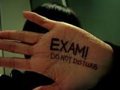
Mid-term Exams
Oh! Mid-term exams are next week,
I had better be at my peak!
I really want to play,
With lots of fun all day,
But it’s knowledge that I must seek.

Slide 67
Your Discussion Topics
Instructions:
  Form groups so you can face each other.
  In discussing each topic: You will have a few minutes to discuss topic and determine some successful conclusions. Please select one person from each group to summarize the group’s discussion.
Topic: What does the following proverb mean: “A man who chases two rabbits at the same time catches neither one.” How does this proverb apply to studying for mid-term exams?

Slide 68
Professors John & Marie Murdoch
Welcome to English Corner

Slide 69

ETHICAL DILEMMAS

Slide 70
Integrity
“Integrity without knowledge is weak and useless and knowledge without integrity is dangerous and dreadful.” (Samuel Johnson (1709-1784) English Poet, Critic and Writer)

Slide 71
VOCABULARY
ethics – the principles (rules) of conduct
governing an individual or a group, the
discipline dealing with what is good
and bad and moral duty and obligation
ethical – moral, conforming to accepted
rules and standards of conduct
moral – principles of right and wrong
behavior
dilemma – a situation involving a choice
between alternatives

Slide 72

expelled – kicked out of school,
suspended from school
0 tolerance – no exceptions, no second
chances
full ride – a scholarship which pays
tuition, books, room and board
Win Win – Solutions in which all parties are better off

Slide 73
ETHICAL DILEMMA
(VICE PRINCIPAL)
You are the vice principal in charge of discipline of a high school. It is your responsibility to see that all students follow the rules and are treated fairly and equally. It is the policy of your school that students caught with alcohol, drugs or weapons on campus will be expelled—0 tolerance.

Slide 74
Your daughter is a senior at the high school. She is an outstanding basketball and volleyball player and is a top academic student. She has applied to several universities and for scholarships that would pay virtually all of her costs at any of these colleges. She is almost certain to be accepted and to receive a full ride at all schools to which she has applied.

Slide 75
One evening, you are supervising a school dance. You need to speak to your daughter and can’t find her. You finally go into the darkened girls’ locker room and hear voices. One is your daughter’s voice and as you listen, you realize they are drinking alcohol. They do not see you.
What will you do?

Slide 76

Life is full of choices and decisions and many of them will present us with moral and ethical dilemmas. Some of these choices and decisions will challenge
the very principles,
standards and values
we were taught by
our family. When
faced with these
moral dilemmas,
what will you do?

Slide 77
Guest Presenter
Molen
Effective Study Skills

Slide 78
Mystery Person
Conversation Game

Slide 79
Instructions
Write down the names of three famous people on the slip of paper that has been provided; names can be in English or Chinese. These people can be real or fictitious, but must be very well known.
Divide into assigned groups.
The first person has 30 seconds to describe their first mystery person without using his or her name.
Then group members have 30 seconds to guess the name of the famous person. The group member who first guesses correctly earns one point.
When time is up and if no one is successful, then the first person gives the answer.
Play continues by moving one person to the left until the time is up.
The winner is the person who has guessed the most correct answers.

Slide 80

Break

Slide 81
Questions
Questions for and from
the Professors.

Slide 82
China Descriptionary
Instructions:
  Form in assigned groups.
  One person will have his/her back to the screen.
  When a word/phrase flashes on the screen, the person(s) facing the screen will describe the word/phrase. However, you cannot use the word or a form of it or use a synonym or an antonym of the word/phrase.
  When the person guesses the word correctly, then trade places and be prepared for the next word.

Slide 83
Great Wall

Slide 84
Terracotta Warriors

Slide 85
Yangzee River

Slide 86
Province

Slide 87
South China Sea

Slide 88
The Bund

Slide 89
Seaport

Slide 90
Construction Crane

Slide 91
Steamed Buns

Slide 92
Rice

Slide 93
Marriage Market

Slide 94
Bargaining

Slide 95
Adventurer

Slide 96
Chinglish

Slide 97
Mandarin

Slide 98
Tongji University

Slide 99
What are some of the topics you would like to discuss in class and/or English Corners?

Slide 100
Vocabulary Builders
Instructions:
  Form groups of three or four people.
  Distribute the vocabulary card so each person in your group has one.
  Taking turns, each person then pronounces each word on his/her card.
  When everyone is finished, pass your card one person to the left and then each person pronounces the words on his/new card.
  Repeat the process until everyone has had a chance to pronounce the words on each card.
  Note: If someone needs help pronouncing a word, other group members should provide assistance.

Slide 101
Talking Cards
Please form groups of 3-5 people.
You will be given a number of playing cards.
In turn, starting with the person whose birthday is closest to today’s date, draw a card from the top of the deck and answer the corresponding question.
Then take turns answering questions, until you have use up all of your cards.
Please speak loudly enough for your group to hear and understand you.

Slide 102

Five Phases of Dating
Phase I – Meeting lots of people.
  Group parties/gatherings.
  Speed Dating and other group games.
Phase II – Making Friends
  Eating lunch or dinner together.
  Studying or going for a walk together.
  Sharing family stories and personal goals.
  Phase III – Formal Dating.
    Planned activities designed to help you know each other better.
    Should begin to be more personable, but set limits as to the time you spend alone with each other and limits to intimacy.

Slide 103

Five Phases of Dating
Phase IV Paring up/Going Steady
  Share your important beliefs and values.
  Introduce each other to your respective families.
  Begin to plan for the future—education, employment, home and family goals.
  Continue to practice limits regarding time alone together and sharing of intimacy.
Phase V Formal Engagement
  The marriage proposal.
  Approval of both sets of parents.
  Set a wedding date.
  Plan more intensely for your wedding and future life together.
  Continue to practice limits regarding time alone together and sharing of intimacy.

Slide 104
Describe your feelings about leaving your home and province for four years.
Try to describe your feelings as you return after successfully completing your B.S or B.A. degree in four years.
Try to describe the feelings of your parents as you return to your home as a college graduate.
Try your best to describe your first day on the job of your dreams.
Describe your future husband or wife.
What do you think your feelings will be when your first child leaves home to go to a school?
What do you think the purpose of life is?
Where do you think you will go when you or your parents die?
Why do you believe that?
Do you believe you came from some where else when you were born? Why do you believe that?
Suppose you move to Australia which has a different form of government. How will that change the way you act in your life, Why?
What about living in Australia would make you nervous?
What do you think you will do to adjust to that concern?

Slide 105

Speaking Activity
Divide into groups of two
Roll the dice and answer the number of the question your rolled.
If you have already answered that question roll the dice again.

Slide 106
What is something you have never done that you would like to try?
Talk about the importance of staying close to your family?
Describe a perfect first date?
Are your years at a university a good time to look for a husband or wife? Explain.
How old should people be before they consider marriage? Why?
Describe your future husband or wife.
How should parents discipline their child(ren)? Is spanking ok?
What do you think the purpose of life is?
Where do you think you will go when you or your parents die? Explain.
Do you believe you came from some where else before you were born? Explain.
Where do you think you will live after you have graduated from college?
What are your thoughts about smoking?

Slide 107
Talking Dice
Unfinished Sentences…

Slide 108
Unfinished Sentences:
Finish these sentences by adding your own words.
On Saturdays, I like to____________
If I had only 24 hours to live, I would__________
I feel best when people_____________
Secretly I wish_____________
If I could change the world, I would____ because_____
The most exciting thing I have done is_____
Right now the most important thing in my life is_____ because_________________
If I could be somewhere else now, I’d______________
I never worry about_____________________
I like people who________________
I find it difficult to_______________________
Studying is________________________________

