Slide 1


Professors John & Marie Murdoch
Welcome to English Corner

Slide 2
English Corner’s Goals
To improve oral English skills—we speak only English.
To improve English listening skills.
To meet new friends.
To build social skills.
To learn about American and Chinese Cultures.
To share ideas and opinions.
Let’s have fun!

Slide 3
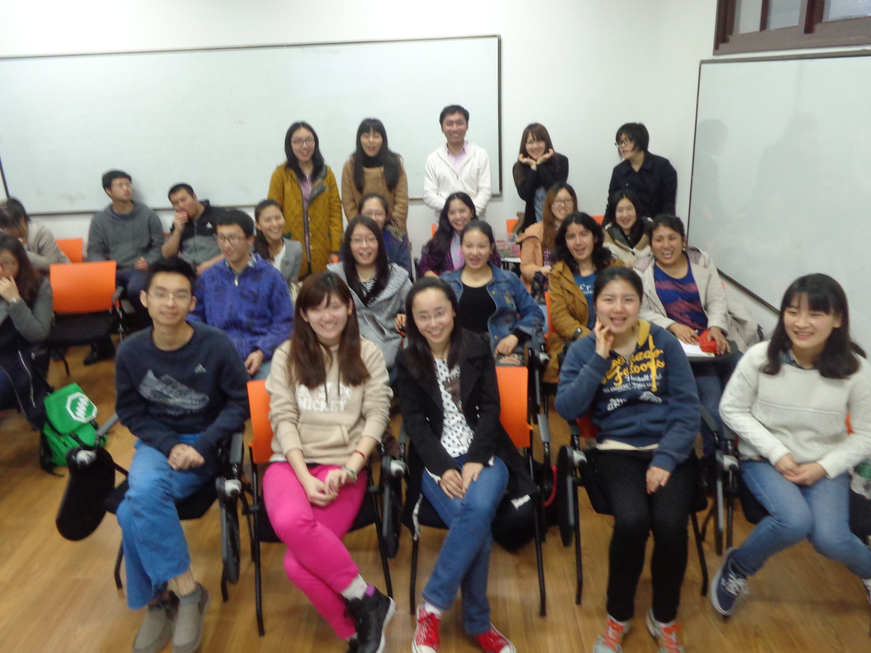
English Corner Friends

Slide 4
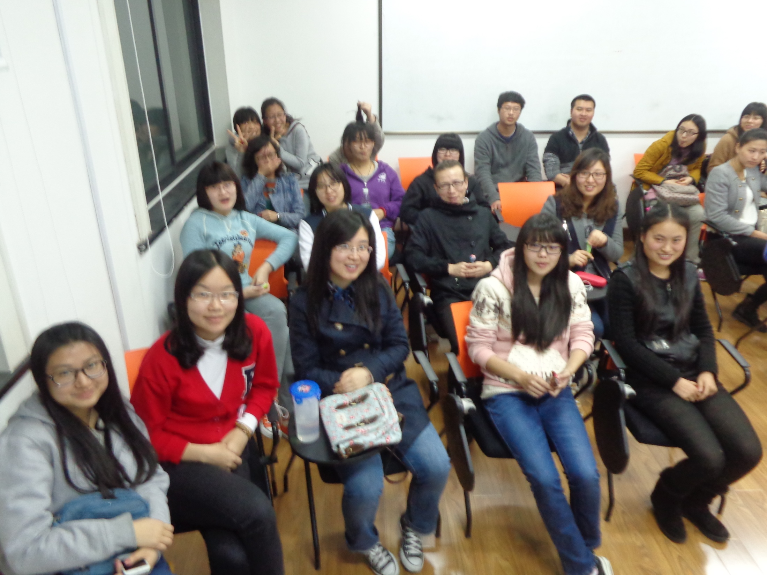
English Corner Friends

Slide 5
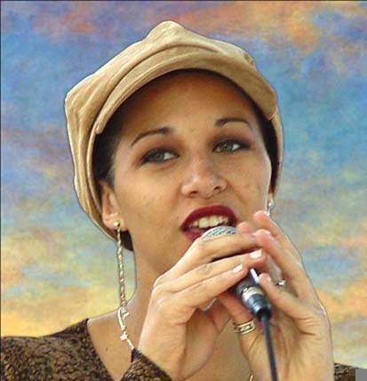
Let’s Sing a Song

Slide 6
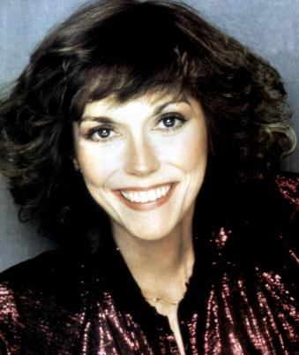
KAREN
CARPENTER
“YESTERDAY
ONCE MORE”

Slide 7
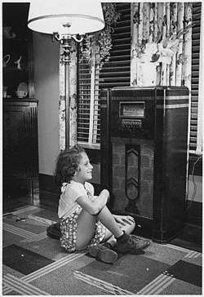
When I was young,
I’d listen to the
radio

Slide 8

Waiting for my
favorite songs.

Slide 9

When they played, I’d sing along;

Slide 10
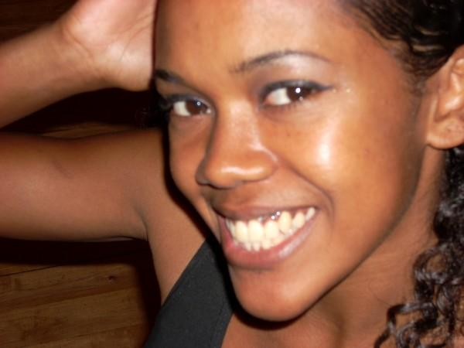
It made me smile.

Slide 11
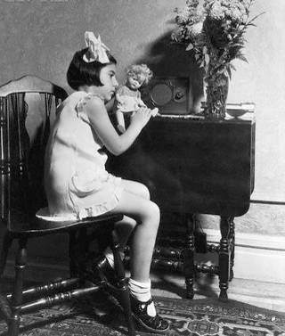
Those were such happy times
and not so long ago,

Slide 12

How I wondered where they’d gone.

Slide 13

But they’re back again,

Slide 14
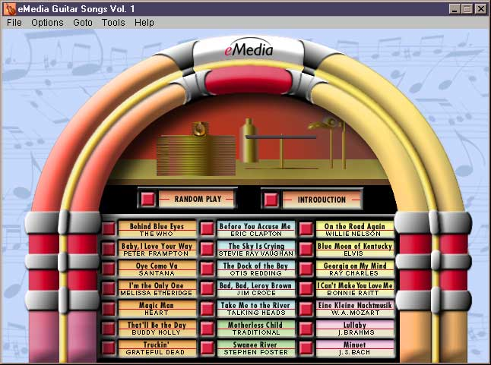
Just like a long lost friend,

Slide 15

All the songs I loved
so
well.

Slide 16

Every sha-la-la-la,
every whoa-oh-oh

Slide 17

Still shines.

Slide 18


Slide 19
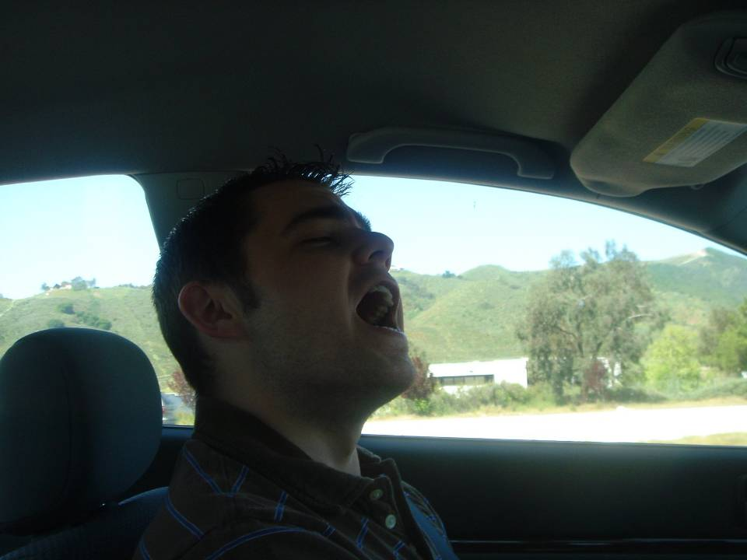
Every shing-a-ling-a-ling
that they’re starting to sing

Slide 20

So fine.

Slide 21
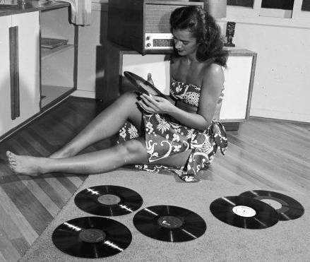

Slide 22
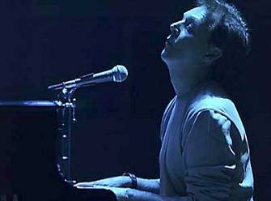
When they get to the part where he’s breaking her heart,

Slide 23
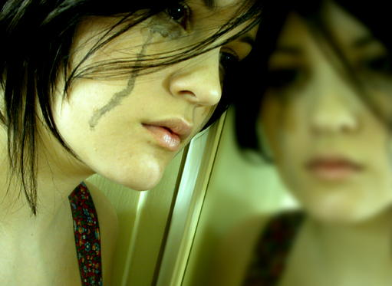
It can really make me cry.

Slide 24

Just like before,

Slide 25
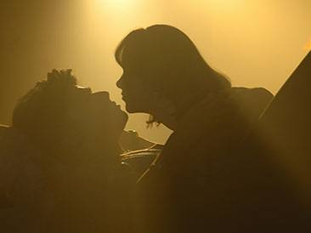
It’s yesterday once more.

Slide 26
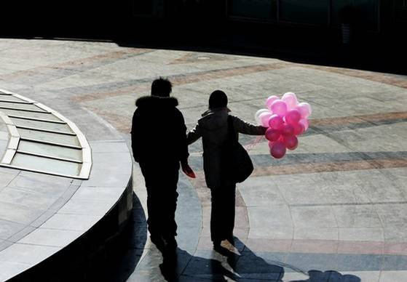

Slide 27
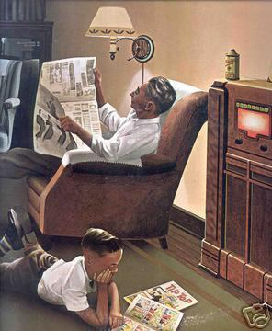
Looking back on how it was
in years gone by

Slide 28

And the good times that I had,

Slide 29
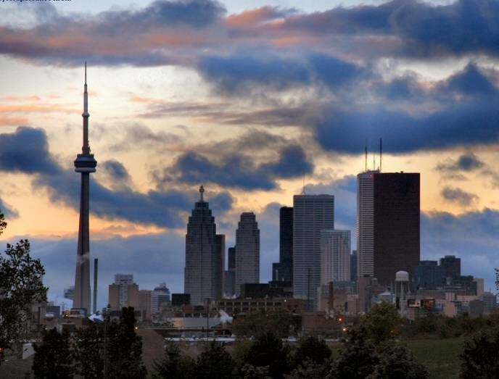
Makes today seem rather sad,

Slide 30
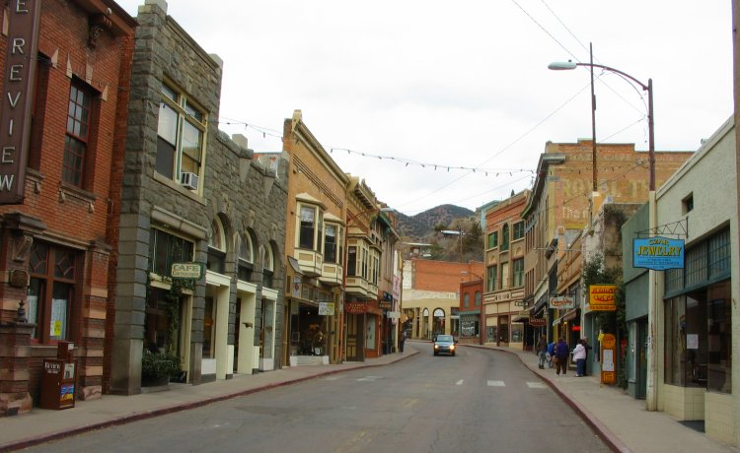
So much has changed.

Slide 31

It was songs of love that
I would sing to then

Slide 32

And I’d memorize each word.

Slide 33
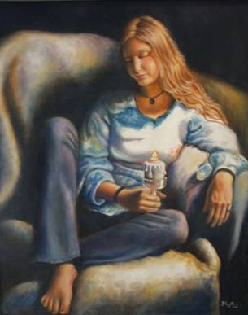
Those old melodies
still sound so good to me

Slide 34

As they melt the years away.

Slide 35

Every sha-la-la-la,
every whoa-oh-oh

Slide 36

Still shines.

Slide 37

All the oldies but goodies!

Slide 38
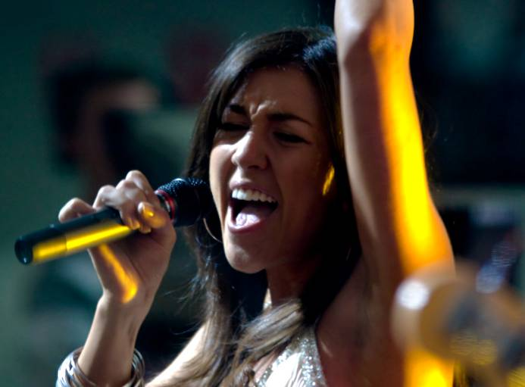
Every shing-a-ling-a-ling
that they’re starting to sing

Slide 39

So fine.

Slide 40


Slide 41
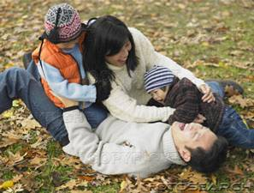
All my best memories come back clearly to me;

Slide 42

Some can even make me cry.

Slide 43
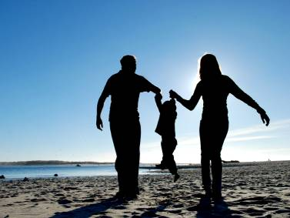
Just like before,

Slide 44

It’s yesterday once more.

Slide 45

Every sha-la-la-la,
every whoa-oh-oh

Slide 46

Still shines.

Slide 47


Slide 48

Every shing-a-ling-a-ling
that they’re starting to sing

Slide 49
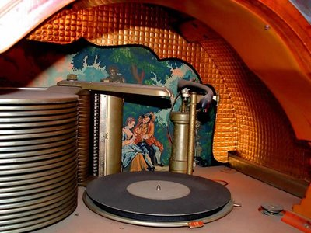
So fine.

Slide 50

Every sha-la-la-la,
every whoa-oh-oh

Slide 51
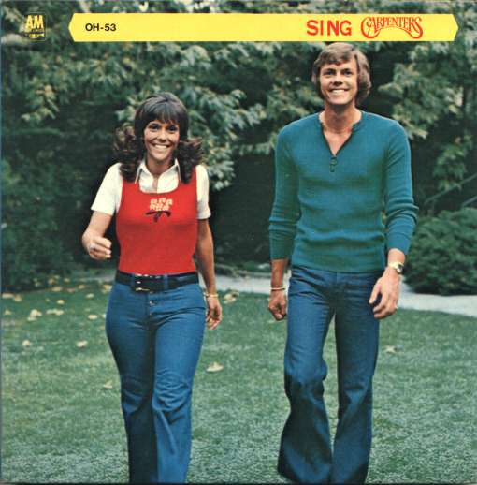
Still shines.
.

Slide 52
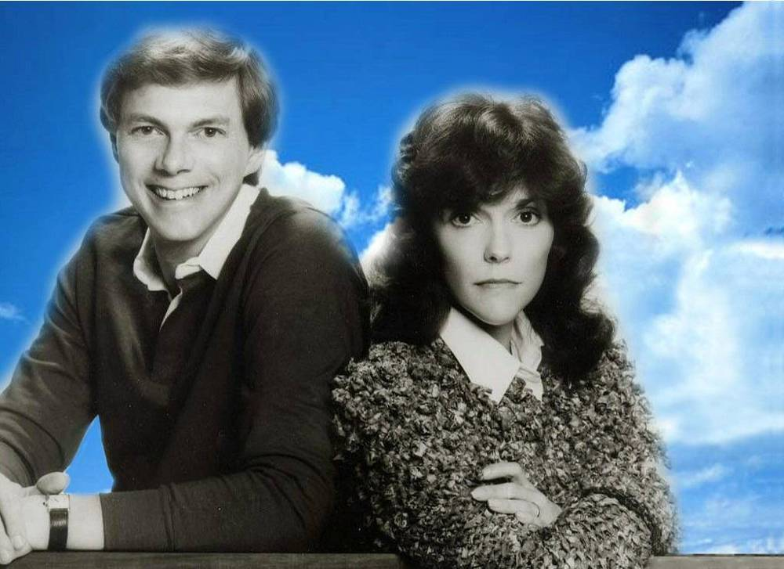
Karen Carpenter
Born: 03/02/50
Died: 02/04/83
Never let yesterday use up too much of today. Will Rogers
bjb/2007

Slide 53
Next English Corner
April 23, 2014
7 PM
The next English Corner
will be in Room 218

Slide 54
English Corner Student Directed Activities
Welcome
Sophomore Team 2-B
Julie
Judy
Rebecca
Tordy

Slide 55
Did anyone write a Limerick?
Limericks are short (sometimes serious; sometime silly) poems that are fun to recite.
A: What is a limerick, Mother?
A: It's a form of verse, said brother
B: In which lines one and two
B: Rhyme with five when it's through
A: And three and four rhyme with each other.

Slide 56
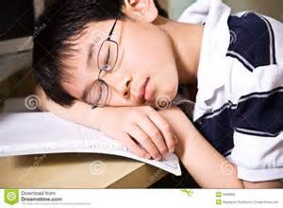
I’m Bored
I’m bored; I’m bored; I’m bored; I’m Bored!
Dreamt the student as he snored!
Wake-up and get a life;
And maybe even a wife--
English Corner will be your reward!

Slide 57
Meet & Greet
We-Chat
Introduce yourselves.
Optional Topics:
    What do you do when you are bored?
    How can you make a boring class interesting?
    What does the following idiom mean: “get into the swing of things?”
    How can you help your classmates improve their Oral English?

Slide 58

Rank order (1-10) from most to least important the following marriage criteria.
___ Physical appearance (handsome / beautiful)
___ Physical traits (height / weight)
___ Education (highest degree / major)
___ Salary (high / average / below average)
___ Employment (professional / skilled worker)
___ Disposition (pleasant / gentle)
___ Shared Values/Beliefs (honesty / integrity)
___ Possessions (car / apartment)
___ Dress and grooming (neat / clean)
___ Personality (outgoing / romantic)

Slide 59

WHICH MAN SHOULD SHE MARRY?

Slide 60
READ AND CONSIDER: Approximately 2.5 million couples get married in the United States every year. Some couples get married quickly; other couples take a long time to decide. Pretend that you work for a marriage counseling service. Every day people come to you for marriage counseling. You try to help them choose a husband or wife. Today, Susan Carson has come to you for advice. Read Susan’s biography carefully. Help her decide who to marry.

Slide 61
Susan Carson, age 29. Job: policewoman, $34,000/year. Height 5 ft 10 in (152.4 cm), weight 150 lb (68 kg). Hobbies: hiking, weightlifting, playing the piano. Personality: quiet and shy. She would like to have children and a happy family.
CONSIDER AND DECIDE: Susan believes that it is time for her to get married. She knows five men and all of the men would like to marry her. Which man do you think is most suitable for Susan to marry? Before talking with your partners, decide and write down your individual preferences (1-5) and the reasons for your choices.

Slide 62
MARRIAGE CANDIDATES:
1. Mike Smith, age 25. Job: athletic
club director, $22,000/year. Height 6 ft 3 in (182.9 cm), weight 220 lb (99.79 kg). Hobby: weightlifting. Personality: loud and social. Susan says, “I met Mike at the athletic club. We have a good time weightlifting together. He’s tall and very handsome, but he’s younger than I am and his salary is not good. I like his personality. I think he loves me a lot but sometimes he still looks at other women. He is not so sure he wants to have children. What do you think?”

Slide 63
2. Harry Walters, age 32. Job: bank manager, $47,000/year. Height 6 ft (182.88 cm), weight 170 lb (77.ll kg). Hobbies: opera, coin collecting. Personality: kind and gentle; he loves children and would like to have a family. Susan says, “I have known Harry since we were children. We grew up next door to each other. Harry is not very good looking but he would do anything for me. He’s been asking me to marry him for ten years. He has a very good job but he wants me to quit my job because he thinks it is too dangerous. I like my job and want to keep working. What do you think?”

Slide 64
3. Parviz Ghorbani, age 29. Graduate student, $?/yr. Height 5 ft 11 in (152.4 cm), weight 165 lb (74.84 kg). Hobbies: chess, cars. Personality: romantic and talkative. Susan says, “I met Parviz when I gave him a speeding ticket three months ago. It was love at first sight—his eyes are so beautiful—and when I asked him why he was driving so fast, he began speaking Persian poetry. I really don’t know much about him. He says he is going to be a doctor in his country after he finishes studying here. He says his family is rich. We haven’t talked about having children. What do you think?”

Slide 65
4. Paul Nelson, age 47. Job: policeman, $42,000/year. Height 6 ft 4 in (182.88 cm), weight 195 lb (88.45 kg). Hobbies: mountain climbing, boating. Personality: strong and quiet. Susan says, “Paul is my boss in the police department. I know he’s a lot older than I am but he’s so exciting to be with. He was married before and divorced. I like him a lot; married life with him would never be boring! He also has a very nice family and we have a lot of the same friends. Since he already has children, he doesn’t want any more. What do you think?”

Slide 66
5. Adrian Tinsley, age 34. Job: professor, $52,000/year. Height 5 ft 7 in (152.4 cm), weight 145 lb (65.77 kg). Hobbies: reading and writing. Personality: quiet and brusque. Susan says, “Of all the men I know, Adrian is the smartest. I met him when I took a criminology class at the university. He’s very difficult to get to know so he doesn’t have any friends. I think he likes me because I understand him. He’s handsome and dresses very well. He thinks he would like to have children. What do you think?

Slide 67
WHICH MAN SHOULD SHE MARRY?

Slide 68
CONSIDER THE VIRTUES OF THESE FIVE MEN AND DECIDE:
Susan knows these five men well and all of them would like to marry her. Before talking with your partners, decide and write down your own individual preferences and reasons. Which man do you think is most suitable for Susan to marry? After a discussion with your partners, list the men in order of preference and give reasons for the order that the group chooses.

Slide 69

REMEMBER: You and your partners are part of a marriage counseling service and Susan has come to you for your expert advice. Discuss the problem with each other in ENGLISH and then you will send your head counselor to the blackboard to list your group’s choices from #1 to #5. You will explain why you have chosen your
#1 choice and
perhaps even
your #5 choice.

Slide 70

Break

Slide 71
Questions
Questions for and from
the Professors.

Slide 72

Speaking Activity
Divide into groups of two
Roll the dice and answer the number of the question your rolled.
If you have already answered that question roll the dice again.

Slide 73
What is something you have never done that you would like to try?
Talk about the importance of staying close to your family?
Describe a perfect first date?
Are your years at a university a good time to look for a husband or wife? Explain.
How old should people be before they consider marriage? Why?
Describe your future husband or wife.
How should parents discipline their child(ren)? Is spanking ok?
What do you think the purpose of life is?
Where do you think you will go when you or your parents die? Explain.
Do you believe you came from some where else before you were born? Explain.
Where do you think you will live after you have graduated from college?
What are your thoughts about smoking?

Slide 74
Talking Dice
Unfinished Sentences…

Slide 75
Unfinished Sentences:
Finish these sentences by adding your own words.
On Saturdays, I like to____________
If I had only 24 hours to live, I would__________
I feel best when people_____________
Secretly I wish_____________
If I could change the world, I would____ because_____
The most exciting thing I have done is_____
Right now the most important thing in my life is_____ because_________________
If I could be somewhere else now, I’d______________
I never worry about_____________________
I like people who________________
I find it difficult to_______________________
Studying is________________________________

Slide 76
China Descriptionary
Instructions:
  Form in assigned groups.
  One person will have his/her back to the screen.
  When a word/phrase flashes on the screen, the person(s) facing the screen will describe the word/phrase. However, you cannot use the word or a form of it or use a synonym or an antonym of the word/phrase.
  When the person guesses the word correctly, then trade places and be prepared for the next word.

Slide 77
Great Wall

Slide 78
Terracotta Warriors

Slide 79
Yangzee River

Slide 80
Province

Slide 81
South China Sea

Slide 82
The Bund

Slide 83
Seaport

Slide 84
Construction Crane

Slide 85
Steamed Buns

Slide 86
Rice

Slide 87
Marriage Market

Slide 88
Bargaining

Slide 89
Adventurer

Slide 90
Chinglish

Slide 91
Mandarin

Slide 92
Tongji University

Slide 93
What are some of the topics you would like to discuss in class and/or English Corners?

Slide 94

ETHICAL DILEMMAS

Slide 95
Integrity
“Integrity without knowledge is weak and useless and knowledge without integrity is dangerous and dreadful.” (Samuel Johnson (1709-1784) English Poet, Critic and Writer)

Slide 96
VOCABULARY
ethics – the principles (rules) of conduct
governing an individual or a group, the
discipline dealing with what is good
and bad and moral duty and obligation
ethical – moral, conforming to accepted
rules and standards of conduct
moral – principles of right and wrong
behavior
dilemma – a situation involving a choice
between alternatives

Slide 97

expelled – kicked out of school,
suspended from school
0 tolerance – no exceptions, no second
chances
full ride – a scholarship which pays
tuition, books, room and board
Win Win – Solutions in which all parties are better off

Slide 98
ETHICAL DILEMMA
(VICE PRINCIPAL)
You are the vice principal in charge of discipline of a high school. It is your responsibility to see that all students follow the rules and are treated fairly and equally. It is the policy of your school that students caught with alcohol, drugs or weapons on campus will be expelled—0 tolerance.

Slide 99
Your daughter is a senior at the high school. She is an outstanding basketball and volleyball player and is a top academic student. She has applied to several universities and for scholarships that would pay virtually all of her costs at any of these colleges. She is almost certain to be accepted and to receive a full ride at all schools to which she has applied.

Slide 100
One evening, you are supervising a school dance. You need to speak to your daughter and can’t find her. You finally go into the darkened girls’ locker room and hear voices. One is your daughter’s voice and as you listen, you realize they are drinking alcohol. They do not see you.
What will you do?

Slide 101

Life is full of choices and decisions and many of them will present us with moral and ethical dilemmas. Some of these choices and decisions will challenge
the very principles,
standards and values
we were taught by
our family. When
faced with these
moral dilemmas,
what will you do?

Slide 102
Vocabulary Builders
Instructions:
  Form groups of three or four people.
  Distribute the vocabulary card so each person in your group has one.
  Taking turns, each person then pronounces each word on his/her card.
  When everyone is finished, pass your card one person to the left and then each person pronounces the words on his/new card.
  Repeat the process until everyone has had a chance to pronounce the words on each card.
  Note: If someone needs help pronouncing a word, other group members should provide assistance.

Slide 103
Talking Cards
Please form groups of 3-5 people.
You will be given a number of playing cards.
In turn, starting with the person whose birthday is closest to today’s date, draw a card from the top of the deck and answer the corresponding question.
Then take turns answering questions, until you have use up all of your cards.
Please speak loudly enough for your group to hear and understand you.

Slide 104

Five Phases of Dating
Phase I – Meeting lots of people.
  Group parties/gatherings.
  Speed Dating and other group games.
Phase II – Making Friends
  Eating lunch or dinner together.
  Studying or going for a walk together.
  Sharing family stories and personal goals.
  Phase III – Formal Dating.
    Planned activities designed to help you know each other better.
    Should begin to be more personable, but set limits as to the time you spend alone with each other and limits to intimacy.

Slide 105

Five Phases of Dating
Phase IV Paring up/Going Steady
  Share your important beliefs and values.
  Introduce each other to your respective families.
  Begin to plan for the future—education, employment, home and family goals.
  Continue to practice limits regarding time alone together and sharing of intimacy.
Phase V Formal Engagement
  The marriage proposal.
  Approval of both sets of parents.
  Set a wedding date.
  Plan more intensely for your wedding and future life together.
  Continue to practice limits regarding time alone together and sharing of intimacy.

Slide 106
Describe your feelings about leaving your home and province for four years.
Try to describe your feelings as you return after successfully completing your B.S or B.A. degree in four years.
Try to describe the feelings of your parents as you return to your home as a college graduate.
Try your best to describe your first day on the job of your dreams.
Describe your future husband or wife.
What do you think your feelings will be when your first child leaves home to go to a school?
What do you think the purpose of life is?
Where do you think you will go when you or your parents die?
Why do you believe that?
Do you believe you came from some where else when you were born? Why do you believe that?
Suppose you move to Australia which has a different form of government. How will that change the way you act in your life, Why?
What about living in Australia would make you nervous?
What do you think you will do to adjust to that concern?

