Slide 1


Professors John & Marie Murdoch
Welcome to English Corner

Slide 2
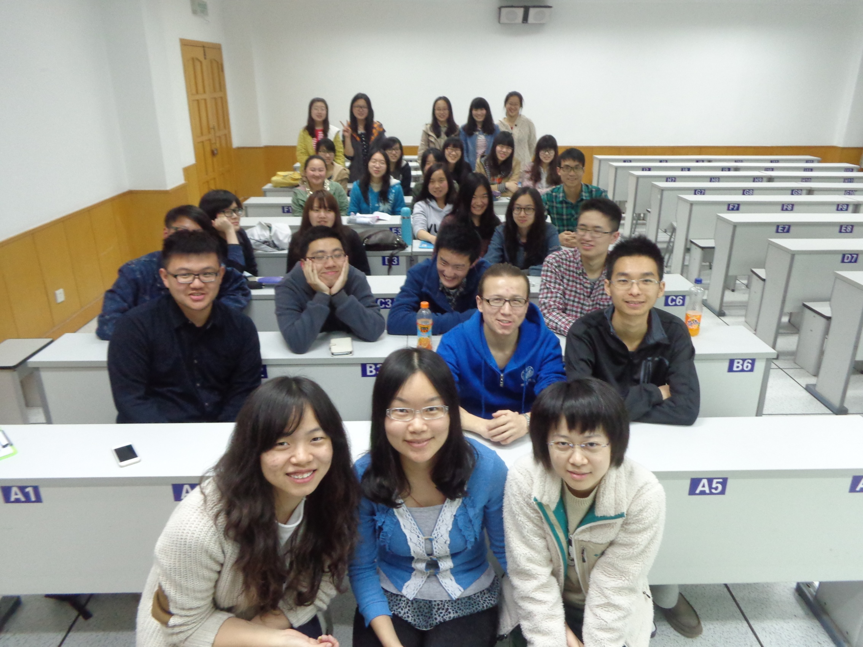
English Corner Friends

Slide 3
Introductions
Please stand and introduce yourself if this is your first English Corner.
What is your name?
Where are you from (hometown)?
Tell one thing you like to do in your free time?

Slide 4
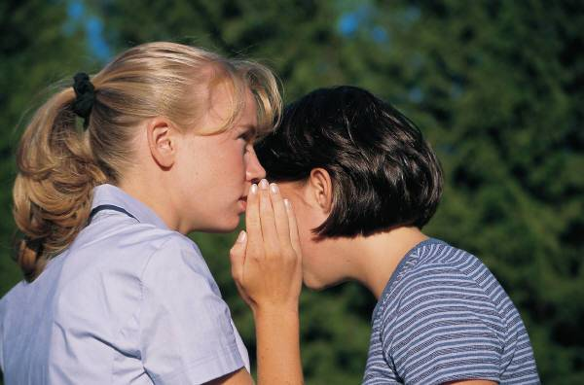
10 REASONS FOR SPEAKING ENGLISH

Slide 5

1. SELF ESTEEM

Slide 6
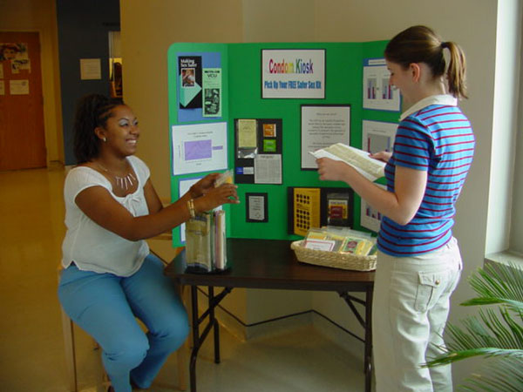
2. TEACHING OTHERS

Slide 7
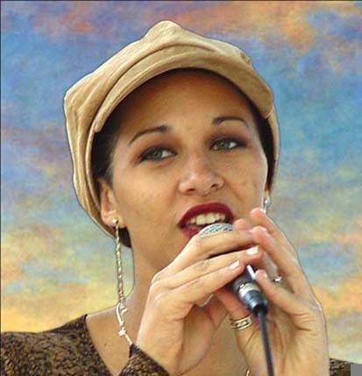
SINGING SONGS -KARYOKE

Slide 8

KAREN
CARPENTER
“YESTERDAY
ONCE MORE”

Slide 9
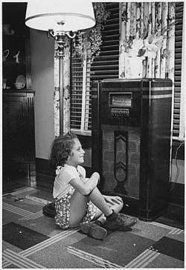
When I was young,
I’d listen to the
radio

Slide 10

Waiting for my
favorite songs.

Slide 11

When they played, I’d sing along;

Slide 12
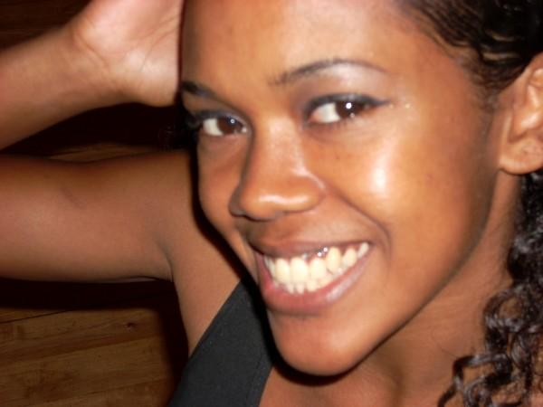
It made me smile.

Slide 13
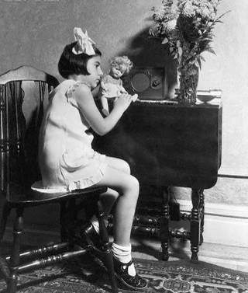
Those were such happy times
and not so long ago,

Slide 14

How I wondered where they’d gone.

Slide 15

But they’re back again,

Slide 16
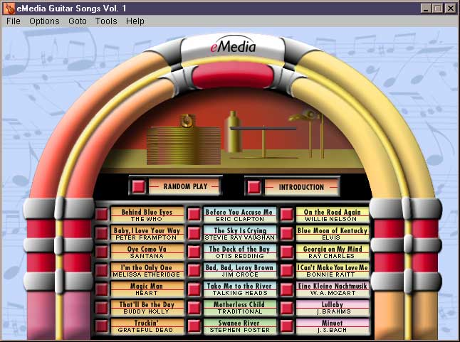
Just like a long lost friend,

Slide 17

All the songs I loved
so
well.

Slide 18

Every sha-la-la-la,
every whoa-oh-oh

Slide 19

Still shines.

Slide 20


Slide 21
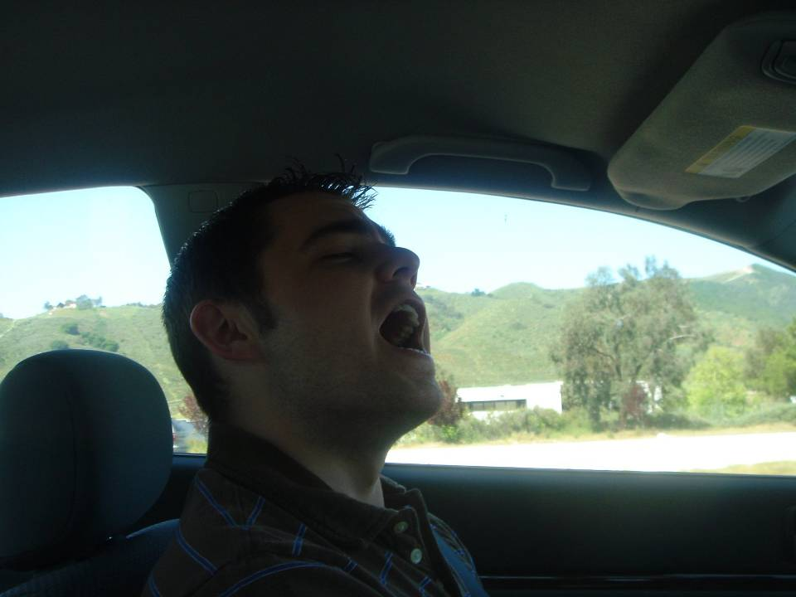
Every shing-a-ling-a-ling
that they’re starting to sing

Slide 22

So fine.

Slide 23


Slide 24
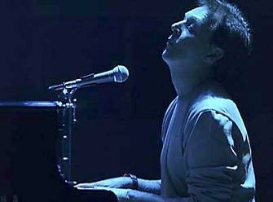
When they get to the part where he’s breaking her heart,

Slide 25

It can really make me cry.

Slide 26

Just like before,

Slide 27
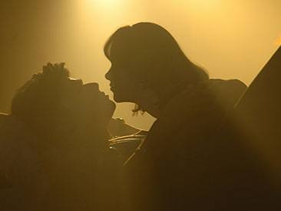
It’s yesterday once more.

Slide 28
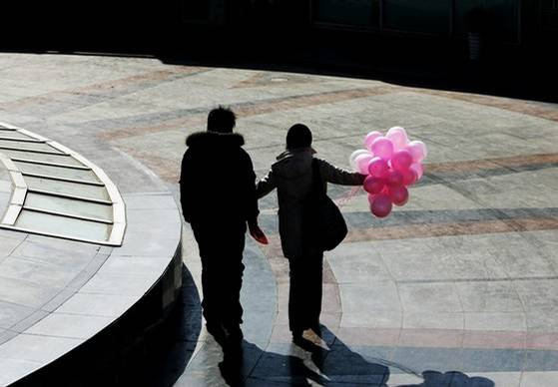

Slide 29

Looking back on how it was
in years gone by

Slide 30

And the good times that I had,

Slide 31
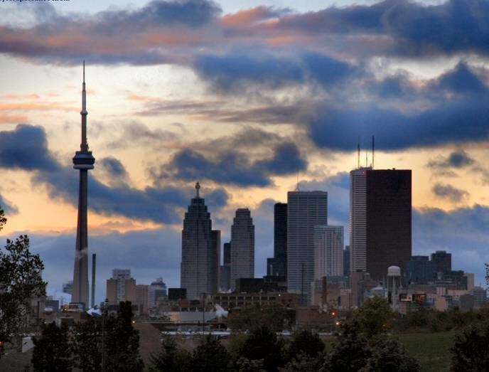
Makes today seem rather sad,

Slide 32

So much has changed.

Slide 33

It was songs of love that
I would sing to then

Slide 34

And I’d memorize each word.

Slide 35
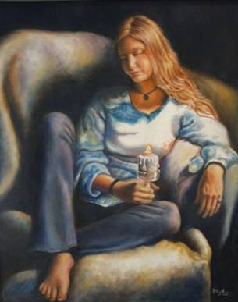
Those old melodies
still sound so good to me

Slide 36

As they melt the years away.

Slide 37

Every sha-la-la-la,
every whoa-oh-oh

Slide 38

Still shines.

Slide 39

All the oldies but goodies!

Slide 40

Every shing-a-ling-a-ling
that they’re starting to sing

Slide 41

So fine.

Slide 42


Slide 43
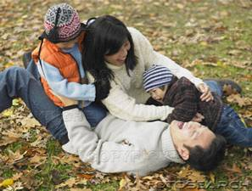
All my best memories come back clearly to me;

Slide 44

Some can even make me cry.

Slide 45
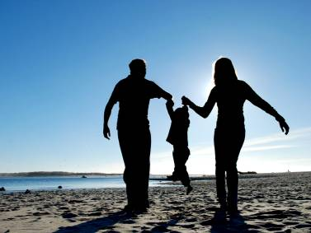
Just like before,

Slide 46

It’s yesterday once more.

Slide 47

Every sha-la-la-la,
every whoa-oh-oh

Slide 48

Still shines.

Slide 49


Slide 50

Every shing-a-ling-a-ling
that they’re starting to sing

Slide 51
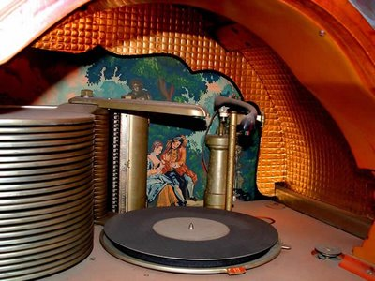
So fine.

Slide 52

Every sha-la-la-la,
every whoa-oh-oh

Slide 53

Still shines.
.

Slide 54

Karen Carpenter
Born: 03/02/50
Died: 02/04/83
Never let yesterday use up too much of today. Will Rogers
bjb/2007

Slide 55
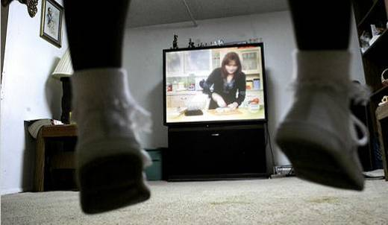

4. TALK TO:
THE T.V.
AND RADIO

Slide 56
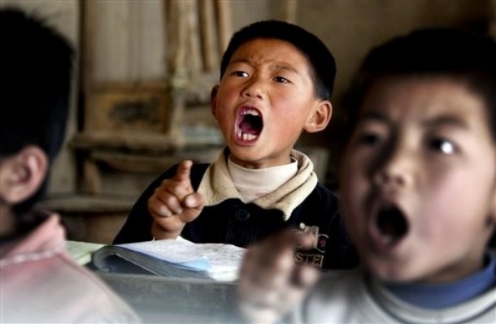
5. READ TEACHER’S POWERPOINTS

Slide 57

6. CALL ENGLISH SPEAKING FRIENDS

Slide 58
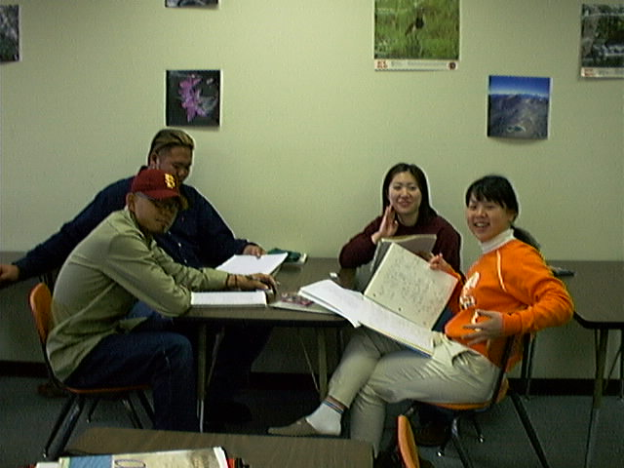
7. GROUP PARTICIPATION

Slide 59
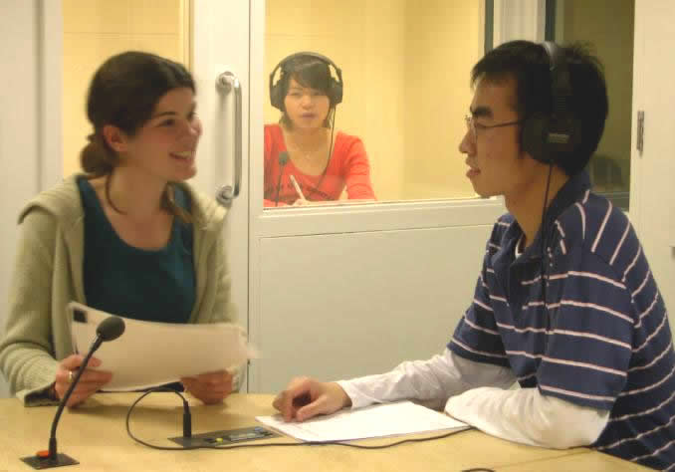
8. INTERPRETING FOR OTHERS

Slide 60


9. READ MORE—Read Seed Folks!

Slide 61
10. HELP Your ENGLISH TEACHERS!

Slide 62
English Corner’s Goals
To improve oral English skills—we speak only English.
To improve English listening skills.
To meet new friends.
To build social skills.
To learn about American and Chinese Cultures.
To share ideas and opinions.
Let’s have fun!

Slide 63
Next English Corner
April 10, 2014 7 PM
The next English Corner
will be in Room 218

Slide 64
Did anyone write a Limerick?
Limericks are short (sometimes serious; sometime silly) poems that are fun to recite.
A: What is a limerick, Mother?
A: It's a form of verse, said brother
B: In which lines one and two
B: Rhyme with five when it's through
A: And three and four rhyme with each other.

Slide 65

Studying Abroad
So why would you want to study abroad?
Just to see how many miles you can log?
No, silly! To learn and grow,
There is much I want to know.
You’ll come back so smart—we’ll all be awed.

Slide 66

Studying Abroad Part II
Are foreign universities much harder?
Not for a hard-working self-starter.
So don’t be a jerk
And just do your work.
Then you will be all the smarter!

Slide 67
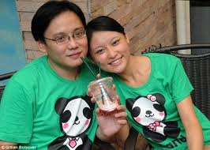
Studying Abroad Part III
I am in a foreign country,
At a top university.
One day, I looked above;
I fell deeply in love--
But the problems I didn’t foresee.

Slide 68
Dilemma: Where Will They Live?

Slide 69
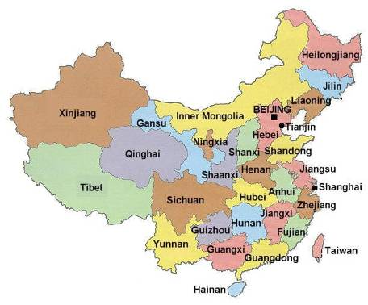

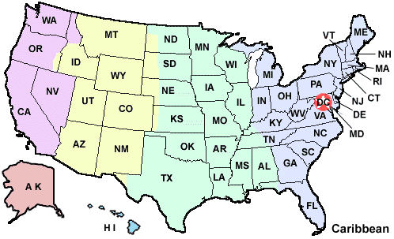
WHERE WILL THEY LIVE?
AMERICA?
CHINA?

Slide 70
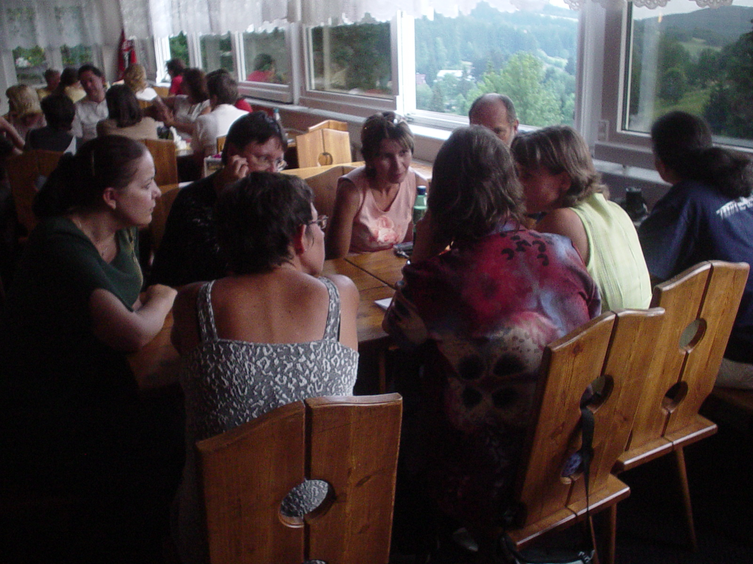
DIVIDE INTO GROUPS OF 6

Slide 71
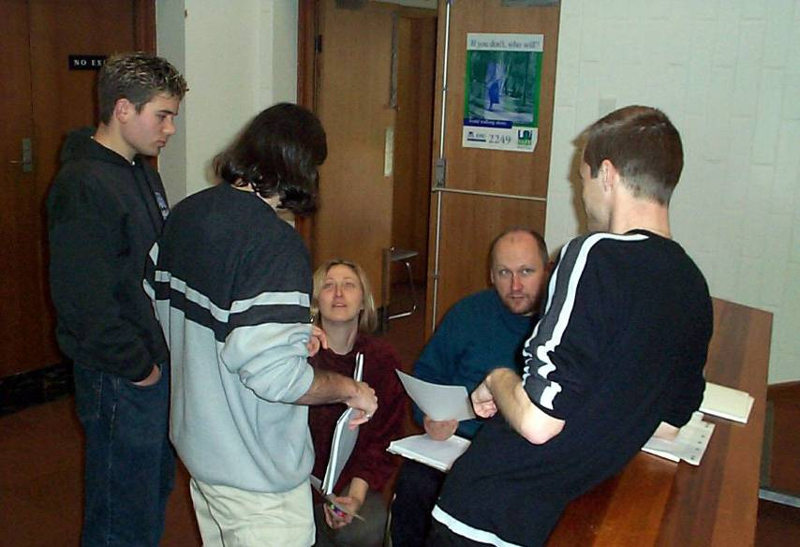
LET’S DO A ROLE-PLAY!

Slide 72
role-play – to act out a role, to play a part, to
“act as if”
biochemical – the chemical reactions in
living organisms
well-known – to be widely known and
recognized
outstanding – noticeable, distinguishing
eminent – famous
*following in the footsteps – to do the same
things in your life, especially as a member
of your own family
currently – at the present time, now
appreciate (v)– to value, treasure, cherish

Slide 73
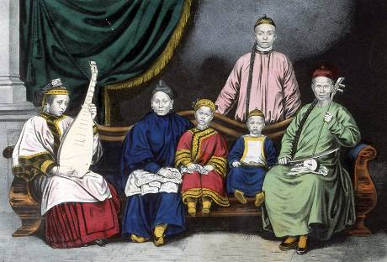
roots – a person’s origin, family history
heritage – tradition, legacy from family
fully – completely, totally
rarely- not often, seldom
*make-up one’s mind – to decide what to
choose, to determine what to do
opinion – one’s view or belief about a matter

Slide 74
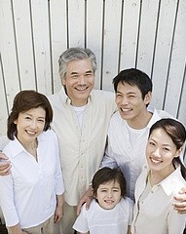
ROLE-PLAY SITUATION

Slide 75
Tom Cheung is a well-known biochemical engineer and his wife, Mary Guo, is an eminent university professor. They were both born and raised in China and met as university students in America. They fell in love, married and remained in America where they both have outstanding careers and where their three children were born and raised. Their oldest daughter, Lisa, is following in the footsteps of her father and is attending the University of Illinois,

Slide 76
where she meets Chen Li from China and they fall in love and are planning to marry.
While both sets of parents currently approve of the marriage, there is a serious disagreement on where the young couple should live after their graduation from the university. Lisa’s parents want their daughter and her husband to remain in America and raise their future family in America. Chen Li’s parents are farmers who have

Slide 77

sacrificed much to educate their only son and they want their son and his wife to return to China to live. They are afraid that if he remains in America, their grandchildren will never fully appreciate their Chinese roots and heritage and that they will rarely get to see their son and his family.
The young couple must make up their mind. What will they do?

Slide 78
ROLES:
1. Lisa
2. Chen Li
3. Lisa’s mother, Mary Guo
4. Lisa’s father, Tom Cheung
5. Chen Li’s mother
6. Chen Li’s father
INSTRUCTIONS: Assign a role to each person in your group. Each of you tells Lisa and Chen Li what you think they should do (remember to give the opinion of your role, not your own

Slide 79

personal opinion). The couples will listen to each person’s opinion and may agree or disagree. The couples will leave the room, discuss the decision together and come to an agreement. The group will try to predict/guess their decision. Each couple will come back into the room, tell their decision and why they decided that way.
(Remember, remember, discussions
are to be in English!)

Slide 80
WHERE WILL THEY LIVE?
AMERICA?
CHINA?

Slide 81

Break

Slide 82
Guest Presenter
Molen

Slide 83
Your Discussion Topics
Instructions:
  Form groups so you can face each other.
  In discussing each topic: You will have a few minutes to discuss topic and determine some successful conclusions. Please select one person from each group to summarize the group’s discussion.
Topics: (1) What do the following idioms mean: “you can lead a horse to water, but you can’t make it drink” and “get into the swing of things?” (2) What do these two idioms have in common?

Slide 84

Speaking Activity
Divide into groups of two
Roll the dice and answer the number of the question your rolled.
If you have already answered that question roll the dice again.

Slide 85
Talking Dice
Unfinished Sentences…

Slide 86
Unfinished Sentences:
Finish these sentences by adding your own words.
On Saturdays, I like to____________
If I had only 24 hours to live, I would__________
I feel best when people_____________
Secretly I wish_____________
If I could change the world, I would____ because_____
The most exciting thing I have done is_____
Right now the most important thing in my life is_____ because_________________
If I could be somewhere else now, I’d______________
I never worry about_____________________
I like people who________________
I find it difficult to_______________________
Studying is________________________________

Slide 87
Describe your feelings about leaving your home and province for four years.
Try to describe your feelings as you return after successfully completing your B.S or B.A. degree in four years.
Try to describe the feelings of your parents as you return to your home as a college graduate.
Try your best to describe your first day on the job of your dreams.
Describe your future husband or wife.
What do you think your feelings will be when your first child leaves home to go to a school?
What do you think the purpose of life is?
Where do you think you will go when you or your parents die?
Why do you believe that?
Do you believe you came from some where else when you were born? Why do you believe that?
Suppose you move to Australia which has a different form of government. How will that change the way you act in your life, Why?
What about living in Australia would make you nervous?
What do you think you will do to adjust to that concern?

Slide 88
Questions
Questions for and from
the Professors.

Slide 89
What are some of the topics you would like to discuss in class and/or English Corners?

Slide 90

ETHICAL DILEMMAS

Slide 91
Integrity
“Integrity without knowledge is weak and useless and knowledge without integrity is dangerous and dreadful.” (Samuel Johnson (1709-1784) English Poet, Critic and Writer)

Slide 92
VOCABULARY
ethics – the principles (rules) of conduct
governing an individual or a group, the
discipline dealing with what is good
and bad and moral duty and obligation
ethical – moral, conforming to accepted
rules and standards of conduct
moral – principles of right and wrong
behavior
dilemma – a situation involving a choice
between alternatives

Slide 93

expelled – kicked out of school,
suspended from school
0 tolerance – no exceptions, no second
chances
full ride – a scholarship which pays
tuition, books, room and board
Win Win – Solutions in which all parties are better off

Slide 94
ETHICAL DILEMMA
(VICE PRINCIPAL)
You are the vice principal in charge of discipline of a high school. It is your responsibility to see that all students follow the rules and are treated fairly and equally. It is the policy of your school that students caught with alcohol, drugs or weapons on campus will be expelled—0 tolerance.

Slide 95
Your daughter is a senior at the high school. She is an outstanding basketball and volleyball player and is a top academic student. She has applied to several universities and for scholarships that would pay virtually all of her costs at any of these colleges. She is almost certain to be accepted and to receive a full ride at all schools to which she has applied.

Slide 96
One evening, you are supervising a school dance. You need to speak to your daughter and can’t find her. You finally go into the darkened girls’ locker room and hear voices. One is your daughter’s voice and as you listen, you realize they are drinking alcohol. They do not see you.
What will you do?

Slide 97

Life is full of choices and decisions and many of them will present us with moral and ethical dilemmas. Some of these choices and decisions will challenge
the very principles,
standards and values
we were taught by
our family. When
faced with these
moral dilemmas,
what will you do?

Slide 98
Vocabulary Builders
Instructions:
  Form groups of three or four people.
  Distribute the vocabulary card so each person in your group has one.
  Taking turns, each person then pronounces each word on his/her card.
  When everyone is finished, pass your card one person to the left and then each person pronounces the words on his/new card.
  Repeat the process until everyone has had a chance to pronounce the words on each card.
  Note: If someone needs help pronouncing a word, other group members should provide assistance.

Slide 99
Talking Cards
Please form groups of 3-5 people.
You will be given a number of playing cards.
In turn, starting with the person whose birthday is closest to today’s date, draw a card from the top of the deck and answer the corresponding question.
Then take turns answering questions, until you have use up all of your cards.
Please speak loudly enough for your group to hear and understand you.

Slide 100

Five Phases of Dating
Phase I – Meeting lots of people.
  Group parties/gatherings.
  Speed Dating and other group games.
Phase II – Making Friends
  Eating lunch or dinner together.
  Studying or going for a walk together.
  Sharing family stories and personal goals.
  Phase III – Formal Dating.
    Planned activities designed to help you know each other better.
    Should begin to be more personable, but set limits as to the time you spend alone with each other and limits to intimacy.

Slide 101

Five Phases of Dating
Phase IV Paring up/Going Steady
  Share your important beliefs and values.
  Introduce each other to your respective families.
  Begin to plan for the future—education, employment, home and family goals.
  Continue to practice limits regarding time alone together and sharing of intimacy.
Phase V Formal Engagement
  The marriage proposal.
  Approval of both sets of parents.
  Set a wedding date.
  Plan more intensely for your wedding and future life together.
  Continue to practice limits regarding time alone together and sharing of intimacy.

