Slide 1


Professors John & Marie Murdoch
Welcome to English Corner

Slide 2
Introductions
Please stand and introduce yourself if this is your first English Corner.
What is your name?
Where are you from (hometown)?
Tell one thing you like to do in your free time?

Slide 3
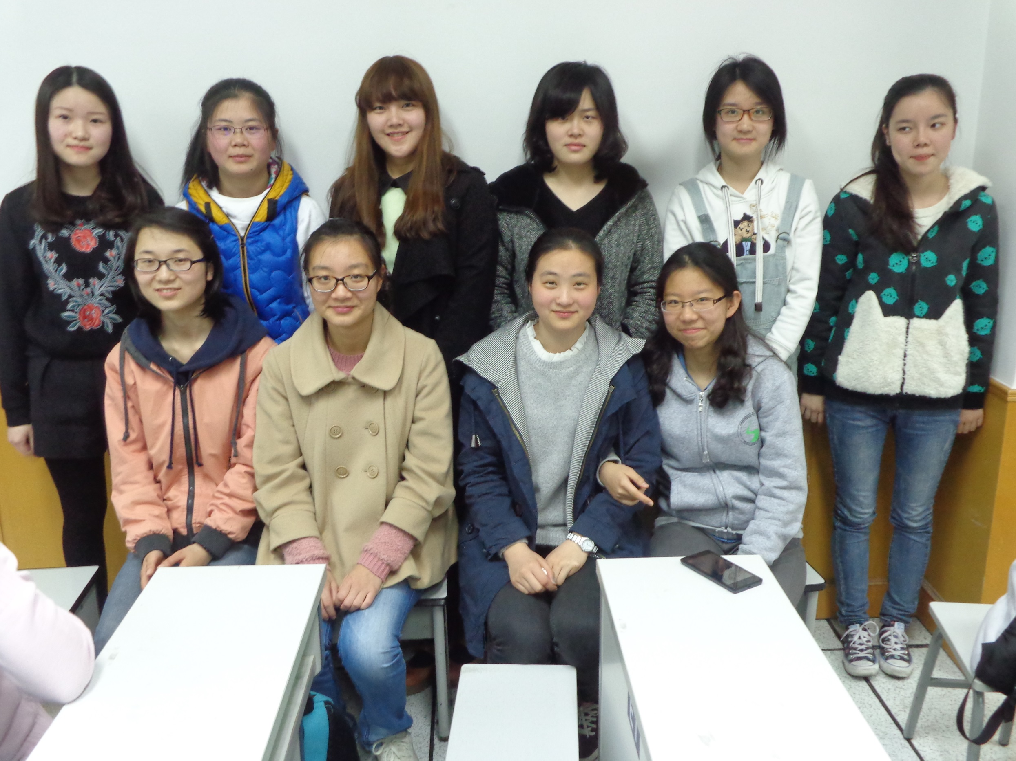
English Corner Friends
March 26, 2014

Slide 4
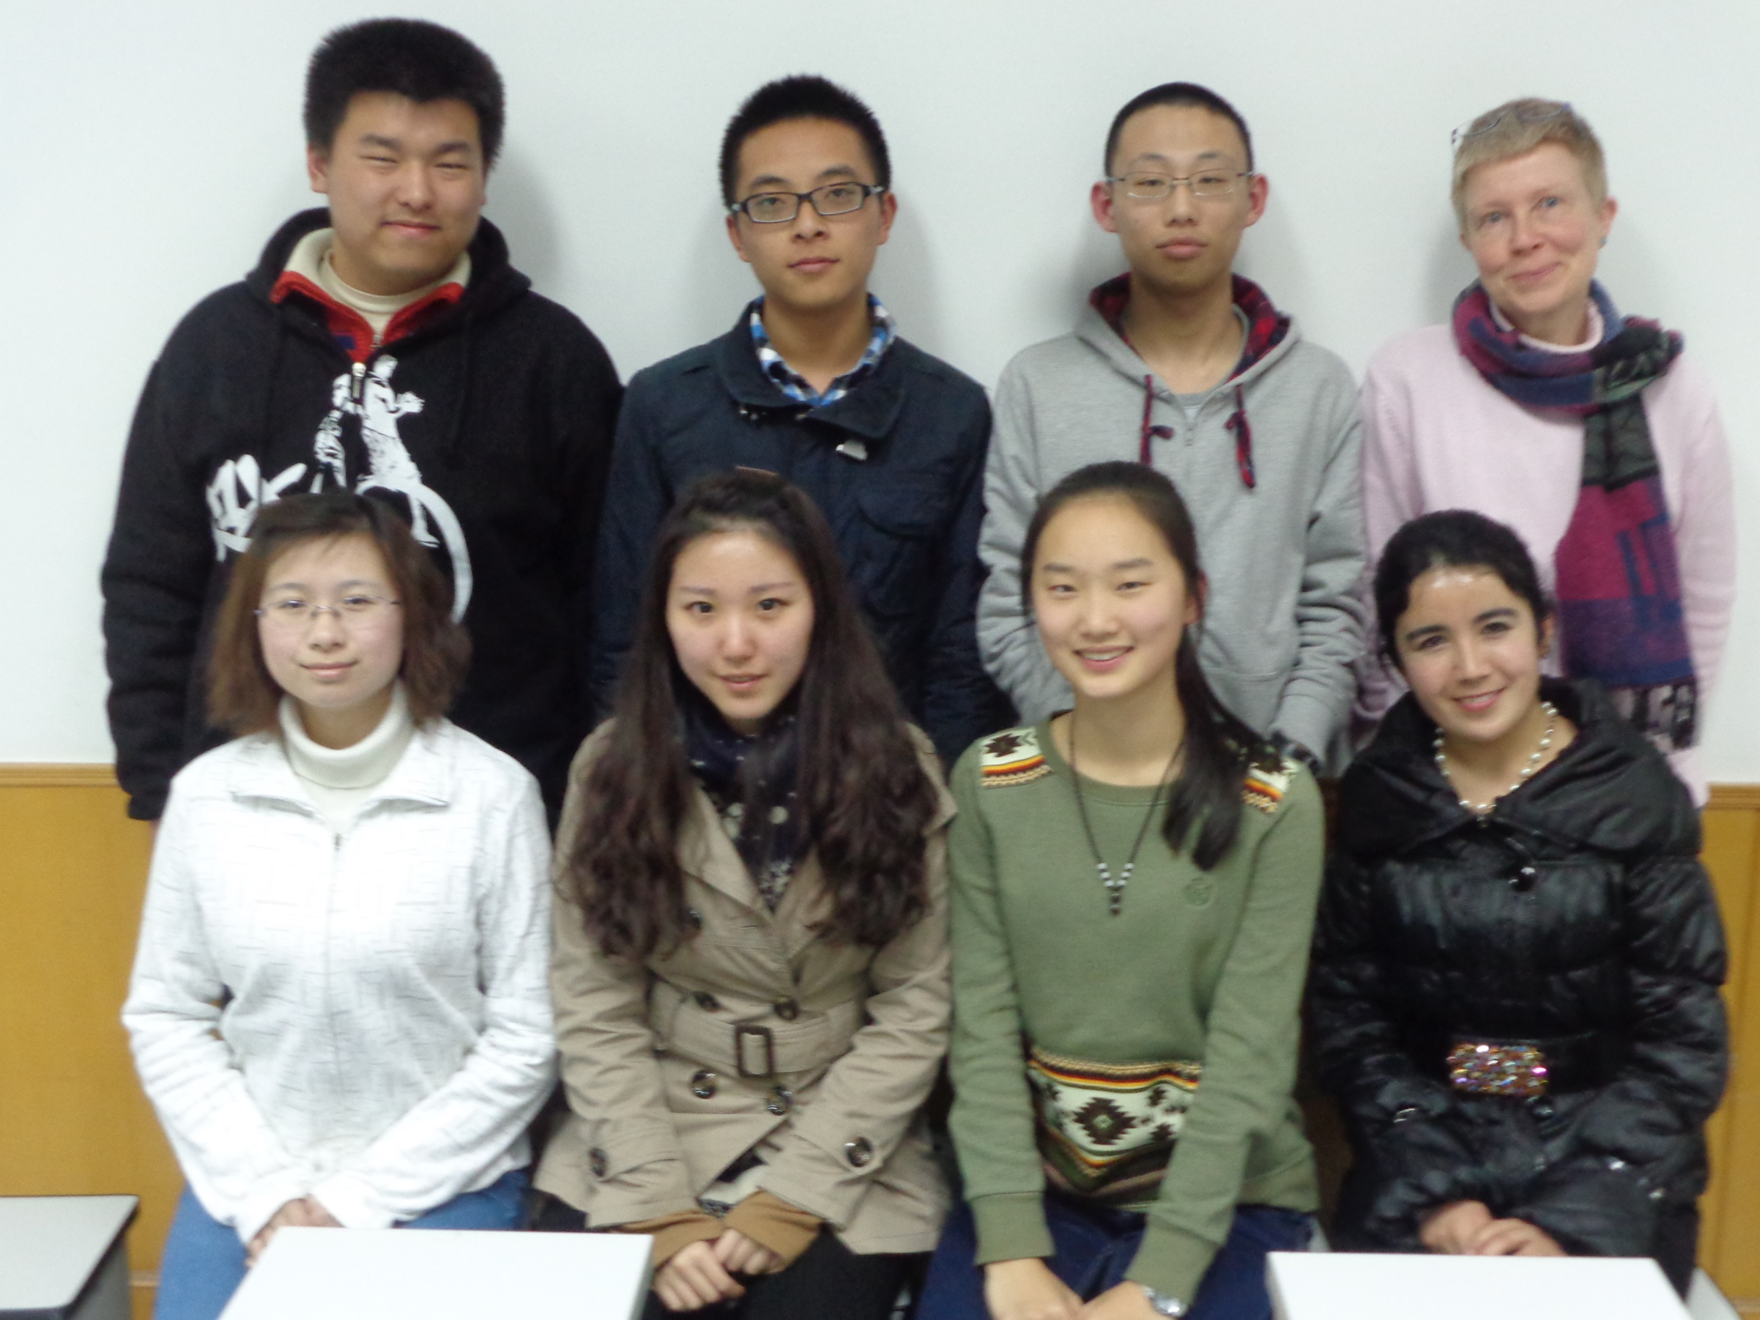
English Corner Friends
March 26, 2014

Slide 5
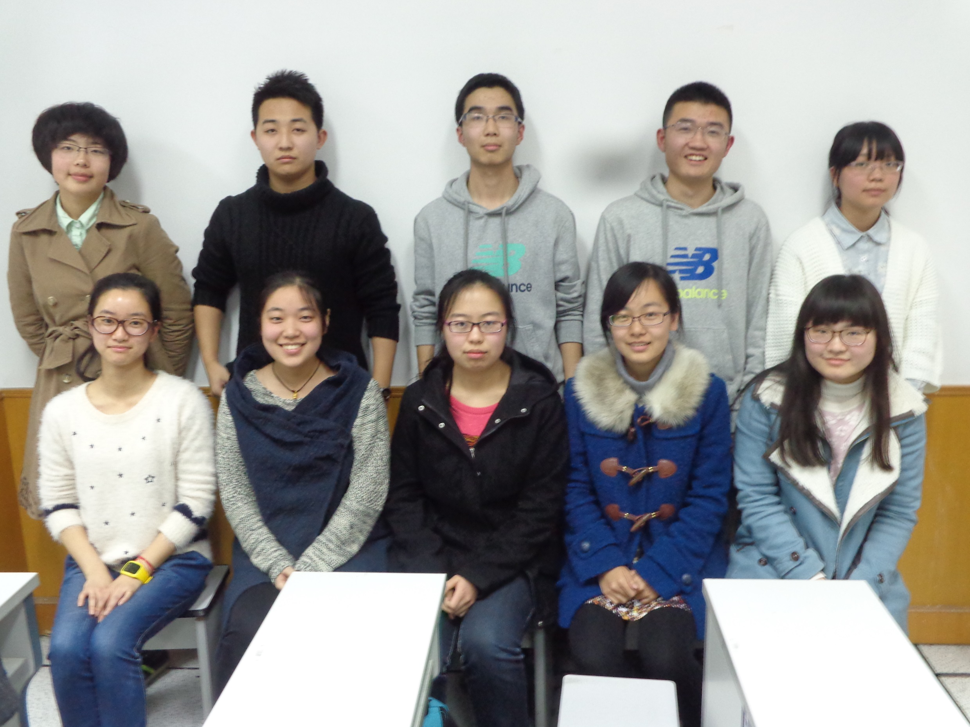
English Corner Friends
March 26, 2014

Slide 6
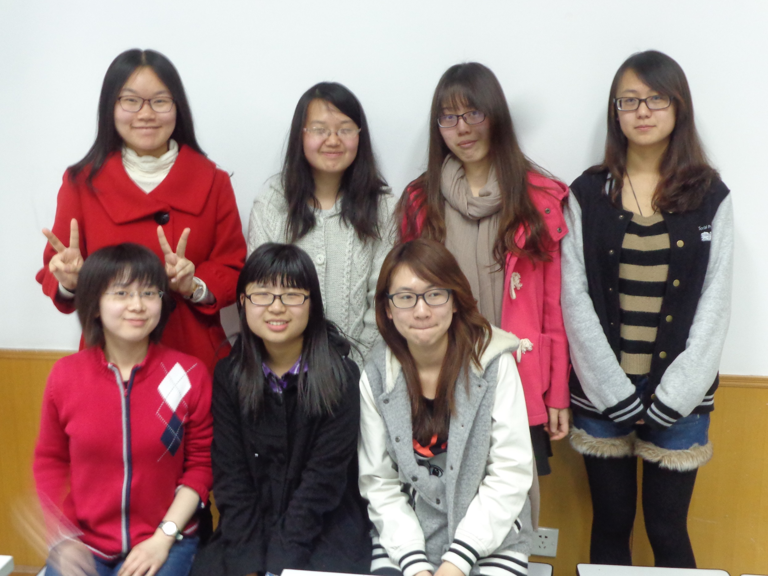
English Corner Friends
March 26, 2014

Slide 7
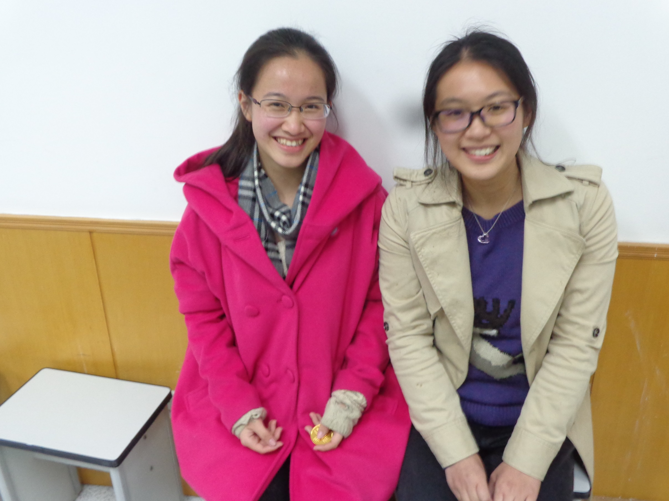
English Corner Friends
March 26, 2014

Slide 8
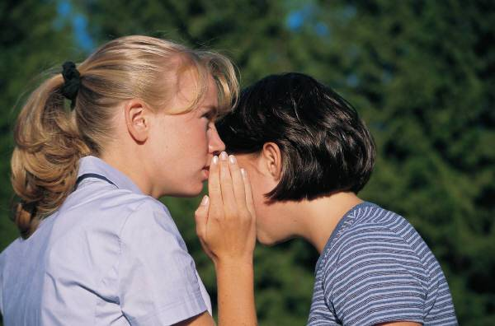
10 REASONS FOR SPEAKING ENGLISH

Slide 9
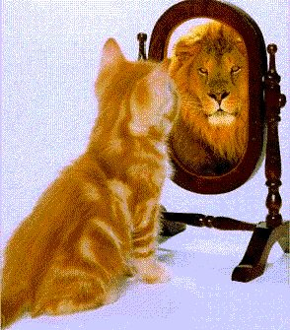
1. SELF ESTEEM

Slide 10
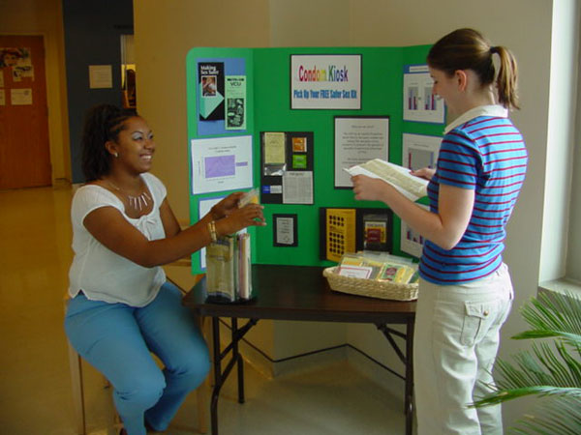
2. TEACHING OTHERS

Slide 11

SINGING SONGS -KARYOKE

Slide 12

KAREN
CARPENTER
“YESTERDAY
ONCE MORE”

Slide 13
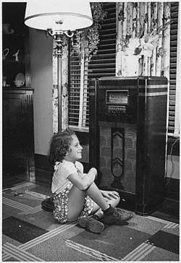
When I was young,
I’d listen to the
radio

Slide 14

Waiting for my
favorite songs.

Slide 15

When they played, I’d sing along;

Slide 16
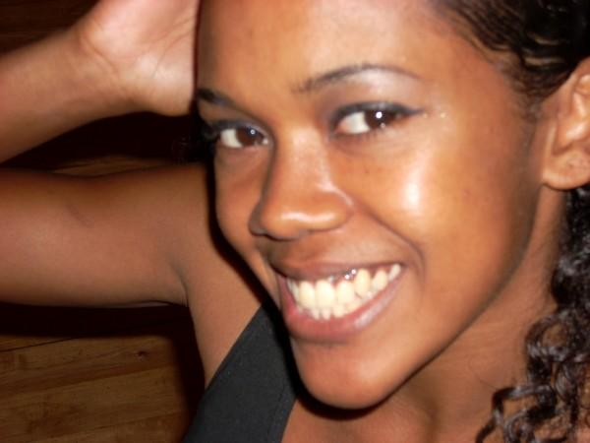
It made me smile.

Slide 17
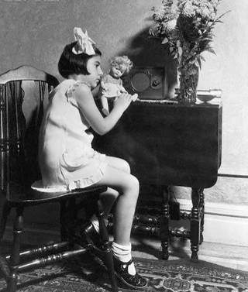
Those were such happy times
and not so long ago,

Slide 18

How I wondered where they’d gone.

Slide 19

But they’re back again,

Slide 20
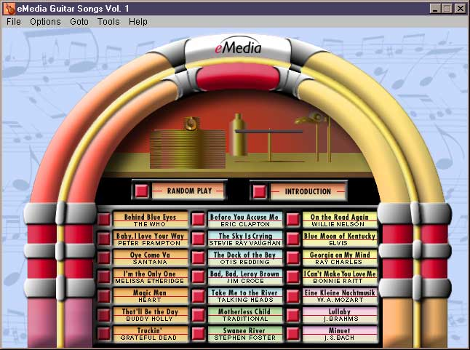
Just like a long lost friend,

Slide 21

All the songs I loved
so
well.

Slide 22

Every sha-la-la-la,
every whoa-oh-oh

Slide 23

Still shines.

Slide 24


Slide 25
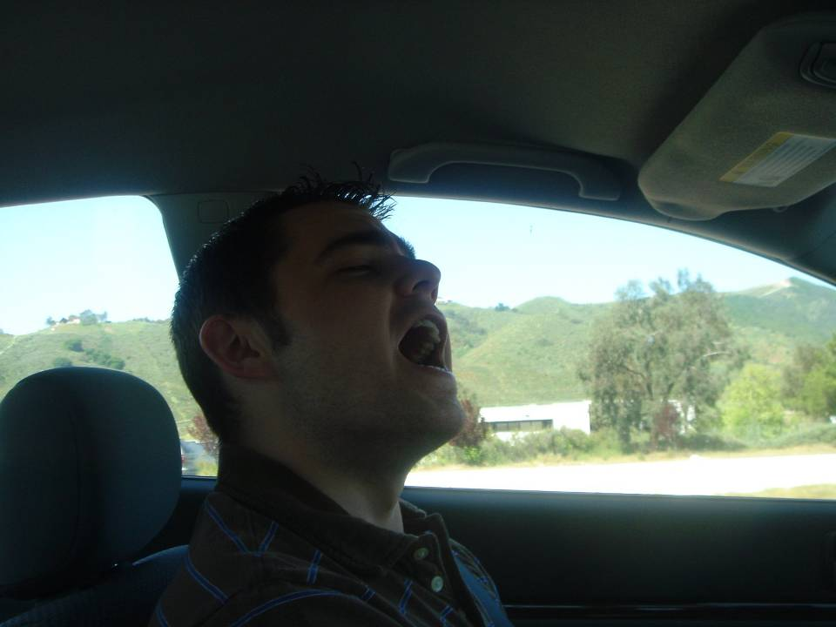
Every shing-a-ling-a-ling
that they’re starting to sing

Slide 26

So fine.

Slide 27
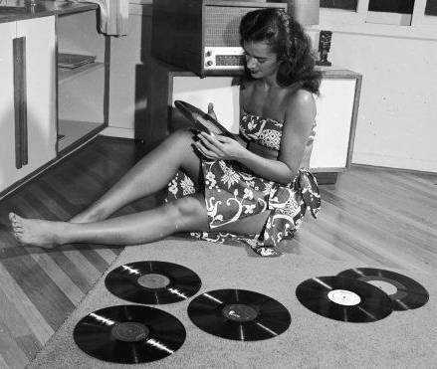

Slide 28
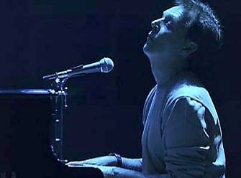
When they get to the part where he’s breaking her heart,

Slide 29
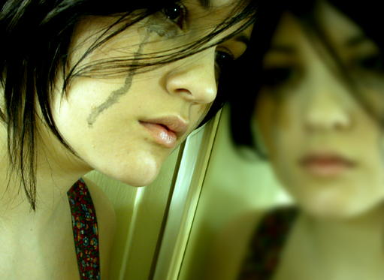
It can really make me cry.

Slide 30

Just like before,

Slide 31
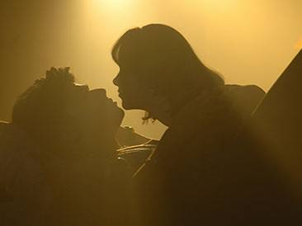
It’s yesterday once more.

Slide 32
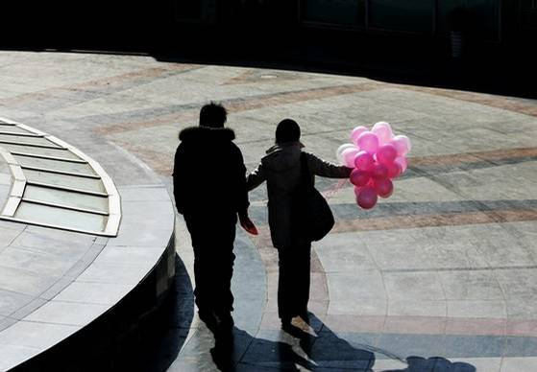

Slide 33
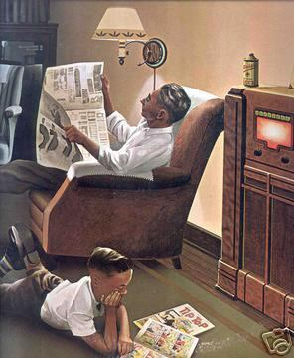
Looking back on how it was
in years gone by

Slide 34

And the good times that I had,

Slide 35
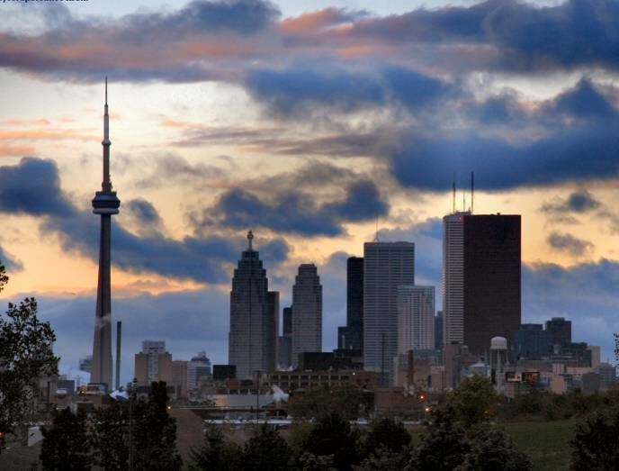
Makes today seem rather sad,

Slide 36
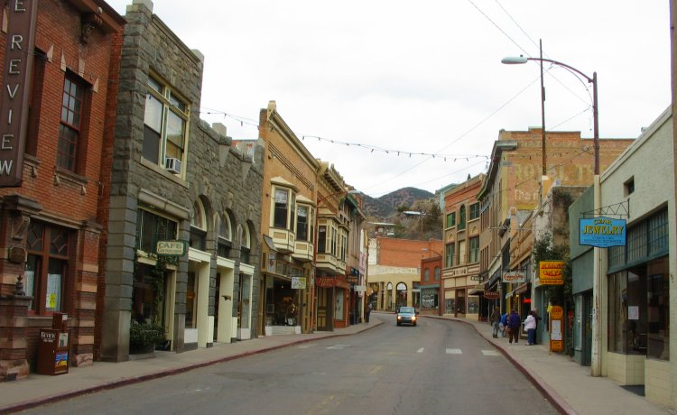
So much has changed.

Slide 37

It was songs of love that
I would sing to then

Slide 38

And I’d memorize each word.

Slide 39
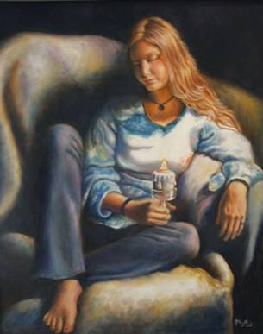
Those old melodies
still sound so good to me

Slide 40

As they melt the years away.

Slide 41

Every sha-la-la-la,
every whoa-oh-oh

Slide 42

Still shines.

Slide 43

All the oldies but goodies!

Slide 44
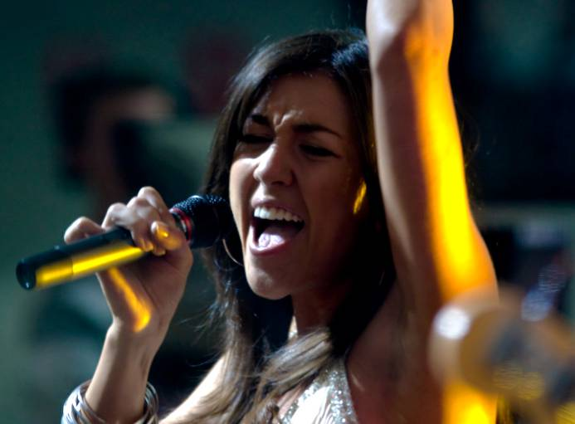
Every shing-a-ling-a-ling
that they’re starting to sing

Slide 45

So fine.

Slide 46


Slide 47
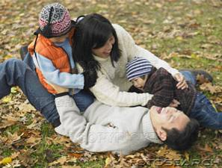
All my best memories come back clearly to me;

Slide 48
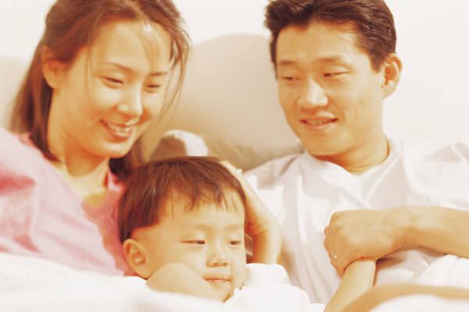
Some can even make me cry.

Slide 49
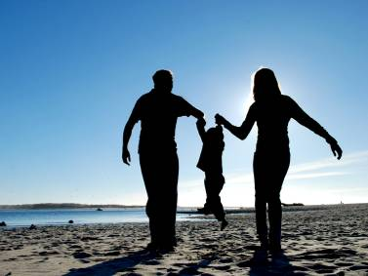
Just like before,

Slide 50

It’s yesterday once more.

Slide 51

Every sha-la-la-la,
every whoa-oh-oh

Slide 52

Still shines.

Slide 53


Slide 54

Every shing-a-ling-a-ling
that they’re starting to sing

Slide 55
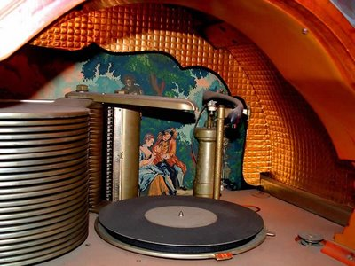
So fine.

Slide 56

Every sha-la-la-la,
every whoa-oh-oh

Slide 57

Still shines.
.

Slide 58

Karen Carpenter
Born: 03/02/50
Died: 02/04/83
Never let yesterday use up too much of today. Will Rogers
bjb/2007

Slide 59
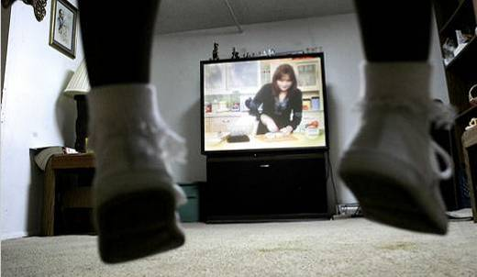

4. TALK TO:
THE T.V.
AND RADIO

Slide 60
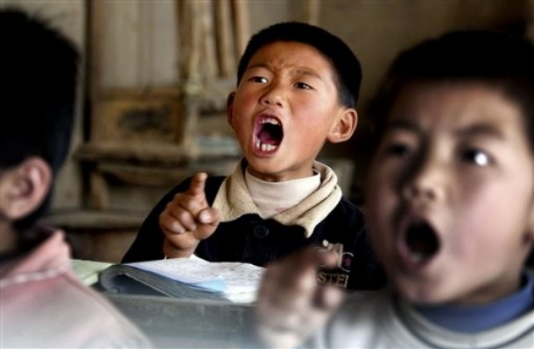
5. READ TEACHER’S POWERPOINTS

Slide 61

6. CALL ENGLISH SPEAKING FRIENDS

Slide 62
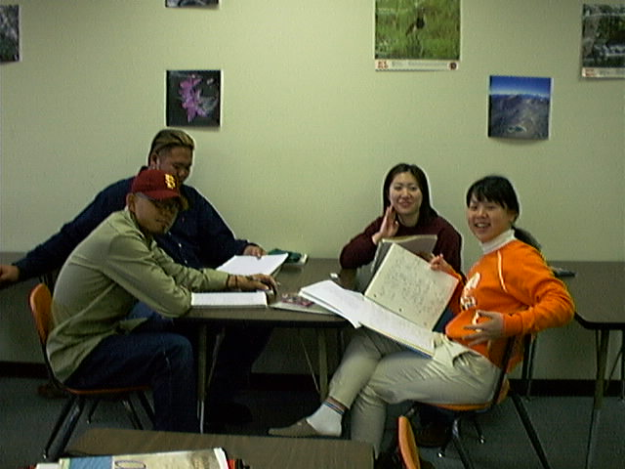
7. GROUP PARTICIPATION

Slide 63
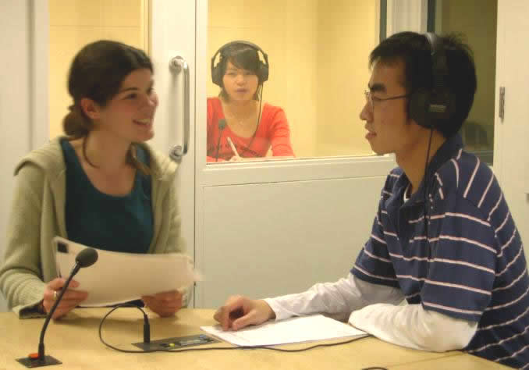
8. INTERPRETING FOR OTHERS

Slide 64


9. READ MORE—Read Seed Folks!

Slide 65
10. HELP Your ENGLISH TEACHERS!

Slide 66
English Corner’s Goals
To improve oral English skills—we speak only English.
To improve English listening skills.
To meet new friends.
To build social skills.
To learn about American and Chinese Cultures.
To share ideas and opinions.
Let’s have fun!

Slide 67
Next English Corner
April 3, 2014
7 PM
The next English Corner
will be in Room 218

Slide 68
English Corner Student Directed Activities
Welcome
Sophomore Team 1-D
Emily
Susan
Yuui

Slide 69
Did anyone write a Limerick?
Limericks are short (sometimes serious; sometime silly) poems that are fun to recite.
A: What is a limerick, Mother?
A: It's a form of verse, said brother
B: In which lines one and two
B: Rhyme with five when it's through
A: And three and four rhyme with each other.

Slide 70

Studying Abroad
So why would you want to study abroad?
Just to see how many miles you can log?
No, silly! To learn and grow,
There is much I want to know.
You’ll come back so smart—we’ll all be awed.

Slide 71

Studying Abroad Part II
Are foreign universities much harder?
Not for a hard-working self-starter.
So don’t be a jerk
And just do your work.
Then you will be all the smarter!

Slide 72



Jim’s Choices
Jim, there are so many choices,
Offered by lots of loud voices.
Jim, do this; no do that--
You’d think he was a pet cat;
But, Jim chooses right and rejoices.

Slide 73
Meet & Greet
We-Chat
Introduce yourselves.
Optional Topics:
    What does this Chinese proverb mean? “Teachers open the door, but students must walk in.”
    Discuss this idiom: “You can lead a horse to water, but you can’t make it drink.”
    What choices are you facing right now?

Slide 74

Break

Slide 75



MARY’S CHOICE
(ROLE-PLAY)
Tongji University
Harvard University

Slide 76
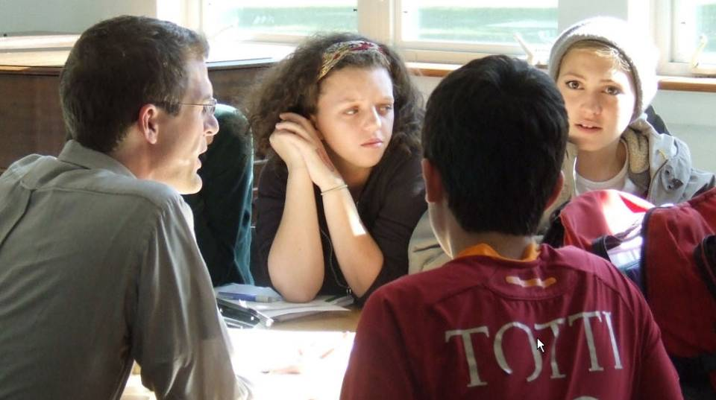
DIVIDE INTO GROUPS OF FOUR

Slide 77

role-play – to act out a role, to
play a part

Slide 78

Mary has a serious choice she must make. She can’t decide which graduate school to attend. She has applied to two schools and has been accepted to both of them. One university is in America
and the other is in China.
The first school she applied to is Harvard University. Harvard is famous throughout the world and a Harvard degree opens many doors of opportunity. After she graduates, there will be no problem for her

Slide 79
to find a very high-paying job. She wants to study law and Harvard’s program would be a real opportunity for her. Harvard will cost $50,000 a year and they have offered to give her a scholarship for $20,000. She doesn’t know how she will pay the remaining tuition. Her father has worked hard to save for her education, but this would mean that he would have no money left and he is now getting old.

Slide 80

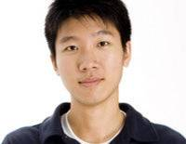
She is concerned for her father and mother being alone while she goes overseas for four years.
She also has another consideration—her
boyfriend. He attends Tongji
University and wants her to stay
with him because he wants to marry her. He’s afraid that if she leaves for America, she will never come back. Mary loves her boyfriend very much. She has also been accepted at Tongji University.

Slide 81

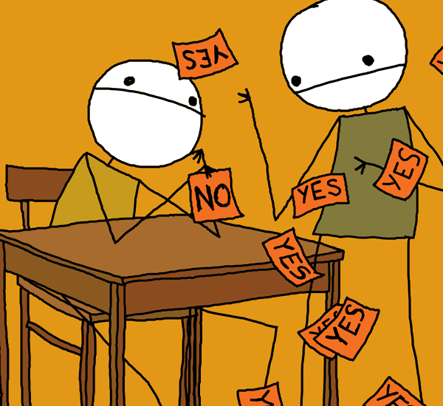
It is one of the best universities
in China and they have offered to pay her
full tuition in scholarship, but the chance to
go to Harvard is once in a lifetime. If she
stays in China, however, she will be near
her boyfriend and her parents.
Mary must make
up her mind.
Where will she go?

Slide 82


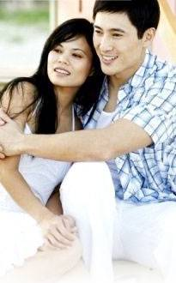
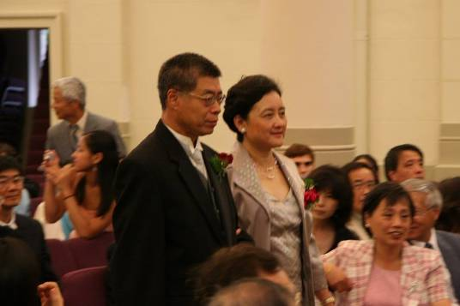
Roles:
1. Mary
2. Mary’s father
3. Mary’s mother
4. Mary’s boyfriend

Slide 83

INSTRUCTIONS: Each of you tell Mary what you think she should do (remember to give the opinion of your role, not your own personal opinion).
Mary will listen to each person’s opinion and may agree or disagree. Mary will then leave the room and the group will try to predict/guess her answer. She will come back into the room and tell her decision and why she decided that way.
We will then discuss this scenario as a class.

Slide 84
Questions
Questions for and from
the Professors.

Slide 85
Tell Me a Story
Form in assigned groups.
Look at your picture.
The first person tells what happens in the story before the picture.
The next person tells what happens in the picture.
The next person tells what will happen after the picture.
Each picture builds upon the previous story.
Practice and be prepared to share with the full class.
Repeat with each picture as time permits.

Slide 86

roses

Slide 87

chocolates

Slide 88
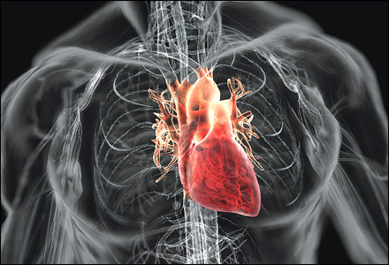
heart

Slide 89
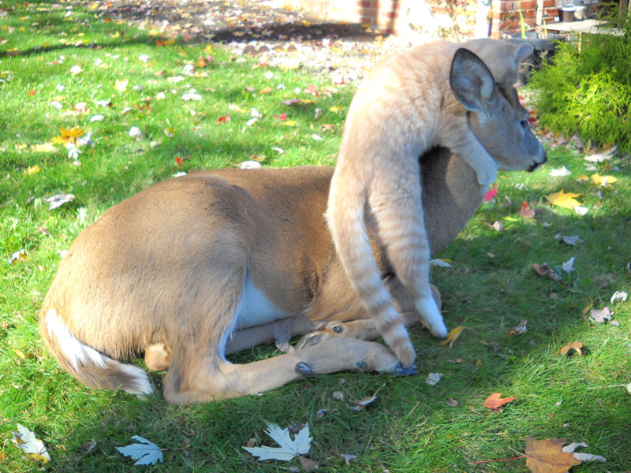

Slide 90

lace

Slide 91
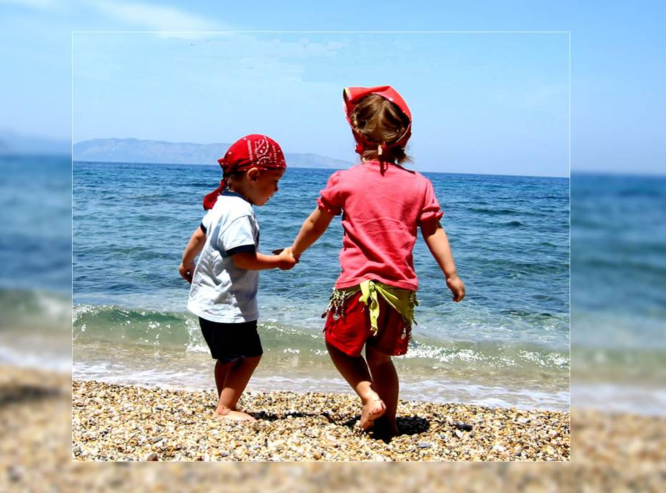
friendship

Slide 92
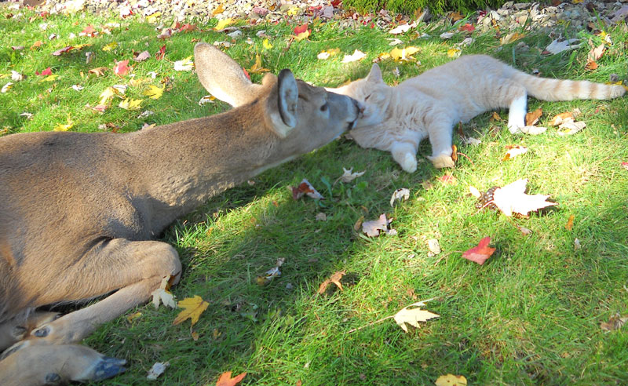

Slide 93

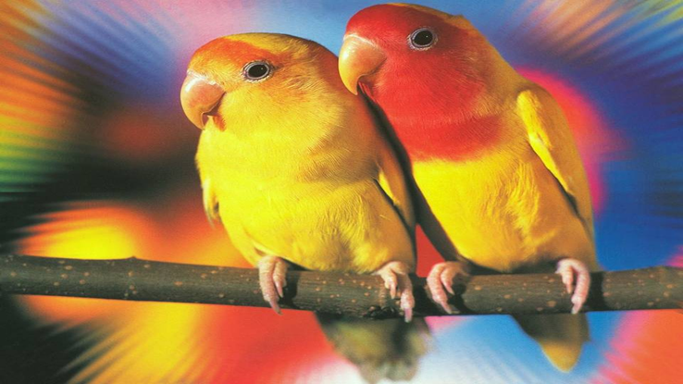
lovebirds

Slide 94
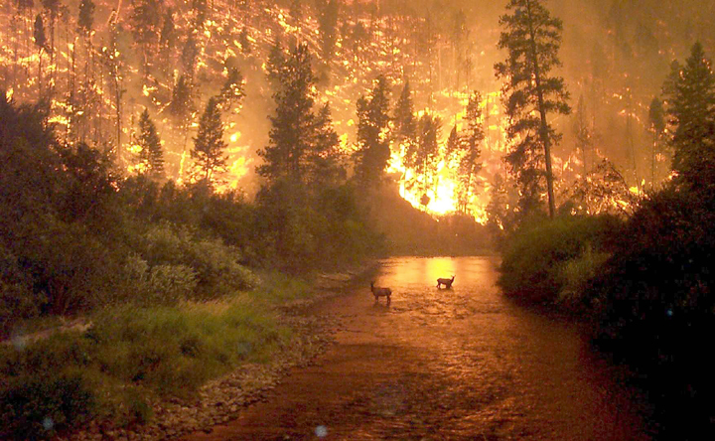

Slide 95

propose

Slide 96
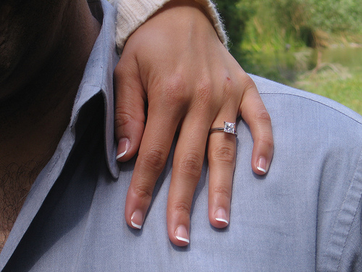

Slide 97
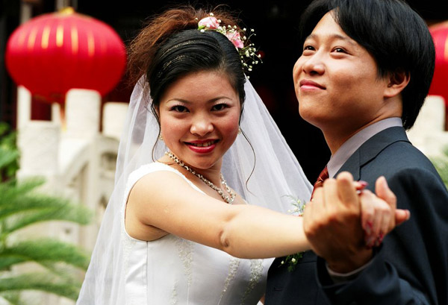

Slide 98
What are some of the topics you would like to discuss in class and/or English Corners?

Slide 99

Speaking Activity
Divide into groups of two
Roll the dice and answer the number of the question your rolled.
If you have already answered that question roll the dice again.

Slide 100
Describe your feelings about leaving your home and province for four years.
Try to describe your feelings as you return after successfully completing your B.S or B.A. degree in four years.
Try to describe the feelings of your parents as you return to your home as a college graduate.
Try your best to describe your first day on the job of your dreams.
Describe your future husband or wife.
What do you think your feelings will be when your first child leaves home to go to a school?
What do you think the purpose of life is?
Where do you think you will go when you or your parents die?
Why do you believe that?
Do you believe you came from some where else when you were born? Why do you believe that?
Suppose you move to Australia which has a different form of government. How will that change the way you act in your life, Why?
What about living in Australia would make you nervous?
What do you think you will do to adjust to that concern?

Slide 101
Professors John & Marie Murdoch
Welcome to English Corner

Slide 102

ETHICAL DILEMMAS

Slide 103
Integrity
“Integrity without knowledge is weak and useless and knowledge without integrity is dangerous and dreadful.” (Samuel Johnson (1709-1784) English Poet, Critic and Writer)

Slide 104
VOCABULARY
ethics – the principles (rules) of conduct
governing an individual or a group, the
discipline dealing with what is good
and bad and moral duty and obligation
ethical – moral, conforming to accepted
rules and standards of conduct
moral – principles of right and wrong
behavior
dilemma – a situation involving a choice
between alternatives

Slide 105

expelled – kicked out of school,
suspended from school
0 tolerance – no exceptions, no second
chances
full ride – a scholarship which pays
tuition, books, room and board
Win Win – Solutions in which all parties are better off

Slide 106
ETHICAL DILEMMA
(VICE PRINCIPAL)
You are the vice principal in charge of discipline of a high school. It is your responsibility to see that all students follow the rules and are treated fairly and equally. It is the policy of your school that students caught with alcohol, drugs or weapons on campus will be expelled—0 tolerance.

Slide 107
Your daughter is a senior at the high school. She is an outstanding basketball and volleyball player and is a top academic student. She has applied to several universities and for scholarships that would pay virtually all of her costs at any of these colleges. She is almost certain to be accepted and to receive a full ride at all schools to which she has applied.

Slide 108
One evening, you are supervising a school dance. You need to speak to your daughter and can’t find her. You finally go into the darkened girls’ locker room and hear voices. One is your daughter’s voice and as you listen, you realize they are drinking alcohol. They do not see you.
What will you do?

Slide 109

Life is full of choices and decisions and many of them will present us with moral and ethical dilemmas. Some of these choices and decisions will challenge
the very principles,
standards and values
we were taught by
our family. When
faced with these
moral dilemmas,
what will you do?

Slide 110
Vocabulary Builders
Instructions:
  Form groups of three or four people.
  Distribute the vocabulary card so each person in your group has one.
  Taking turns, each person then pronounces each word on his/her card.
  When everyone is finished, pass your card one person to the left and then each person pronounces the words on his/new card.
  Repeat the process until everyone has had a chance to pronounce the words on each card.
  Note: If someone needs help pronouncing a word, other group members should provide assistance.

Slide 111
Talking Cards
Please form groups of 3-5 people.
You will be given a number of playing cards.
In turn, starting with the person whose birthday is closest to today’s date, draw a card from the top of the deck and answer the corresponding question.
Then take turns answering questions, until you have use up all of your cards.
Please speak loudly enough for your group to hear and understand you.

Slide 112

Five Phases of Dating
Phase I – Meeting lots of people.
  Group parties/gatherings.
  Speed Dating and other group games.
Phase II – Making Friends
  Eating lunch or dinner together.
  Studying or going for a walk together.
  Sharing family stories and personal goals.
  Phase III – Formal Dating.
    Planned activities designed to help you know each other better.
    Should begin to be more personable, but set limits as to the time you spend alone with each other and limits to intimacy.

Slide 113

Five Phases of Dating
Phase IV Paring up/Going Steady
  Share your important beliefs and values.
  Introduce each other to your respective families.
  Begin to plan for the future—education, employment, home and family goals.
  Continue to practice limits regarding time alone together and sharing of intimacy.
Phase V Formal Engagement
  The marriage proposal.
  Approval of both sets of parents.
  Set a wedding date.
  Plan more intensely for your wedding and future life together.
  Continue to practice limits regarding time alone together and sharing of intimacy.

