Slide 1


Professors John & Marie Murdoch
Welcome to English Corner

Slide 2
English Corner’s Goals
To improve oral English skills—we speak only English.
To improve English listening skills.
To meet new friends.
To build social skills.
To learn about American and Chinese Cultures.
To share ideas and opinions.
Let’s have fun!

Slide 3
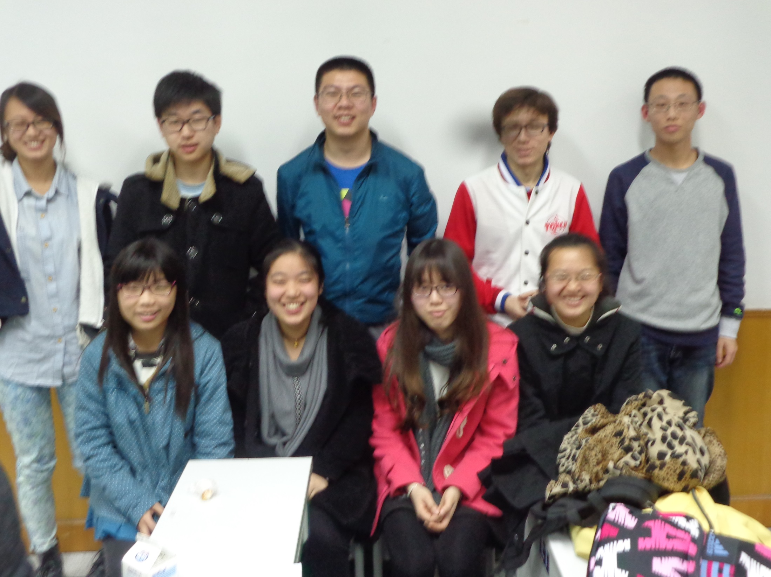
English Corner Friends
March 19, 2015

Slide 4
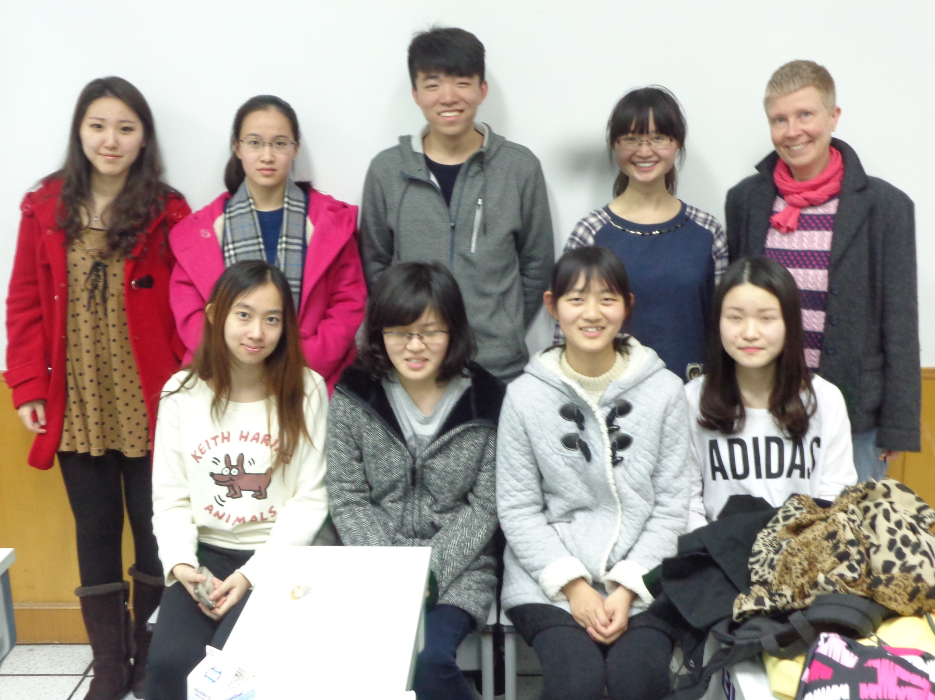
English Corner Friends
March 19, 2015

Slide 5
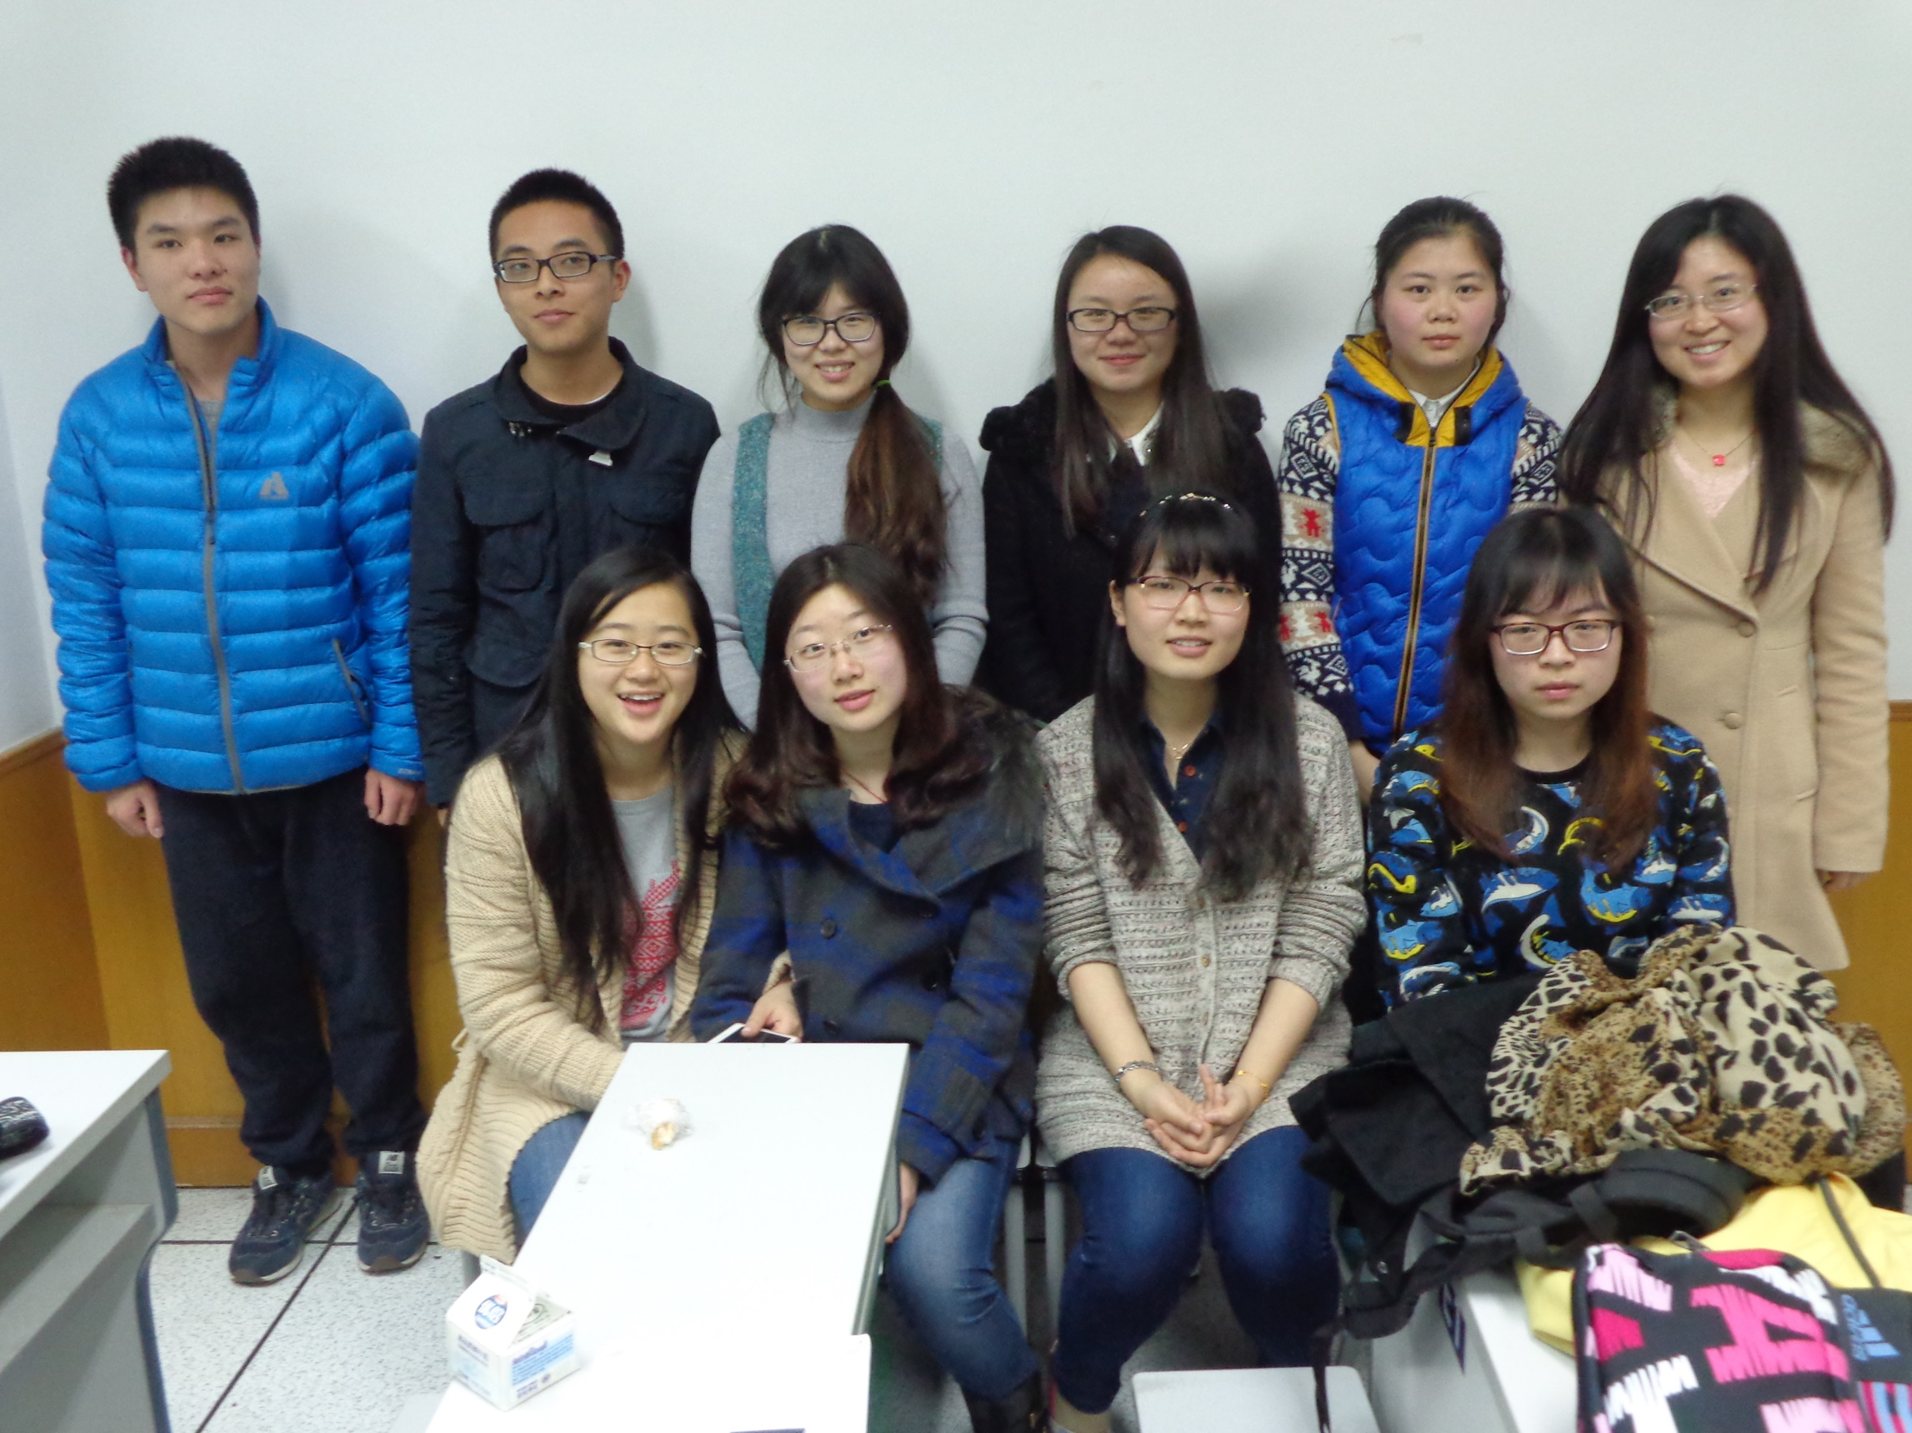
English Corner Friends
March 19, 2015

Slide 6
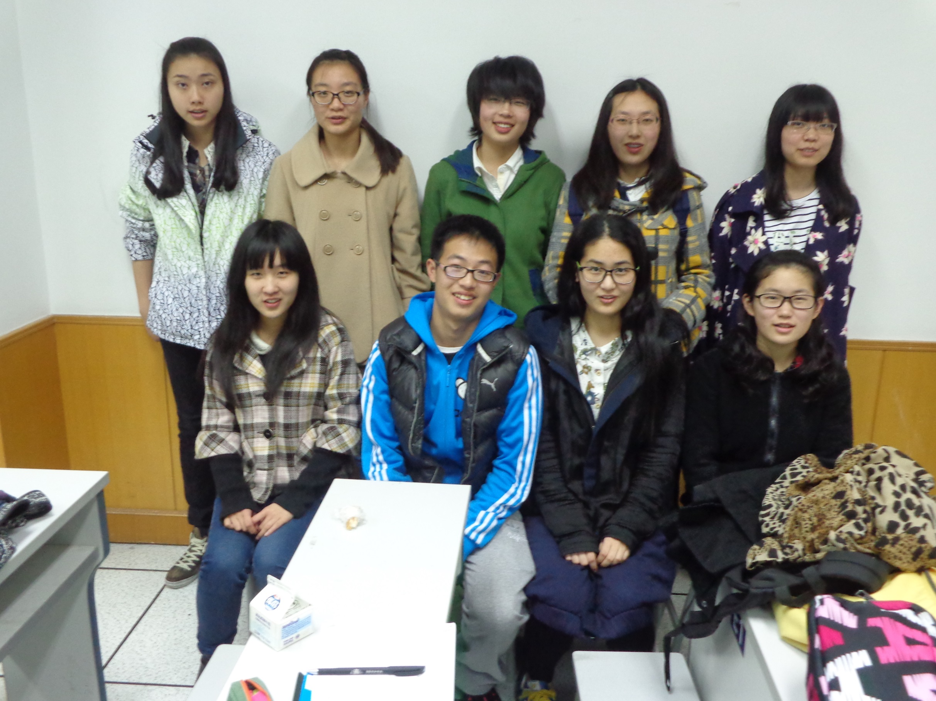
English Corner Friends
March 19, 2015

Slide 7

Why Learn a Second Language?

Slide 8
Next English Corner
Thursday, April 2, 2015
7 PM
Bring a friend!
Have
a
Treat.
Let’s have some Fun!
Come One; Come ALL

Slide 9
Did anyone write a Limerick?
Limericks are short (sometimes serious; sometime silly) poems that are fun to recite.
A: What is a limerick, Mother?
A: It's a form of verse, said brother
B: In which lines one and two
B: Rhyme with five when it's through
A: And three and four rhyme with each other.

Slide 10

Studying Abroad
So why would you want to study abroad?
Just to see how many miles you can log?
No, silly! To learn and grow,
There is much I want to know.
You’ll come back so smart—we’ll all be awed.

Slide 11

Studying Abroad Part II
Are foreign universities much harder?
Not for a hard-working self-starter.
So don’t be a jerk
And just do your work.
Then you will be all the smarter!

Slide 12

Let’s
Sing
Yesterday
Once More

Slide 13
English Corner Student Directed Activities
Welcome
Sophomore Team 1-C
Anna
Linda
Rebecca

Slide 14
Meet & Greet
We-Chat
Introduce yourselves.
Optional Topics:
    What advantages and disadvantages would there be to studying abroad?
    What must a person do to qualify for a foreign university?
    If you could study abroad what country/university would you choose?

Slide 15

Pictures & Treats
Break

Slide 16

Five Phases of Dating
Phase I – Meeting lots of people.
  Group parties/gatherings.
  Speed Dating and other group games.
Phase II – Making Friends
  Eating lunch or dinner together.
  Studying or going for a walk together.
  Sharing family stories and personal goals.
  Phase III – Formal Dating.
    Planned activities designed to help you know each other better.
    Should begin to be more personable, but set limits as to the time you spend alone with each other and limits to intimacy.

Slide 17

Five Phases of Dating
Phase IV Paring up/Going Steady
  Share your important beliefs and values.
  Introduce each other to your respective families.
  Begin to plan for the future—education, employment, home and family goals.
  Continue to practice limits regarding time alone together and sharing of intimacy.
Phase V Formal Engagement
  The marriage proposal.
  Approval of both sets of parents.
  Set a wedding date.
  Plan more intensely for your wedding and future life together.
  Continue to practice limits regarding time alone together and sharing of intimacy.

Slide 18
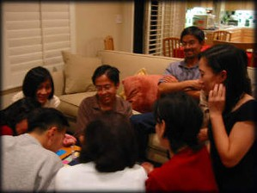
Descriptionary

Slide 19

roses

Slide 20
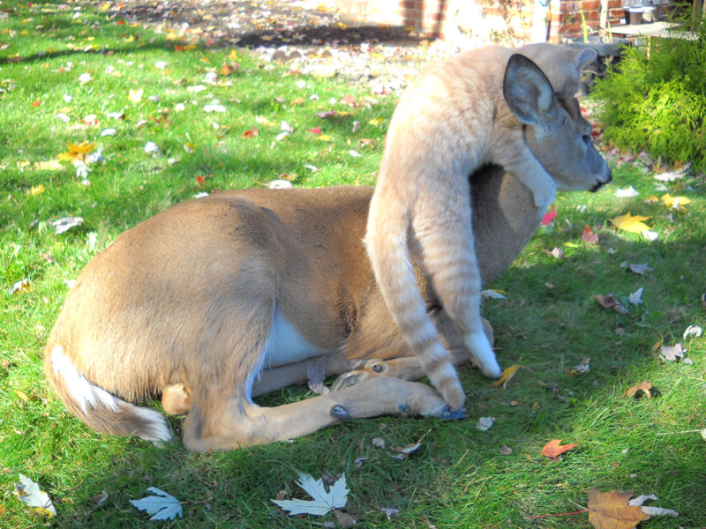
Cat

Slide 21

chocolates

Slide 22
Deer

Slide 23

heart

Slide 24
Hug

Slide 25

lace

Slide 26
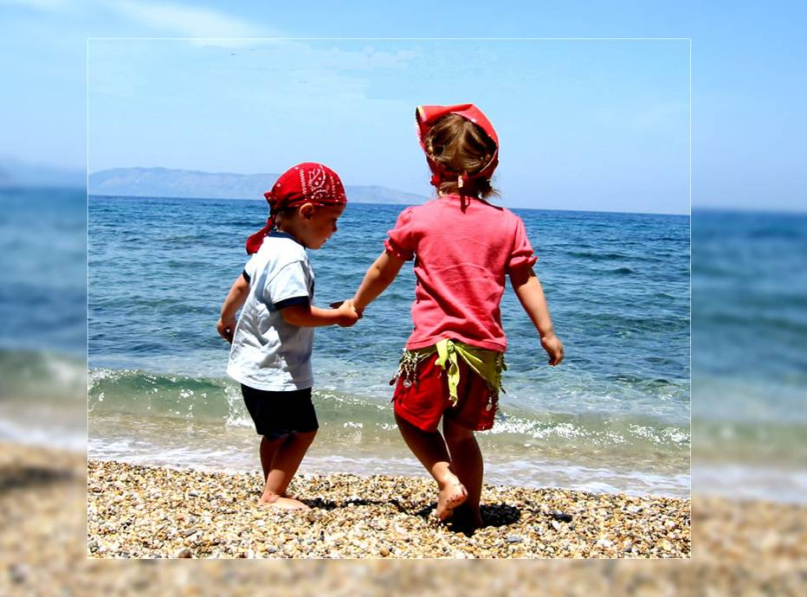
friendship

Slide 27
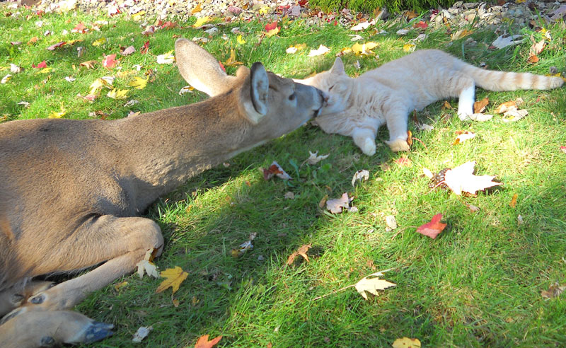
Kiss

Slide 28


lovebirds

Slide 29

propose

Slide 30
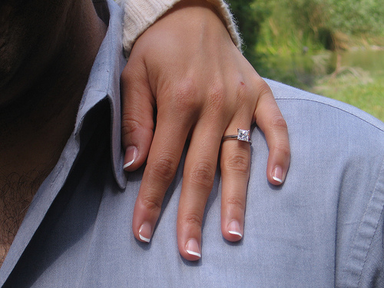
engaged

Slide 31
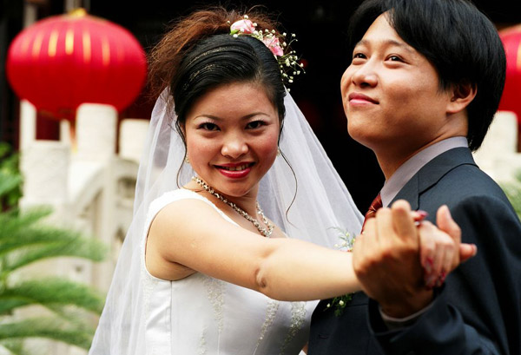
Bride

Slide 32
Groom

Slide 33
Grass

Slide 34

Speaking Dice Activity
Divide into assigned groups
Roll the dice and answer the number of the question you rolled.
If you have already answered a question, then question then answer question #1. After answering question #1, then answer any other question that you have not yet answered.

Slide 35
Talking Dice
Getting to Know Each Other
Tell us about where you are from?
What is the one thing about yourself that you would like us to know?
What do you think is the most important value between two people in a relationship?
What do you do for fun?
What accomplishment are you most proud about?
Which is the last book you read?
Which is your favorite music and your favorite singer/band?
What adjectives would a close friend use to describe you?
Which is your favorite genre of movies - comedy/thriller/action?
Who was your hero, as a child?
Tell us about your first crush?
Describe your favorite meal.

Slide 36
Describe your feelings about leaving your home and province for four years.
Try to describe your feelings as you return after successfully completing your B.S or B.A. degree in four years.
Try to describe the feelings of your parents as you return to your home as a college graduate.
Try your best to describe your first day on the job of your dreams.
Describe your future husband or wife.
What do you think your feelings will be when your first child leaves home to go to a school?
What do you think the purpose of life is?
Where do you think you will go when you or your parents die?
Why do you believe that?
Do you believe you came from some where else when you were born? Why do you believe that?
Suppose you move to Australia which has a different form of government. How will that change the way you act in your life, Why?
What about living in Australia would make you nervous?
What do you think you will do to adjust to that concern?

