Slide 1

Professors John & Marie Murdoch
Welcome to English Corner

Slide 2
English Corner’s Goals
To improve oral English skills—we speak only English.
To improve English listening skills.
To meet new friends.
To build social skills.
To learn about American and Chinese Cultures.
To share ideas and opinions.
Let’s have fun!

Slide 3
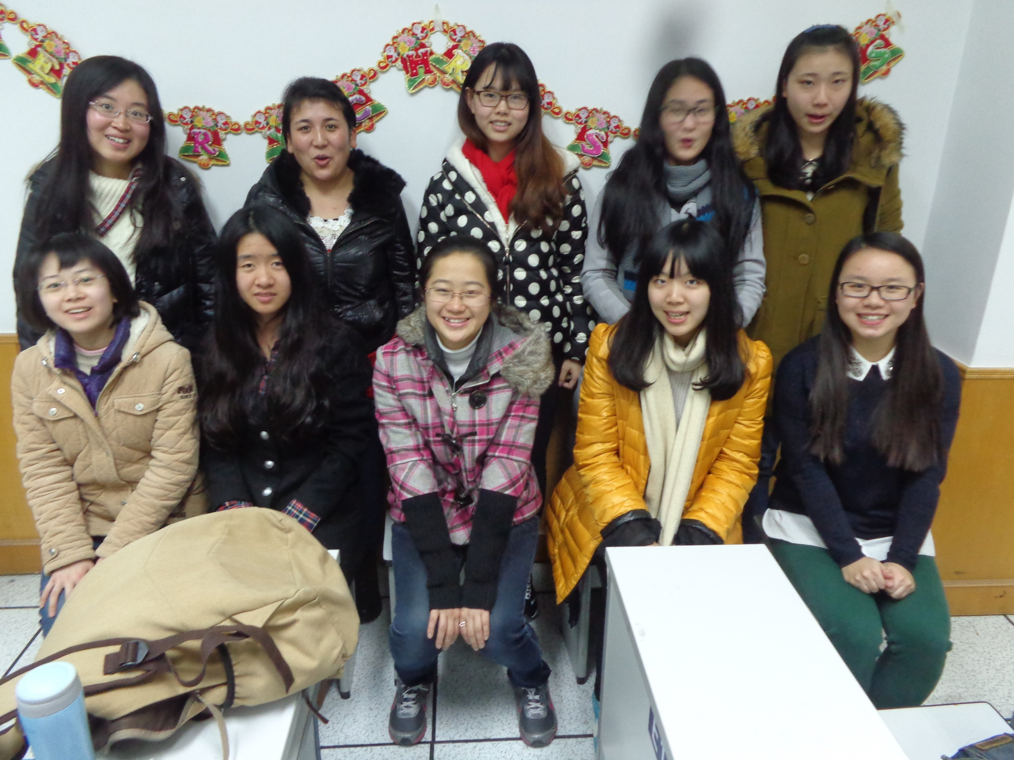
English Corner Friends
December 25, 2014

Slide 4
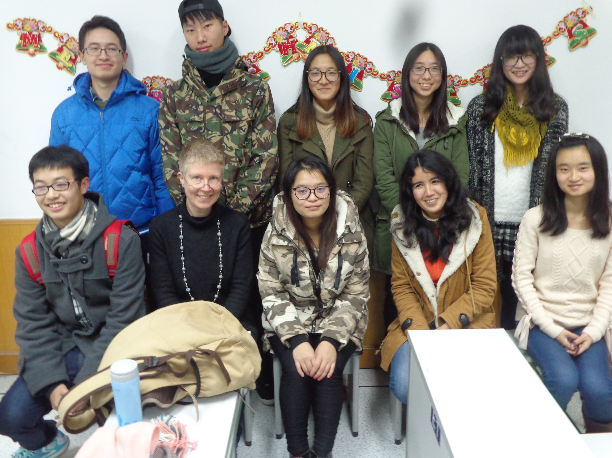
English Corner Friends
December 25, 2014

Slide 5
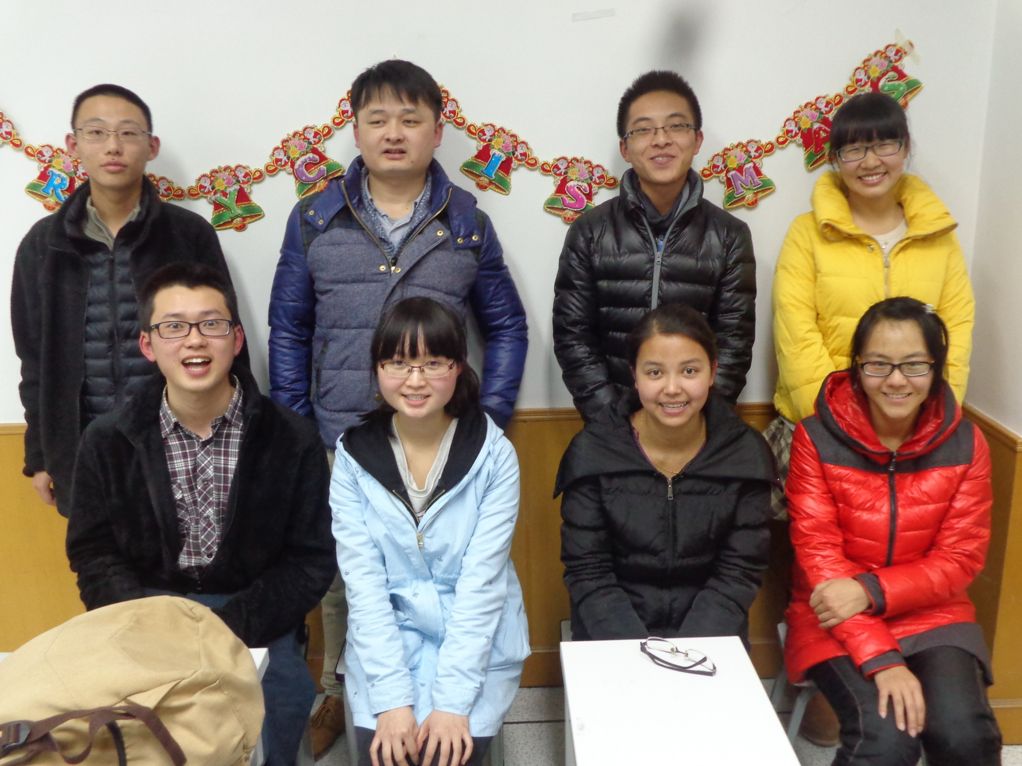
English Corner Friends
December 25, 2014

Slide 6
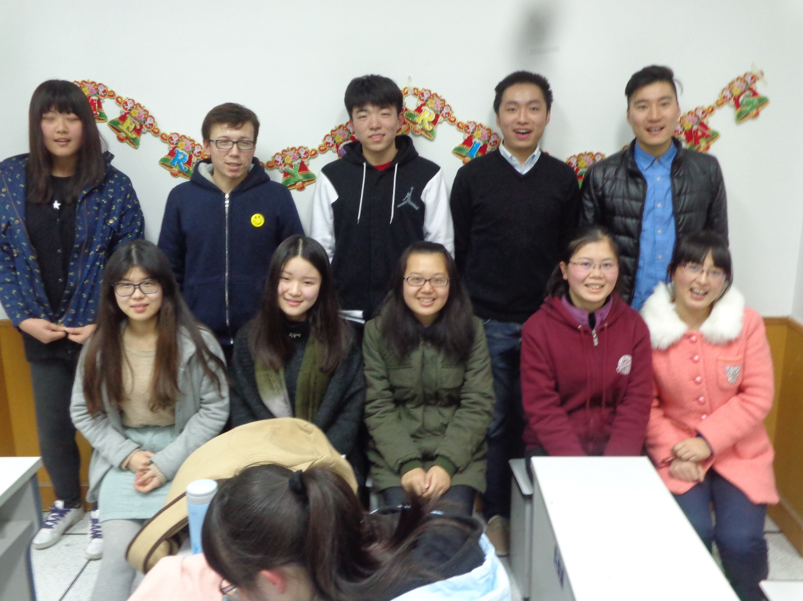
English Corner Friends
December 25, 2014

Slide 7
Next English Corner
Thursday, March 12, 2015
7 PM
Bring a friend!
Have
a
Treat.
Let’s have some Fun!
Come One; Come ALL

Slide 8
Did anyone write a Limerick?
Limericks are short (sometimes serious; sometime silly) poems that are fun to recite.
A: What is a limerick, Mother?
A: It's a form of verse, said brother
B: In which lines one and two
B: Rhyme with five when it's through
A: And three and four rhyme with each other.

Slide 9

My VALENTINE
A: There was a pretty girl named Marie,
A: Who I hoped my attention she would see,
B: So, I asked her to dance,
B: Oh how we did prance,
A: And my love for her was the key!

Slide 10
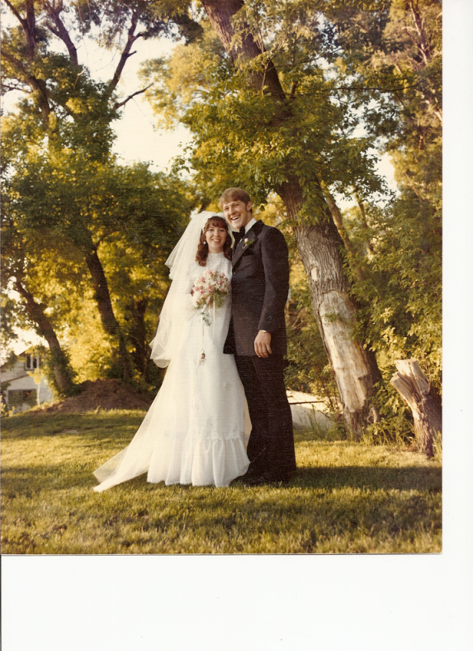
Happy Valentine’s Day
There was a young girl named Marie,
Who was so beautiful to see.
Oh, she captured my eye
And I hoped she’d say aye.
When I asked her to marry me.

Slide 11

Valentine for Mom
I bought a box of chocolates for my mother's valentine; a giant, heart-shaped package with a flowery design. They had them at the market and I got the biggest one. I nearly couldn't pick it up. It must have weighed a ton. I had to use a shopping cart to haul it from the store. At home I almost couldn't even fit it through the door.
I gave it to my mother
and you should have seen her eyes!
I clearly had impressed her
with my chocolate box's size.
That carton was gargantuan --
the largest I could find --
but not because I'm generous
and not because I'm kind.
I didn't buy the biggest one
to show how much I care.
I bought it just to guarantee
my mom would have to share.

Slide 12
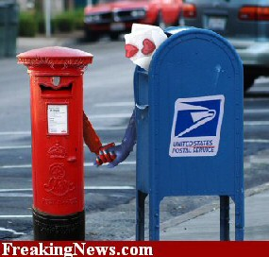
Valentine’s Day Riddles
Q: What did the Valentine card say to the stamp?
A: Stick with me and we'll go places!
Q: What travels around the world but stays in one corner?
A: A stamp.
Q: What happens when you fall in love with a chef?
A: You get buttered up.
Q: What did the Valentine’s stamp say to the envelope?
A: I'm stuck on you.

Slide 13
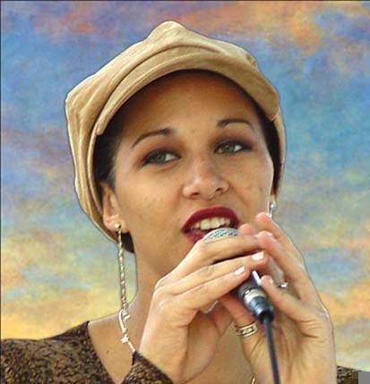
Let’s
Sing
My Valentine

Slide 14
Meet & Greet
We-Chat
Introduce yourselves.
Optional Topics:
    What are some effective ways to build positive relationships with members of the opposite sex?
    Do men and women have the same and/or different needs?

Slide 15

Treat a person as he/she is and
He/she will remain as he is.
Treat him/her as he/she could be and
He/she will become what he/she should be.

Slide 16

VALENTINE VOCABULARY

Slide 17

Valentine Bingo
Please select 24 of the 36 valentine vocabulary words on the next slide and randomly write them in the spaces provided on your Bingo card.
As one of your words is drawn, place an X in the corner of that word’s space.
Call out Bingo each time you have five X’s in a row (up/down, across, or diagonal.)
Call out blackout when you have an X in each of your spaces.

Slide 18
adore | arrow | bow | boyfriend
butterfly kiss | candy | charm | chick flicks
chocolates | cupid | embrace | endearment
engaged | Eskimo kiss | fiancé | fiancée
fox | friendship | girlfriend | heart
hug | husband | infatuation | kiss
lace | love | love songs | lovebirds
friend | propose | puppy love | roses
romance | smooch | spouse | sweetheart
tenderness | valentines | wife | xoxoxo

Slide 19

Pictures & Treats
Break

Slide 20
Communication
“Dear Stefanie, Dinner tasted awful, and it smelled
so I am leaving you
I have to just go
I have taken all my things
Just can’t stand you
I won’t be back
I have had enough
Enjoy your life
Goodbye,

Slide 21
Communication requires knowing both sides of the story.
“Dear Stefanie, Dinner tasted awful
and it smelled,
so I am leaving you
I have to just go
I have taken all my things
Just can’t stand you
I won’t be back
I have had enough
Enjoy your life
Goodbye,
ly good,
great,
a note,
to the library.
I need to study.
r being gone.
until 8 PM.
dinner. Thanks.
cereal as a snack.
Love, Max”

Slide 22

Talking Dice
Divide into groups of two
Roll the dice and answer the number of the question your rolled.
If you have already answered that question roll the dice again answer question one or if you have answered question one, roll the dice again.

Slide 23
What is the one thing about yourself that you would like me to know?
What do you think is the most important value between two people in a relationship?
What do you do for fun?
What are you looking for in a relationship?
What accomplishment are you most proud about?
Which is the last book you read?
Which is your favorite music and your favorite singer/band?
What adjective would a close friend use to describe you? Why?
Which is your favorite genre of movies - comedy/thriller/action?
Who was your hero, as a child?
Tell me about your first crush?
Are you a morning person or a night person?

Slide 24
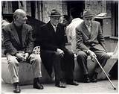
Who to Invite
A woman saw three old men sitting in her front yard. She said, “I don’t think I know you, but you must be hungry. Please come in and have something to eat.” “We do not go into a house together,” they replied. “Why is that?” she asked. One of them explained: “His name is Wealth, this is Success and I am love. Now go in and discuss with your husband which one of us you want in your home.”

Slide 25

Who to Invite
Then the woman went in and told her husband what was said. Her husband said, “Let’s invite wealth. Let him come and fill our home with Wealth.” “My dear, why don’t we invite Success?” the woman disagreed. Then the daughter made a suggestion, “Wouldn’t it be better to invite Love? Our home will then be filled with love!”

Slide 26

Who to Invite
So the woman went out to ask, “Which one of you is Love? Please come in and be our guest.” Love got up and started walking towards the house. The other two also got up and followed him. The lady asked Wealth and Success, “I only invited Love. Why are you coming in?” The old men replied together, “If you had invited Wealth or Success, the other two of us would have stayed out, but since you invited Love, wherever he goes, we go with him. Wherever there is Love, there is also Wealth and Success!”

Slide 27
Valentine’s Questions
Questions for and from
the Professors.

Slide 28
Speed Dating Instructions
Form two lines so that you face the person across from you.
Take turns answering the questions on the screen.
Smile, be personable and do only half of the talking.
We will change partners every two minutes.
Even if there are not enough boys to talk with, this is still good oral English practice.
You may use any of the questions on the screen or any of your own questions.

Slide 29
Speed Dating Questions Part I
Where are you from?
What is the one thing about yourself that you would like me to know?
What do you think is the most important value between two people in a relationship?
What do you do for fun?
What accomplishment are you most proud about?

Slide 30
Speed Dating Questions Part II
Which is the last book you read?
Which is your favorite music and your favorite singer/band?
What adjective would a close friend use to describe you?
Which is your favorite genre of movies - comedy/thriller/action?
Who was your hero, as a child?

Slide 31
Speed Dating Questions Part III
Tell me about your first crush?
Describe your favorite meal.
Are you a morning person or a night person?
Would you like to climb a mountain or trek across a desert? Why?
Describe your perfect holiday.

Slide 32
Speed Dating Questions Part IV
If you could live anywhere in the world, where would it be? Why?
If you could be a famous person for one day—who would you want to be? Why?
What is your favorite sporting activity?
What are you looking for in a relationship?
One is one activity you would like to do on a date?

Slide 33
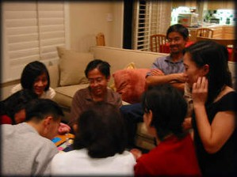
Guess – Guess – Guess – Guess
Descriptionary

Slide 34
Talking Cards
Please form groups of 3-5 people.
You will be given a number of playing cards.
In turn, starting with the person whose birthday is closest to today’s date, draw a card from the top of the deck and answer the corresponding question.
Then take turns answering questions, until you have use up all of your cards.
Please speak loudly enough for your group to hear and understand you.

Slide 35

ETHICAL DILEMMAS

Slide 36
Integrity
“Integrity without knowledge is weak and useless and knowledge without integrity is dangerous and dreadful.” (Samuel Johnson (1709-1784) English Poet, Critic and Writer)

Slide 37
VOCABULARY
ethics – the principles (rules) of conduct
governing an individual or a group, the
discipline dealing with what is good
and bad and moral duty and obligation
ethical – moral, conforming to accepted
rules and standards of conduct
moral – principles of right and wrong
behavior
dilemma – a situation involving a choice
between alternatives

Slide 38
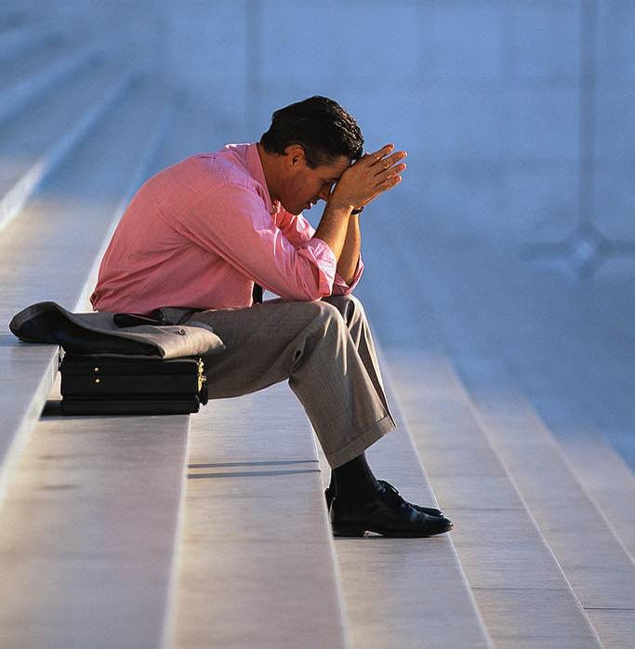
expelled – kicked out of school,
suspended from school
0 tolerance – no exceptions, no second
chances
full ride – a scholarship which pays
tuition, books, room and board
Win Win – Solutions in which all parties are better off

Slide 39
ETHICAL DILEMMA
(VICE PRINCIPAL)
You are the vice principal in charge of discipline of a high school. It is your responsibility to see that all students follow the rules and are treated fairly and equally. It is the policy of your school that students caught with alcohol, drugs or weapons on campus will be expelled—0 tolerance.

Slide 40
Your daughter is a senior at the high school. She is an outstanding basketball and volleyball player and is a top academic student. She has applied to several universities and for scholarships that would pay virtually all of her costs at any of these colleges. She is almost certain to be accepted and to receive a full ride at all schools to which she has applied.

Slide 41
One evening, you are supervising a school dance. You need to speak to your daughter and can’t find her. You finally go into the darkened girls’ locker room and hear voices. One is your daughter’s voice and as you listen, you realize they are drinking alcohol. They do not see you.
What will you do?

Slide 42

Life is full of choices and decisions and many of them will present us with moral and ethical dilemmas. Some of these choices and decisions will challenge
the very principles,
standards and values
we were taught by
our family. When
faced with these
moral dilemmas,
what will you do?

Slide 43
Vocabulary Builders
Instructions:
  Form groups of three or four people.
  Distribute the vocabulary card so each person in your group has one.
  Taking turns, each person then pronounces each word on his/her card.
  When everyone is finished, pass your card one person to the left and then each person pronounces the words on his/new card.
  Repeat the process until everyone has had a chance to pronounce the words on each card.
  Note: If someone needs help pronouncing a word, other group members should provide assistance.

Slide 44
Speaking Activity
Divide into groups of two
Roll the dice and answer the number of the question your rolled.
If you have already answered that question roll the dice again.

Slide 45
Describe your feelings about leaving your home and province for four years.
Try to describe your feelings as you return after successfully completing your B.S or B.A. degree in four years.
Try to describe the feelings of your parents as you return to your home as a college graduate.
Try your best to describe your first day on the job of your dreams.
Describe your future husband or wife.
What do you think your feelings will be when your first child leaves home to go to a school?
What do you think the purpose of life is?
Where do you think you will go when you or your parents die?
Why do you believe that?
Do you believe you came from some where else when you were born? Why do you believe that?
Suppose you move to Australia which has a different form of government. How will that change the way you act in your life, Why?
What about living in Australia would make you nervous?
What do you think you will do to adjust to that concern?

Slide 46
What are some of the topics you would like to discuss in class and/or English Corners?

