Slide 1

THOSE WE LOVE DON’T HAVE TO LOOK EXACTLY LIKE US
These pictures were taken in Harrisburg, Pennsylvania. This deer visits the family cat in the yard every morning! The owner finally took pictures of this extraordinary friendship.

Slide 2
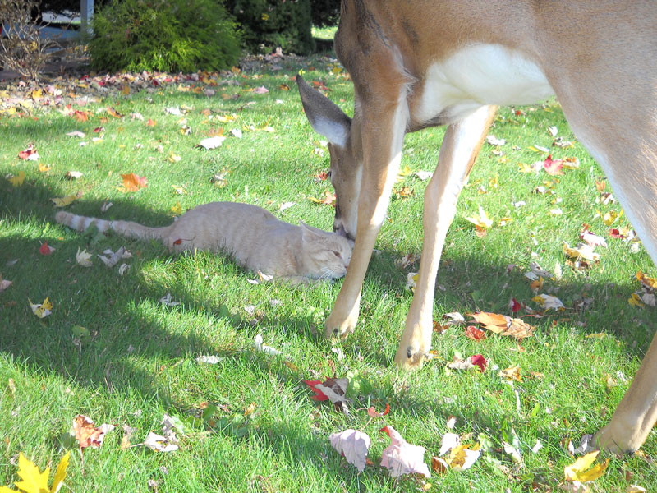

Slide 3
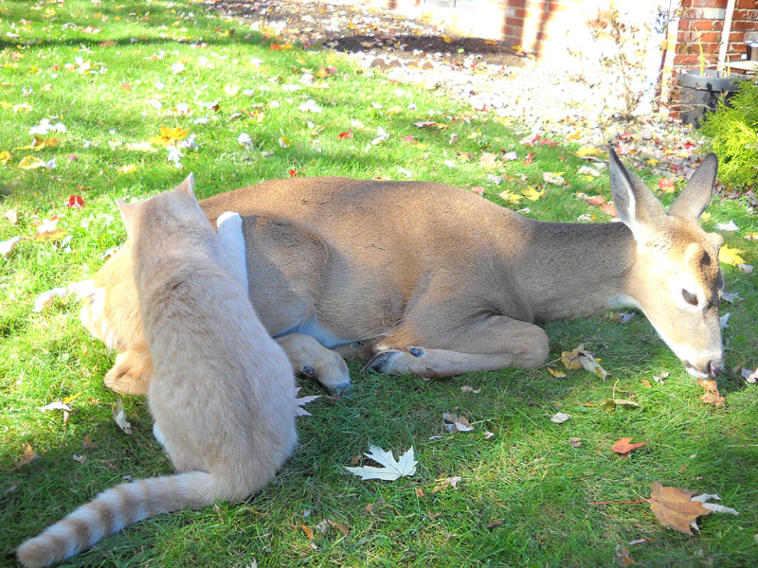

Slide 4
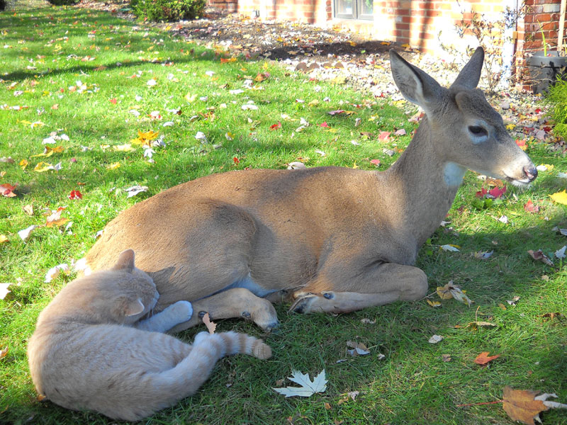

Slide 5
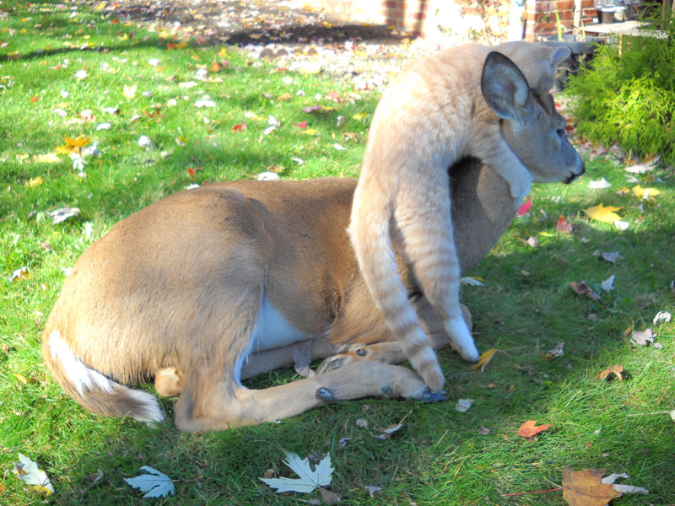

Slide 6
