Slide 1



Slide 4
My Heart Will Go On
By Celine Dion

Slide 5

My Heart Will Go On
By Celine Dion

Slide 6


Slide 7
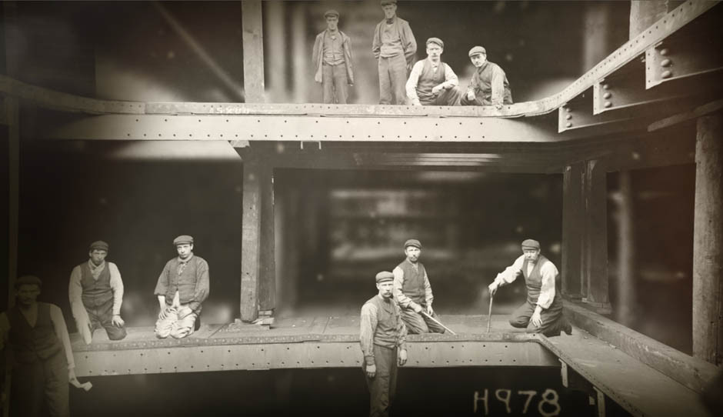
Every night in my dreams

Slide 8
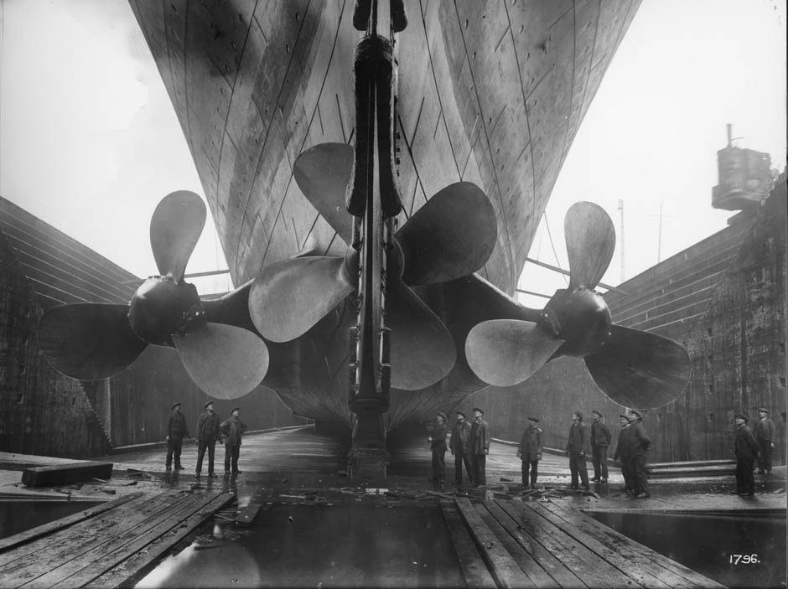
I see you, I feel you,

Slide 9
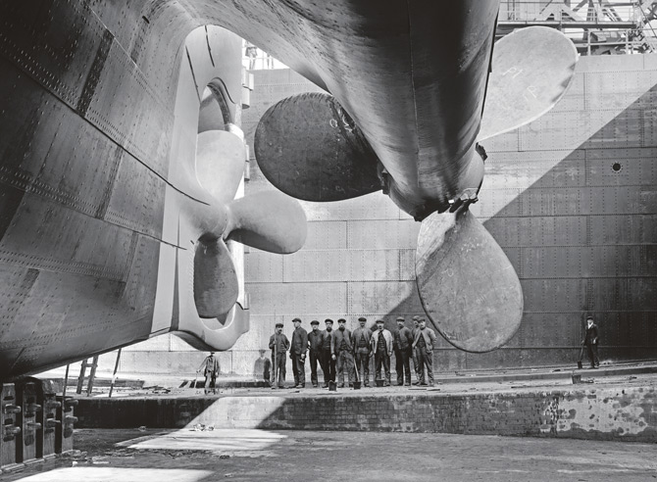
That is how I know you go on…

Slide 10
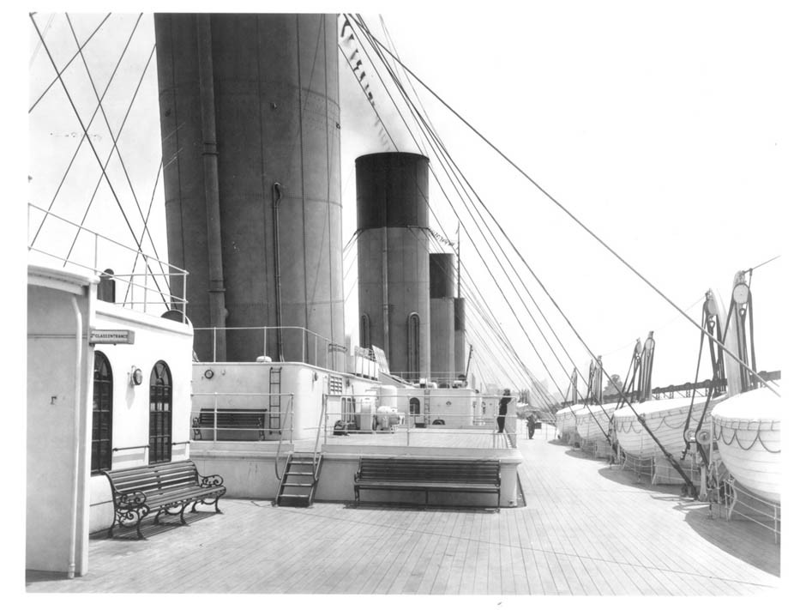
Far across the distance

Slide 11
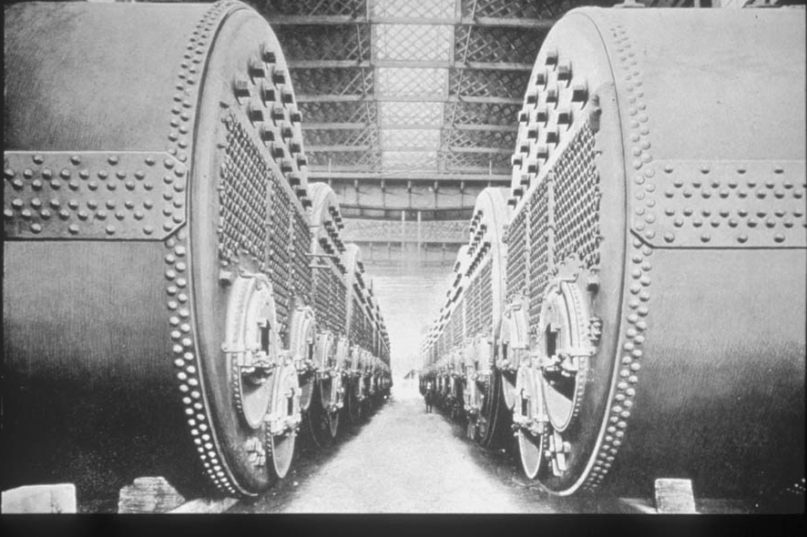
And spaces between us

Slide 12
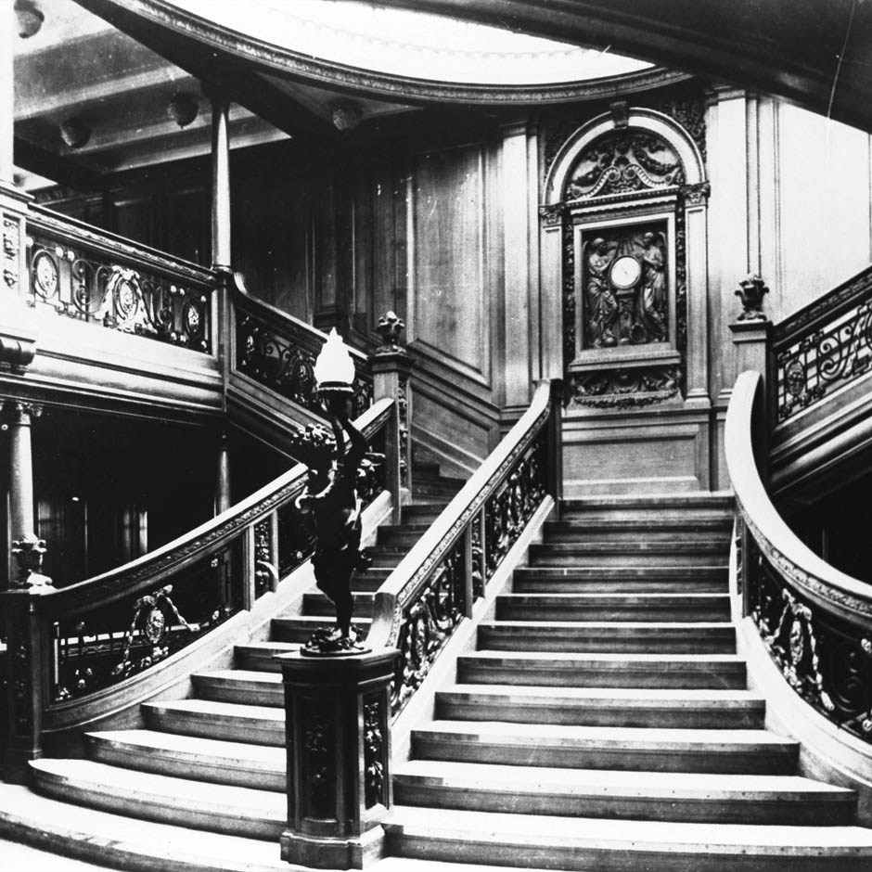
You have come to show
you go on…

Slide 13
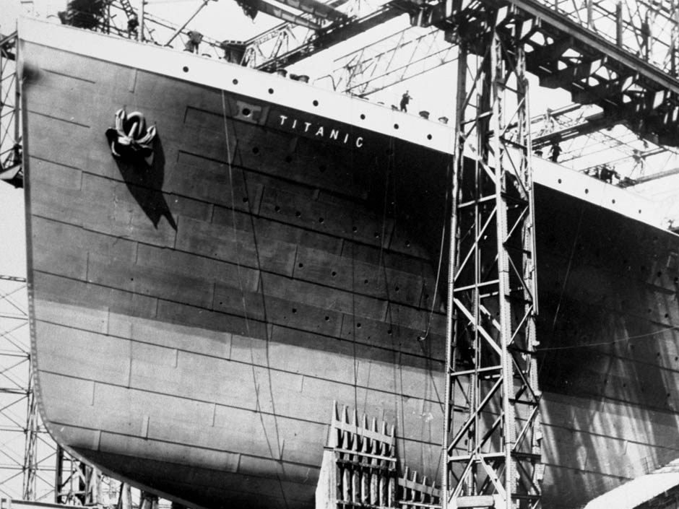
Near, far, wherever you are

Slide 14
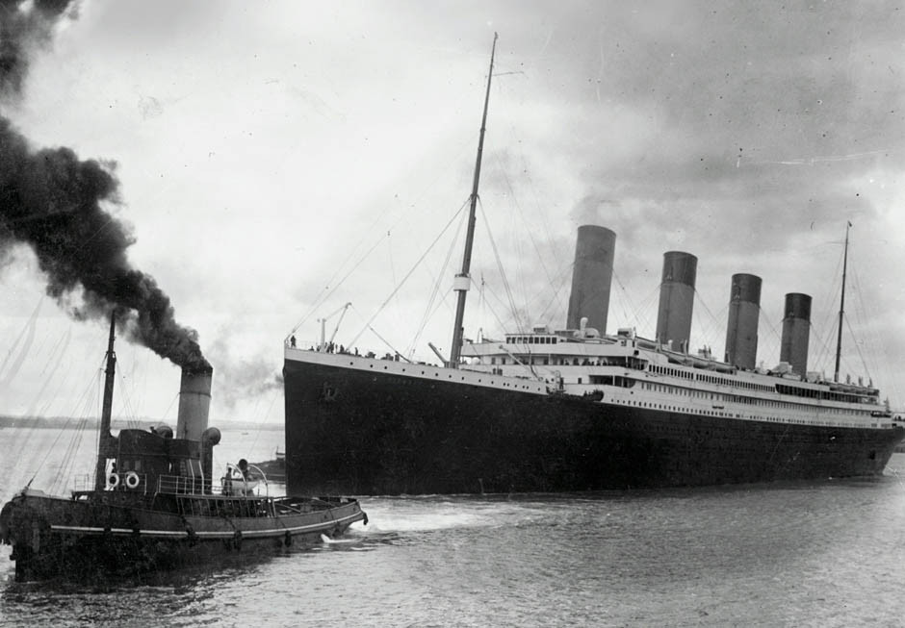
I believe that the heart does go on

Slide 15
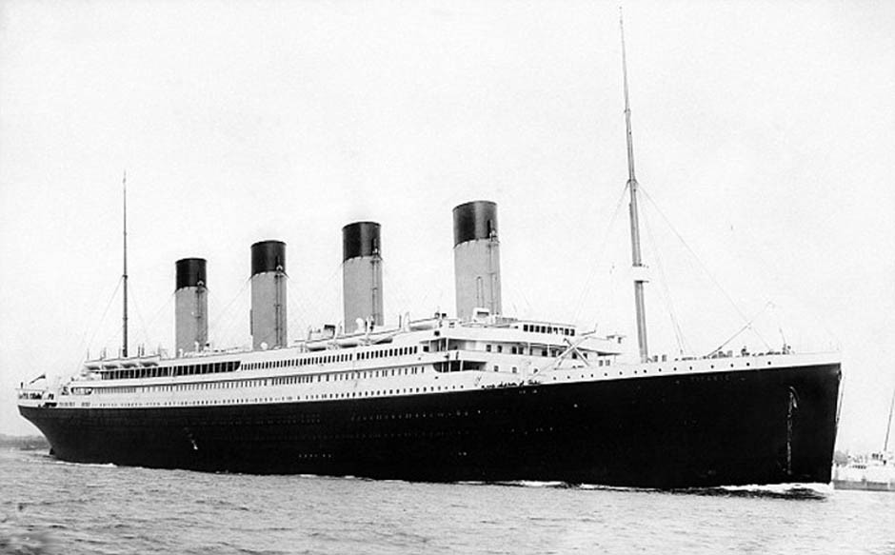
Once more you open the door

Slide 16
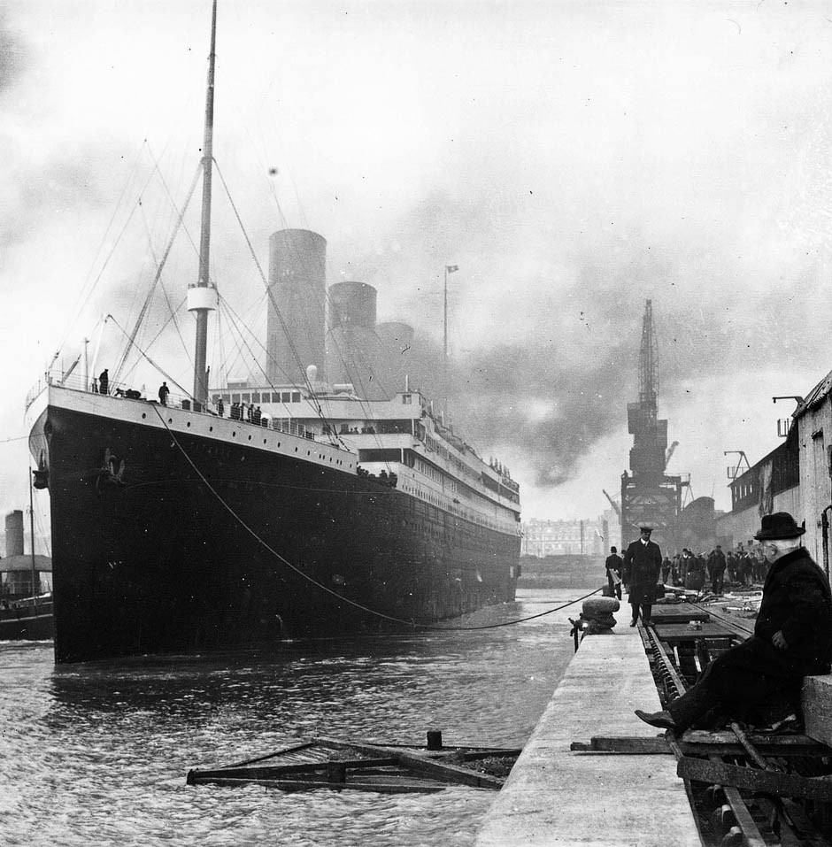
And you’re here in my heart…, and . . .

Slide 17
My heart will go on and on . . .

Slide 18


Slide 19
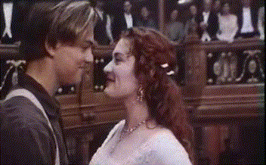
Love can touch us one time…

Slide 20
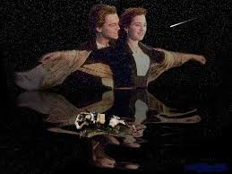
And last for a lifetime. . .

Slide 21
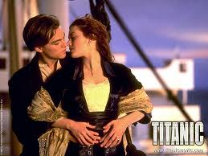
And never let go till we’re one. . .

Slide 22


Slide 23
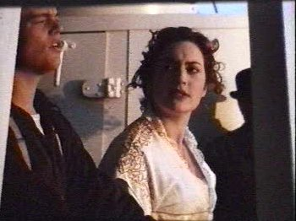
Love was when I loved you . . .

Slide 24
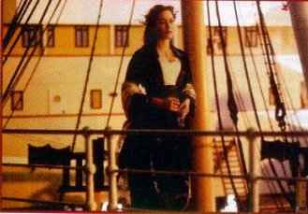
One true time
I hold to . . .

Slide 25
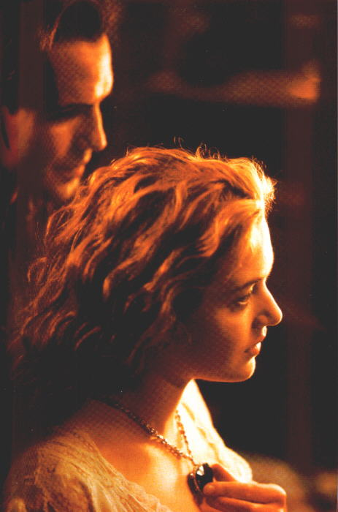
In my life we’ll
always go on . . .

Slide 26
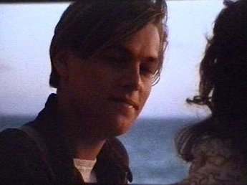
Near, far, wherever you are . . .

Slide 27
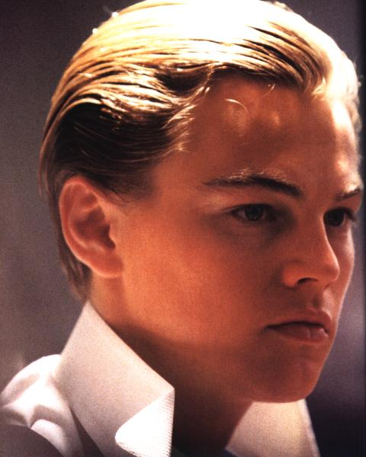
I believe that the heart does go on . . .

Slide 28
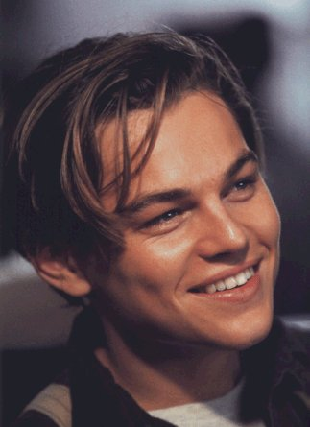
Once more you open the door . . .

Slide 29
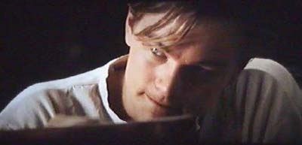
And you’re here in my heart, and . . .

Slide 30
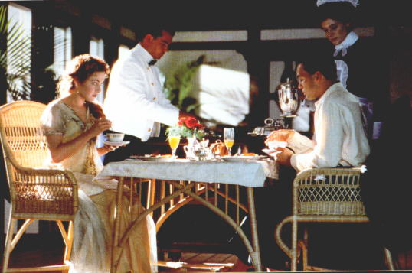
. . . my heart will go on -

Slide 33
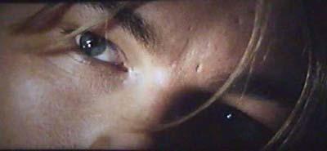

Slide 34
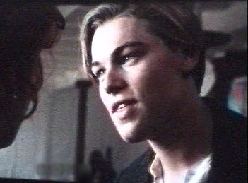

Slide 35
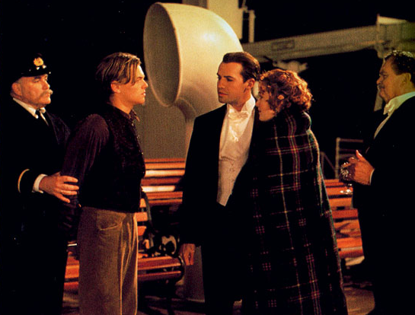

Slide 36
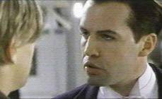
You’re here, there’s nothing I fear,

Slide 37
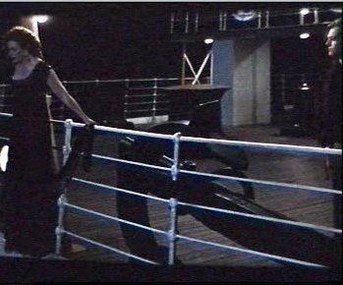
And I know that my heart will go on . . .

Slide 38

We’ll stay forever this way . . .

Slide 39
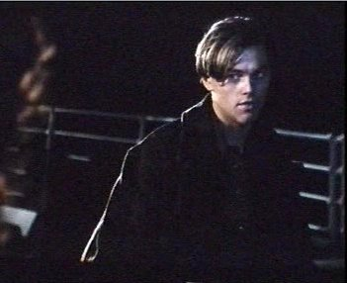
You are safe in my heart . . , and . . .

Slide 40
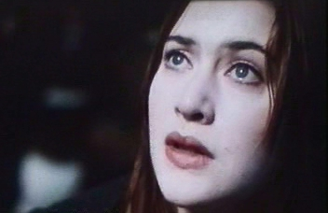
My heart will go on and on . . .

Slide 42


Slide 43
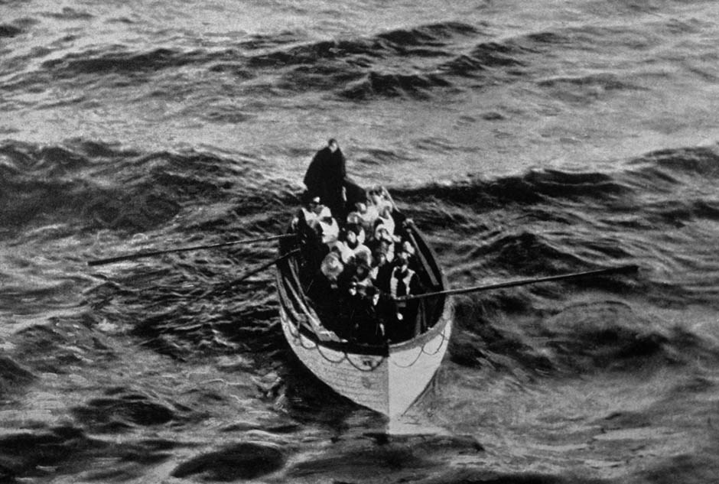
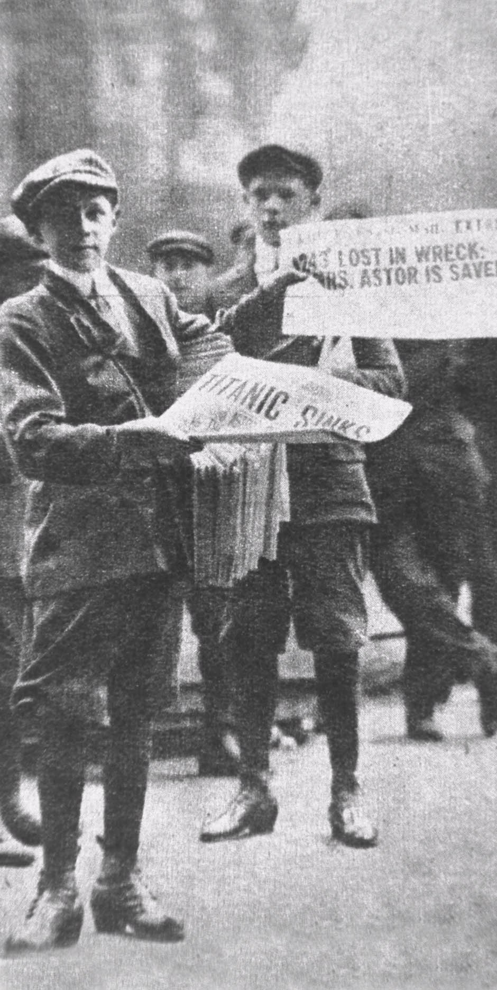

Slide 44


Slide 45
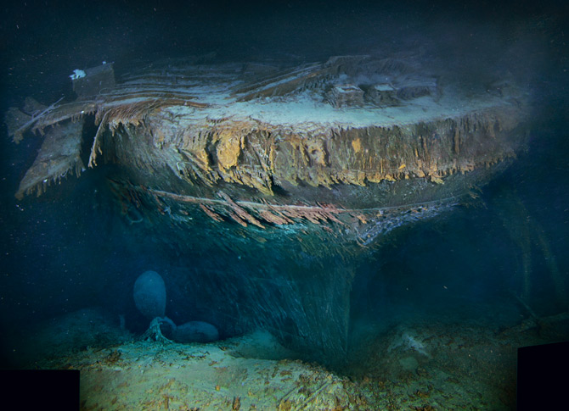

Slide 46


Slide 47
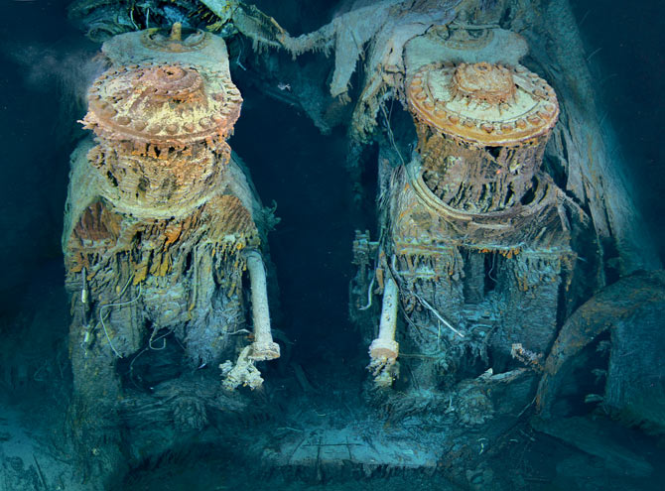

Slide 48


Slide 49
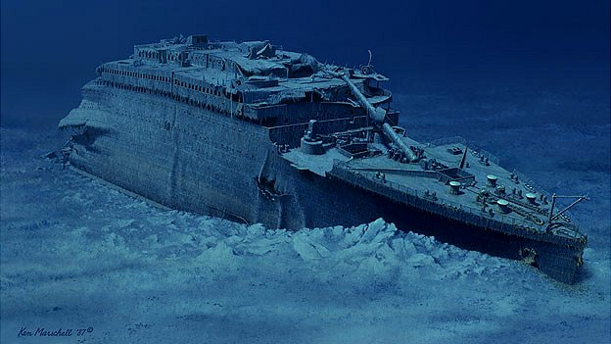

Slide 50

brent

