Slide 1
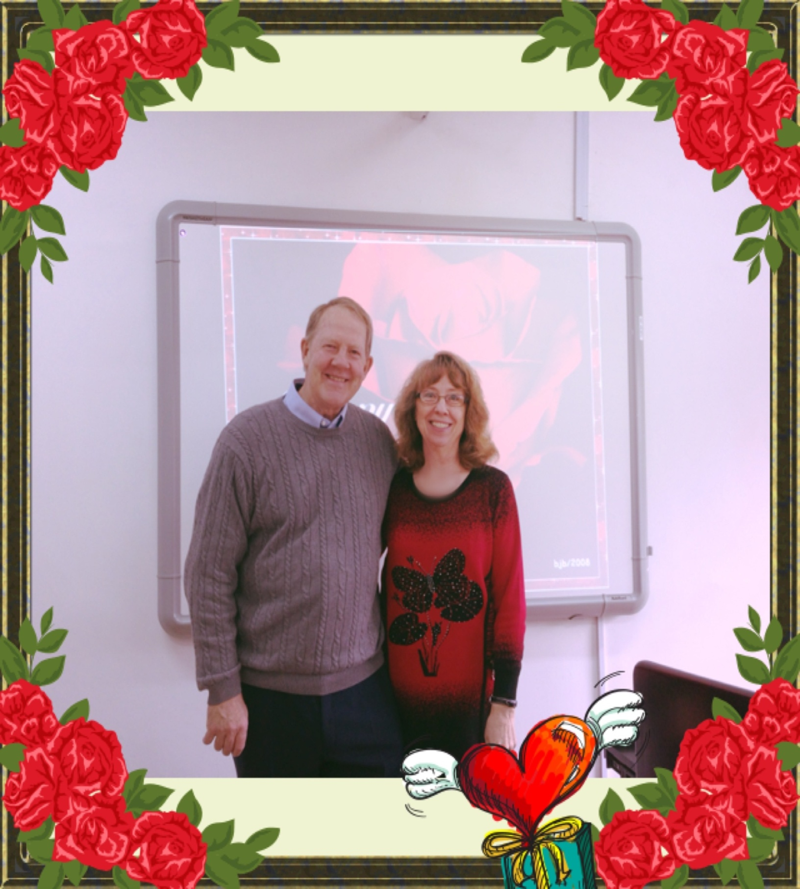
Welcome to English Corner
Professors
John and Marie Murdoch

Slide 2
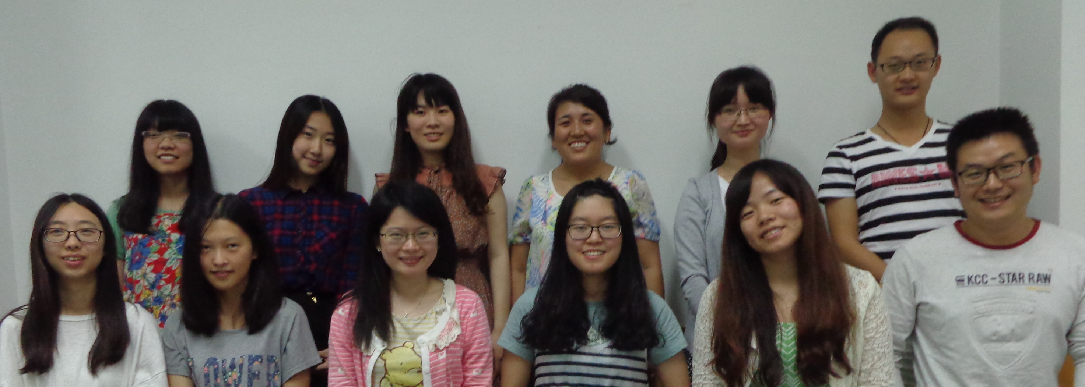
English Corner Friends

Slide 3
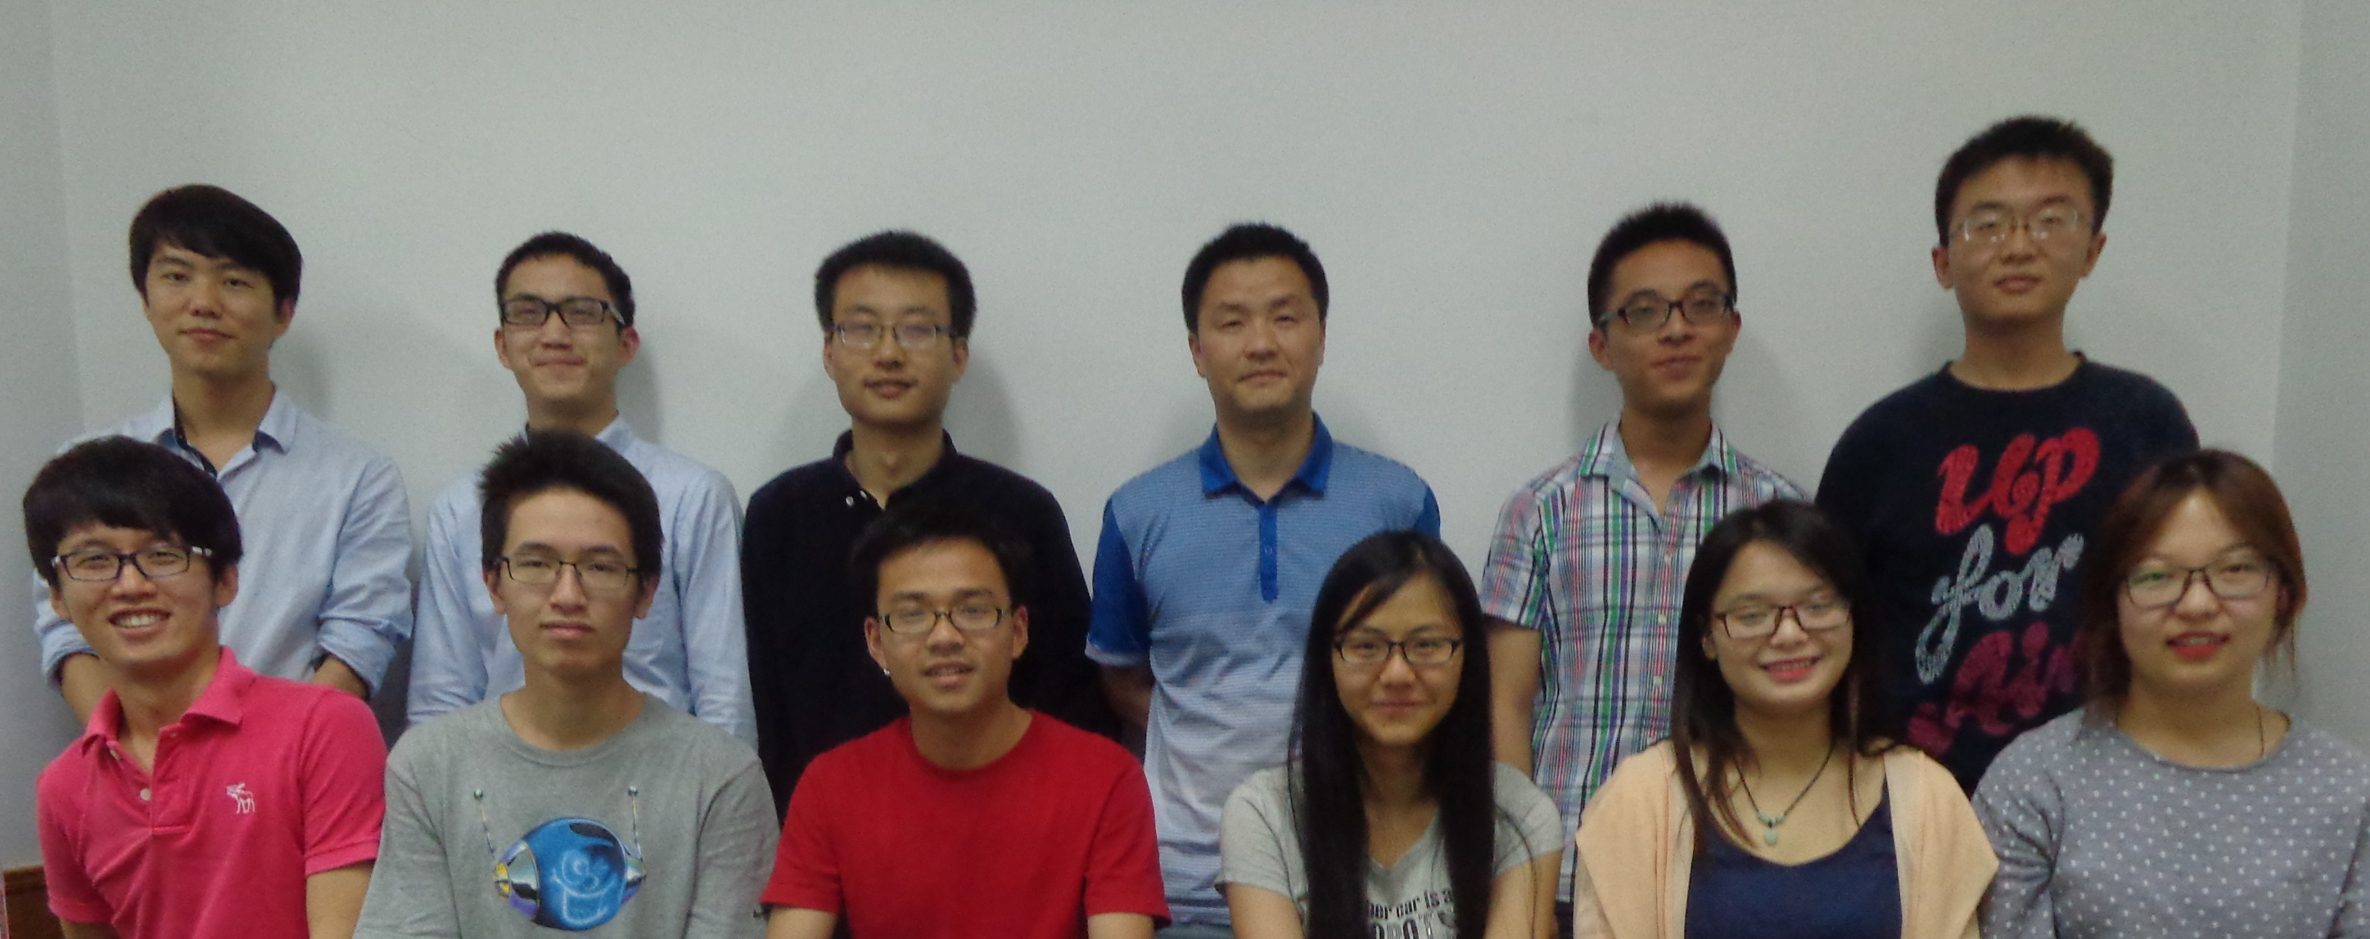
English Corner Friends

Slide 4
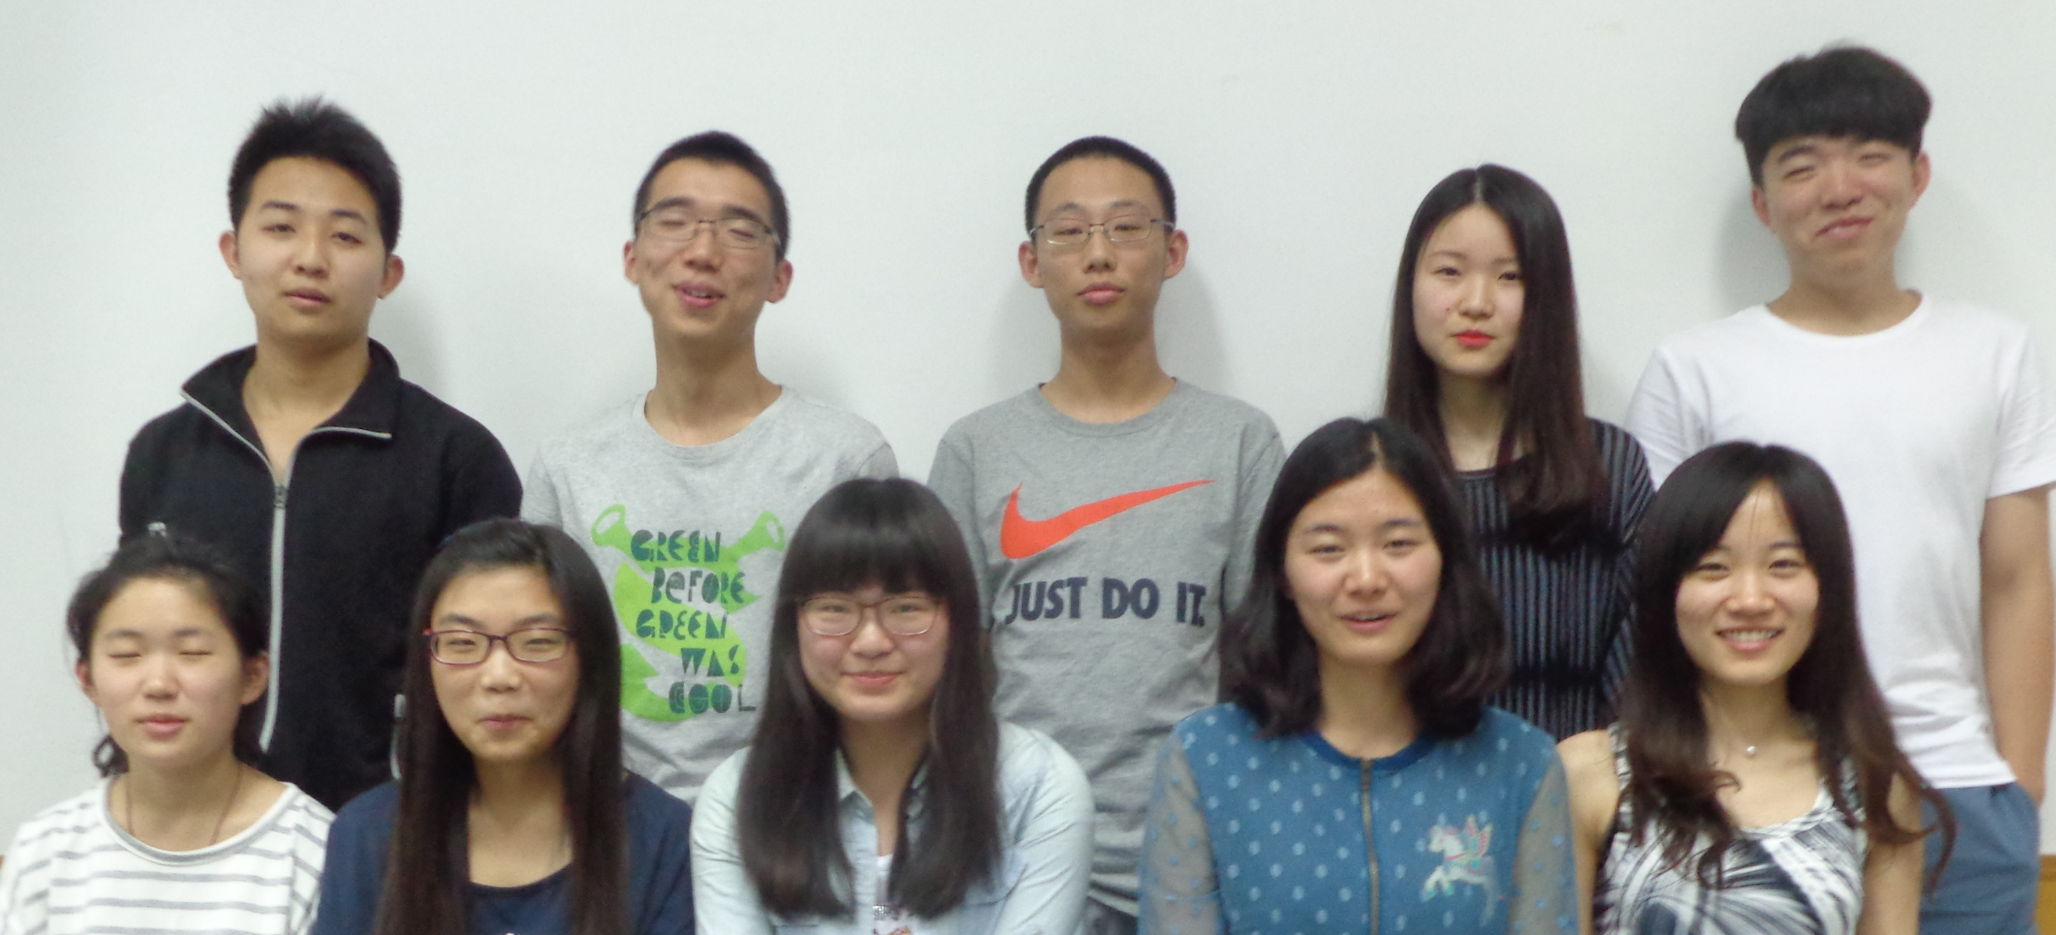
English Corner Friends

Slide 5
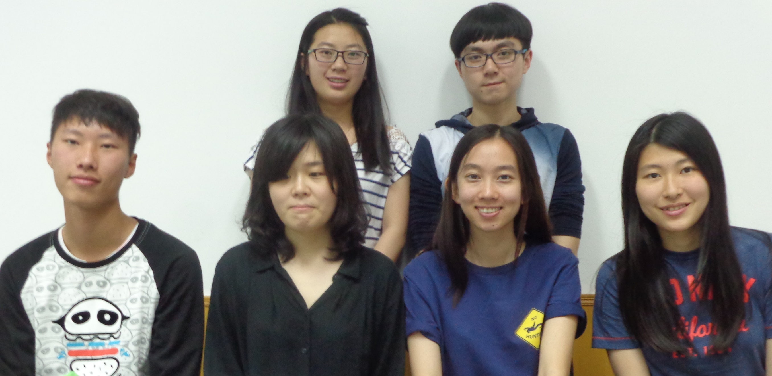
English Corner Friends

Slide 6
English Corner’s Goals
To improve oral English skills—we speak only English.
To improve English listening skills.
To meet new friends.
To build social skills.
To learn about American and Chinese Cultures.
To share ideas and opinions.
Let’s have fun!

Slide 7
Next English Corner
Thursday, June 18, 2015
7 PM
Bring a friend!
Have
a
Treat.
Let’s have some Fun!
Come One; Come ALL

Slide 8
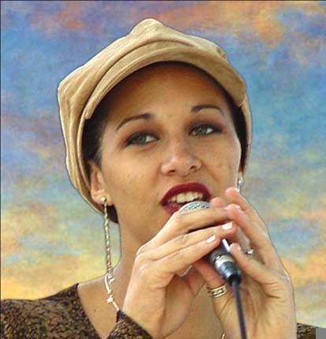
Let’s Sing
Yesterday
Once
More

Slide 9
English Corner Student Led Activity
Welcome Team 4-C
Demi
Patricia
Sherry

Slide 10
Did anyone write a Limerick?
Limericks are short (sometimes serious; sometime silly) poems that are fun to recite.
A: What is a limerick, Mother?
A: It's a form of verse, said brother
B: In which lines one and two
B: Rhyme with five when it's through
A: And three and four rhyme with each other.

Slide 11
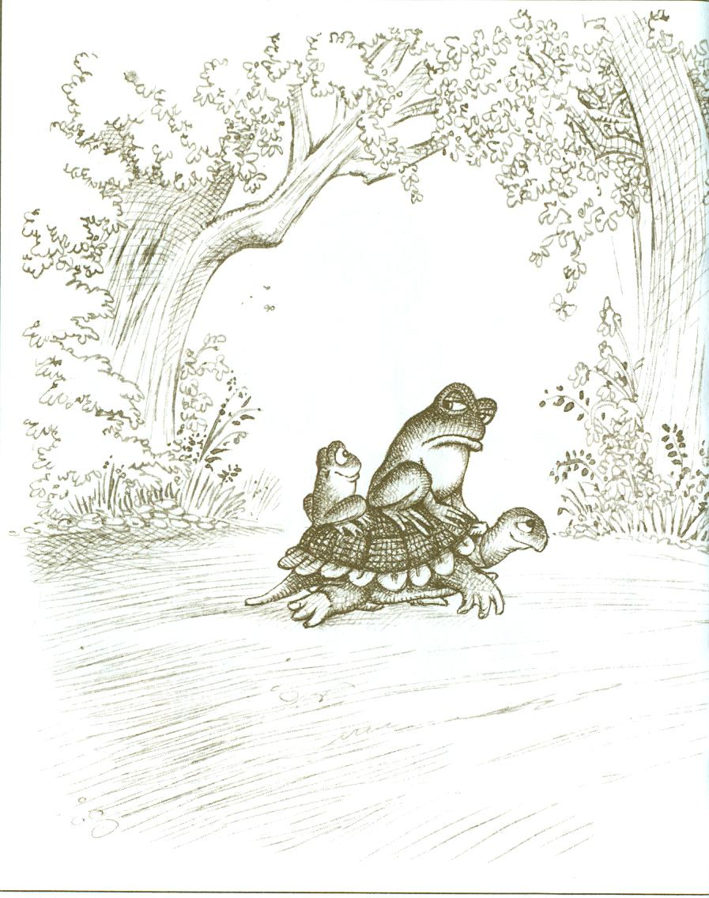
Dealing with a Difficulty Personality
How do you handle a difficult person?
A selfish, obnoxious, and two-faced one?
With patience and kindness,
Being friendly and selfless.
Invite to a party and have some fun!

Slide 12
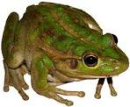
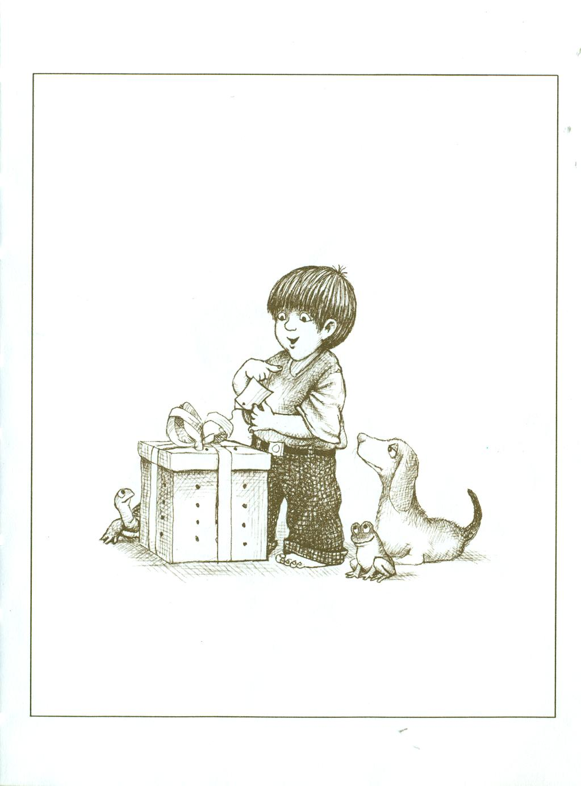
One Frog Too Many
Form in assigned groups.
Each group member will represent one or more of these characters.
  Boy
  Dog
  Turtle
  Big Frog
  Little Frog
On each slide, each group member will tell his/her version of what is happening.
Be prepared to share what you learn.

Slide 13
What Can We Learn from One Frog to Many?

Slide 14
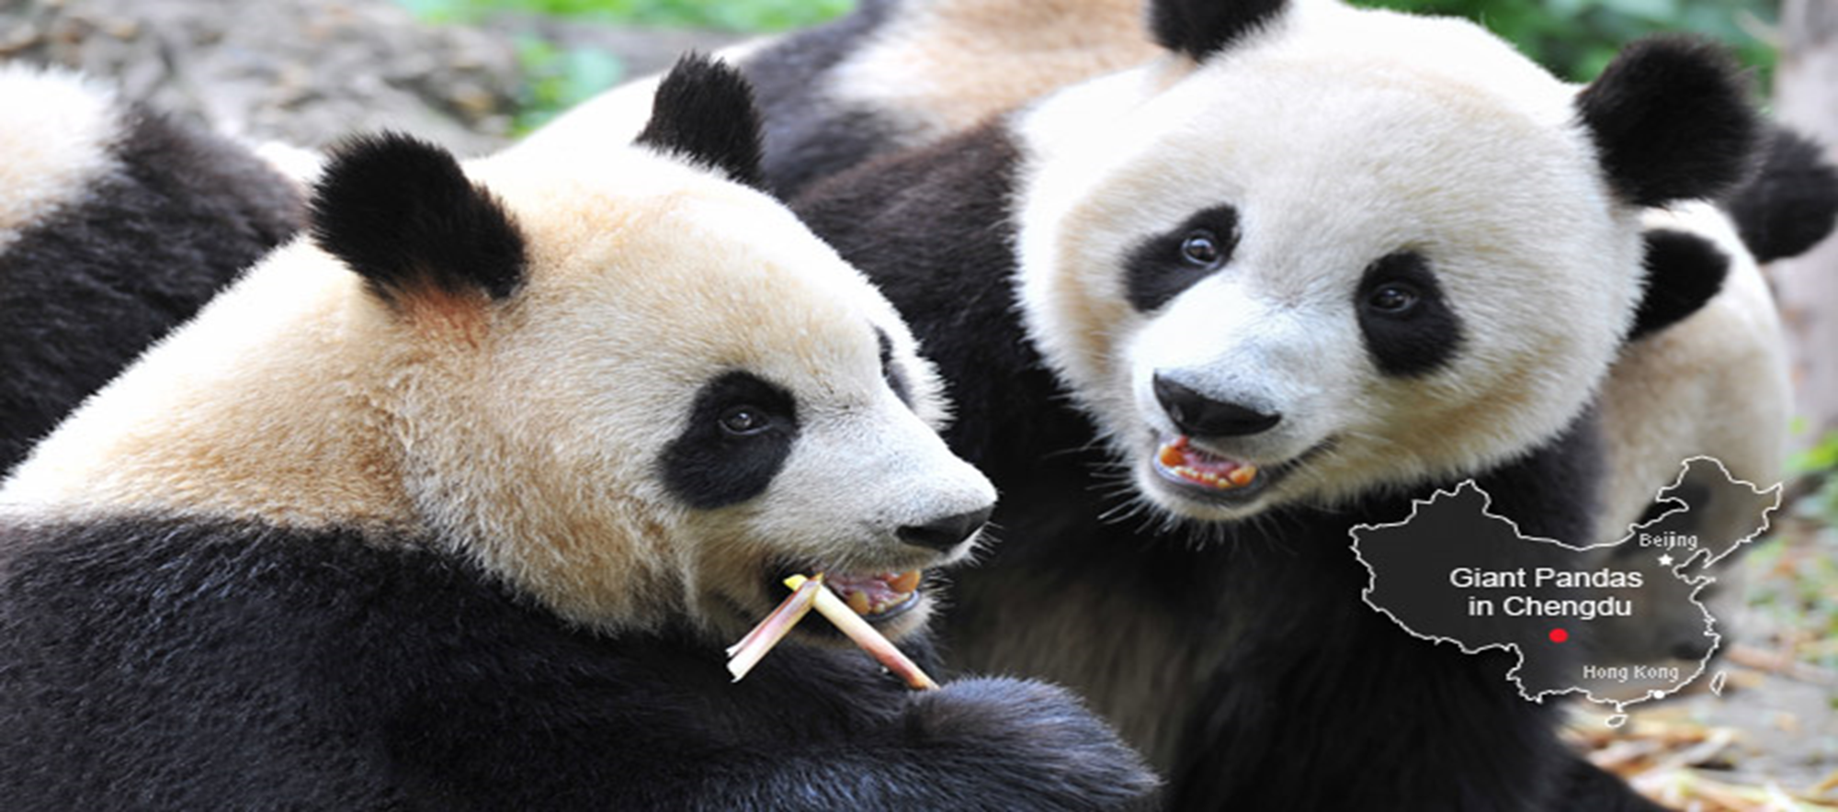
Meet & Greet
We-Chat
What are your interests and hobbies?
What is the best way to make friends?
Describe your best friend(s).

Slide 15

Break

Slide 16
Questions
Questions for and from
the Professors.

Slide 17
Descriptionary
Moods and Dispositions
Instructions:
  Form in assigned groups.
  One person will have his/her back to the screen.
  When a word/phrase flashes on the screen, the person(s) facing the screen will describe the word/phrase. However, you cannot use the word or a form of it or use a synonym or an antonym of the word/phrase.
  When the person guesses the word correctly, then trade places and be prepared for the next word.

Slide 18
Cheerful

Slide 19
Angry

Slide 20
Moody

Slide 21
Sad

Slide 22
Discouraged

Slide 23
Happy

Slide 24
Grumpy

Slide 25
Cooperative

Slide 26
Thoughtful

Slide 27
Sleepy

Slide 28
Social

Slide 29
Selfish

Slide 30
Friendly

Slide 31
Helpful

Slide 32
Romantic

Slide 33
Revengeful

Slide 34
Belligerent

Slide 35
Dealing with a Difficulty Personality
How do you handle a difficult person?
A selfish, obnoxious, and two-faced one?
With patience and kindness,
A friendly smile is a plus.
Invite to a party and have some fun!

Slide 36
What are some of the topics you would like to discuss in class and/or English Corners?

Slide 37
Vocabulary Builders
Instructions:
  Form groups of three or four people.
  Distribute the vocabulary card so each person in your group has one.
  Taking turns, each person then pronounces each word on his/her card.
  When everyone is finished, pass your card one person to the left and then each person pronounces the words on his/new card.
  Repeat the process until everyone has had a chance to pronounce the words on each card.
  Note: If someone needs help pronouncing a word, other group members should provide assistance.

Slide 38
Talking Cards
Please form groups of 3-5 people.
You will be given a number of playing cards.
In turn, starting with the person whose birthday is closest to today’s date, draw a card from the top of the deck and answer the corresponding question.
Then take turns answering questions, until you have use up all of your cards.
Please speak loudly enough for your group to hear and understand you.

Slide 39

Five Phases of Dating
Phase I – Meeting lots of people.
  Group parties/gatherings.
  Speed Dating and other group games.
Phase II – Making Friends
  Eating lunch or dinner together.
  Studying or going for a walk together.
  Sharing family stories and personal goals.
  Phase III – Formal Dating.
    Planned activities designed to help you know each other better.
    Should begin to be more personable, but set limits as to the time you spend alone with each other and limits to intimacy.

Slide 40

Five Phases of Dating
Phase IV Paring up/Going Steady
  Share your important beliefs and values.
  Introduce each other to your respective families.
  Begin to plan for the future—education, employment, home and family goals.
  Continue to practice limits regarding time alone together and sharing of intimacy.
Phase V Formal Engagement
  The marriage proposal.
  Approval of both sets of parents.
  Set a wedding date.
  Plan more intensely for your wedding and future life together.
  Continue to practice limits regarding time alone together and sharing of intimacy.

Slide 41
Describe your feelings about leaving your home and province for four years.
Try to describe your feelings as you return after successfully completing your B.S or B.A. degree in four years.
Try to describe the feelings of your parents as you return to your home as a college graduate.
Try your best to describe your first day on the job of your dreams.
Describe your future husband or wife.
What do you think your feelings will be when your first child leaves home to go to a school?
What do you think the purpose of life is?
Where do you think you will go when you or your parents die?
Why do you believe that?
Do you believe you came from some where else when you were born? Why do you believe that?
Suppose you move to Australia which has a different form of government. How will that change the way you act in your life, Why?
What about living in Australia would make you nervous?
What do you think you will do to adjust to that concern?

Slide 42
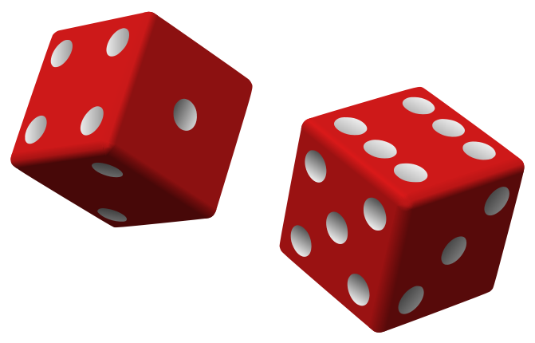
Speaking Activity
Divide into groups of two
Roll the dice and answer the number of the question your rolled.
If you have already answered that question roll the dice again.

Slide 43
What is something you have never done that you would like to try?
Talk about the importance of staying close to your family?
Describe a perfect first date?
Are your years at a university a good time to look for a husband or wife? Explain.
How old should people be before they consider marriage? Why?
Describe your future husband or wife.
How should parents discipline their child(ren)? Is spanking ok?
What do you think the purpose of life is?
Where do you think you will go when you or your parents die? Explain.
Do you believe you came from some where else before you were born? Explain.
Where do you think you will live after you have graduated from college?
What are your thoughts about smoking?

Slide 44
Talking Dice
Unfinished Sentences…

Slide 45
Unfinished Sentences:
Finish these sentences by adding your own words.
On Saturdays, I like to____________
If I had only 24 hours to live, I would__________
I feel best when people_____________
Secretly I wish_____________
If I could change the world, I would____ because_____
The most exciting thing I have done is_____
Right now the most important thing in my life is_____ because_________________
If I could be somewhere else now, I’d______________
I never worry about_____________________
I like people who________________
I find it difficult to_______________________
Studying is________________________________

Slide 46

ETHICAL DILEMMAS

Slide 47
Integrity
“Integrity without knowledge is weak and useless and knowledge without integrity is dangerous and dreadful.” (Samuel Johnson (1709-1784) English Poet, Critic and Writer)

Slide 48
VOCABULARY
ethics – the principles (rules) of conduct
governing an individual or a group, the
discipline dealing with what is good
and bad and moral duty and obligation
ethical – moral, conforming to accepted
rules and standards of conduct
moral – principles of right and wrong
behavior
dilemma – a situation involving a choice
between alternatives

Slide 49

expelled – kicked out of school,
suspended from school
0 tolerance – no exceptions, no second
chances
full ride – a scholarship which pays
tuition, books, room and board
Win Win – Solutions in which all parties are better off

Slide 50
ETHICAL DILEMMA
(VICE PRINCIPAL)
You are the vice principal in charge of discipline of a high school. It is your responsibility to see that all students follow the rules and are treated fairly and equally. It is the policy of your school that students caught with alcohol, drugs or weapons on campus will be expelled—0 tolerance.

Slide 51
Your daughter is a senior at the high school. She is an outstanding basketball and volleyball player and is a top academic student. She has applied to several universities and for scholarships that would pay virtually all of her costs at any of these colleges. She is almost certain to be accepted and to receive a full ride at all schools to which she has applied.

Slide 52
One evening, you are supervising a school dance. You need to speak to your daughter and can’t find her. You finally go into the darkened girls’ locker room and hear voices. One is your daughter’s voice and as you listen, you realize they are drinking alcohol. They do not see you.
What will you do?

Slide 53

Life is full of choices and decisions and many of them will present us with moral and ethical dilemmas. Some of these choices and decisions will challenge
the very principles,
standards and values
we were taught by
our family. When
faced with these
moral dilemmas,
what will you do?

Slide 54
Mystery Person
Conversation Game

Slide 55
Instructions
Write down the names of three famous people on the slip of paper that has been provided; names can be in English or Chinese. These people can be real or fictitious, but must be very well known.
Divide into assigned groups.
The first person has 30 seconds to describe their first mystery person without using his or her name.
Then group members have 30 seconds to guess the name of the famous person. The group member who first guesses correctly earns one point.
When time is up and if no one is successful, then the first person gives the answer.
Play continues by moving one person to the left until the time is up.
The winner is the person who has guessed the most correct answers.

