Slide 1
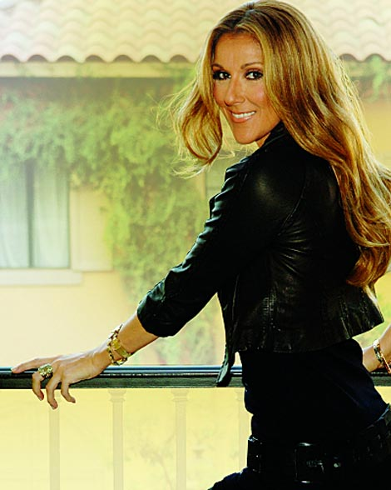
Because You Loved Me
By Celine Dion

Slide 2

Because You Loved Me
By Celine Dion

Slide 3
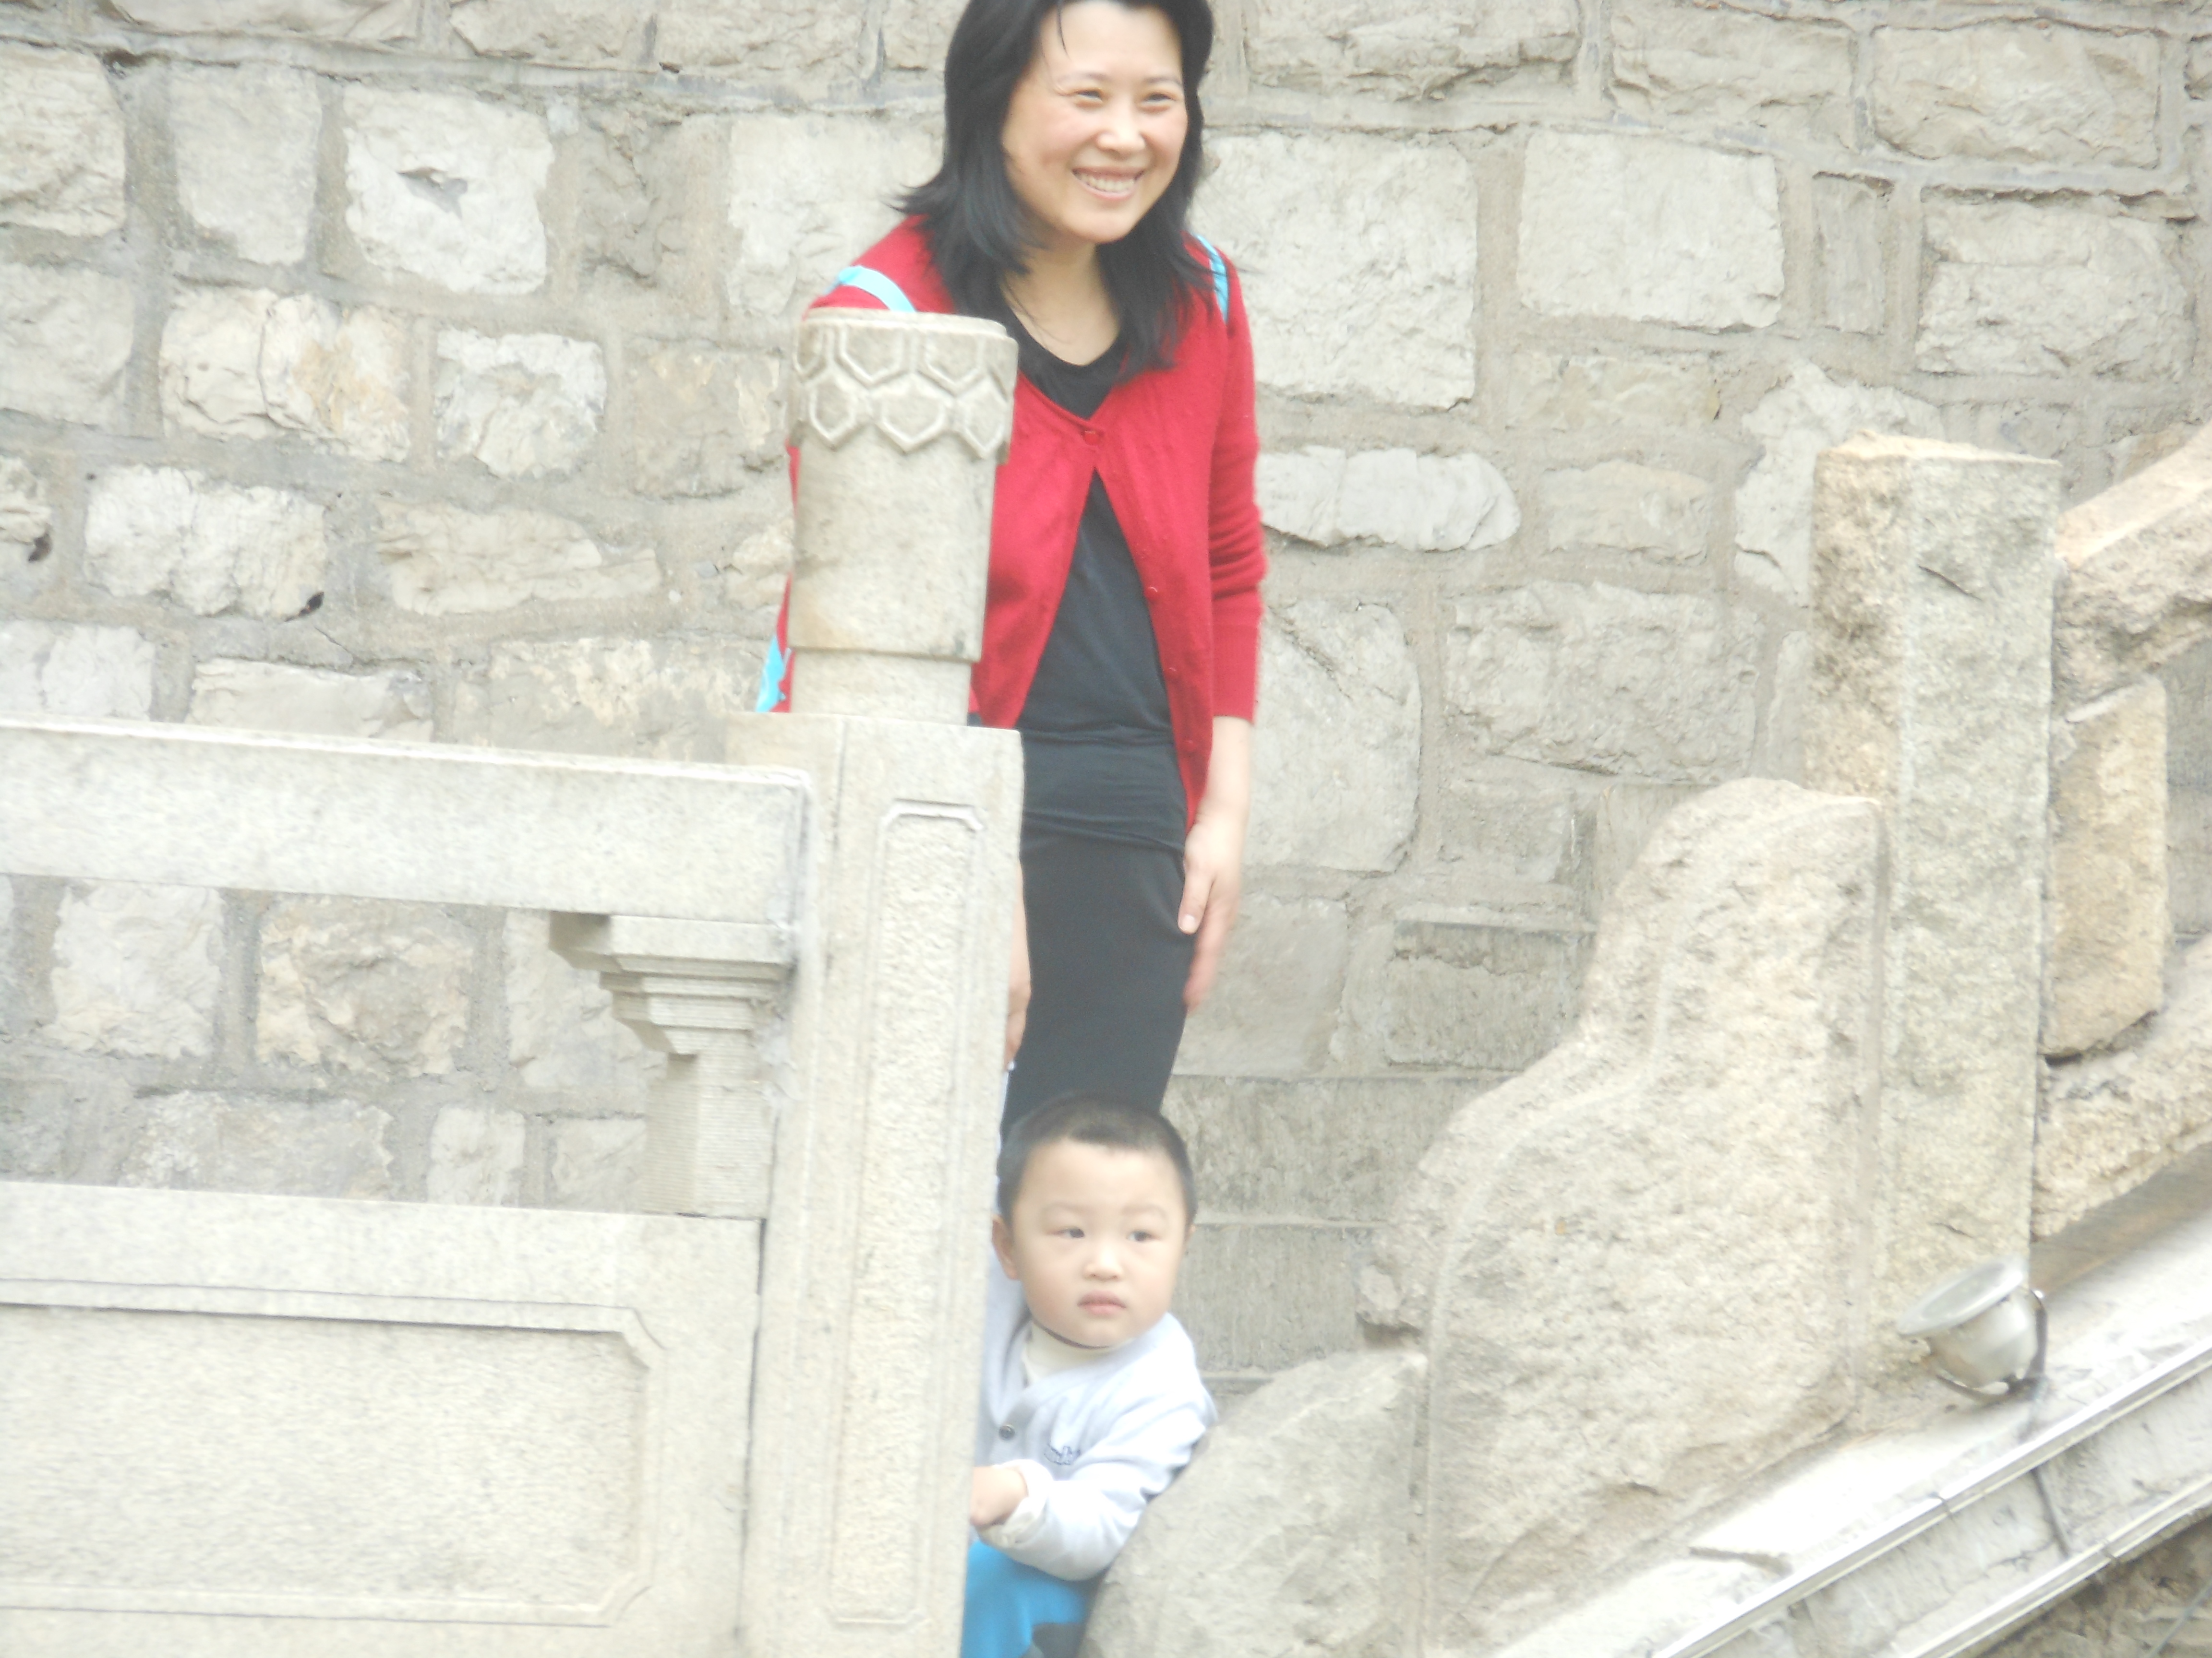
For all those times you stood by me

Slide 4
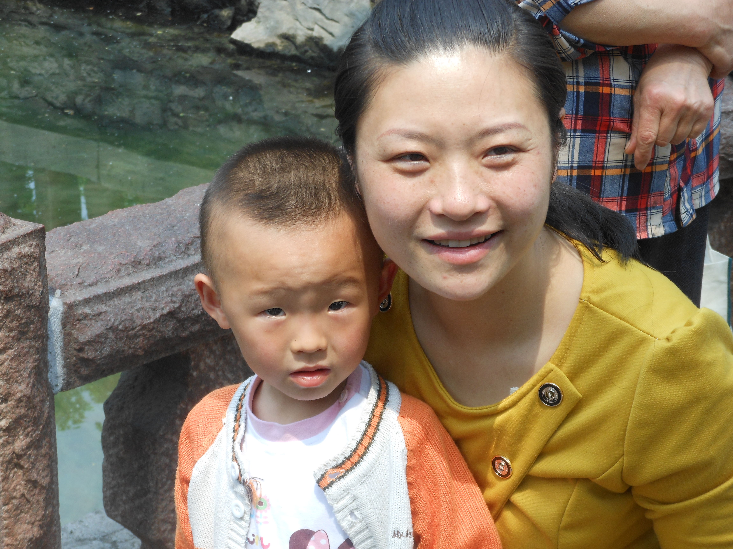
For all the truth you made me see

Slide 5
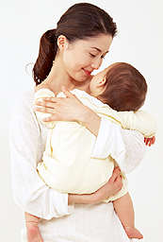
For all the joy you brought to my life

Slide 6
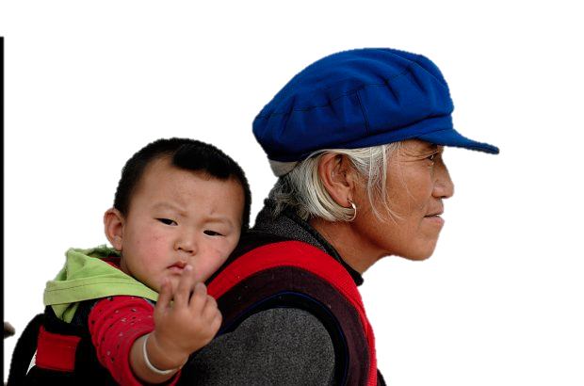
For all the wrong that you made right

Slide 7
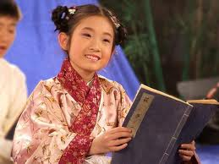
For every dream you made come true

Slide 8
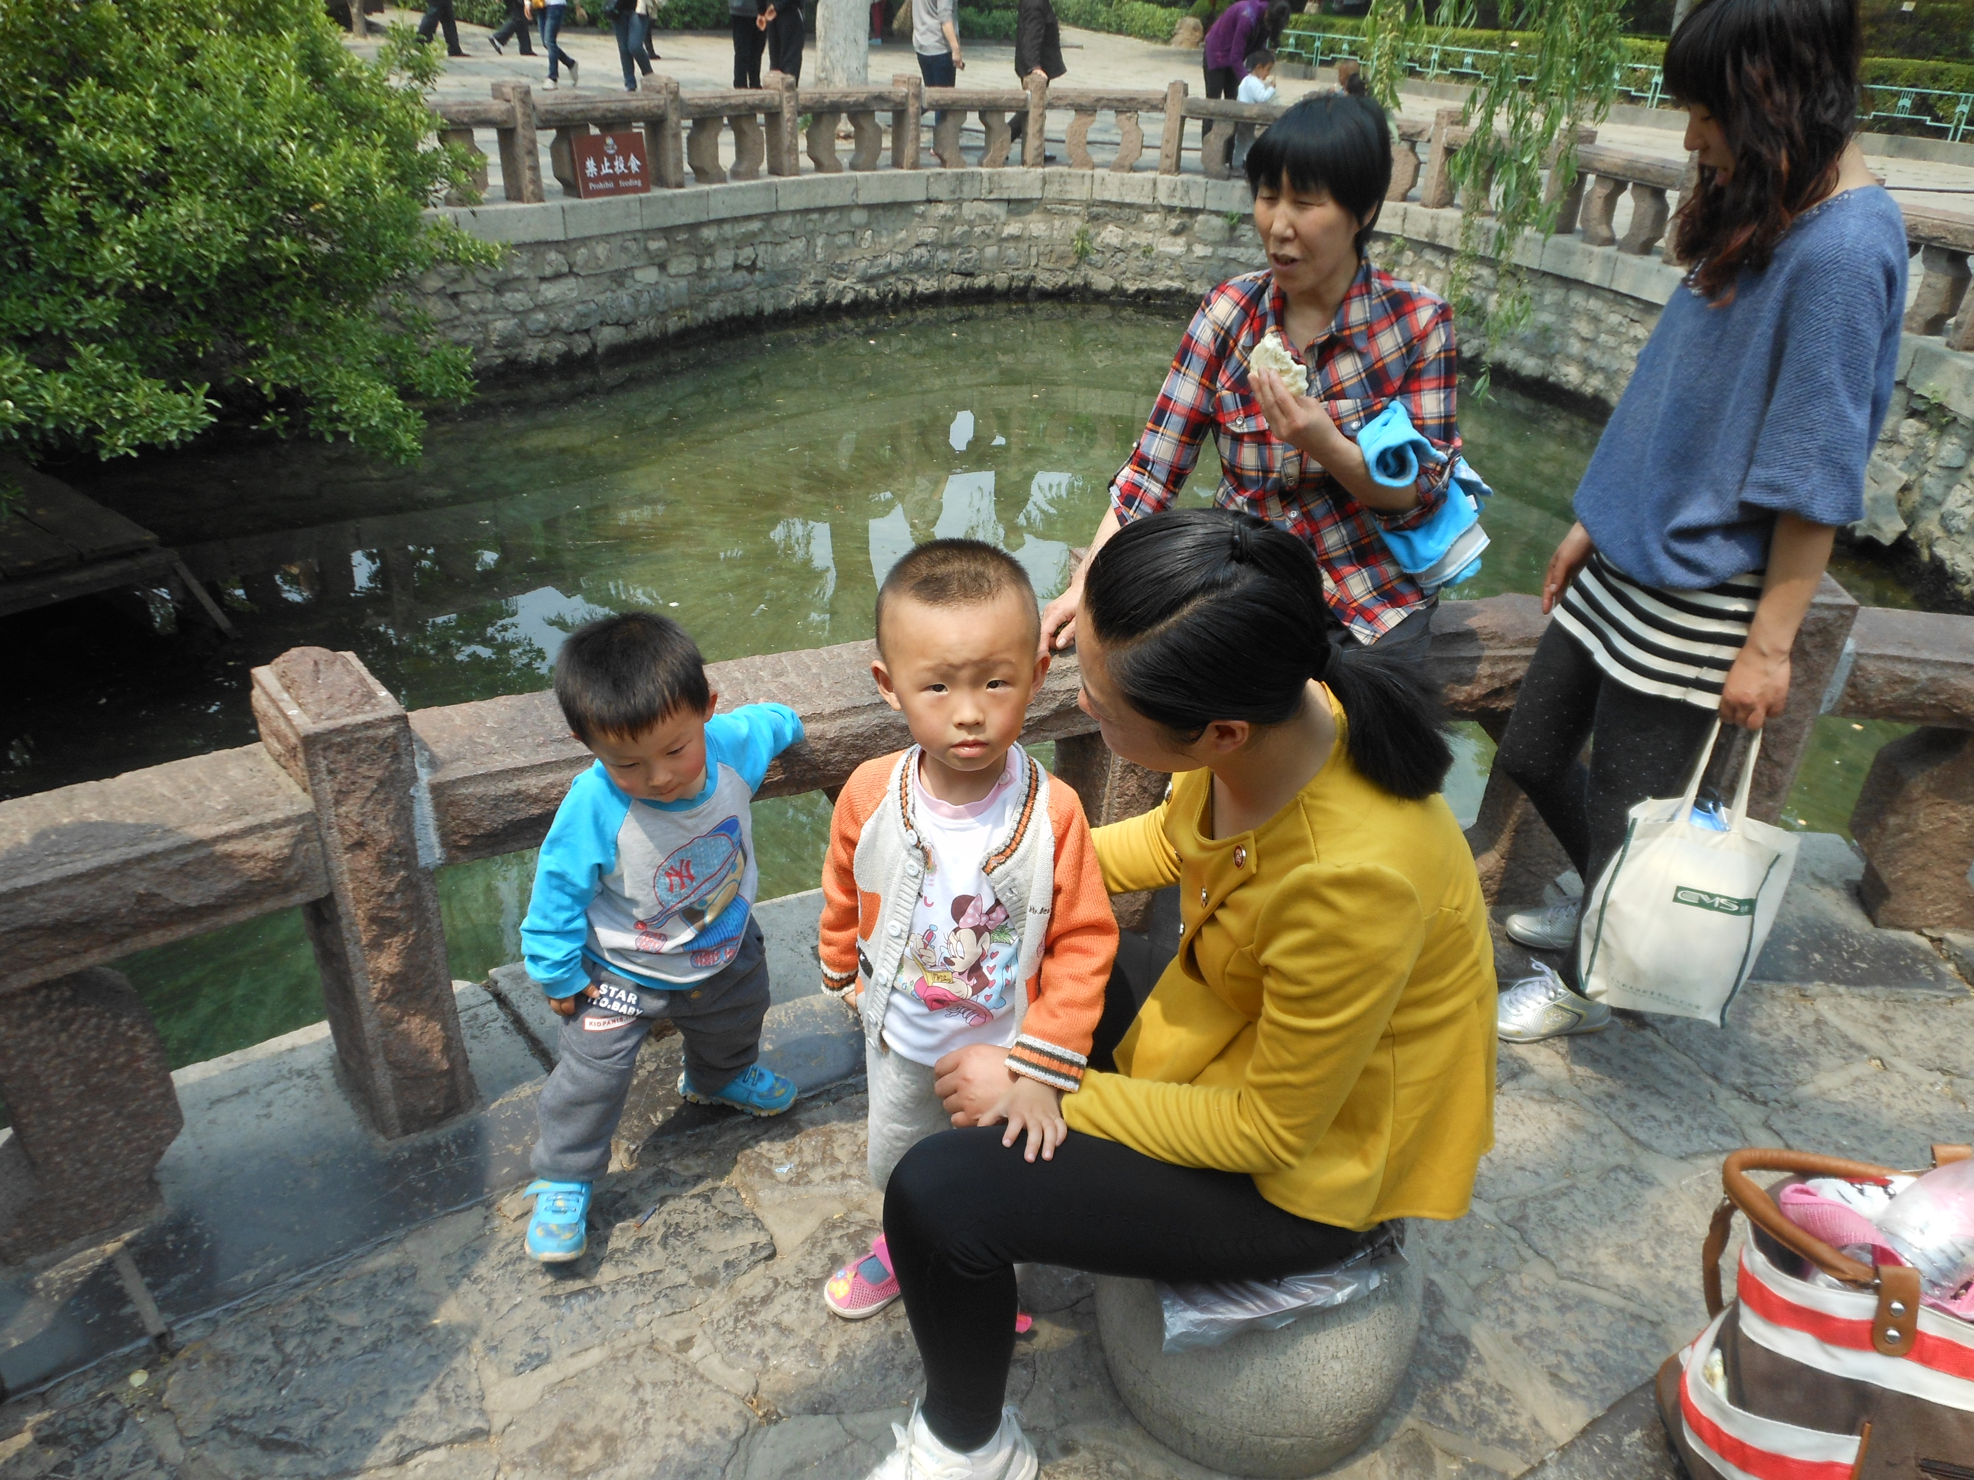
For all the love I found in you

Slide 9
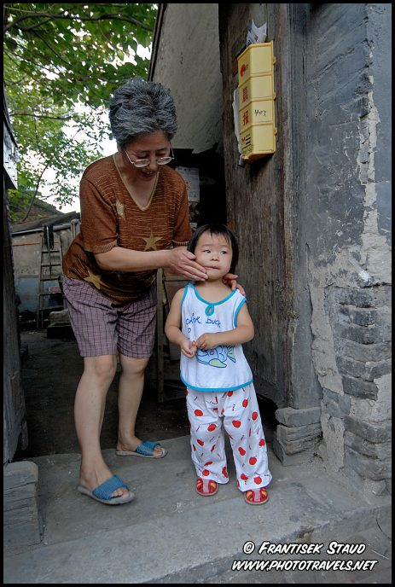
I’ll be forever thankful baby

Slide 10
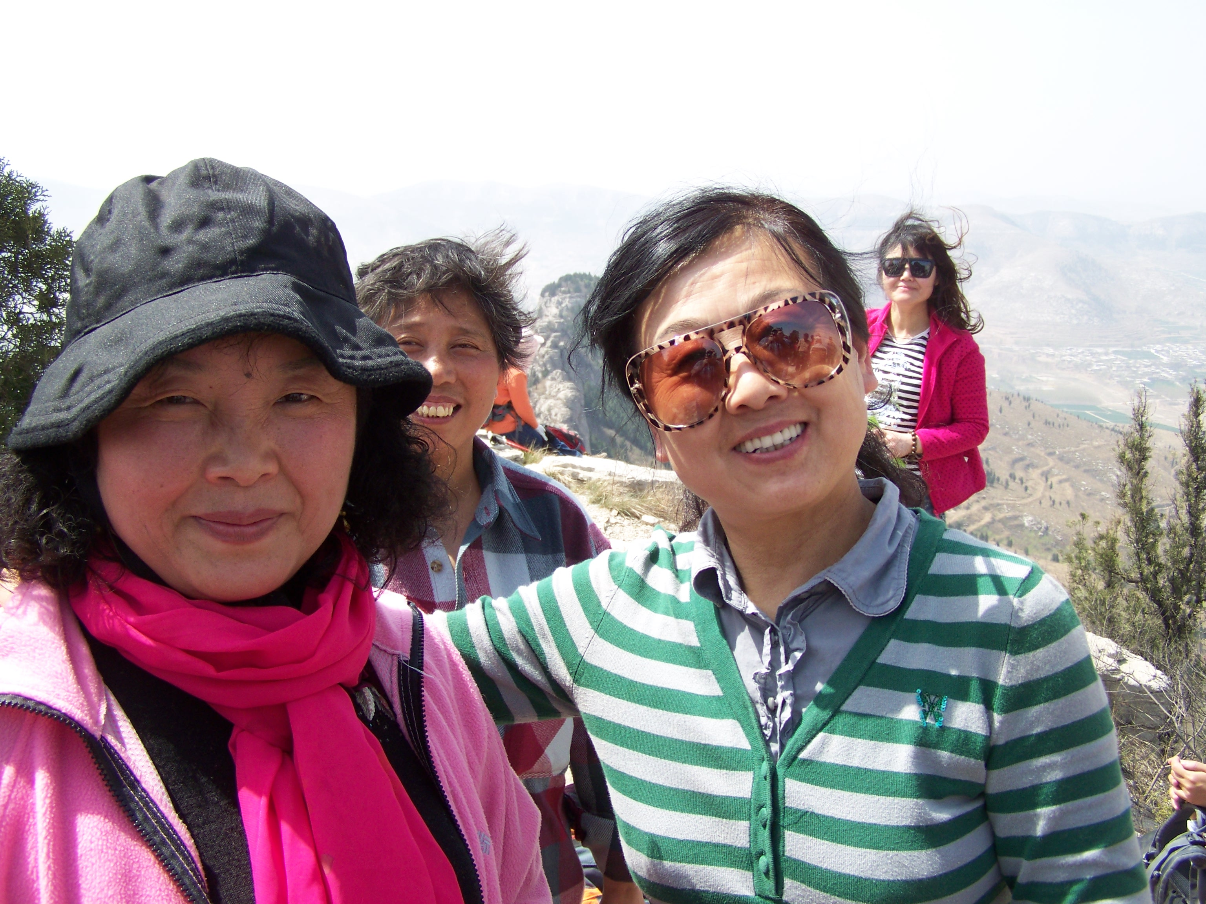
You’re the one who held me up

Slide 11
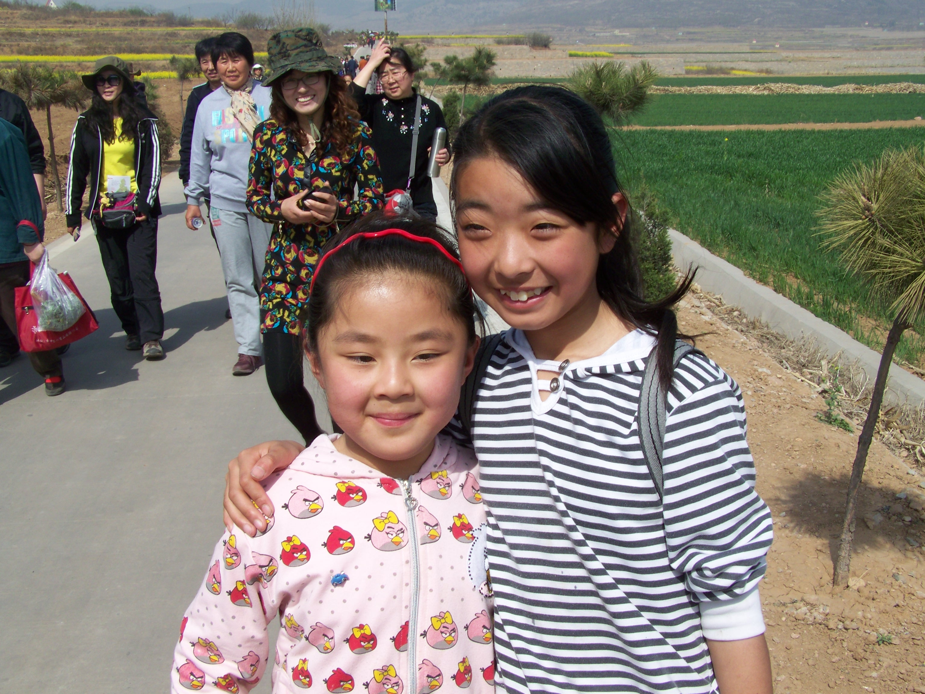
Never let me fall

Slide 12
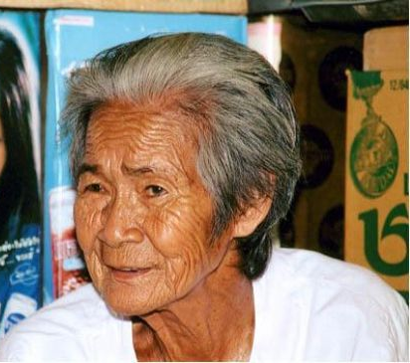
You’re the one who saw me through,

Slide 13
. . .through it all

Slide 14
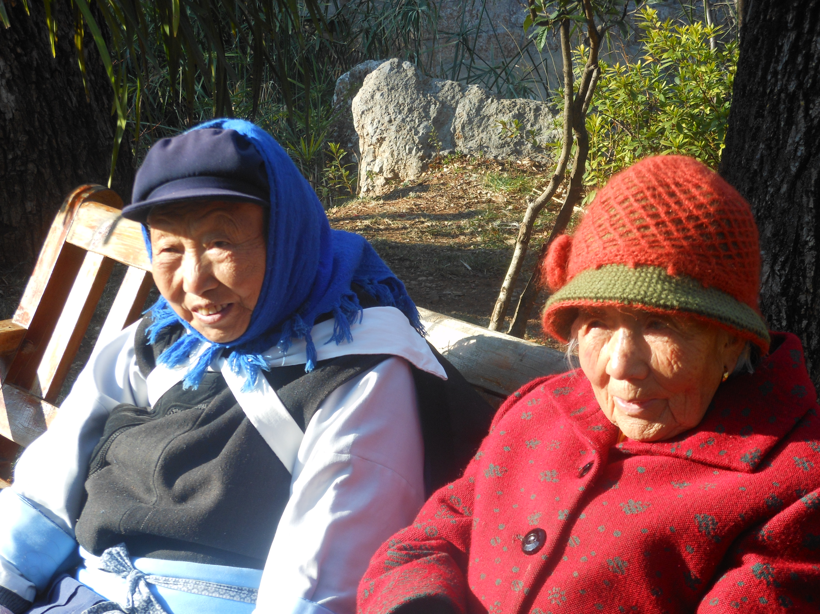
You were my strength
when I was weak

Slide 15
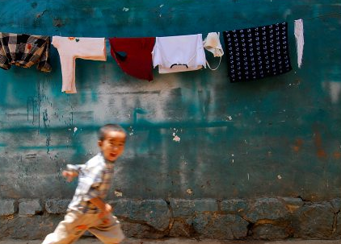
You were my voice when I couldn’t speak

Slide 16
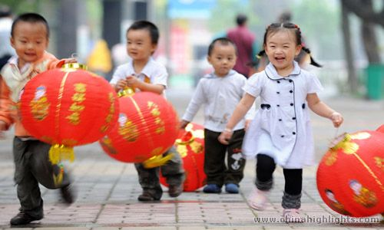
You were my eyes when I couldn’t see

Slide 17
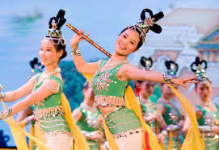
You saw the best there was in me

Slide 18
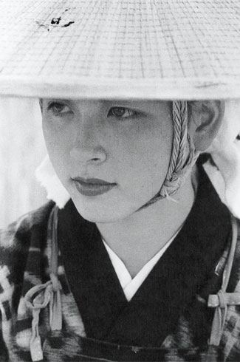
Lifted me up when I couldn’t reach

Slide 19
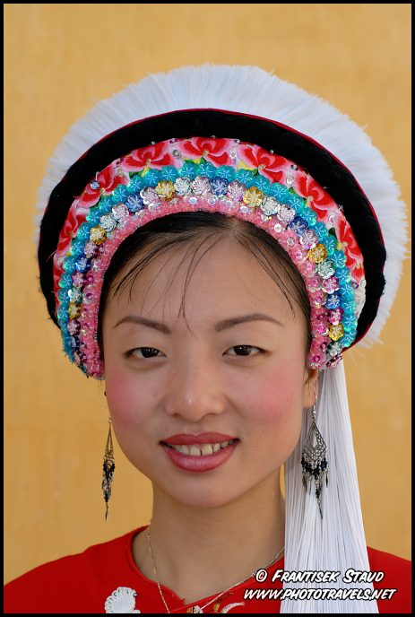
You gave me faith ‘cuz you believed

Slide 20
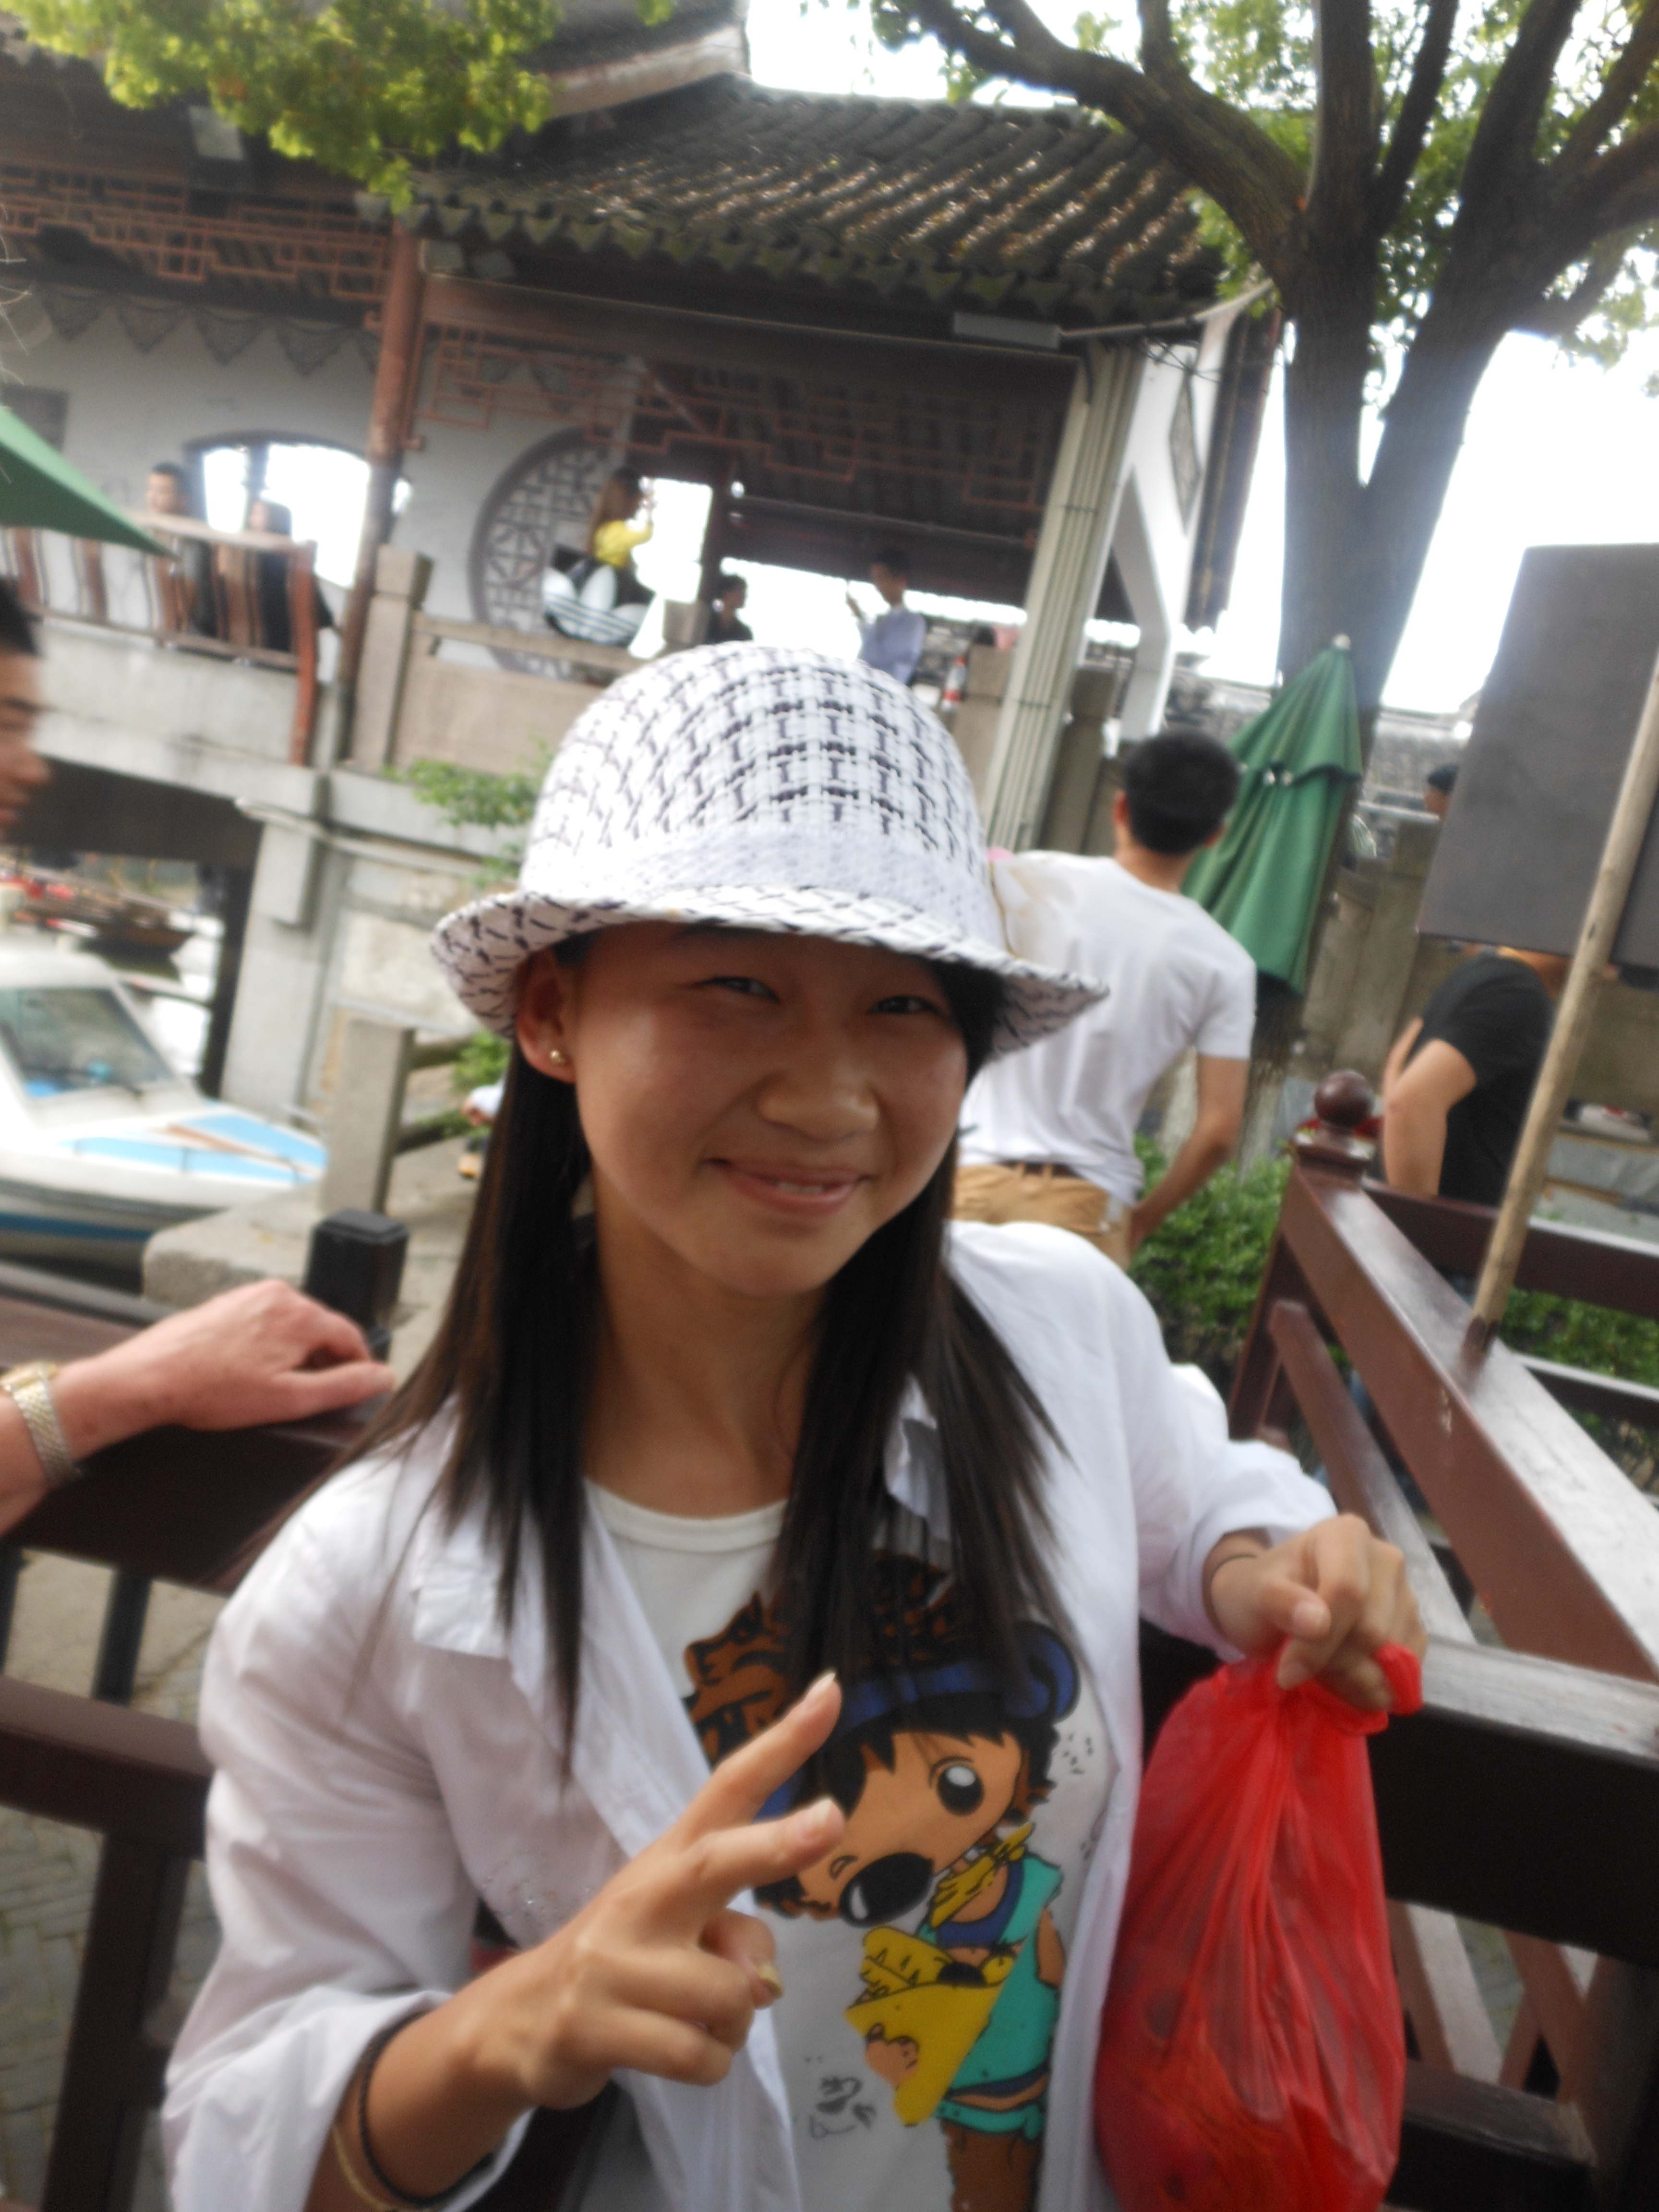
I’m everything
I am

Slide 21
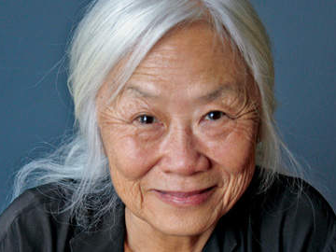
Because
You loved me

Slide 22
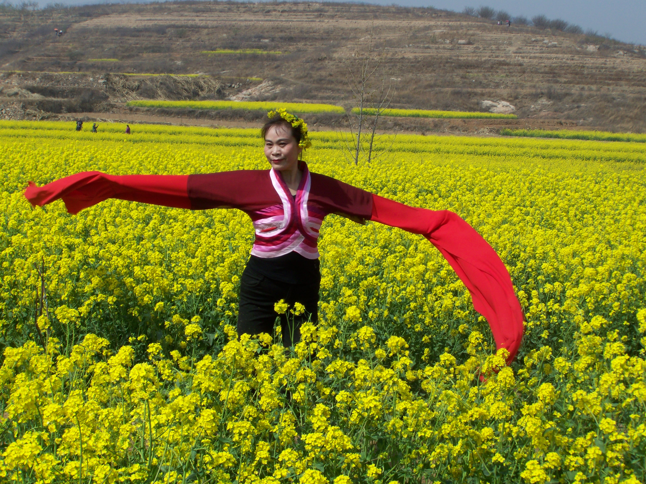
You gave me wings and made me fly

Slide 23
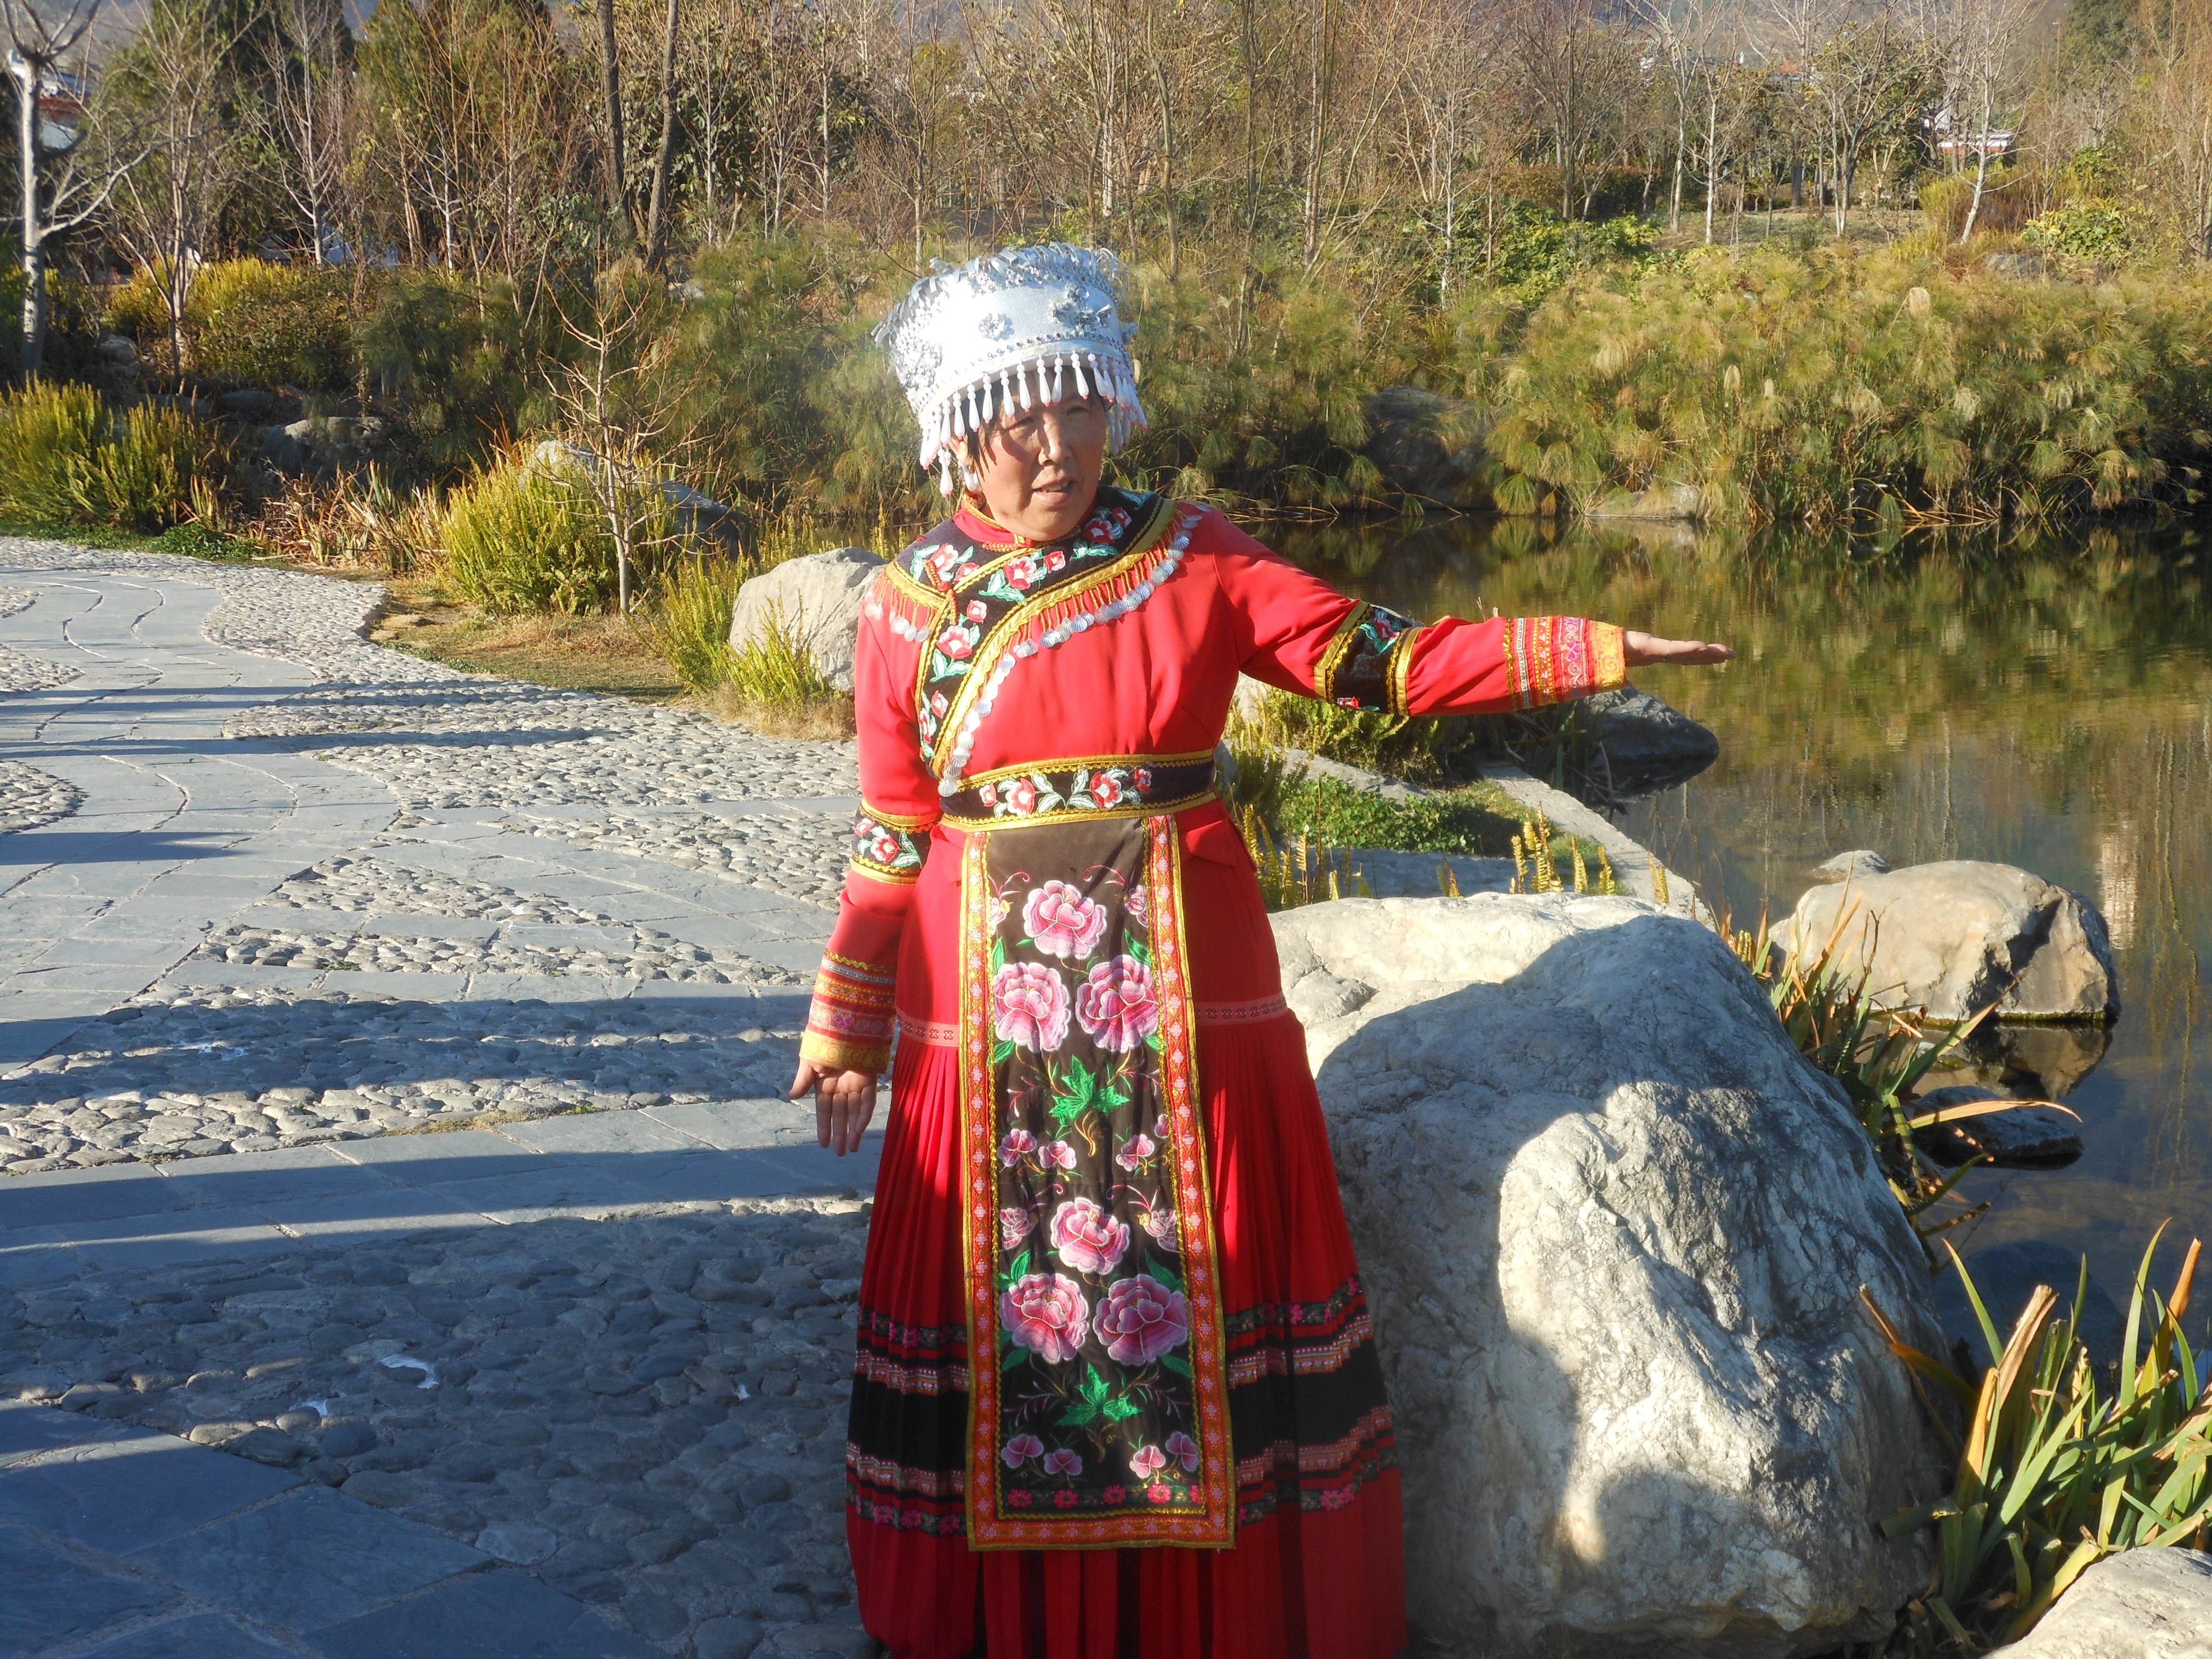
You touched my hand
I could touch the sky

Slide 24
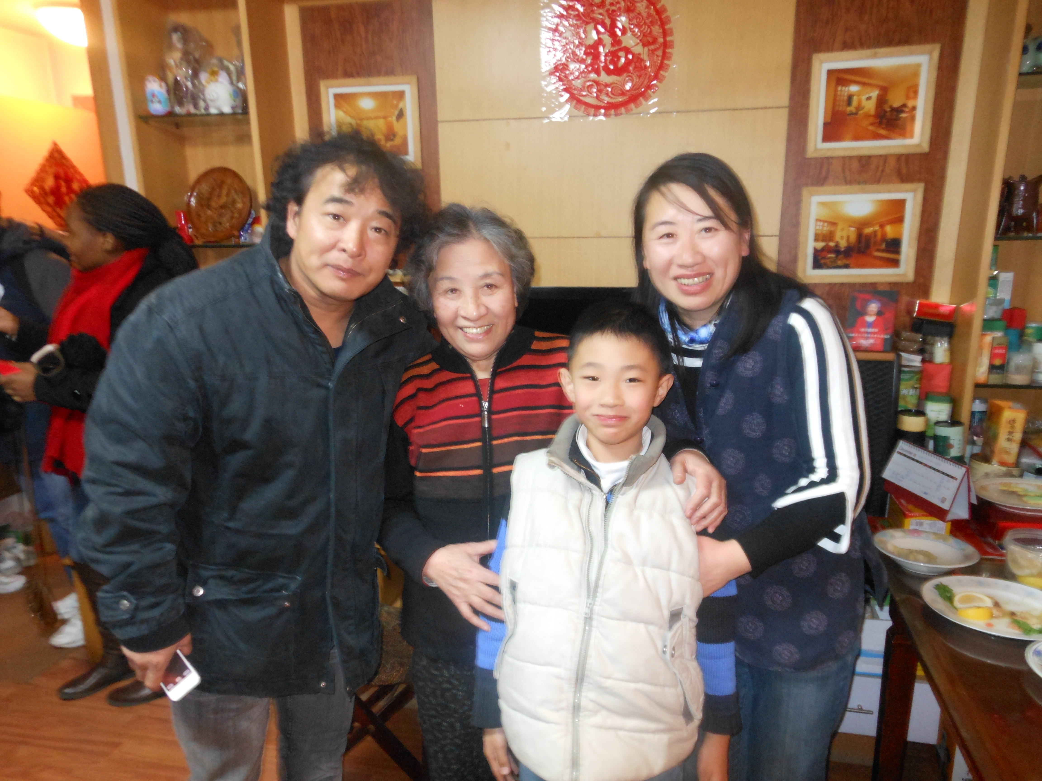
I lost my faith,
you gave it back to me

Slide 25
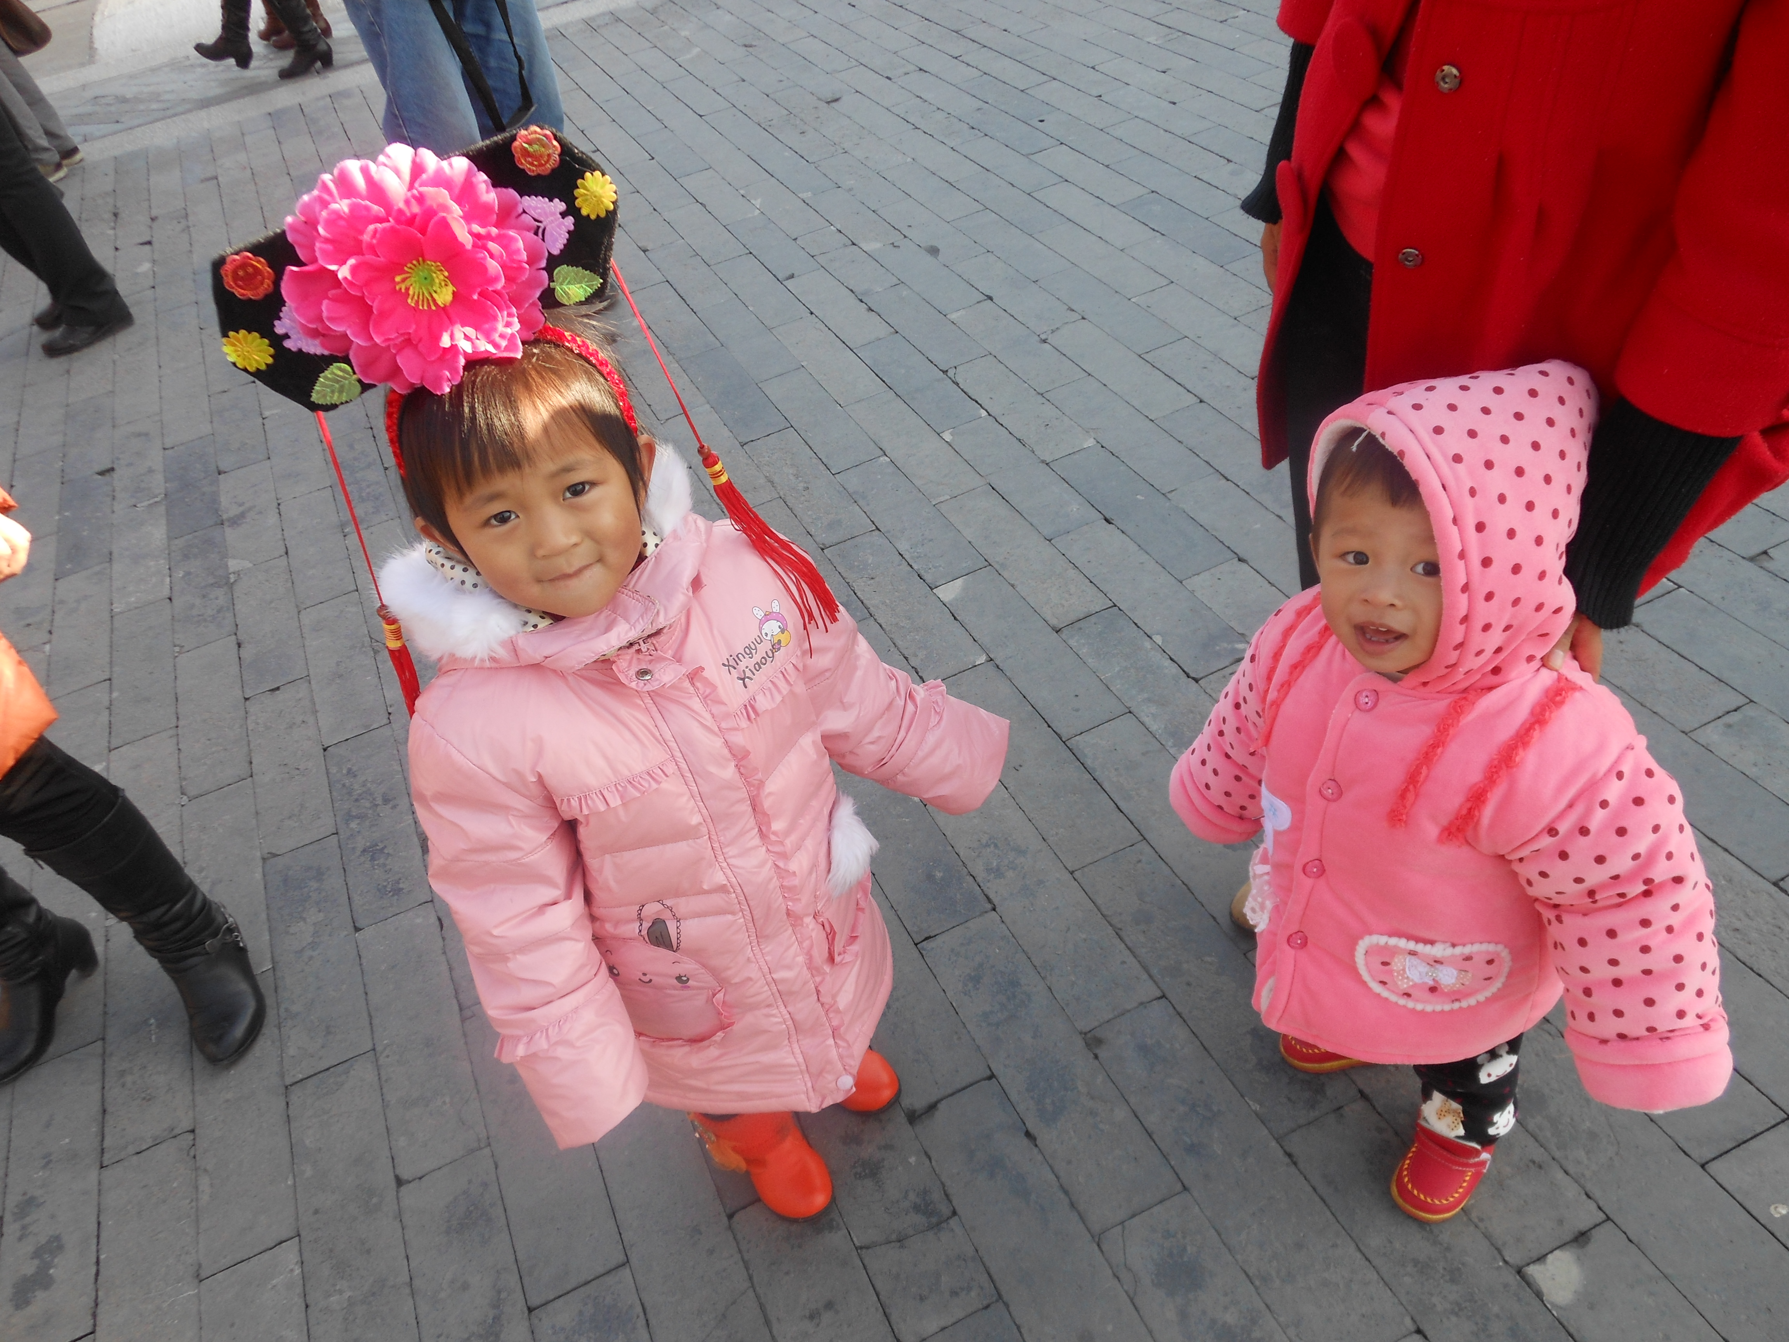
You said no star was out of reach

Slide 26
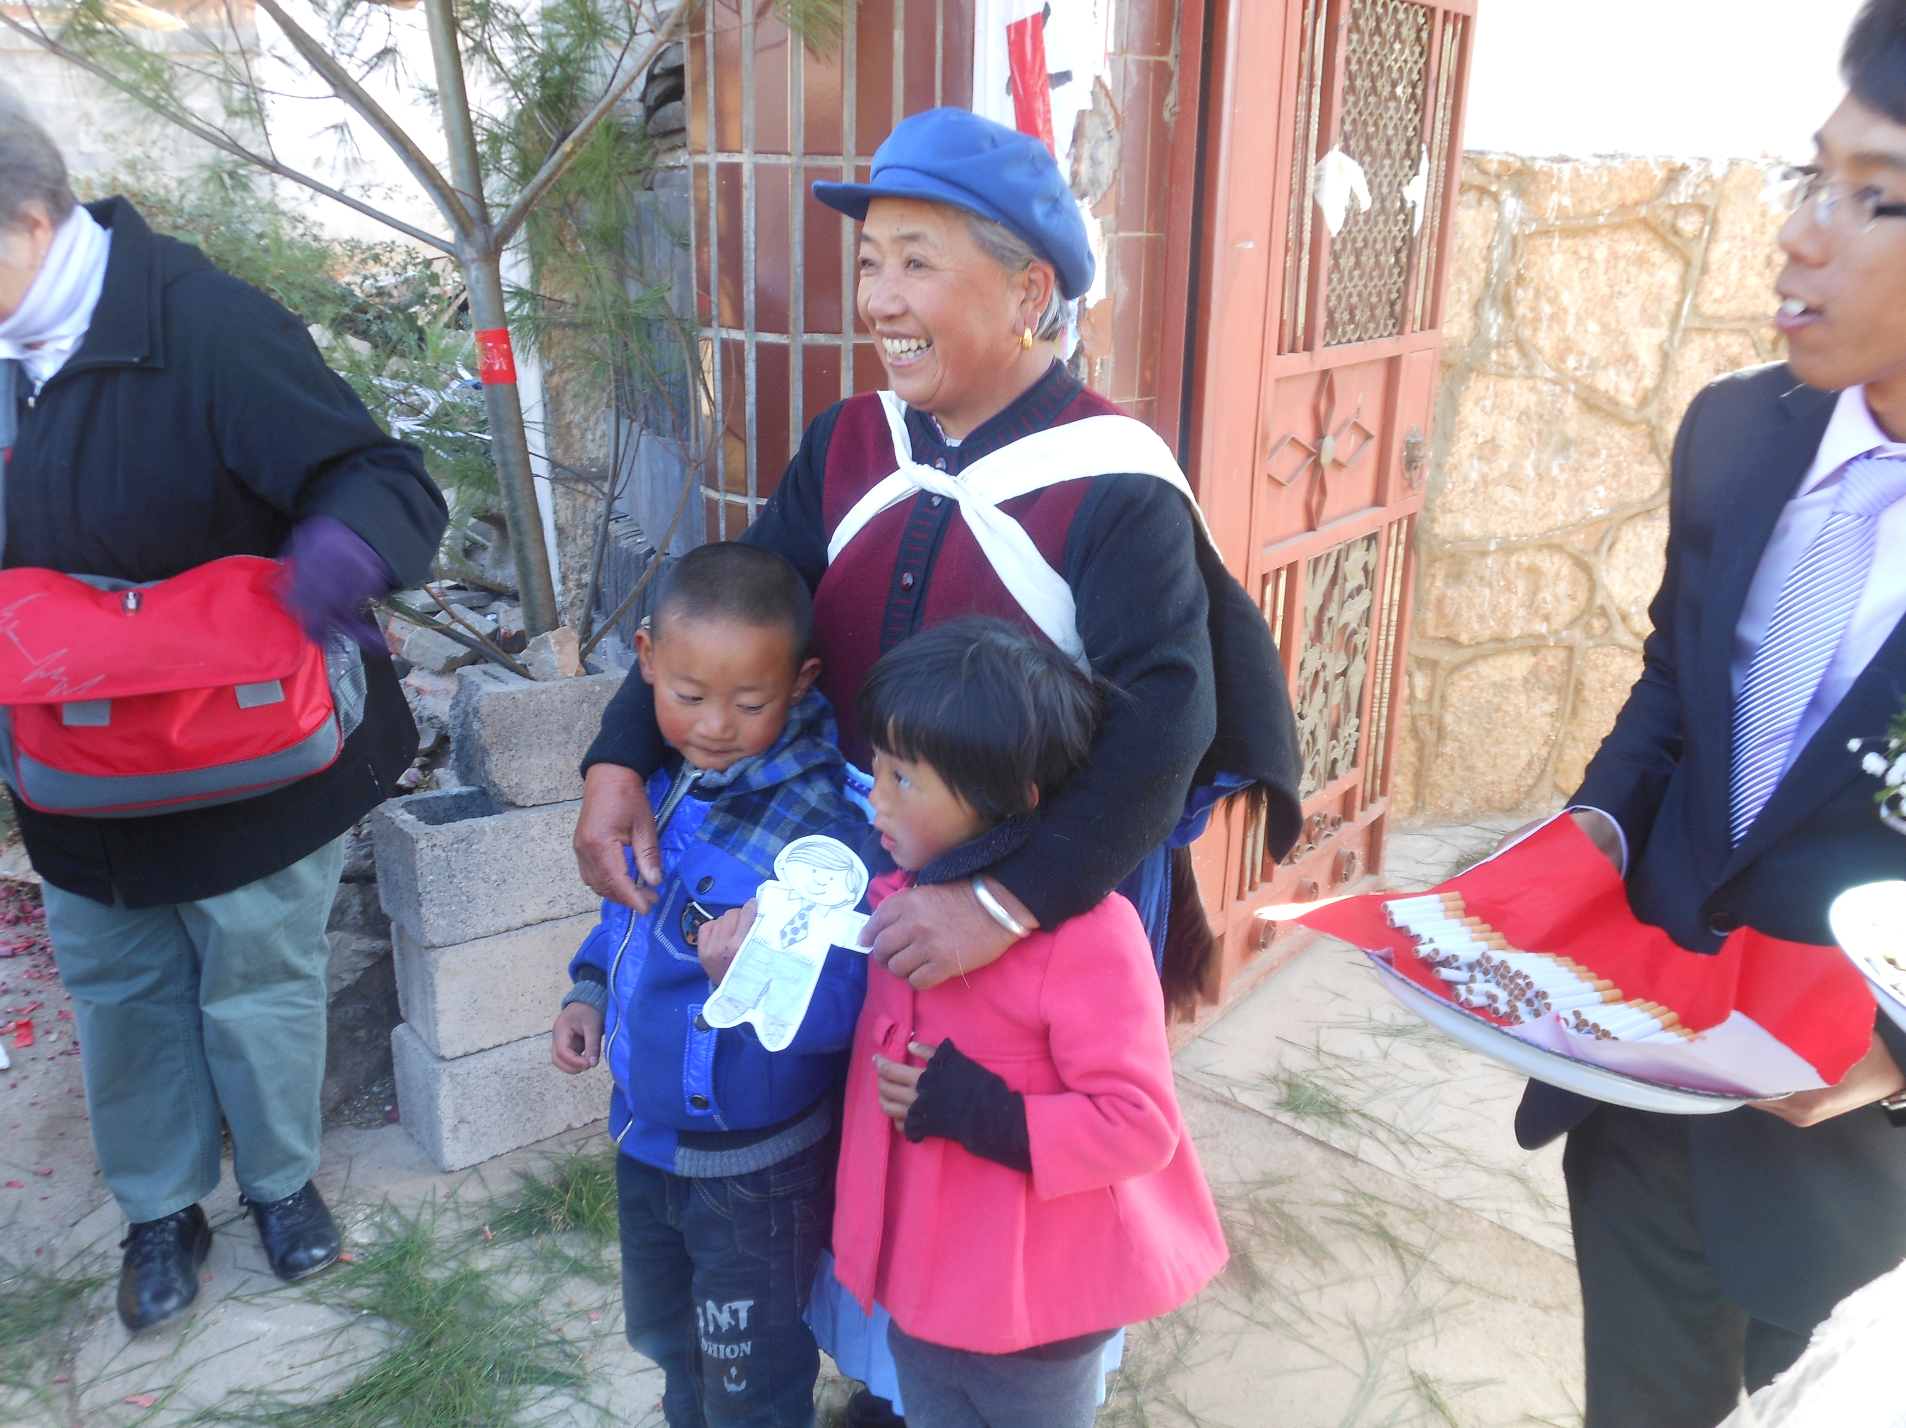
You stood by me and I stood tall

Slide 27
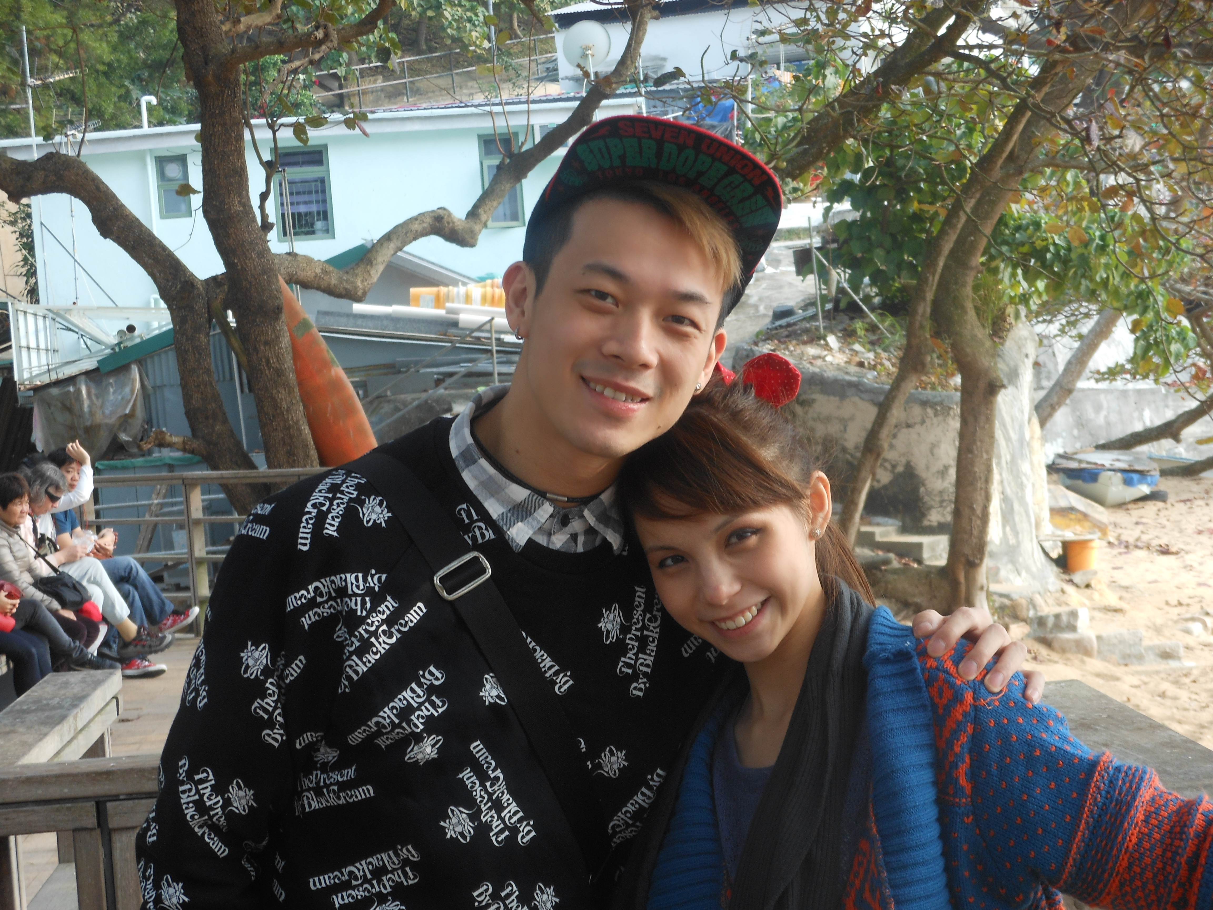
I had your love I had it all

Slide 28
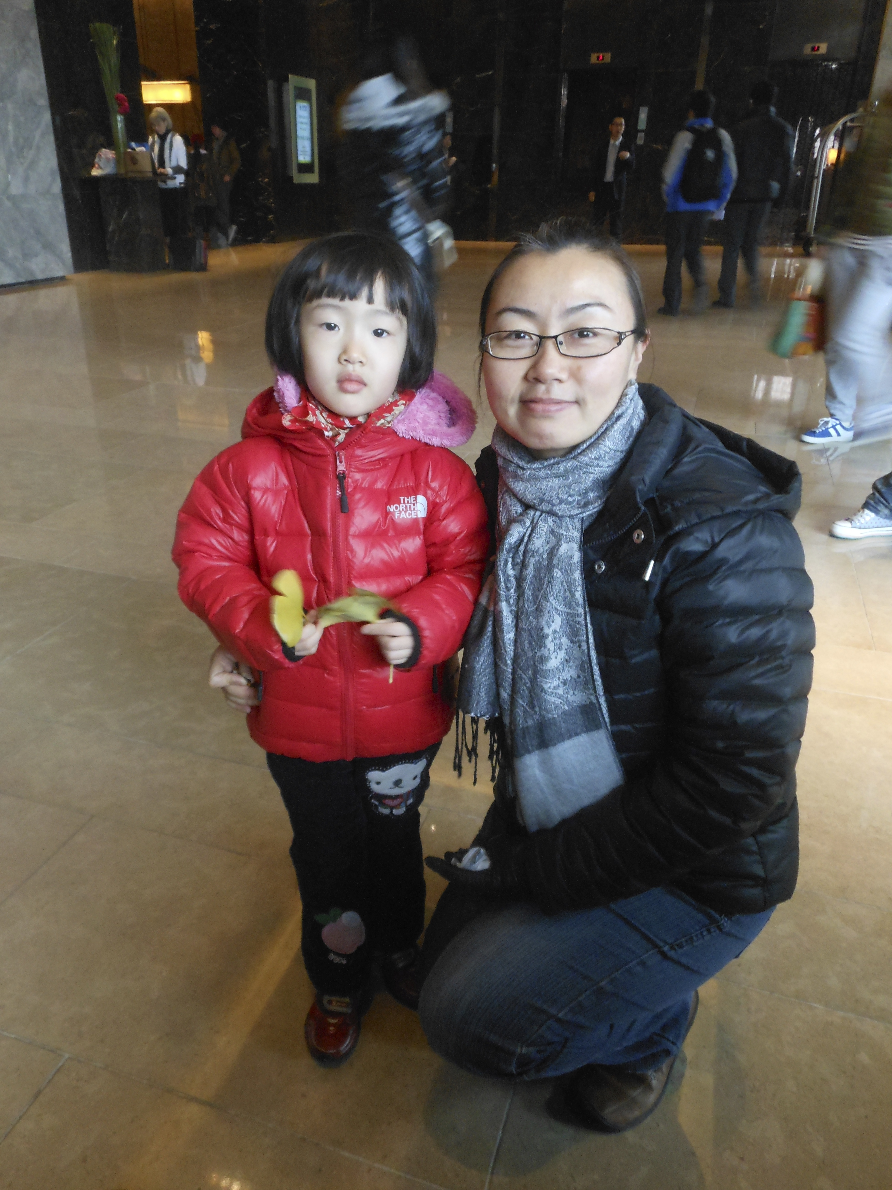
I’m grateful for each day you gave me

Slide 29
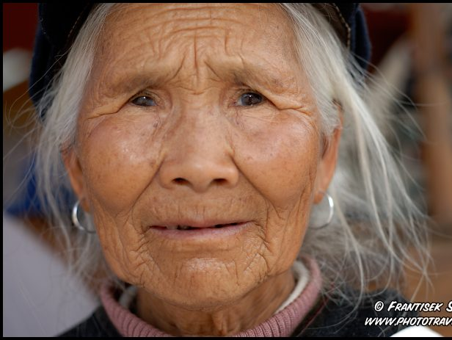
Maybe I don’t know that much

Slide 30
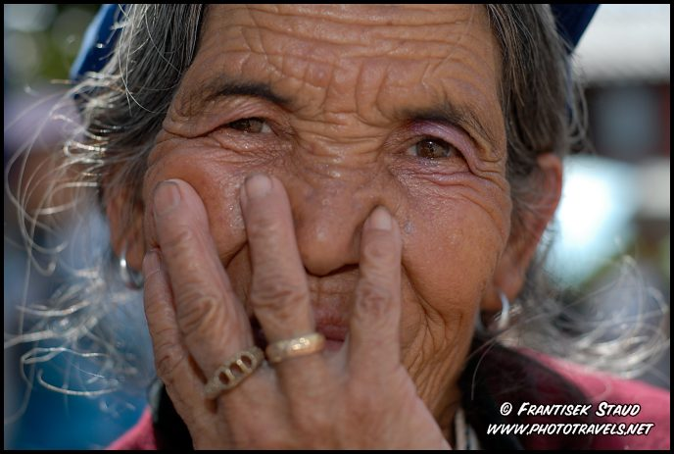
But I know this much is true

Slide 31
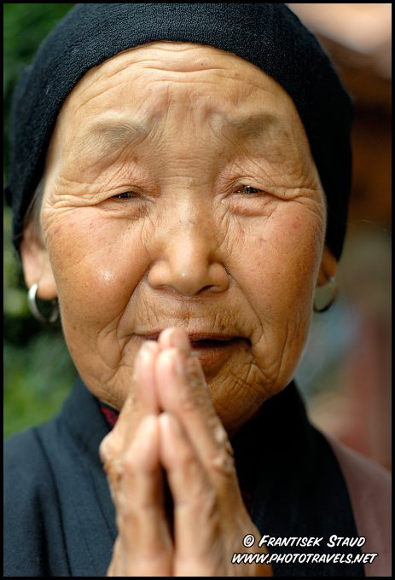
I was blessed
because I was loved by you

Slide 32
You were my strength
when I was weak

Slide 33
You were my voice when I couldn’t speak

Slide 34
You were my eyes when I couldn’t see

Slide 35
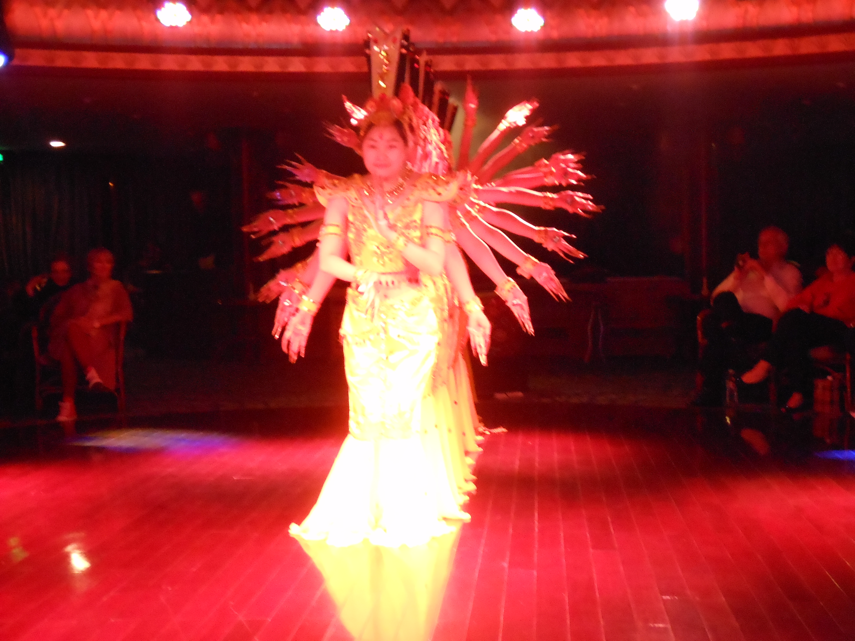
You saw the best there was in me

Slide 36
Lifted me up when I couldn’t reach

Slide 37
You gave me faith ‘cuz you believed

Slide 38
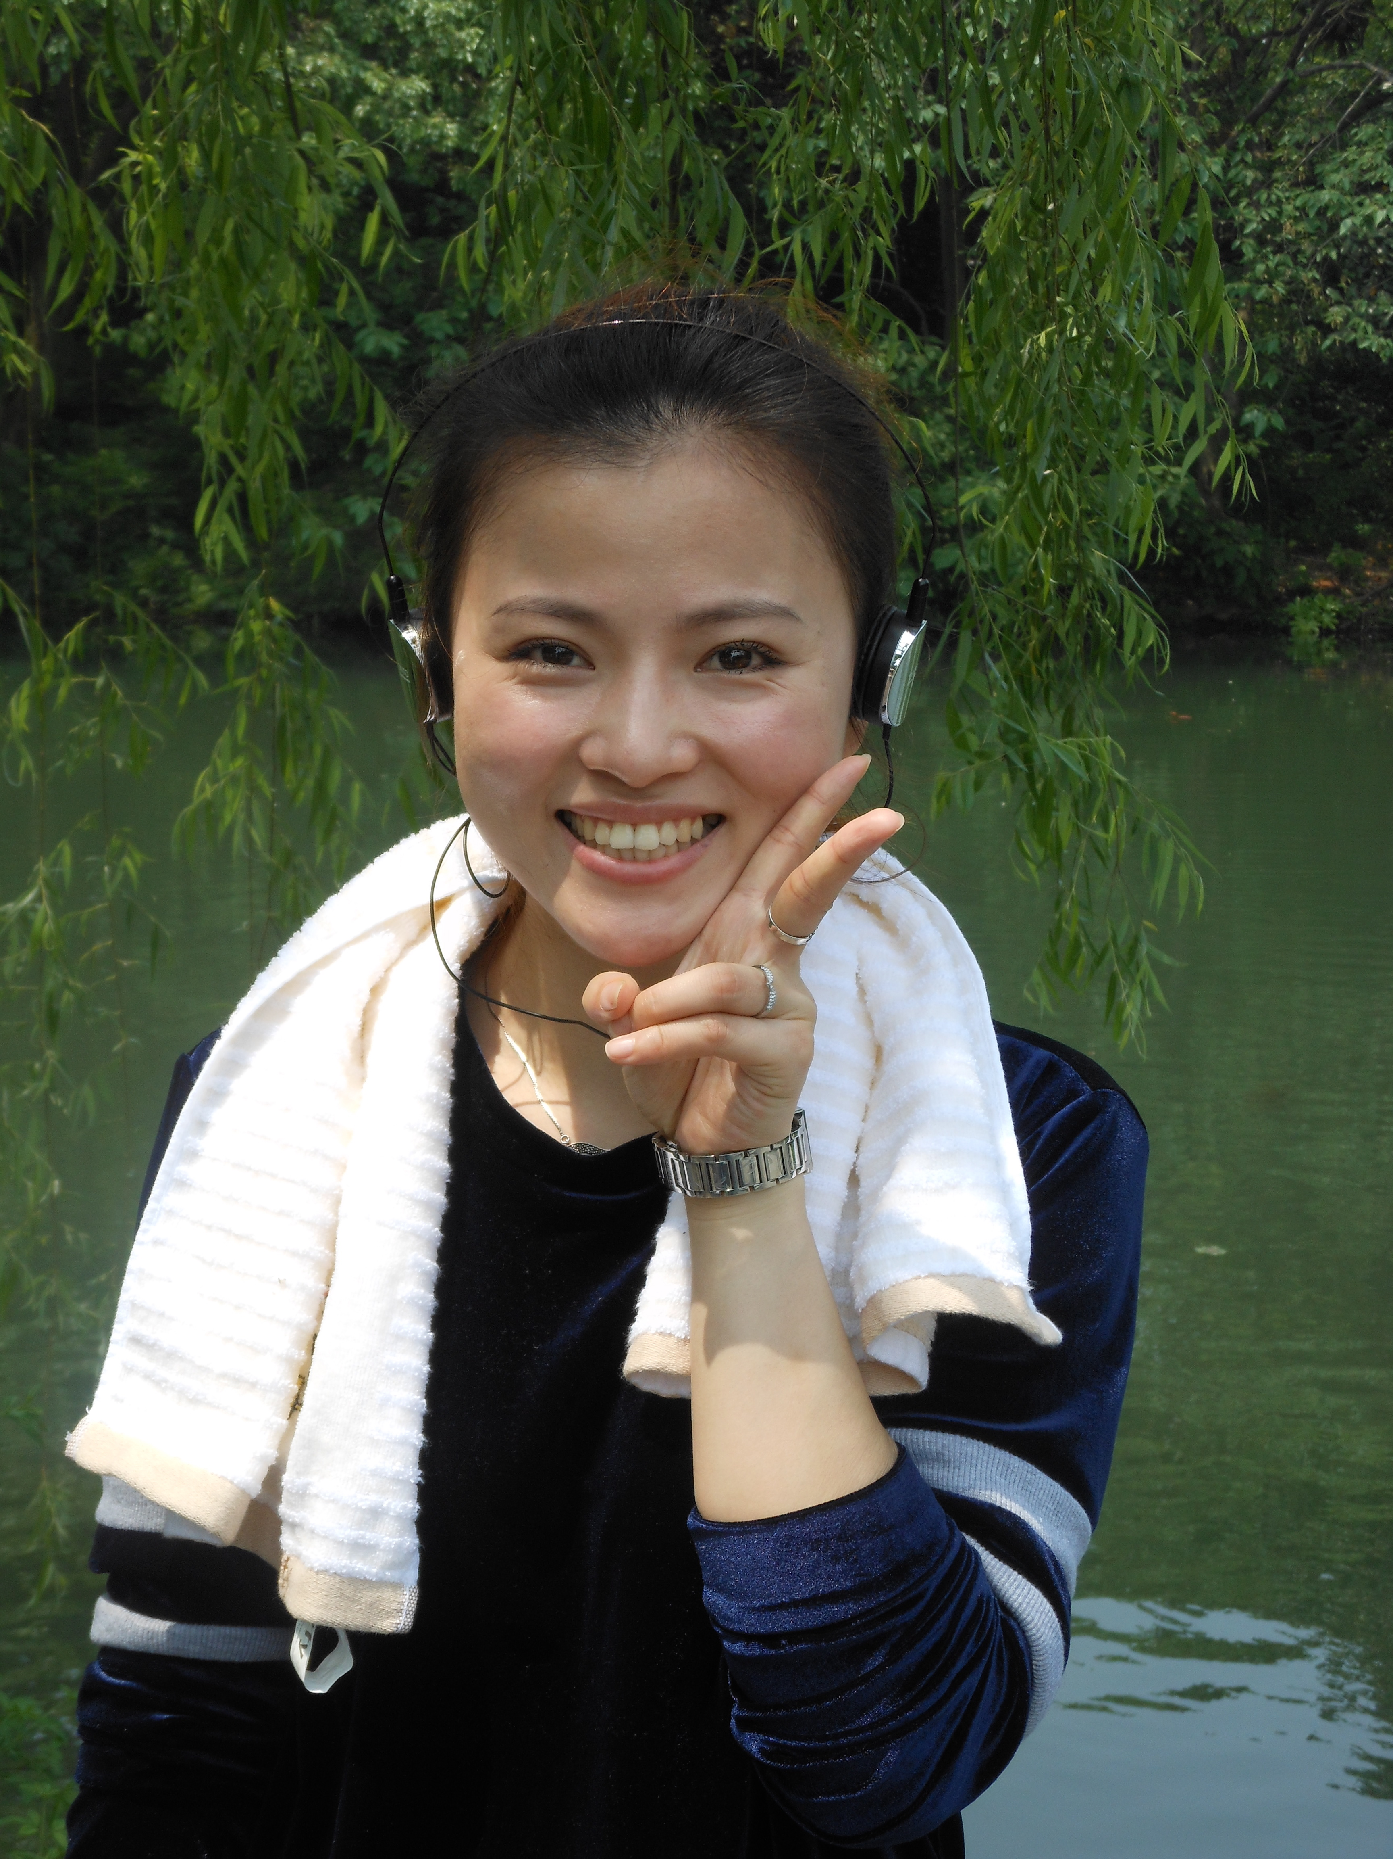
I’m everything
I am

Slide 39
Because
You loved me

Slide 40
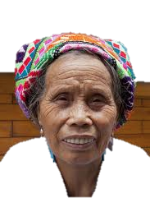

Slide 41
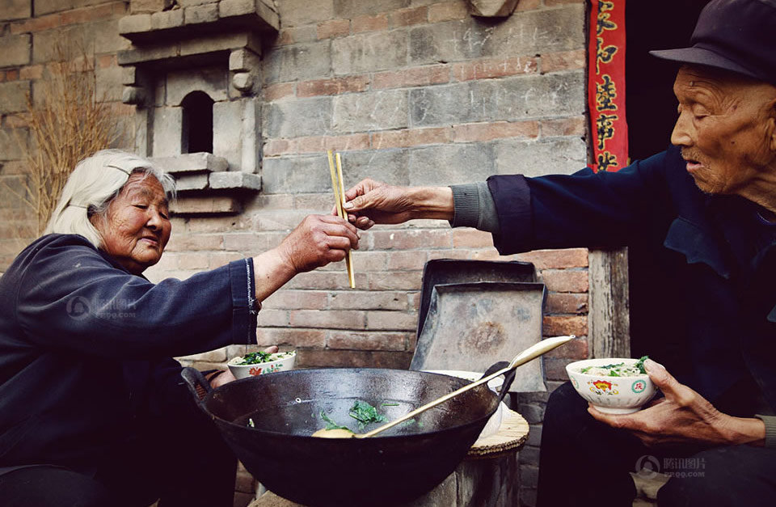
You were always there for me

Slide 42
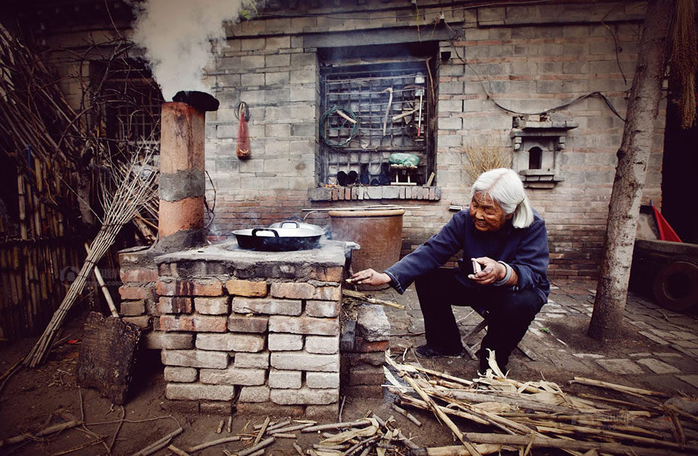
The tender wind that carried me

Slide 43
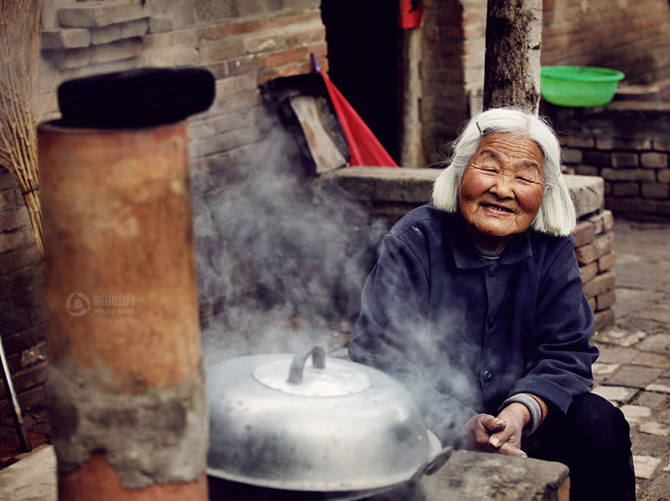
A light in the dark shining your love into my life

Slide 44
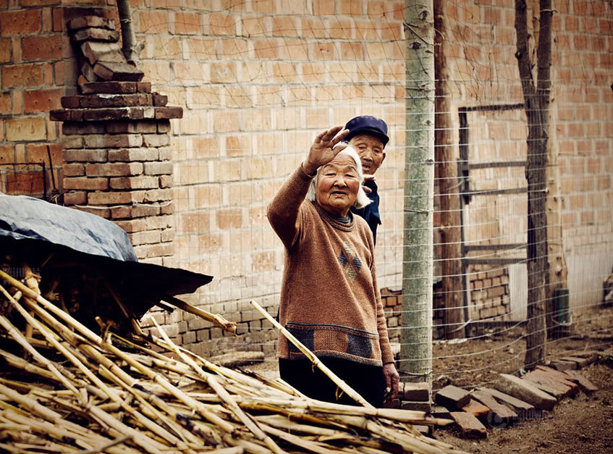
You’ve been my inspiration

Slide 45
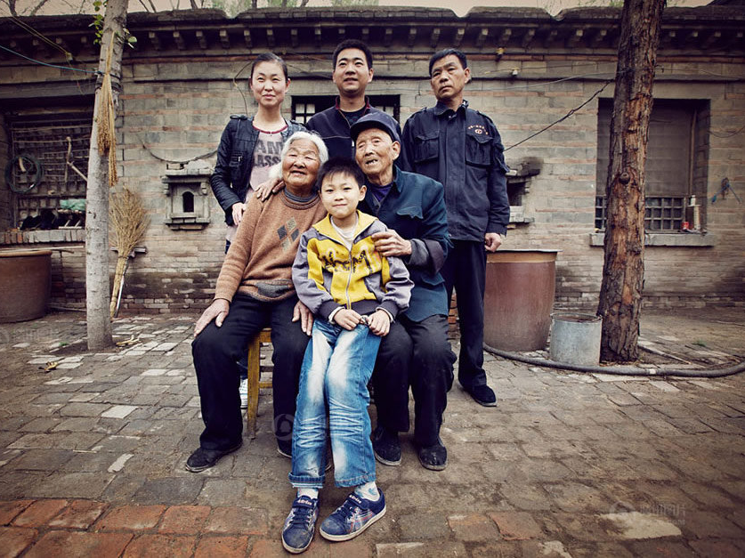
Through the lies you were the truth

Slide 46
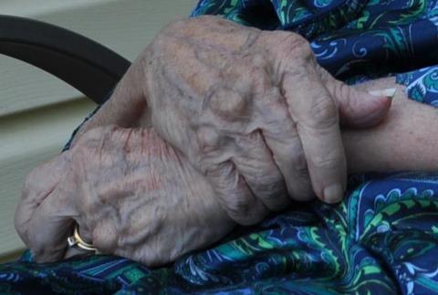
My world is a better place
because of you

Slide 47
You were my strength
when I was weak

Slide 48
You were my voice when I couldn’t speak

Slide 49
You were my eyes when I couldn’t see

Slide 50
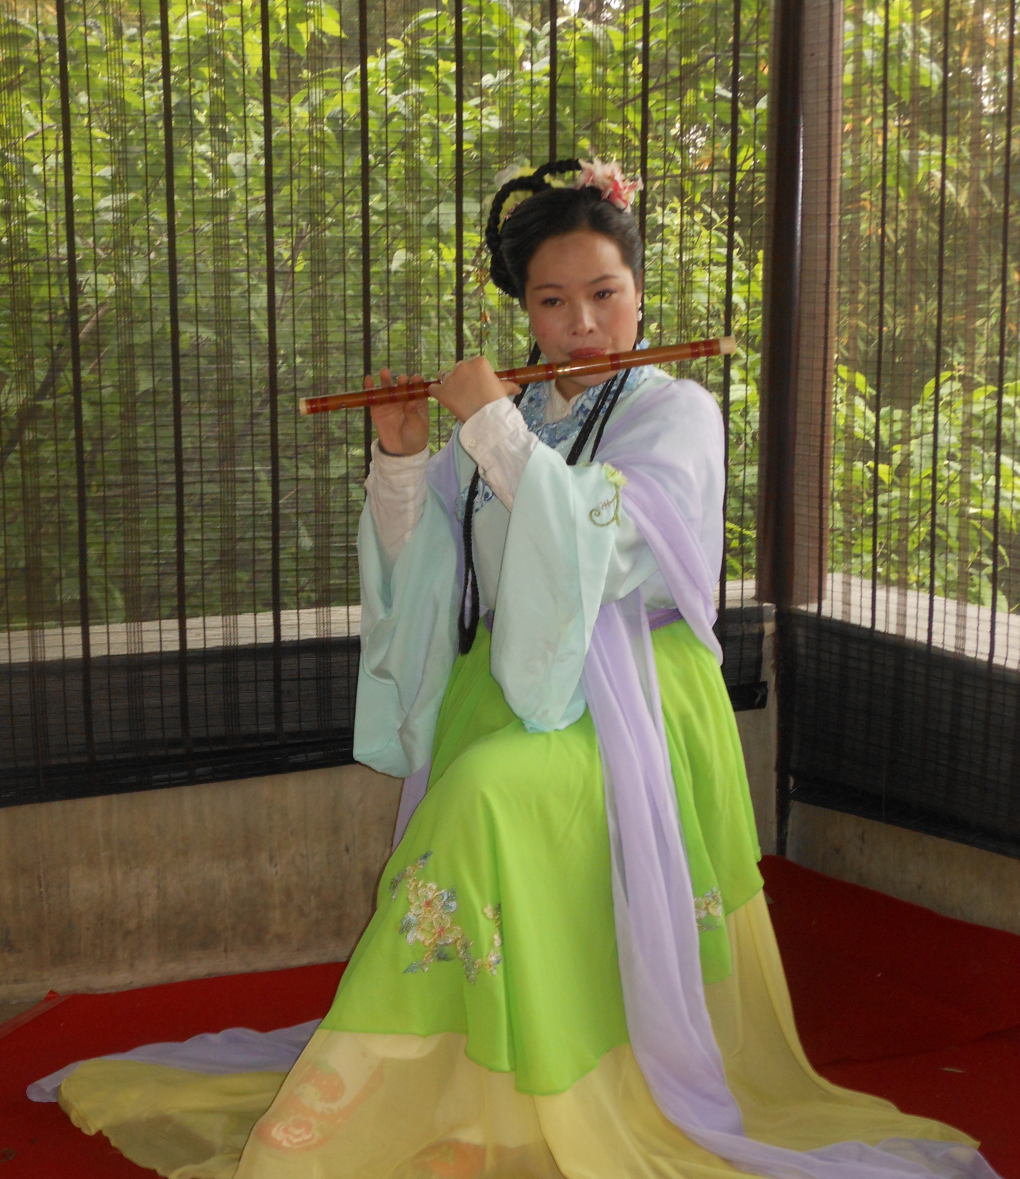
You saw the best there was in me

Slide 51
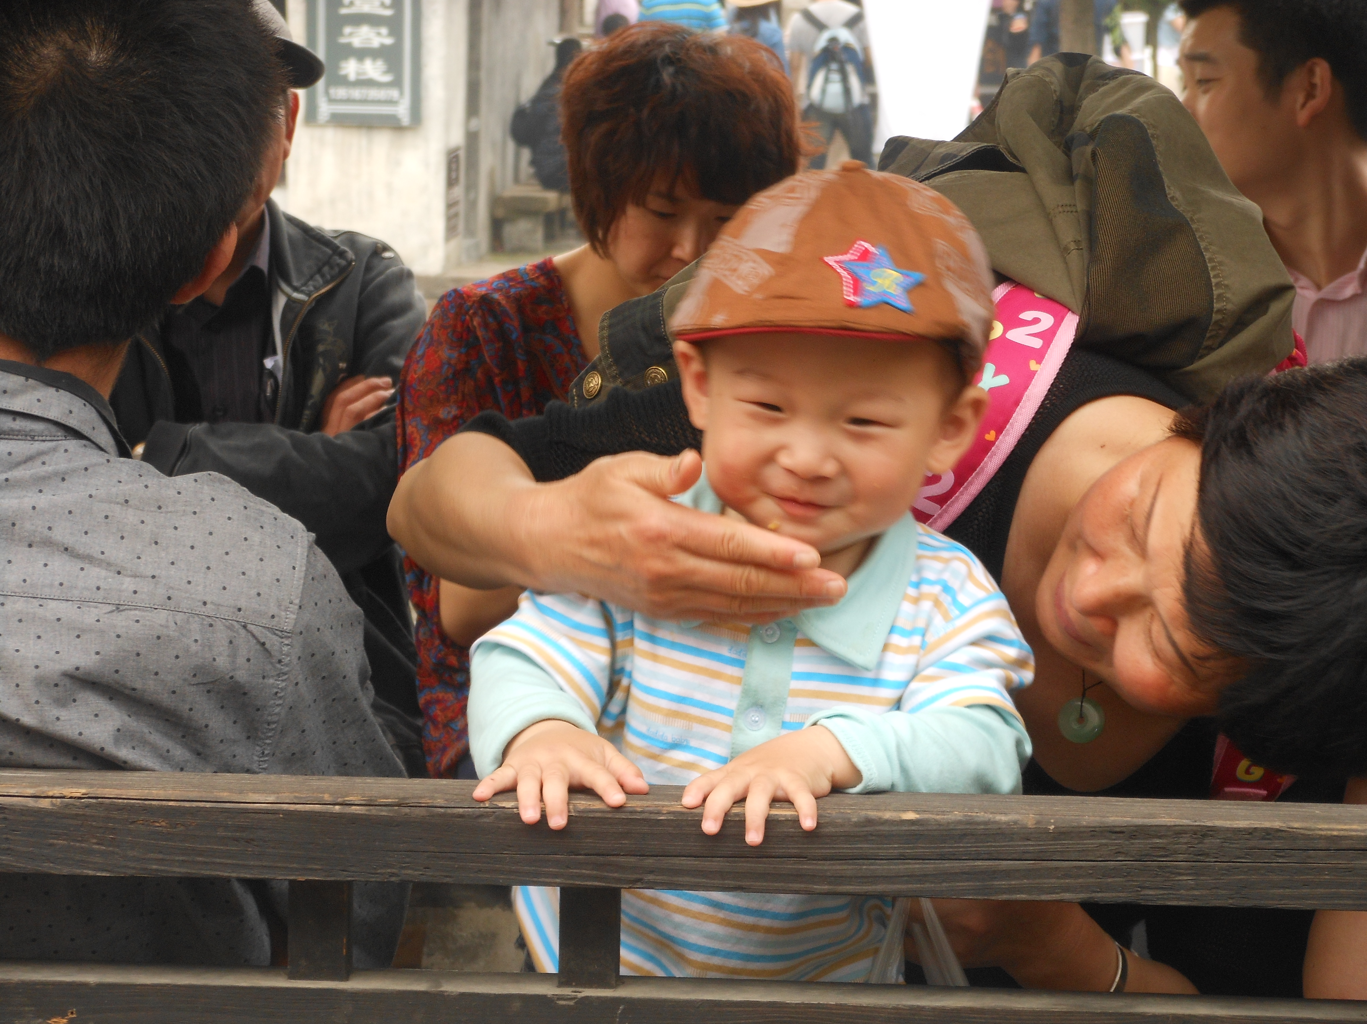
Lifted me up when I couldn’t reach

Slide 52
You gave me faith ‘cuz you believed

Slide 53
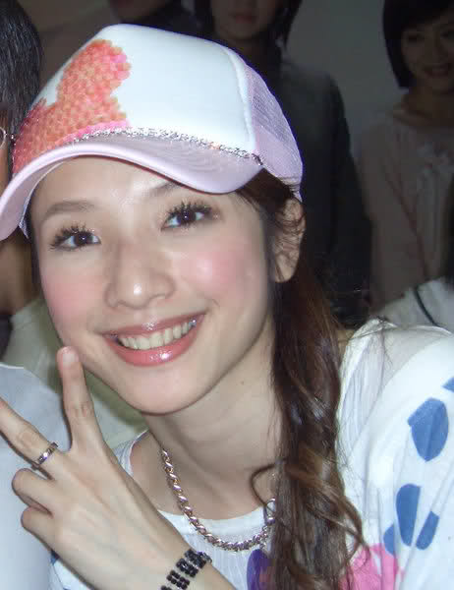
I’m everything
I am

Slide 54
Because
you loved me

Slide 55
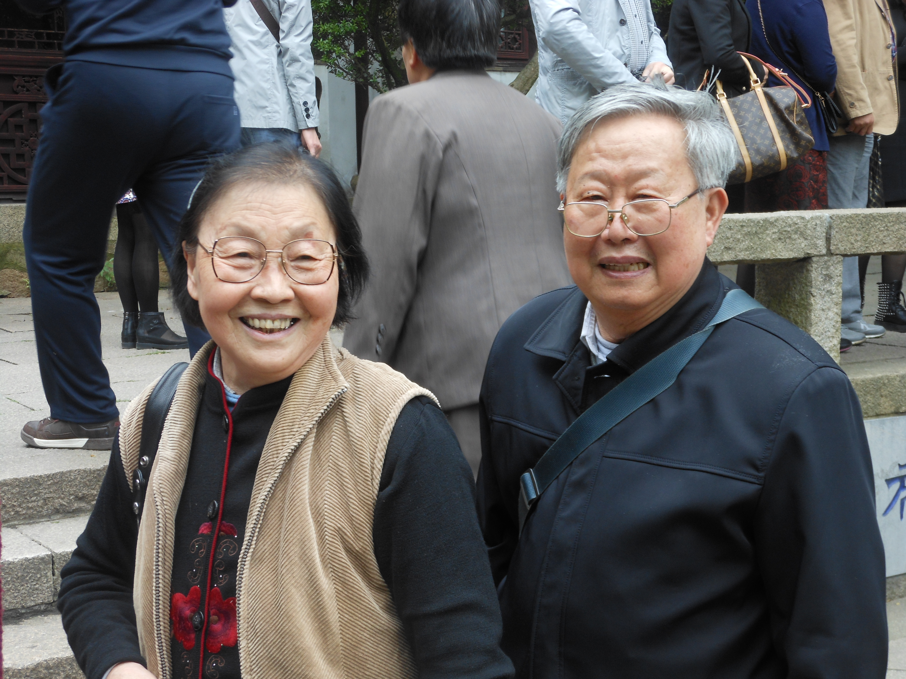
You were my strength when
I was weak

Slide 56
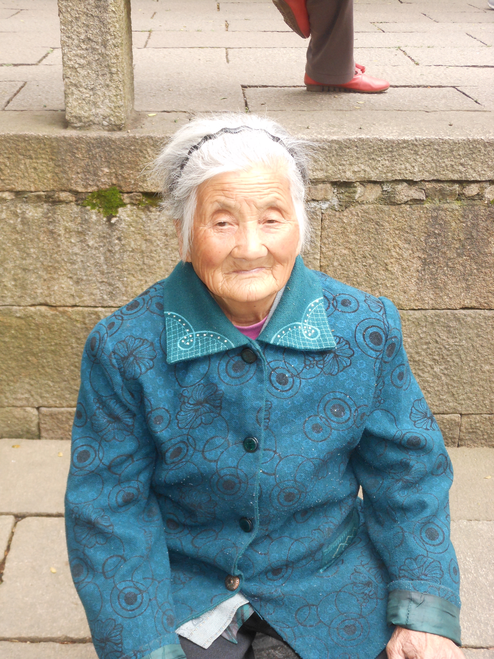
You were my voice when I couldn’t speak

Slide 57
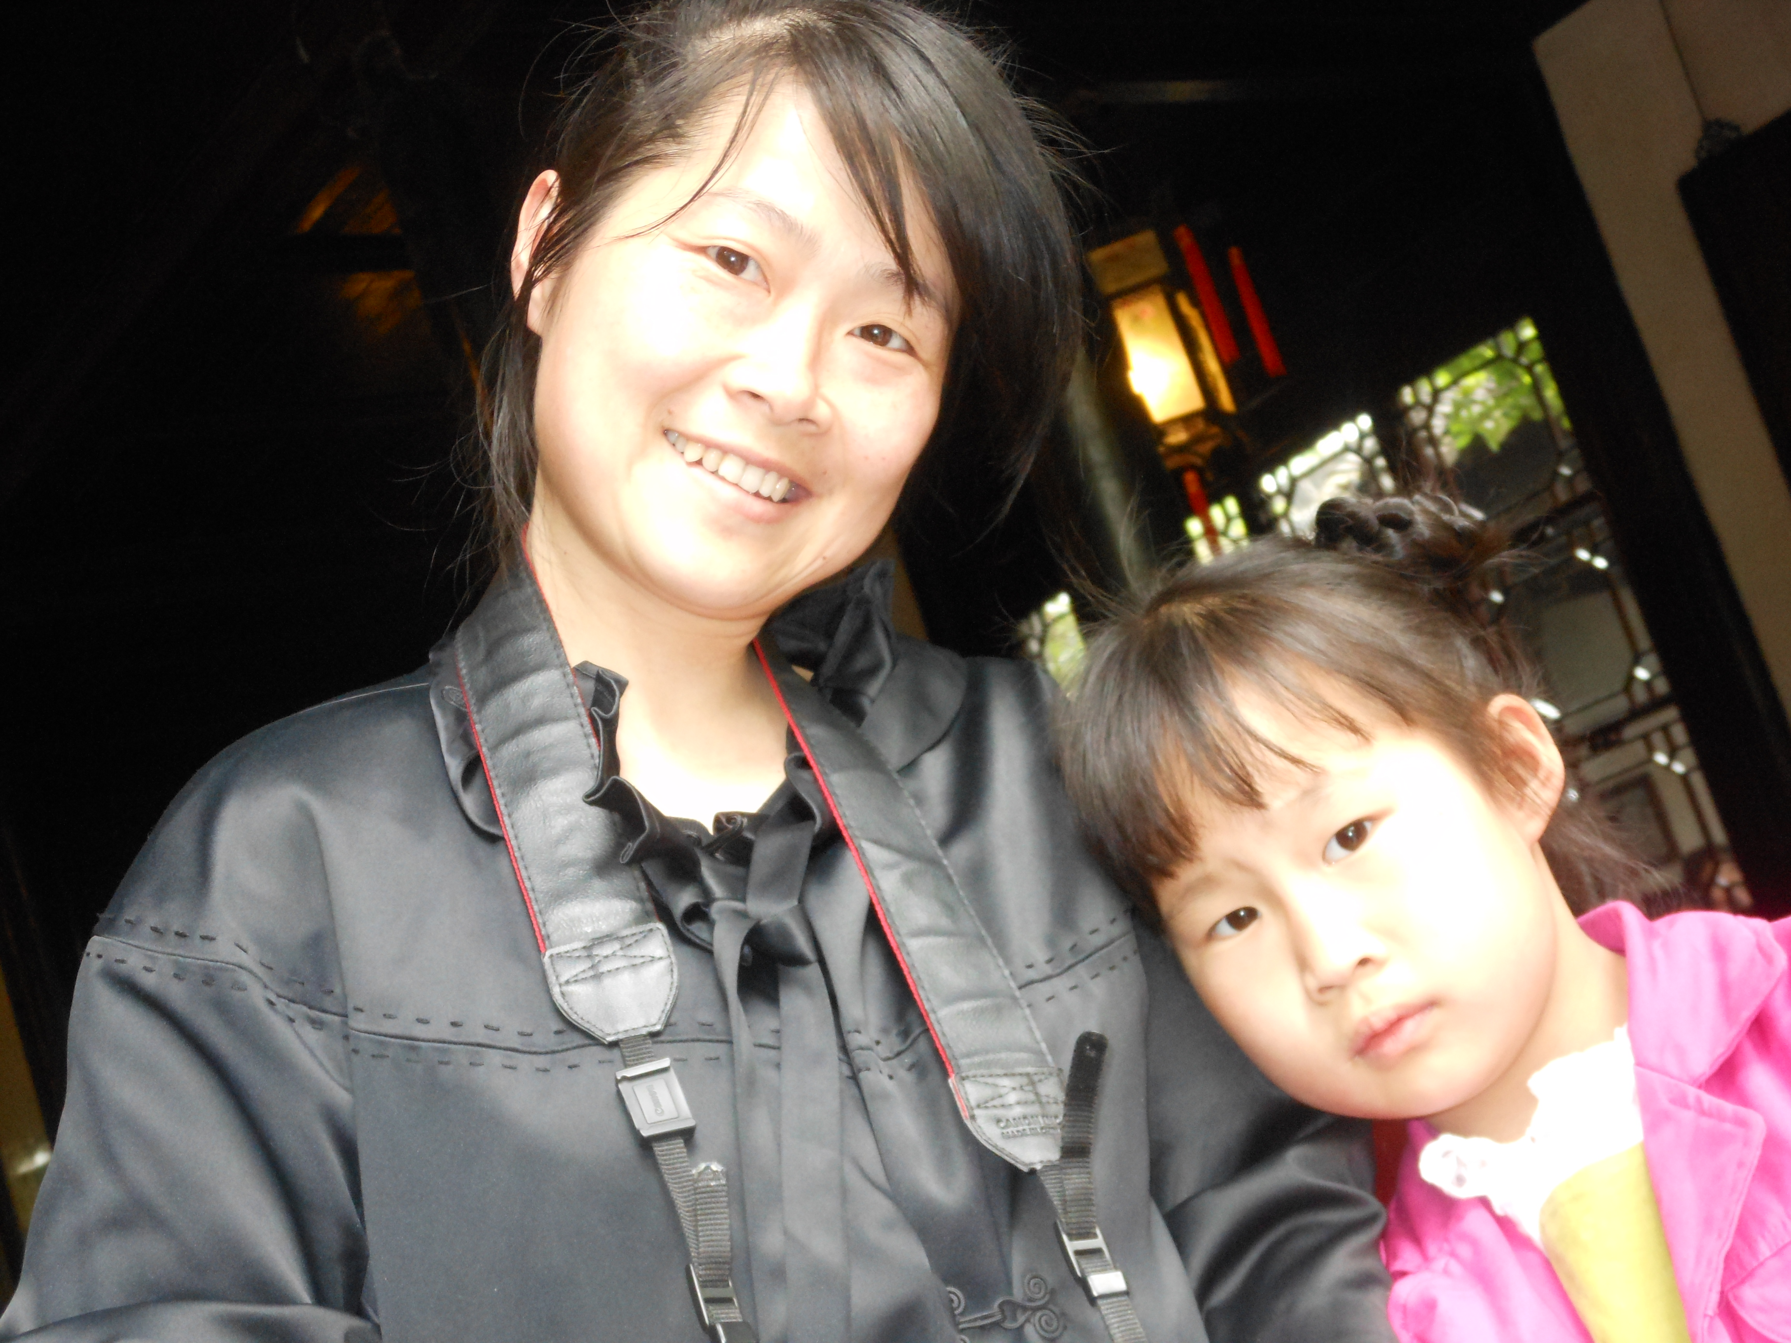
You were my eyes when I couldn’t see

Slide 58
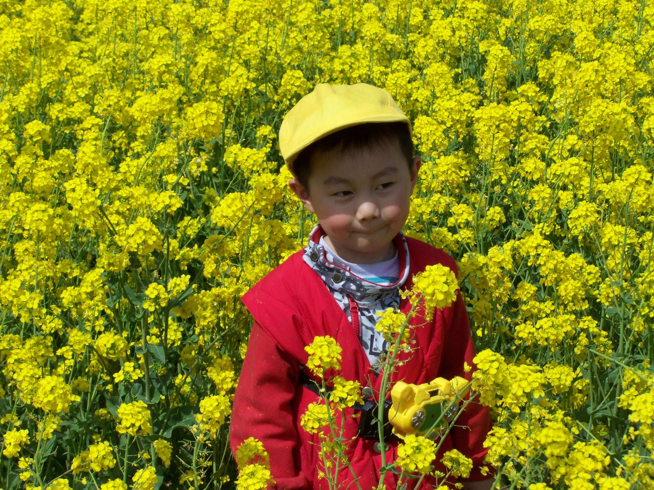
You saw the best there was in me

Slide 59
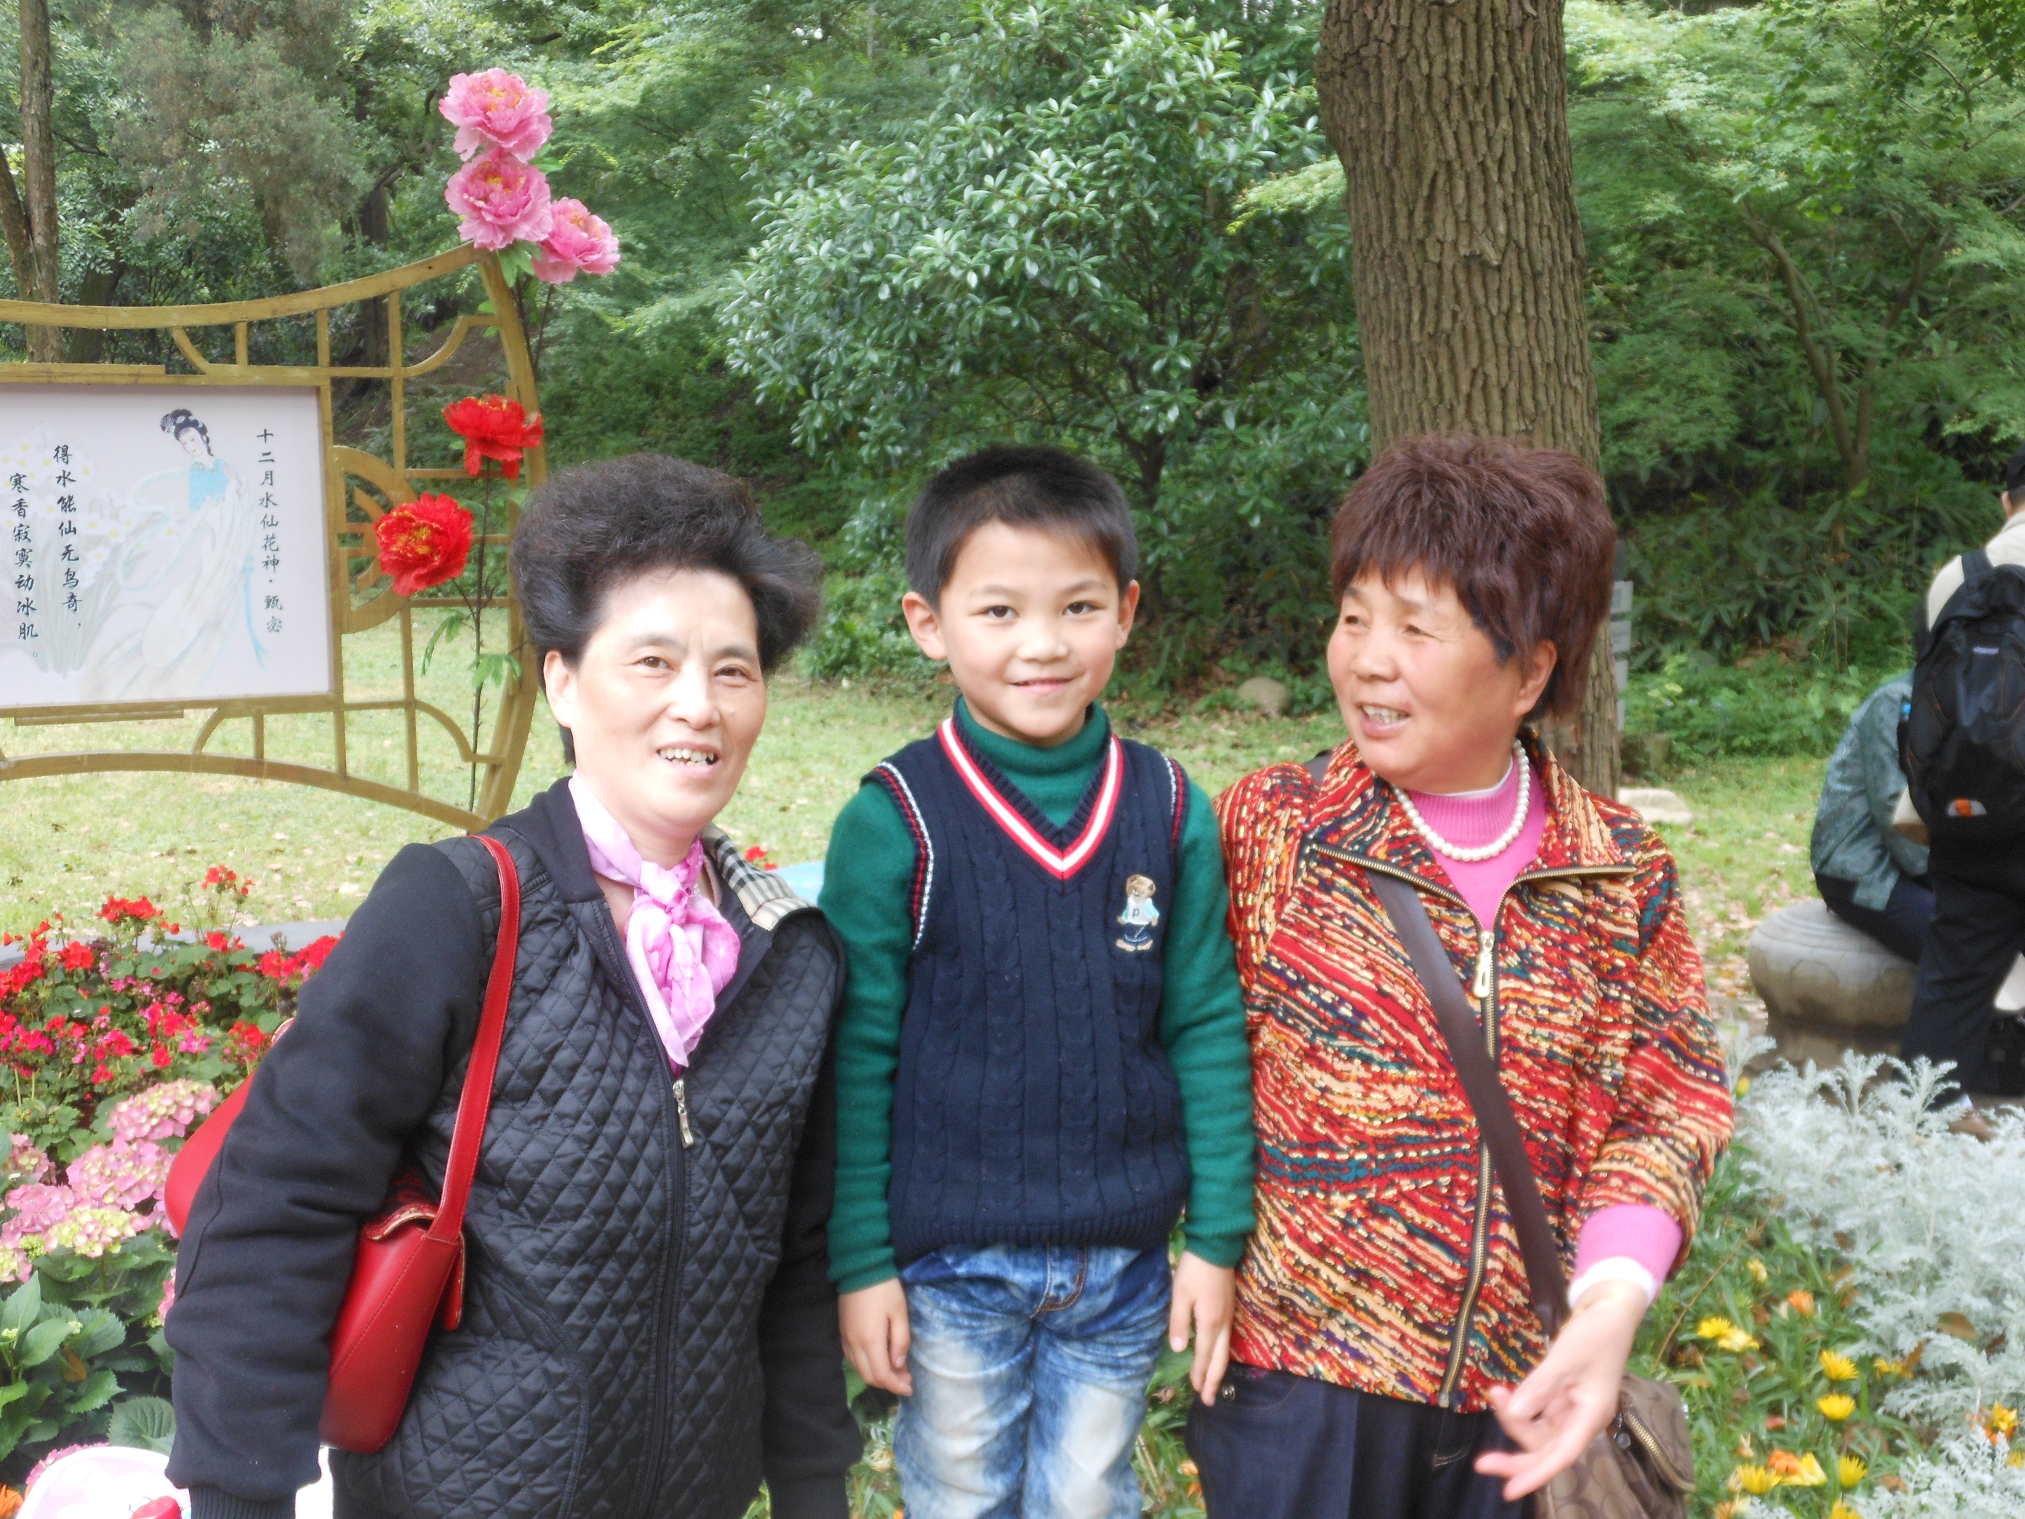
Lifted me up when I couldn’t reach

Slide 60
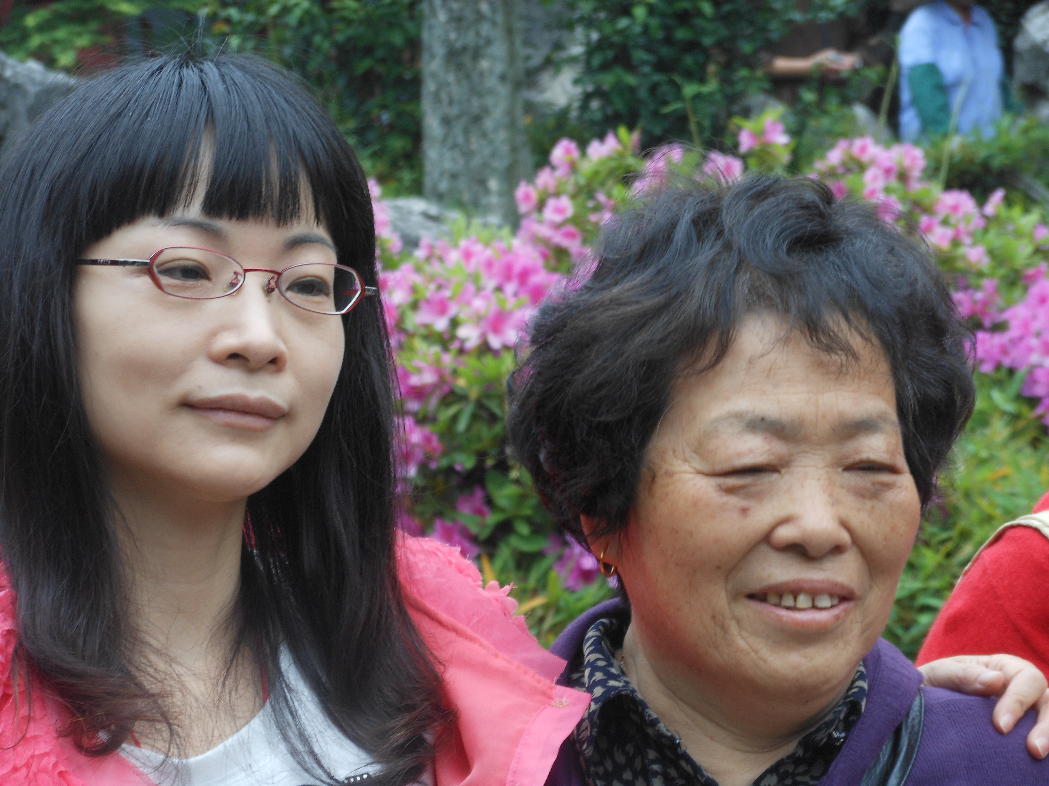
You gave me faith ‘cuz you believed

Slide 61
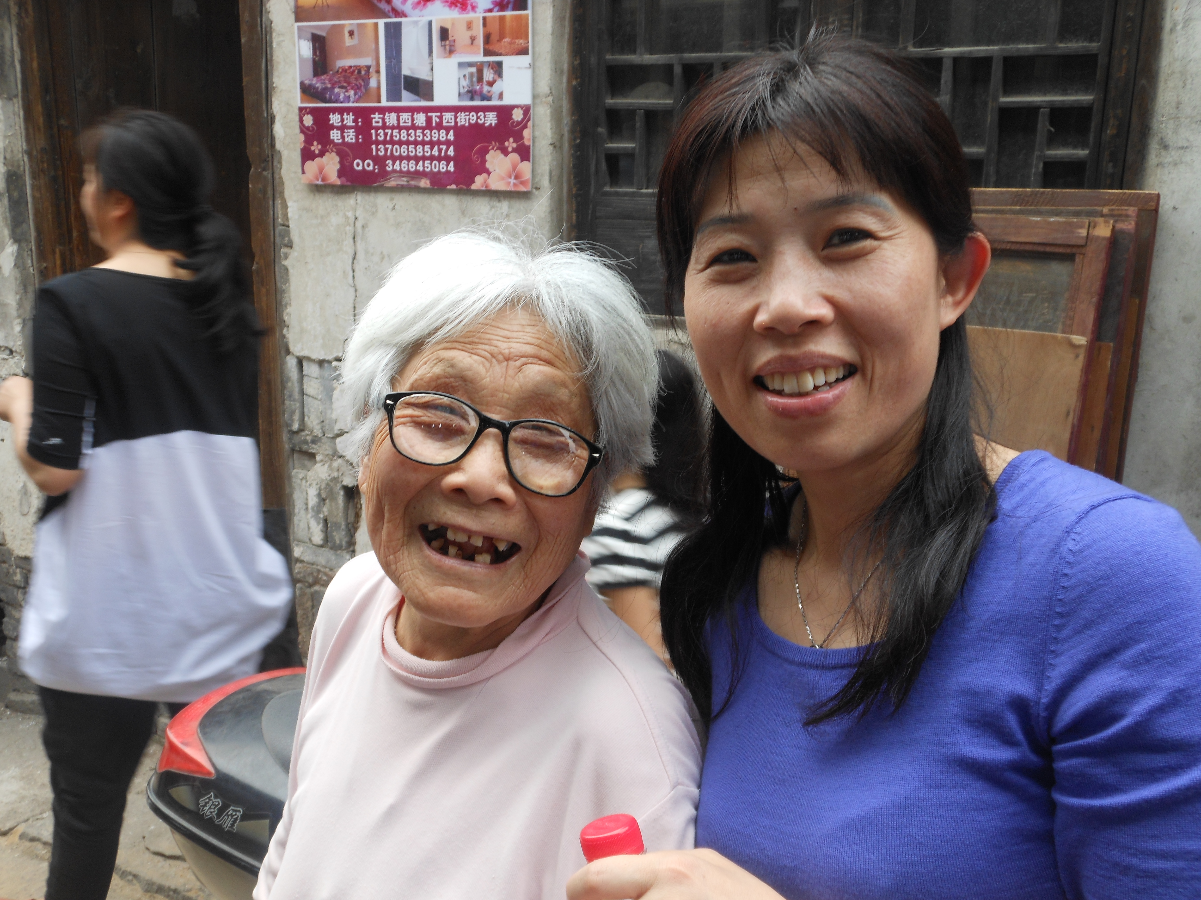
I’m everything
I am

Slide 62
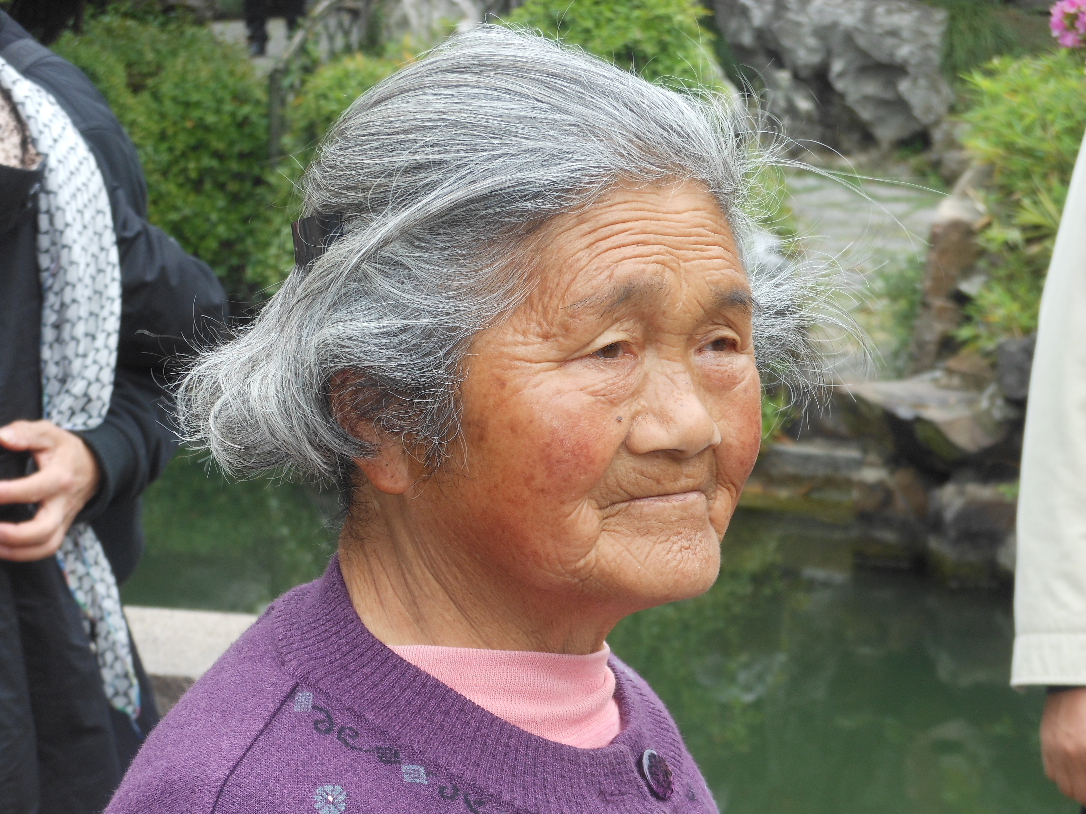
Because you loved me

Slide 63
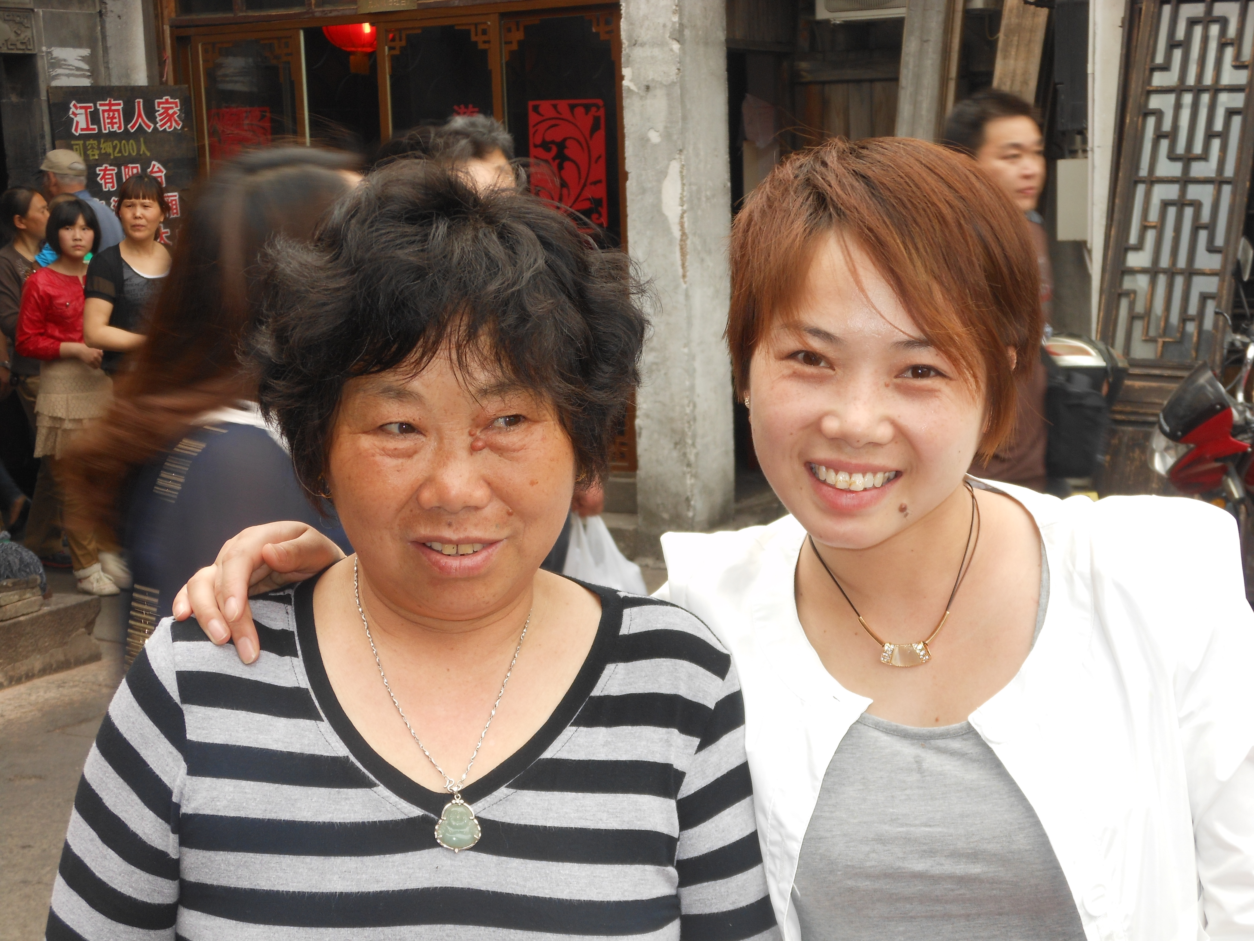
I’m everything I am . . .

Slide 64


Because you loved me. . .

Slide 65

Because “you” loved me!
Wish your Mother and Grandmother
A

Slide 66


Slide 67


Slide 68


Slide 69


Slide 70

May 12

Slide 72


Slide 73

She’s 103, he’s 101 ~ married 88 years!

