Slide 1


Professors John & Marie Murdoch
Welcome to English Corner

Slide 2
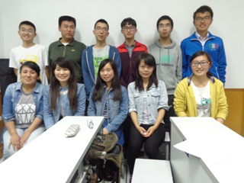
April 23rd English Corner Friends

Slide 3
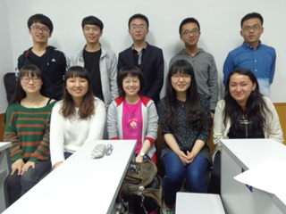
April 23rd English Corner Friends

Slide 4
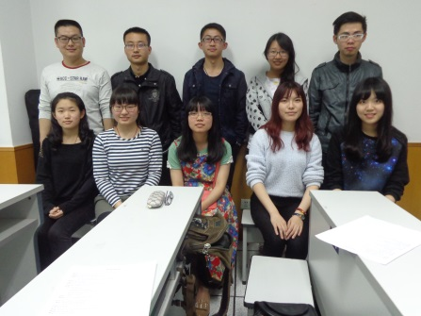
English Corner Friends
April 23rd

Slide 5
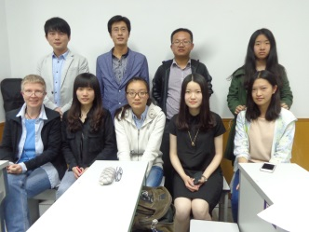
English Corner Friends
April 23rd

Slide 6
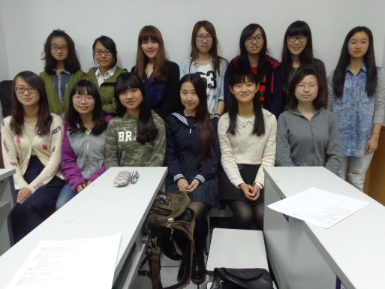
English Corner Friends
April 23rd

Slide 7
Did anyone write a Limerick?
Limericks are short (sometimes serious; sometime silly) poems that are fun to recite.
A: What is a limerick, Mother?
A: It's a form of verse, said brother
B: In which lines one and two
B: Rhyme with five when it's through
A: And three and four rhyme with each other.

Slide 8




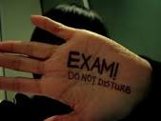
Mid-term Exams
Oh! Mid-term exams are this week,
I had better be at my peak!
I really want to play,
With lots of fun all day,
But it’s knowledge that I must seek.

Slide 9
Next English Corner
Thursday, May7, 2015
7 PM
Bring a friend!
Have
a
Treat.
Let’s have some Fun!
Come One; Come ALL

Slide 10

Let’s Sing
a Song

Slide 11

KAREN
CARPENTER
“YESTERDAY
ONCE MORE”

Slide 12
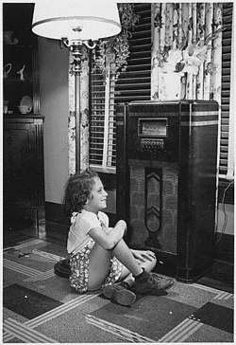
When I was young,
I’d listen to the
radio

Slide 13

Waiting for my
favorite songs.

Slide 14

When they played, I’d sing along;

Slide 15
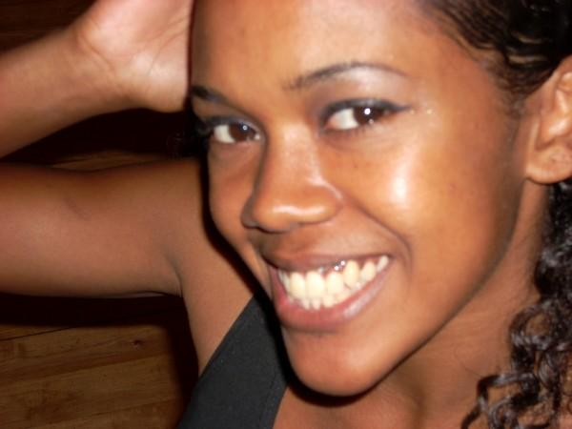
It made me smile.

Slide 16
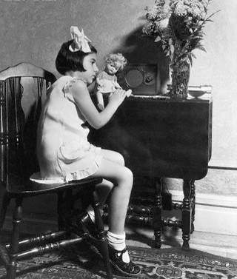
Those were such happy times
and not so long ago,

Slide 17

How I wondered where they’d gone.

Slide 18

But they’re back again,

Slide 19
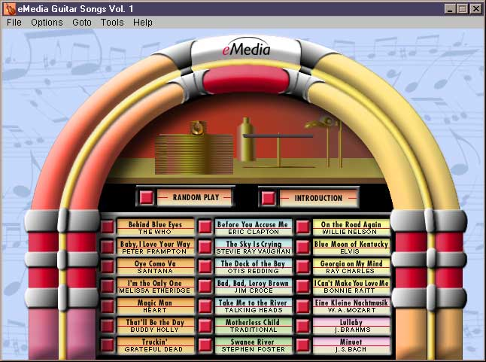
Just like a long lost friend,

Slide 20

All the songs I loved
so
well.

Slide 21

Every sha-la-la-la,
every whoa-oh-oh

Slide 22

Still shines.

Slide 23


Slide 24

Every shing-a-ling-a-ling
that they’re starting to sing

Slide 25

So fine.

Slide 26


Slide 27
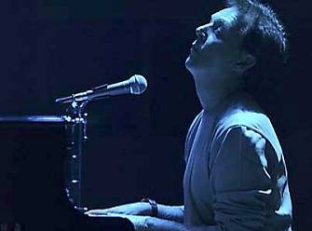
When they get to the part where he’s breaking her heart,

Slide 28

It can really make me cry.

Slide 29

Just like before,

Slide 30
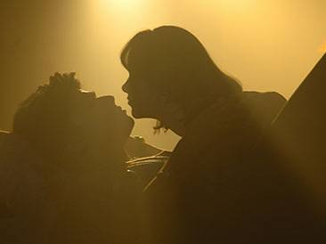
It’s yesterday once more.

Slide 31
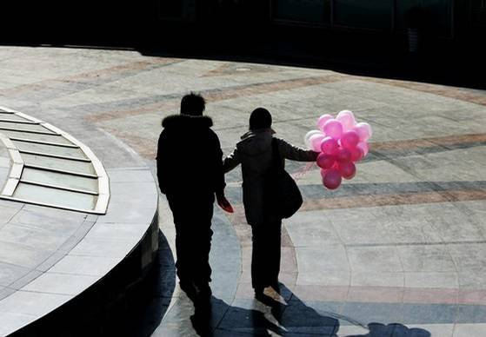

Slide 32
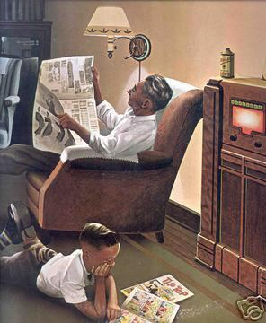
Looking back on how it was
in years gone by

Slide 33

And the good times that I had,

Slide 34
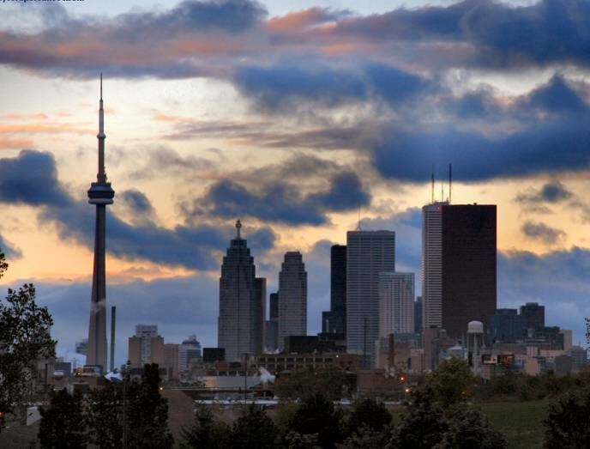
Makes today seem rather sad,

Slide 35

So much has changed.

Slide 36

It was songs of love that
I would sing to then

Slide 37

And I’d memorize each word.

Slide 38
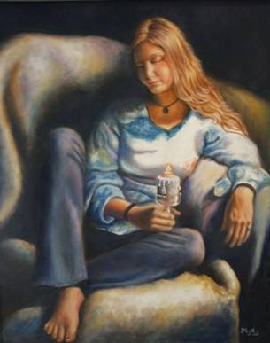
Those old melodies
still sound so good to me

Slide 39

As they melt the years away.

Slide 40

Every sha-la-la-la,
every whoa-oh-oh

Slide 41

Still shines.

Slide 42

All the oldies but goodies!

Slide 43

Every shing-a-ling-a-ling
that they’re starting to sing

Slide 44

So fine.

Slide 45


Slide 46
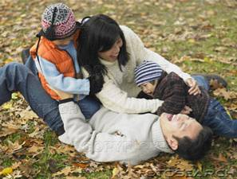
All my best memories come back clearly to me;

Slide 47

Some can even make me cry.

Slide 48
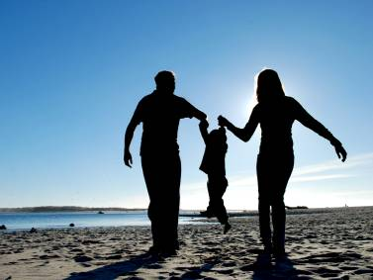
Just like before,

Slide 49

It’s yesterday once more.

Slide 50

Every sha-la-la-la,
every whoa-oh-oh

Slide 51

Still shines.

Slide 52


Slide 53

Every shing-a-ling-a-ling
that they’re starting to sing

Slide 54
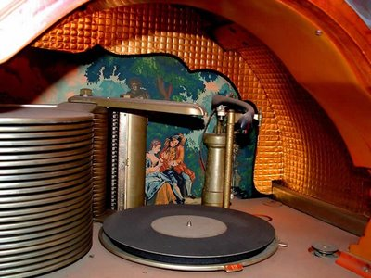
So fine.

Slide 55

Every sha-la-la-la,
every whoa-oh-oh

Slide 56

Still shines.
.

Slide 57

Karen Carpenter
Born: 03/02/50
Died: 02/04/83
Never let yesterday use up too much of today. Will Rogers
bjb/2007

Slide 58
English Corner’s Goals
To improve oral English skills—we speak only English.
To improve English listening skills.
To meet new friends.
To build social skills.
To learn about American and Chinese Cultures.
To share ideas and opinions.
Let’s have fun!

Slide 59
English Corner Student Directed Activities
Welcome
Sophomore Team 2-D
Daisy
Lisa
Sharon
Stella

Slide 60

ETHICAL DILEMMAS

Slide 61
VOCABULARY
ethics – the principles (rules) of conduct
governing an individual or a group, the
discipline dealing with what is good
and bad and moral duty and obligation
ethical – moral, conforming to accepted
rules and standards of conduct
moral – principles of right and wrong
behavior
dilemma – a situation involving a choice
between alternatives

Slide 62
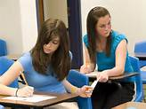
Cheating during Mid-term Exams
A classmate who is very popular and who you would like to have for a friend asks you for answers during the mid-term exam. How will you respond.

Slide 63

Lying to a Girl/Boy Friend
For Men
For Women
Your best friend told you that his girlfriend can’t go on a date because she has to study all evening. That evening you go over to the Family Mart next to the Tongji University Metro Station for an ice-cream cone. You see your best friend’s girlfriend coming out of the Metro Station and holding hands with another man. What will you do?
Your best friend told you that her boyfriend can’t go on a date because he has to study all evening. That evening you go over to the Family Mart next to the Tongji University Metro Station for an ice-cream cone. You see your best friend’s boyfriend coming out of the Metro Station and holding hands with another girl. What will you do?

Slide 64
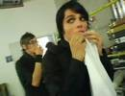
Shoplifting
You go shopping with a good friend. Your friend finds some great looking clothes, but doesn’t have enough money to pay for them. The store is fill with shoppers and is very crowded. You notice that your friend slips some of the clothes into a backpack and then tells you that it is time to leave. What will you do?

Slide 65
Meet & Greet
We-Chat
Introduce yourselves.
Optional Topics:
    Topic: What does the following proverb mean: “A man who chases two rabbits at the same time catches neither one.” How does this proverb apply to studying for mid-term exams? How does it apply to being honest?
    What are your favorite ways to study for exams.
    How can you help your classmates study for exams?
    How can you help classmates be honest during exams?

Slide 66
Integrity
“Integrity without knowledge is weak and useless and knowledge without integrity is dangerous and dreadful.” (Samuel Johnson (1709-1784) English Poet, Critic and Writer)

Slide 67

expelled – kicked out of school,
suspended from school
0 tolerance – no exceptions, no second
chances
full ride – a scholarship which pays
tuition, books, room and board
Win Win – Solutions in which all parties are better off

Slide 68
ETHICAL DILEMMA
(VICE PRINCIPAL)
You are the vice principal in charge of discipline of a high school. It is your responsibility to see that all students follow the rules and are treated fairly and equally. It is the policy of your school that students caught with alcohol, drugs or weapons on campus will be expelled—0 tolerance.

Slide 69
Your daughter is a senior at the high school. She is an outstanding basketball and volleyball player and is a top academic student. She has applied to several universities and for scholarships that would pay virtually all of her costs at any of these colleges. She is almost certain to be accepted and to receive a full ride at all schools to which she has applied.

Slide 70
One evening, you are supervising a school dance. You need to speak to your daughter and can’t find her. You finally go into the darkened girls’ locker room and hear voices. One is your daughter’s voice and as you listen, you realize they are drinking alcohol. They do not see you.
What will you do?

Slide 71

Life is full of choices and decisions and many of them will present us with moral and ethical dilemmas. Some of these choices and decisions will challenge
the very principles,
standards and values
we were taught by
our family. When
faced with these
moral dilemmas,
what will you do?

Slide 72
Mystery Person
Conversation Game

Slide 73
Instructions
Write down the names of three famous people on the slip of paper that has been provided; names can be in English or Chinese. These people can be real or fictitious, but must be very well known.
Divide into assigned groups.
The first person has 30 seconds to describe their first mystery person without using his or her name.
Then group members have 30 seconds to guess the name of the famous person. The group member who first guesses correctly earns one point.
When time is up and if no one is successful, then the first person gives the answer.
Play continues by moving one person to the left until the time is up.
The winner is the person who has guessed the most correct answers.

Slide 74

Break

Slide 75
Questions
Questions for and from
the Professors.

Slide 76
China Descriptionary
Instructions:
  Form in assigned groups.
  One person will have his/her back to the screen.
  When a word/phrase flashes on the screen, the person(s) facing the screen will describe the word/phrase. However, you cannot use the word or a form of it or use a synonym or an antonym of the word/phrase.
  When the person guesses the word correctly, then trade places and be prepared for the next word.

Slide 77
Great Wall

Slide 78
Terracotta Warriors

Slide 79
Yangzee River

Slide 80
Province

Slide 81
South China Sea

Slide 82
The Bund

Slide 83
Seaport

Slide 84
Construction Crane

Slide 85
Steamed Buns

Slide 86
Rice

Slide 87
Marriage Market

Slide 88
Bargaining

Slide 89
Adventurer

Slide 90
Chinglish

Slide 91
Mandarin

Slide 92
Tongji University

Slide 93
What are some of the topics you would like to discuss in class and/or English Corners?

Slide 94
Vocabulary Builders
Instructions:
  Form groups of three or four people.
  Distribute the vocabulary card so each person in your group has one.
  Taking turns, each person then pronounces each word on his/her card.
  When everyone is finished, pass your card one person to the left and then each person pronounces the words on his/new card.
  Repeat the process until everyone has had a chance to pronounce the words on each card.
  Note: If someone needs help pronouncing a word, other group members should provide assistance.

Slide 95
Talking Cards
Please form groups of 3-5 people.
You will be given a number of playing cards.
In turn, starting with the person whose birthday is closest to today’s date, draw a card from the top of the deck and answer the corresponding question.
Then take turns answering questions, until you have use up all of your cards.
Please speak loudly enough for your group to hear and understand you.

Slide 96

Five Phases of Dating
Phase I – Meeting lots of people.
  Group parties/gatherings.
  Speed Dating and other group games.
Phase II – Making Friends
  Eating lunch or dinner together.
  Studying or going for a walk together.
  Sharing family stories and personal goals.
  Phase III – Formal Dating.
    Planned activities designed to help you know each other better.
    Should begin to be more personable, but set limits as to the time you spend alone with each other and limits to intimacy.

Slide 97

Five Phases of Dating
Phase IV Paring up/Going Steady
  Share your important beliefs and values.
  Introduce each other to your respective families.
  Begin to plan for the future—education, employment, home and family goals.
  Continue to practice limits regarding time alone together and sharing of intimacy.
Phase V Formal Engagement
  The marriage proposal.
  Approval of both sets of parents.
  Set a wedding date.
  Plan more intensely for your wedding and future life together.
  Continue to practice limits regarding time alone together and sharing of intimacy.

Slide 98
Describe your feelings about leaving your home and province for four years.
Try to describe your feelings as you return after successfully completing your B.S or B.A. degree in four years.
Try to describe the feelings of your parents as you return to your home as a college graduate.
Try your best to describe your first day on the job of your dreams.
Describe your future husband or wife.
What do you think your feelings will be when your first child leaves home to go to a school?
What do you think the purpose of life is?
Where do you think you will go when you or your parents die?
Why do you believe that?
Do you believe you came from some where else when you were born? Why do you believe that?
Suppose you move to Australia which has a different form of government. How will that change the way you act in your life, Why?
What about living in Australia would make you nervous?
What do you think you will do to adjust to that concern?

Slide 99

Speaking Activity
Divide into groups of two
Roll the dice and answer the number of the question your rolled.
If you have already answered that question roll the dice again.

Slide 100
What is something you have never done that you would like to try?
Talk about the importance of staying close to your family?
Describe a perfect first date?
Are your years at a university a good time to look for a husband or wife? Explain.
How old should people be before they consider marriage? Why?
Describe your future husband or wife.
How should parents discipline their child(ren)? Is spanking ok?
What do you think the purpose of life is?
Where do you think you will go when you or your parents die? Explain.
Do you believe you came from some where else before you were born? Explain.
Where do you think you will live after you have graduated from college?
What are your thoughts about smoking?

Slide 101
Talking Dice
Unfinished Sentences…

Slide 102
Unfinished Sentences:
Finish these sentences by adding your own words.
On Saturdays, I like to____________
If I had only 24 hours to live, I would__________
I feel best when people_____________
Secretly I wish_____________
If I could change the world, I would____ because_____
The most exciting thing I have done is_____
Right now the most important thing in my life is_____ because_________________
If I could be somewhere else now, I’d______________
I never worry about_____________________
I like people who________________
I find it difficult to_______________________
Studying is________________________________

