Slide 1

Professors John & Marie Murdoch
Welcome to English Corner

Slide 2
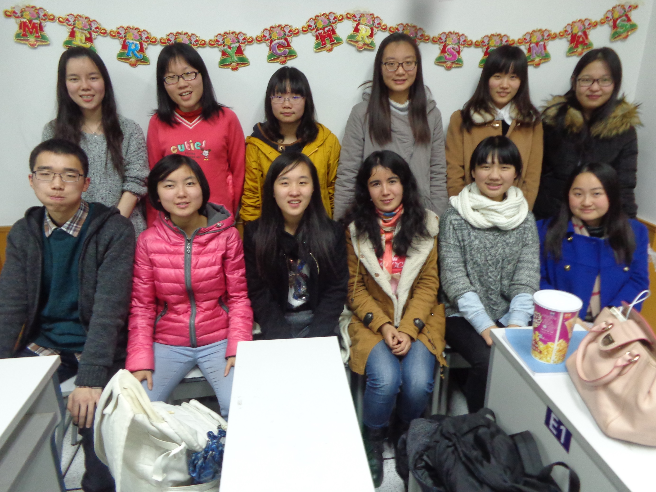
Our English Corner Friends
December 18, 2014

Slide 3
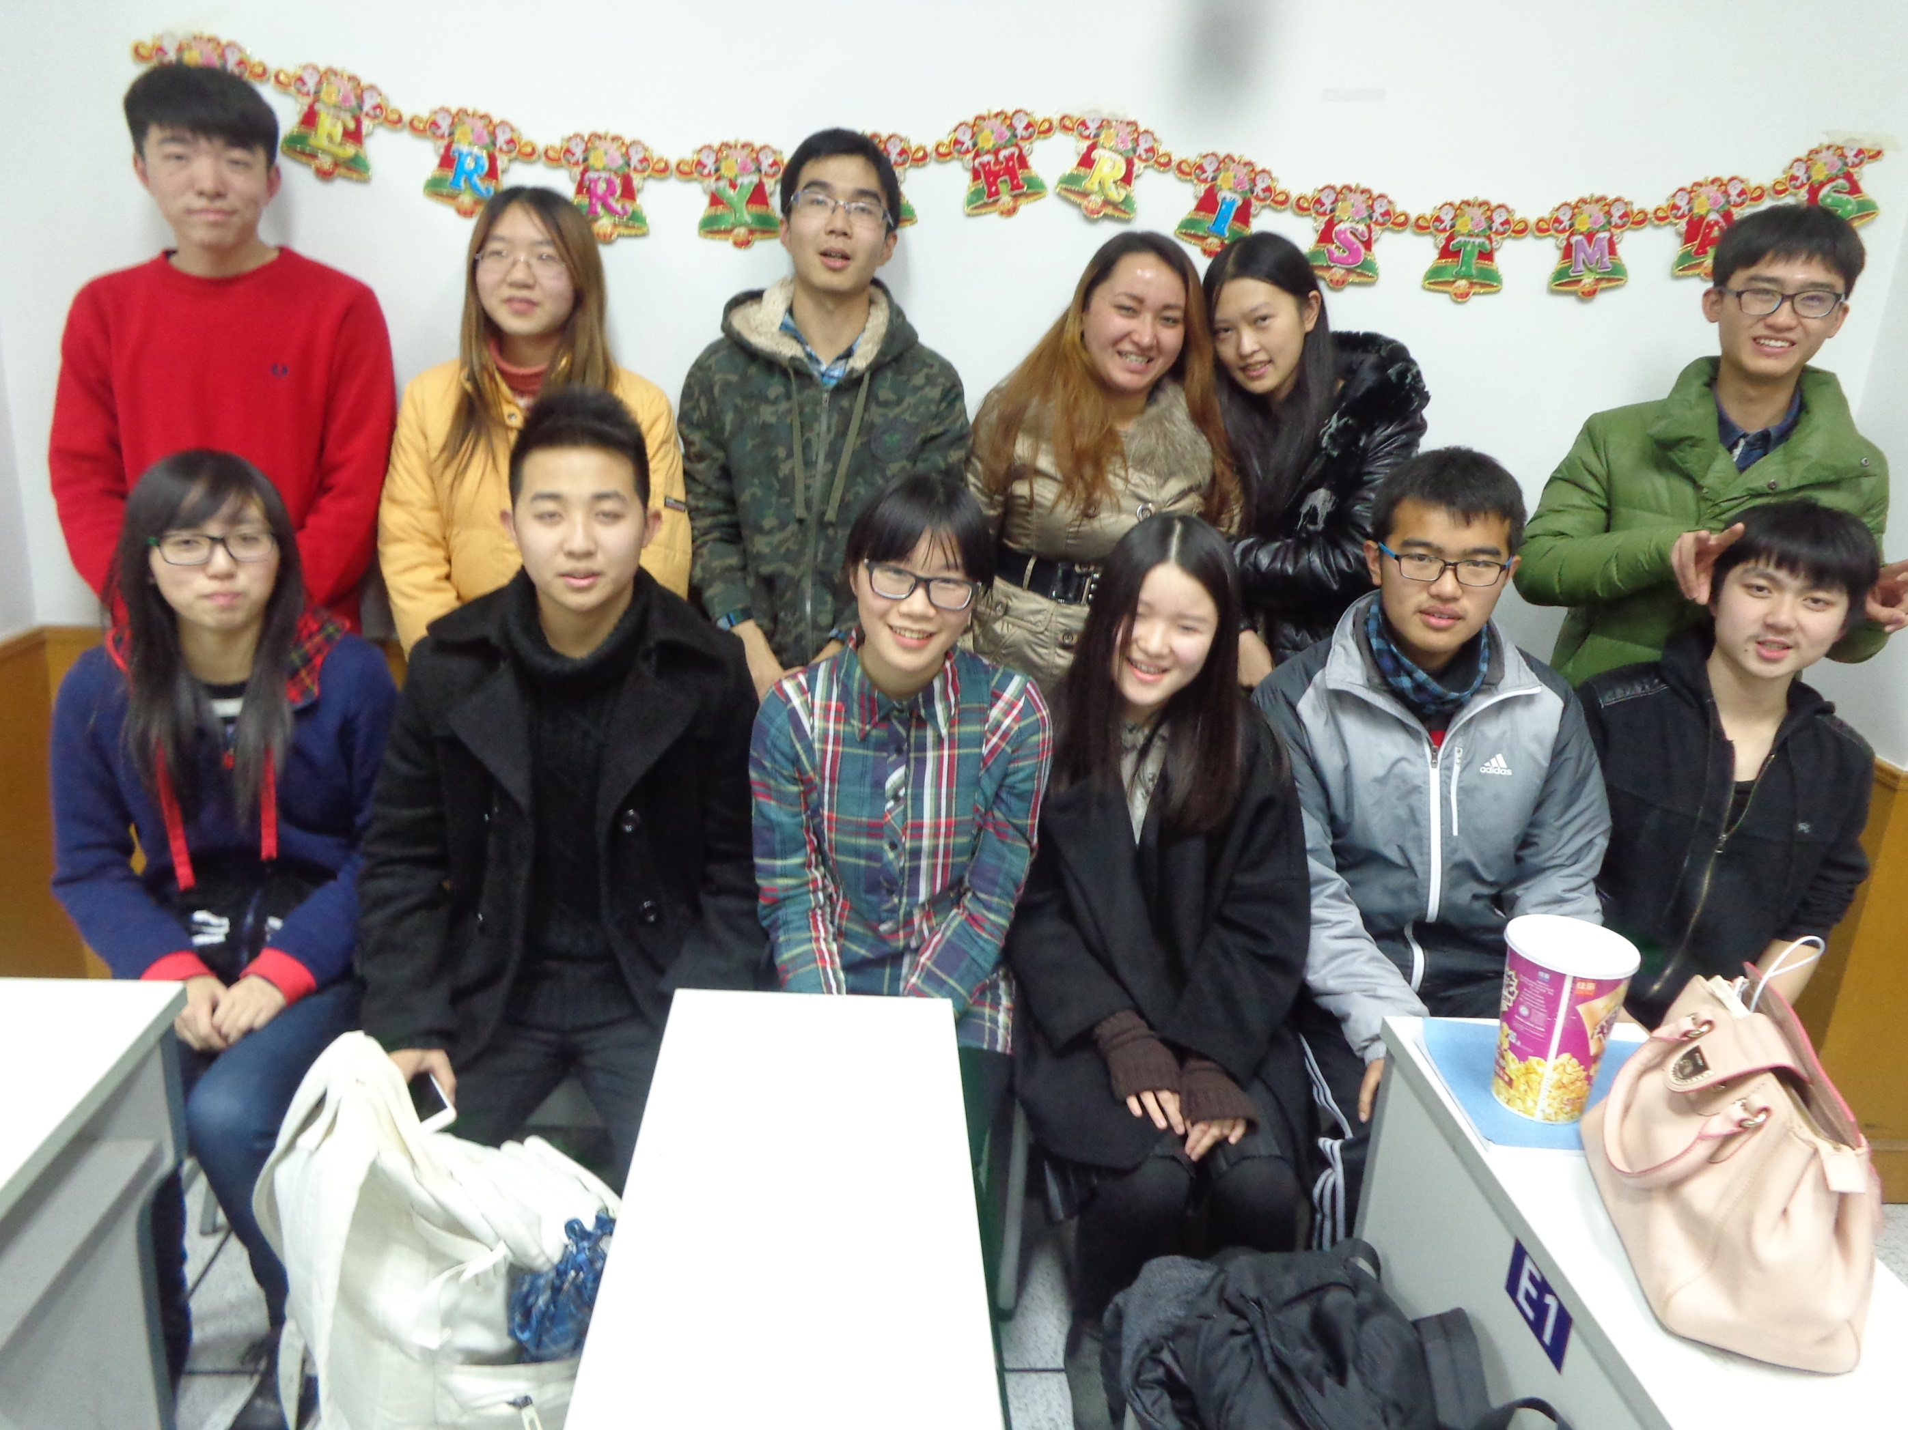
Our English Corner Friends
December 18, 2014

Slide 4
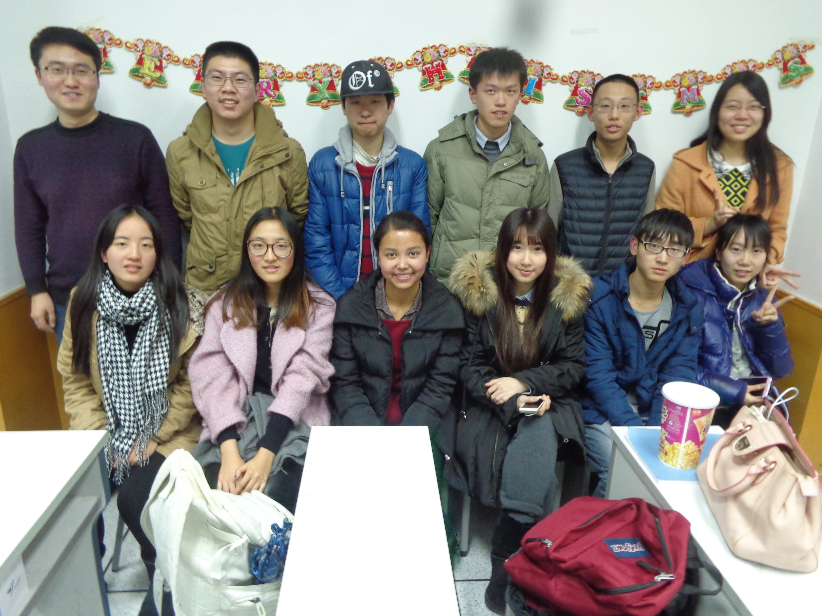
Our English Corner Friends
December 18, 2014

Slide 5
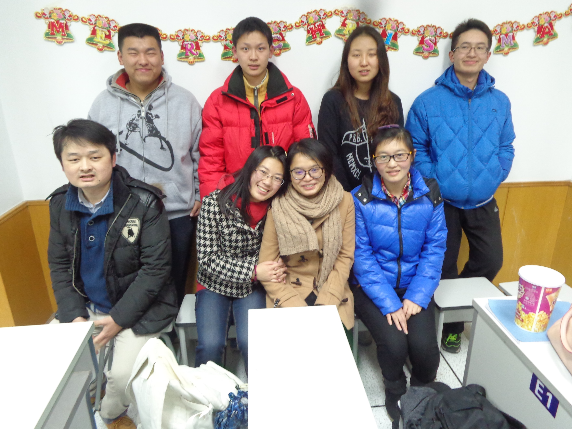
Our English Corner Friends
December 18, 2014

Slide 6
Next English Corner
Thursday, March 5, 2015
7 PM
Bring a friend!
Have
a
Treat.
Let’s have some Fun!
Come One; Come ALL

Slide 7
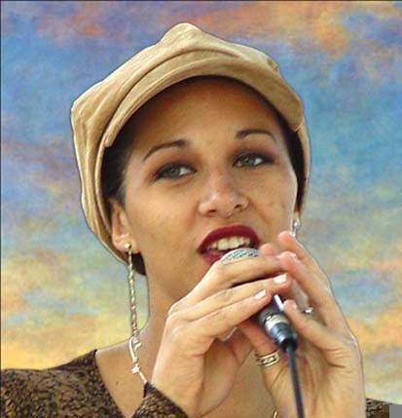
Let’s
Sing
Christmas
Carols

Slide 8
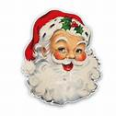

Santa Claus is Coming To Town
Gonna find out who’s naughty and nice
Santa Claus is coming to town
He sees you when you’re sleeping
He knows when you’re awake
He knows when you’ve been bad or good so be good, for goodness sake.
(Back to the first stanza)
You’d better watch out
You better not cry,
You’d better not pout,
I’m telling you why
Santa Claus is coming to town
He’s making a list
And checking it twice

Slide 9



Jingle Bells
Oh, jingle bells, jingle bells
Jingle all the way
Oh, what fun it is to ride
In a one horse open sleigh
Jingle bells, jingle bells
Jingle all the way
Oh, what fun it is to ride
In a one horse open sleigh
Dashing through the snow
In a one horse open sleigh
O'er the fields we go
Laughing all the way
Bells on bob tails ring
Making spirits bright
What fun it is to laugh and sing a sleighing song tonight

Slide 10
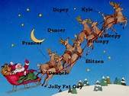
Rudolph the Red Nosed
Reindeer
You’ve heard of Dasher, and Dancer, Prancer, and Vixin,
Comet, Cupid, Donner, and Blitzen
But do you recall the most famous reindeer of all?
Rudolph, the red-nosed reindeer
had a very shiny nose.
And if you ever saw him,
you would even say it glows.
All of the other reindeer
used to laugh and call him names.
They never let poor Rudolph
join in any reindeer games.
Then one foggy Christmas Eve
Santa came to say:
"Rudolph with your nose so bright,
won't you guide my sleigh tonight?"
Then all the reindeer loved him
as they shouted out with glee,
Rudolph the red-nosed reindeer,
you'll go down in history!
(Robert May)

Slide 11
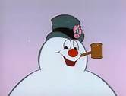
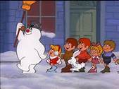
Frosty the Snowman
Frosty the Snowman, was a jolly happy soul,
With a corn cob pipe and a button nose, and two eyes made out of coal.
Frosty the Snowman, is a fairytale, they say.
He was made of snow, but the children know how he came to life one day.
There must have been some magic in that old silk hat they found, For when they placed it on his head, he began to dance around!
Oh, Frosty, the Snowman, was alive as he could be; and the children say he could laugh and play, just the same as you and me.
Frosty the Snowman, knew the sun was hot that day, so he said, "Let's run, and we'll have some fun now, before I melt away."
Down to the village, with a broomstick in his hand, Running here and there, all around the square sayin’ “Catch me if you can."
He led them down the streets of town, right to the traffic cop; and only paused a moment, when he heard him holler, "Stop!"
For Frosty, the Snowman, had to hurry on his way, but he waved goodbye, sayin' "Don't you cry, I'll be back again some day.“
Thumpety thump, thump, thumpety thump, thump, look at Frosty go. Thumpety
thump, thump, thumpety thump, thump, over the hills of snow.

Slide 12
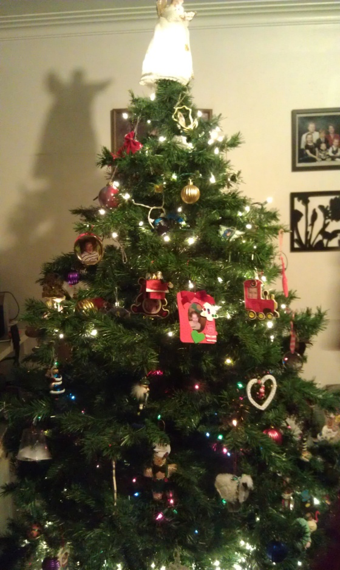
We Wish You a Merry Christmas
We wish you a Merry Christmas;
We wish you a Merry Christmas;
We wish you a Merry Christmas
and a Happy New Year.
Good tidings we bring to you and your kin;
Good tidings for Christmas and a Happy New Year.

Slide 13
Did anyone write a Limerick?
Limericks are short (sometimes serious; sometime silly) poems that are fun to recite.
A: What is a limerick, Mother?
A: It's a form of verse, said brother
B: In which lines one and two
B: Rhyme with five when it's through
A: And three and four rhyme with each other.

Slide 14
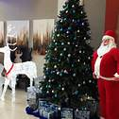
Merry Christmas to You
If we wait, we would be remiss
In wishing good tidings for this,
Holiday of lights
And a magical night.
We wish you a merry Christmas.

Slide 15
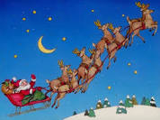
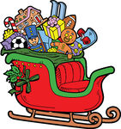
Santa Claus
The North Pole is bustle and noise
As Santa and those he employs,
Prepare for the day
By loading the sleigh
With gifts for the good girls and boys.

Slide 16



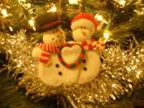
Seasons Greetings
This Christmas I'm writing to you
Our friendship to warmly renew.
May the season be glad,
The best that you've had,
And all of your best dreams come true.

Slide 17
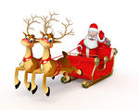
Santa’s Sleigh
.We're singing the song of the sleigh
As Santa gets his underway.
The bells are a-jingle,
Our tummies a-tingle,
SO SHOUT OUT FOR THIS CHRISTMAS DAY!

Slide 18
Meet & Greet
Introduce yourselves.
Optional Topics:
    Share the special gifts and the have given and received in your life?
    Describe a gift that you would love to receive during Spring Festival.
    Describe what you know about Western Christmas Traditions.

Slide 19
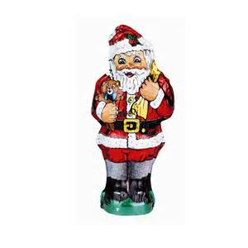
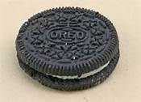
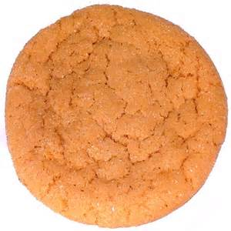
Christmas Treats for good boys and girls!

Slide 20
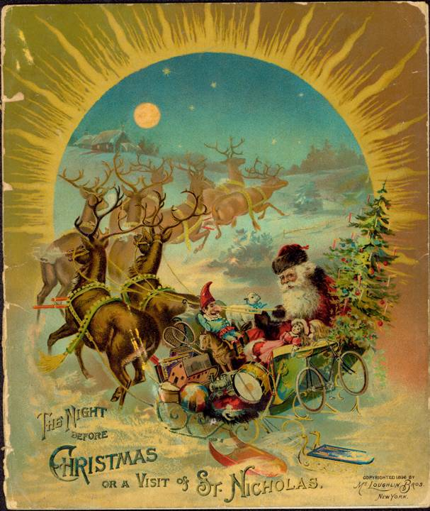
“TWAS THE NIGHT BEFORE CHRISTMAS”
Clement Moore, 1822

Slide 21

Christmas
Vocabulary

Slide 22

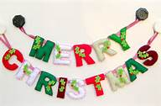

Christmas Jeopardy

Slide 23
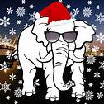

White Elephant
Christmas
Gift
Exchange

Slide 24
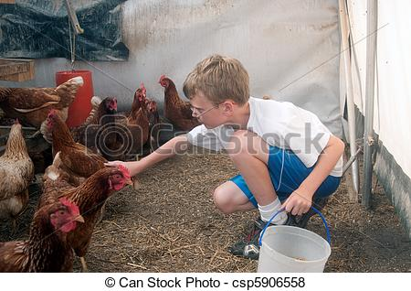
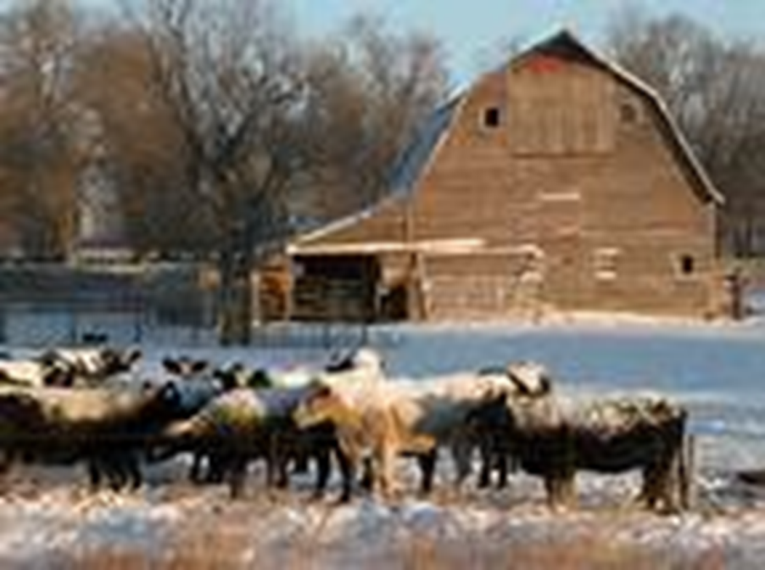

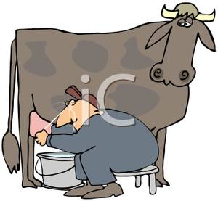
The Gift

Slide 25
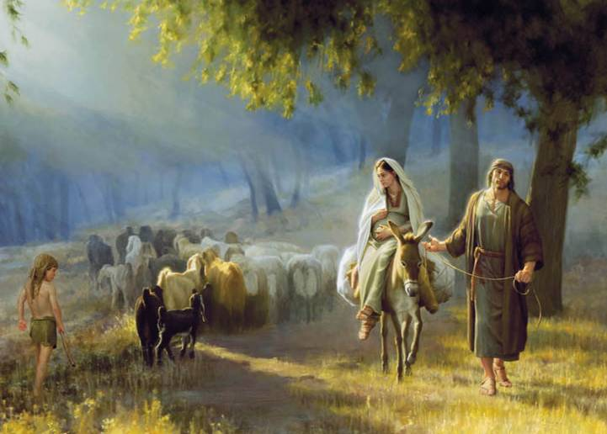
Silent night,

Slide 26

Break

Slide 27
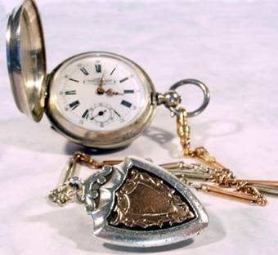

“THE GIFT OF THE MAGI”
O. Henry

Slide 28
Have a Treat
Break
Let’s Take a Picture

Slide 29
Christmas Questions
Questions for and from
the Professors.

Slide 30
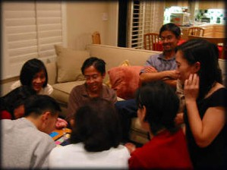
Guess – Guess – Guess – Guess
Descriptionary

Slide 31
Talking Cards
Please form groups of 3-5 people.
You will be given a number of playing cards.
In turn, starting with the person whose birthday is closest to today’s date, draw a card from the top of the deck and answer the corresponding question.
Then take turns answering questions, until you have use up all of your cards.
Please speak loudly enough for your group to hear and understand you.

Slide 32

ETHICAL DILEMMAS

Slide 33
Integrity
“Integrity without knowledge is weak and useless and knowledge without integrity is dangerous and dreadful.” (Samuel Johnson (1709-1784) English Poet, Critic and Writer)

Slide 34
VOCABULARY
ethics – the principles (rules) of conduct
governing an individual or a group, the
discipline dealing with what is good
and bad and moral duty and obligation
ethical – moral, conforming to accepted
rules and standards of conduct
moral – principles of right and wrong
behavior
dilemma – a situation involving a choice
between alternatives

Slide 35
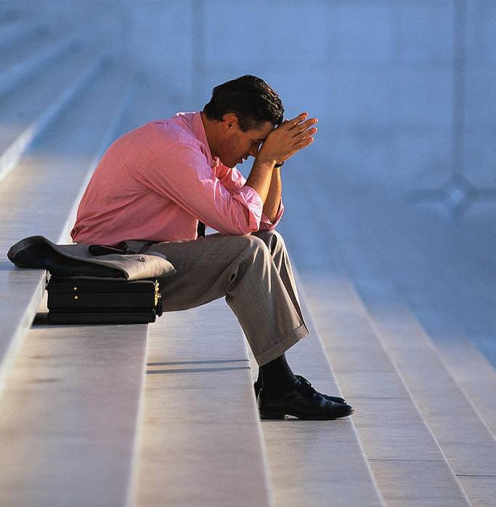
expelled – kicked out of school,
suspended from school
0 tolerance – no exceptions, no second
chances
full ride – a scholarship which pays
tuition, books, room and board
Win Win – Solutions in which all parties are better off

Slide 36
ETHICAL DILEMMA
(VICE PRINCIPAL)
You are the vice principal in charge of discipline of a high school. It is your responsibility to see that all students follow the rules and are treated fairly and equally. It is the policy of your school that students caught with alcohol, drugs or weapons on campus will be expelled—0 tolerance.

Slide 37
Your daughter is a senior at the high school. She is an outstanding basketball and volleyball player and is a top academic student. She has applied to several universities and for scholarships that would pay virtually all of her costs at any of these colleges. She is almost certain to be accepted and to receive a full ride at all schools to which she has applied.

Slide 38
One evening, you are supervising a school dance. You need to speak to your daughter and can’t find her. You finally go into the darkened girls’ locker room and hear voices. One is your daughter’s voice and as you listen, you realize they are drinking alcohol. They do not see you.
What will you do?

Slide 39

Life is full of choices and decisions and many of them will present us with moral and ethical dilemmas. Some of these choices and decisions will challenge
the very principles,
standards and values
we were taught by
our family. When
faced with these
moral dilemmas,
what will you do?

Slide 40
Vocabulary Builders
Instructions:
  Form groups of three or four people.
  Distribute the vocabulary card so each person in your group has one.
  Taking turns, each person then pronounces each word on his/her card.
  When everyone is finished, pass your card one person to the left and then each person pronounces the words on his/new card.
  Repeat the process until everyone has had a chance to pronounce the words on each card.
  Note: If someone needs help pronouncing a word, other group members should provide assistance.

Slide 41

Speaking Activity
Divide into groups of two
Roll the dice and answer the number of the question your rolled.
If you have already answered that question roll the dice again.

Slide 42
Describe your feelings about leaving your home and province for four years.
Try to describe your feelings as you return after successfully completing your B.S or B.A. degree in four years.
Try to describe the feelings of your parents as you return to your home as a college graduate.
Try your best to describe your first day on the job of your dreams.
Describe your future husband or wife.
What do you think your feelings will be when your first child leaves home to go to a school?
What do you think the purpose of life is?
Where do you think you will go when you or your parents die?
Why do you believe that?
Do you believe you came from some where else when you were born? Why do you believe that?
Suppose you move to Australia which has a different form of government. How will that change the way you act in your life, Why?
What about living in Australia would make you nervous?
What do you think you will do to adjust to that concern?

Slide 43
What are some of the topics you would like to discuss in class and/or English Corners?

Slide 44
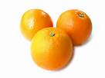
Christmas Oranges

