Slide 1

Welcome to English Corner
Professors
John and Marie Murdoch

Slide 2
Next English Corner
No English Corner, but please come to the Star Speaking Competition:
Building
PM
This is a great chance to listen and learn how to speak effectively in public. Come one; come all!!!

Slide 3
Next English Corner
Thursday, November 27, 2014
7 PM
Bring a friend!
Have
a
Treat.
Let’s have some Fun!
Come One; Come ALL

Slide 4
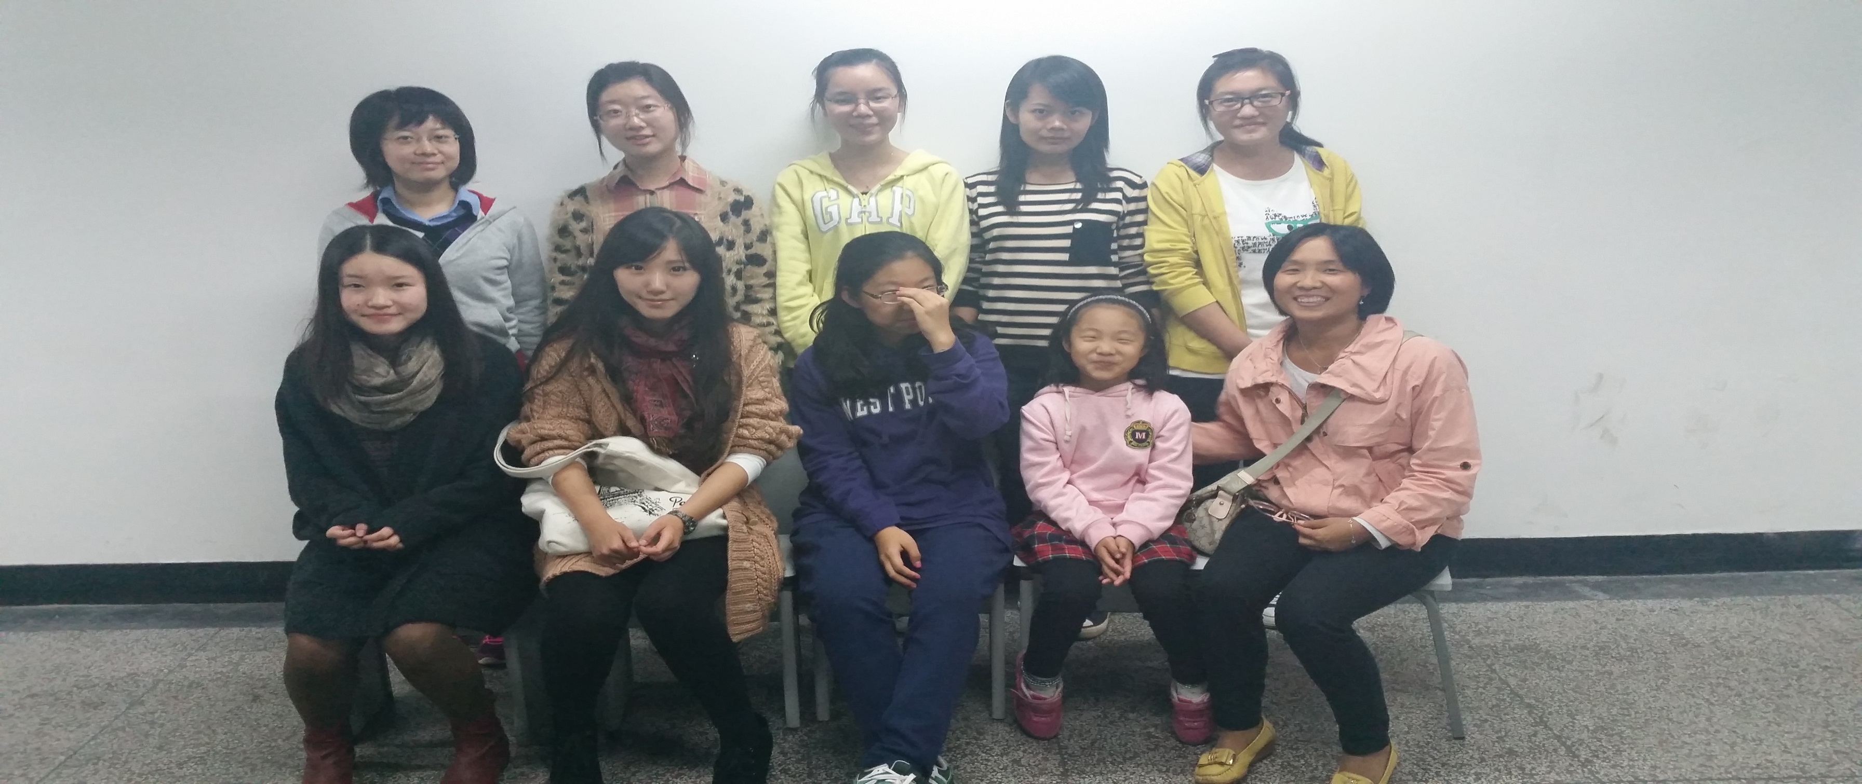
Our English Corner Friends
November 6, 2014

Slide 5
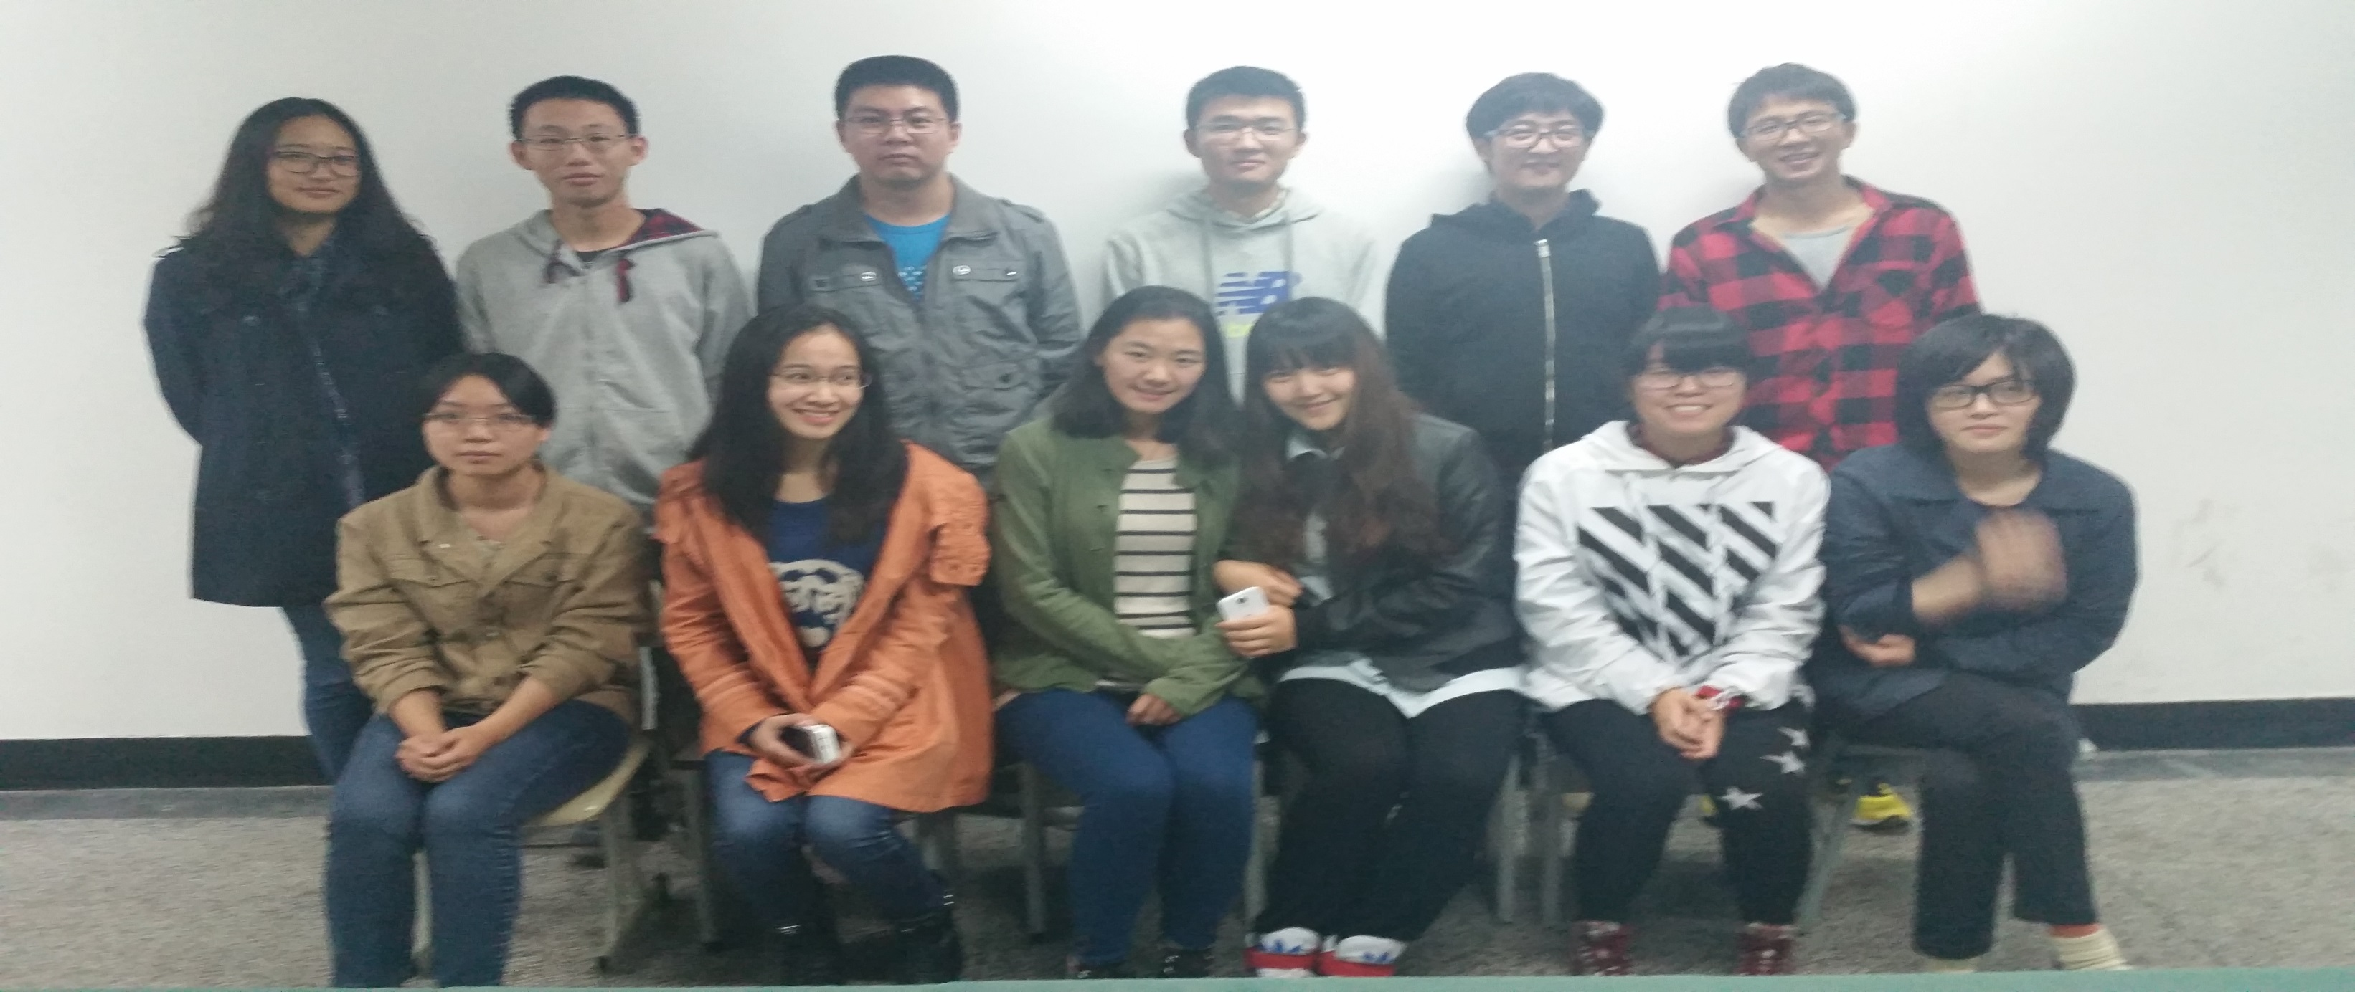
Our English Corner Friends
November 6, 2014

Slide 6
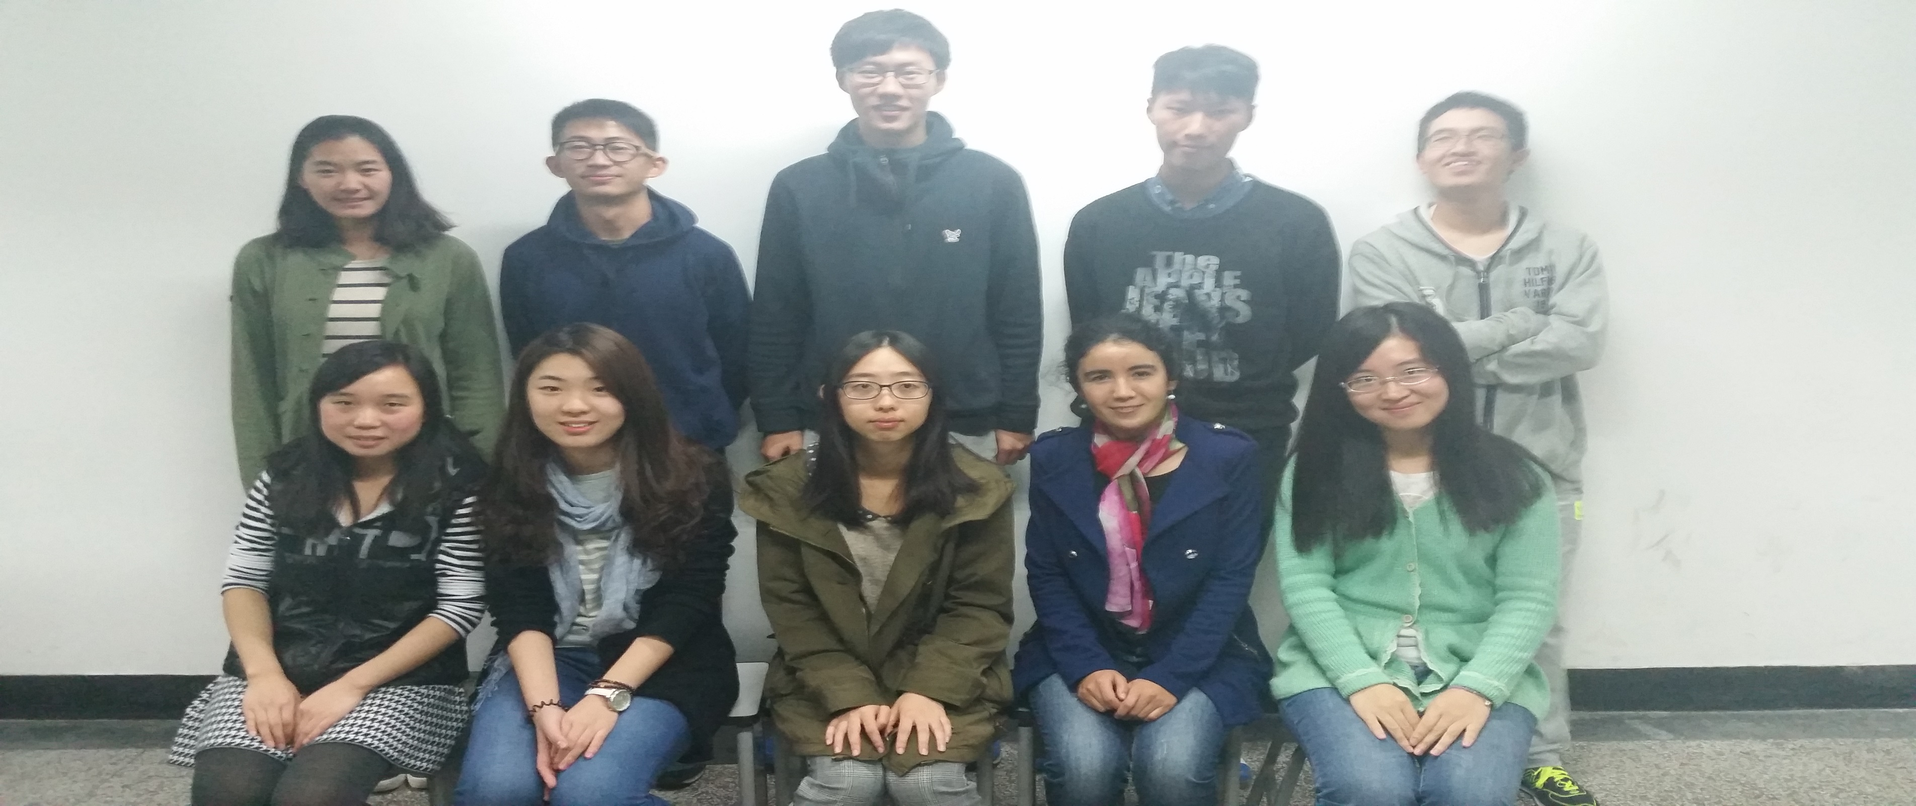
Our English Corner Friends
November 6, 2014

Slide 7

Let’s
Sing
Love Can Build a Bridge

Slide 8
Did anyone write a Limerick?
Limericks are short (sometimes serious; sometime silly) poems that are fun to recite.
A: What is a limerick, Mother?
A: It's a form of verse, said brother
B: In which lines one and two
B: Rhyme with five when it's through
A: And three and four rhyme with each other.

Slide 9
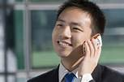
Singles Day—11/11
What did you do on singles day?
I didn’t hear; what did you say?
I try to meet friends and mingle,
However, I am still single.
Which for me is really okay!

Slide 10

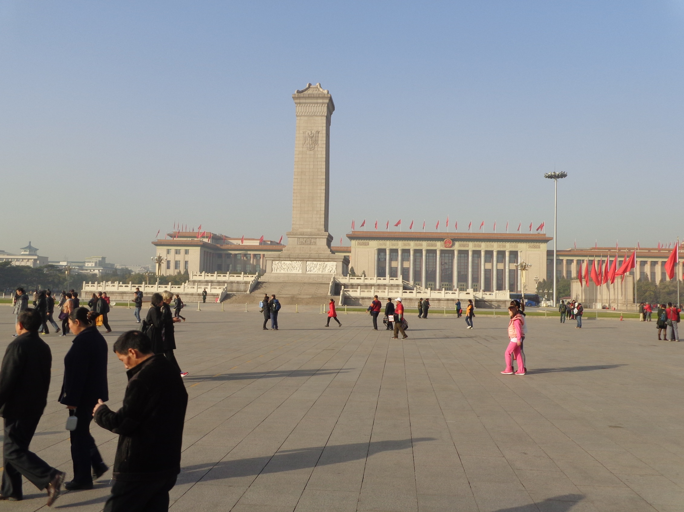

The Amazing China—Where are We?
Arise, ye who refuse to be slaves
With our very flesh and blood Let us build our new Great Wall!
The Peoples of China are in the most critical time,
Everybody must roar his defiance.
Arise! Arise! Arise! Millions of hearts with one mind,
Brave the enemy's gunfire, March on! Brave the enemy's gunfire,
March on! March on! March on, on!
The People’s Square

Slide 11
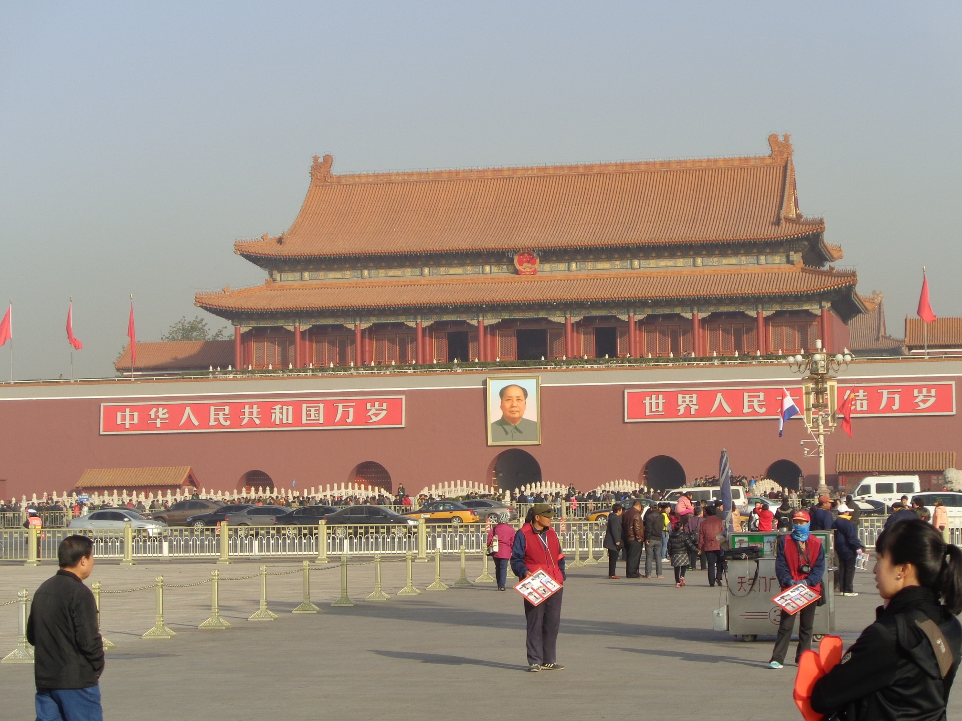
The Amazing China—Where are We?
Entrance to the Forbidden City

Slide 12
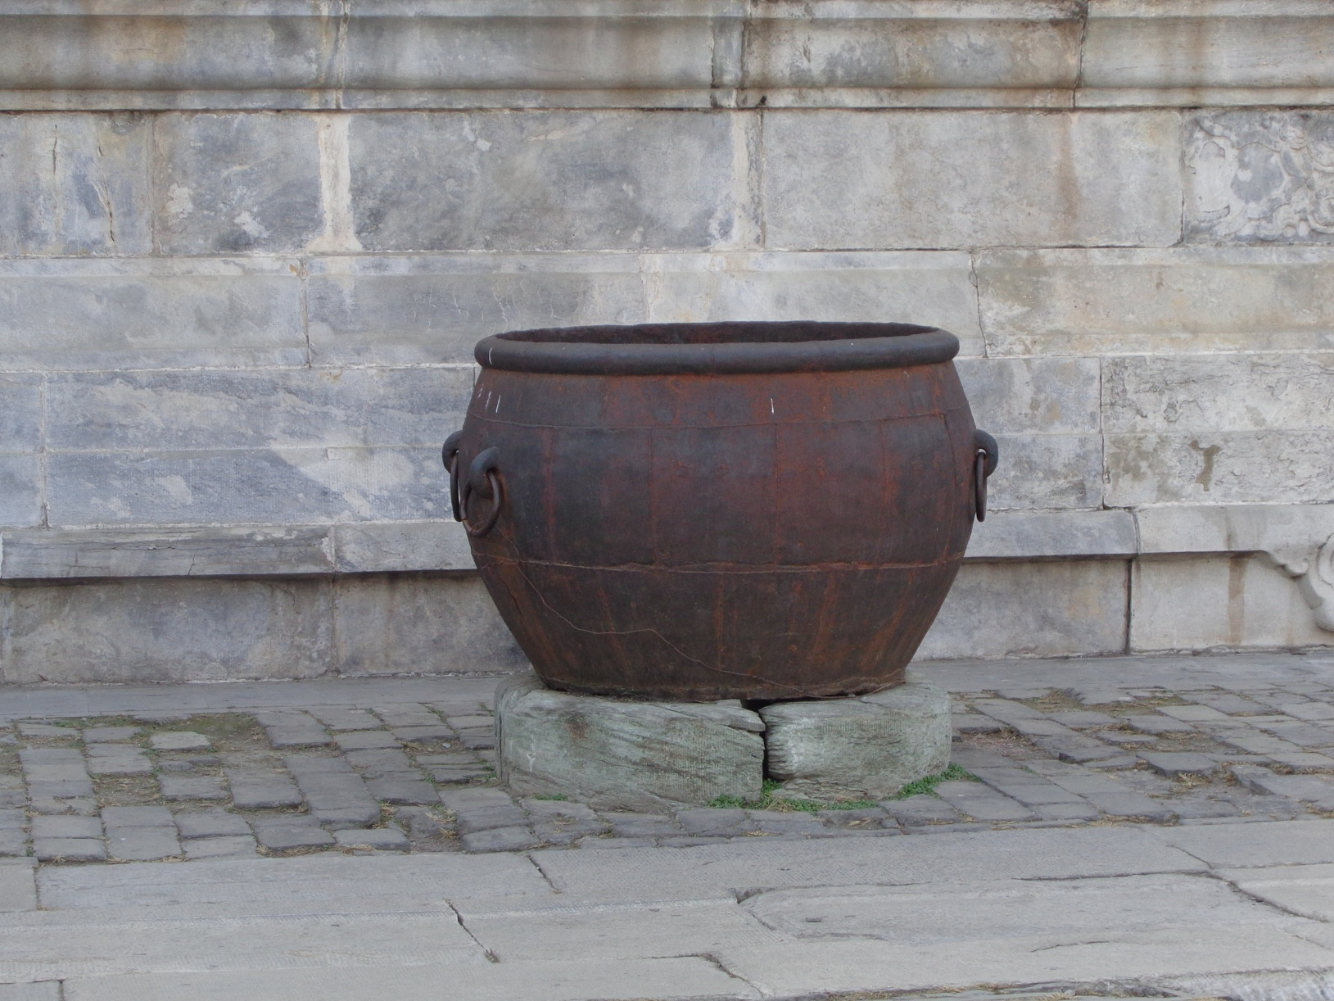
The Amazing China—What is this?
Large cauldron which holds water used to put out fires

Slide 13

The Amazing China
What is this story?

Slide 14
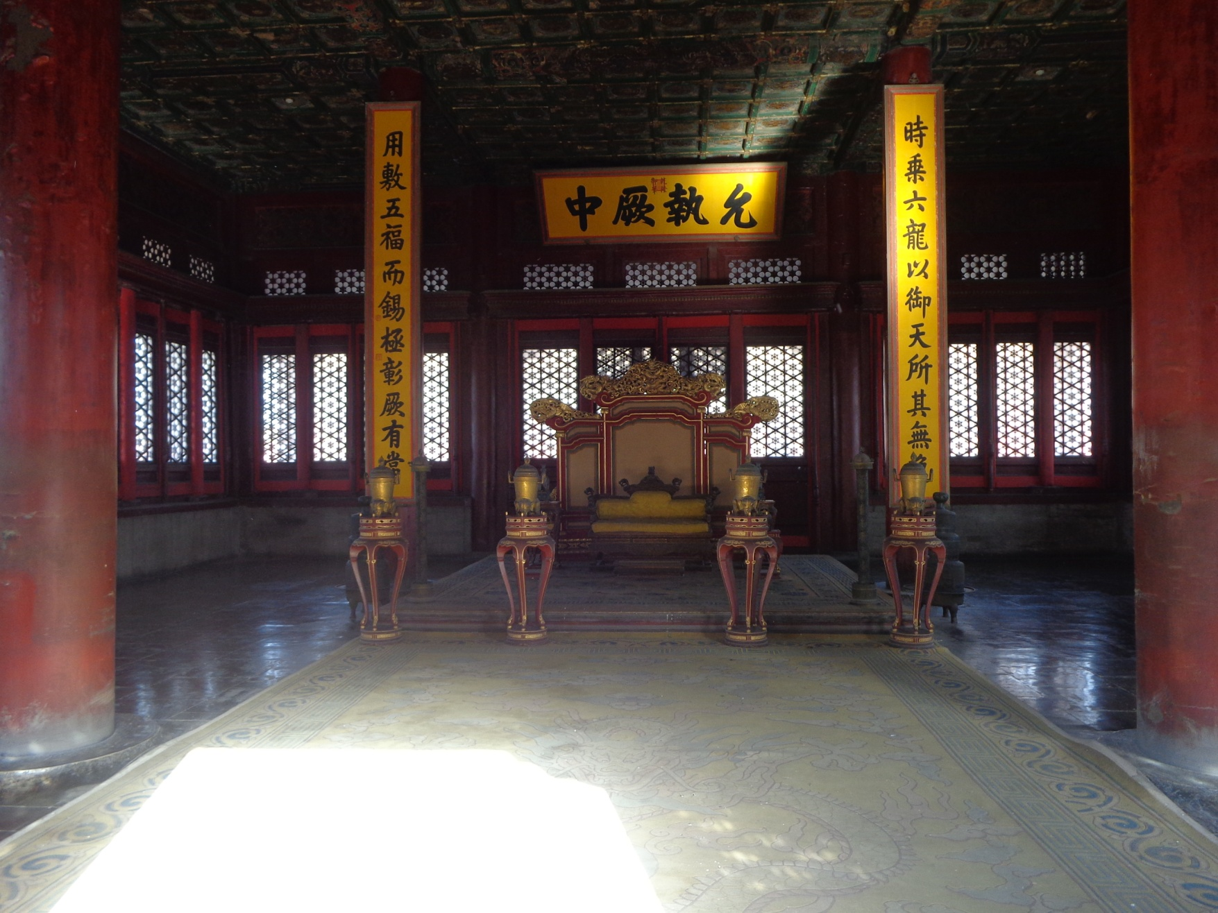
The Amazing China—Where are We?
The Emperor’s Throne

Slide 15

The Amazing China—Where are We?
Temple to Heaven

Slide 16
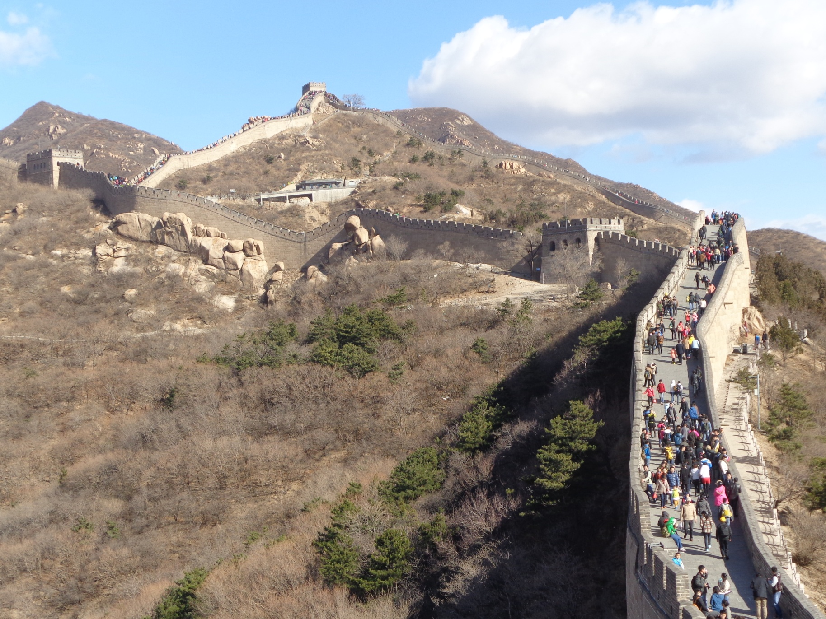
The Amazing China—Where are We?
The Great Wall

Slide 17
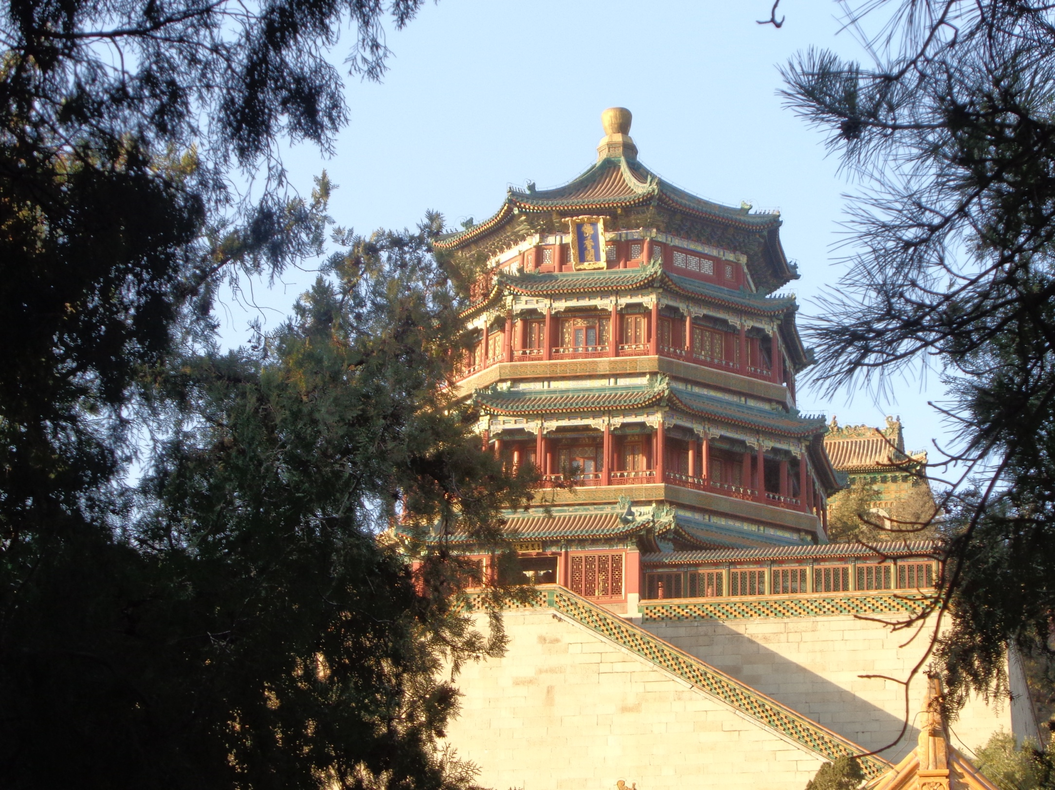
The Amazing China—Where are We?
The Emperor’s Summer Palace

Slide 18

The Amazing China
Full Moon over China

Slide 19
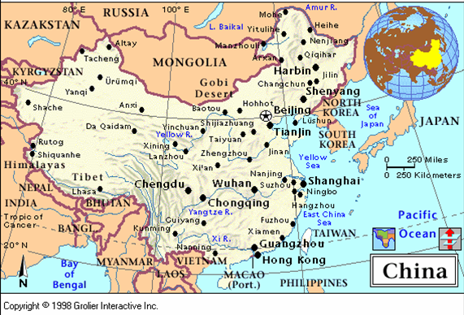
What is China?

Slide 20
Agree / Disagree
I agree with ….
I disagree with ….

Slide 21
Meet & Greet
Introduce yourselves.
Optional Topics:
    What do you think of 11/11 (singles day)? What did you do on singles day?
    If you were to rewrite the script for this presentation on China what would you leave out? What would you add that is not currently included?

Slide 22

Have a Treat
Break
Let’s Take a Picture

Slide 23
Let’s
Play
Jeopardy!

Slide 24
Communication
“Dear Stefanie, Dinner tasted awful, and it smelled
so I am leaving you
I have to just go
I have taken all my things
Just can’t stand you
I won’t be back
I have had enough
Enjoy your life
Goodbye,

Slide 25
Communication requires knowing both sides of the story.
“Dear Stefanie, Dinner tasted awful
and it smelled,
so I am leaving you
I have to just go
I have taken all my things
Just can’t stand you
I won’t be back
I have had enough
Enjoy your life
Goodbye,
ly good,
great,
a note,
to the library.
I need to study.
r being gone.
until 8 PM.
dinner. Thanks.
cereal as a snack.
Love, Max”

Slide 26

Talking Dice--Speaking Activity
Divide into assigned groups
Roll the dice and answer the number of the question you rolled.
If you have already answered the question then answer question #1. If you have answered that question #1
then roll the dice again.

Slide 27
TD-2
What is something you have never done that you want to try? Why?
What is something you really like about yourself? Why?
If you could develop a new talent / ability, what would want it to be. Why?
Talk about something in your life you will never forget.
Tell about someone you really admire. Explain why.
Share something that none of us know about you.
My life’s dream is___________________.
Why is exercise important and which exercise do you like most? Why?
What can you be doing now that will improve your life in ten years?
Do you tend to have a positive or negative attitude? Explain.
Do you prefer being a leader or a follower? Explain.
What would you do with a million yuan? Why?

Slide 28
Questions
Questions for and from
the Professors
about promoting peace.

Slide 29
What are some of the topics you would like to discuss in class and/or English Corners?

Slide 30
TD-3
If you could be someone else, who would you want to be? Why?
What is something you feel too young to do? Explain.
What is something you feel too old to do? Explain.
Talk about the importance of keeping your promises?
What is it about your university experience that is most challenging?
What could you do to improve your health? Explain.
If you were a teacher, what subject(s) would you like to teacher? Why?
Why would you be a good teacher?
Would you ever consider being a farmer? Why?
Would you ever consider moving to a foreign country? Why?
Would you ever consider getting plastic surgery? Explain.
How important is one’s physical appearance? Explain.

Slide 31
TD-4
What would you do if your boss asked you to do something illegal?
Would you ever consider donating a kidney or other vital organ? Why?
What is the best way for you to help the poor? Explain.
Is telling a lie ever justified? Explain.
How do you control your anger? Explain.
What are your thoughts about smoking?
How will you discipline your child? Is spanking okay? Explain.
What are your feelings about arranged marriages? Explain.
What qualities do you look for in a good friend?
Do you ever feel unsafe? Explain?
What should we do to make the world a safer place? Explain.
What do you want to do during the next summer break? Why?

Slide 32
Unfinished Sentences:
Finish these sentences by adding your own words.
On Saturdays, I like to____________
If I had only 24 hours to live, I would__________
I feel best when people_____________
Secretly I wish_____________
If I could change the world, I would____ because_____
The most exciting thing I have done is_____
TD-5
Right now the most important thing in my life is_____ because_________________
If I could be somewhere else now, I’d______________
I never worry about_____________________
I like people who________________
I find it difficult to_______________________
Studying is________________________________

Slide 33
What qualities do you appreciate in a good friend? Explain. TD-6
What is the most exotic food you have eaten? Describe.
Who are the very most important people in your life? Explain.
What are the things that stress university students the most? Explain.
What is the best advice you have ever been given? Explain.
What is the best advice that you have ever shared with someone? Explain.
What is the biggest challenge for young people today? Explain.
What time should all electronic devices be turned off at night? Why?
Can a person be poor and still be happy? Explain.
What do you think the world will be like in 25 years? Explain.
What are your thoughts about America?
What are your thoughts about Africa?

Slide 34
TD-1
Describe your bedroom at home?
How should we reduce pollution?
What advice do you have for a failing student?
What time should students turn off their electronic devices and go to sleep?
How will you apply for your first job after graduation?
Describe the last party that you attended?
What do you think the purpose of life is?
Why do you want to learn to speak English fluently?
What is one thing you’ve learned this week?
Describe your best friend from high school? What made this person special?
What are your thoughts about smoking/drinking alcohol/using drugs?
What benefits do you receive when you volunteer?

Slide 35

The Values Game
Instructions:
Form in assigned groups.
Write your name on your marker.
Each person rolls the dice and moves his/her marker forward.
If your marker lands on a white square, you respond to the topic in the square.
If your marker lands on a “Free Question” square, you may ask one of the other players a question. The player may refuse to answer your question, but must explain why he/she refuses.
Play continues until time is up.

Slide 36
Vocabulary Builders
Instructions:
  Form groups of three or four people.
  Distribute the vocabulary card so each person in your group has one.
  Taking turns, each person then pronounces each word on his/her card.
  When everyone is finished, pass your card one person to the left and then each person pronounces the words on his/new card.
  Repeat the process until everyone has had a chance to pronounce the words on each card.
  Note: If someone needs help pronouncing a word, other group members should provide assistance.

Slide 37

Five Phases of Dating
Phase I – Meeting lots of people.
  Group parties/gatherings.
  Speed Dating and other group games.
Phase II – Making Friends
  Eating lunch or dinner together.
  Studying or going for a walk together.
  Sharing family stories and personal goals.
  Phase III – Formal Dating.
    Planned activities designed to help you know each other better.
    Should begin to be more personable, but set limits as to the time you spend alone with each other and limits to intimacy.

Slide 38

Five Phases of Dating
Phase IV Paring up/Going Steady
  Share your important beliefs and values.
  Introduce each other to your respective families.
  Begin to plan for the future—education, employment, home and family goals.
  Continue to practice limits regarding time alone together and sharing of intimacy.
Phase V Formal Engagement
  The marriage proposal.
  Approval of both sets of parents.
  Set a wedding date.
  Plan more intensely for your wedding and future life together.
  Continue to practice limits regarding time alone together and sharing of intimacy.

Slide 39
Describe your feelings about leaving your home and province for four years.
Try to describe your feelings as you return after successfully completing your B.S or B.A. degree in four years.
Try to describe the feelings of your parents as you return to your home as a college graduate.
Try your best to describe your first day on the job of your dreams.
Describe your future husband or wife.
What do you think your feelings will be when your first child leaves home to go to a school?
What do you think the purpose of life is?
Where do you think you will go when you or your parents die?
Why do you believe that?
Do you believe you came from some where else when you were born? Why do you believe that?
Suppose you move to Australia which has a different form of government. How will that change the way you act in your life, Why?
What about living in Australia would make you nervous?
What do you think you will do to adjust to that concern?

Slide 40
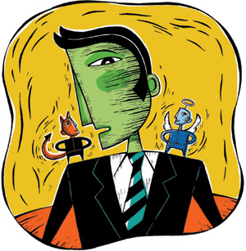
ETHICAL DILEMMAS

Slide 41
Integrity
“Integrity without knowledge is weak and useless and knowledge without integrity is dangerous and dreadful.” (Samuel Johnson (1709-1784) English Poet, Critic and Writer)

Slide 42
VOCABULARY
ethics – the principles (rules) of conduct
governing an individual or a group, the
discipline dealing with what is good
and bad and moral duty and obligation
ethical – moral, conforming to accepted
rules and standards of conduct
moral – principles of right and wrong
behavior
dilemma – a situation involving a choice
between alternatives

Slide 43
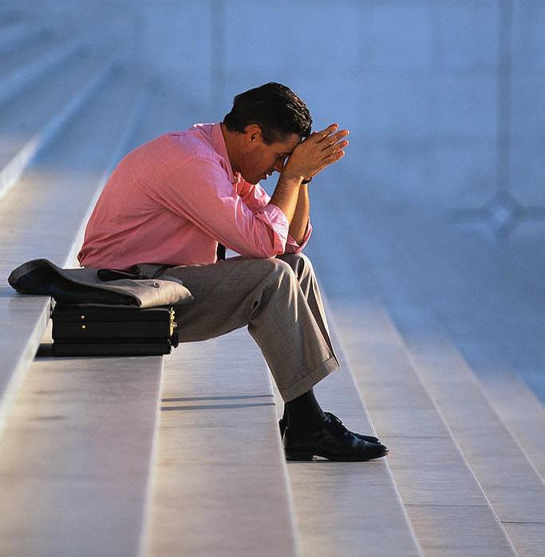
expelled – kicked out of school,
suspended from school
0 tolerance – no exceptions, no second
chances
full ride – a scholarship which pays
tuition, books, room and board
Win Win – Solutions in which all parties are better off

Slide 44
ETHICAL DILEMMA
(VICE PRINCIPAL)
You are the vice principal in charge of discipline of a high school. It is your responsibility to see that all students follow the rules and are treated fairly and equally. It is the policy of your school that students caught with alcohol, drugs or weapons on campus will be expelled—0 tolerance.

Slide 45
Your daughter is a senior at the high school. She is an outstanding basketball and volleyball player and is a top academic student. She has applied to several universities and for scholarships that would pay virtually all of her costs at any of these colleges. She is almost certain to be accepted and to receive a full ride at all schools to which she has applied.

Slide 46
One evening, you are supervising a school dance. You need to speak to your daughter and can’t find her. You finally go into the darkened girls’ locker room and hear voices. One is your daughter’s voice and as you listen, you realize they are drinking alcohol. They do not see you.
What will you do?

Slide 47

Life is full of choices and decisions and many of them will present us with moral and ethical dilemmas. Some of these choices and decisions will challenge
the very principles,
standards and values
we were taught by
our family. When
faced with these
moral dilemmas,
what will you do?

Slide 48

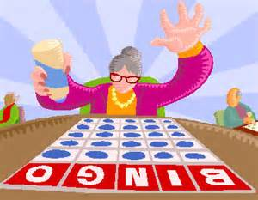
Halloween Bingo
Materials: Bingo Score Card and pen.
Instructions: Halloween related words will be drawn out of a jar. When a word is drawn that matches one of your words, place a X in the corner of that word’s square.
The first person to get five words in any straight line (up and down; across, or diagonal calls out “Bingo.” The person then reads his/her words to verify accuracy. If all are correct; he/she is declared the winner.
Play will then resume until a person has a X in all of his/her squares. If all are correct; he/she is declared the Grand Champion.

