Slide 1

Welcome to English Corner
Professors
John and Marie Murdoch

Slide 2
Next English Corner
Thursday, November 6, 2014
7 PM
Bring a friend!
Have
a
Treat.
Let’s have some Fun!
Come One; Come ALL

Slide 3
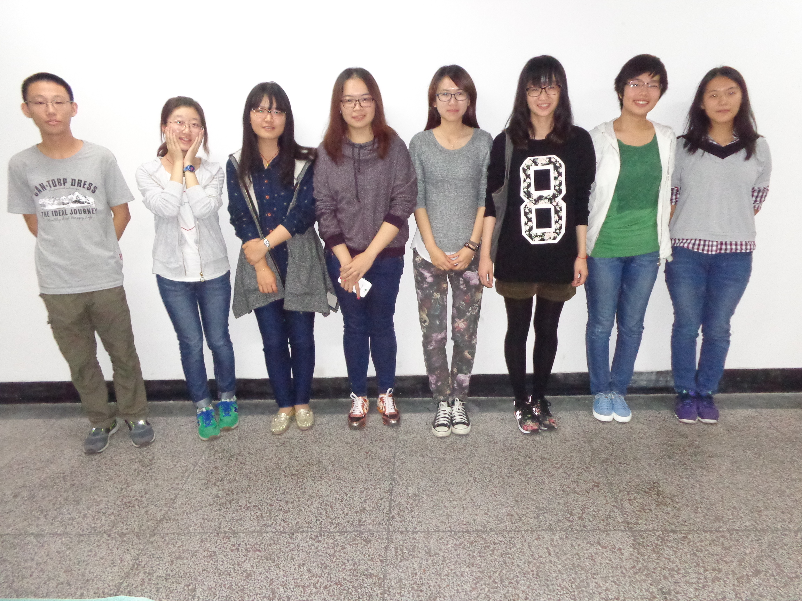
Our English Corner Friends
October 23, 2014

Slide 4
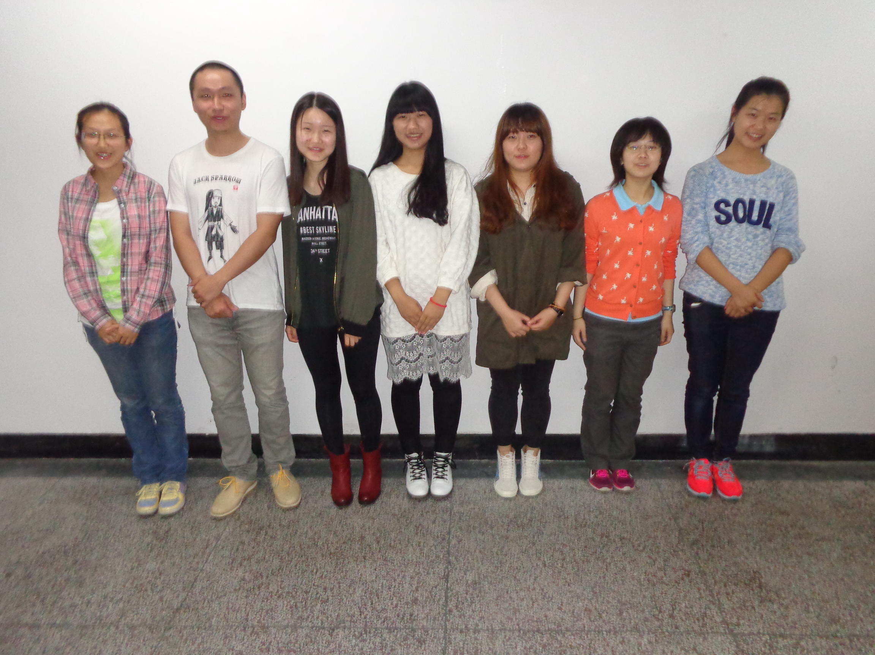
Our English Corner Friends
October 23, 2014

Slide 5
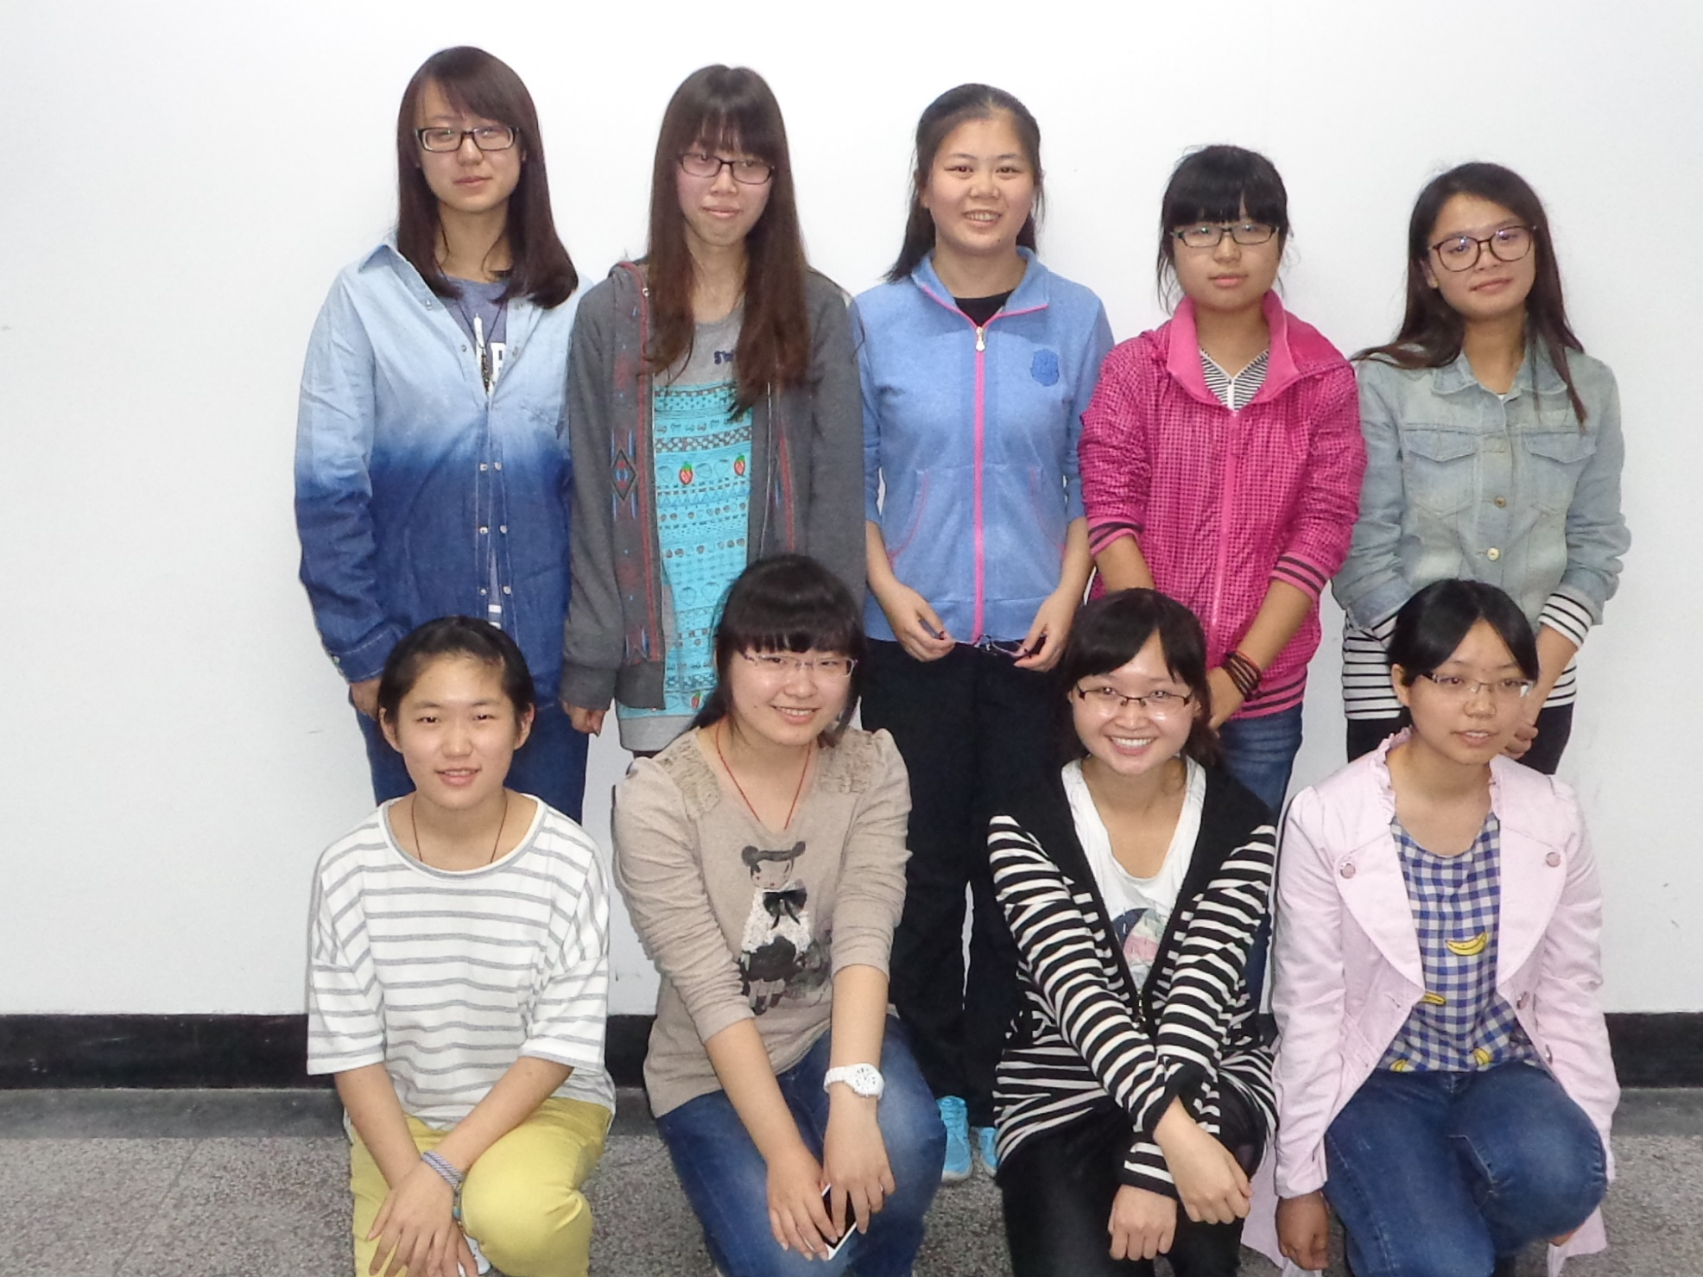
Our English Corner Friends
October 23, 2014

Slide 6
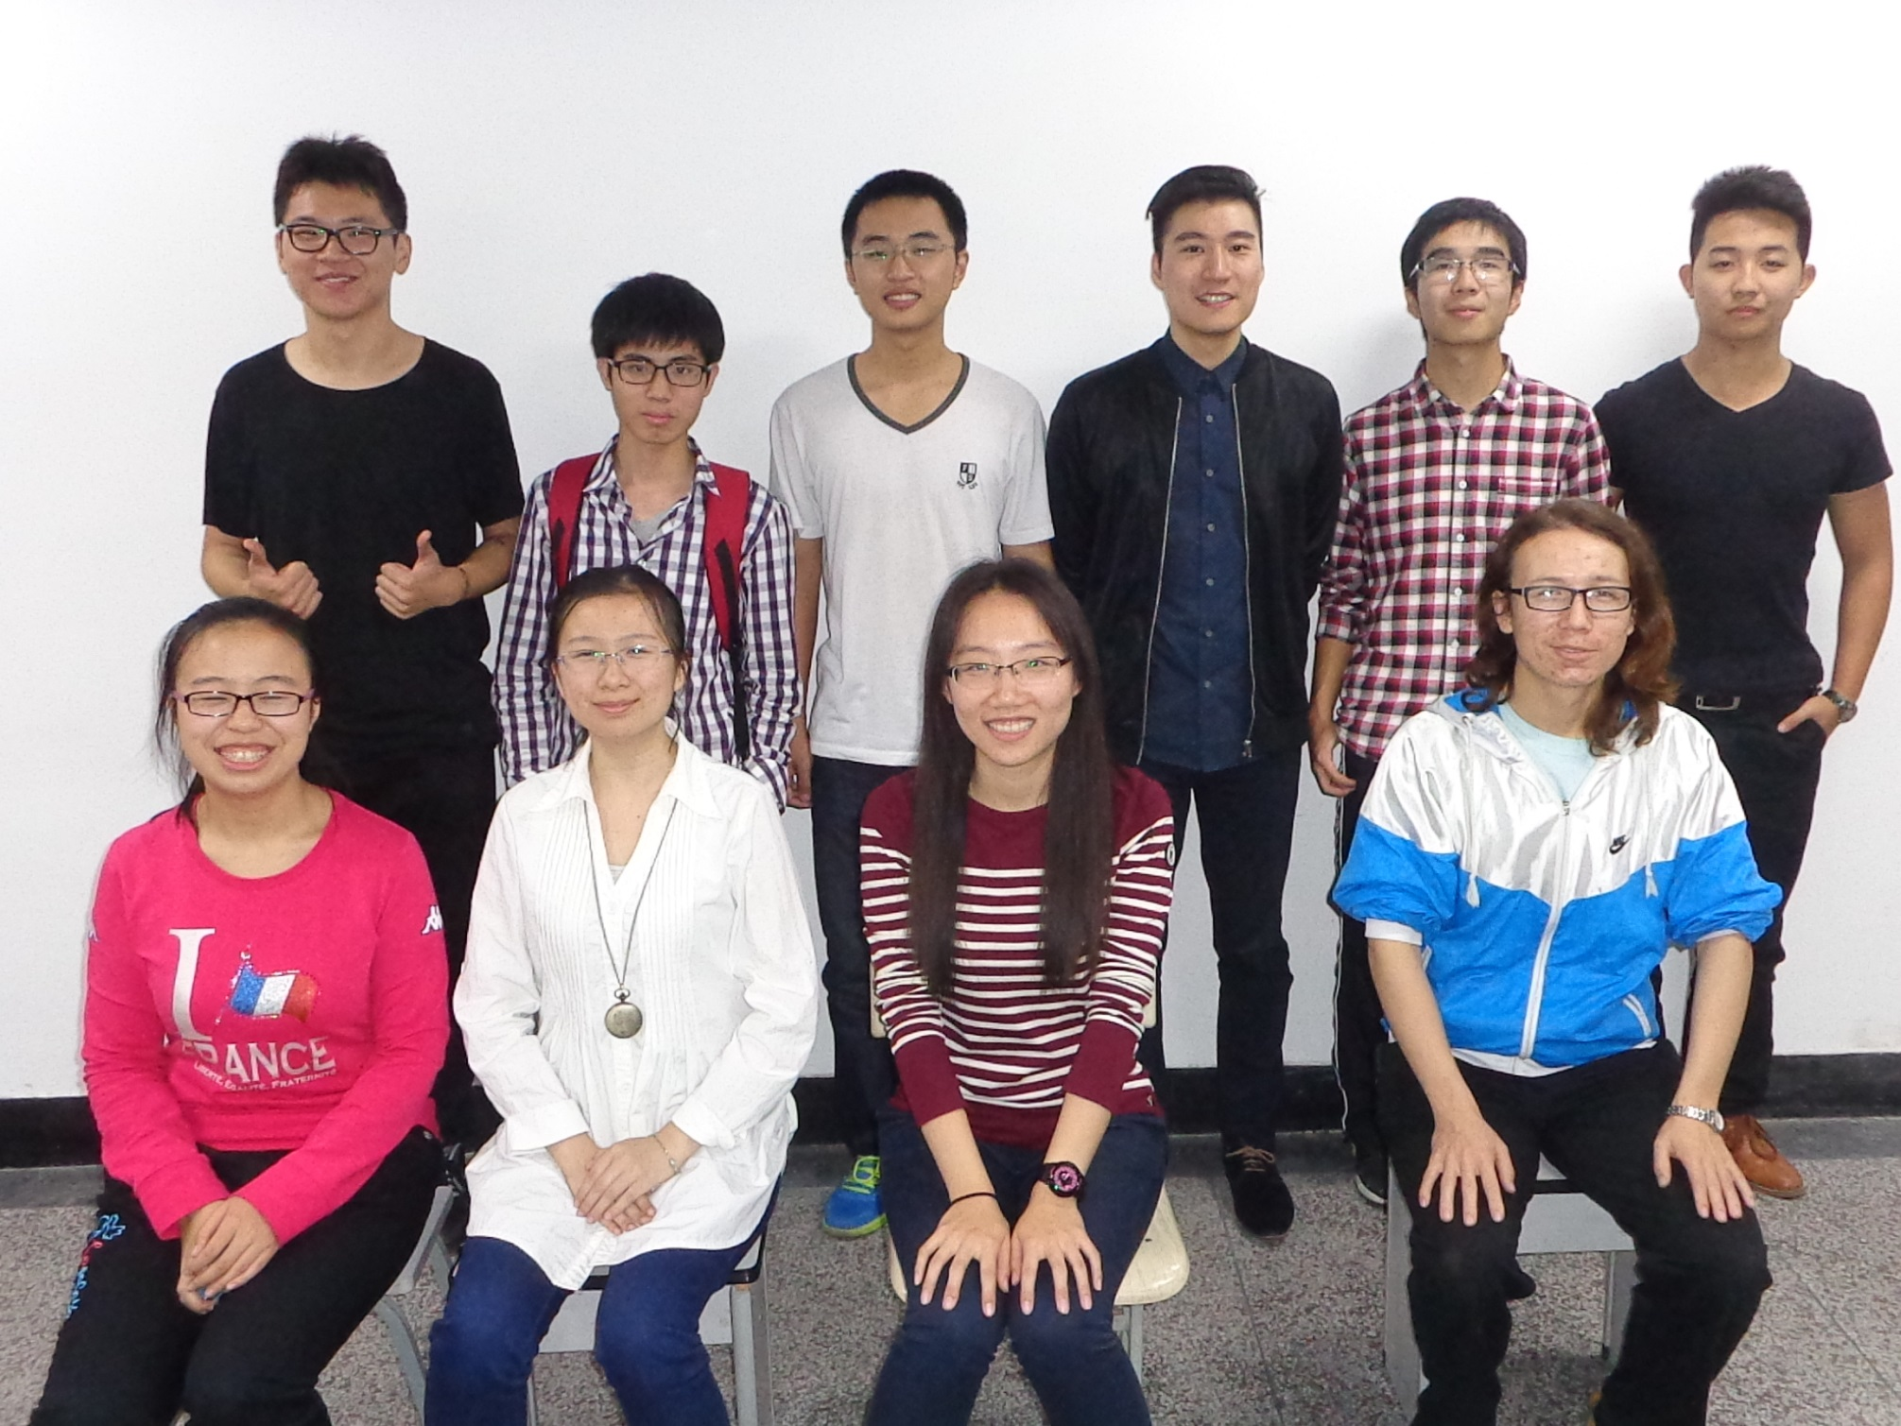
Our English Corner Friends
October 23, 2014

Slide 7
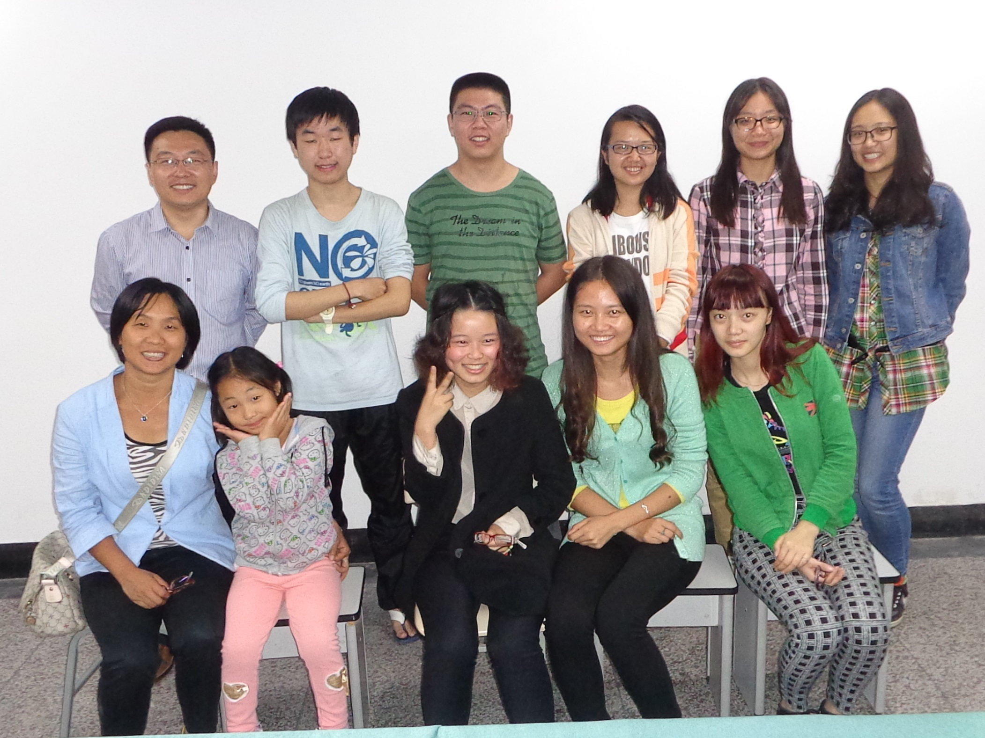
Our English Corner Friends
October 23, 2014

Slide 8

Let’s
Sing
5 Little Pumpkins

Slide 9


Five Little Pumpkins
Five little pumpkins sitting on a gate.
The first one said, “Oh, my it’s getting late!”
The second one said, “There are witches in the air.”
The third one said, “But we don’t care.”
The fourth one said, “Let’s run and run and run!”
The fifth one said, “We’re ready for some fun!”
Then Woooooo went the wind
And out went the lights
And the five little pumpkins rolled out of sight.

Slide 10
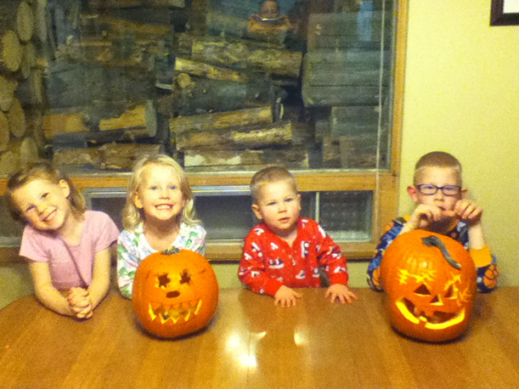
Plus Two More Pumpkins
Katie Maddie Ryan Ryker

Slide 11
Did anyone write a Limerick?
Limericks are short (sometimes serious; sometime silly) poems that are fun to recite.
A: What is a limerick, Mother?
A: It's a form of verse, said brother
B: In which lines one and two
B: Rhyme with five when it's through
A: And three and four rhyme with each other.

Slide 12

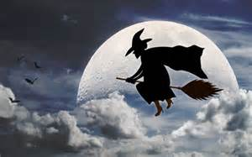

A Halloween Limerick
Limericks are short (sometimes serious; sometime silly) poems that are fun to recite.
A: I find some things to be scary,
A: So I warn you to be wary,
B: Of witches and ghosts,
B: Who hang out on fence posts,
A: And frighten children who tarry!

Slide 13


Slide 14

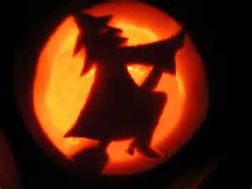


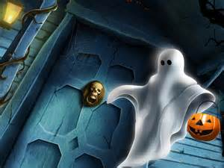
If You've Never
by Elsie Melchert Fowler
If you've never seen an old witch
Riding through the sky--
Or never felt big bat's wings
Flopping, as they fly--
If you've never touched a white thing
Gliding through the air,
And knew it was a ghost because
You got a dreadful scare--
If you've never heard the night owls,
Crying, "Whoo-whoo-whoo?"
And never jumped at pumpkin eyes
Gleaming out at you--
If all of these exciting things
You've never heard or seen,
Why then--you've missed a lot of fun,
Because--that's HALLOWEEN!

Slide 15

Halloween Story

Slide 16

Halloween Story Page 1
One night, Lulu had a dream; she was dancing with her dolls. Suddenly…..

Slide 17
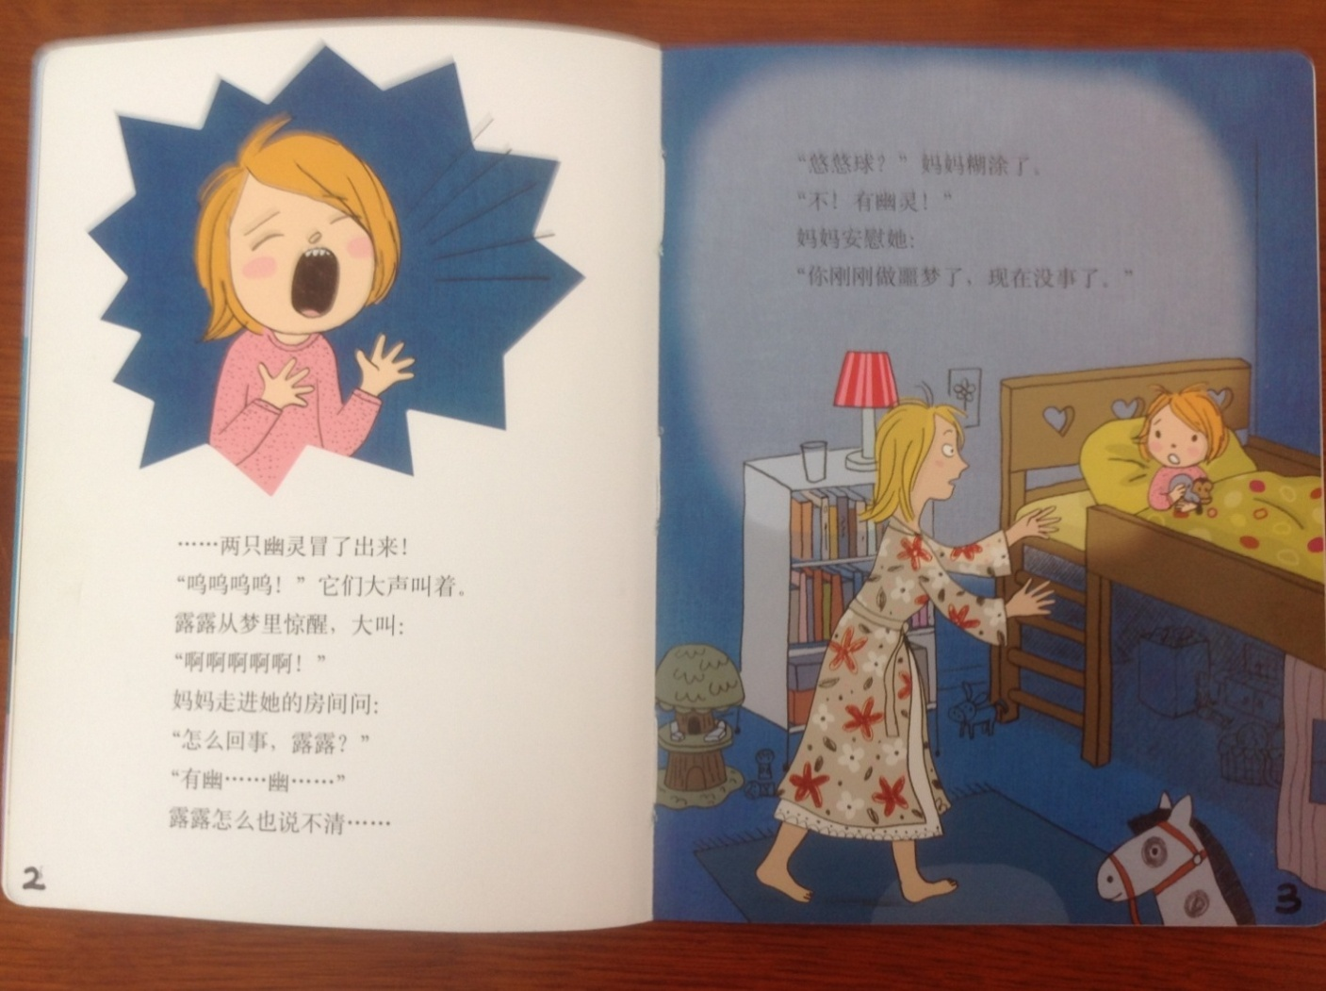
Halloween Story Pages 2 and 3
…two ghosts came out and shouted loudly, “Woo ooo ooo.”
Lulu woke up with a start and screamed, “Ahhhhhhh!”
Mother rushed into the room and asked, “What happened Lulu.”
“There’s a gho..gho..” as there was a twist to Lulu’s tongue—that is all she could say.
“A yo-yo?” Her mom was confused.
“No! There were two ghosts!” cried Lulu.
Her mom comforted her, “You’ve just had a nightmare, but it’s ok now.”

Slide 18
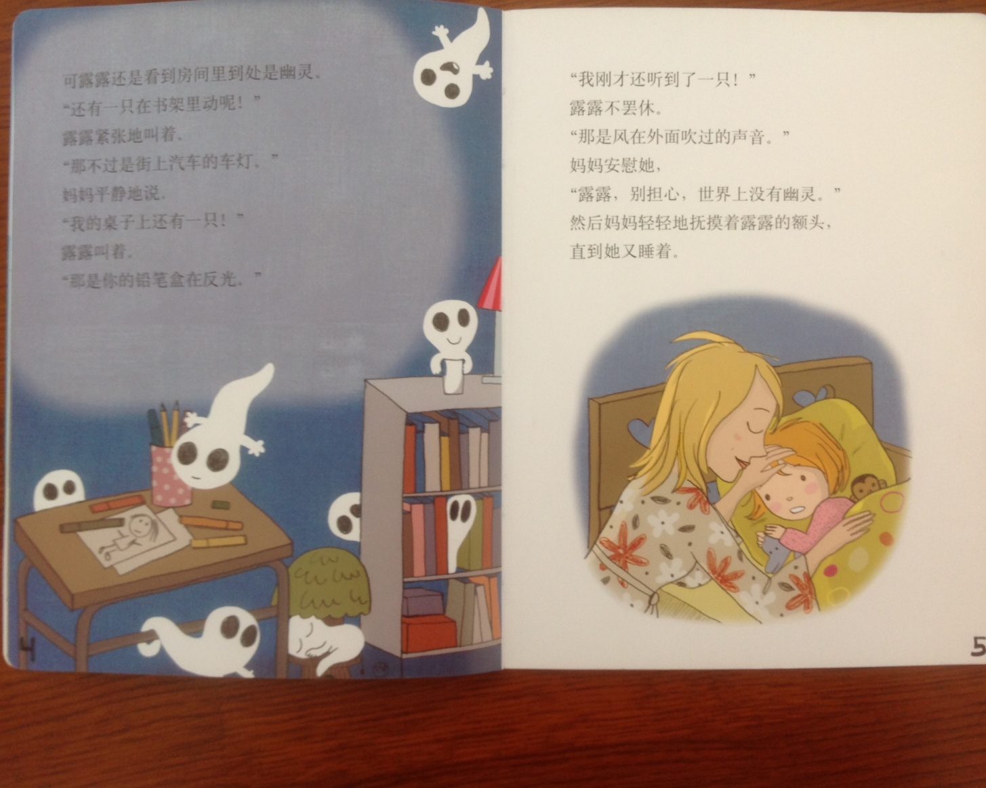
Halloween Story Page 4
However, Lulu still found that there were ghosts everywhere.
“There is one moving in the bookshelf!” Lulu shouted nervously.
“That’s just the lights of the cars on the street,” Mom replied peacefully.
“There is one on my desk!” Lulu shouted.
“That’s your pencil case reflecting the lights,” sighed Mother.

Slide 19

Halloween Story Page 5
“I just heard one,” Lulu didn’t give up.
“That was the wind blowing,” comforted Mother, “Don’t worry Lulu, there is no ghost in the whole world.”
Mom gently caressed Lulu’s forehead until she fell asleep.

Slide 20
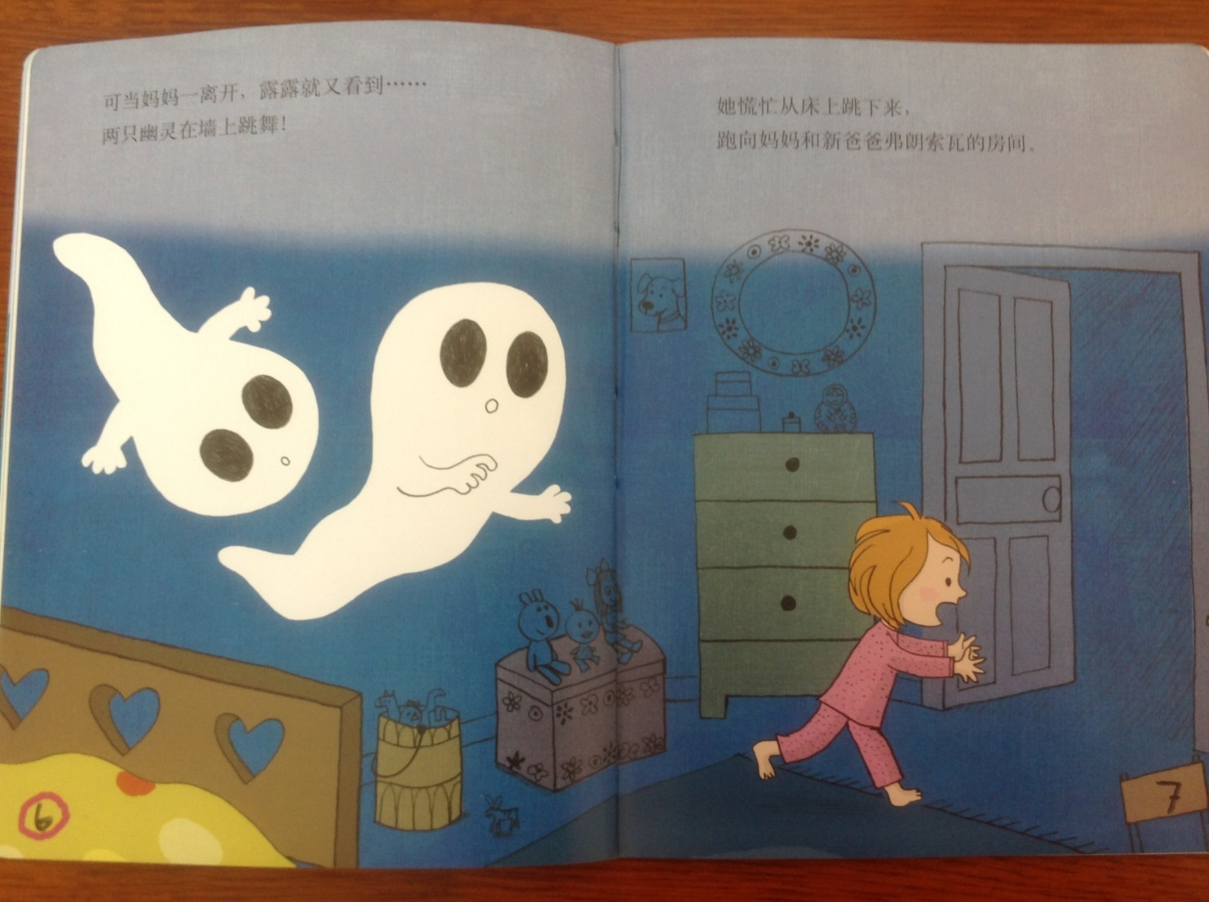
Halloween Story Pages 6 and 7
As soon as mom left, Lulu saw them again—two ghosts dancing on the wall! She jumped off her bed in a great panic and ran to her mother and stepfather’s room.

Slide 21
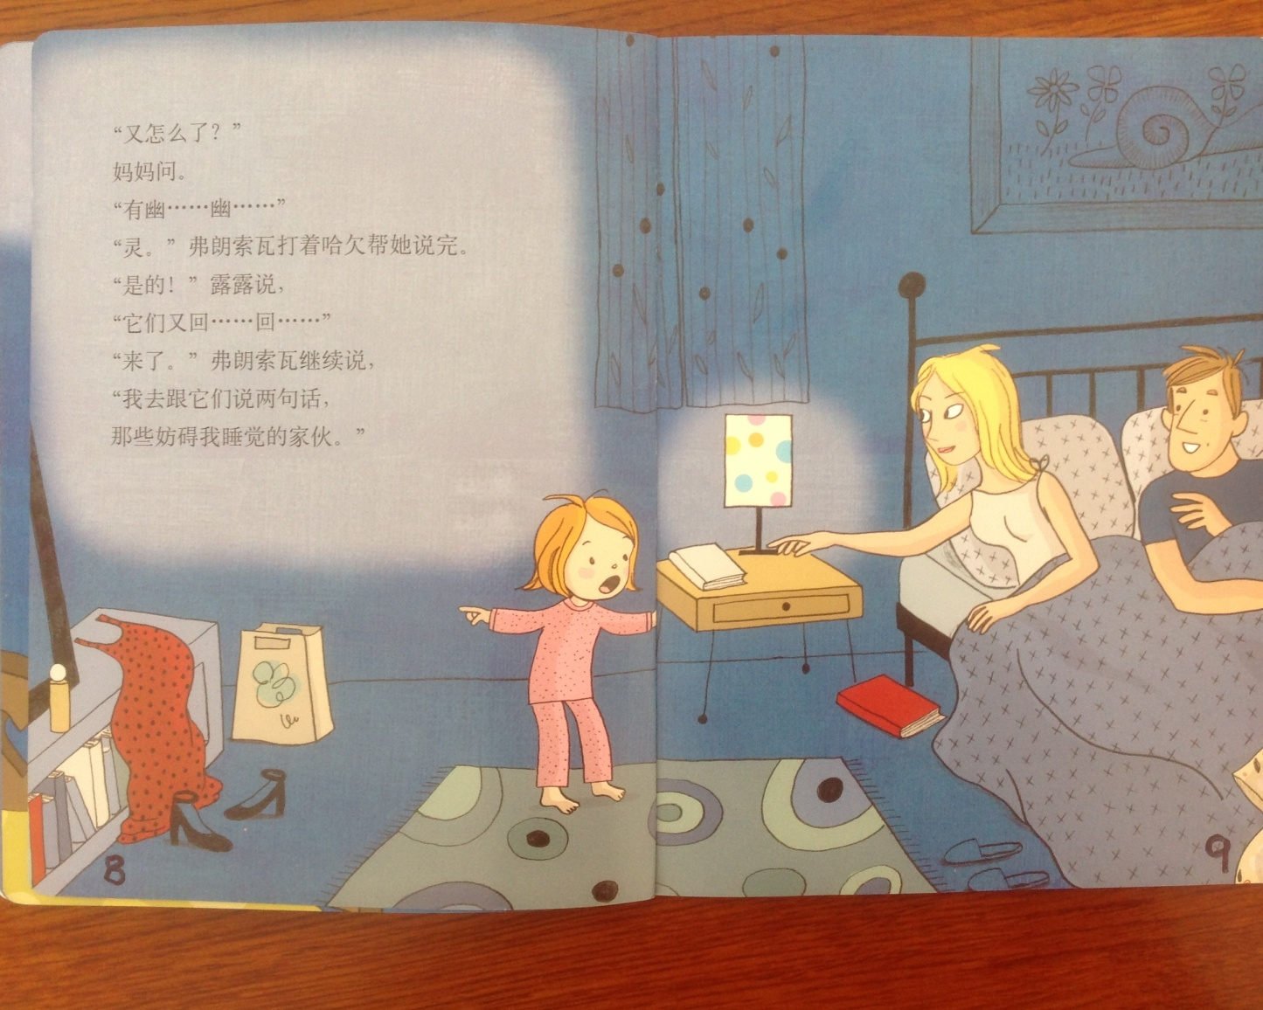
Halloween Story Pages 8 and 9
“What Happened--again?” asked Mother.
“G..G..G,” whimpered Lulu.
“Ghost,” Father helped her finish while yawning.
“Yes,” said Lulu, “They are b….back.”
Father continued, “I am going to talk to them; they are interrupting my sweet dreams.”

Slide 22
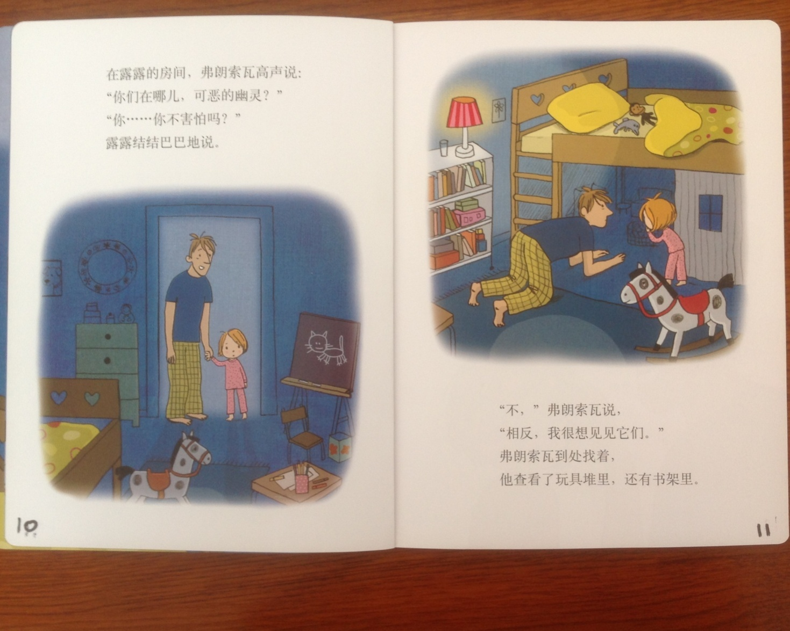
Halloween Story Pages 10 and 11
Back in Lulu’s room, Father speaks in a loud voice, “Where are you bad ghosts?”
“Don’t you feel scared?” Lulu said.
“No,” Father said, “just the opposite, I really want to see them.” He looked for them here and there; he looked through the piles of toys and in the bookshelf.

Slide 23
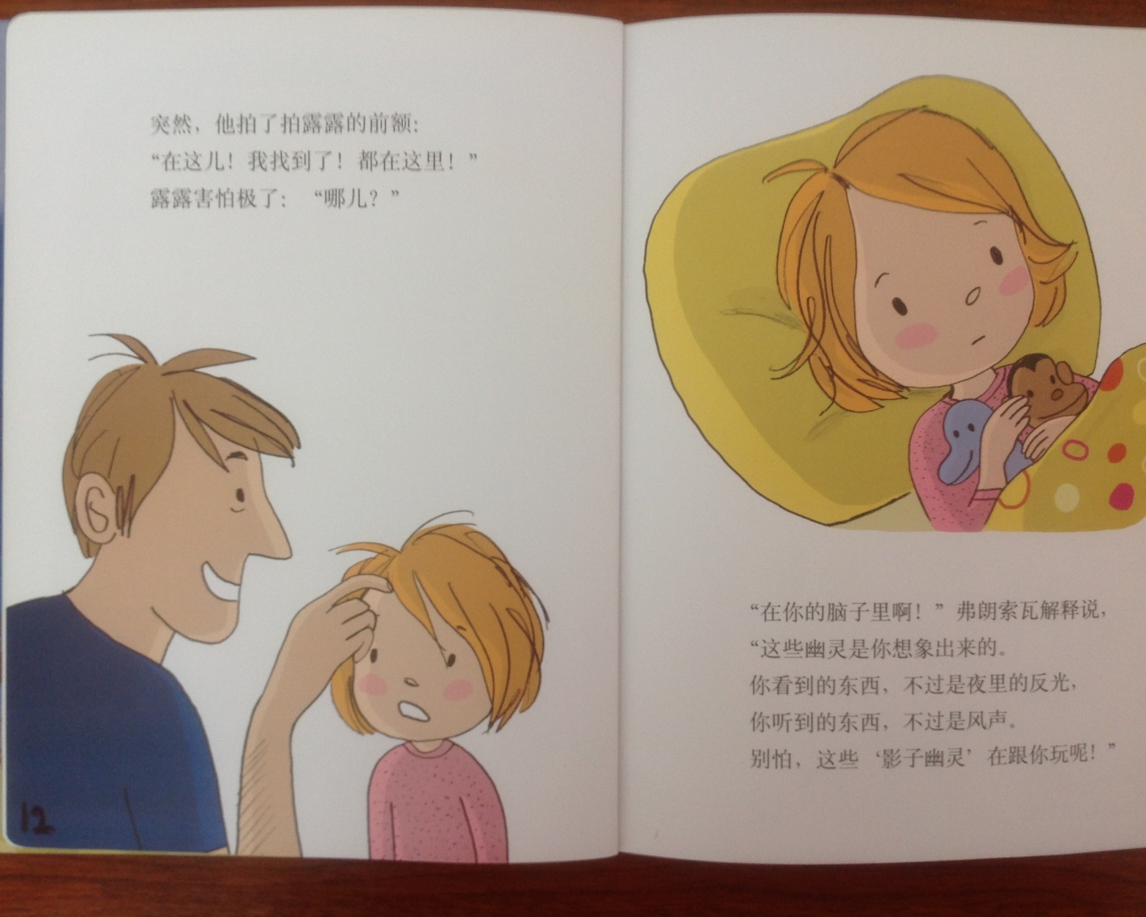
Halloween Story Pages 12 and 13
Abruptly, he patted Lulu’s forehead. “Here—I found it! All the ghosts are in here.”
Lulu, felt very scared, “Where?”
“In your brain,” explained Father, “From your imagination comes these ghosts! What you see is nothing, but a reflection in the night and what you heard is nothing but the wooo of the wind. So don’t be scared.”

Slide 24
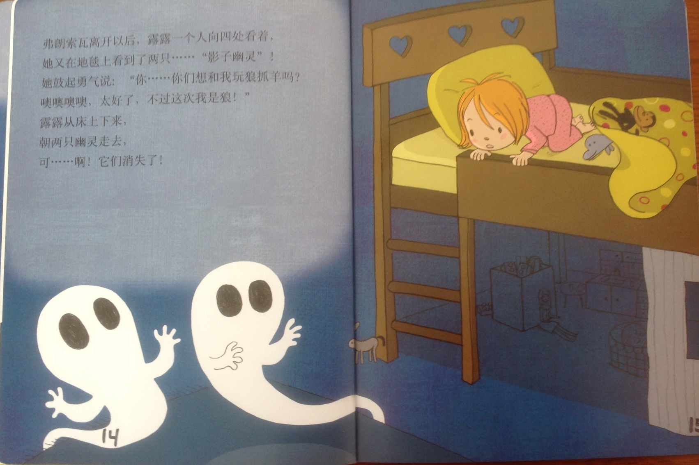
Halloween Story Pages 14 and 15
After father left, Lulu was alone; she looked around and saw two shadow ghosts on the carpet. She mustered up her courage and asked, “Do you want to play a game named wolf catches the sheep with me? Oh, great. I’m acting as the wolf this time!” Lulu slipped on the bed and walked towards the ghosts, but they vanished.

Slide 25
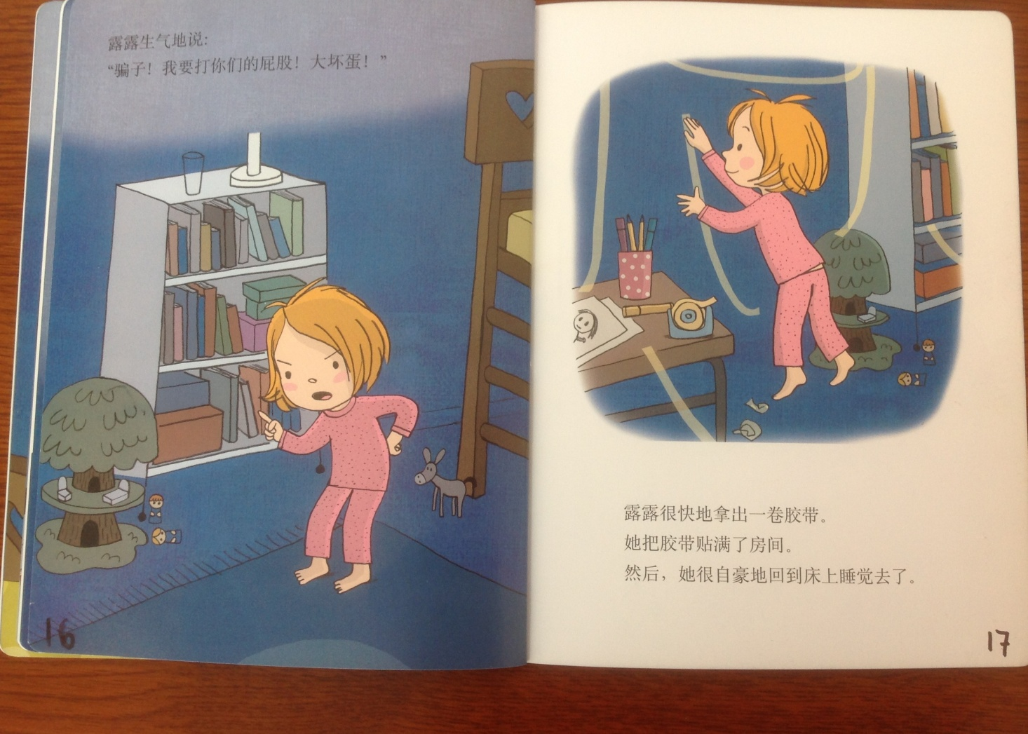
Halloween Story Pages 16 and 17
“I will bite your hip,” Lulu said angrily. She then took a roll of cello tape and put it around the room. Then she went to bed with pride.

Slide 26
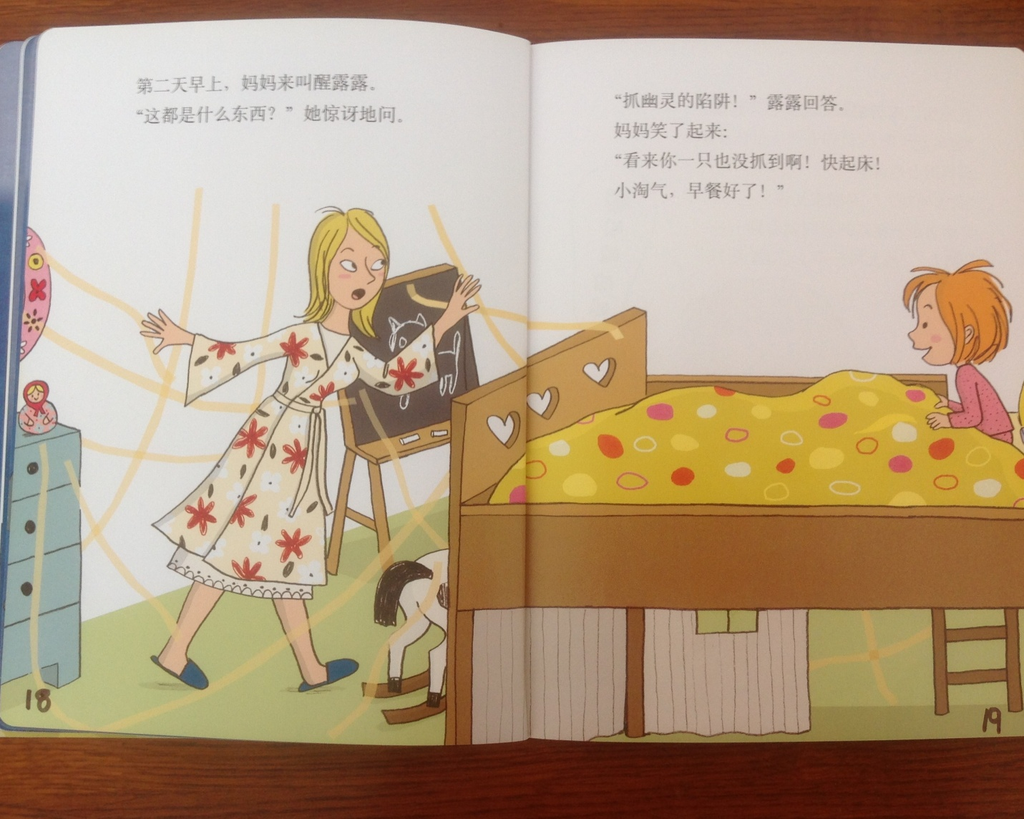
Halloween Story Pages 18 and 19
In the morning, Mom woke up Lulu. “What are these?” she asked with amazement.
“A trap to grab ghosts,” Lulu said.
“It seems that you didn’t catch anything; wake up quickly my naughty girl—breakfast is ready,” Mother replied.

Slide 27
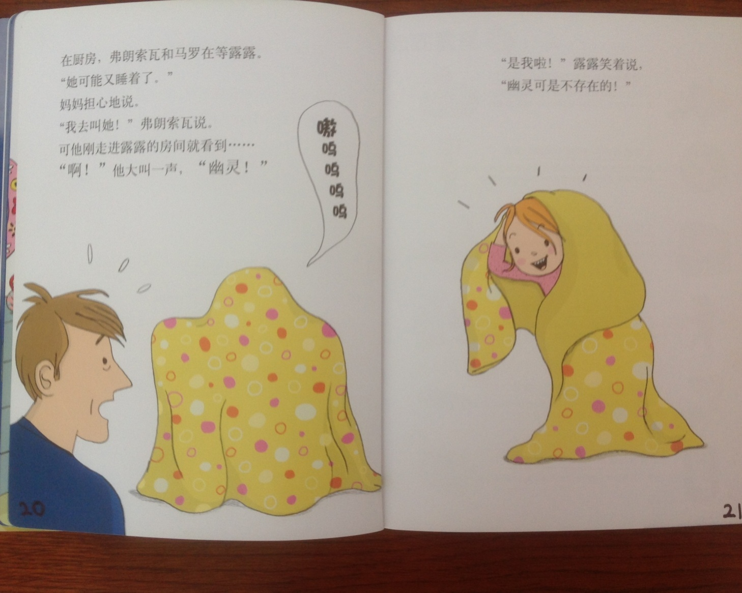
Halloween Story Pages 20 and 21
In the kitchen, father and mother were waiting for Lulu.
“Maybe she has fallen to sleep again,” said Mother.
“I’ll wake her up,” said Father, but the moment he entered the room he looked and then screamed loudly, “a ghost!”
“It’s me,” Lulu said smiling, “there is no ghost.”

Slide 28


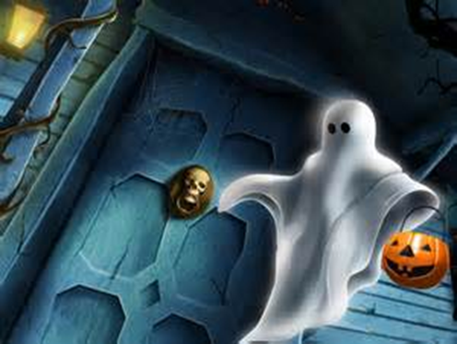

This is Halloween

Slide 29

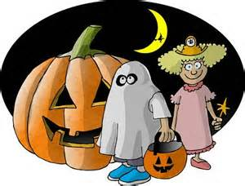
Meet & Greet
Tell a Scary Story
Instructions:
Share a story about a time that you were really scared. Never been scared? Then make a story up.

Slide 30
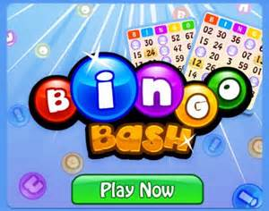
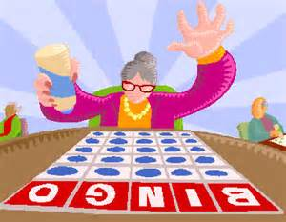
Halloween Bingo
Materials: Bingo Score Card and pen.
Instructions: Halloween related words will be drawn out of a jar. When a word is drawn that matches one of your words, place a X in the corner of that word’s square.
The first person to get five words in any straight line (up and down; across, or diagonal calls out “Bingo.” The person then reads his/her words to verify accuracy. If all are correct; he/she is declared the winner.
Play will then resume until a person has a X in all of his/her squares. If all are correct; he/she is declared the Grand Champion.

Slide 31
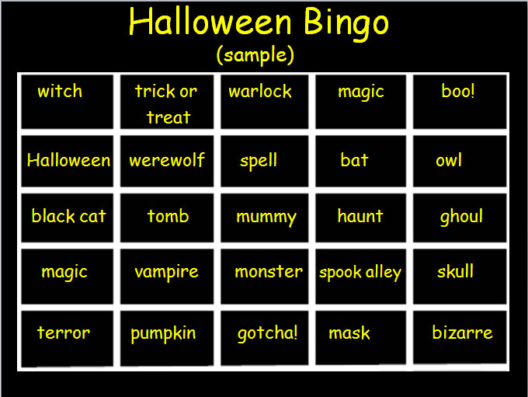

HALLOWEEN BINGO

Slide 32
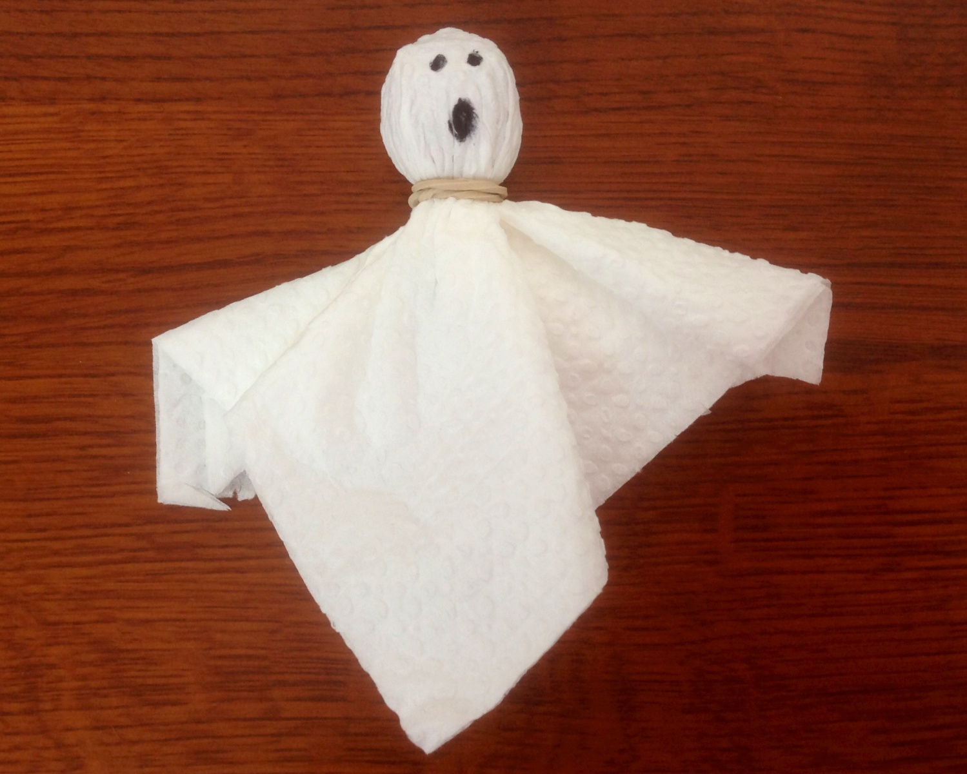
Make a Halloween Ghost
Materials: You will need two napkins, one elastic band, and one sucker. You will also need to share a black marker.
Instructions: Place the sucker inside the double layer of napkins and then wrap the elastic band around the neck. Finally, add eyes and a mouth as desired.
Enjoy eating your ghost!!!

Slide 33

Have a Treat
Break
Let’s Take a Picture

Slide 34
HOW MANY WORDS YOU CAN MAKE FROM THE LETTERS IN
“HALLOWEEN”
YOU MAY ONLY USE THE LETTERS IN HALLOWEEN.

Slide 35
WORDS YOU CAN MAKE FROM “HALLOWEEN”
a ale all allow alone an aw awl eel ell eon | ha hale hall hallow haw heal heel hell hello hen ho | hoe hole hon hone how howl la lane law lawn Lea | lean lee loan lone low new no now oh on one | owe owl own wale wall we wean well whale wheel when | whoa whole woe won

Slide 36
Questions
Questions for and from
the Professors
about Halloween.

Slide 37
Trick or Treat!!!!!
Harry Potter
&
The Snake

Slide 38
Communication
“Dear Stefanie, Dinner tasted awful, and it smelled
so I am leaving you
I have to just go
I have taken all my things
Just can’t stand you
I won’t be back
I have had enough
Enjoy your life
Goodbye,

Slide 39
Communication requires knowing both sides of the story.
“Dear Stefanie, Dinner tasted awful
and it smelled,
so I am leaving you
I have to just go
I have taken all my things
Just can’t stand you
I won’t be back
I have had enough
Enjoy your life
Goodbye,
ly good,
great,
a note,
to the library.
I need to study.
r being gone.
until 8 PM.
dinner. Thanks.
cereal as a snack.
Love, Max”

Slide 40
What are some of the topics you would like to discuss in class and/or English Corners?

Slide 41

Talking Dice--Speaking Activity
Divide into assigned groups
Roll the dice and answer the number of the question you rolled.
If you have already answered the question then answer question #1. If you have answered that question #1
then roll the dice again.

Slide 42
TD-2
What is something you have never done that you want to try? Why?
What is something you really like about yourself? Why?
If you could develop a new talent / ability, what would want it to be. Why?
Talk about something in your life you will never forget.
Tell about someone you really admire. Explain why.
Share something that none of us know about you.
My life’s dream is___________________.
Why is exercise important and which exercise do you like most? Why?
What can you be doing now that will improve your life in ten years?
Do you tend to have a positive or negative attitude? Explain.
Do you prefer being a leader or a follower? Explain.
What would you do with a million yuan? Why?

Slide 43
TD-3
If you could be someone else, who would you want to be? Why?
What is something you feel too young to do? Explain.
What is something you feel too old to do? Explain.
Talk about the importance of keeping your promises?
What is it about your university experience that is most challenging?
What could you do to improve your health? Explain.
If you were a teacher, what subject(s) would you like to teacher? Why?
Why would you be a good teacher?
Would you ever consider being a farmer? Why?
Would you ever consider moving to a foreign country? Why?
Would you ever consider getting plastic surgery? Explain.
How important is one’s physical appearance? Explain.

Slide 44
TD-4
What would you do if your boss asked you to do something illegal?
Would you ever consider donating a kidney or other vital organ? Why?
What is the best way for you to help the poor? Explain.
Is telling a lie ever justified? Explain.
How do you control your anger? Explain.
What are your thoughts about smoking?
How will you discipline your child? Is spanking okay? Explain.
What are your feelings about arranged marriages? Explain.
What qualities do you look for in a good friend?
Do you ever feel unsafe? Explain?
What should we do to make the world a safer place? Explain.
What do you want to do during the next summer break? Why?

Slide 45
Unfinished Sentences:
Finish these sentences by adding your own words.
On Saturdays, I like to____________
If I had only 24 hours to live, I would__________
I feel best when people_____________
Secretly I wish_____________
If I could change the world, I would____ because_____
The most exciting thing I have done is_____
TD-5
Right now the most important thing in my life is_____ because_________________
If I could be somewhere else now, I’d______________
I never worry about_____________________
I like people who________________
I find it difficult to_______________________
Studying is________________________________

Slide 46
What qualities do you appreciate in a good friend? Explain. TD-6
What is the most exotic food you have eaten? Describe.
Who are the very most important people in your life? Explain.
What are the things that stress university students the most? Explain.
What is the best advice you have ever been given? Explain.
What is the best advice that you have ever shared with someone? Explain.
What is the biggest challenge for young people today? Explain.
What time should all electronic devices be turned off at night? Why?
Can a person be poor and still be happy? Explain.
What do you think the world will be like in 25 years? Explain.
What are your thoughts about America?
What are your thoughts about Africa?

Slide 47
TD-1
Describe your bedroom at home?
How should we reduce pollution?
What advice do you have for a failing student?
What time should students turn off their electronic devices and go to sleep?
How will you apply for your first job after graduation?
Describe the last party that you attended?
What do you think the purpose of life is?
Why do you want to learn to speak English fluently?
What is one thing you’ve learned this week?
Describe your best friend from high school? What made this person special?
What are your thoughts about smoking/drinking alcohol/using drugs?
What benefits do you receive when you volunteer?

Slide 48
Vocabulary Builders
Instructions:
  Form groups of three or four people.
  Distribute the vocabulary card so each person in your group has one.
  Taking turns, each person then pronounces each word on his/her card.
  When everyone is finished, pass your card one person to the left and then each person pronounces the words on his/new card.
  Repeat the process until everyone has had a chance to pronounce the words on each card.
  Note: If someone needs help pronouncing a word, other group members should provide assistance.

Slide 49

Five Phases of Dating
Phase I – Meeting lots of people.
  Group parties/gatherings.
  Speed Dating and other group games.
Phase II – Making Friends
  Eating lunch or dinner together.
  Studying or going for a walk together.
  Sharing family stories and personal goals.
  Phase III – Formal Dating.
    Planned activities designed to help you know each other better.
    Should begin to be more personable, but set limits as to the time you spend alone with each other and limits to intimacy.

Slide 50

Five Phases of Dating
Phase IV Paring up/Going Steady
  Share your important beliefs and values.
  Introduce each other to your respective families.
  Begin to plan for the future—education, employment, home and family goals.
  Continue to practice limits regarding time alone together and sharing of intimacy.
Phase V Formal Engagement
  The marriage proposal.
  Approval of both sets of parents.
  Set a wedding date.
  Plan more intensely for your wedding and future life together.
  Continue to practice limits regarding time alone together and sharing of intimacy.

Slide 51
Describe your feelings about leaving your home and province for four years.
Try to describe your feelings as you return after successfully completing your B.S or B.A. degree in four years.
Try to describe the feelings of your parents as you return to your home as a college graduate.
Try your best to describe your first day on the job of your dreams.
Describe your future husband or wife.
What do you think your feelings will be when your first child leaves home to go to a school?
What do you think the purpose of life is?
Where do you think you will go when you or your parents die?
Why do you believe that?
Do you believe you came from some where else when you were born? Why do you believe that?
Suppose you move to Australia which has a different form of government. How will that change the way you act in your life, Why?
What about living in Australia would make you nervous?
What do you think you will do to adjust to that concern?

Slide 52

ETHICAL DILEMMAS

Slide 53
Integrity
“Integrity without knowledge is weak and useless and knowledge without integrity is dangerous and dreadful.” (Samuel Johnson (1709-1784) English Poet, Critic and Writer)

Slide 54
VOCABULARY
ethics – the principles (rules) of conduct
governing an individual or a group, the
discipline dealing with what is good
and bad and moral duty and obligation
ethical – moral, conforming to accepted
rules and standards of conduct
moral – principles of right and wrong
behavior
dilemma – a situation involving a choice
between alternatives

Slide 55
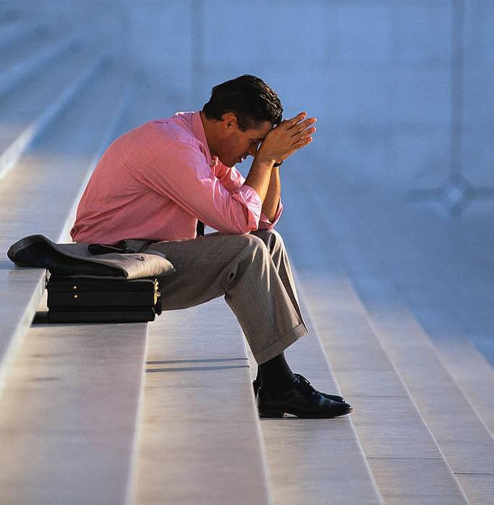
expelled – kicked out of school,
suspended from school
0 tolerance – no exceptions, no second
chances
full ride – a scholarship which pays
tuition, books, room and board
Win Win – Solutions in which all parties are better off

Slide 56
ETHICAL DILEMMA
(VICE PRINCIPAL)
You are the vice principal in charge of discipline of a high school. It is your responsibility to see that all students follow the rules and are treated fairly and equally. It is the policy of your school that students caught with alcohol, drugs or weapons on campus will be expelled—0 tolerance.

Slide 57
Your daughter is a senior at the high school. She is an outstanding basketball and volleyball player and is a top academic student. She has applied to several universities and for scholarships that would pay virtually all of her costs at any of these colleges. She is almost certain to be accepted and to receive a full ride at all schools to which she has applied.

Slide 58
One evening, you are supervising a school dance. You need to speak to your daughter and can’t find her. You finally go into the darkened girls’ locker room and hear voices. One is your daughter’s voice and as you listen, you realize they are drinking alcohol. They do not see you.
What will you do?

Slide 59

Life is full of choices and decisions and many of them will present us with moral and ethical dilemmas. Some of these choices and decisions will challenge
the very principles,
standards and values
we were taught by
our family. When
faced with these
moral dilemmas,
what will you do?

Slide 60
Halloween Bingo
Materials: Bingo Score Card and pen.
Instructions: Halloween related words will be drawn out of a jar. When a word is drawn that matches one of your words, place a X in the corner of that word’s square.
The first person to get five words in any straight line (up and down; across, or diagonal calls out “Bingo.” The person then reads his/her words to verify accuracy. If all are correct; he/she is declared the winner.
Play will then resume until a person has a X in all of his/her squares. If all are correct; he/she is declared the Grand Champion.

