Slide 1

Welcome to English Corner
Professors
John and Marie Murdoch

Slide 2
Next English Corner
Thursday, October 30, 2014
7 PM
Bring a friend!
Have
a
Treat.
Let’s have some Fun!
Come One; Come ALL

Slide 3
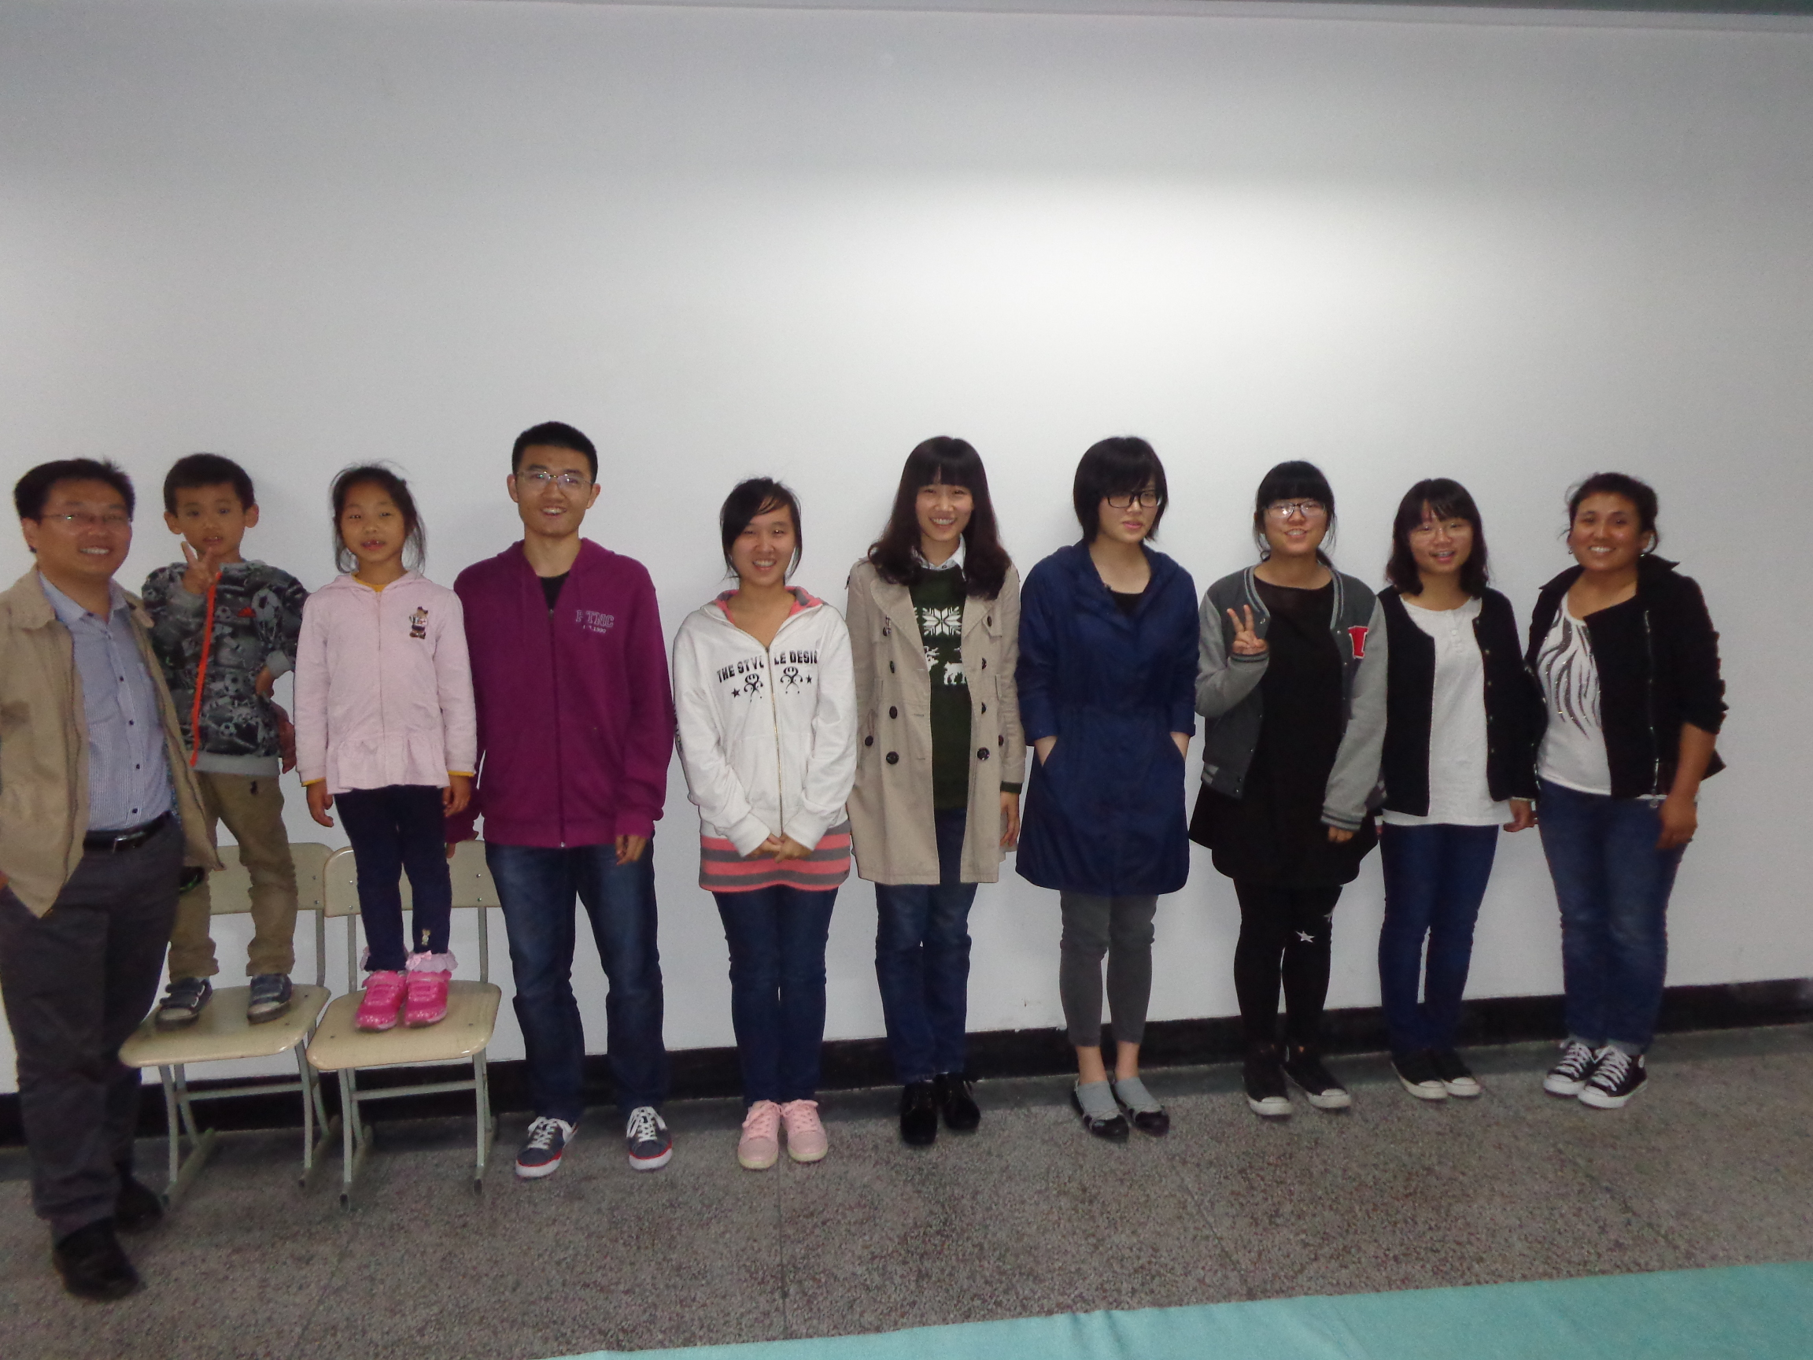
Our English Corner Friends
October 16, 2014

Slide 4
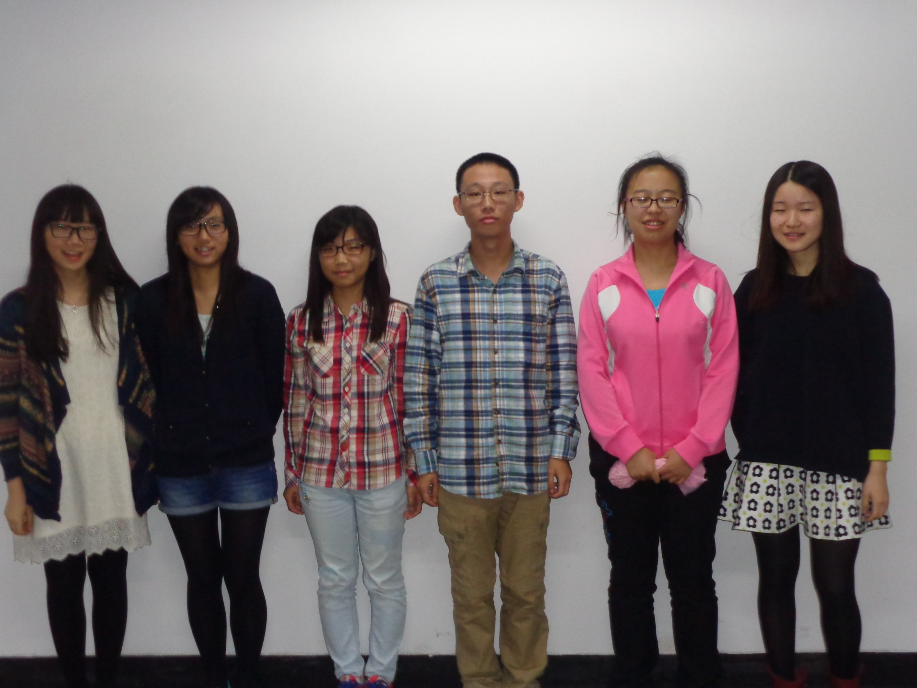
Our English Corner Friends
October 16, 2014

Slide 5
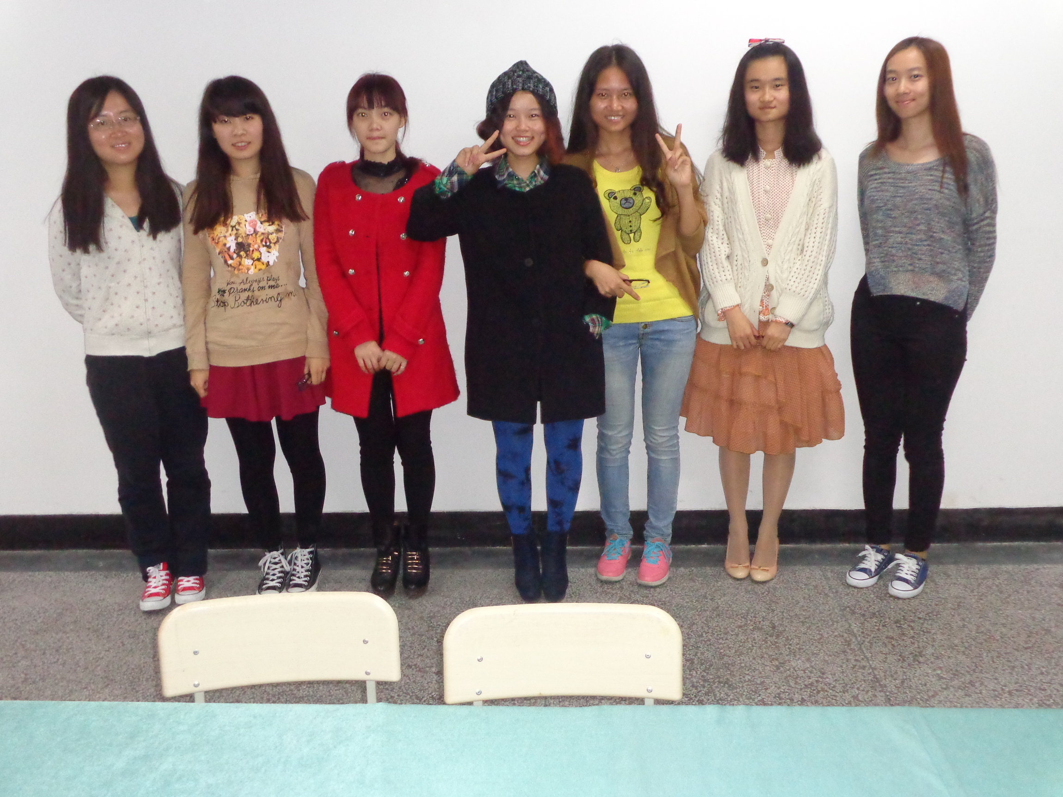
Our English Corner Friends
October 16, 2014

Slide 6
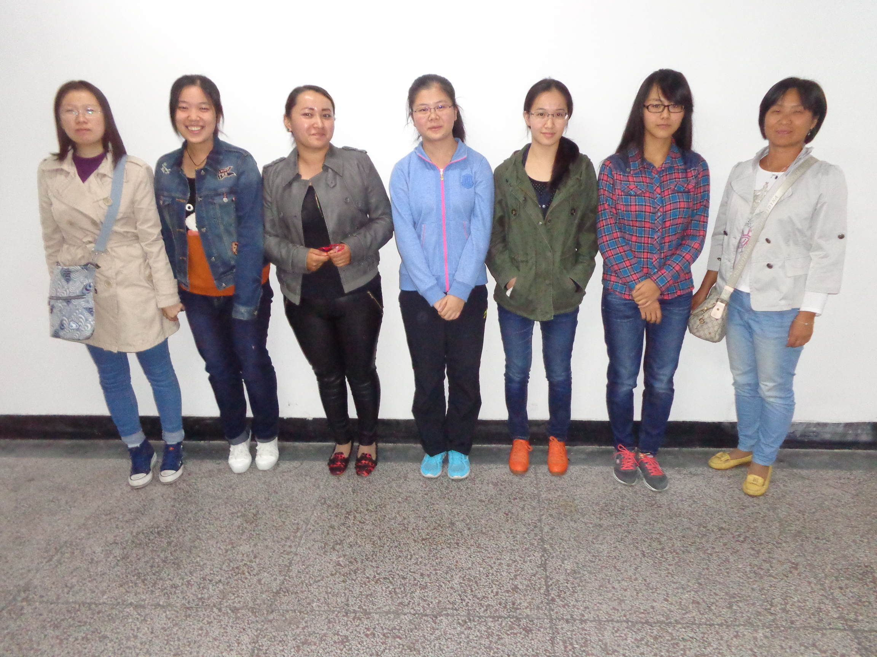
Our English Corner Friends
October 16, 2014

Slide 7
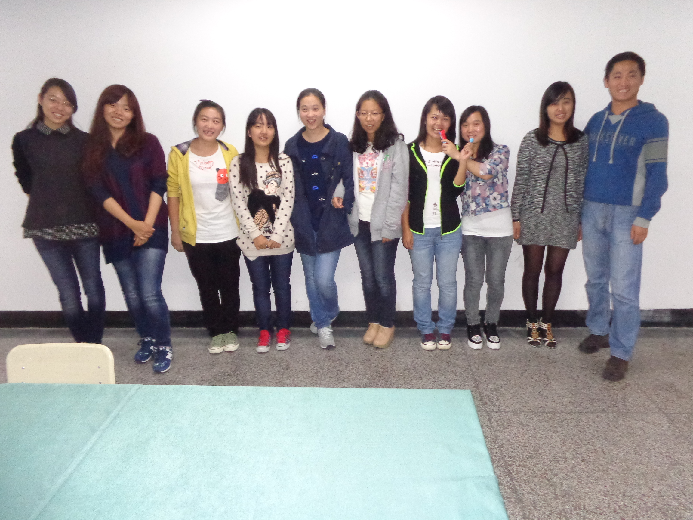
Our English Corner Friends
October 16, 2014

Slide 8
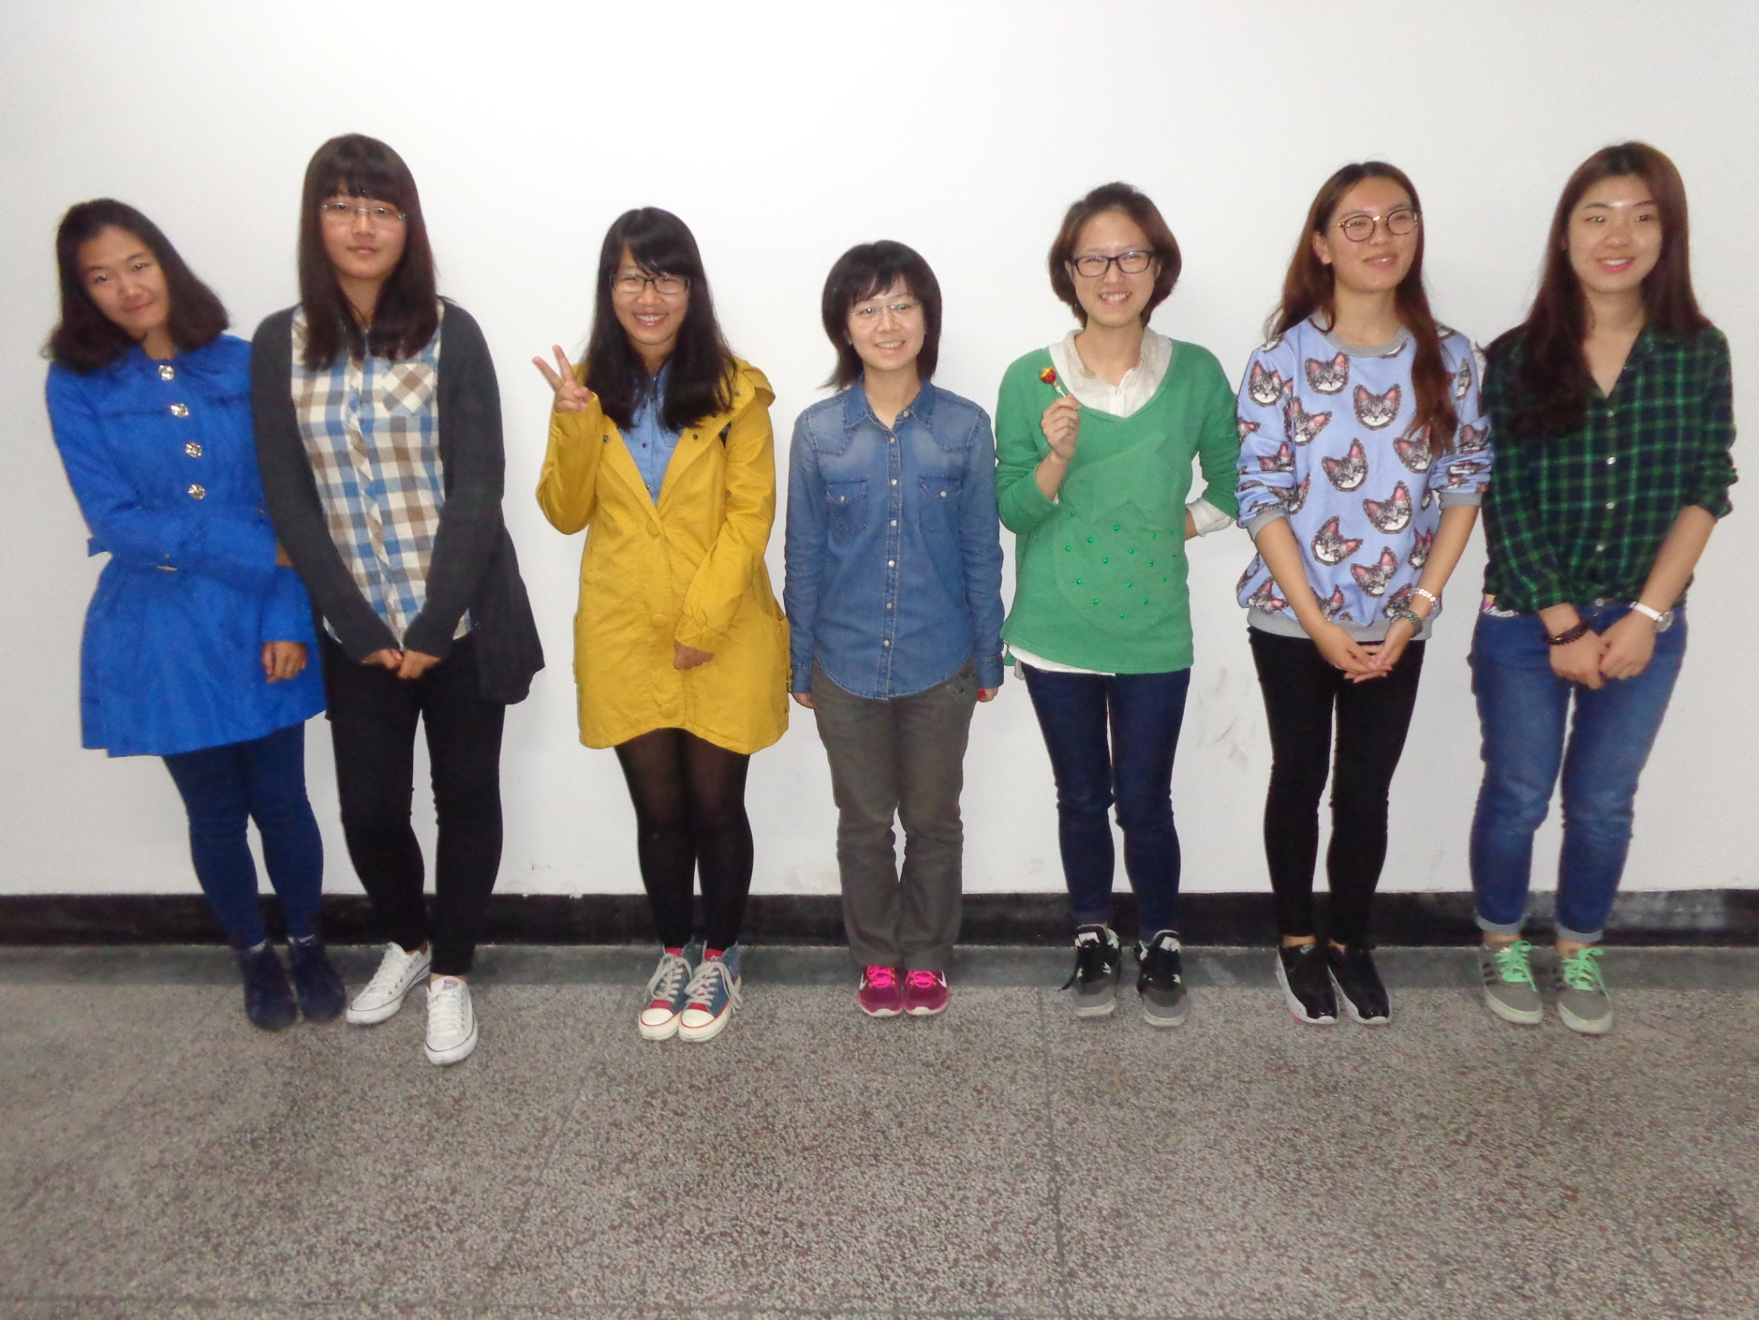
Our English Corner Friends
October 16, 2014

Slide 9

Let’s
Sing
Monster
Mash

Slide 10
Did anyone write a Limerick?
Limericks are short (sometimes serious; sometime silly) poems that are fun to recite.
A: What is a limerick, Mother?
A: It's a form of verse, said brother
B: In which lines one and two
B: Rhyme with five when it's through
A: And three and four rhyme with each other.

Slide 11
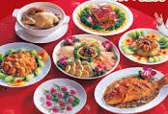

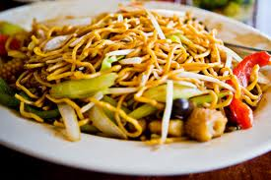
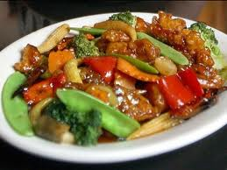
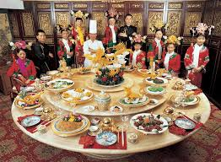
The Foods We Love to Eat
Oh how do you love tasty food,
You know the best you’ve ever chewed--
Delectable and scrumptious,
Delicious and luscious,
That leaves you in a savory mood!

Slide 12










Fast Food Establishments
In recent years, reduced leisure time in China has led to a consumer shift away from traditional full-service restaurants toward fast-food establishments. Over the five years to 2012, revenue for the Fast-Food Restaurant industry in China grew at an annualized rate of 16.9% to $89.6 billion, says IBISWorld.

Slide 13
Meet & Greet
Let’s Have a Chat!!!!
Introduce yourself:
  Name
Topic:
My favorite Foods

Slide 14
Comparisons of Cultures
Fast Food
America
China
Burgers (beef / chicken)
Hotdogs
French Fries
Tacos (Mexican)
Soda Pop
Pizza
Ice Cream Cones, Malts, Ice Cream Sundays
Fried rice /Sweet & Sour pork or chicken
Chicken Nuggets
Fried Chicken

Slide 15
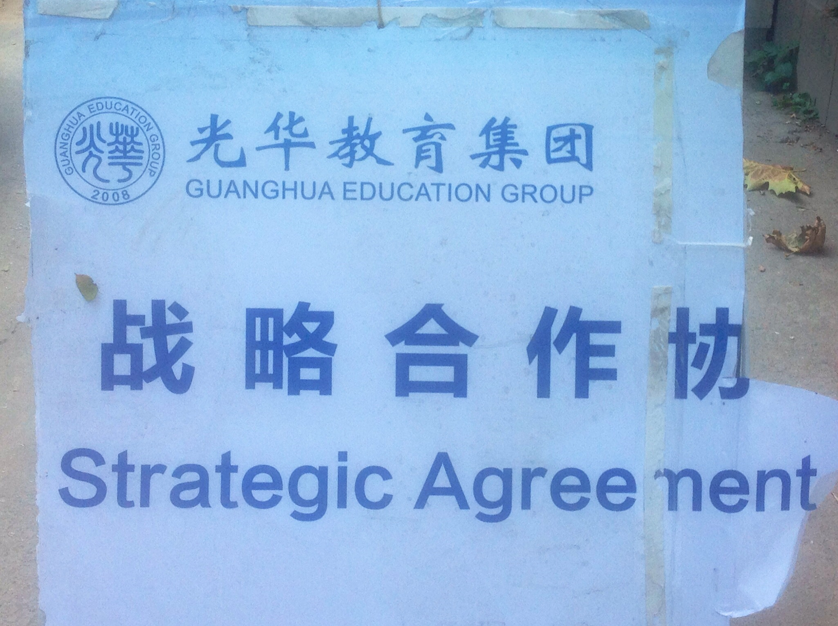

Slide 16
Choosing the favorite Fast Food Restaurant
Caucus Format
A caucus is a format for making a group decision.
Caucus rules:
  Divide into assigned groups.
  Appoint a spokesperson.
  From the list of fast food restaurants (select) the one that your group prefers. Your decision, must be based upon some rational criteria i.e. quality, nutritional value, taste, cleanliness, etc.
  The spokesperson should be prepared to announce your groups choice and the reasons for the choice.
  Restaurants/food choices receiving the fewest votes will be dropped from the list and the process will be repeated until there is only one restaurant/food choice remaining or until one has the majority of the votes.

Slide 17
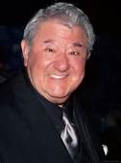
Food Humor
As a child my family’s menu consisted of two choices: take it or leave it!
(Buddy Hackett, American Comedian)

Slide 18

Have a Treat
Break
Let’s Take a Picture

Slide 19

This is not Communication!!!

Slide 20

This is Communication

Slide 21

Effective Communication
Speaking
Listening
Eye Contact.
Undivided attention.
Think about what you are saying.
Speak with your heart.
Use a soft, gentle voice.
Be responsible; do not blame others—speak the truth.
Smile and nod to show your sincerity.
Eye contact.
Undivided attention.
Think about what is being said.
Listen with your heart.
Reflect what is being said.
Smile and nod to show you understand and have empathy.

Slide 22
Listen Actively
Seek first to understand and then seek to be understood.
Actively listening is about listening with all of our senses and making sure that we understand the other person's views and thoughts before speaking our own.
Active listening requires watching for body language to help us understand what is being said.

Slide 23
A Story About Effective Communication
The 90/10 Principle

Slide 24

The 90/10 Principle,
an absolute truth to live by

Slide 25
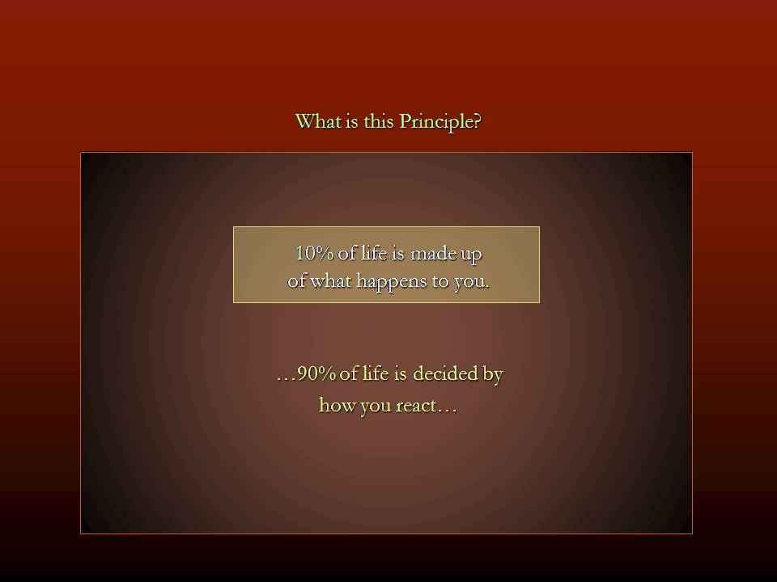

Slide 26
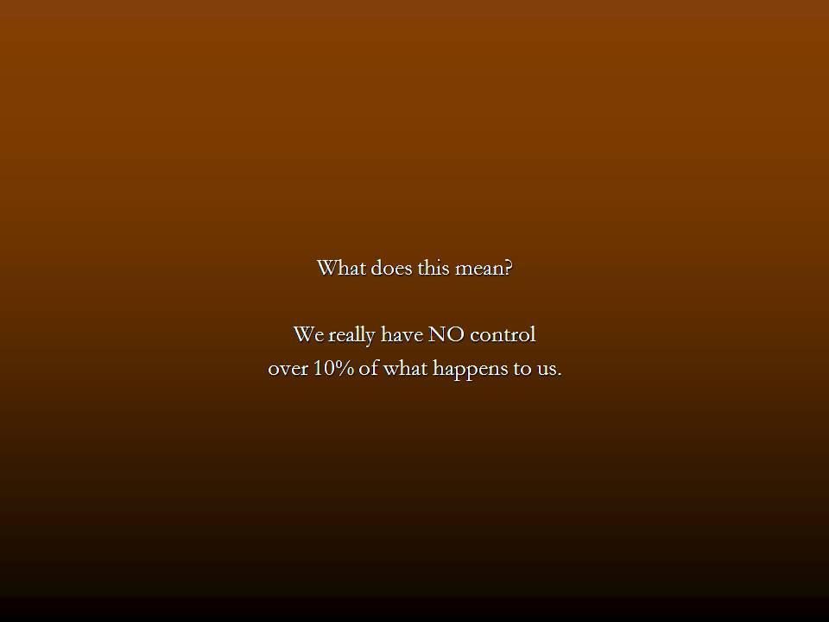

Slide 27
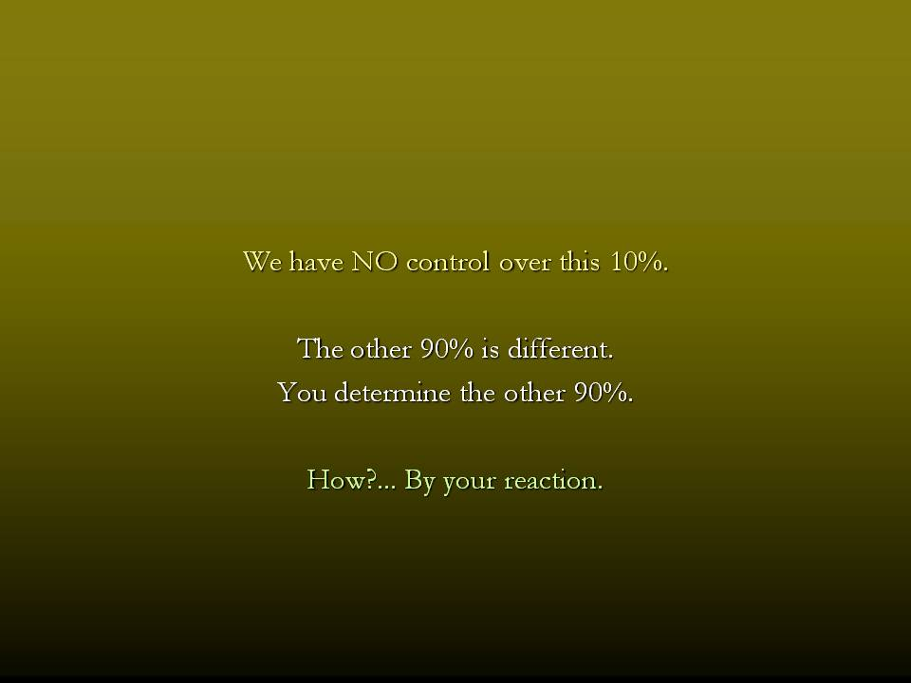

Slide 28
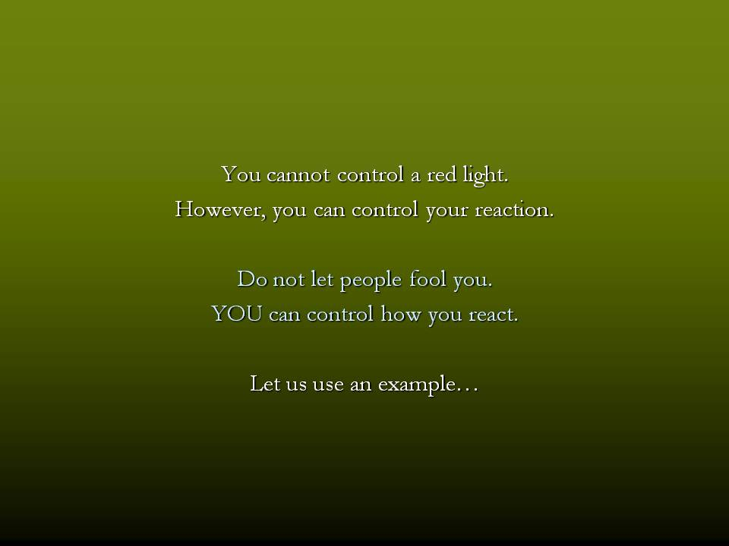

Slide 29


90/10 Principle
You are having breakfast with your family. Your daughter knocks over a cup of coffee; it splashes onto your new, white business shirt.
You have no control over what just happened.
You do have control over how you will react.

Slide 30


90/10 Principle
You curse, you harshly scold your daughter for knocking the cup over. She cries.
Next you criticize your wife for placing the cup to close to the end of the table. An argument ensues.

Slide 31


90/10 Principle
You storm upstairs to change your shirt. When you arrived downstairs, your daughter is too upset to finish her breakfast. She isn’t ready and misses her ride to school.

Slide 32

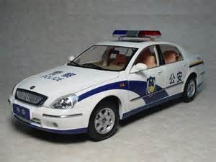
90/10 Principle
Your spouse must leave immediately for her work. So, you drive your daughter to school. You drive too fast and you are stopped by a police officer.
The police officer gives you a ticket for speeding. It will cost you 400 RMB.

Slide 33

90/10 Principle
After a 20 minute delay and a 400RMB fine, you arrive at school. Your daughter runs into school without saying goodbye.
You arrive at your office 30 minutes late.
You realize you forgot and left your briefcase at home, which contained many important papers.

Slide 34
90/10 Principle
Your day has started out terrible; you have a disagreement with your boss.
At the end of the workday, you are very tired and look forward to going home only to find that there is a wedge between you and your wife and daughter.

Slide 35
90/10 Principle
Did the coffee cause it?
Did your daughter cause it?
Did the policeman cause it?
Did your boss cause it?
Did you cause it?
Why did you have such a bad day?

Slide 36
90/10 Principle
Answer
E. You caused it!

Slide 37
Communication: The 90/10 Principle,
an absolute truth to live by.

Slide 38

You had no control over what happened to the coffee.
How you responded when the spill occurred is what caused the bad day!
How could you have handled the spilled coffee better?

Slide 39

The coffee splashes over you; your daughter begins to cry.
You gentle say, “It’s okay, honey, you just need to be more careful next time.”
Grabbing a towel, you clean-up the coffee; change your shirt, and pick-up your briefcase.
Your daughter smiles, waves and says, “Love you Daddy,” as she leaves for school.
You arrive at the office 5 minutes early and greet everyone with a smile.

Slide 40
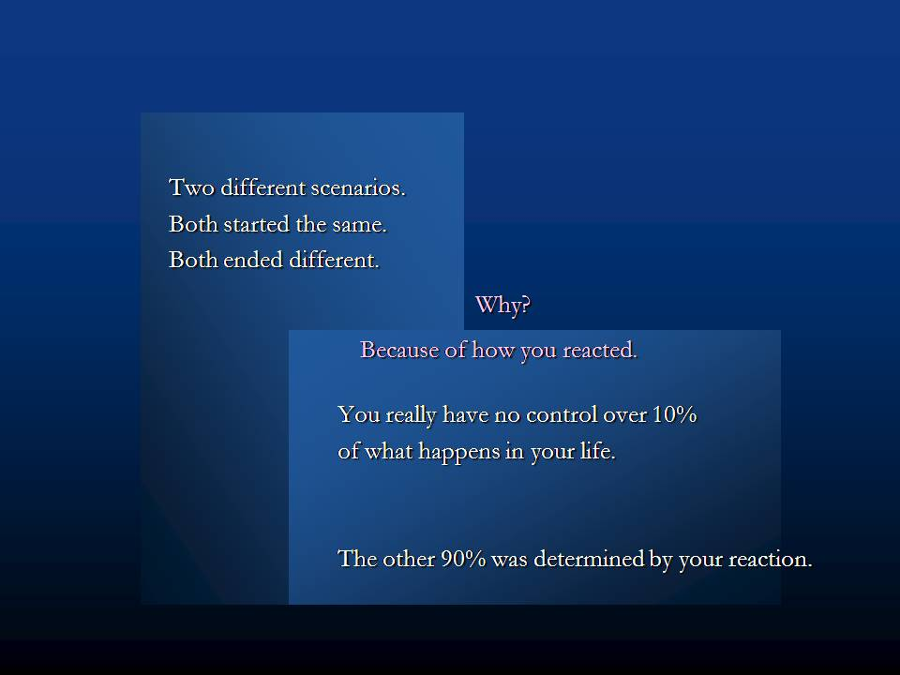

Slide 41
Two Different Scenarios
Both started with a spilled cup of coffee.
Both ended differently.
Discuss with your seat partners.
Why?

Slide 42


Slide 43
What have you learned so far?
Share what you have learned about communication with the people seated next to you.
What questions do you have for us?

Slide 44
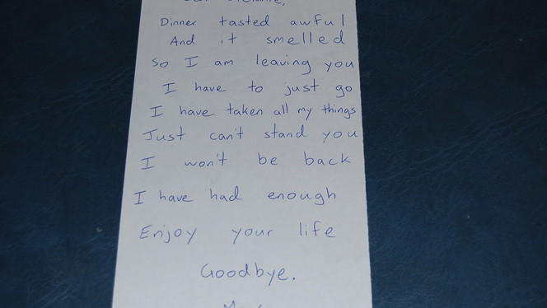

Slide 45
Communication
“Dear Stefanie, Dinner tasted awful, and it smelled
so I am leaving you
I have to just go
I have taken all my things I need
Just can’t stand you
I won’t be back
I have had enough dinner. Thanks.
Enjoy your life
Goodbye,

Slide 46
Communication requires knowing both sides of the story.
“Dear Stefanie, Dinner tasted awful
and it smelled,
so I am leaving you
I have to just go.
I have taken all my things I need
Just can’t stand you
I won’t be back
I have had enough dinner.
Enjoy your life
Goodbye,
ly good,
great,
a note,
to the library.
I need to study.
r being gone.
until 8 PM.
dinner. Thanks.
cereal as a snack.
Love, Max”

Slide 47
Questions
Questions for and from
the Professors.

Slide 48
What are some of the topics you would like to discuss in class and/or English Corners?

Slide 49

Talking Dice--Speaking Activity
Divide into assigned groups
Roll the dice and answer the number of the question you rolled.
If you have already answered the question then answer question #1. If you have answered that question #1
then roll the dice again.

Slide 50
TD-2
What is something you have never done that you want to try? Why?
What is something you really like about yourself? Why?
If you could develop a new talent / ability, what would want it to be. Why?
Talk about something in your life you will never forget.
Tell about someone you really admire. Explain why.
Share something that none of us know about you.
My life’s dream is___________________.
Why is exercise important and which exercise do you like most? Why?
What can you be doing now that will improve your life in ten years?
Do you tend to have a positive or negative attitude? Explain.
Do you prefer being a leader or a follower? Explain.
What would you do with a million yuan? Why?

Slide 51
TD-3
If you could be someone else, who would you want to be? Why?
What is something you feel too young to do? Explain.
What is something you feel too old to do? Explain.
Talk about the importance of keeping your promises?
What is it about your university experience that is most challenging?
What could you do to improve your health? Explain.
If you were a teacher, what subject(s) would you like to teacher? Why?
Why would you be a good teacher?
Would you ever consider being a farmer? Why?
Would you ever consider moving to a foreign country? Why?
Would you ever consider getting plastic surgery? Explain.
How important is one’s physical appearance? Explain.

Slide 52
TD-4
What would you do if your boss asked you to do something illegal?
Would you ever consider donating a kidney or other vital organ? Why?
What is the best way for you to help the poor? Explain.
Is telling a lie ever justified? Explain.
How do you control your anger? Explain.
What are your thoughts about smoking?
How will you discipline your child? Is spanking okay? Explain.
What are your feelings about arranged marriages? Explain.
What qualities do you look for in a good friend?
Do you ever feel unsafe? Explain?
What should we do to make the world a safer place? Explain.
What do you want to do during the next summer break? Why?

Slide 53
Unfinished Sentences:
Finish these sentences by adding your own words.
On Saturdays, I like to____________
If I had only 24 hours to live, I would__________
I feel best when people_____________
Secretly I wish_____________
If I could change the world, I would____ because_____
The most exciting thing I have done is_____
TD-5
Right now the most important thing in my life is_____ because_________________
If I could be somewhere else now, I’d______________
I never worry about_____________________
I like people who________________
I find it difficult to_______________________
Studying is________________________________

Slide 54
What qualities do you appreciate in a good friend? Explain. TD-6
What is the most exotic food you have eaten? Describe.
Who are the very most important people in your life? Explain.
What are the things that stress university students the most? Explain.
What is the best advice you have ever been given? Explain.
What is the best advice that you have ever shared with someone? Explain.
What is the biggest challenge for young people today? Explain.
What time should all electronic devices be turned off at night? Why?
Can a person be poor and still be happy? Explain.
What do you think the world will be like in 25 years? Explain.
What are your thoughts about America?
What are your thoughts about Africa?

Slide 55
TD-1
Describe your bedroom at home?
How should we reduce pollution?
What advice do you have for a failing student?
What time should students turn off their electronic devices and go to sleep?
How will you apply for your first job after graduation?
Describe the last party that you attended?
What do you think the purpose of life is?
Why do you want to learn to speak English fluently?
What is one thing you’ve learned this week?
Describe your best friend from high school? What made this person special?
What are your thoughts about smoking/drinking alcohol/using drugs?
What benefits do you receive when you volunteer?

Slide 56
Vocabulary Builders
Instructions:
  Form groups of three or four people.
  Distribute the vocabulary card so each person in your group has one.
  Taking turns, each person then pronounces each word on his/her card.
  When everyone is finished, pass your card one person to the left and then each person pronounces the words on his/new card.
  Repeat the process until everyone has had a chance to pronounce the words on each card.
  Note: If someone needs help pronouncing a word, other group members should provide assistance.

Slide 57

Five Phases of Dating
Phase I – Meeting lots of people.
  Group parties/gatherings.
  Speed Dating and other group games.
Phase II – Making Friends
  Eating lunch or dinner together.
  Studying or going for a walk together.
  Sharing family stories and personal goals.
  Phase III – Formal Dating.
    Planned activities designed to help you know each other better.
    Should begin to be more personable, but set limits as to the time you spend alone with each other and limits to intimacy.

Slide 58

Five Phases of Dating
Phase IV Paring up/Going Steady
  Share your important beliefs and values.
  Introduce each other to your respective families.
  Begin to plan for the future—education, employment, home and family goals.
  Continue to practice limits regarding time alone together and sharing of intimacy.
Phase V Formal Engagement
  The marriage proposal.
  Approval of both sets of parents.
  Set a wedding date.
  Plan more intensely for your wedding and future life together.
  Continue to practice limits regarding time alone together and sharing of intimacy.

Slide 59
Describe your feelings about leaving your home and province for four years.
Try to describe your feelings as you return after successfully completing your B.S or B.A. degree in four years.
Try to describe the feelings of your parents as you return to your home as a college graduate.
Try your best to describe your first day on the job of your dreams.
Describe your future husband or wife.
What do you think your feelings will be when your first child leaves home to go to a school?
What do you think the purpose of life is?
Where do you think you will go when you or your parents die?
Why do you believe that?
Do you believe you came from some where else when you were born? Why do you believe that?
Suppose you move to Australia which has a different form of government. How will that change the way you act in your life, Why?
What about living in Australia would make you nervous?
What do you think you will do to adjust to that concern?

Slide 60

ETHICAL DILEMMAS

Slide 61
Integrity
“Integrity without knowledge is weak and useless and knowledge without integrity is dangerous and dreadful.” (Samuel Johnson (1709-1784) English Poet, Critic and Writer)

Slide 62
VOCABULARY
ethics – the principles (rules) of conduct
governing an individual or a group, the
discipline dealing with what is good
and bad and moral duty and obligation
ethical – moral, conforming to accepted
rules and standards of conduct
moral – principles of right and wrong
behavior
dilemma – a situation involving a choice
between alternatives

Slide 63

expelled – kicked out of school,
suspended from school
0 tolerance – no exceptions, no second
chances
full ride – a scholarship which pays
tuition, books, room and board
Win Win – Solutions in which all parties are better off

Slide 64
ETHICAL DILEMMA
(VICE PRINCIPAL)
You are the vice principal in charge of discipline of a high school. It is your responsibility to see that all students follow the rules and are treated fairly and equally. It is the policy of your school that students caught with alcohol, drugs or weapons on campus will be expelled—0 tolerance.

Slide 65
Your daughter is a senior at the high school. She is an outstanding basketball and volleyball player and is a top academic student. She has applied to several universities and for scholarships that would pay virtually all of her costs at any of these colleges. She is almost certain to be accepted and to receive a full ride at all schools to which she has applied.

Slide 66
One evening, you are supervising a school dance. You need to speak to your daughter and can’t find her. You finally go into the darkened girls’ locker room and hear voices. One is your daughter’s voice and as you listen, you realize they are drinking alcohol. They do not see you.
What will you do?

Slide 67

Life is full of choices and decisions and many of them will present us with moral and ethical dilemmas. Some of these choices and decisions will challenge
the very principles,
standards and values
we were taught by
our family. When
faced with these
moral dilemmas,
what will you do?

