Slide 1

Welcome to English Corner
Professors
John and Marie Murdoch

Slide 2
Next English Corner
Thursday, October 16, 2014
7 PM
Bring a friend!
Have
a
Treat.
Let’s have some Fun!
Come One; Come ALL

Slide 3
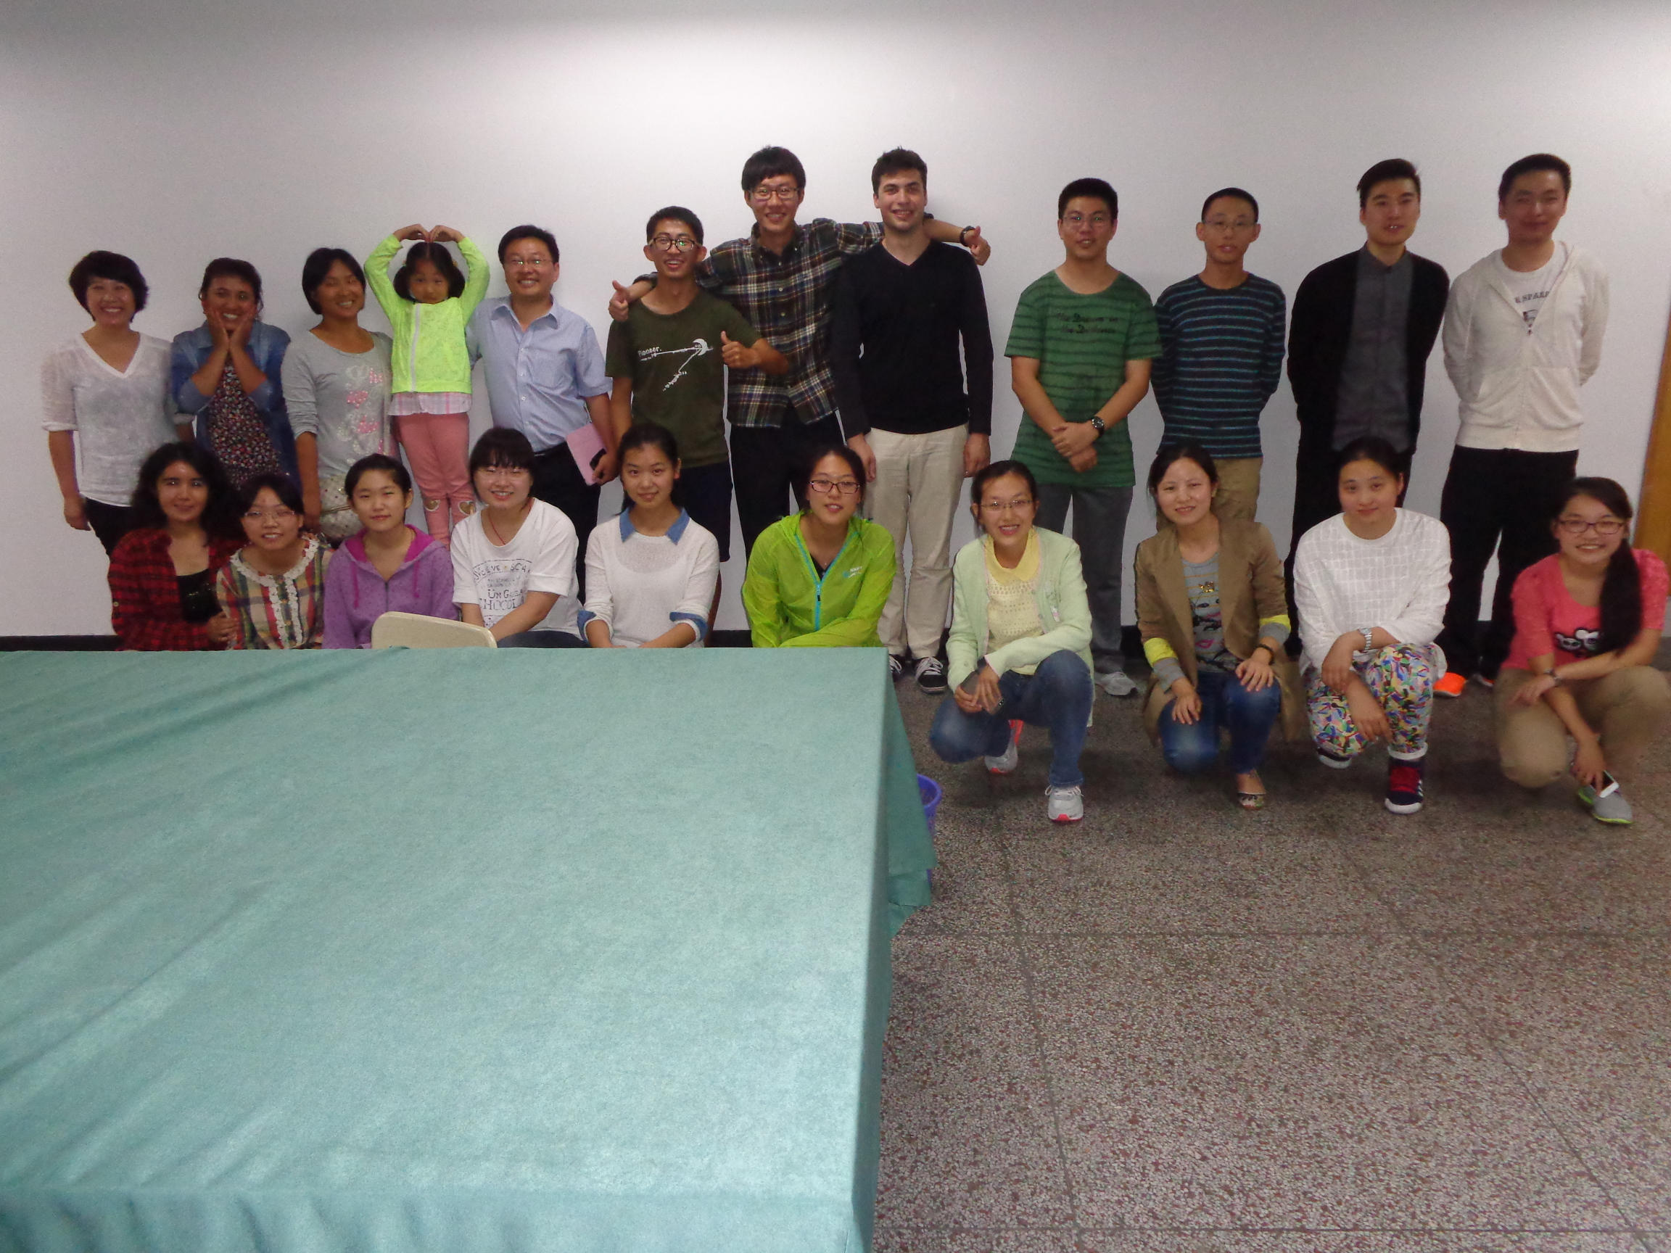
Our English Corner Friends
October 9, 2014

Slide 4
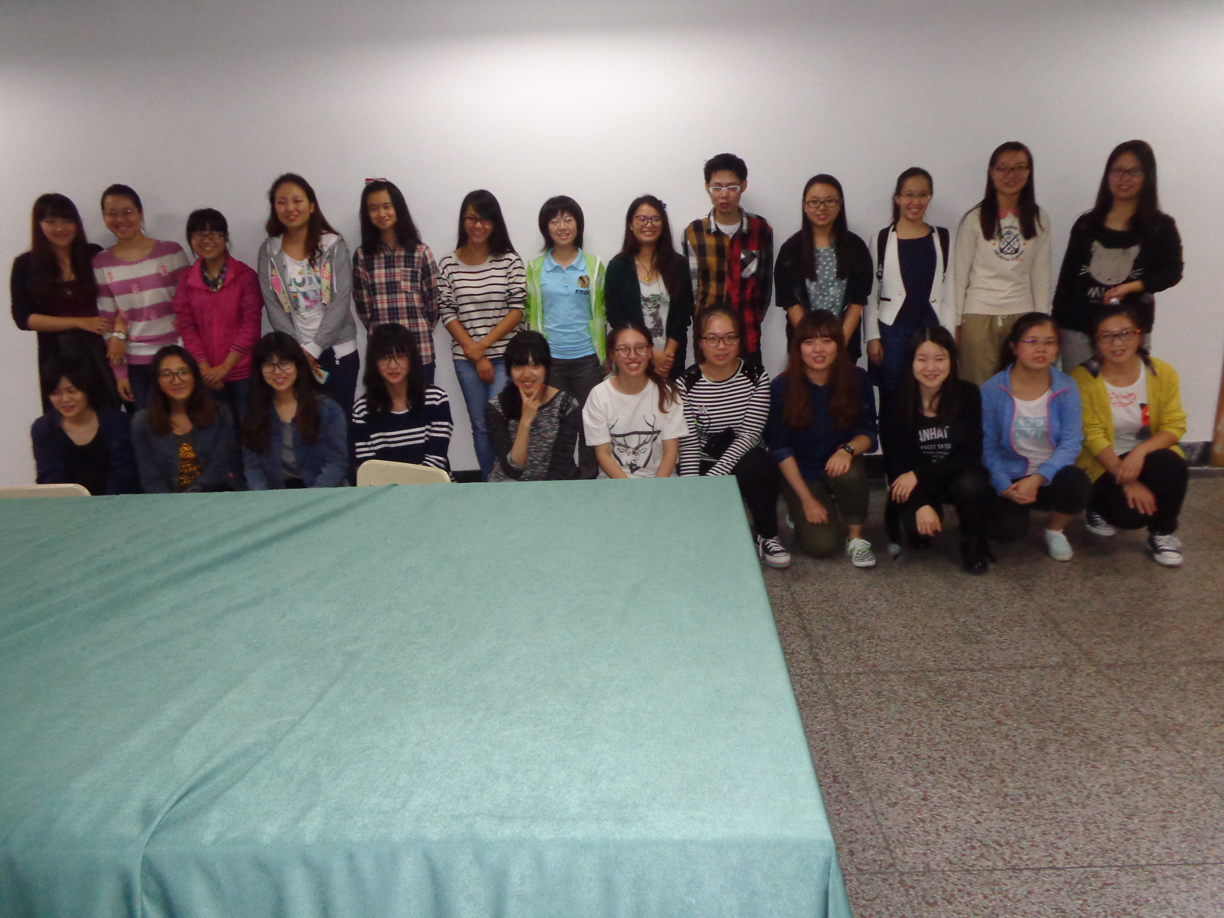
Our English Corner Friends
October 9, 2014

Slide 5

Let’s
Sing
China’s National Anthem

Slide 6

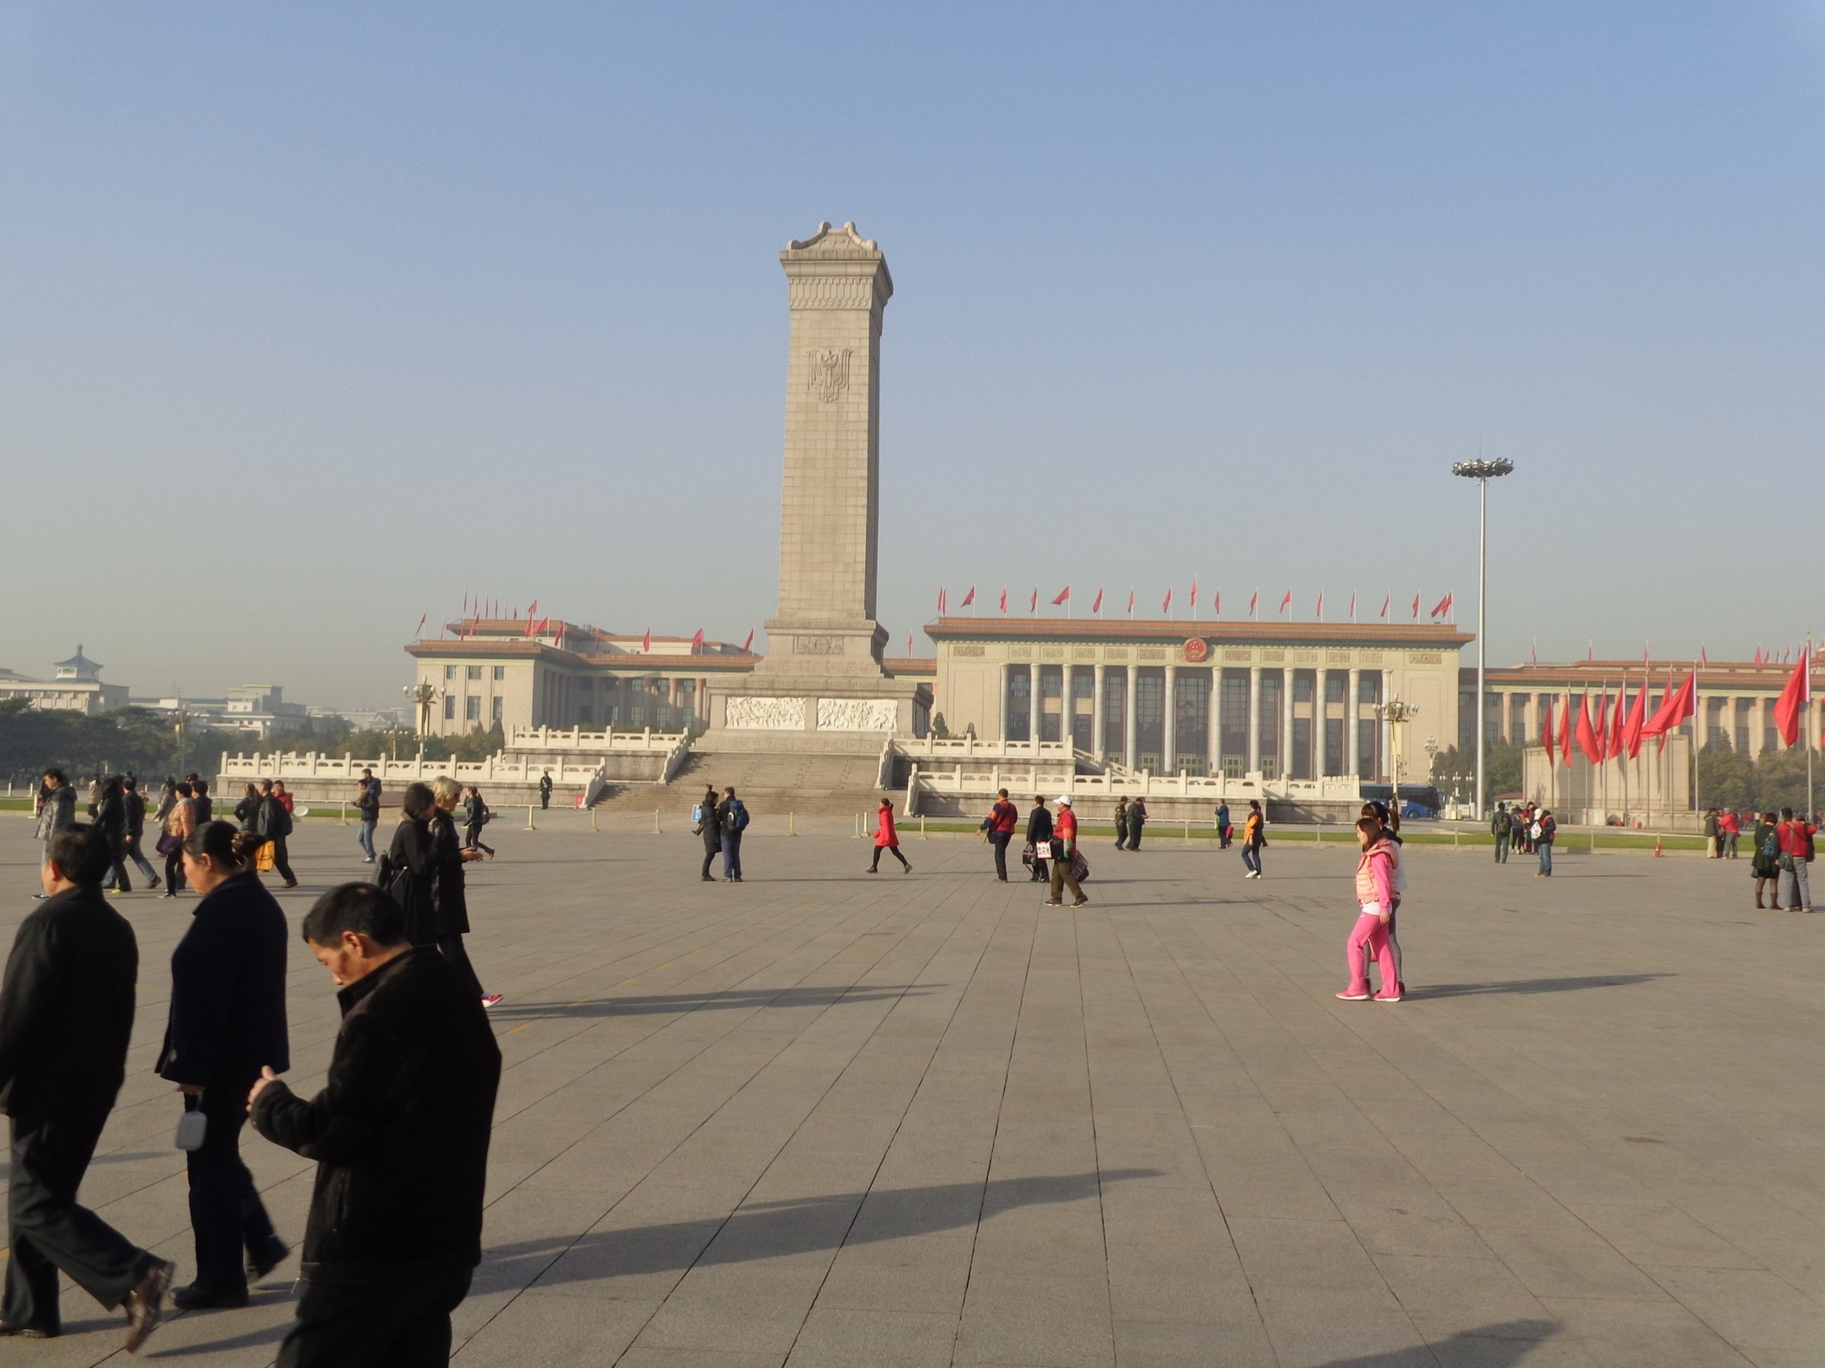

The Amazing China
March of the Volunteers
Arise, ye who refuse to be slaves
With our very flesh and blood Let us build our new Great Wall!
The Peoples of China are in the most critical time,
Everybody must roar his defiance.
Arise! Arise! Arise! Millions of hearts with one mind,
Brave the enemy's gunfire, March on! Brave the enemy's gunfire,
March on! March on! March on, on!
The People’s Square

Slide 7

This Land is My Land

Slide 8
Did anyone write a Limerick?
Limericks are short (sometimes serious; sometime silly) poems that are fun to recite.
A: What is a limerick, Mother?
A: It's a form of verse, said brother
B: In which lines one and two
B: Rhyme with five when it's through
A: And three and four rhyme with each other.

Slide 9
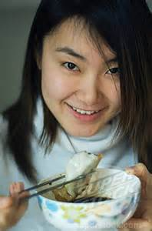
Holidays
We love holidays so very much,
For we love to stay in touch,
With friends and family,
Visiting happily,
Eating sweet dumplings and such.

Slide 10



National Holiday
I love our national holiday.
We celebrate in a special way,
With parades and fireworks,
Lots of parties and perks,
And homage to our country we pay.

Slide 11

Tell Me a Story

Slide 12


Slide 13
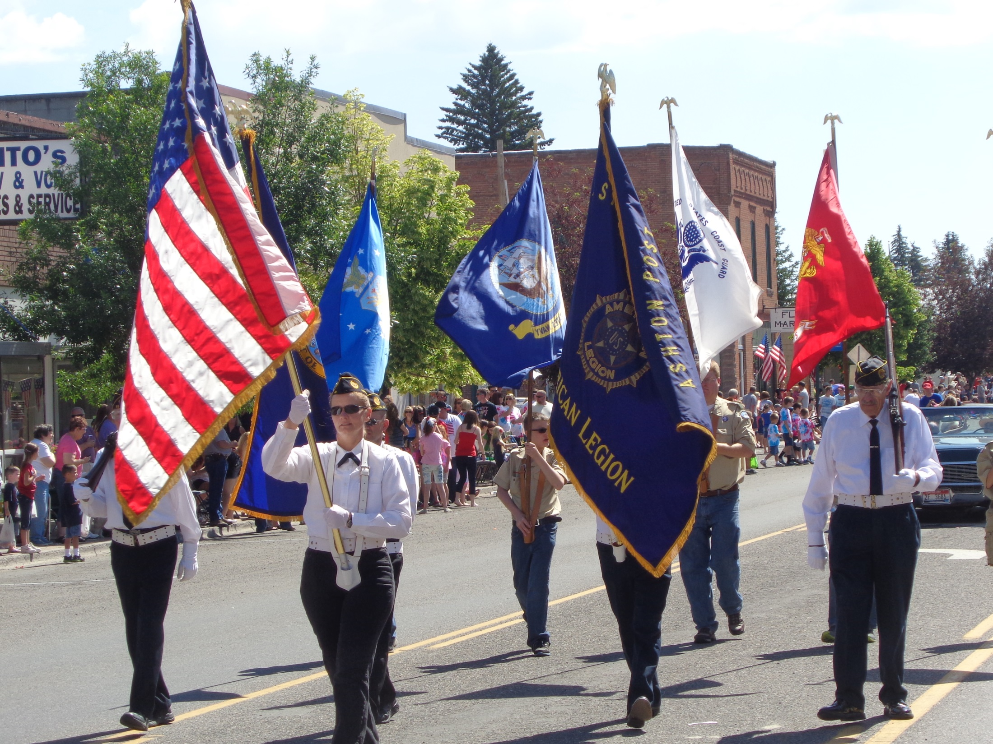

Slide 14


Slide 15
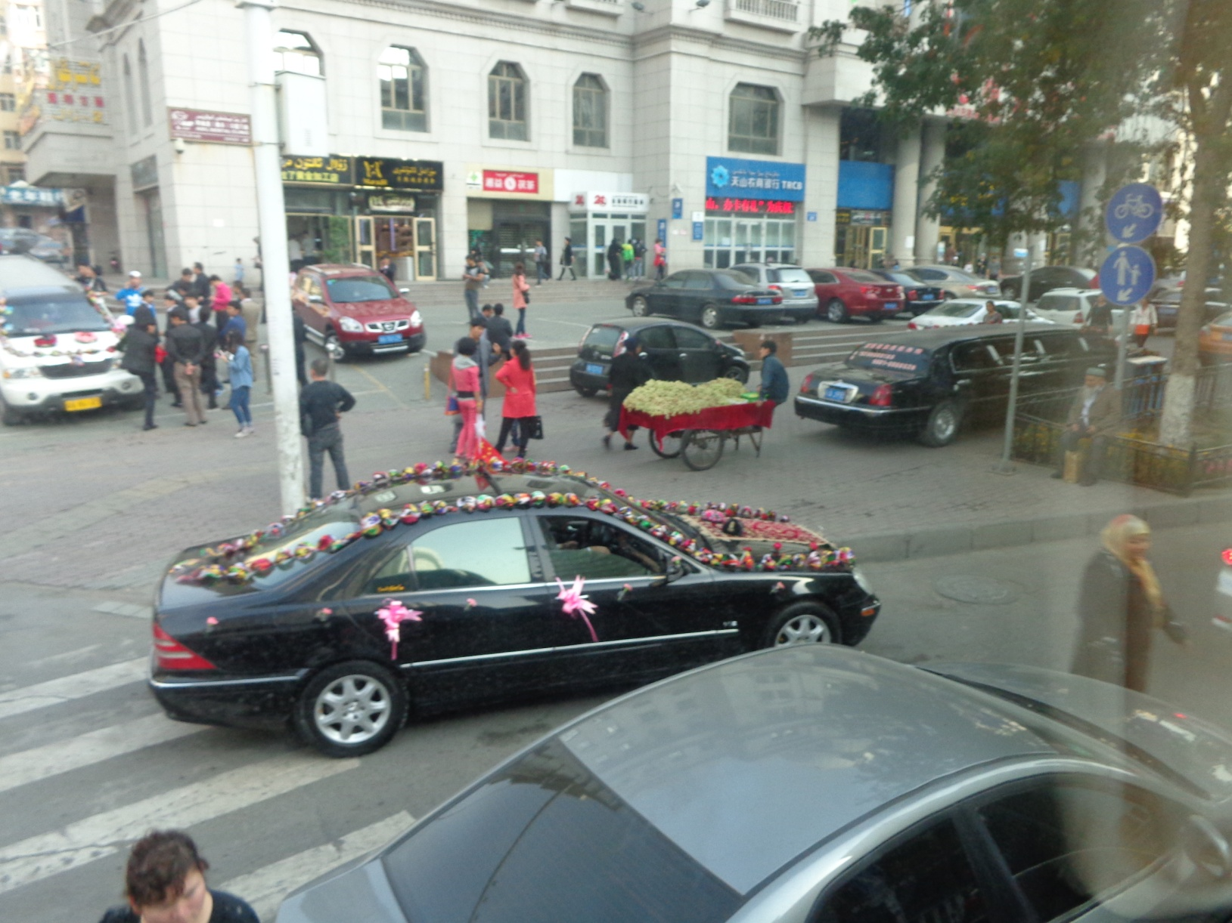
Wedding Celebrations

Slide 16
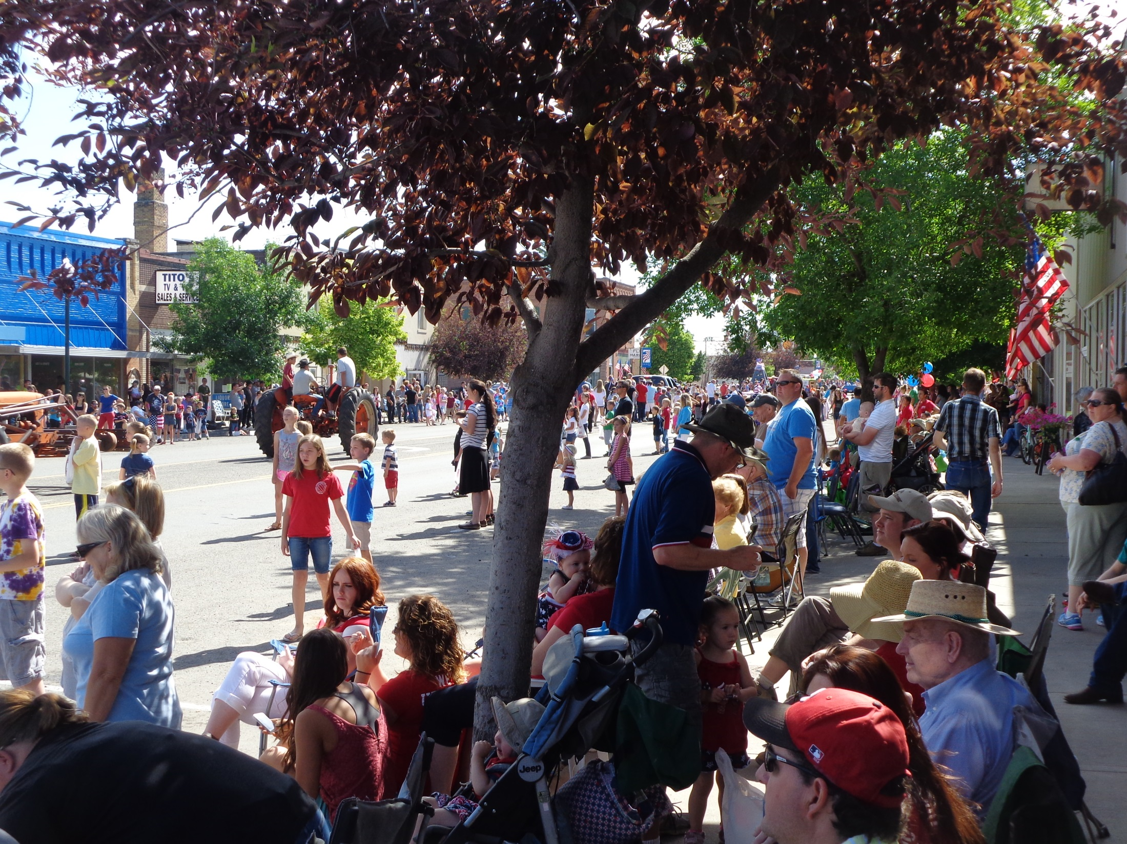

Slide 17
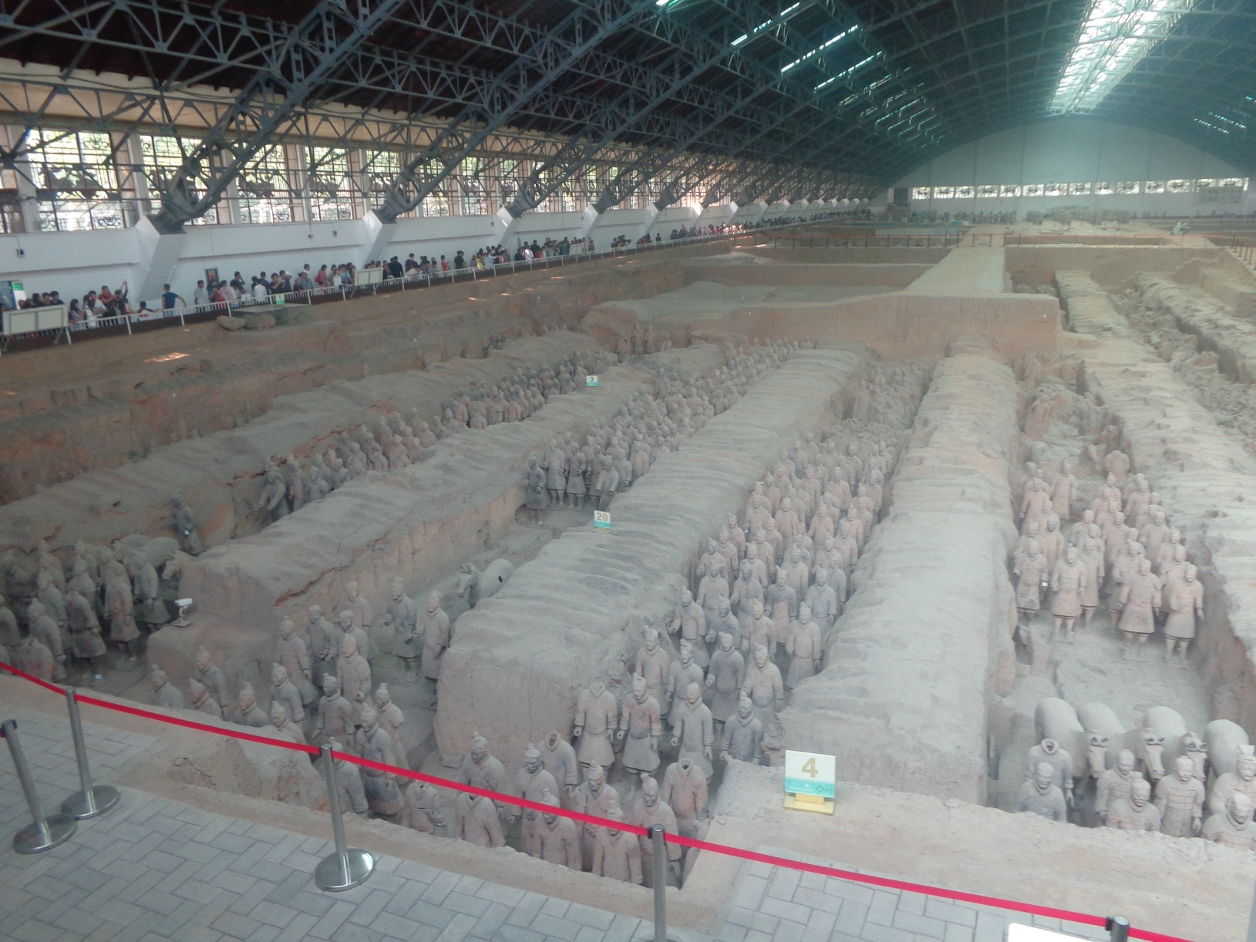
Terra-cotta Warriors
8th Wonder of the World

Slide 18
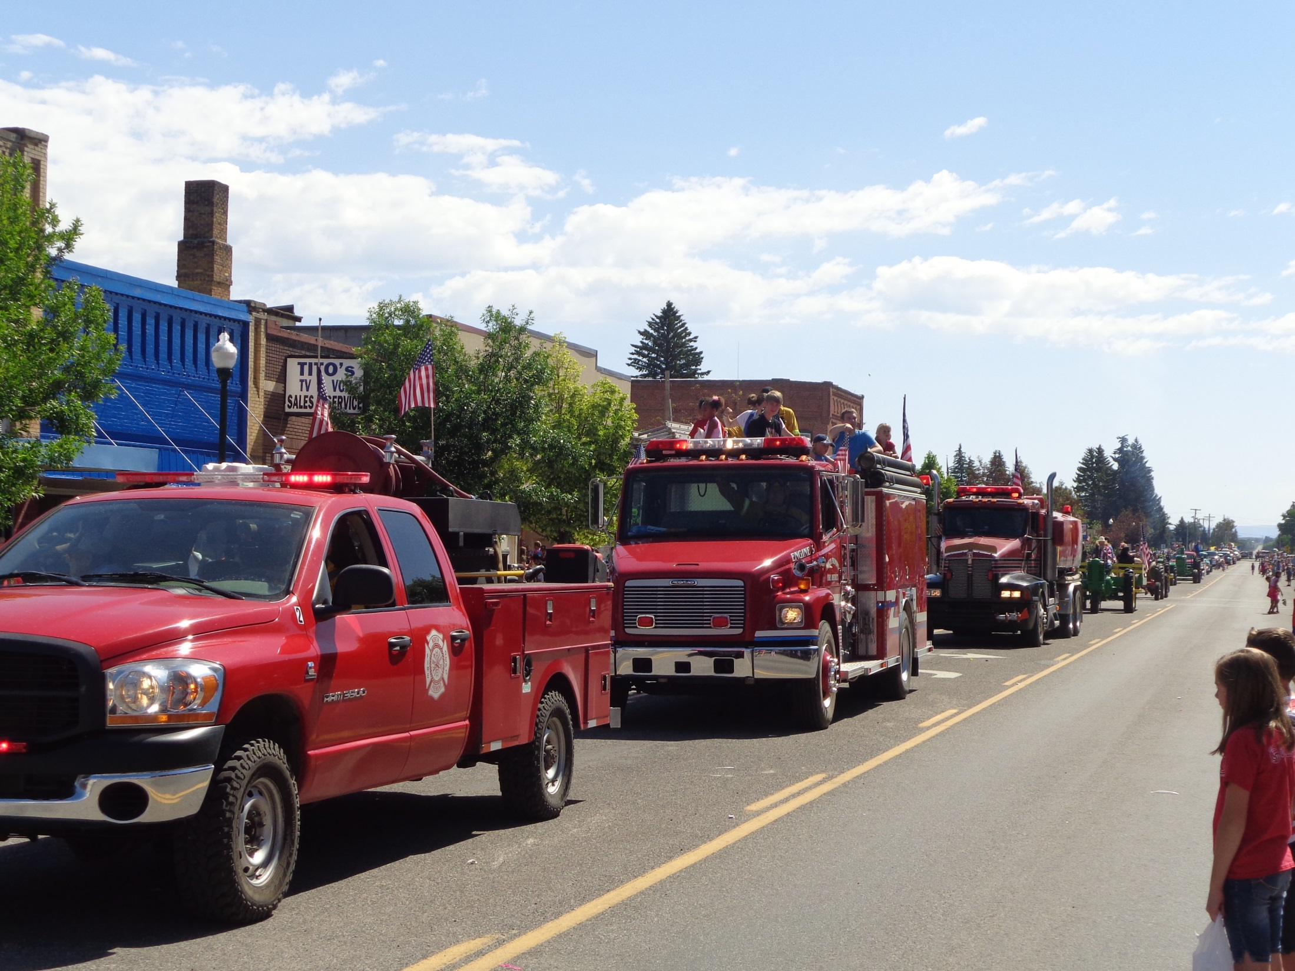

Slide 19
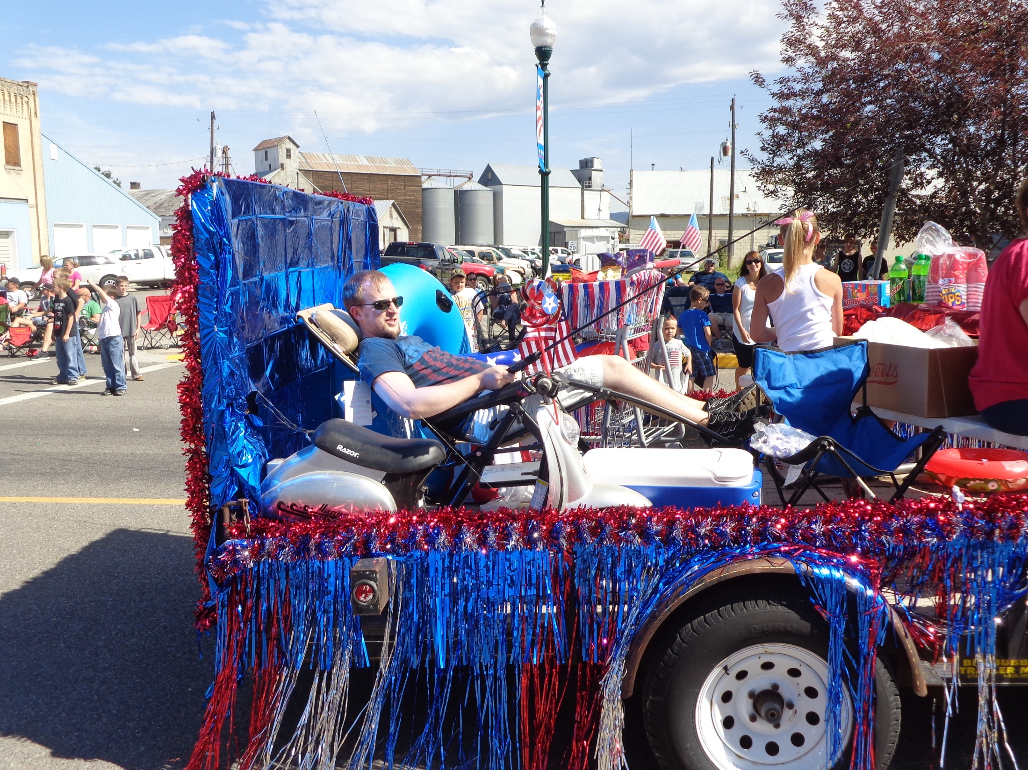

Slide 20
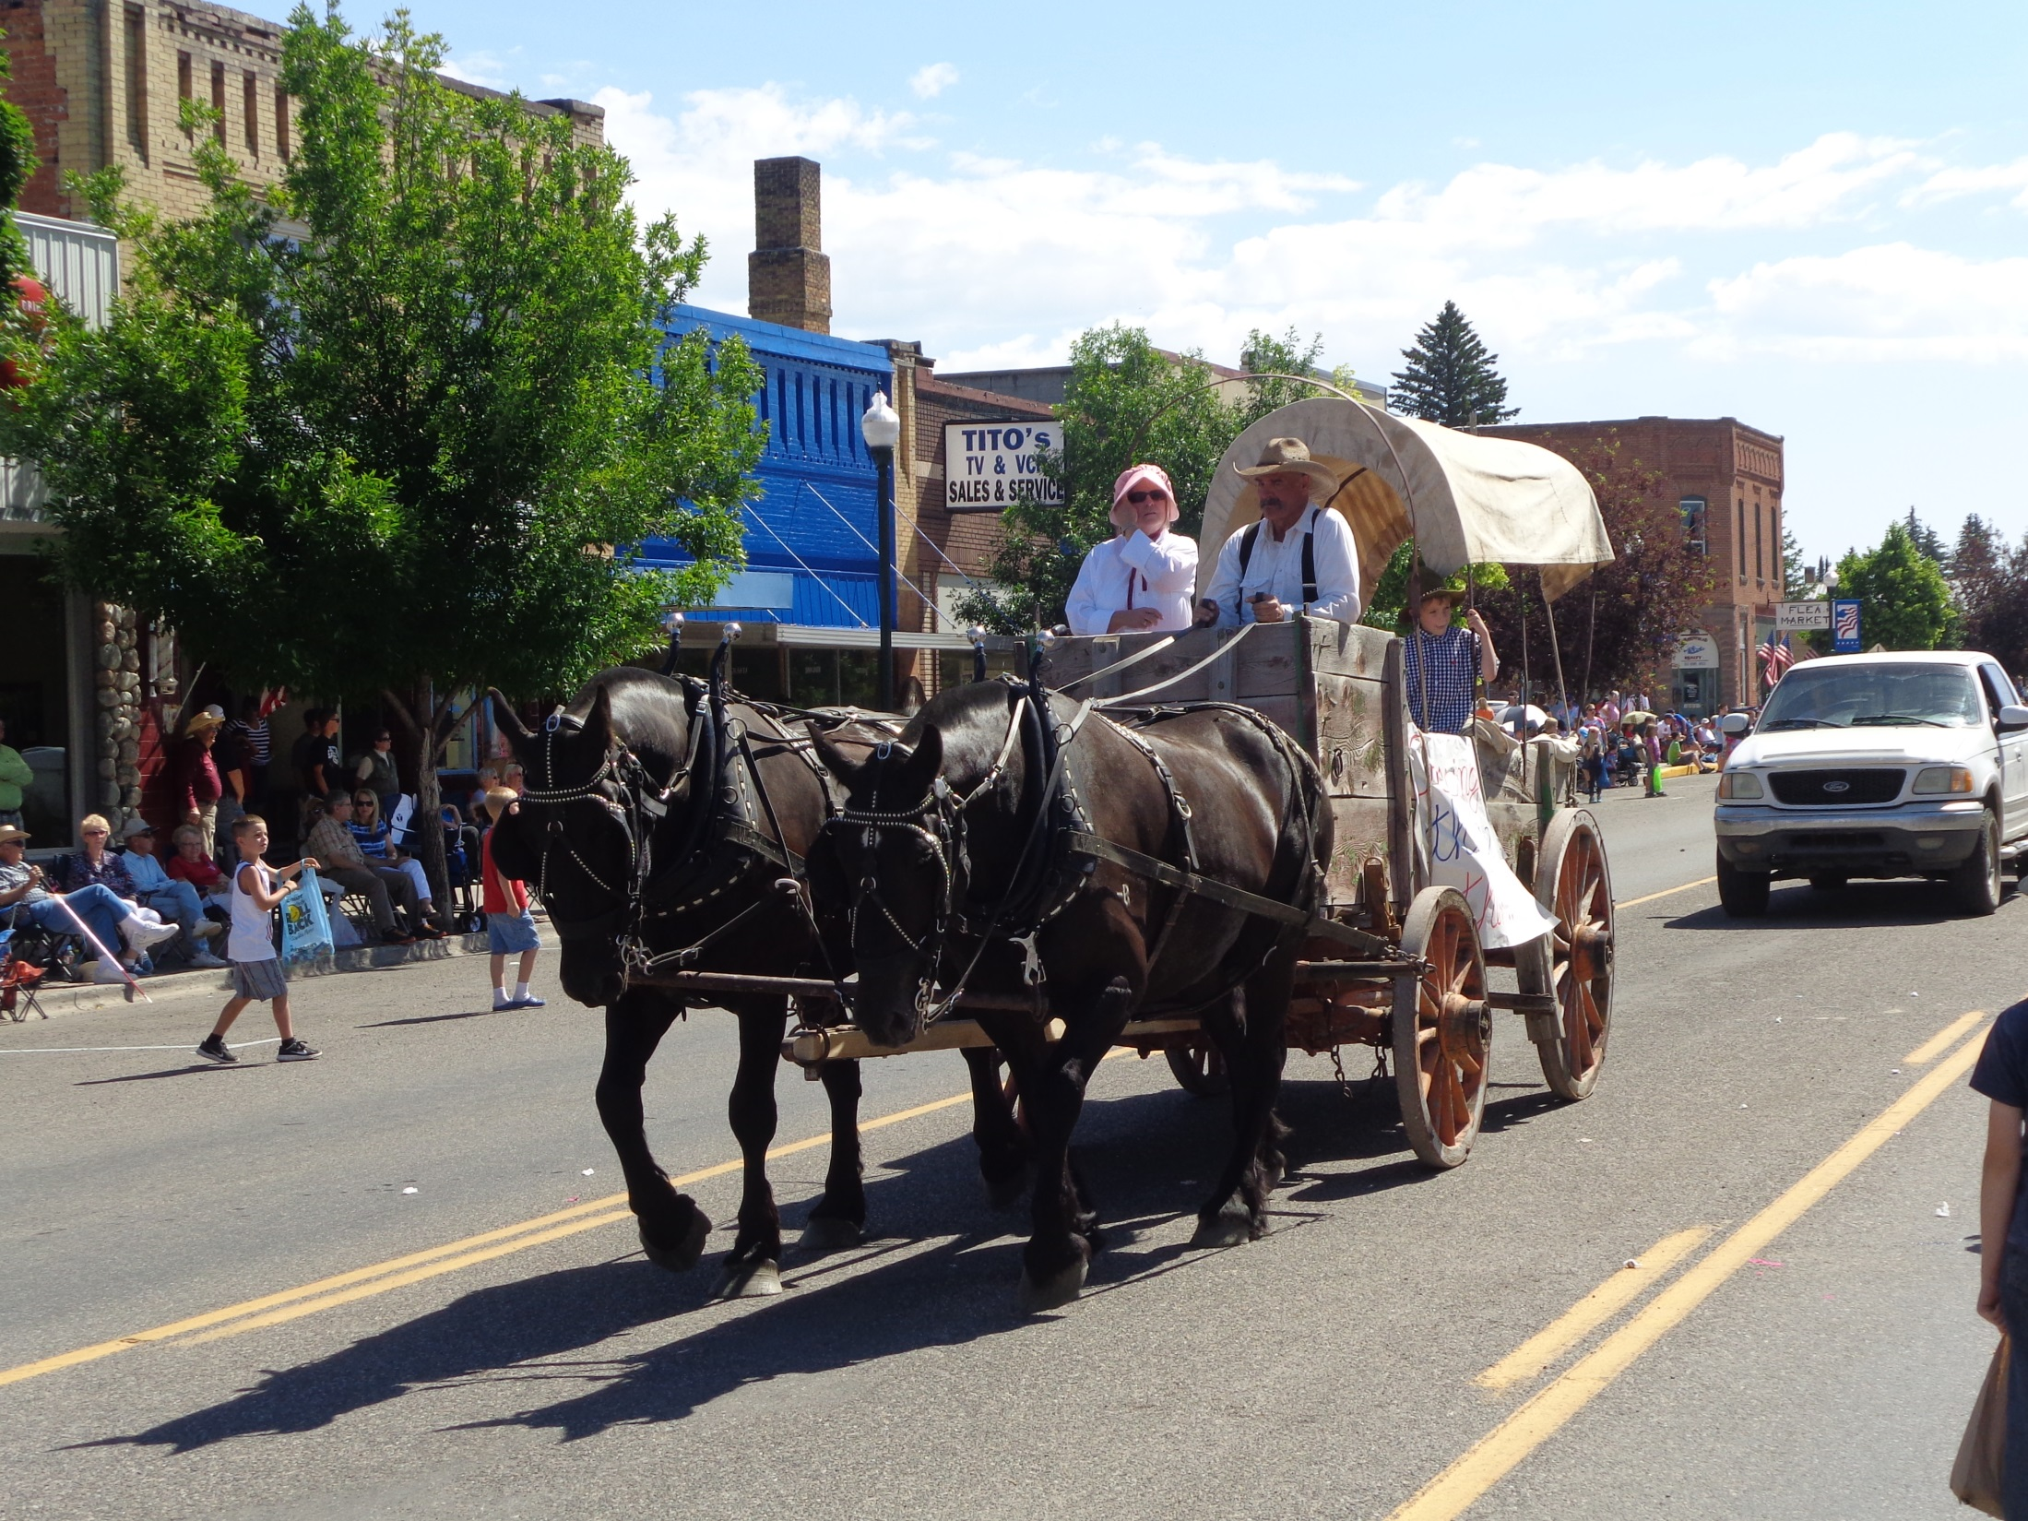

Slide 21
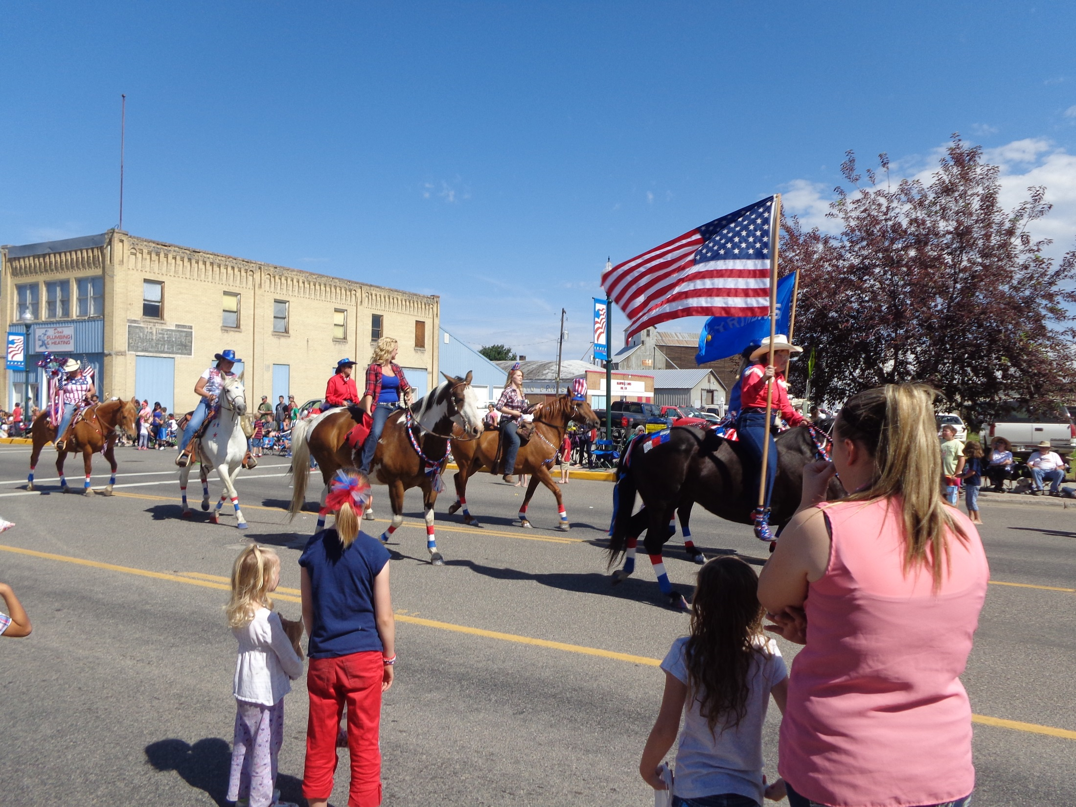

Slide 22
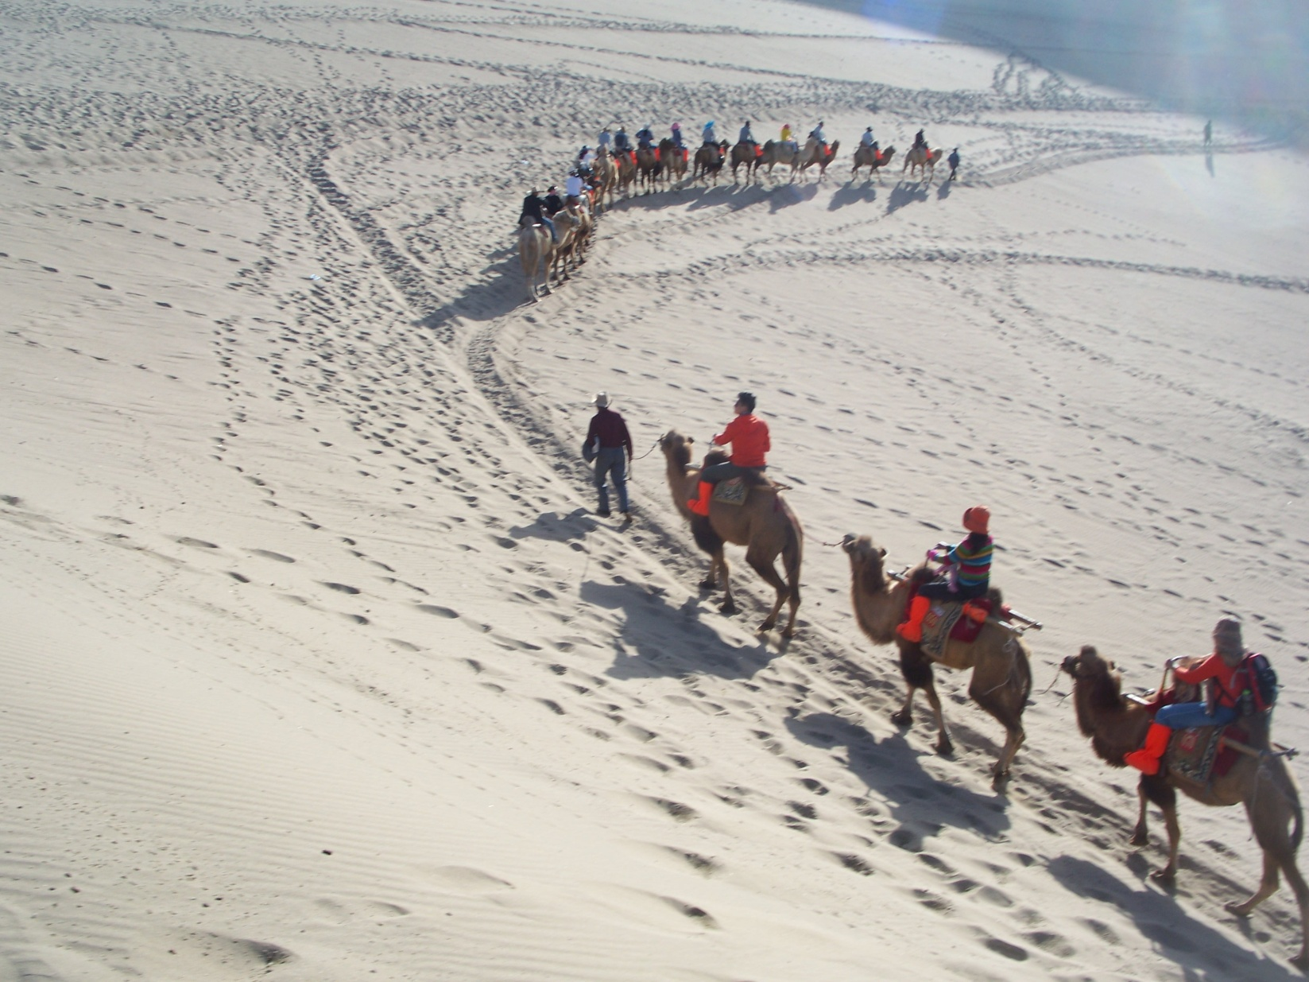
Traveling by Camel Train

Slide 23
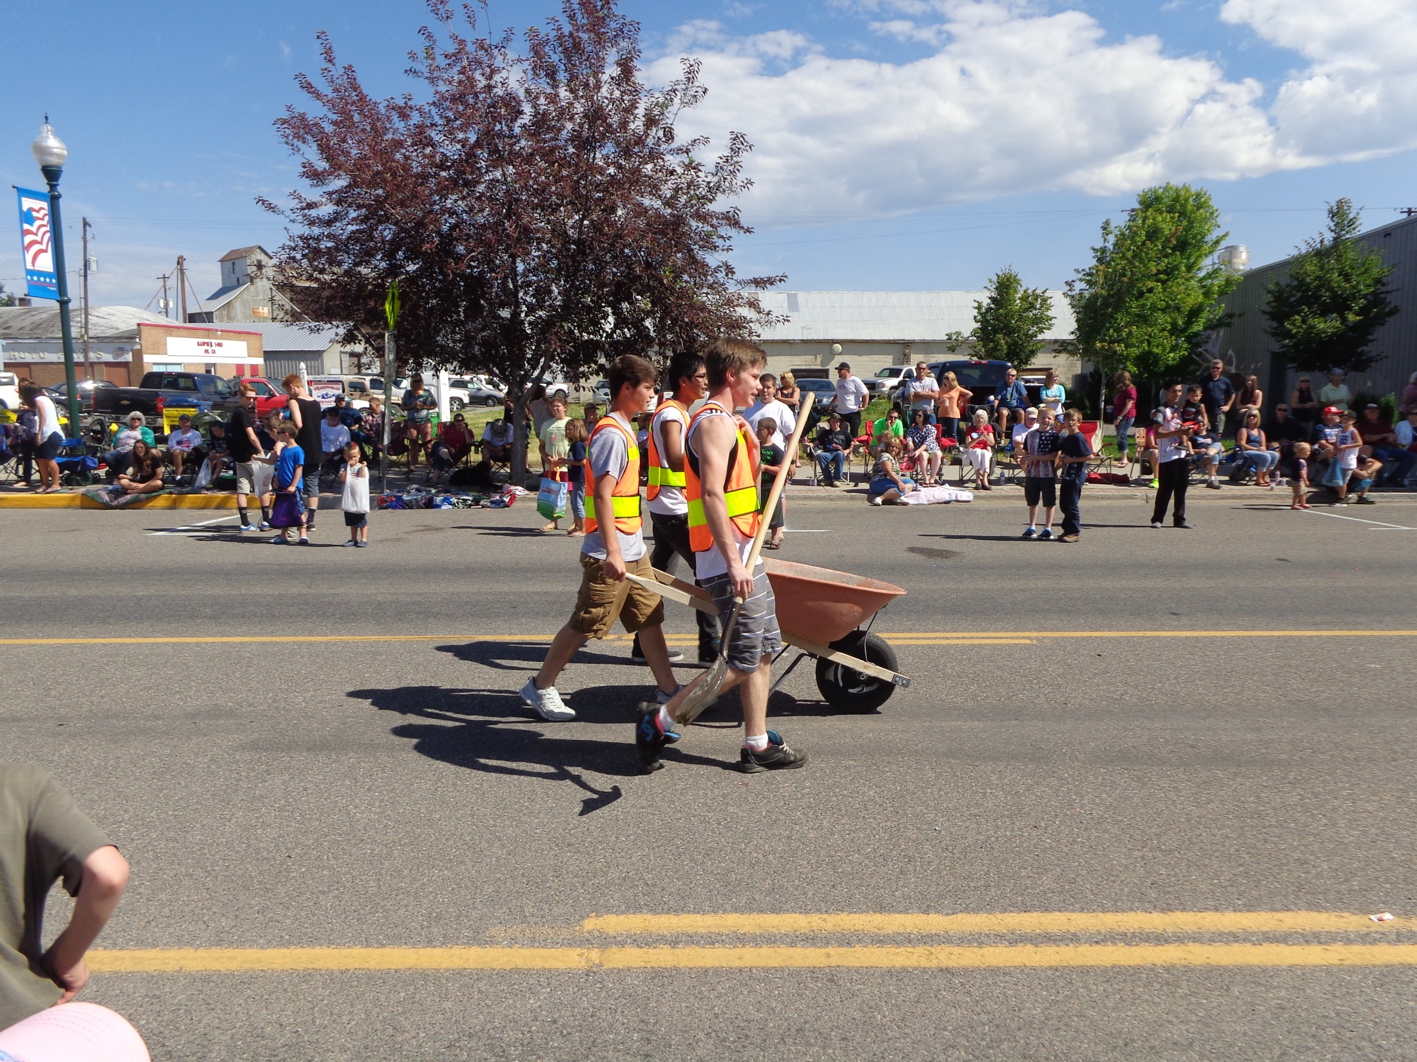

Slide 24
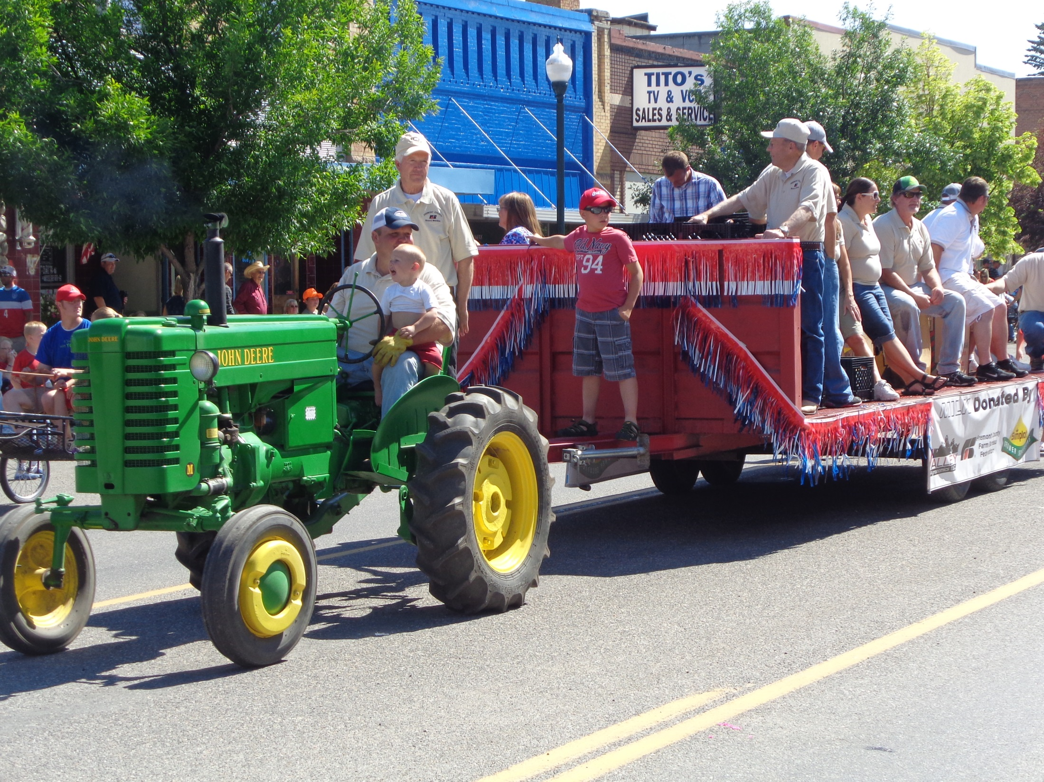

Slide 25
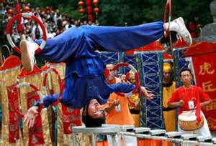

Slide 26
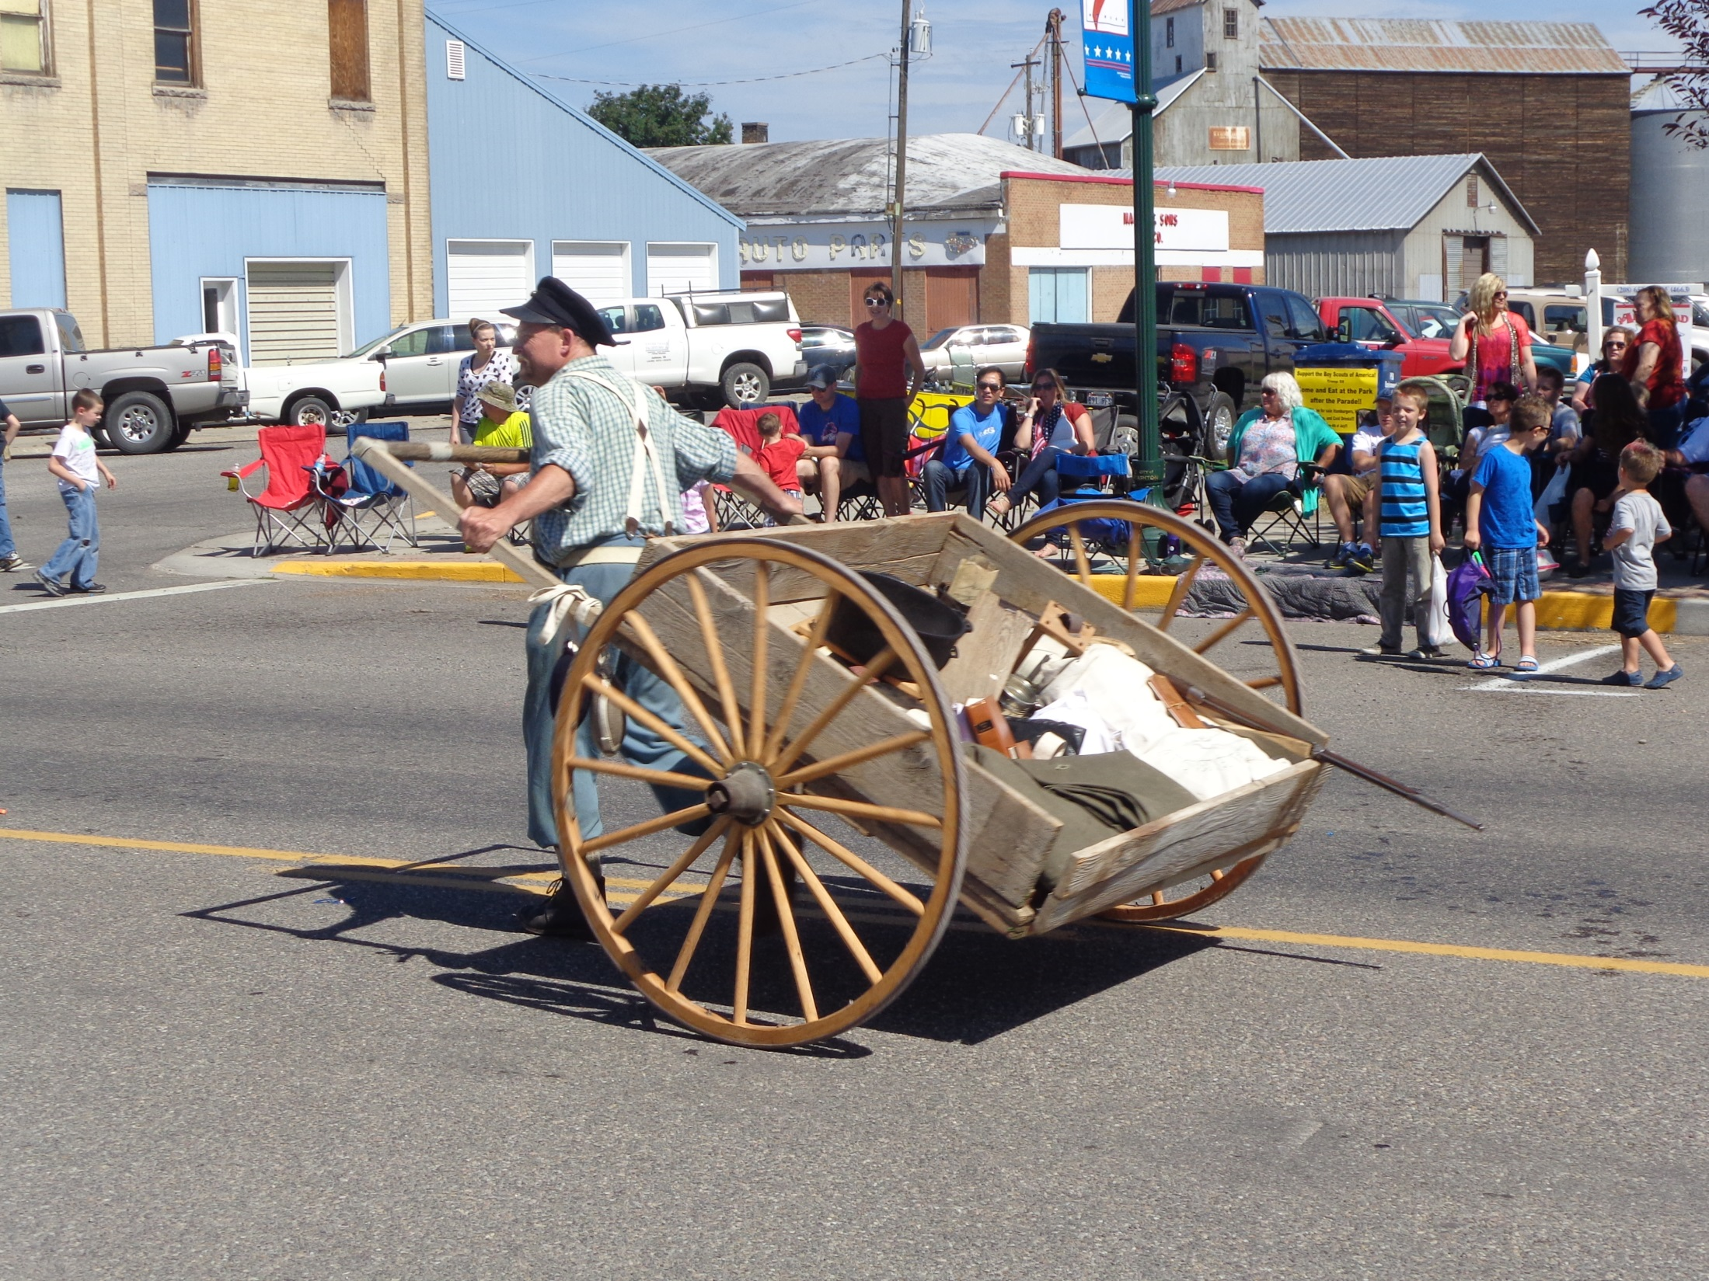

Slide 27
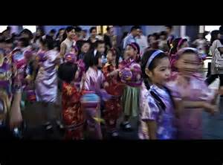

Slide 28
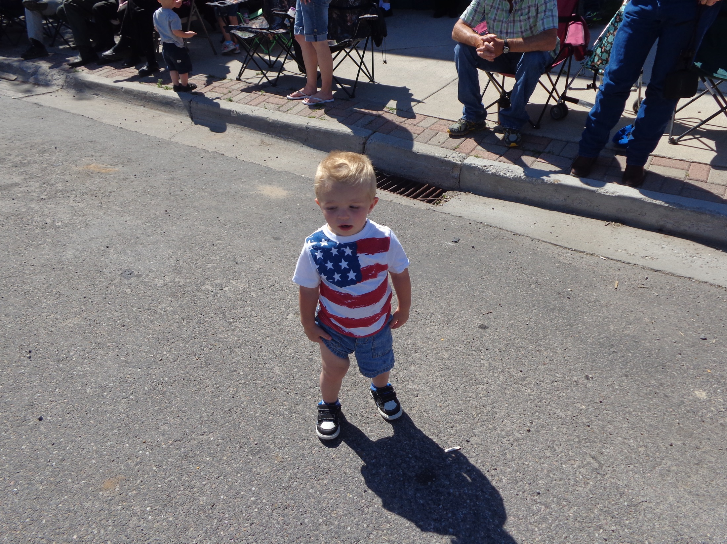

Slide 29

Monkey King

Slide 30
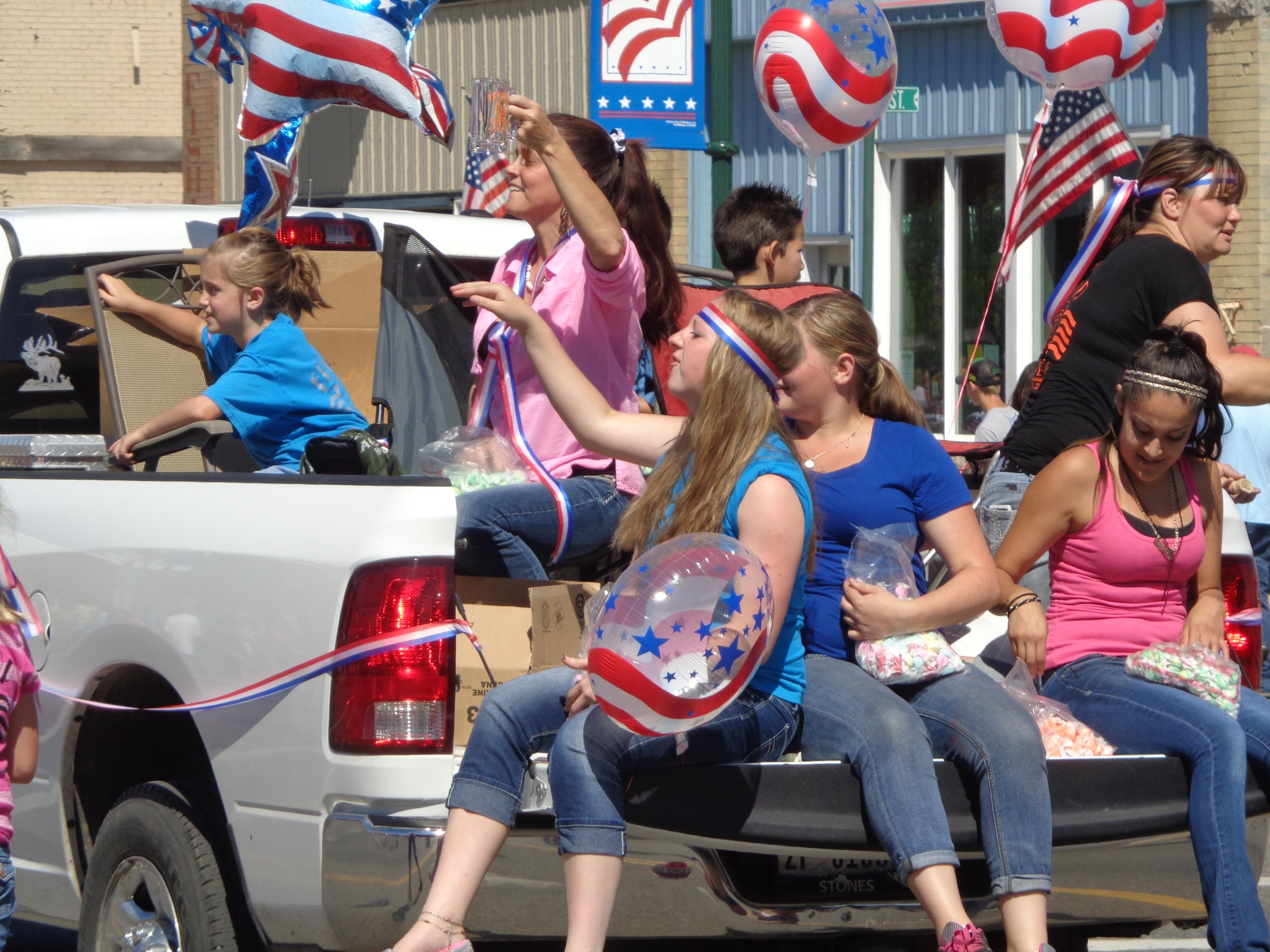

Slide 31
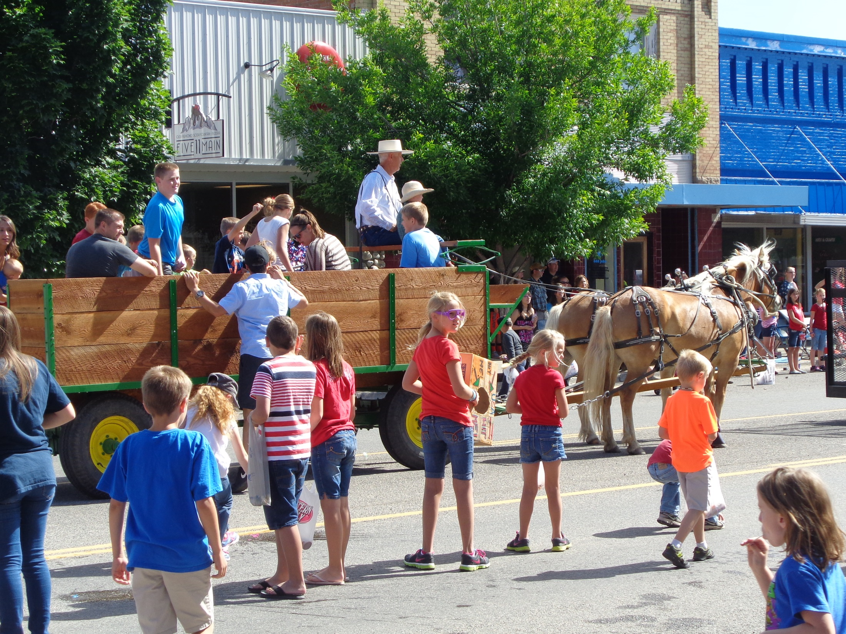

Slide 32
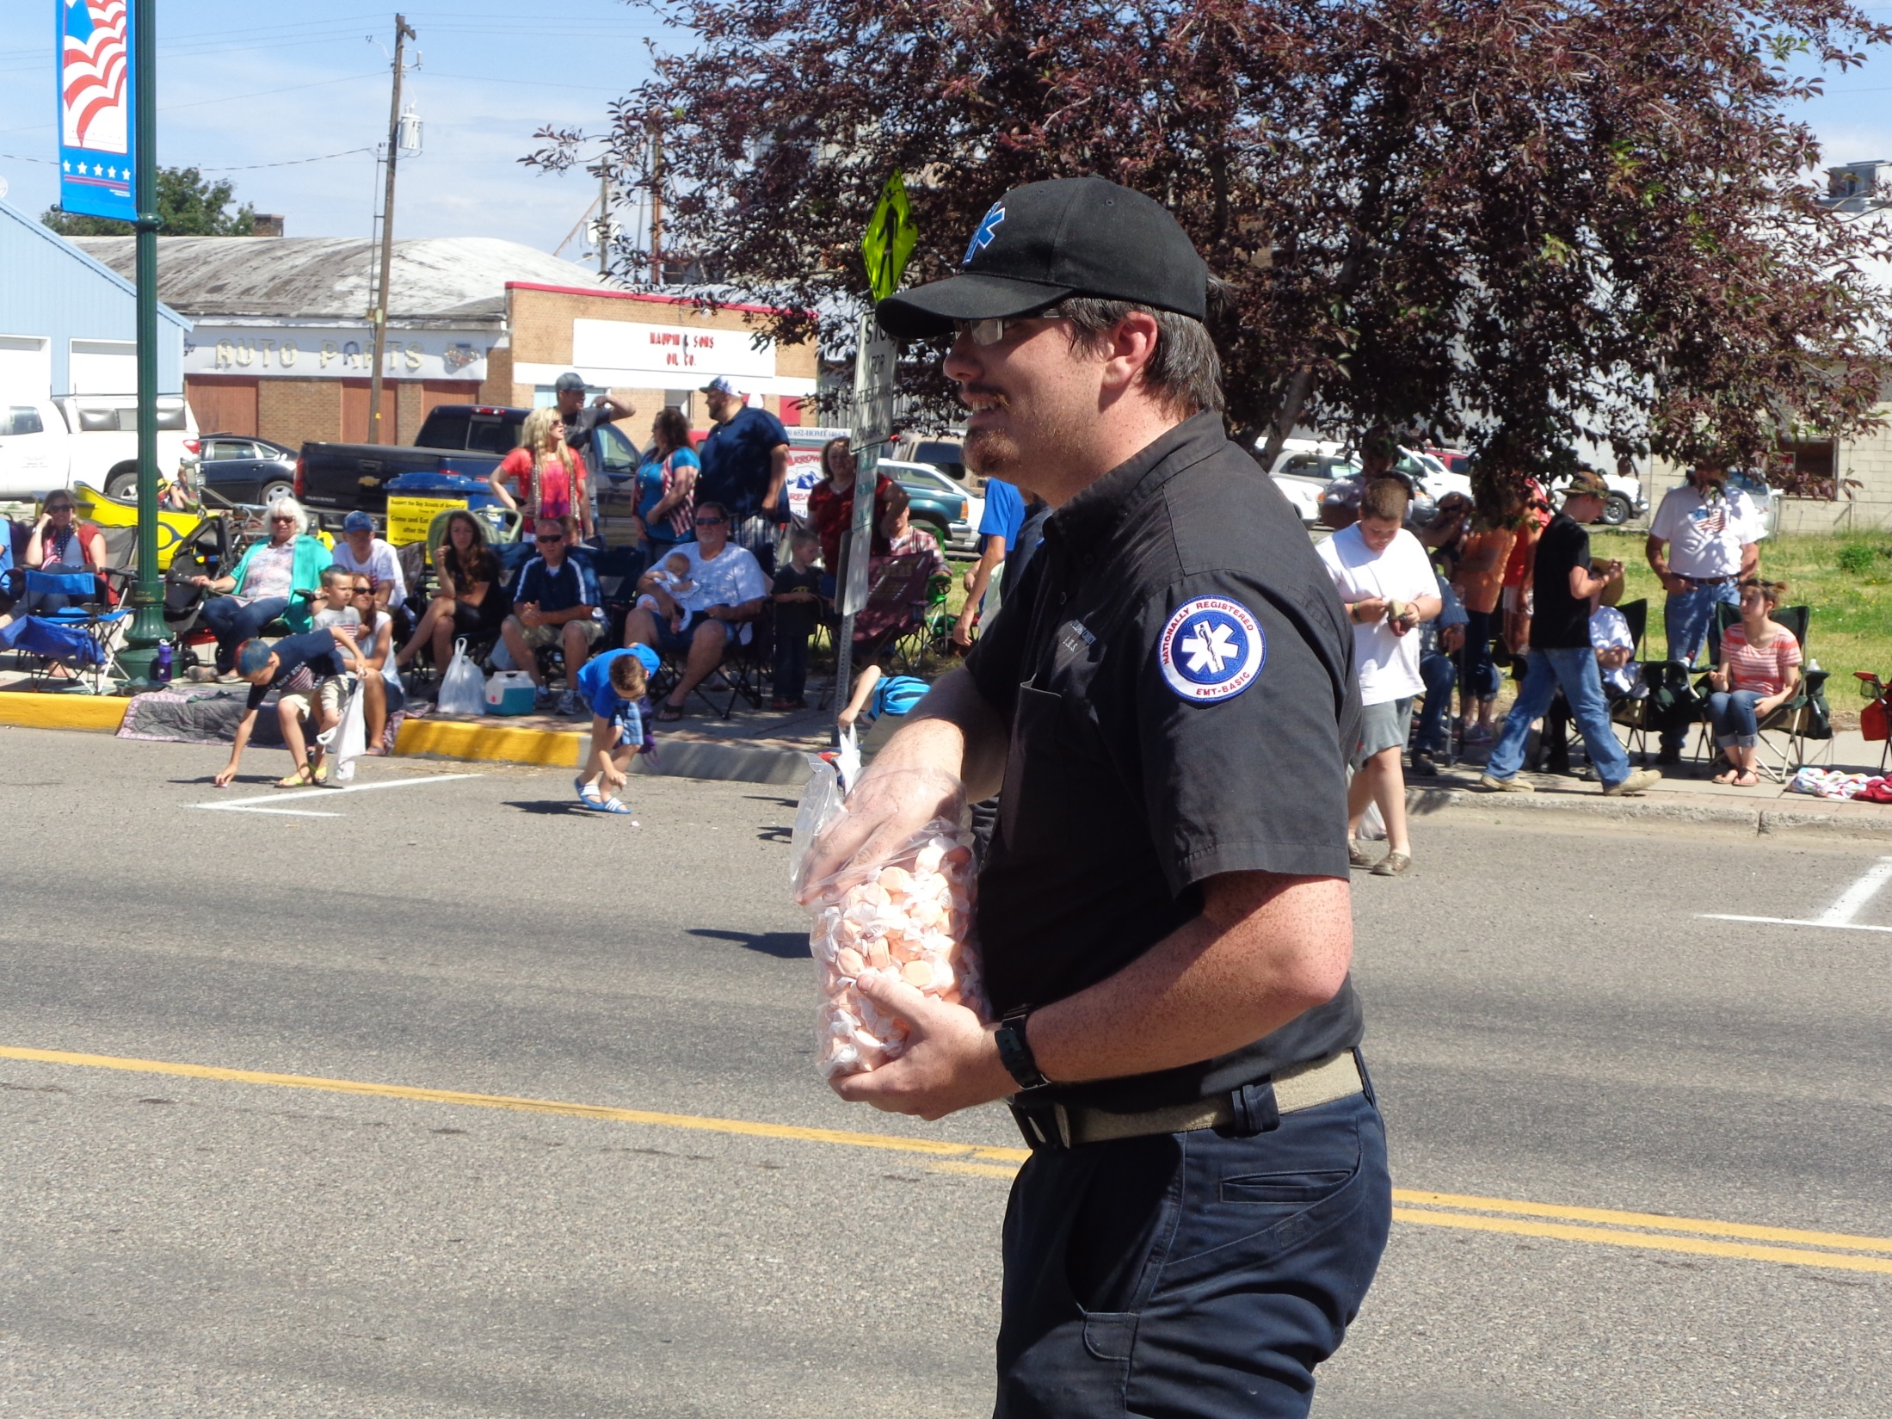

Slide 33
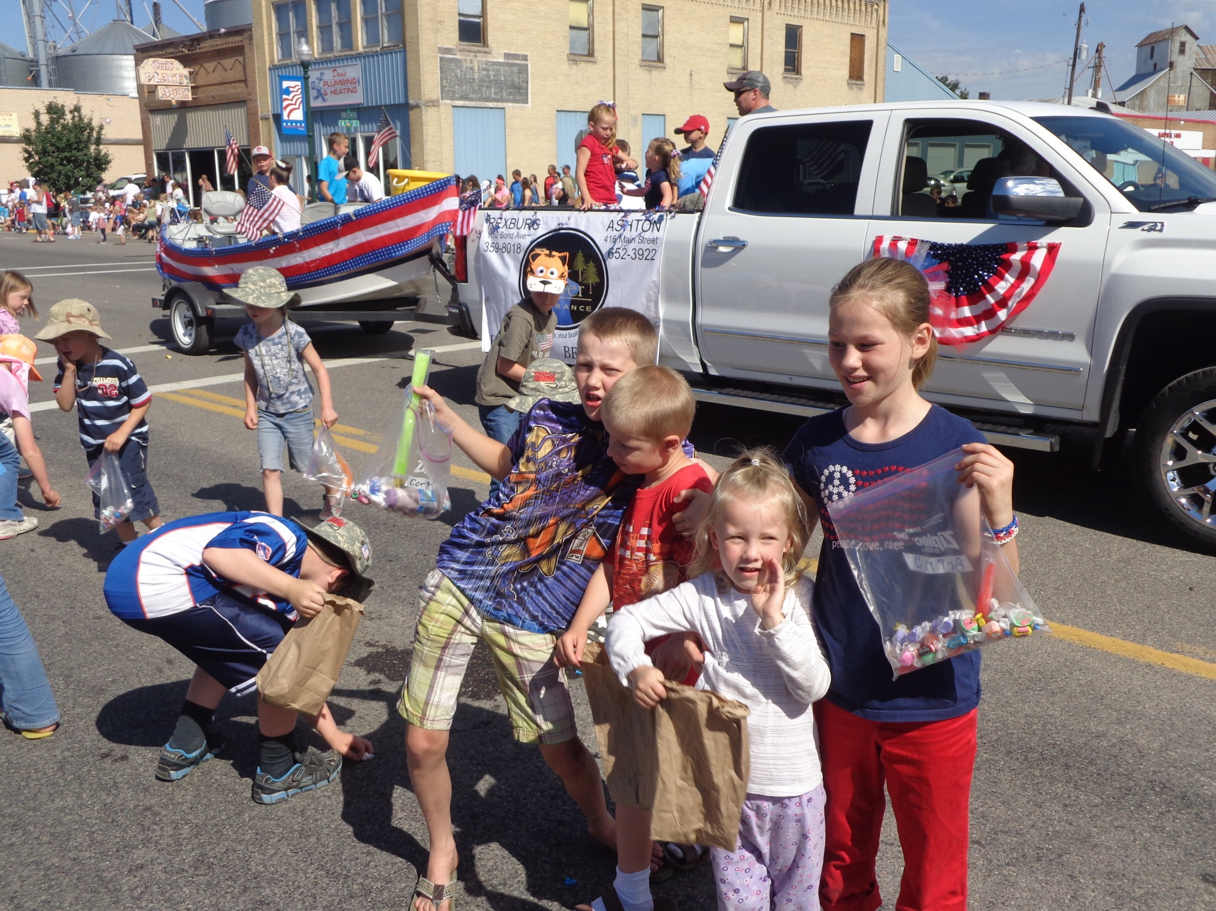

Slide 34
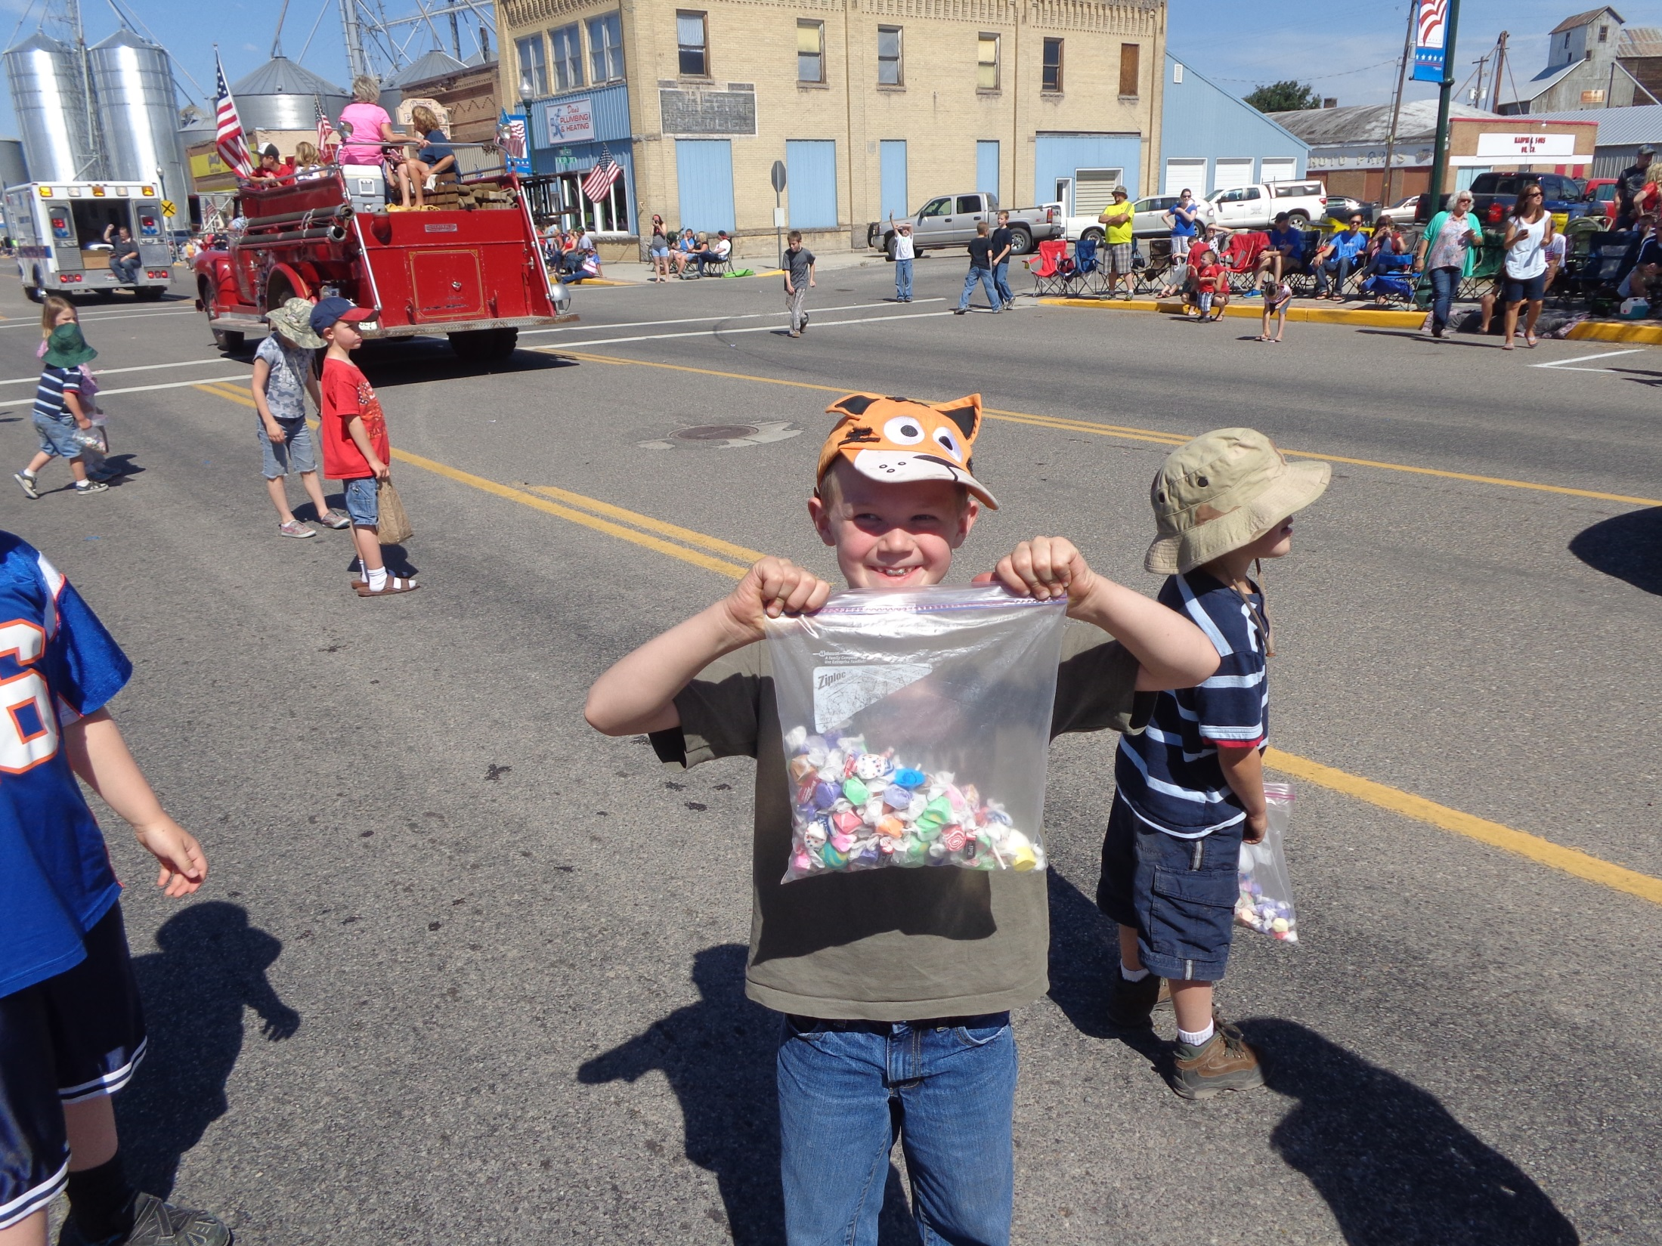

Slide 35
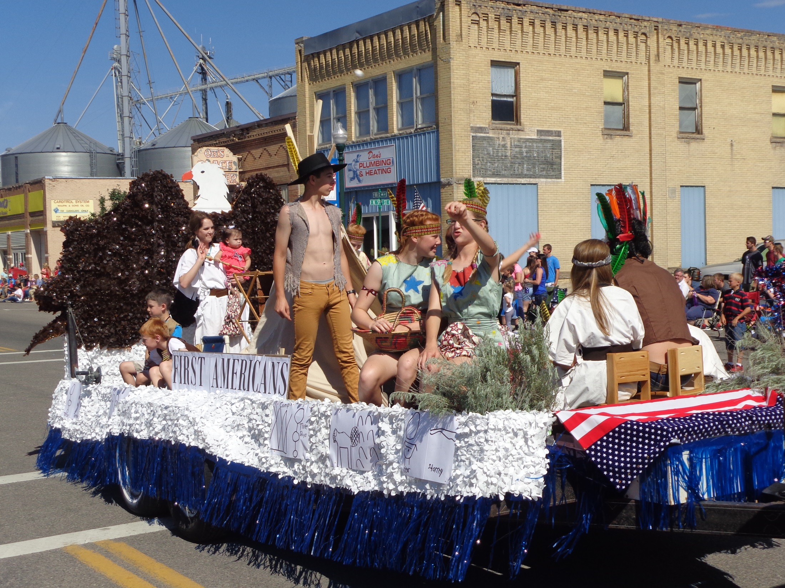

Slide 36
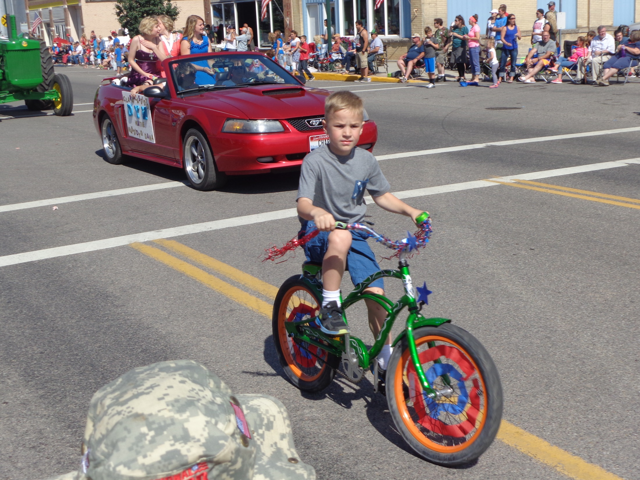

Slide 37
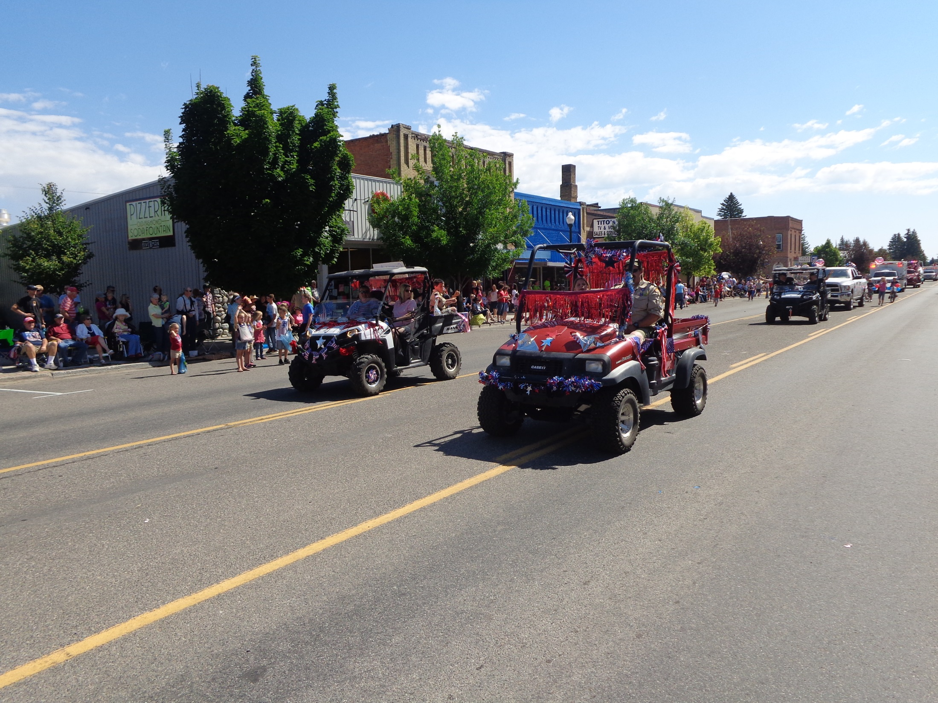

Slide 38
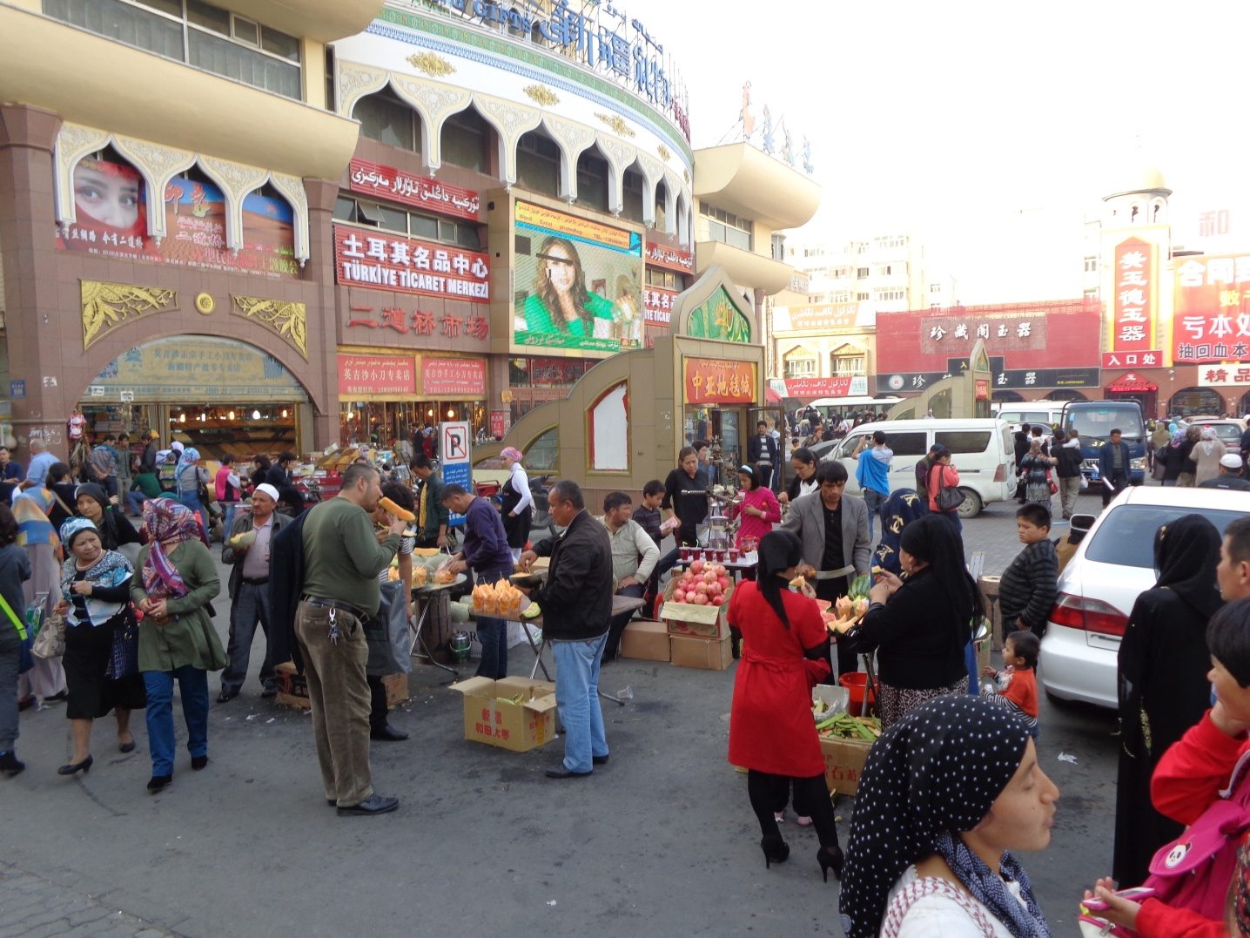
Bazaars

Slide 39
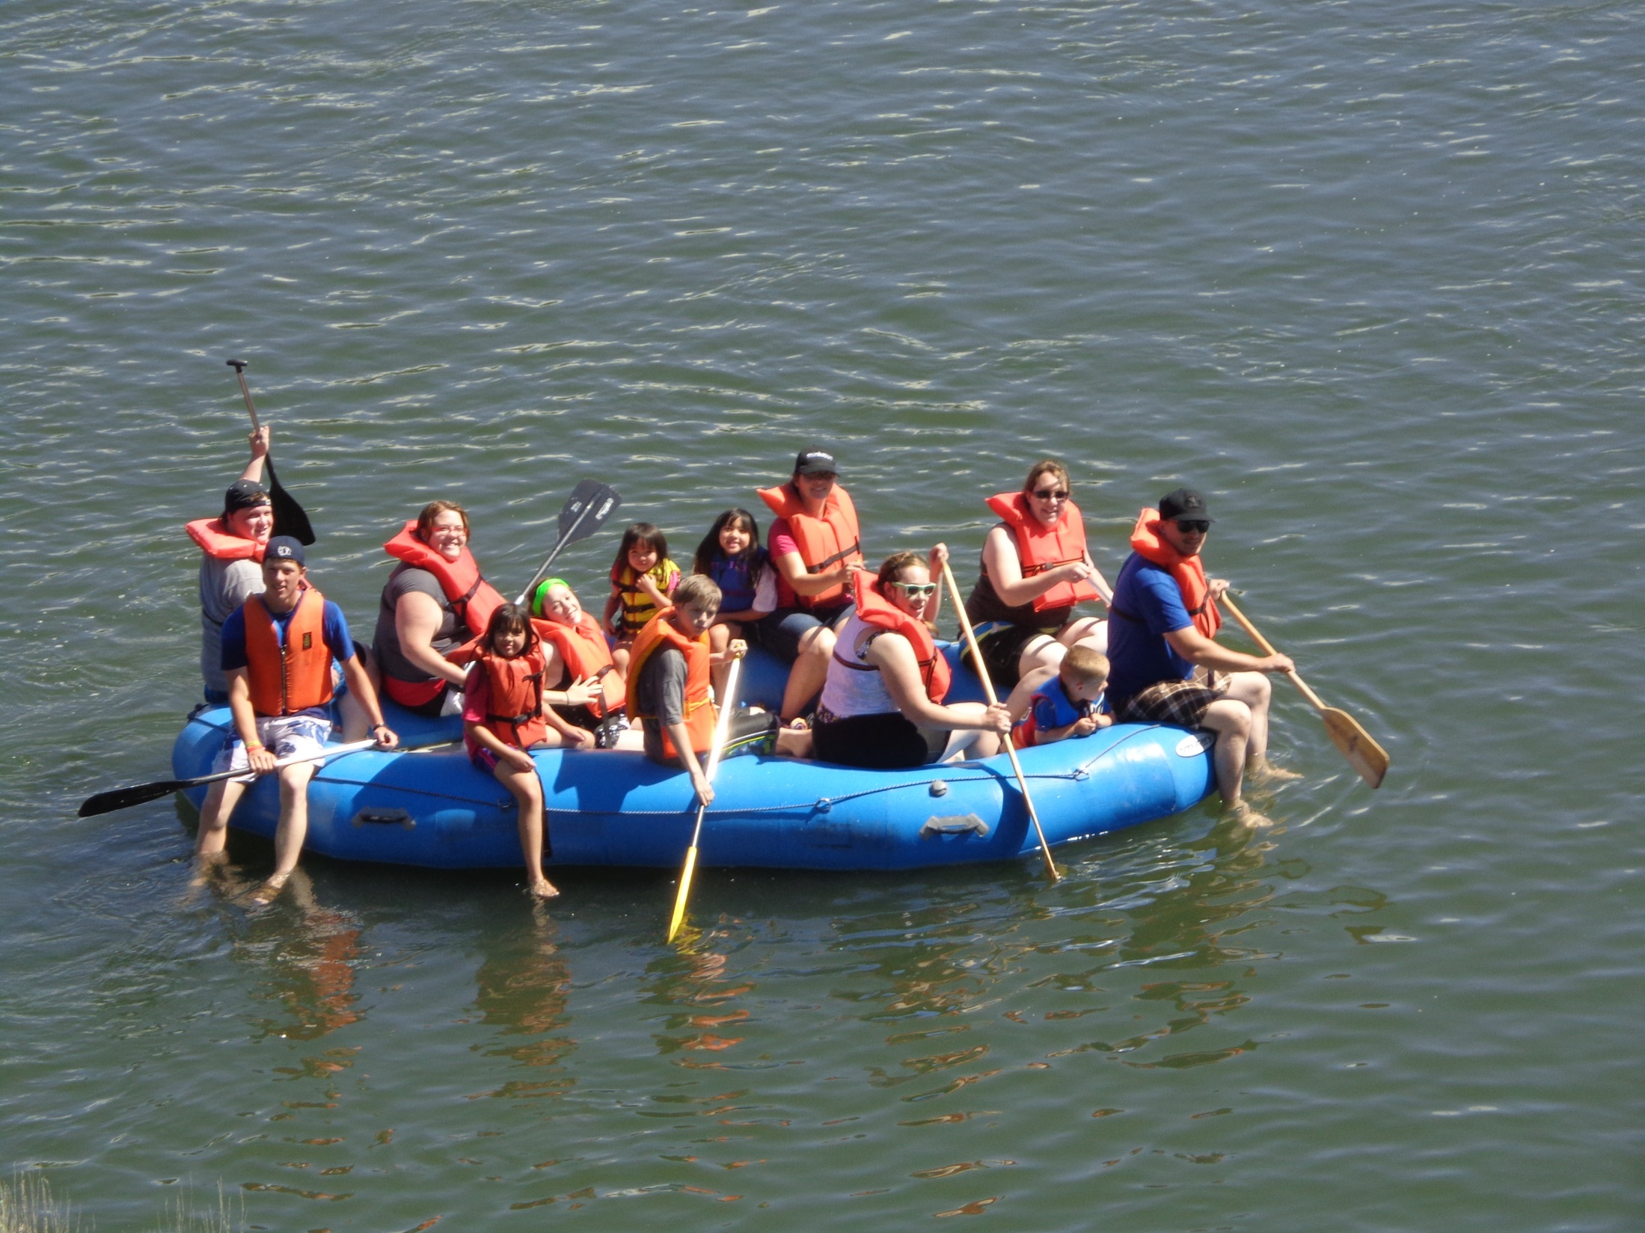

Slide 40
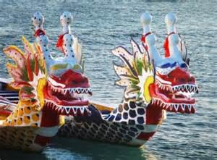

Slide 41
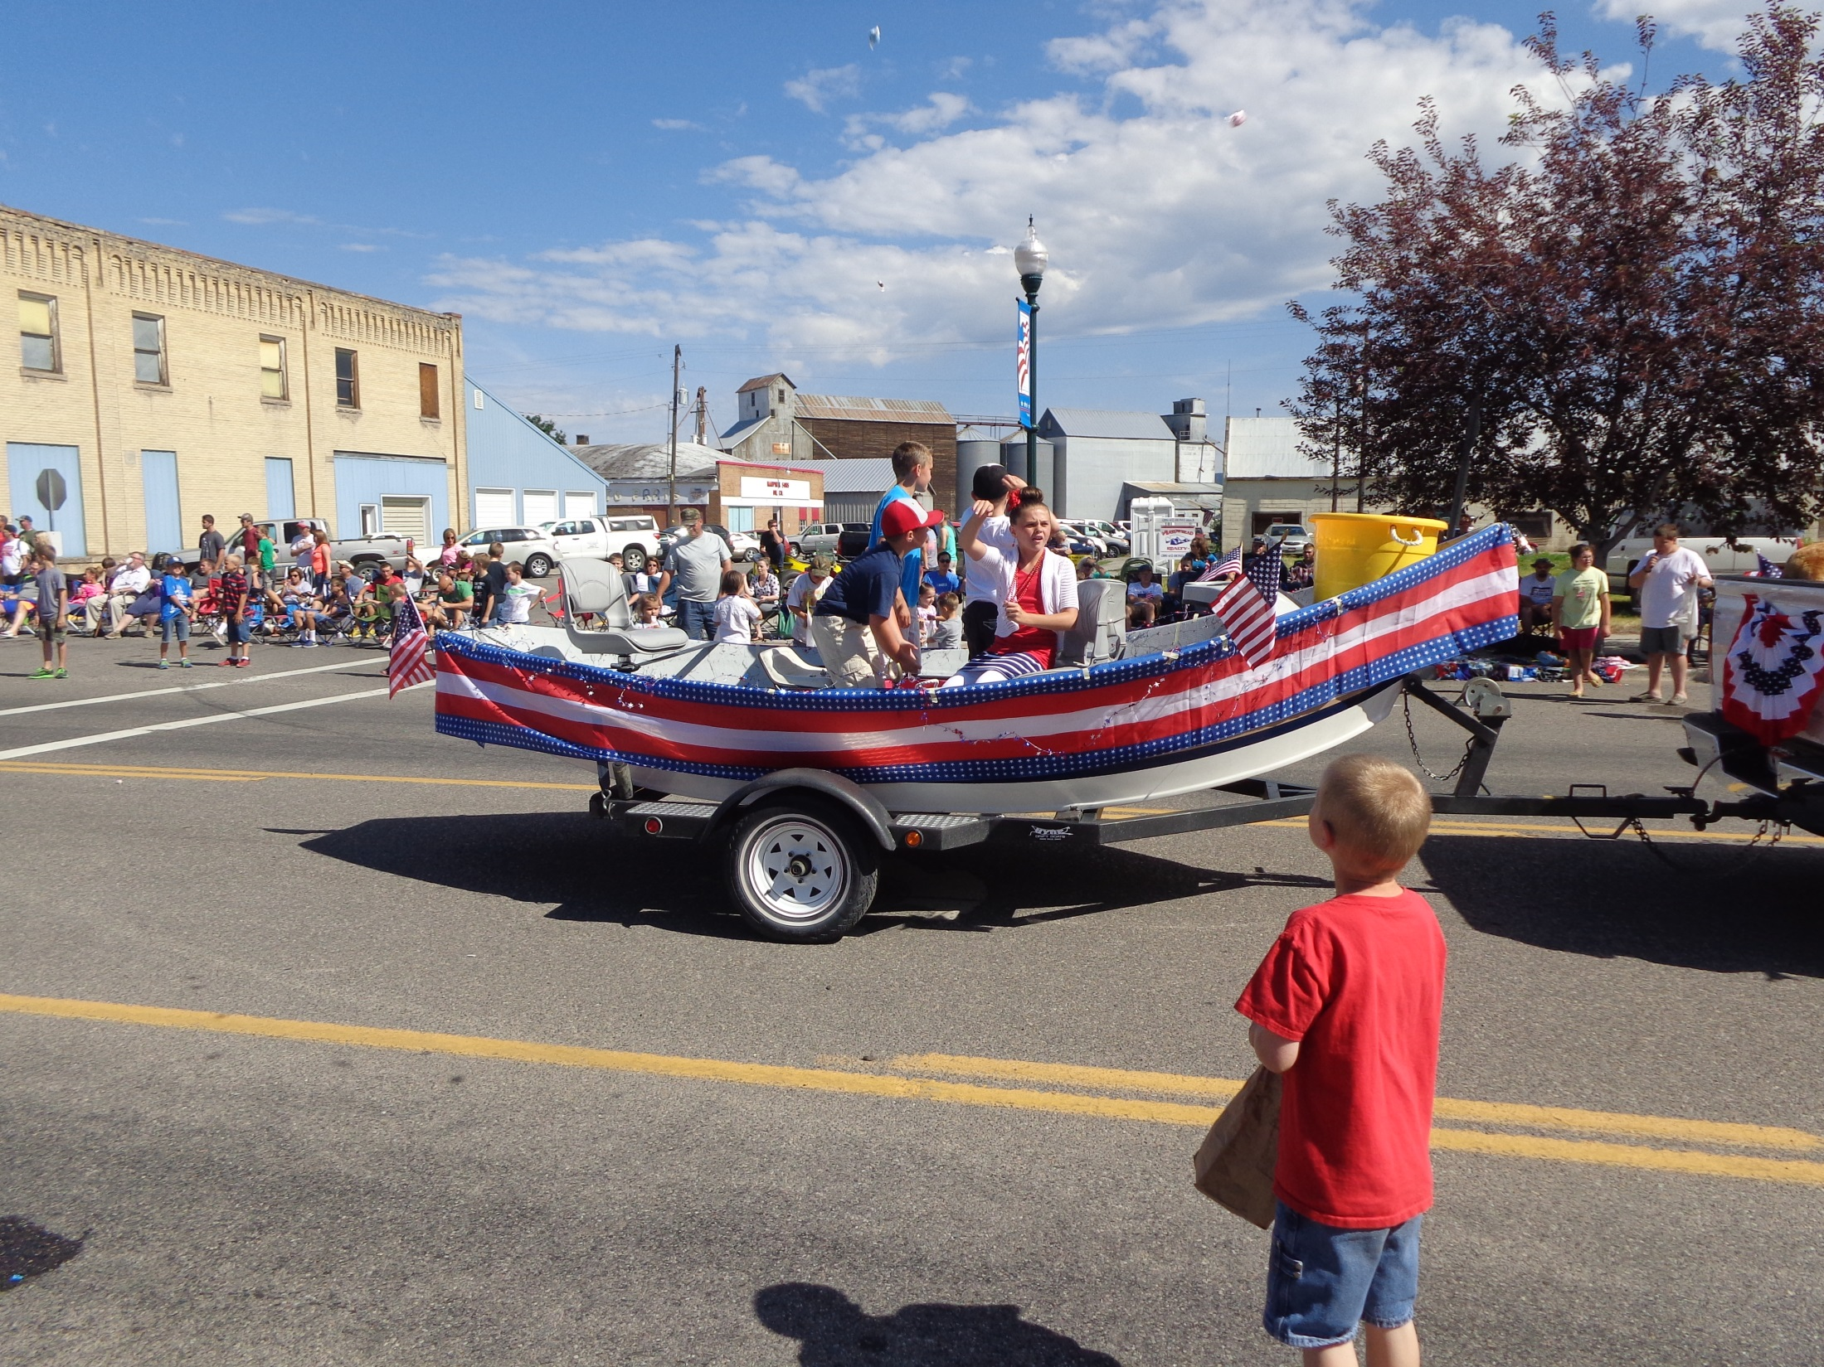

Slide 42
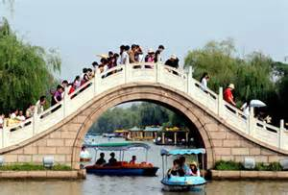

Slide 43
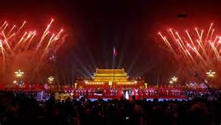

Slide 44
Meet & Greet
Let’s Have a Chat!!!!
Introduce yourself:
  Name
  Home Town / Province
Topic:
Fun activities around campus.

Slide 45

Have a Treat
Break
Let’s Take a Picture

Slide 46

Idiom Mime
Idiom: an expression whose meanings cannot be inferred from the meanings of the words that make it up
Mime: to tell a story or express yourself without words, using only the movements of your body and face.

Slide 47
Idiom Mime Directions
Form in assigned groups.
Your group will be given one or two idioms.
Prepare the meaning of the idiom without using any words.
The audience will guess which idiom you are performing.
We will rotate groups until all of the idioms have been presented.

Slide 48
Idioms
A rotten apple can spoil the barrel: One bad person or thing may spoil an entire group.
Salt of the earth: A person or group considered to be the finest, most admirable, and noble.
Straighten up and fly right: To stop behaving foolishly and start acting serious.
To eat humble pie--to admit you are wrong and to say you are sorry.
Take someone under your wing: To help, guide, or protect someone.
Food for thought: A worthy idea or action that is worth thinking about.
Calm before the storm: A period of peace before a crisis.
Lay your cards on the table: To reveal all of the facts openly and honestly; to reveal one’s purpose and plan.
If the shoe fits, wear it. Takes responsibility.
School of hard knocks. Refers to life’s tough lessons by making mistakes, doing strenuous work, challenging experiences that can teach you a lot.
Sink or swim: To fail or succeed by one’s own efforts without anyone’s help or interference.
Take it to the hoop: To accomplish a project successfully; to do a great and thorough job.
Button your lip: To stop talking and begin listening; to be quiet.
Talking through your hat: To talk nonsense; to talk about something you really know nothing about.
Take the words right out of your mouth: To say what another person is thinking or was just going to say.
Put the cart before the horse: To do things backwards or in reverse order.

Slide 49
Chinglish
Translations
Form in assigned groups.
Rewrite translation into Standard English.
Be prepared to share your translations.

Slide 50
Questions
Questions for and from
the Professors.

Slide 51
What are some of the topics you would like to discuss in class and/or English Corners?

Slide 52

Talking Dice--Speaking Activity
Divide into assigned groups
Roll the dice and answer the number of the question you rolled.
If you have already answered the question then answer question #1. If you have answered that question #1
then roll the dice again.

Slide 53
Describe your bedroom at home?
How should we reduce pollution?
What advice do you have for a failing student?
What time should students turn off their electronic devices and go to sleep?
How will you apply for your first job after graduation?
Describe the last party that you attended?
What do you think the purpose of life is?
Why do you want to learn to speak English fluently?
What is one thing you’ve learned this week?
Describe your best friend from high school? What made this person special?
What are your thoughts about smoking/drinking alcohol/using drugs?
What benefits do you receive when you volunteer?

Slide 54
Vocabulary Builders
Instructions:
  Form groups of three or four people.
  Distribute the vocabulary card so each person in your group has one.
  Taking turns, each person then pronounces each word on his/her card.
  When everyone is finished, pass your card one person to the left and then each person pronounces the words on his/new card.
  Repeat the process until everyone has had a chance to pronounce the words on each card.
  Note: If someone needs help pronouncing a word, other group members should provide assistance.

Slide 55

Five Phases of Dating
Phase I – Meeting lots of people.
  Group parties/gatherings.
  Speed Dating and other group games.
Phase II – Making Friends
  Eating lunch or dinner together.
  Studying or going for a walk together.
  Sharing family stories and personal goals.
  Phase III – Formal Dating.
    Planned activities designed to help you know each other better.
    Should begin to be more personable, but set limits as to the time you spend alone with each other and limits to intimacy.

Slide 56

Five Phases of Dating
Phase IV Paring up/Going Steady
  Share your important beliefs and values.
  Introduce each other to your respective families.
  Begin to plan for the future—education, employment, home and family goals.
  Continue to practice limits regarding time alone together and sharing of intimacy.
Phase V Formal Engagement
  The marriage proposal.
  Approval of both sets of parents.
  Set a wedding date.
  Plan more intensely for your wedding and future life together.
  Continue to practice limits regarding time alone together and sharing of intimacy.

Slide 57
Describe your feelings about leaving your home and province for four years.
Try to describe your feelings as you return after successfully completing your B.S or B.A. degree in four years.
Try to describe the feelings of your parents as you return to your home as a college graduate.
Try your best to describe your first day on the job of your dreams.
Describe your future husband or wife.
What do you think your feelings will be when your first child leaves home to go to a school?
What do you think the purpose of life is?
Where do you think you will go when you or your parents die?
Why do you believe that?
Do you believe you came from some where else when you were born? Why do you believe that?
Suppose you move to Australia which has a different form of government. How will that change the way you act in your life, Why?
What about living in Australia would make you nervous?
What do you think you will do to adjust to that concern?

Slide 58
Speaking Activity
Divide into groups of two
Roll the dice and answer the number of the question your rolled.
If you have already answered that question roll the dice again.

Slide 59
Talking Dice
Unfinished Sentences…

Slide 60
Unfinished Sentences:
Finish these sentences by adding your own words.
On Saturdays, I like to____________
If I had only 24 hours to live, I would__________
I feel best when people_____________
Secretly I wish_____________
If I could change the world, I would____ because_____
The most exciting thing I have done is_____
Right now the most important thing in my life is_____ because_________________
If I could be somewhere else now, I’d______________
I never worry about_____________________
I like people who________________
I find it difficult to_______________________
Studying is________________________________

Slide 61

ETHICAL DILEMMAS

Slide 62
Integrity
“Integrity without knowledge is weak and useless and knowledge without integrity is dangerous and dreadful.” (Samuel Johnson (1709-1784) English Poet, Critic and Writer)

Slide 63
VOCABULARY
ethics – the principles (rules) of conduct
governing an individual or a group, the
discipline dealing with what is good
and bad and moral duty and obligation
ethical – moral, conforming to accepted
rules and standards of conduct
moral – principles of right and wrong
behavior
dilemma – a situation involving a choice
between alternatives

Slide 64

expelled – kicked out of school,
suspended from school
0 tolerance – no exceptions, no second
chances
full ride – a scholarship which pays
tuition, books, room and board
Win Win – Solutions in which all parties are better off

Slide 65
ETHICAL DILEMMA
(VICE PRINCIPAL)
You are the vice principal in charge of discipline of a high school. It is your responsibility to see that all students follow the rules and are treated fairly and equally. It is the policy of your school that students caught with alcohol, drugs or weapons on campus will be expelled—0 tolerance.

Slide 66
Your daughter is a senior at the high school. She is an outstanding basketball and volleyball player and is a top academic student. She has applied to several universities and for scholarships that would pay virtually all of her costs at any of these colleges. She is almost certain to be accepted and to receive a full ride at all schools to which she has applied.

Slide 67
One evening, you are supervising a school dance. You need to speak to your daughter and can’t find her. You finally go into the darkened girls’ locker room and hear voices. One is your daughter’s voice and as you listen, you realize they are drinking alcohol. They do not see you.
What will you do?

Slide 68

Life is full of choices and decisions and many of them will present us with moral and ethical dilemmas. Some of these choices and decisions will challenge
the very principles,
standards and values
we were taught by
our family. When
faced with these
moral dilemmas,
what will you do?

