Slide 1

Welcome to English Corner
Professors
John and Marie Murdoch

Slide 2
Next English Corner
Thursday, October 16, 2014
7 PM
Bring a friend!
Have
a
Treat.
Let’s have some Fun!
Come One; Come ALL

Slide 3
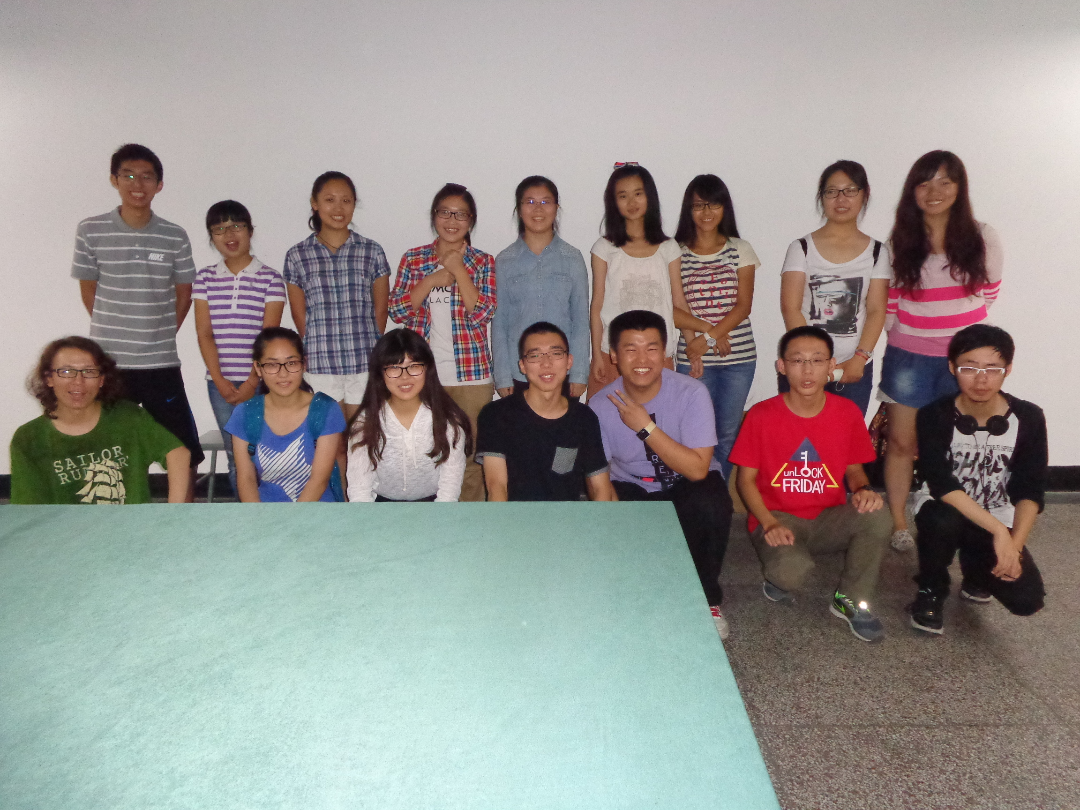
Our English Corner Friends
September 25, 2014

Slide 4
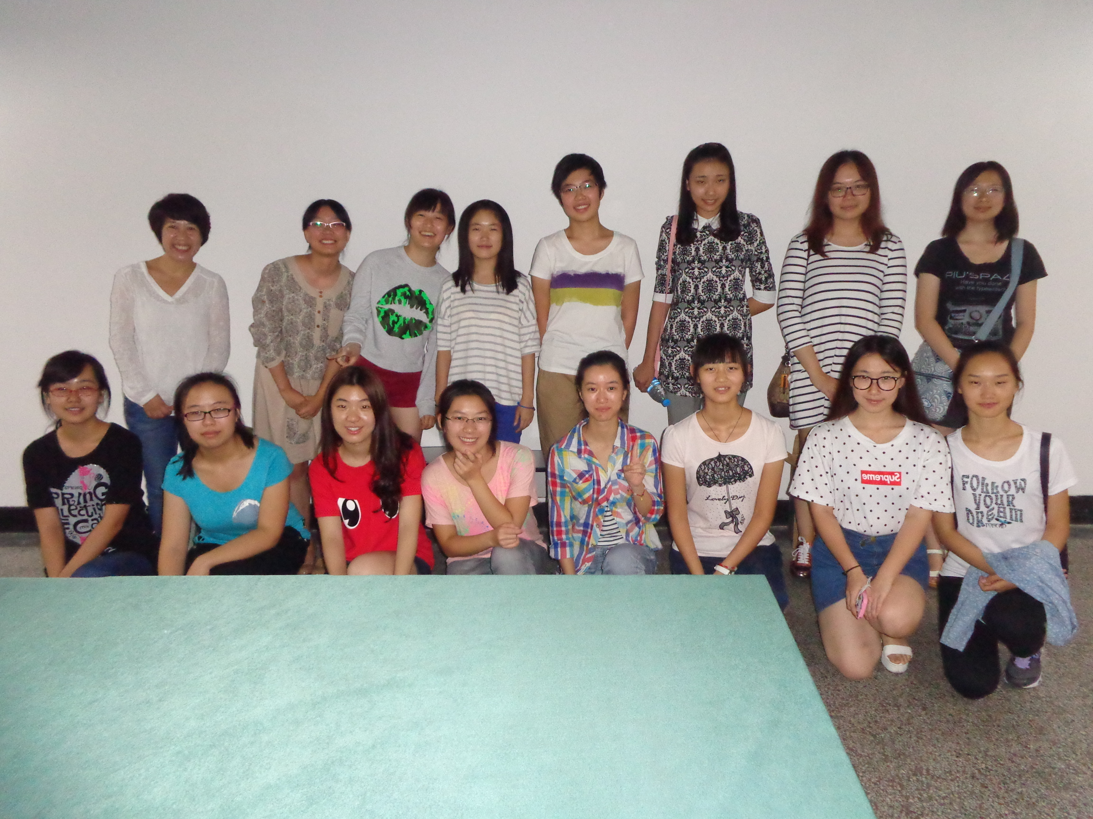
Our English Corner Friends
September 25, 2014

Slide 5
Did anyone write a Limerick?
Limericks are short (sometimes serious; sometime silly) poems that are fun to recite.
A: What is a limerick, Mother?
A: It's a form of verse, said brother
B: In which lines one and two
B: Rhyme with five when it's through
A: And three and four rhyme with each other.

Slide 6
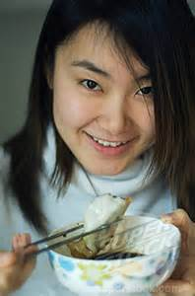
Holidays
We love holidays so very much,
For we love to stay in touch,
With friends and family,
Visiting happily,
Eating sweet dumplings and such.

Slide 7

Let’s
Sing
China’s National Anthem

Slide 8

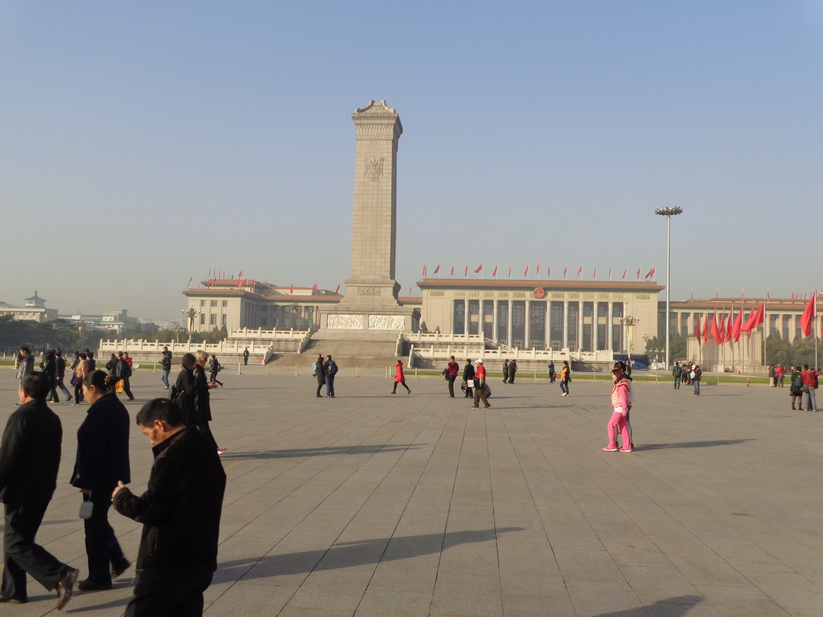

The Amazing China
March of the Volunteers
Arise, ye who refuse to be slaves
With our very flesh and blood Let us build our new Great Wall!
The Peoples of China are in the most critical time,
Everybody must roar his defiance.
Arise! Arise! Arise! Millions of hearts with one mind,
Brave the enemy's gunfire, March on! Brave the enemy's gunfire,
March on! March on! March on, on!
The People’s Square

Slide 9

This Land is My Land

Slide 10


Slide 11
Northwest China
Urumchi
Xi’an

Slide 12
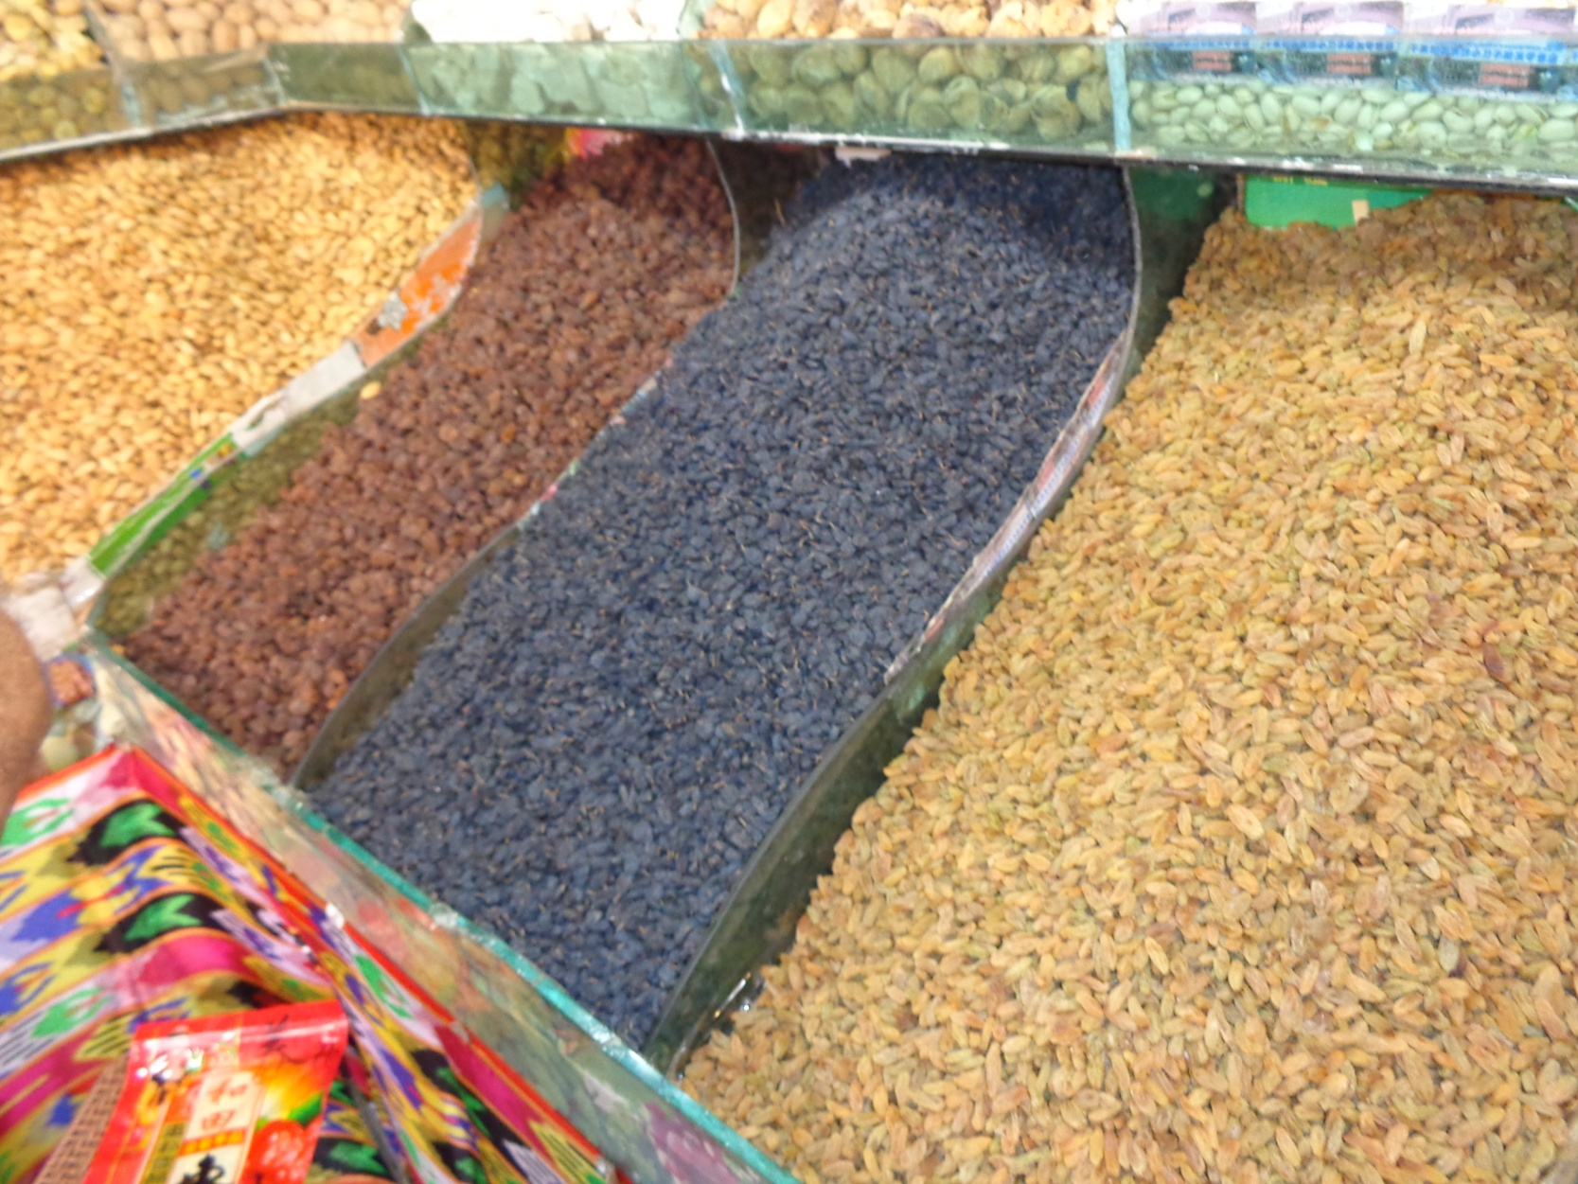
Famous Raisins

Slide 13
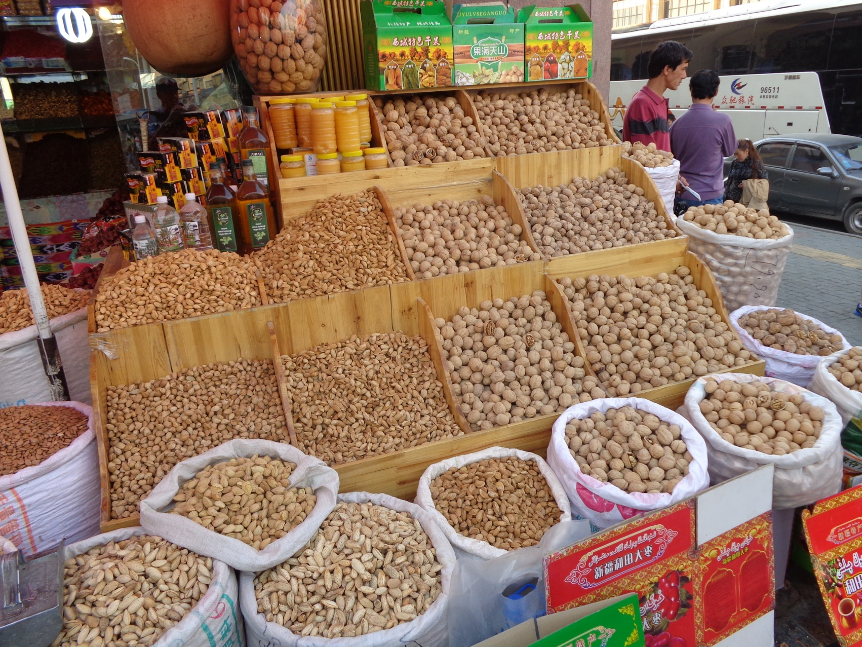
Famous Nuts

Slide 14
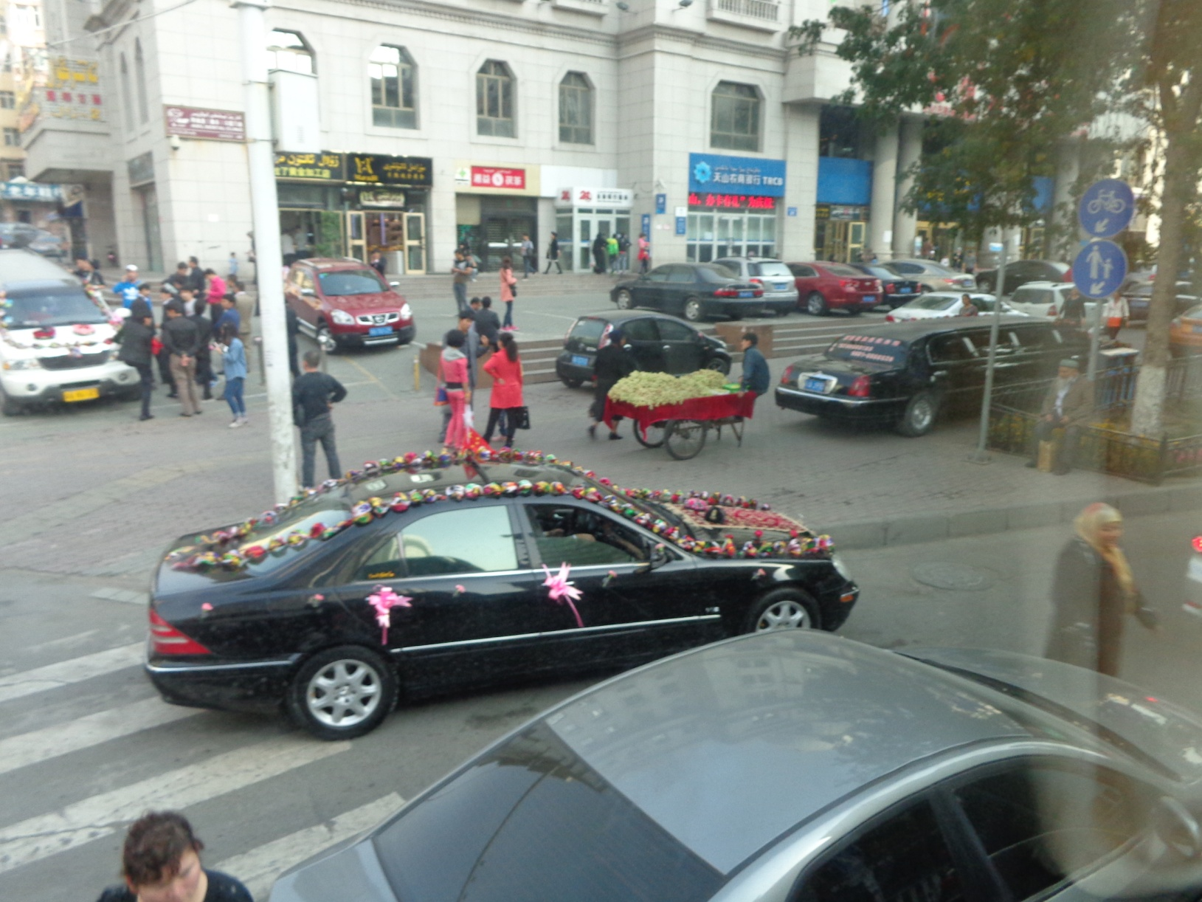
Wedding Celebrations

Slide 15
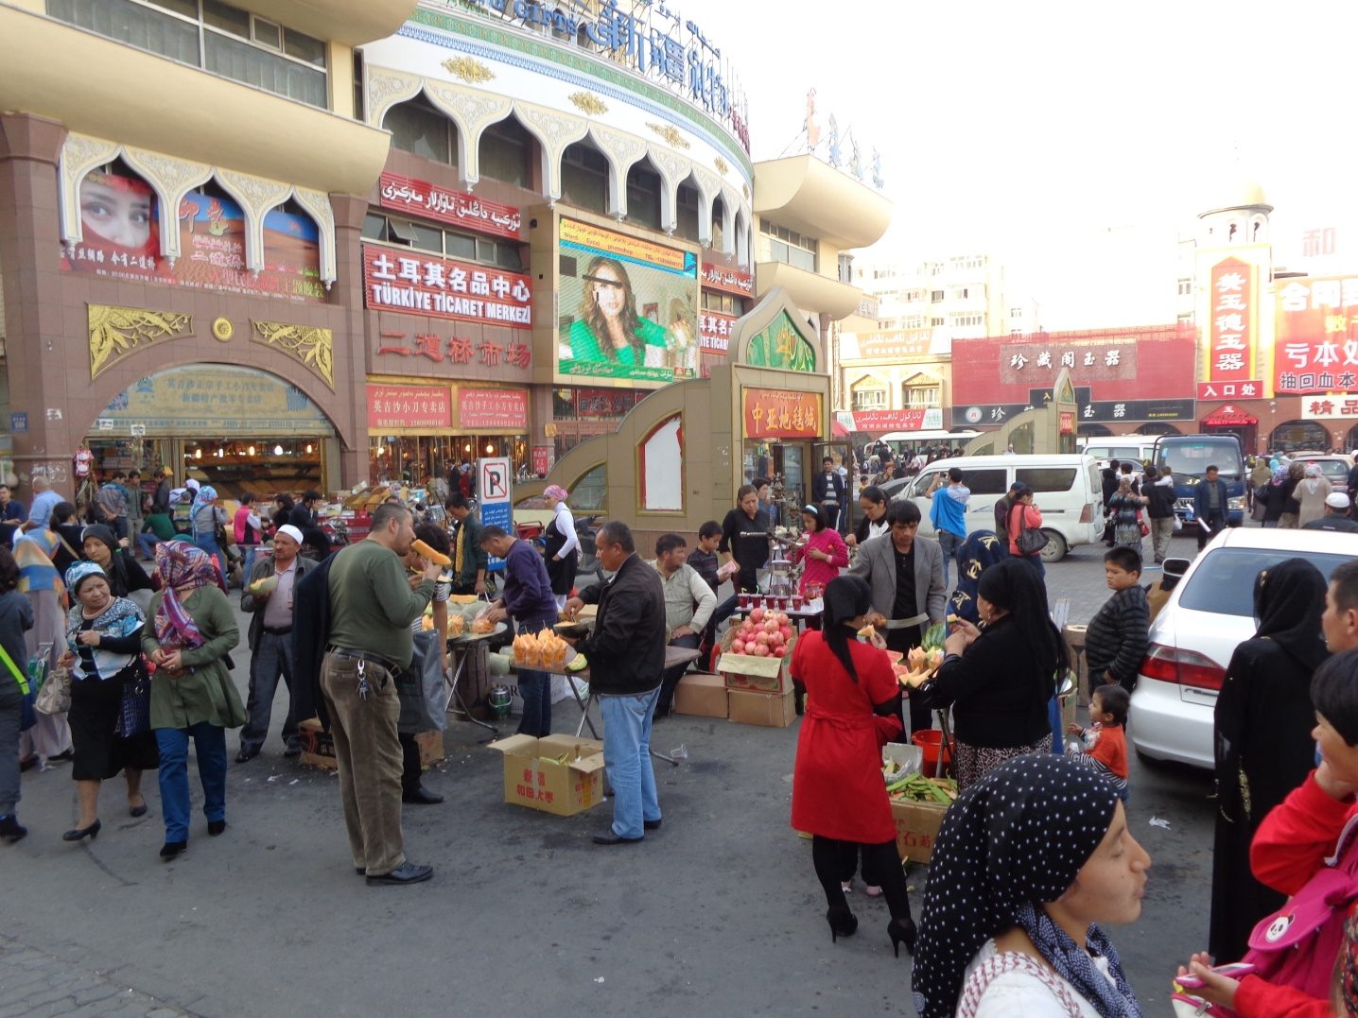
Bazaars

Slide 16
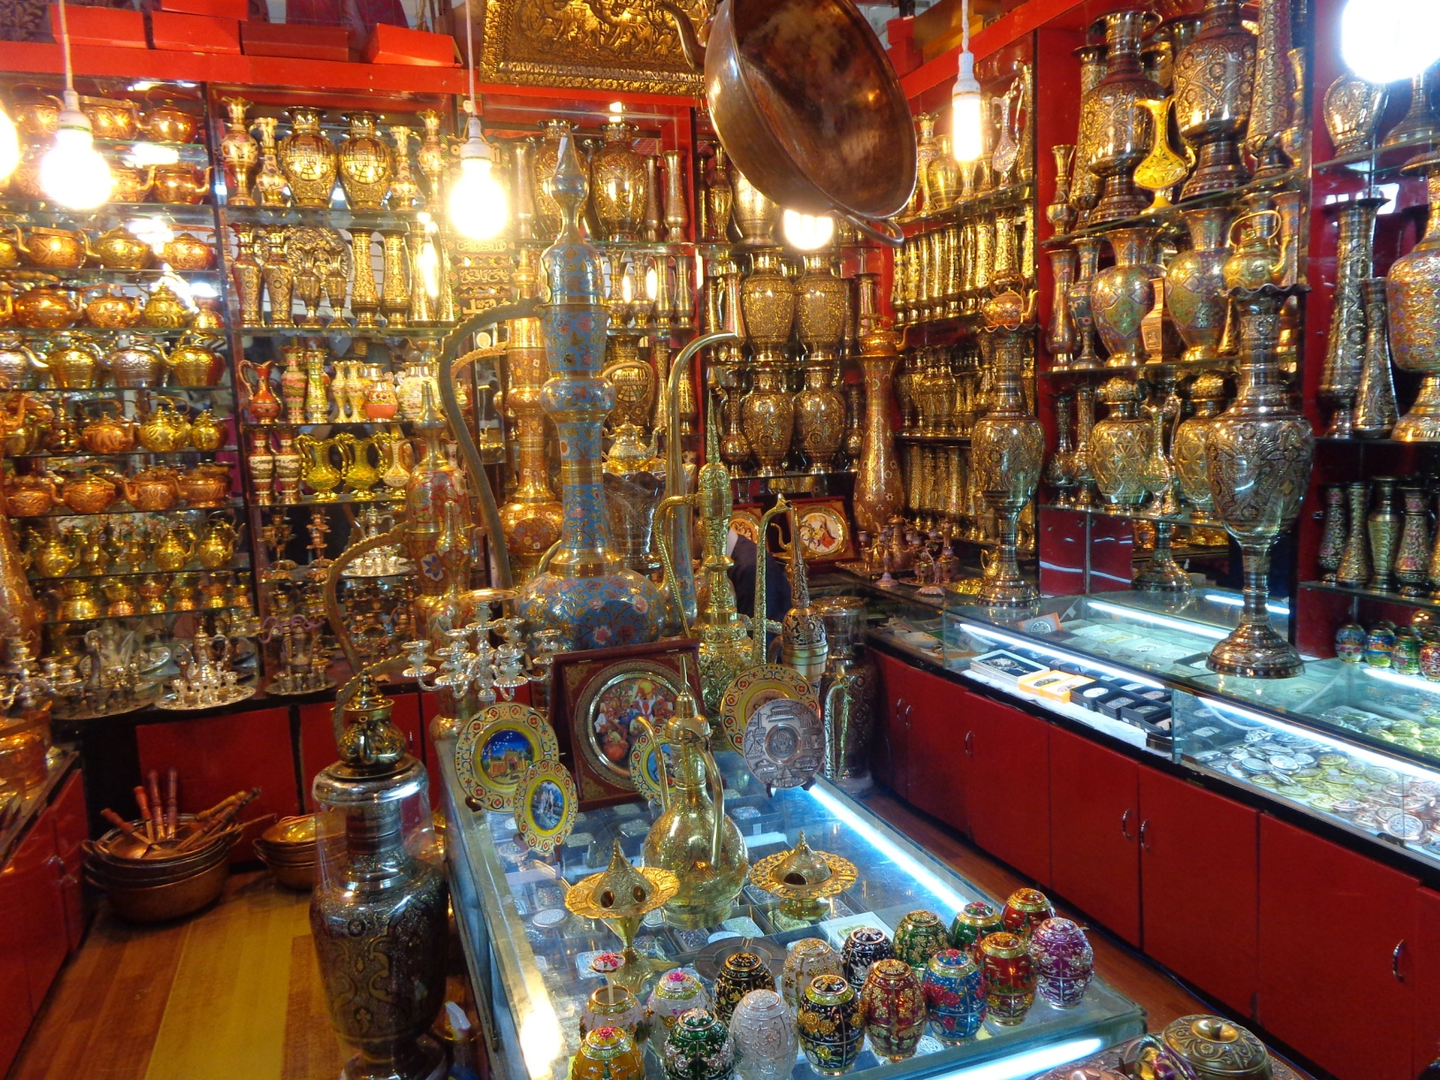
Beautiful Bronze

Slide 17

Beautiful Art Work

Slide 18
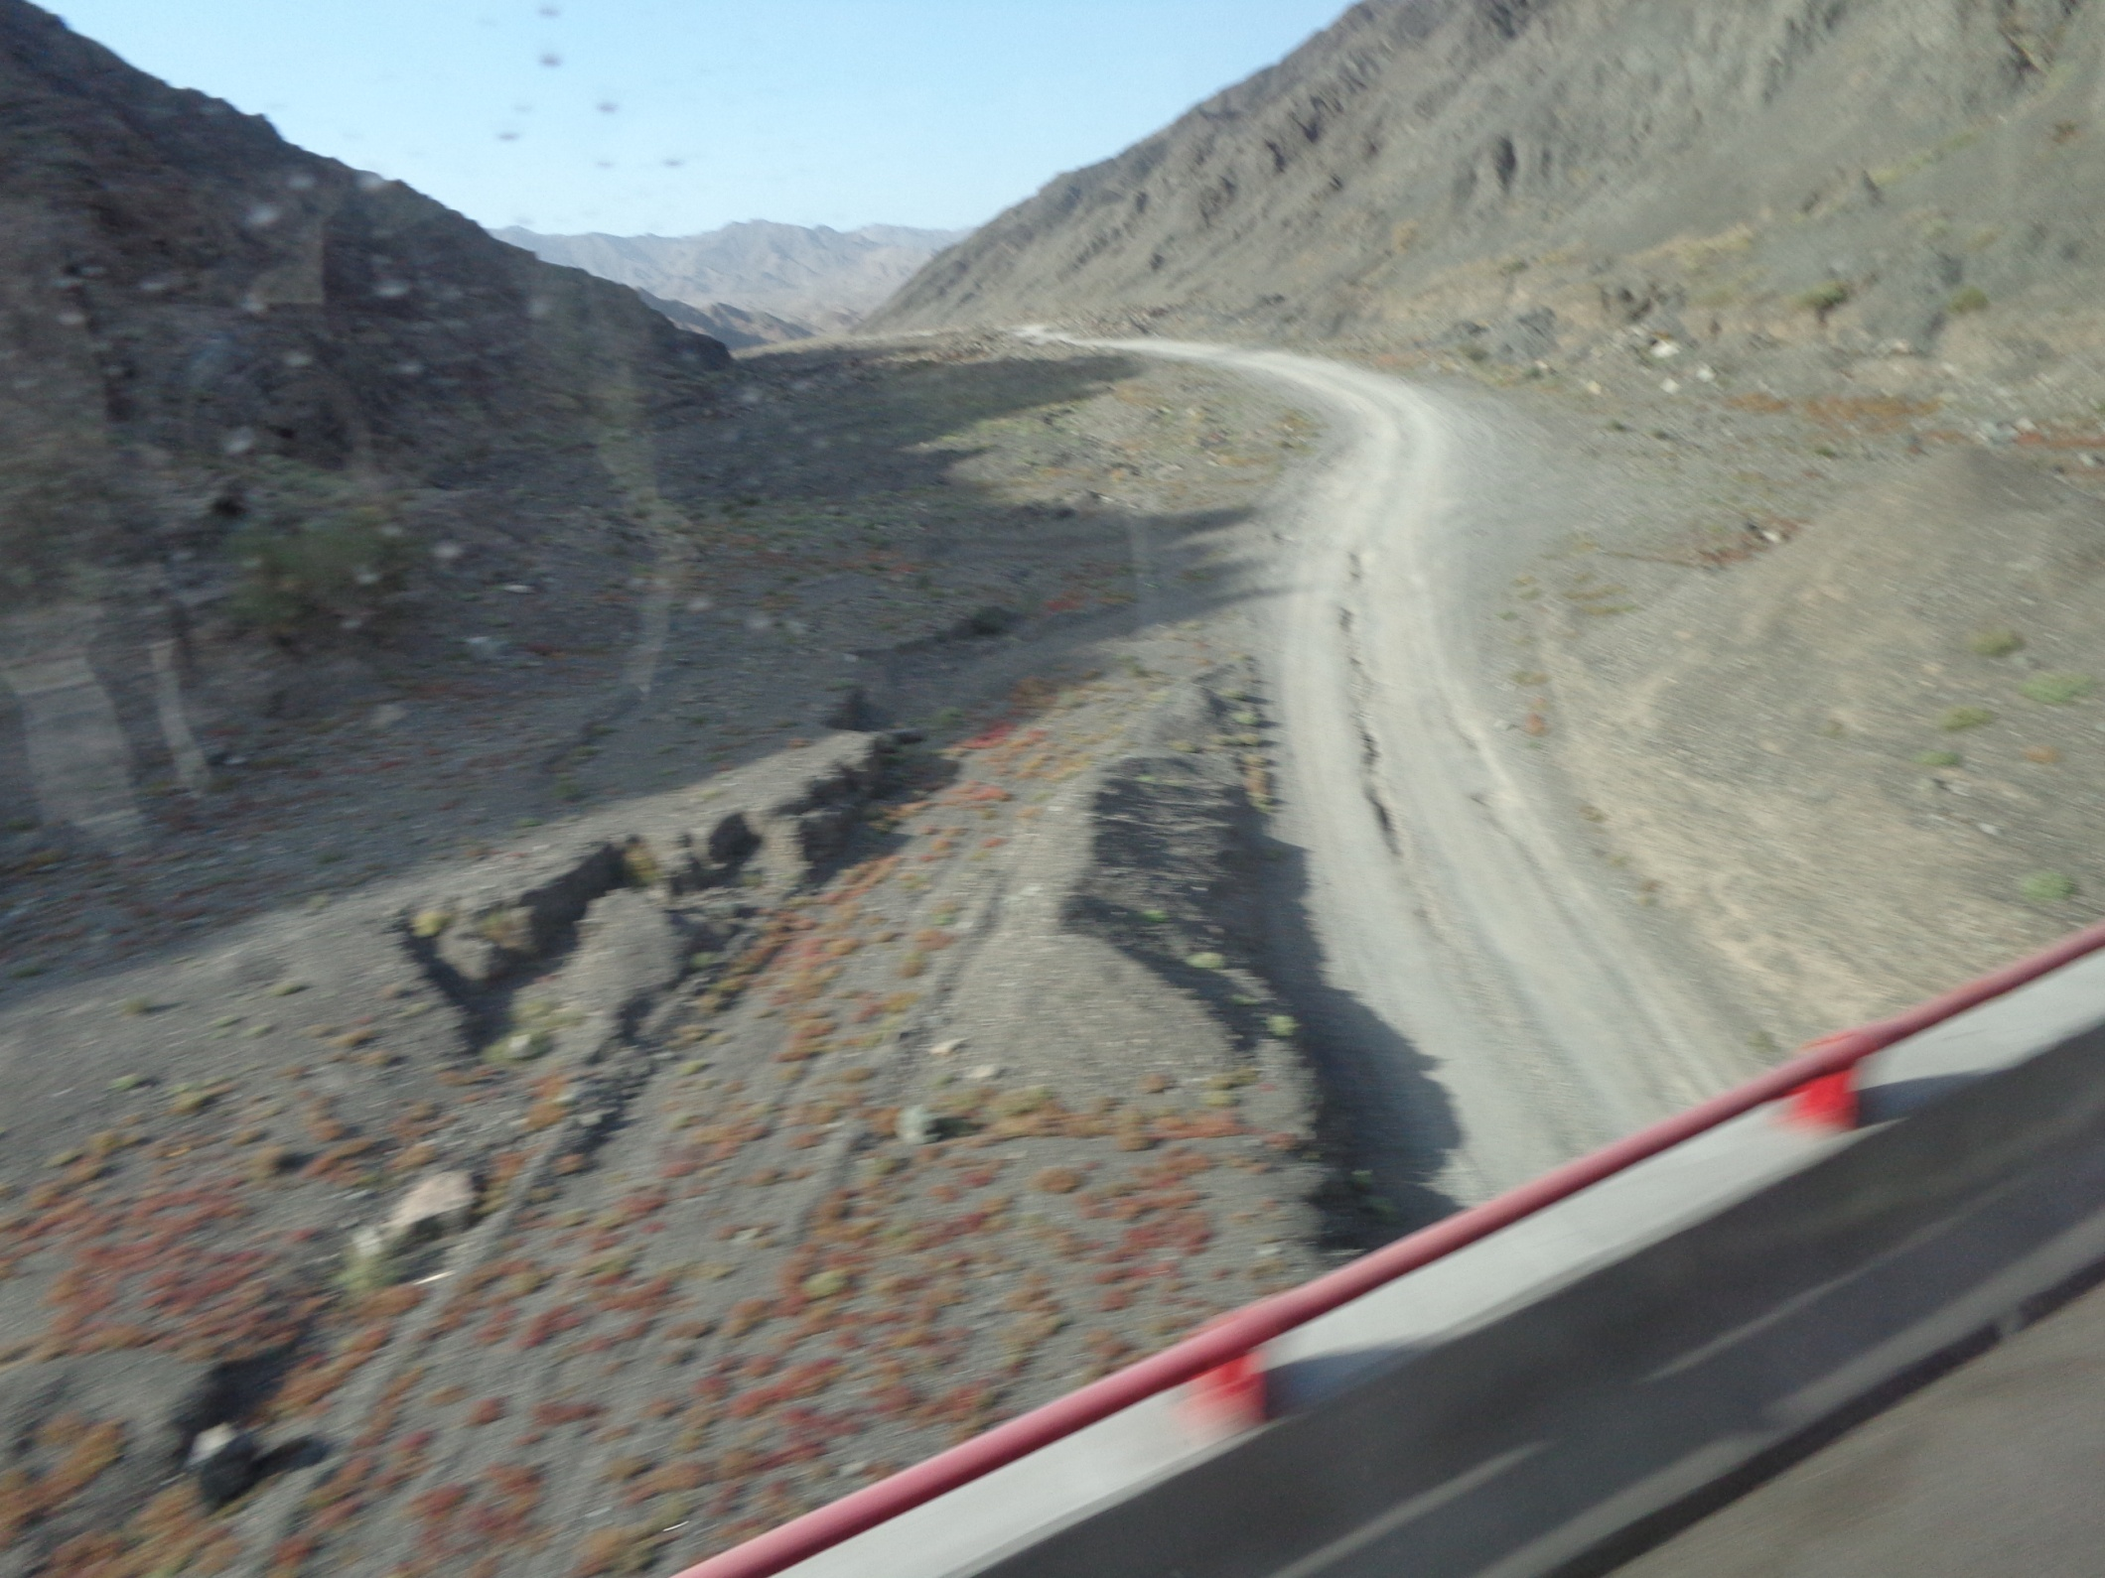
Remote Roads

Slide 19
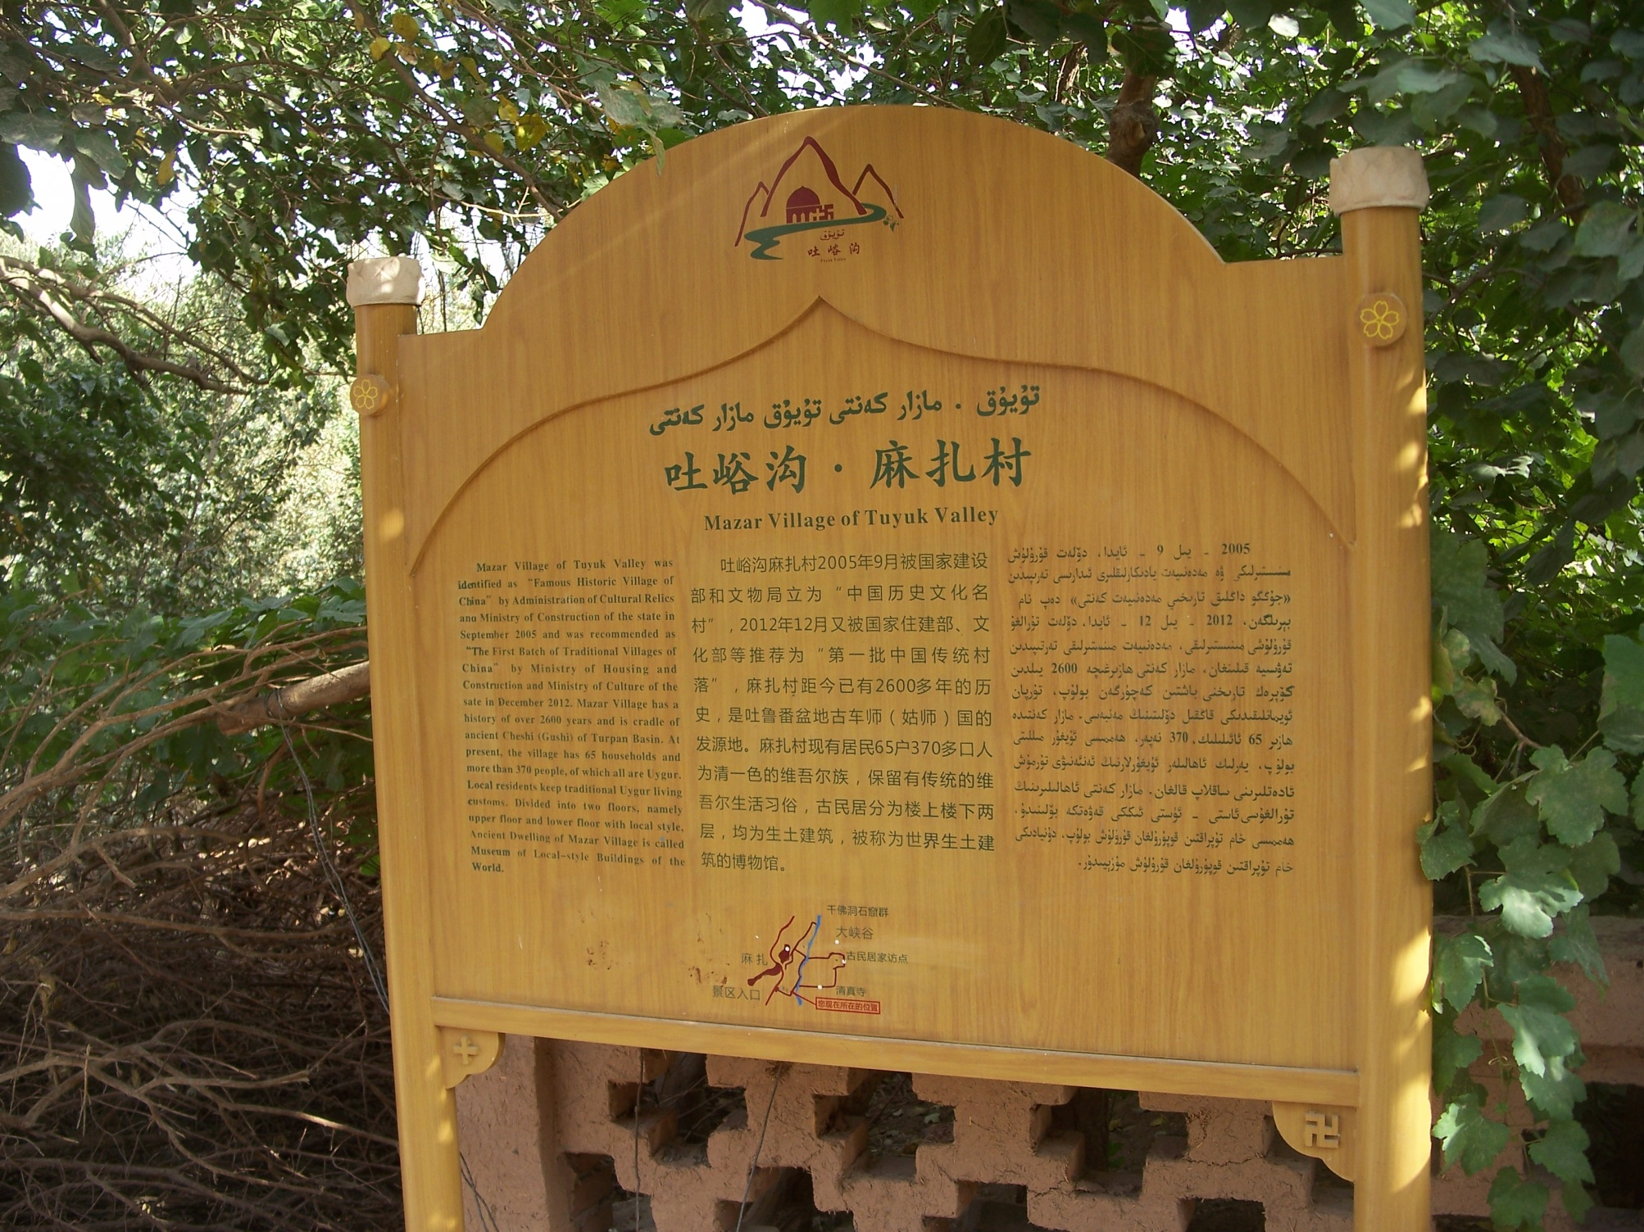
Mazar Village

Slide 20
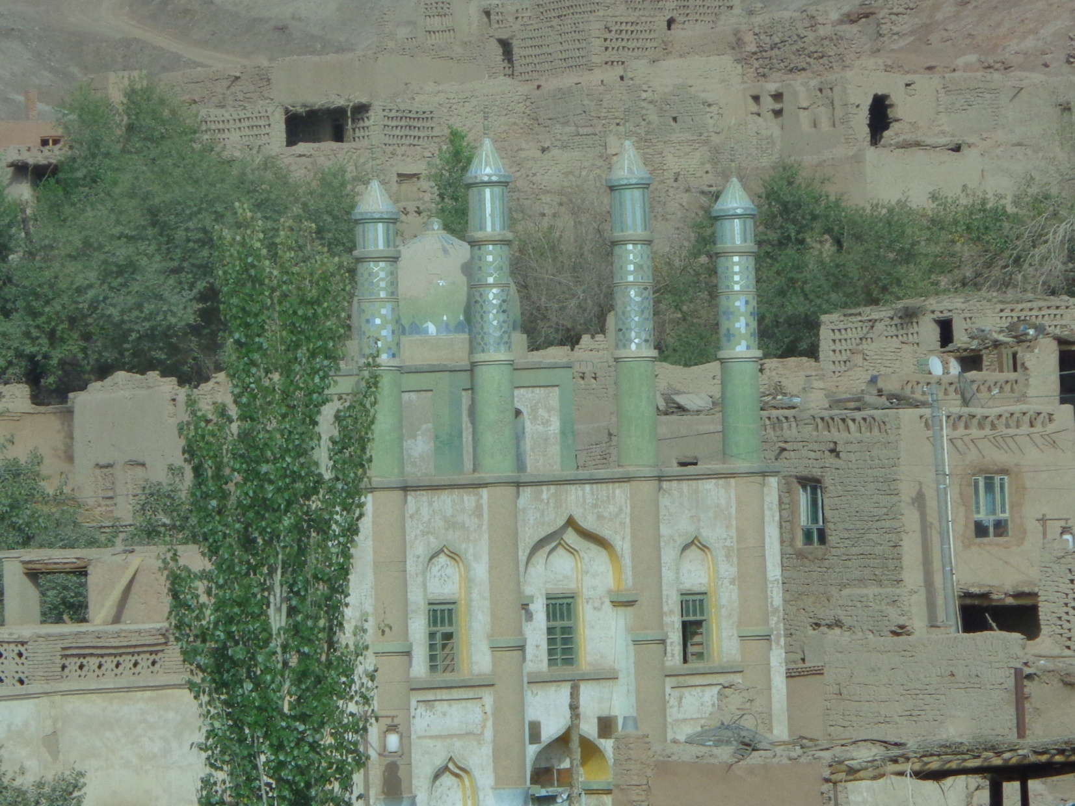
Uyghur/Uighur Village Sacred Shrine

Slide 21
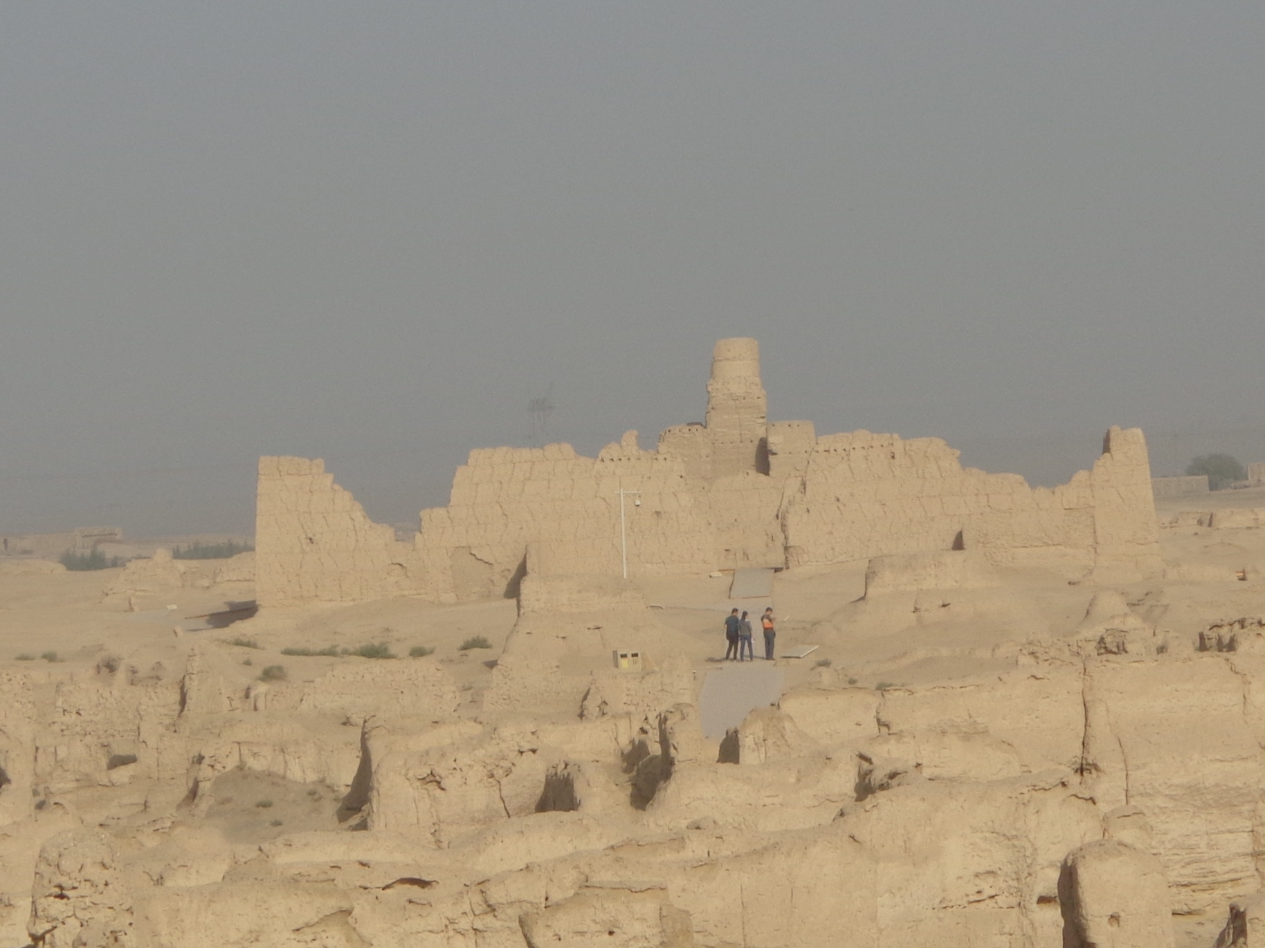
Yar City Sacred Shrine

Slide 22
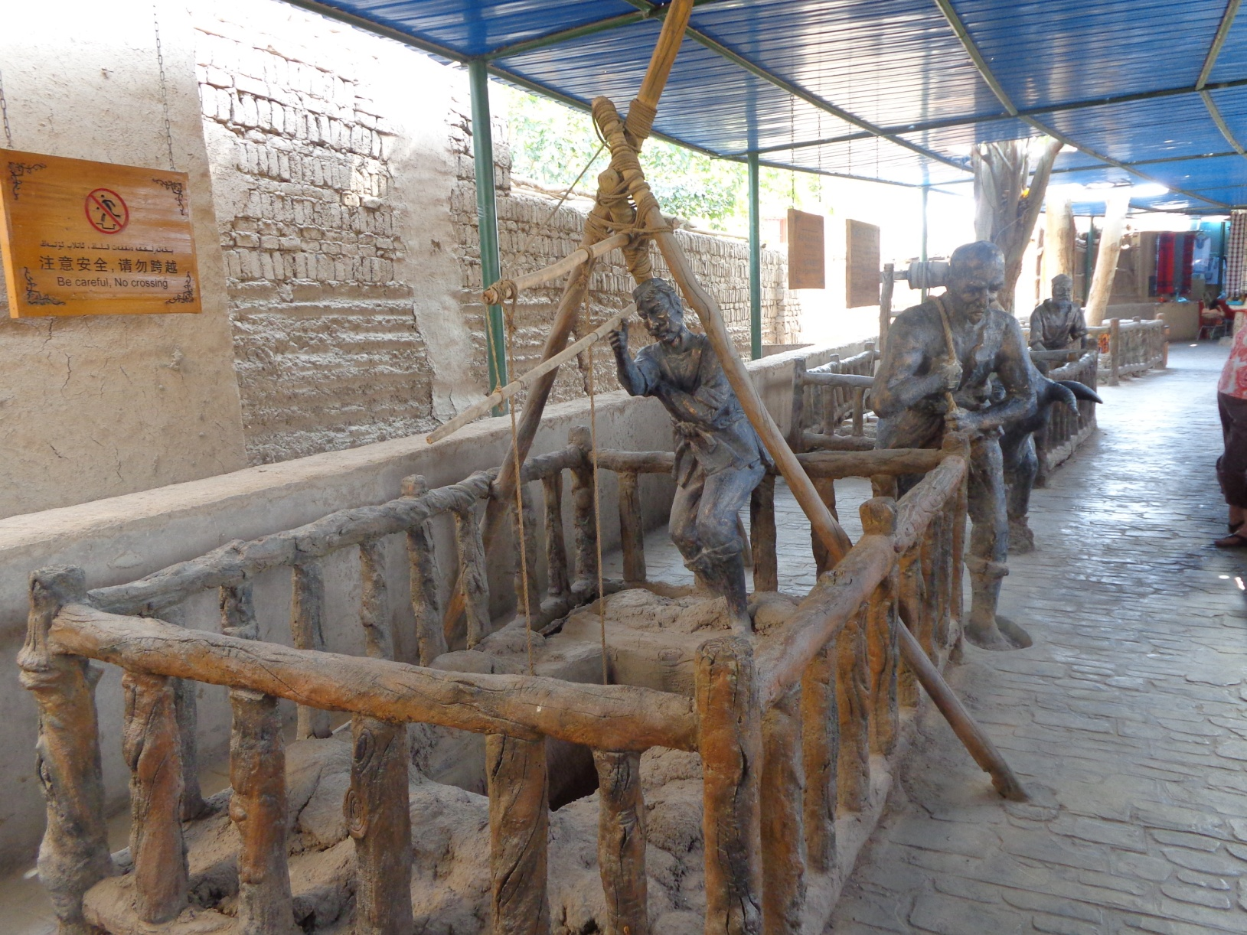
Karez Ancient Irrigation Project

Slide 23
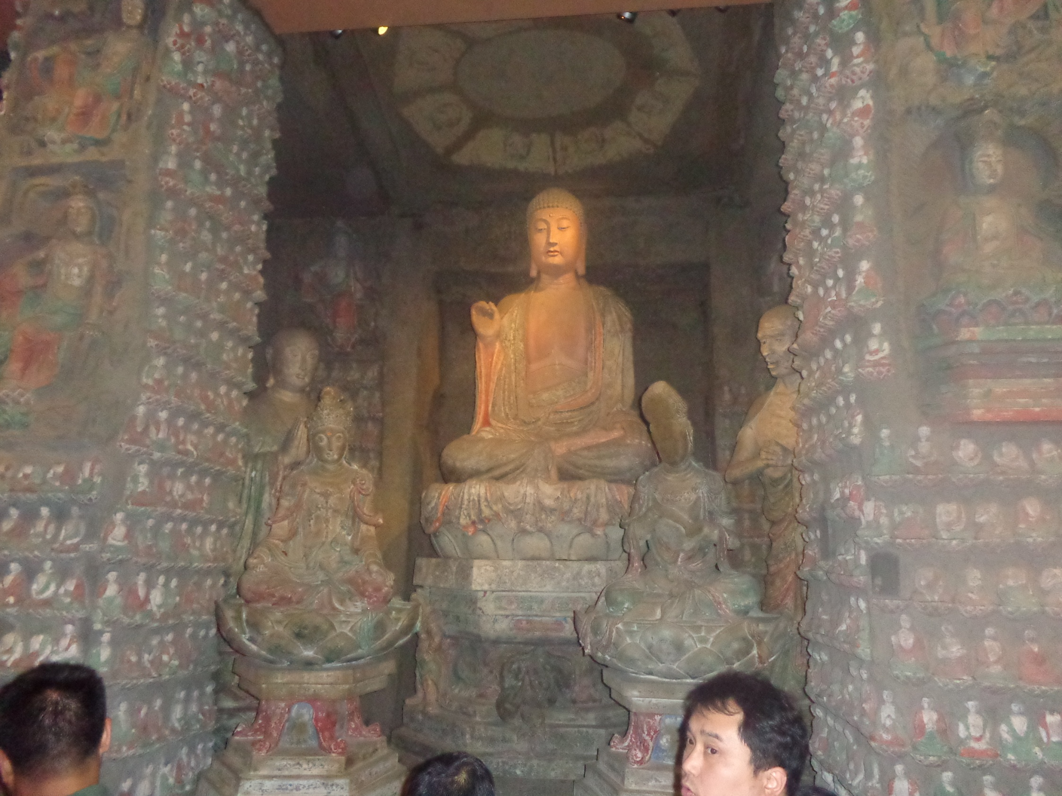
Mogao Grottos--Sacred Shrine

Slide 24
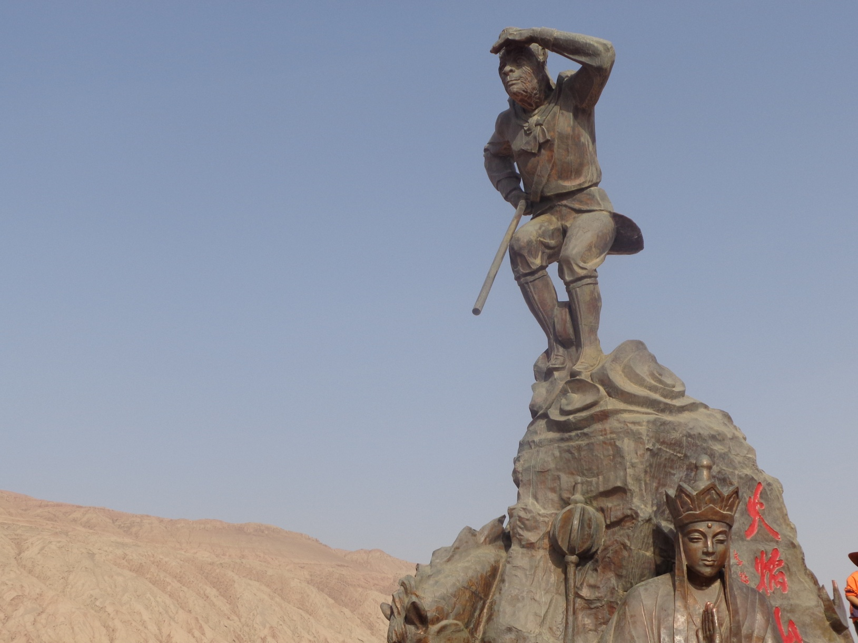
Monkey King

Slide 25
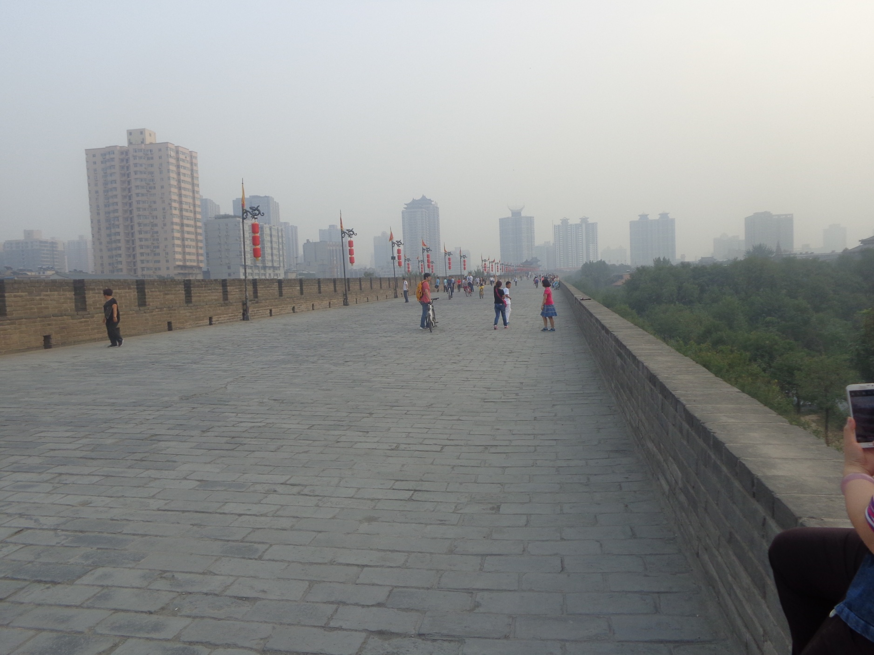
Xi’an City Wall

Slide 26
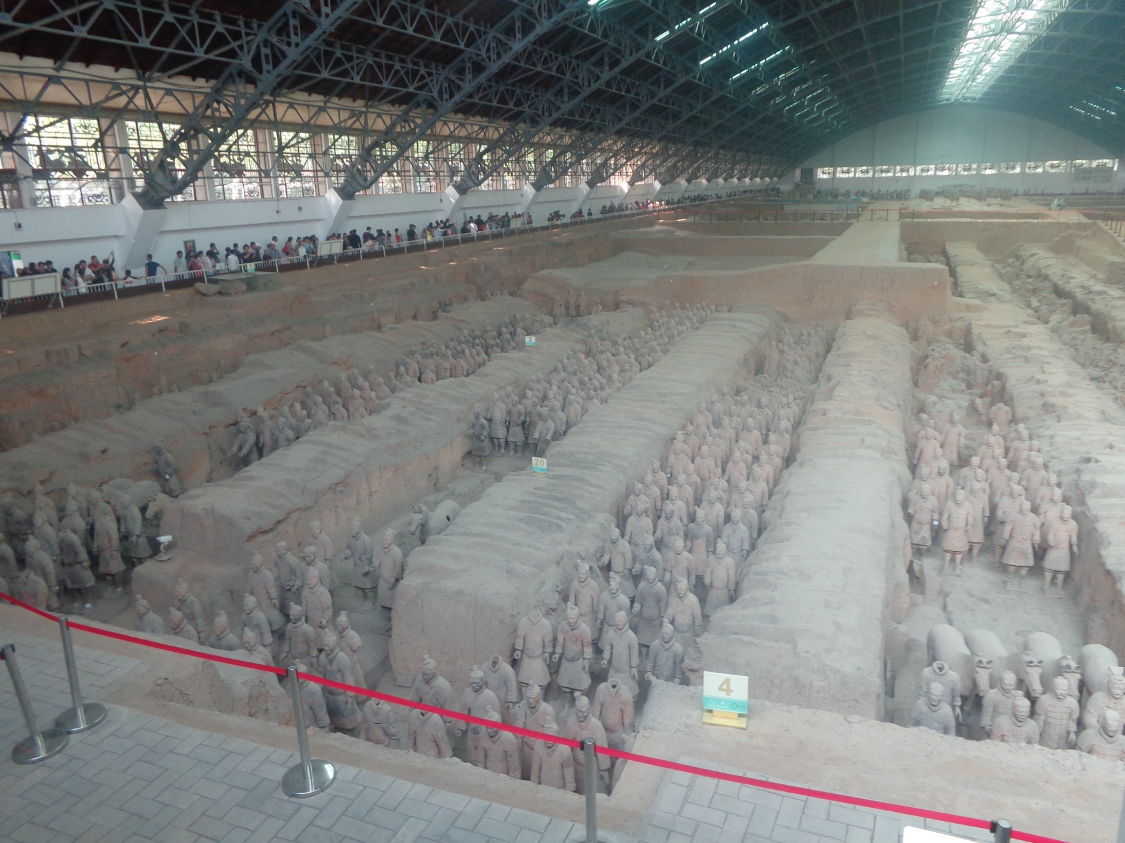
Terra-cotta Warriors
8th Wonder of the World

Slide 27
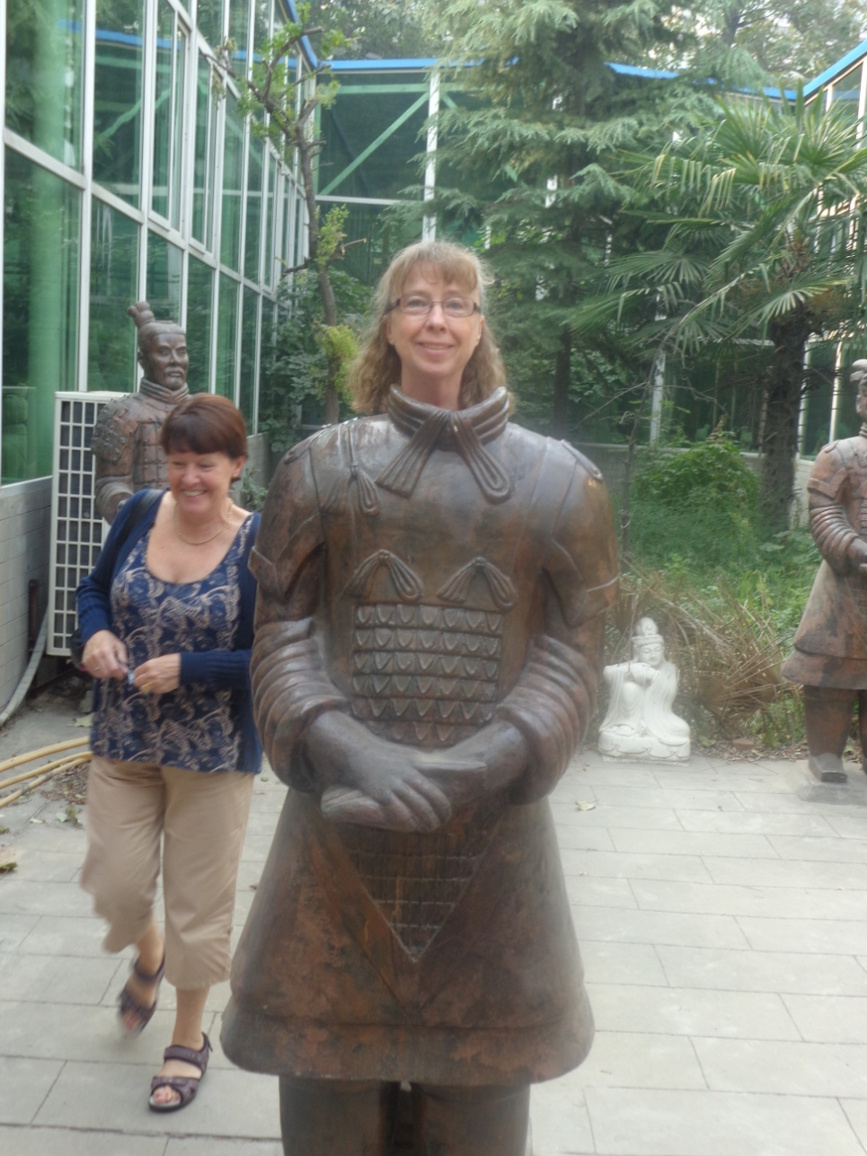
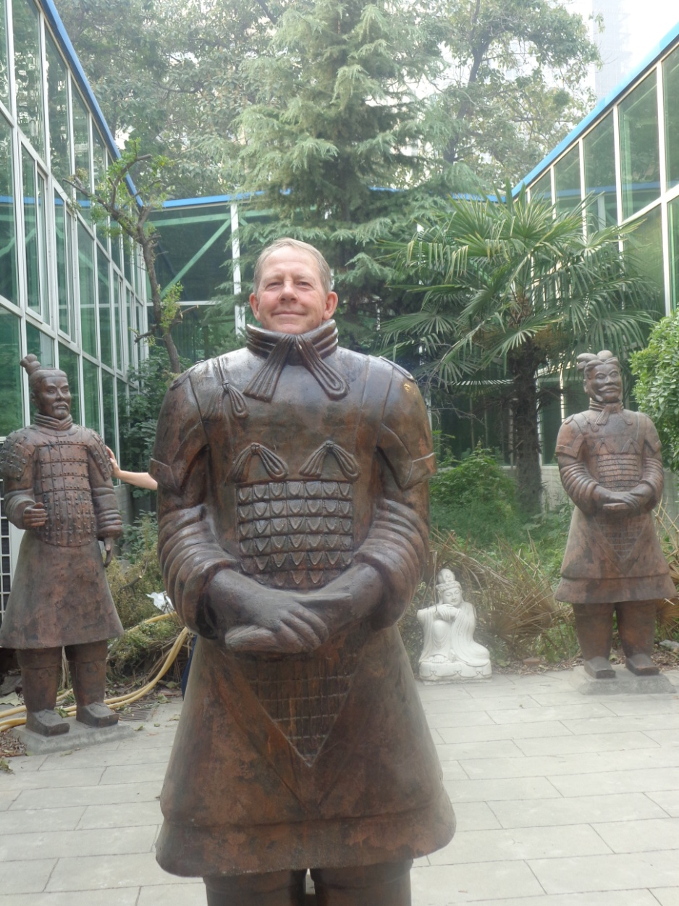
Modern Terra-cotta Professors
Professor Marie Murdoch
Professor John Murdoch

Slide 28
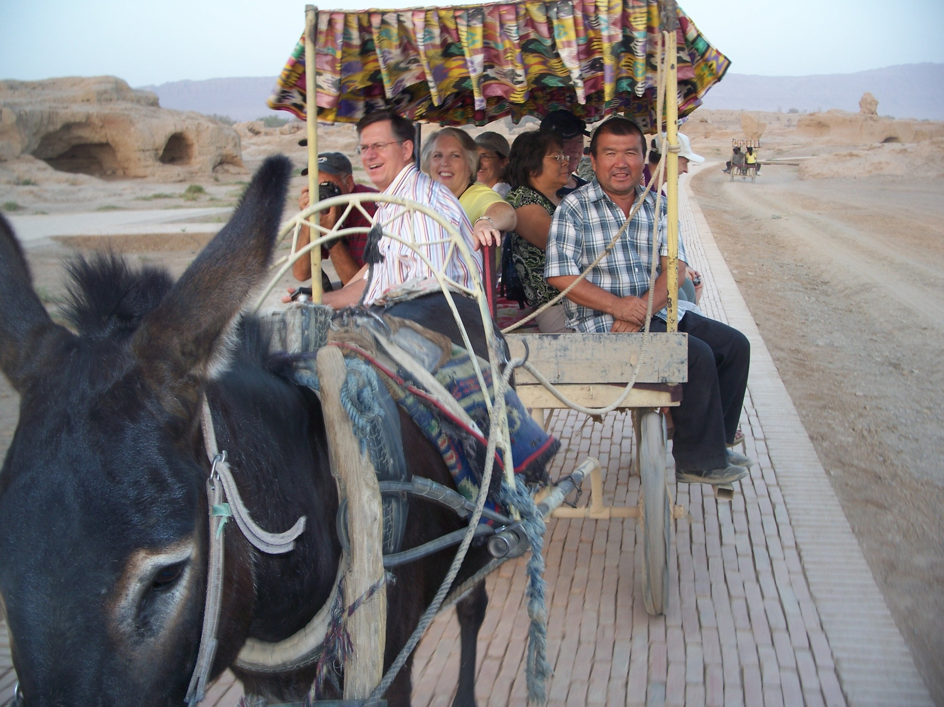
Traveling By Donkey

Slide 29
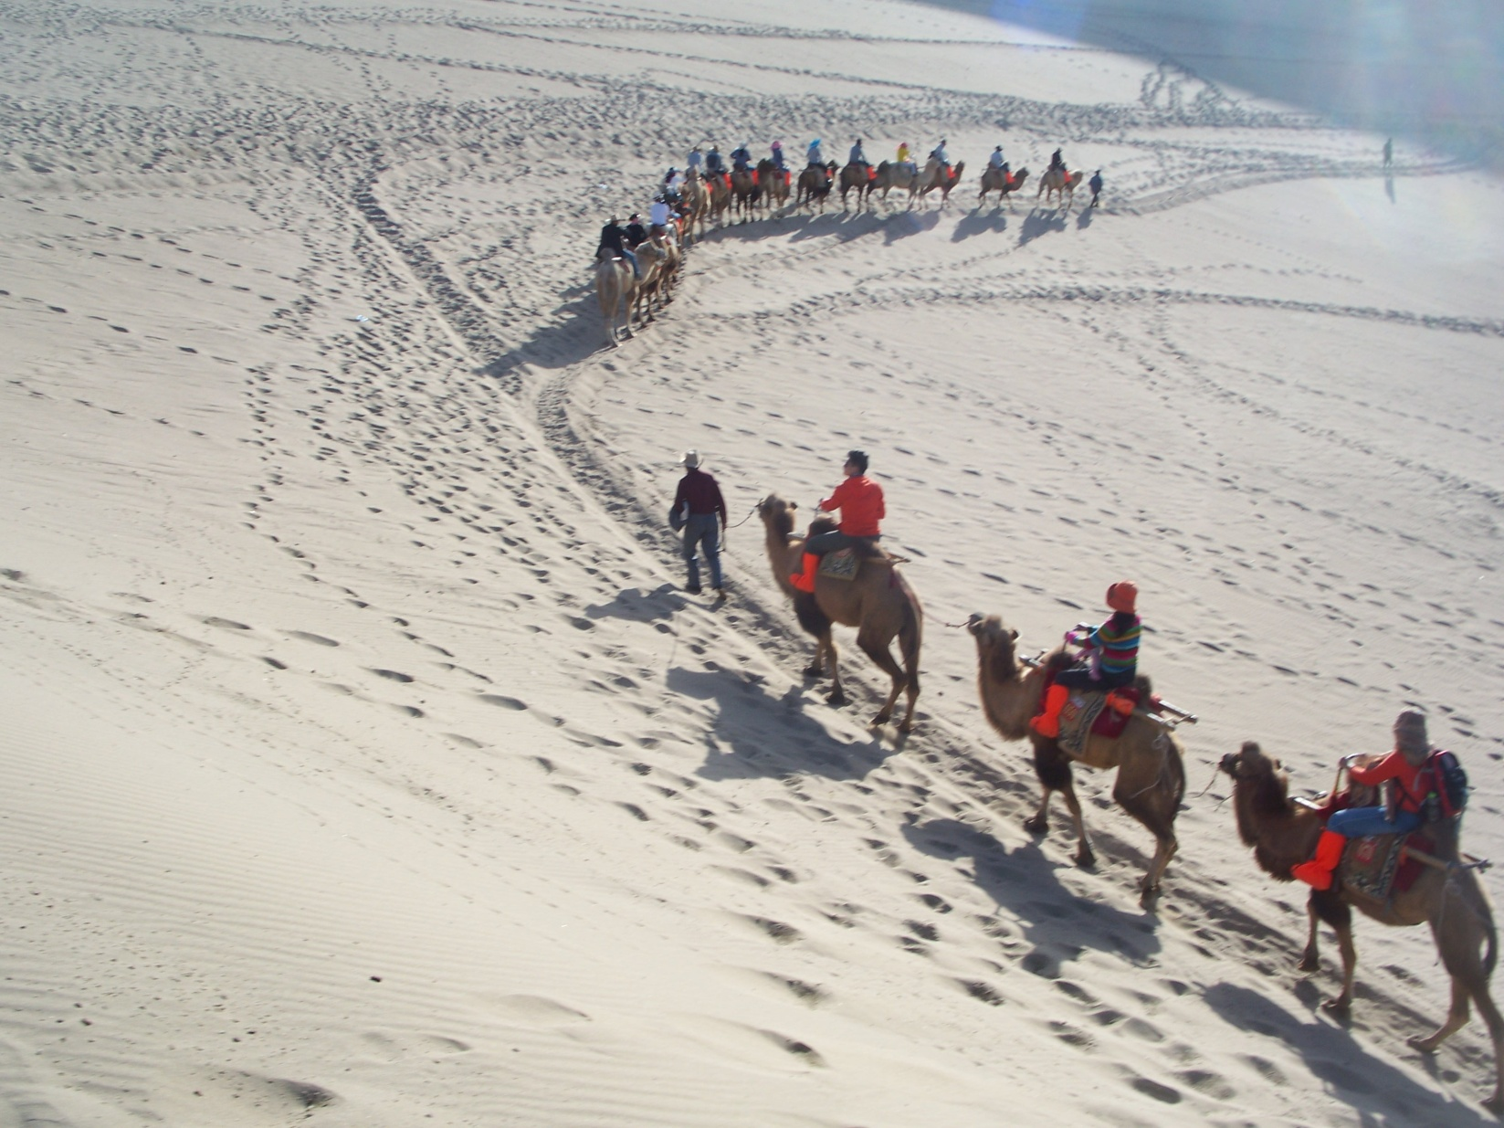
Traveling by Camel Train

Slide 30
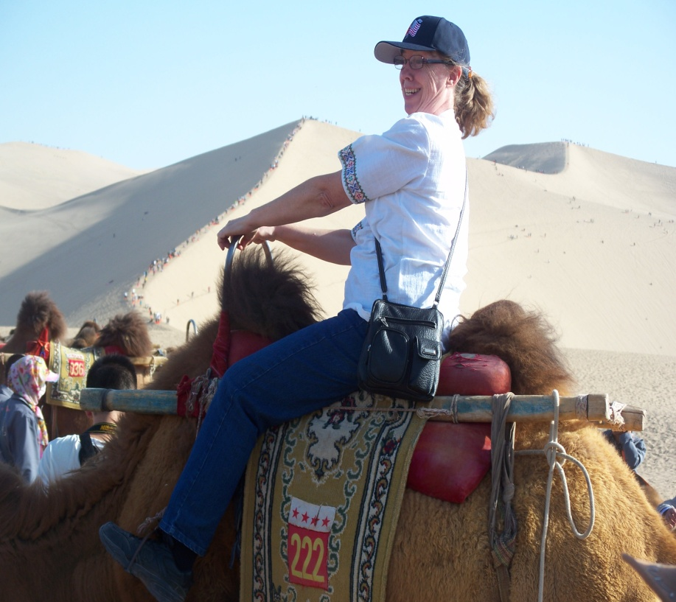
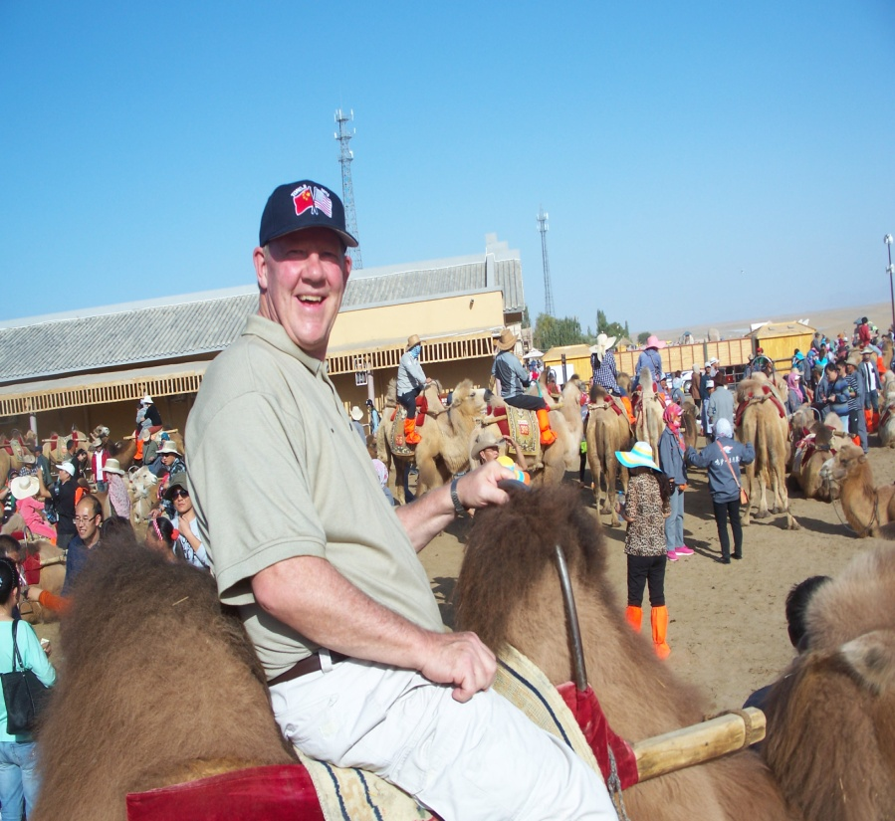
Traveling By Camel

Slide 31
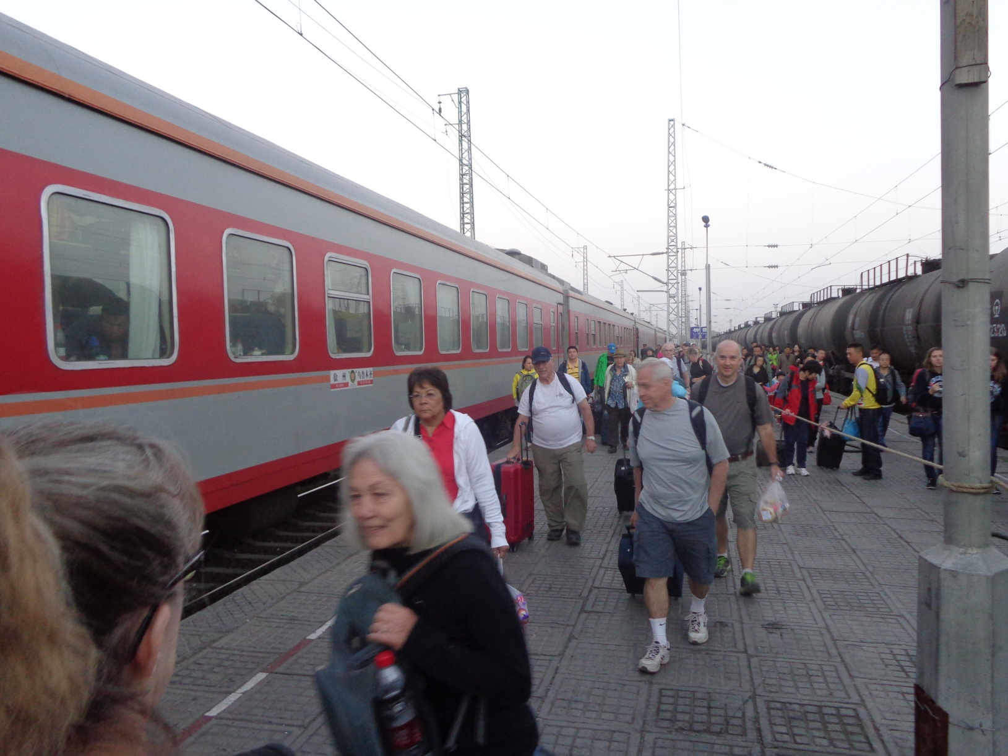
Traveling By Rail

Slide 32
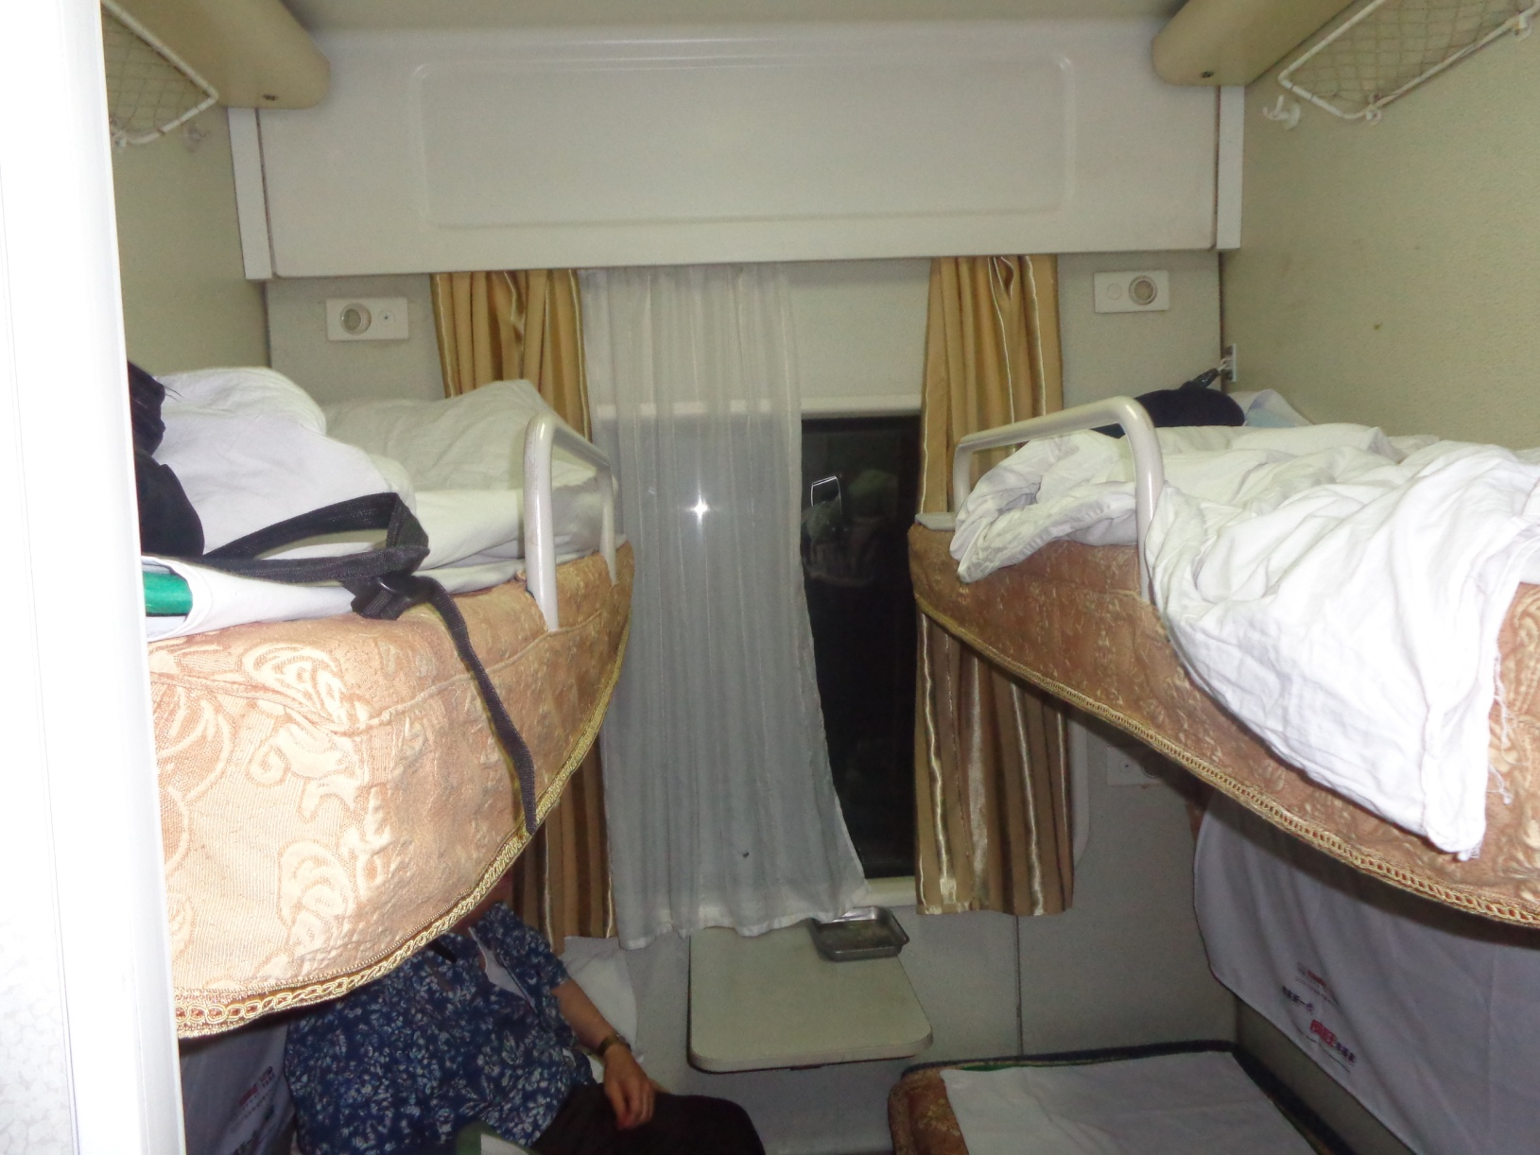
Our Soft Sleeper

Slide 34
Speed Meet and Chat
What is your name?
Where are you from (hometown)?
Interesting Places to Visit.

Slide 35

Have a Treat
Break
Let’s Take a Picture

Slide 36
Mystery Places
Conversation Game

Slide 37
Mystery Places in China Instructions
Write down the names of three famous places in China on the slip of paper that has been provided; names can be in English or Chinese lettering. These people can be real or fictitious, but must be very well known.
Divide into assigned groups.
The first person has one minute to describe their first mystery place without using its name.
Then group members have one minute to guess the name of the famous place. The group member who first guesses correctly earns one point.
When time is up and if no one is successful, then the first person gives the answer.
Play continues by moving one person to the left until the time is up.
The winner is the person who has guessed the most correct answers.

Slide 38
Descriptionary
Instructions:
  Form in assigned groups.
  One person will have his/her back to the screen.
  When a word/phrase flashes on the screen, the person(s) facing the screen will describe the word/phrase. However, you cannot use the word or a form of it or use a synonym or an antonym of the word/phrase.
  When the person guesses the word correctly, then trade places and be prepared for the next word.

Slide 39
Forbidden City
Bejing

Slide 40
Great Wall

Slide 41
Yellow Mountain
Mt. Huangshan

Slide 42
Hainan Islands

Slide 43
West Lake

Slide 44
Three Gorges

Slide 45
Yangzi River

Slide 46
Three Pagodas
Dali
Yunnan Province

Slide 47
Terracotta Warriers
Xian

Slide 48
Li River &
Yangshou

Slide 49
Inner Mongolian
Grasslands

Slide 50
Gobi Desert

Slide 51
Harbin

Slide 52
The Bund

Slide 53
Benxi Water Cave

Slide 54
Hailuogou
National Park
Sichuan Province

Slide 55
Guangzhou Circle

Slide 56
Chinglish
Translations
Form in assigned groups.
Rewrite translation into Standard English.
Be prepared to share your translation.

Slide 57
Questions
Questions for and from
the Professors.

Slide 58
What are some of the topics you would like to discuss in class and/or English Corners?

Slide 59

Talking Dice--Speaking Activity
Divide into assigned groups
Roll the dice and answer the number of the question you rolled.
If you have already answered the question then answer question #1. If you have answered that question #1
then roll the dice again.

Slide 60
Describe your bedroom at home?
How should we reduce pollution?
What advice do you have for a failing student?
What time should students turn off their electronic devices and go to sleep?
How will you apply for your first job after graduation?
Describe the last party that you attended?
What do you think the purpose of life is?
Why do you want to learn to speak English fluently?
What is one thing you’ve learned this week?
Describe your best friend from high school? What made this person special?
What are your thoughts about smoking/drinking alcohol/using drugs?
What benefits do you receive when you volunteer?

Slide 61
Vocabulary Builders
Instructions:
  Form groups of three or four people.
  Distribute the vocabulary card so each person in your group has one.
  Taking turns, each person then pronounces each word on his/her card.
  When everyone is finished, pass your card one person to the left and then each person pronounces the words on his/new card.
  Repeat the process until everyone has had a chance to pronounce the words on each card.
  Note: If someone needs help pronouncing a word, other group members should provide assistance.

Slide 62

Five Phases of Dating
Phase I – Meeting lots of people.
  Group parties/gatherings.
  Speed Dating and other group games.
Phase II – Making Friends
  Eating lunch or dinner together.
  Studying or going for a walk together.
  Sharing family stories and personal goals.
  Phase III – Formal Dating.
    Planned activities designed to help you know each other better.
    Should begin to be more personable, but set limits as to the time you spend alone with each other and limits to intimacy.

Slide 63

Five Phases of Dating
Phase IV Paring up/Going Steady
  Share your important beliefs and values.
  Introduce each other to your respective families.
  Begin to plan for the future—education, employment, home and family goals.
  Continue to practice limits regarding time alone together and sharing of intimacy.
Phase V Formal Engagement
  The marriage proposal.
  Approval of both sets of parents.
  Set a wedding date.
  Plan more intensely for your wedding and future life together.
  Continue to practice limits regarding time alone together and sharing of intimacy.

Slide 64
Describe your feelings about leaving your home and province for four years.
Try to describe your feelings as you return after successfully completing your B.S or B.A. degree in four years.
Try to describe the feelings of your parents as you return to your home as a college graduate.
Try your best to describe your first day on the job of your dreams.
Describe your future husband or wife.
What do you think your feelings will be when your first child leaves home to go to a school?
What do you think the purpose of life is?
Where do you think you will go when you or your parents die?
Why do you believe that?
Do you believe you came from some where else when you were born? Why do you believe that?
Suppose you move to Australia which has a different form of government. How will that change the way you act in your life, Why?
What about living in Australia would make you nervous?
What do you think you will do to adjust to that concern?

Slide 65
Speaking Activity
Divide into groups of two
Roll the dice and answer the number of the question your rolled.
If you have already answered that question roll the dice again.

Slide 66
Talking Dice
Unfinished Sentences…

Slide 67
Unfinished Sentences:
Finish these sentences by adding your own words.
On Saturdays, I like to____________
If I had only 24 hours to live, I would__________
I feel best when people_____________
Secretly I wish_____________
If I could change the world, I would____ because_____
The most exciting thing I have done is_____
Right now the most important thing in my life is_____ because_________________
If I could be somewhere else now, I’d______________
I never worry about_____________________
I like people who________________
I find it difficult to_______________________
Studying is________________________________

Slide 68

ETHICAL DILEMMAS

Slide 69
Integrity
“Integrity without knowledge is weak and useless and knowledge without integrity is dangerous and dreadful.” (Samuel Johnson (1709-1784) English Poet, Critic and Writer)

Slide 70
VOCABULARY
ethics – the principles (rules) of conduct
governing an individual or a group, the
discipline dealing with what is good
and bad and moral duty and obligation
ethical – moral, conforming to accepted
rules and standards of conduct
moral – principles of right and wrong
behavior
dilemma – a situation involving a choice
between alternatives

Slide 71

expelled – kicked out of school,
suspended from school
0 tolerance – no exceptions, no second
chances
full ride – a scholarship which pays
tuition, books, room and board
Win Win – Solutions in which all parties are better off

Slide 72
ETHICAL DILEMMA
(VICE PRINCIPAL)
You are the vice principal in charge of discipline of a high school. It is your responsibility to see that all students follow the rules and are treated fairly and equally. It is the policy of your school that students caught with alcohol, drugs or weapons on campus will be expelled—0 tolerance.

Slide 73
Your daughter is a senior at the high school. She is an outstanding basketball and volleyball player and is a top academic student. She has applied to several universities and for scholarships that would pay virtually all of her costs at any of these colleges. She is almost certain to be accepted and to receive a full ride at all schools to which she has applied.

Slide 74
One evening, you are supervising a school dance. You need to speak to your daughter and can’t find her. You finally go into the darkened girls’ locker room and hear voices. One is your daughter’s voice and as you listen, you realize they are drinking alcohol. They do not see you.
What will you do?

Slide 75

Life is full of choices and decisions and many of them will present us with moral and ethical dilemmas. Some of these choices and decisions will challenge
the very principles,
standards and values
we were taught by
our family. When
faced with these
moral dilemmas,
what will you do?

