Slide 1

Professors John & Marie Murdoch
Welcome to English Corner

Slide 2
Introductions
Please stand and introduce yourself if this is your first English Corner.
What is your name?
Where are you from (hometown)?
What is one thing you did during this past summer?
Tell one thing you like to do in your free time?

Slide 3
English Corner’s Goals
To improve oral English skills—we speak only English.
To improve English listening skills.
To meet new friends.
To build social skills.
To learn about American and Chinese Cultures.
To share ideas and opinions.
Let’s have fun!

Slide 4
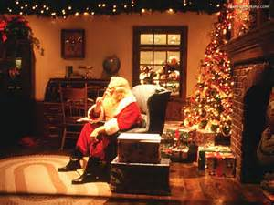
Next English Corner
Christmas Party Part I
December 17, 2013
7 PM
The next English Corner
will be in Room 218-this same room.

Slide 5
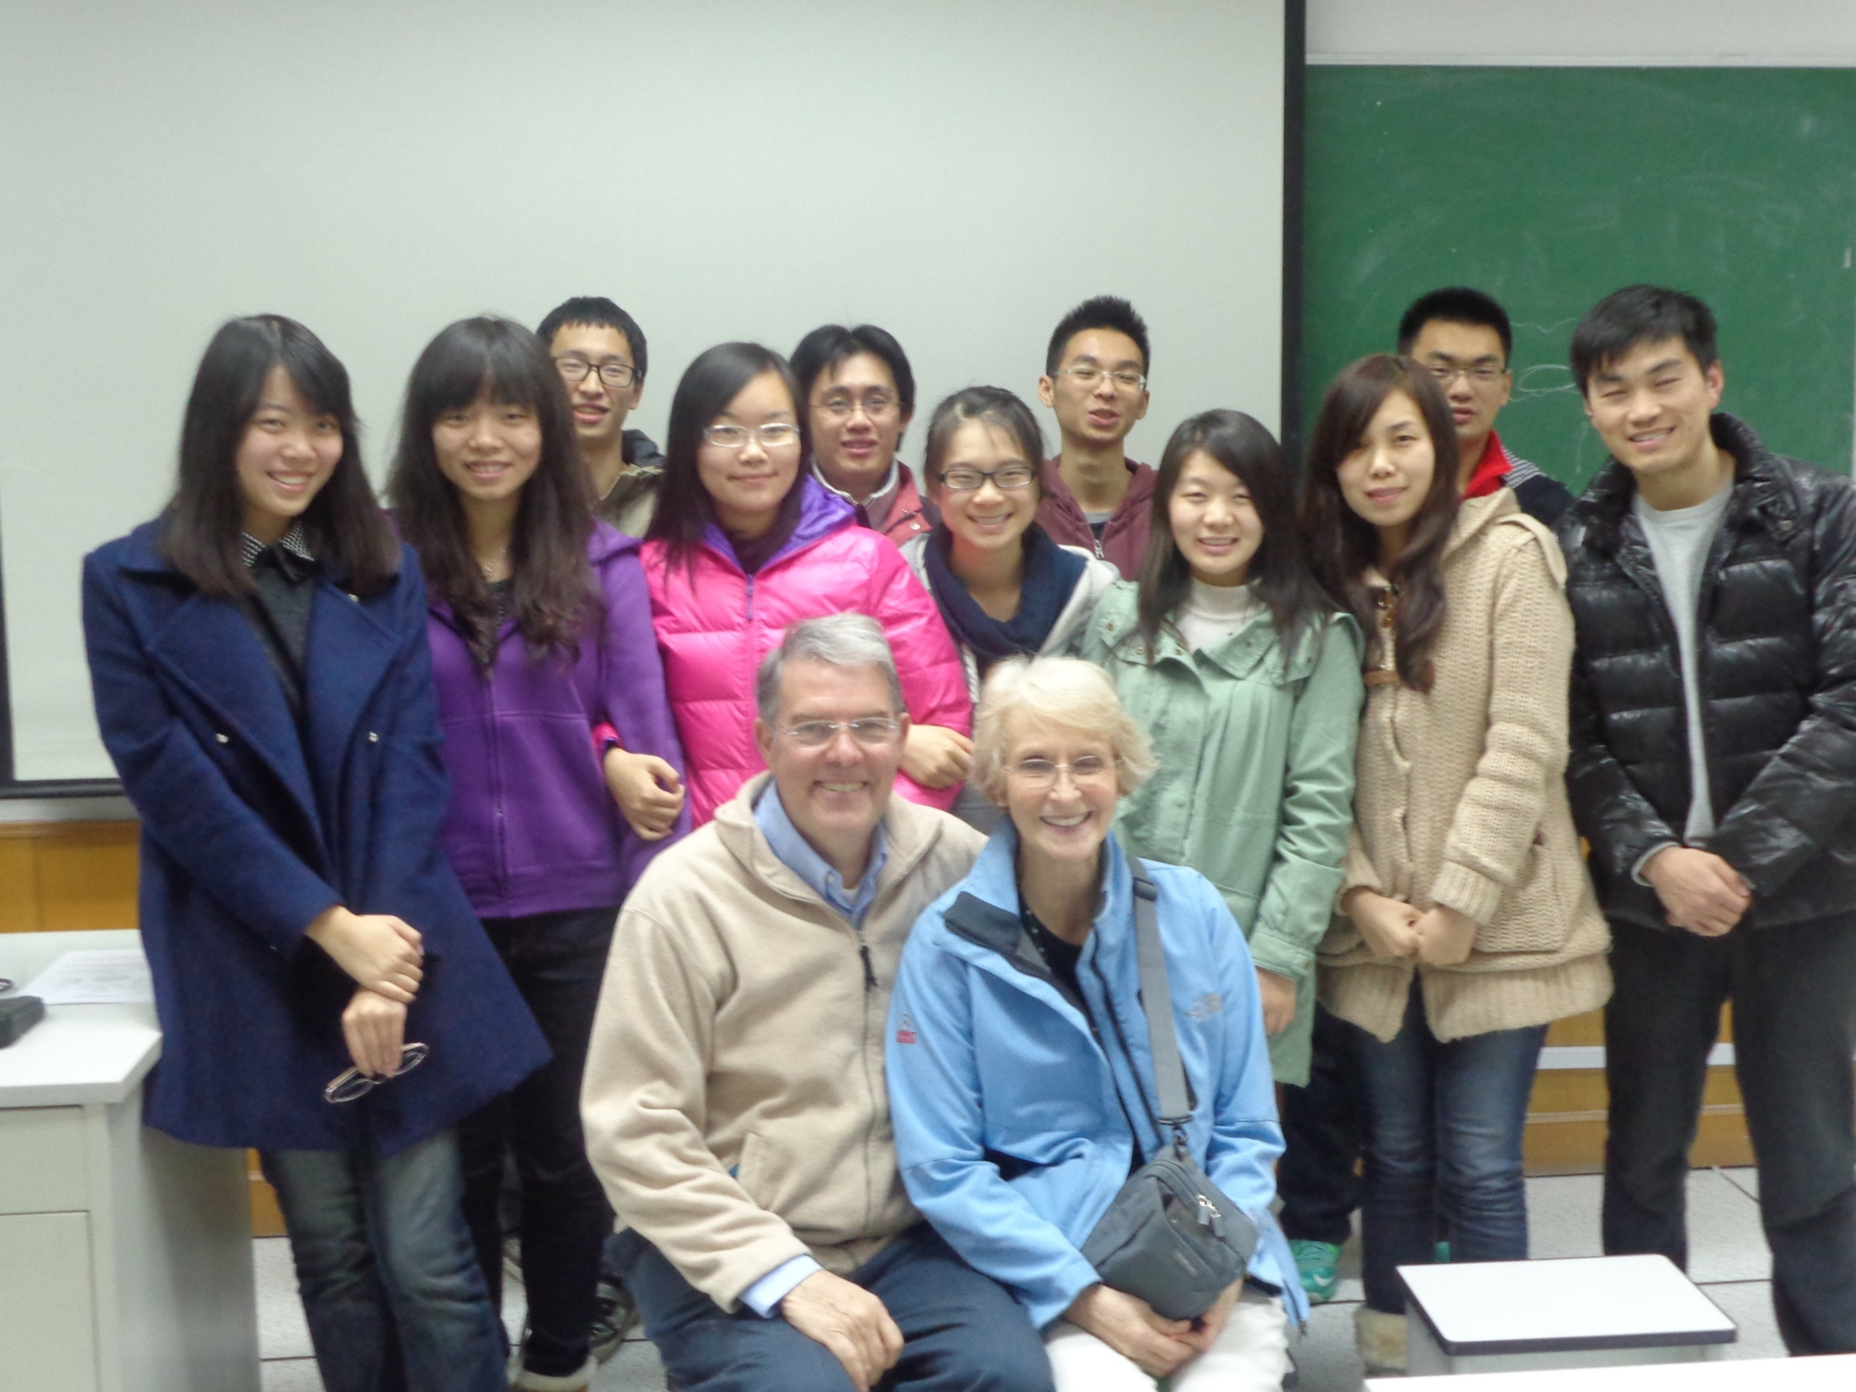
English Corner Friends

Slide 6

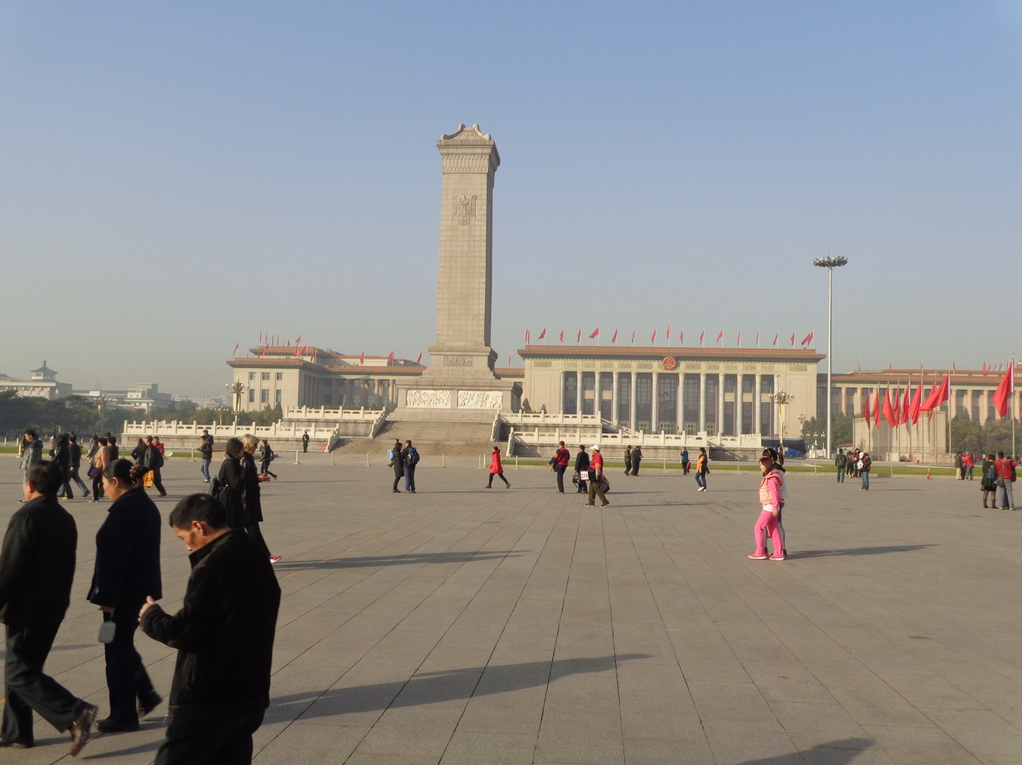

The Amazing China
Arise, ye who refuse to be slaves
With our very flesh and blood Let us build our new Great Wall!
The Peoples of China are in the most critical time,
Everybody must roar his defiance.
Arise! Arise! Arise! Millions of hearts with one mind,
Brave the enemy's gunfire, March on! Brave the enemy's gunfire,
March on! March on! March on, on!
The People’s Square

Slide 7
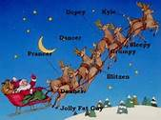

Christmas Is Coming
You’ve heard of Dasher, and Dancer, Prancer, and Vixin,
Comet, Cupid, Donner, and Blitizen
But do you recall the most famous reindeer of all?
Rudolph, the red-nosed reindeer
had a very shiny nose.
And if you ever saw him,
you would even say it glows.
All of the other reindeer
used to laugh and call him names.
They never let poor Rudolph
join in any reindeer games.
Then one foggy Christmas Eve
Santa came to say:
"Rudolph with your nose so bright,
won't you guide my sleigh tonight?"
Then all the reindeer loved him
as they shouted out with glee,
Rudolph the red-nosed reindeer,
you'll go down in history!
(Robert May)

Slide 8
Did anyone write a Limerick?
Limericks are short (sometimes serious; sometime silly) poems that are fun to recite.
A: What is a limerick, Mother?
A: It's a form of verse, said brother
B: In which lines one and two
B: Rhyme with five when it's through
A: And three and four rhyme with each other.

Slide 9
Games and Names
We ought to have some fun and games,
Using our English Corner names,
Like Terry and Mila,
Joanna and Ella,
Hey! Don’t forget the boys Bruce exclaims.

Slide 10
Your Discussion Topics
Instructions:
  Form groups so you can face each other.
  In discussing your assigned topic: You will first few minutes to define the topic / problem / issue. Second, you will have a few more minutes to discuss possible answers. Third, we will select one person from each group to summarize the group’s discussion of your assigned topic.
  Topic: What are the games you enjoy playing the most?

Slide 11
Games You Enjoy Playing Most
Games with No Technology
Games Using Technology
Swimming
Baseball
Uno
Beat the Landlord
Army Chess
The Killers Games
The Werewolf Game
Three Kingdoms Game
Mahjong
Fruit Ninja
Rhythm Master
Plants vs. Zombies
Air Traffic Controller

Slide 12
Adjective Opposites Crossword Puzzle
Form groups of 2 or 3.
Working together complete the crossword puzzle; no technology please.
When completed come to the front and check your answers.

Slide 13
Homonyms / Definitions #1
Aid
Air
Aisle
Allowed
Ant
Ate
Aide
Err
Isle
Aloud
Aunt
eight

Slide 14
Homonyms / Definitions #2
bare
berry
base
be
beach
beat
bear
bury
bass
bee
beech
beet

Slide 15
Homonyms / Definitions #3
cell
cent
cereal
Chile
chord
cite
close
sell
sent
serial
chilly
cord
site
clothes

Slide 16
Homonyms / Definitions #4
council
creak
crews
dear
dew
die
counsel
creek
cruise
deer
due
dye

Slide 17

Break

Slide 18
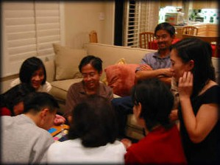
Guess – Guess – Guess – Guess
Descriptionary

Slide 19
Questions for and from
the Professors.

Slide 20
Talking Cards
Please form groups of 3-5 people.
You will be given a number of playing cards.
In turn, starting with the person whose birthday is closest to today’s date, draw a card from the top of the deck and answer the corresponding question.
Then take turns answering questions, until you have use up all of your cards.
Please speak loudly enough for your group to hear and understand you.

Slide 21

ETHICAL DILEMMAS

Slide 22
Integrity
“Integrity without knowledge is weak and useless and knowledge without integrity is dangerous and dreadful.” (Samuel Johnson (1709-1784) English Poet, Critic and Writer)

Slide 23
VOCABULARY
ethics – the principles (rules) of conduct
governing an individual or a group, the
discipline dealing with what is good
and bad and moral duty and obligation
ethical – moral, conforming to accepted
rules and standards of conduct
moral – principles of right and wrong
behavior
dilemma – a situation involving a choice
between alternatives

Slide 24
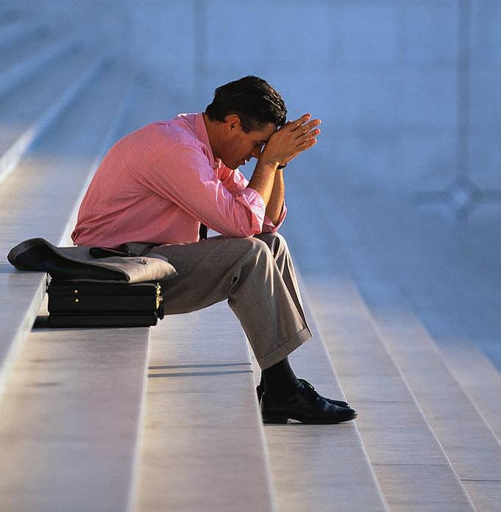
expelled – kicked out of school,
suspended from school
0 tolerance – no exceptions, no second
chances
full ride – a scholarship which pays
tuition, books, room and board
Win Win – Solutions in which all parties are better off

Slide 25
ETHICAL DILEMMA
(VICE PRINCIPAL)
You are the vice principal in charge of discipline of a high school. It is your responsibility to see that all students follow the rules and are treated fairly and equally. It is the policy of your school that students caught with alcohol, drugs or weapons on campus will be expelled—0 tolerance.

Slide 26
Your daughter is a senior at the high school. She is an outstanding basketball and volleyball player and is a top academic student. She has applied to several universities and for scholarships that would pay virtually all of her costs at any of these colleges. She is almost certain to be accepted and to receive a full ride at all schools to which she has applied.

Slide 27
One evening, you are supervising a school dance. You need to speak to your daughter and can’t find her. You finally go into the darkened girls’ locker room and hear voices. One is your daughter’s voice and as you listen, you realize they are drinking alcohol. They do not see you.
What will you do?

Slide 28

Life is full of choices and decisions and many of them will present us with moral and ethical dilemmas. Some of these choices and decisions will challenge
the very principles,
standards and values
we were taught by
our family. When
faced with these
moral dilemmas,
what will you do?

Slide 29
Vocabulary Builders
Instructions:
  Form groups of three or four people.
  Distribute the vocabulary card so each person in your group has one.
  Taking turns, each person then pronounces each word on his/her card.
  When everyone is finished, pass your card one person to the left and then each person pronounces the words on his/new card.
  Repeat the process until everyone has had a chance to pronounce the words on each card.
  Note: If someone needs help pronouncing a word, other group members should provide assistance.

Slide 30

Speaking Activity
Divide into groups of two
Roll the dice and answer the number of the question your rolled.
If you have already answered that question roll the dice again.

Slide 31
Describe your feelings about leaving your home and province for four years.
Try to describe your feelings as you return after successfully completing your B.S or B.A. degree in four years.
Try to describe the feelings of your parents as you return to your home as a college graduate.
Try your best to describe your first day on the job of your dreams.
Describe your future husband or wife.
What do you think your feelings will be when your first child leaves home to go to a school?
What do you think the purpose of life is?
Where do you think you will go when you or your parents die?
Why do you believe that?
Do you believe you came from some where else when you were born? Why do you believe that?
Suppose you move to Australia which has a different form of government. How will that change the way you act in your life, Why?
What about living in Australia would make you nervous?
What do you think you will do to adjust to that concern?

Slide 32
What are some of the topics you would like to discuss in class and/or English Corners?

