Slide 1

Professors John & Marie Murdoch
Welcome to English Corner

Slide 2
Introductions
Please stand and introduce yourself if this is your first English Corner.
What is your name?
Where are you from (hometown)?
What is one thing you did during this past summer?
Tell one thing you like to do in your free time?

Slide 3
English Corner’s Goals
To improve oral English skills—we speak only English.
To improve English listening skills.
To meet new friends.
To build social skills.
To learn about American and Chinese Cultures.
To share ideas and opinions.
Let’s have fun!

Slide 4

Next English Corner
December 10, 2013
7 PM
The next English Corner
will be in Room 218-this same room.

Slide 5
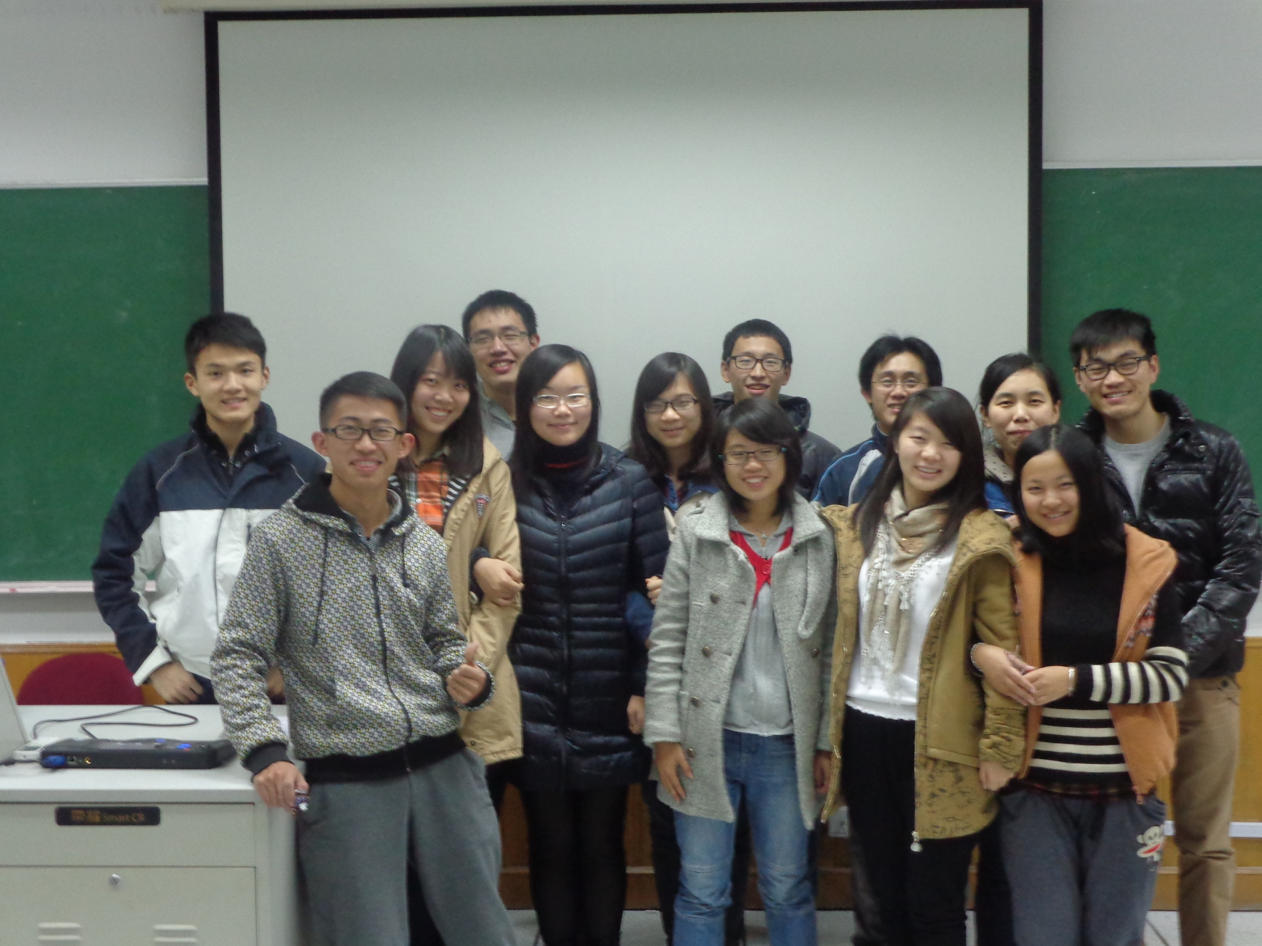
English Corner Friends

Slide 6

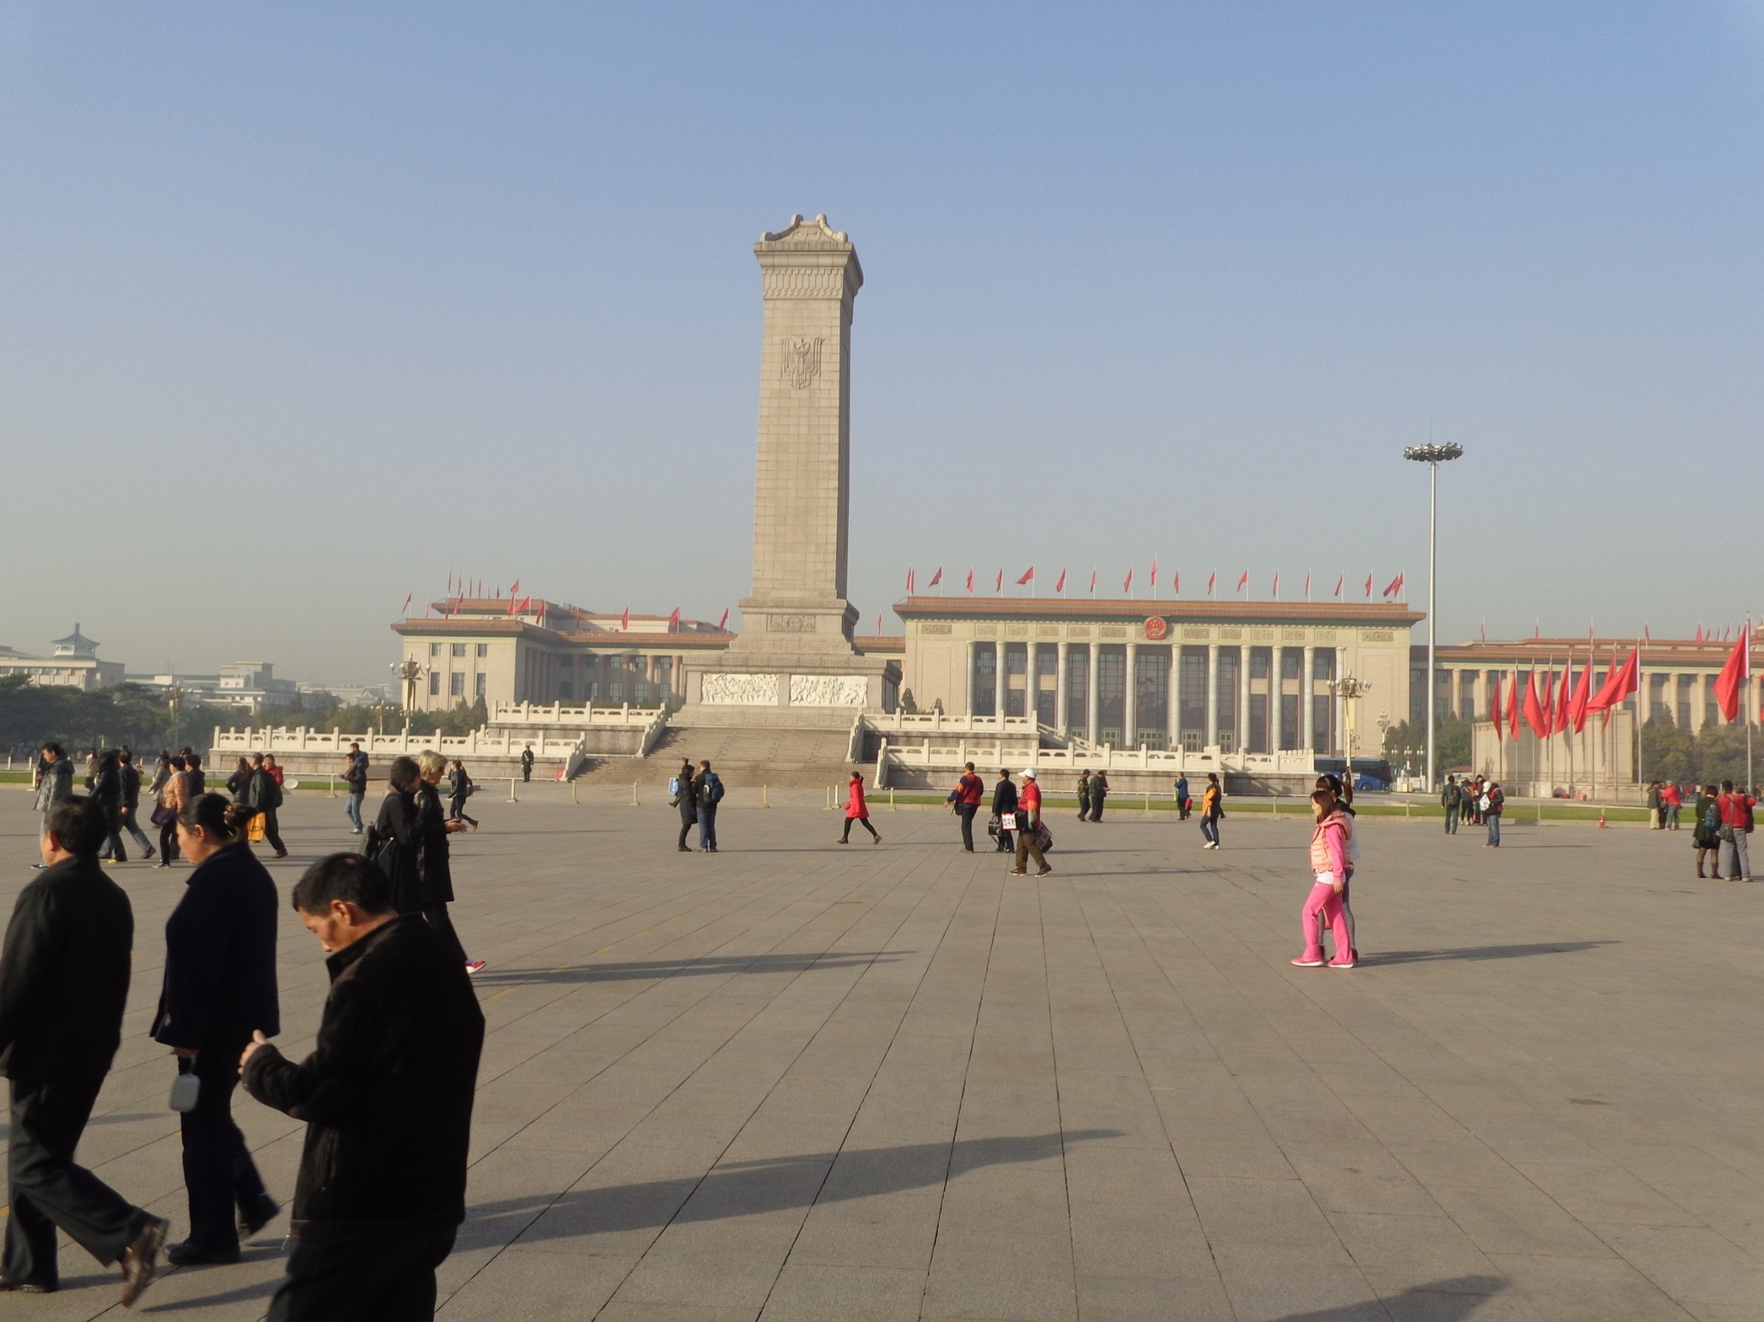

The Amazing China
Arise, ye who refuse to be slaves
With our very flesh and blood Let us build our new Great Wall!
The Peoples of China are in the most critical time,
Everybody must roar his defiance.
Arise! Arise! Arise! Millions of hearts with one mind,
Brave the enemy's gunfire, March on! Brave the enemy's gunfire,
March on! March on! March on, on!
The People’s Square

Slide 7
Did anyone write a Limerick?
Limericks are short (sometimes serious; sometime silly) poems that are fun to recite.
A: What is a limerick, Mother?
A: It's a form of verse, said brother
B: In which lines one and two
B: Rhyme with five when it's through
A: And three and four rhyme with each other.

Slide 8



Integrity
You’ve heard about integrity,
And of reliability,
So don’t lie, steal, or cheat.
Keeping yourself clean and neat
All adds to your civility.

Slide 9
Your Discussion Topics
Instructions:
  Form groups so you can face each other.
  In discussing your assigned topic: You will first have 3 minutes to define the topic / problem / issue. Second, you will have 5 minutes to discuss possible solutions. Third, we will select one person from each group to summarize the group’s discussion of your assigned topic.
  Topic: What is cheating and what are its consequences?

Slide 10
What is Cheating and
What are its Consequences?
What is cheating?
What are the consequences of cheating?
Betrayal
Copy other students’ work
Plagiarize
Trick someone
Gain your own benefit by being dishonest.
Sell something that is worth less
Behavior which is not acceptable to the general public
More cheating
Lose face--dignity
Nothing (immediate)
Punished by Mom etc.
Conscience suffer—feel guilty and regret—even feel resentment.
Regret turns into determination to do better.

Slide 11

ETHICAL DILEMMAS
James Faust

Slide 12
Integrity
“Integrity without knowledge is weak and useless and knowledge without integrity is dangerous and dreadful.” (Samuel Johnson (1709-1784) English Poet, Critic and Writer)

Slide 13
VOCABULARY
ethics – the principles (rules) of conduct
governing an individual or a group, the
discipline dealing with what is good
and bad and moral duty and obligation
ethical – moral, conforming to accepted
rules and standards of conduct
moral – principles of right and wrong
behavior
dilemma – a situation involving a choice
between alternatives

Slide 14
confided – to tell something in secret
welding - to unite (metallic parts) by
heating and allowing the metals to
flow together
barely hanging on – the business is
about to fail
pressures – try to get someone to do
what you want them to do
certify – to assure, to confirm
expelled – kicked out of school,
suspended from school

Slide 15

0 tolerance – no exceptions, no second
chances
full ride – a scholarship which pays
tuition, books, room and board
Win Win – Solutions in which all parties are better off

Slide 16
ETHICAL DILEMMA
(Computer Programming)
In your spare time at work, you have developed a new powerpoint program on the company’s computer in your office. It is even more powerful, yet easier to use than anything on the market. You share your new program with a friend who encourages you to market it on your own because you could probably make an incredible profit in a very short time. This is a very attractive option, yet you developed it using company equipment and during time that you were at work. What do you do?

Slide 17

Break

Slide 18
ETHICAL DILEMMA
(ENGINEER)
You are the only engineer in a small manufacturing company that makes steel trusses (roof support beams). The owner of the company has confided in you that the company is in financial trouble—barely hanging on.
The company has completed the manufacture of a large order of trusses, which you designed for a

Slide 19
shopping mall. They are about to be delivered to the builder when you inspect them and discover that they were welded incorrectly.
You go to the owner and tell him of the problem. The boss, of course, is very upset. He says it would be very expensive to remake them or even to break them apart and re-weld them correctly. He says the company will go broke and all of the employees (25), including yourself, will not have jobs.

Slide 20
Your wife is pregnant and you will also lose health insurance covering delivery of the baby. Your calculations show that the faulty trusses are not as strong as your original design and could result in a possibly dangerous structure for the mall roof. The boss thinks they will be okay and pressures you to certify them for delivery.
What will you do?

Slide 21
ETHICAL DILEMMA
(VICE PRINCIPAL)
You are the vice principal in charge of discipline of a high school. It is your responsibility to see that all students follow the rules and are treated fairly and equally. It is the policy of your school that students caught with alcohol, drugs or weapons on campus will be expelled—0 tolerance.

Slide 22
Your daughter is a senior at the high school. She is an outstanding basketball and volleyball player and is a top academic student. She has applied to several universities and for scholarships that would pay virtually all of her costs at any of these colleges. She is almost certain to be accepted and to receive a full ride at all schools to which she has applied.

Slide 23
One evening, you are supervising a school dance. You need to speak to your daughter and can’t find her. You finally go into the darkened girls’ locker room and hear voices. One is your daughter’s voice and as you listen, you realize they are drinking alcohol. They do not see you.
What will you do?

Slide 24

Life is full of choices and decisions and many of them will present us with moral and ethical dilemmas. Some of these choices and decisions will challenge
the very principles,
standards and values
we were taught by
our family. When
faced with these
moral dilemmas,
what will you do?

Slide 25
What is Cheating and
What are its Consequences?

Slide 26

Brigham Young University’s
Student Honor Code
Be honest.
Live a chaste and virtuous life.
Obey the law and all campus policies.
Use clean language.
Respect others.
Abstain from alcoholic beverages, tobacco, tea, coffee, and substance abuse.
Observe the Dress and Grooming Standards.
Encourage others in their commitment to comply with the Honor Code.

Slide 27


Slide 28
Talking Cards
Please form groups of 3-5 people.
You will be given a number of playing cards.
In turn, starting with the person whose birthday is closest to today’s date, draw a card from the top of the deck and answer the corresponding question.
Then take turns answering questions, until you have use up all of your cards.
Please speak loudly enough for your group to hear and understand you.

Slide 29
Adjective Opposites Crossword Puzzle
Form groups of 3 or 4.
Working together complete the crossword puzzle; no technology please.
When completed come to the front and check your answers.

Slide 30
Questions for and from
the Professors.

Slide 31
Vocabulary Builders
Instructions:
  Form groups of three or four people.
  Distribute the vocabulary card so each person in your group has one.
  Taking turns, each person then pronounces each word on his/her card.
  When everyone is finished, pass your card one person to the left and then each person pronounces the words on his/new card.
  Repeat the process until everyone has had a chance to pronounce the words on each card.
  Note: If someone needs help pronouncing a word, other group members should provide assistance.

Slide 32

Speaking Activity
Divide into groups of two
Roll the dice and answer the number of the question your rolled.
If you have already answered that question roll the dice again.

Slide 33
Describe your feelings about leaving your home and province for four years.
Try to describe your feelings as you return after successfully completing your B.S or B.A. degree in four years.
Try to describe the feelings of your parents as you return to your home as a college graduate.
Try your best to describe your first day on the job of your dreams.
Describe your future husband or wife.
What do you think your feelings will be when your first child leaves home to go to a school?
What do you think the purpose of life is?
Where do you think you will go when you or your parents die?
Why do you believe that?
Do you believe you came from some where else when you were born? Why do you believe that?
Suppose you move to Australia which has a different form of government. How will that change the way you act in your life, Why?
What about living in Australia would make you nervous?
What do you think you will do to adjust to that concern?

Slide 34
What are some of the topics you would like to discuss in class and/or English Corners?

