Slide 1

Professors John & Marie Murdoch
Welcome to English Corner

Slide 2
Introductions
Please stand and introduce yourself if this is your first English Corner.
What is your name?
Where are you from (hometown)?
What is one thing you did during this past summer?
Tell one thing you like to do in your free time?

Slide 3
English Corner’s Goals
To improve oral English skills—we speak only English.
To improve English listening skills.
To meet new friends.
To build social skills.
To learn about American and Chinese Cultures.
To share ideas and opinions.
Let’s have fun!

Slide 4

Next English Corner
November 26, 2013
7 PM
The next English Corner
will be in Room 218-this same room.

Slide 5
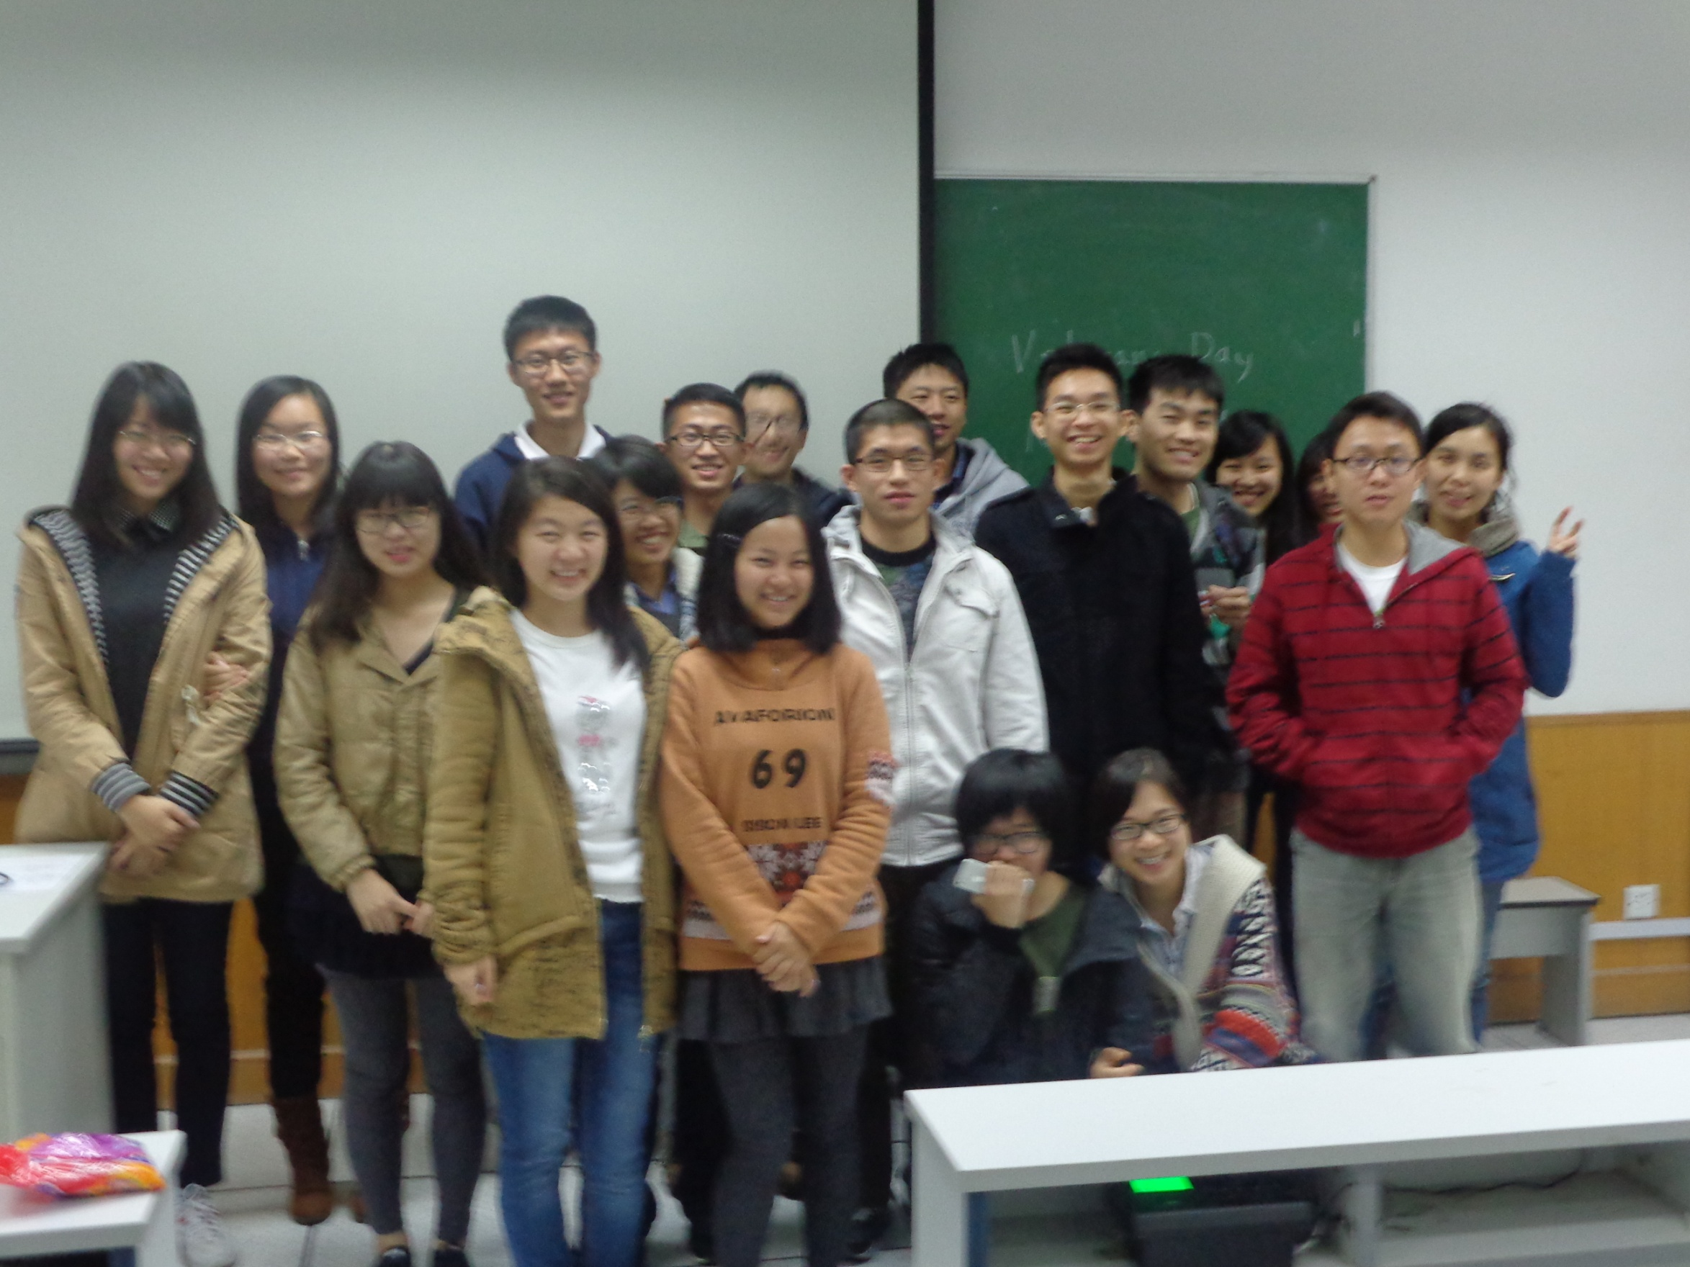
English Corner Friends

Slide 6
Did anyone write a Limerick?
Limericks are short (sometimes serious; sometime silly) poems that are fun to recite.
A: What is a limerick, Mother?
A: It's a form of verse, said brother
B: In which lines one and two
B: Rhyme with five when it's through
A: And three and four rhyme with each other.

Slide 7

Good Judgment
There are some Chinese Students,
Who show very good judgment,
At university
They face adversity,
But from class are never absent!

Slide 8

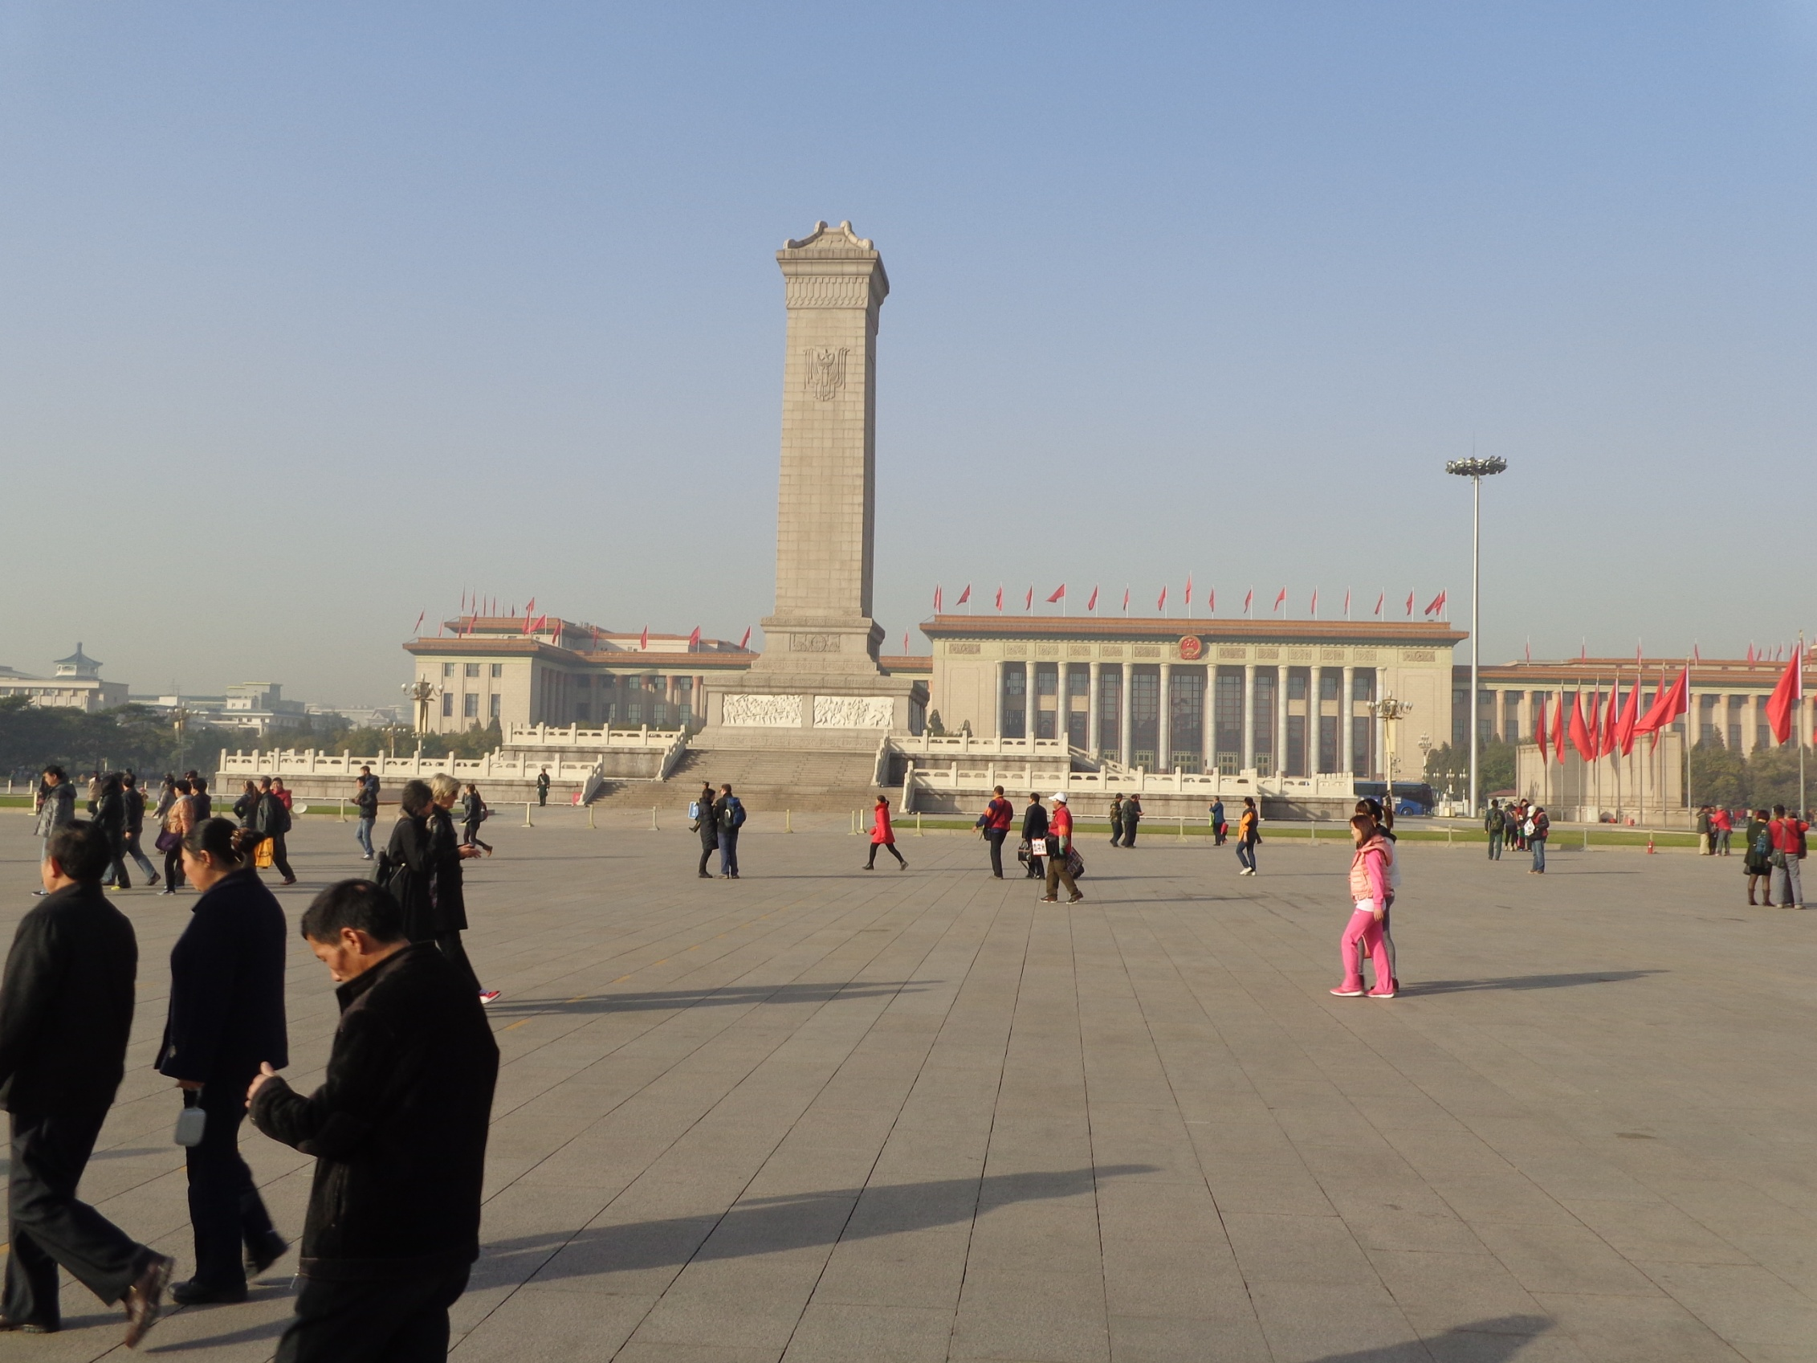
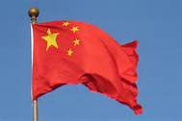
The Amazing China—Where are We?
Arise, ye who refuse to be slaves
With our very flesh and blood Let us build our new Great Wall!
The Peoples of China are in the most critical time,
Everybody must roar his defiance.
Arise! Arise! Arise! Millions of hearts with one mind,
Brave the enemy's gunfire, March on! Brave the enemy's gunfire,
March on! March on! March on, on!
The People’s Square

Slide 9
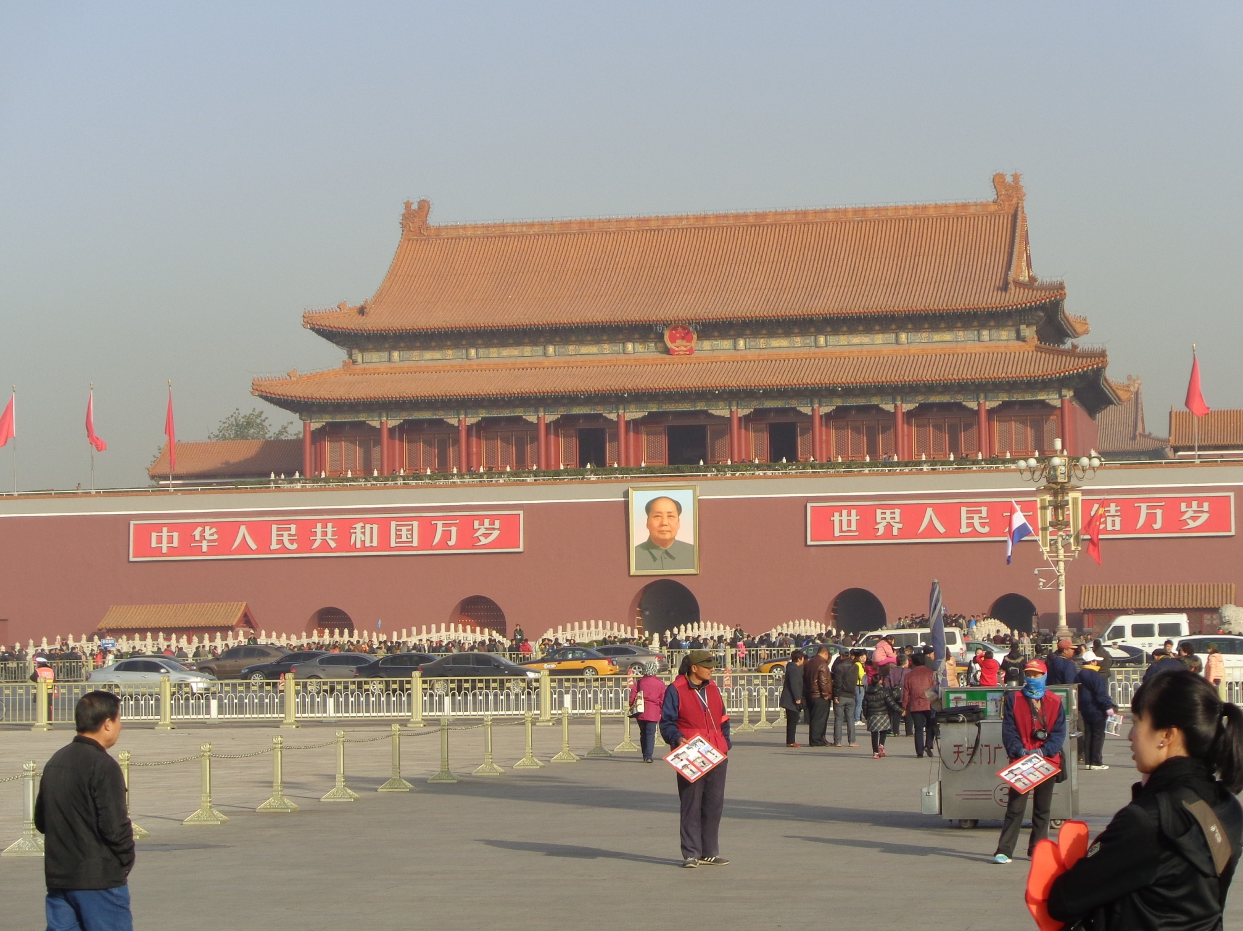
The Amazing China—Where are We?
Entrance to the Forbidden City

Slide 10
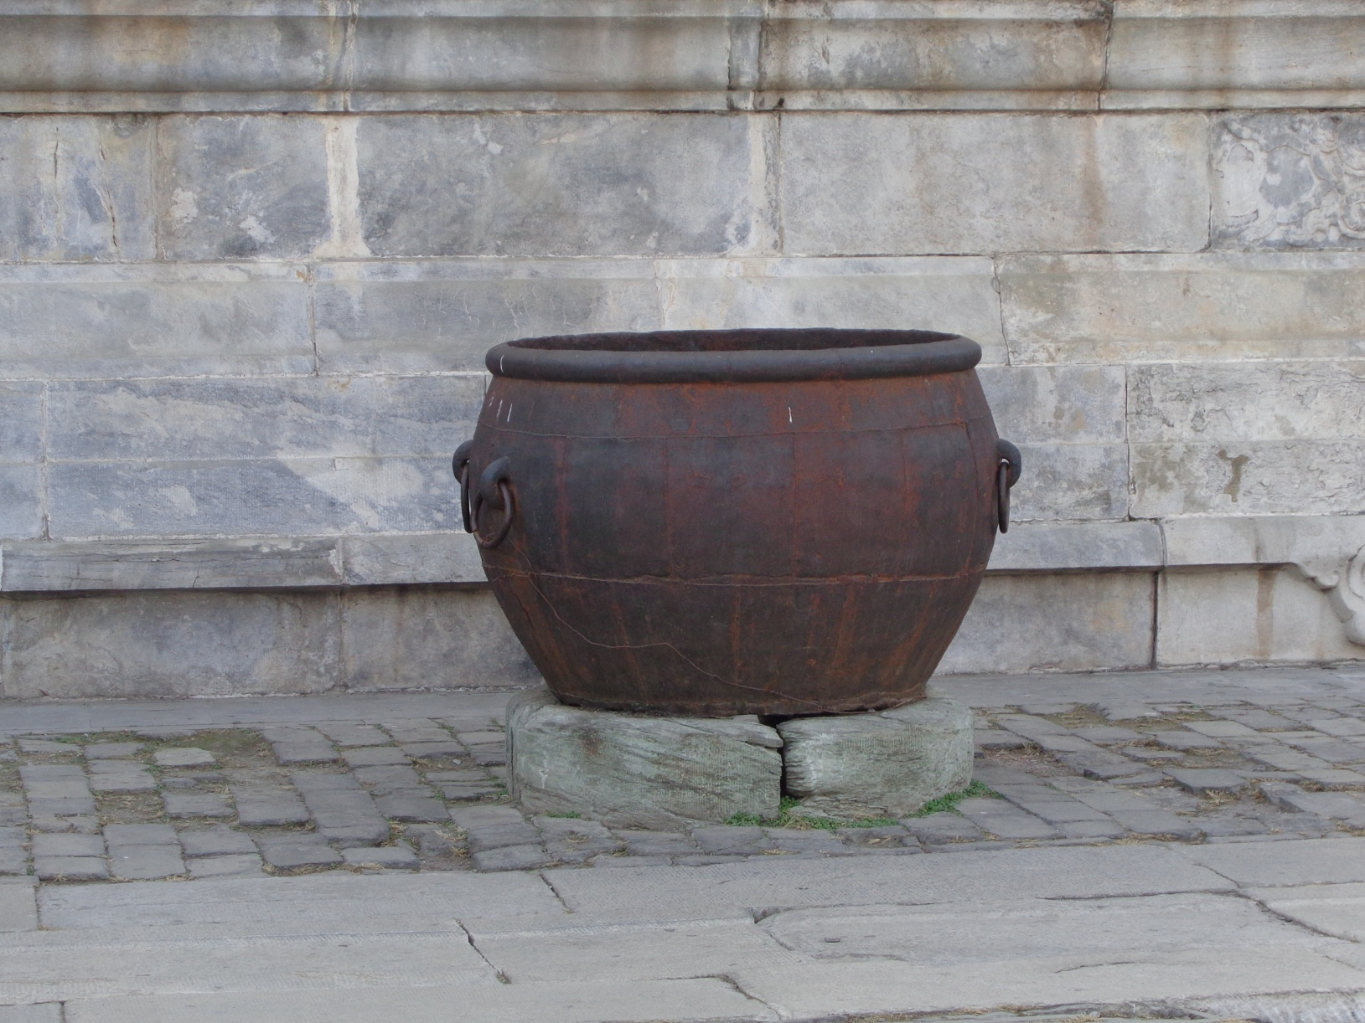
The Amazing China—What is this?
Large cauldron which holds water used to put out fires

Slide 11
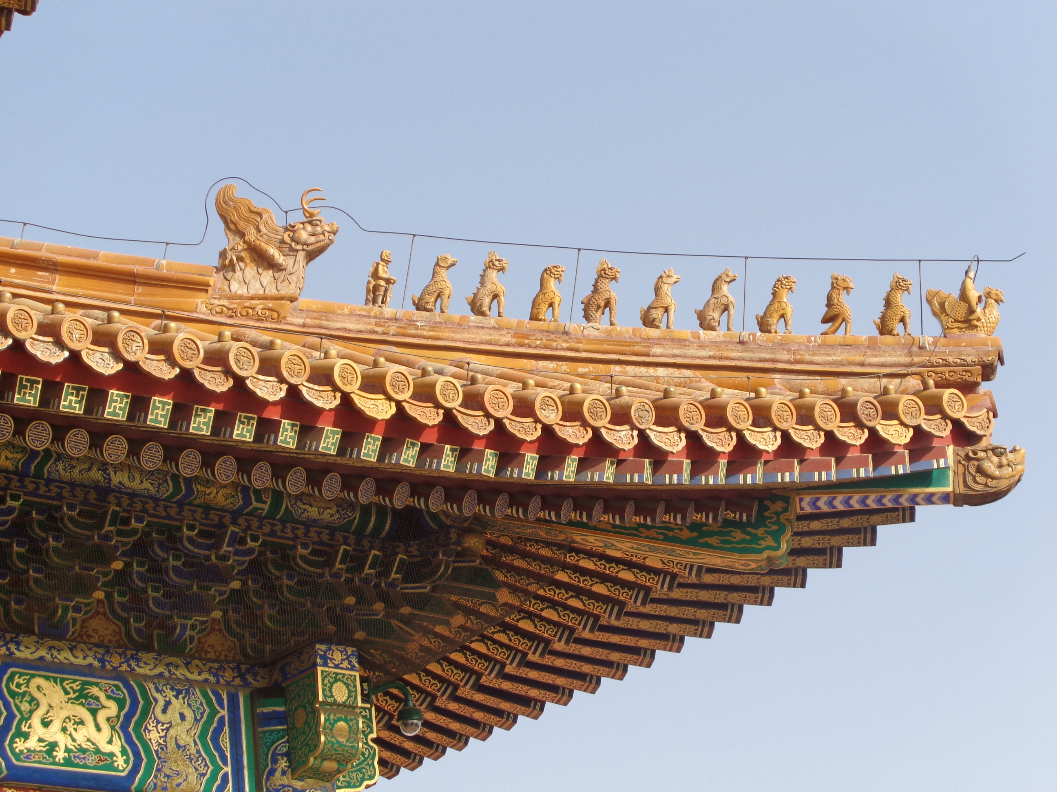
The Amazing China
What is this story?

Slide 12
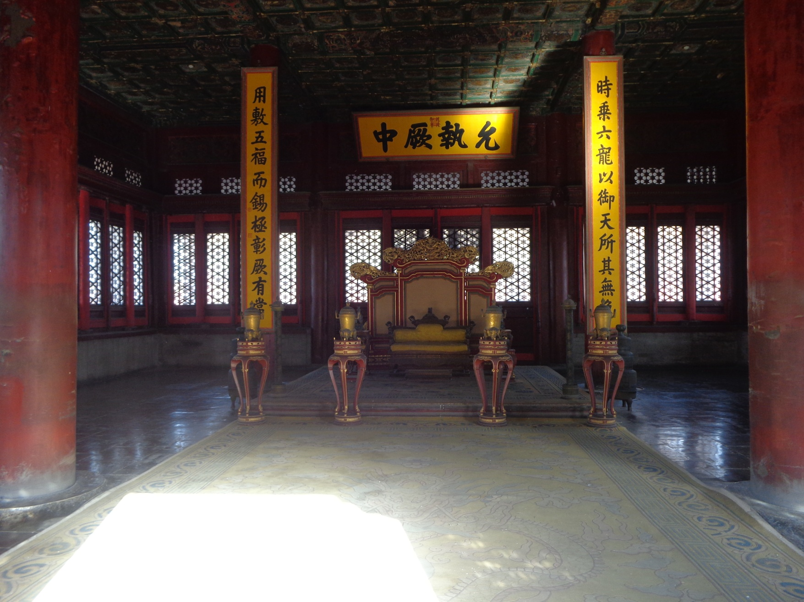
The Amazing China—Where are We?
The Emperor’s Throne

Slide 13
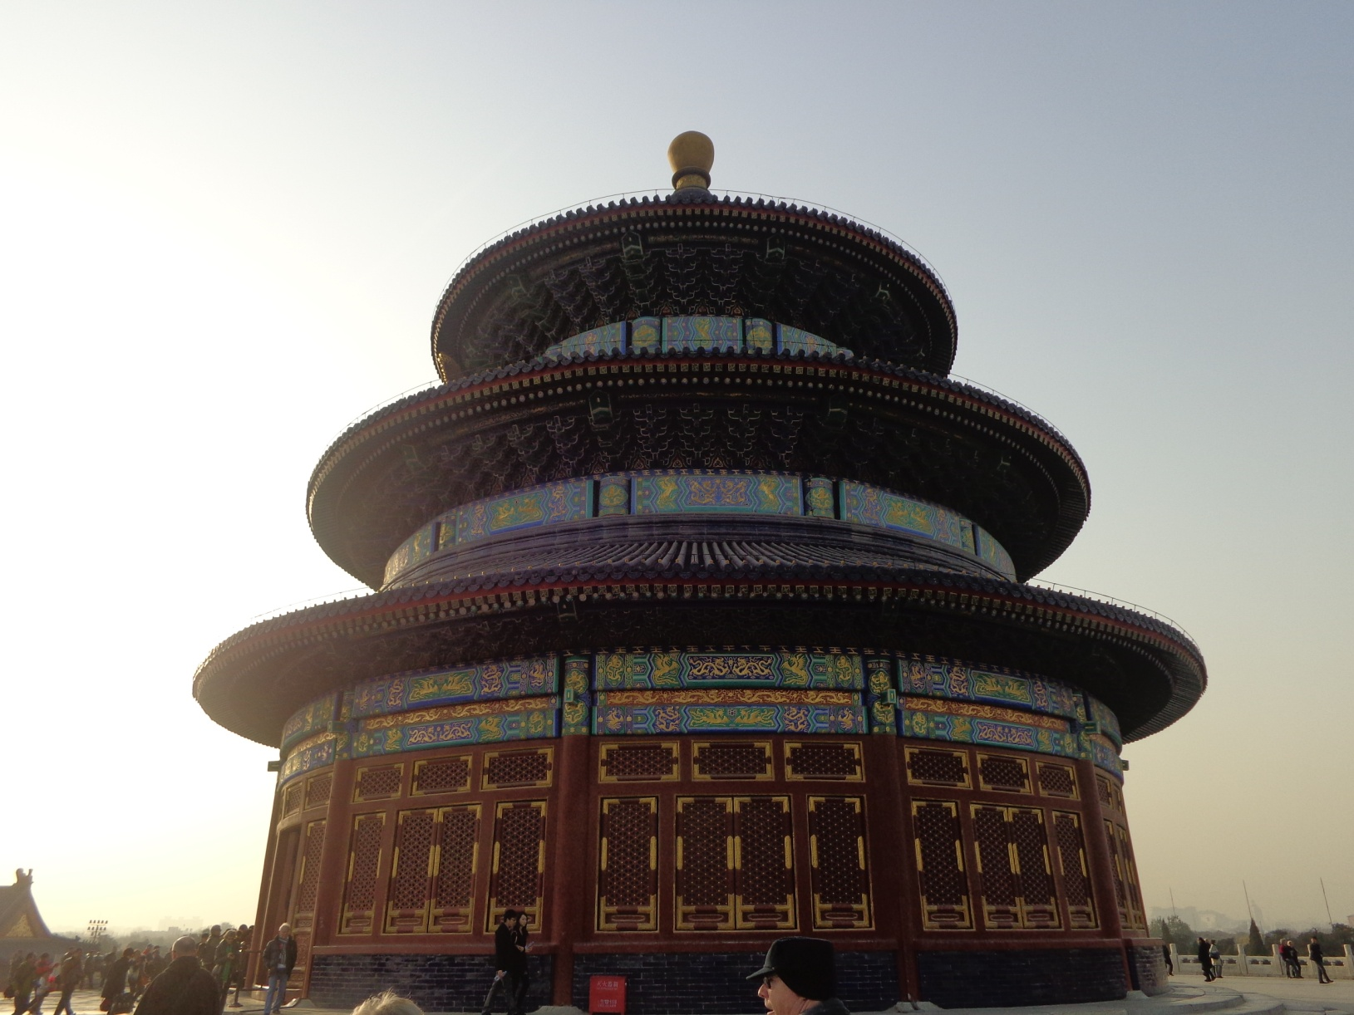
The Amazing China—Where are We?
Temple of Heaven

Slide 14
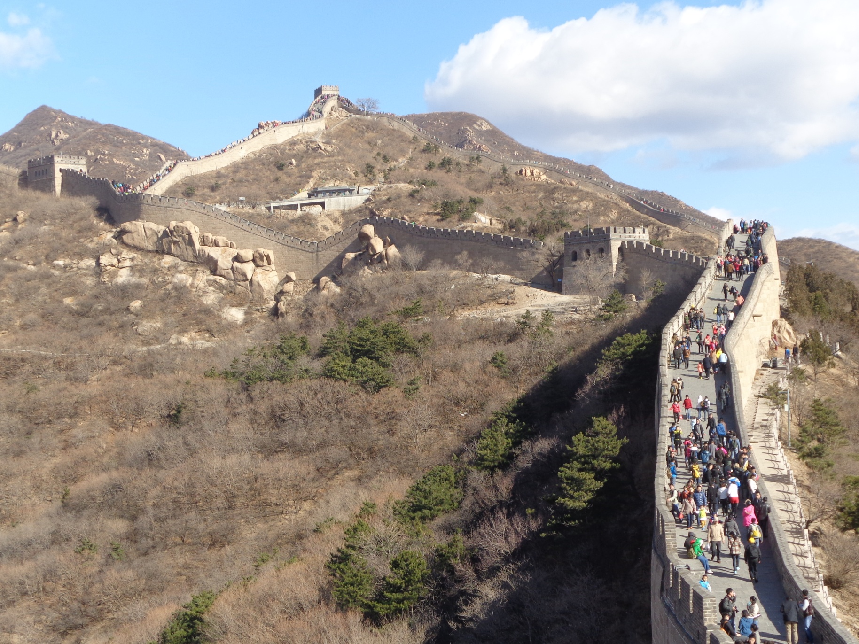
The Amazing China—Where are We?
The Great Wall

Slide 15
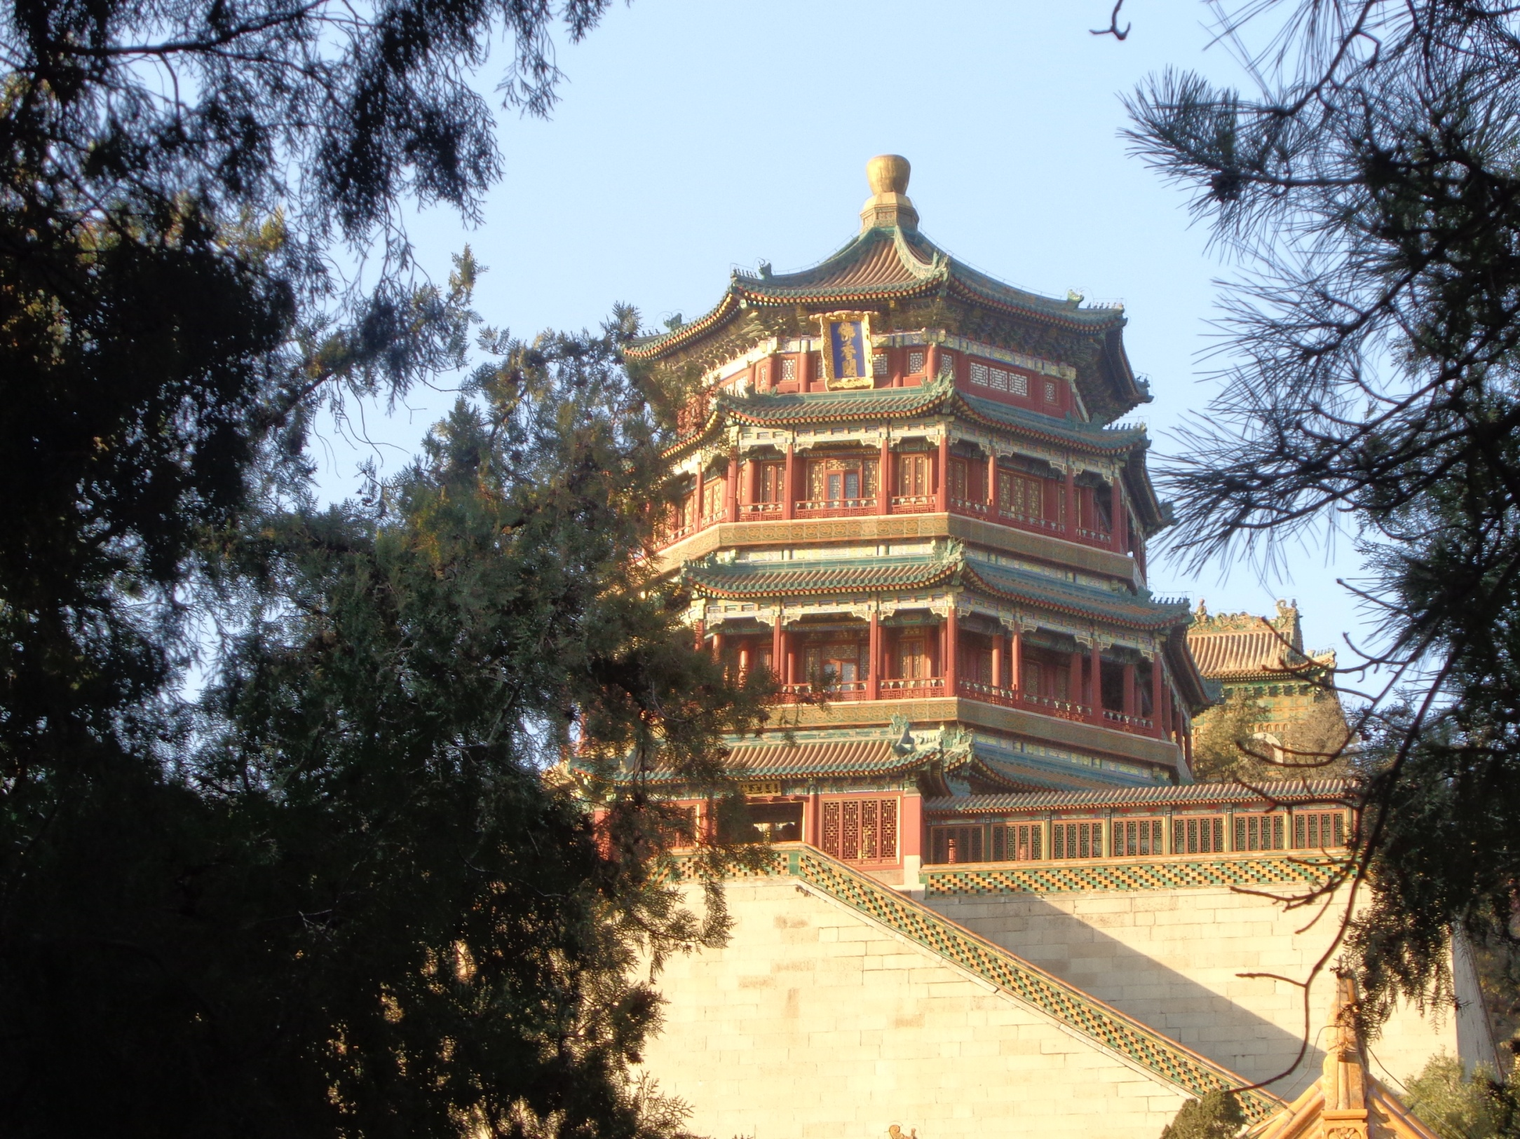
The Amazing China—Where are We?
The Emperor’s Summer Palace

Slide 16

The Amazing China
Full Moon over China

Slide 17
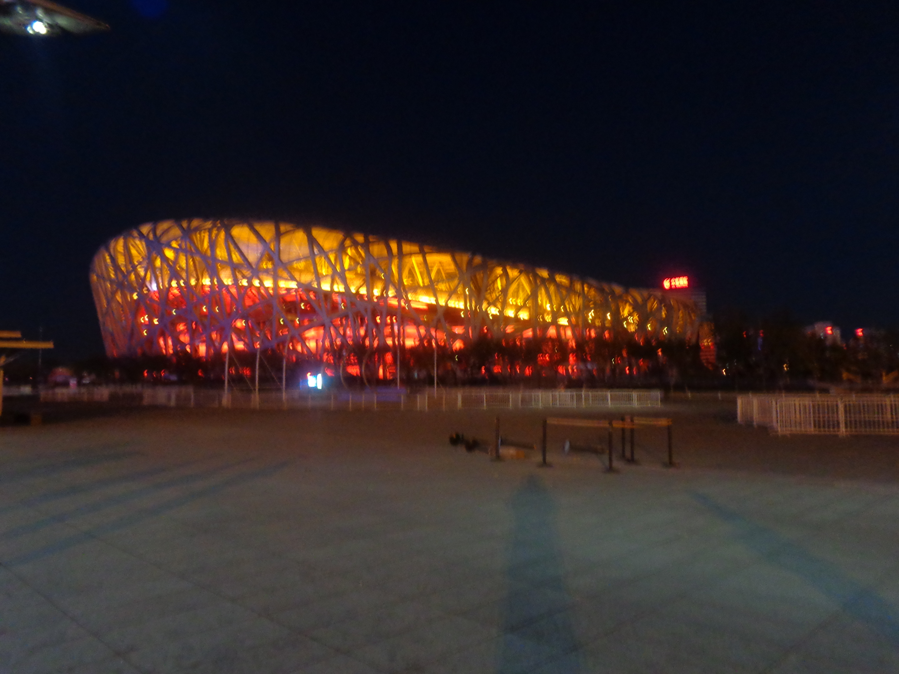
The Amazing China—Where are We?
The Olympic Stadium

Slide 18
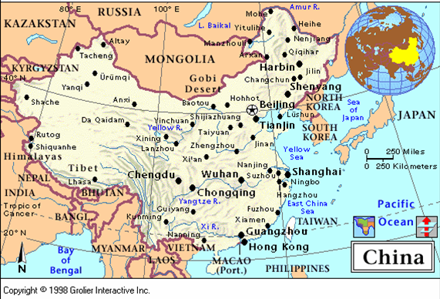
What is China?

Slide 19
Agree / Disagree
I agree with ….
I disagree with ….

Slide 20
Your Discussion Topics
Instructions:
  Form three groups so you can face each other.
  In discussing your assigned topic: You will first have 3 minutes to define the topic / problem / issue. Second, you will have 5 minutes to discuss possible solutions. Third, we will select one person from each group to summarize the group’s discussion of your assigned topic.
  Topics:
    If you were to rewrite the script for this presentation on China what would you leave out? What would you add that is not currently included?

Slide 21

Break

Slide 22
Let’s
Play
Jeopardy!

Slide 23
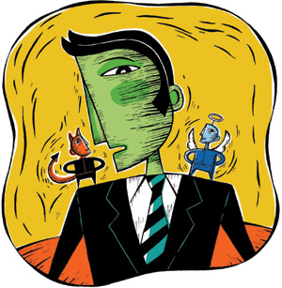
ETHICAL DILEMMAS

Slide 24
Integrity
“Integrity without knowledge is weak and useless and knowledge without integrity is dangerous and dreadful.” (Samuel Johnson (1709-1784) English Poet, Critic and Writer)

Slide 25
VOCABULARY
ethics – the principles of conduct
governing an individual or a group, the
discipline dealing with what is good
and bad and moral duty and obligation
ethical – moral, conforming to accepted
standards of conduct
moral – principles of right and wrong
behavior
dilemma – a situation involving a choice
between alternatives

Slide 26
confided – to tell something in secret
welding - to unite (metallic parts) by
heating and allowing the metals to
flow together
barely hanging on – the business is
about to fail
pressures – try to get someone to do
what you want them to do
certify – to assure, to confirm
expelled – kicked out of school,
suspended from school

Slide 27
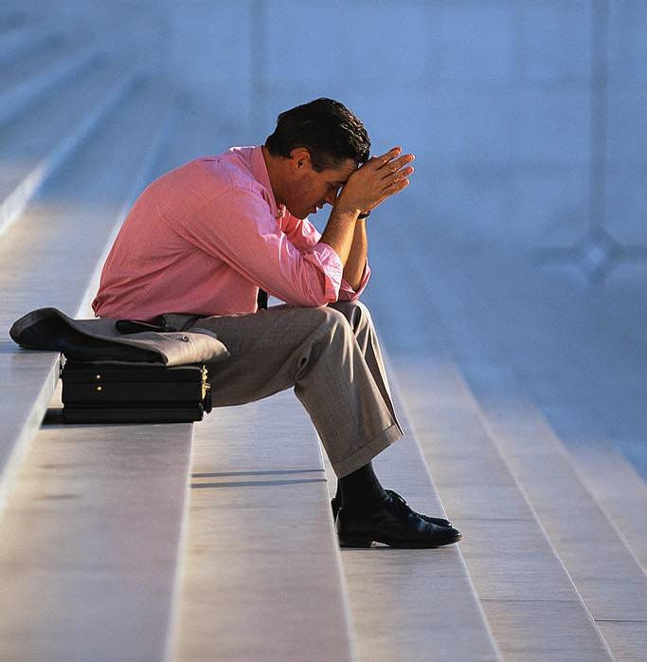
0 tolerance – no exceptions, no second
chances
full ride – a scholarship which pays
tuition, books, room and board

Slide 28
ETHICAL DILEMMA
(ENGINEER)
You are the only engineer in a small manufacturing company that makes steel trusses (roof support beams). The owner of the company has confided in you that the company is in financial trouble—barely hanging on.
The company has completed the manufacture of a large order of trusses, which you designed for a

Slide 29
shopping mall. They are about to be delivered to the builder when you inspect them and discover that they were welded incorrectly.
You go to the owner and tell him of the problem. The boss, of course, is very upset. He says it would be very expensive to remake them or even to break them apart and re-weld them correctly. He says the company will go broke and all of the employees (25), including yourself, will not have jobs.

Slide 30
Your wife is pregnant and you will also lose health insurance covering delivery of the baby. Your calculations show that the faulty trusses are not as strong as your original design and could result in a possibly dangerous structure for the mall roof. The boss thinks they will be okay and pressures you to certify them for delivery.
What will you do?

Slide 31
ETHICAL DILEMMA
(VICE PRINCIPAL)
You are the vice principal in charge of discipline of a high school. It is your responsibility to see that all students follow the rules and are treated fairly and equally. It is the policy of your school that students caught with alcohol, drugs or weapons on campus will be expelled—0 tolerance.

Slide 32
Your daughter is a senior at the high school. She is an outstanding basketball and volleyball player and is a top academic student. She has applied to several universities and for scholarships that would pay virtually all of her costs at any of these colleges. She is almost certain to be accepted and to receive a full ride at all schools to which she has applied.

Slide 33
One evening, you are supervising a school dance. You need to speak to your daughter and can’t find her. You finally go into the darkened girls’ locker room and hear voices. One is your daughter’s voice and as you listen, you realize they are drinking alcohol. They do not see you.
What will you do?

Slide 34

Life is full of choices and decisions and many of them will present us with moral and ethical dilemmas. Some of these choices and decisions will challenge
the very principles,
standards and values
we were taught by
our family. When
faced with these
moral dilemmas,
what will you do?

Slide 35
Vocabulary Builders
Instructions:
  Form groups of three or four people.
  Distribute the vocabulary card so each person in your group has one.
  Taking turns, each person then pronounces each word on his/her card.
  When everyone is finished, pass your card one person to the left and then each person pronounces the words on his/new card.
  Repeat the process until everyone has had a chance to pronounce the words on each card.
  Note: If someone needs help pronouncing a word, other group members should provide assistance.

Slide 36
Adjective Opposites Crossword Puzzle
Form groups of 3 or 4.
Working together complete the crossword puzzle; no technology please.
When completed come to the front and check your answers.

Slide 37
Talking Cards
Please form groups of 3-5 people.
You will be given a number of playing cards.
In turn, starting with the person whose birthday is closest to today’s date, draw a card from the top of the deck and answer the corresponding question.
Then take turns answering questions, until you have use up all of your cards.
Please speak loudly enough for your group to hear and understand you.

Slide 38

Speaking Activity
Divide into groups of two
Roll the dice and answer the number of the question your rolled.
If you have already answered that question roll the dice again.

Slide 39
Describe your feelings about leaving your home and province for four years.
Try to describe your feelings as you return after successfully completing your B.S or B.A. degree in four years.
Try to describe the feelings of your parents as you return to your home as a college graduate.
Try your best to describe your first day on the job of your dreams.
Describe your future husband or wife.
What do you think your feelings will be when your first child leaves home to go to a school?
What do you think the purpose of life is?
Where do you think you will go when you or your parents die?
Why do you believe that?
Do you believe you came from some where else when you were born? Why do you believe that?
Suppose you move to Australia which has a different form of government. How will that change the way you act in your life, Why?
What about living in Australia would make you nervous?
What do you think you will do to adjust to that concern?

Slide 40
What are some of the topics you would like to discuss in class and/or English Corners?

Slide 41
Questions for and from
the Professors.

Slide 42
