Slide 1

Professors John & Marie Murdoch
Welcome to English Corner

Slide 2
Introductions
Please stand and introduce yourself if this is your first English Corner.
What is your name?
Where are you from (hometown)?
What is one thing you did during this past summer?
Tell one thing you like to do in your free time?

Slide 3
English Corner’s Goals
To improve oral English skills—we speak only English.
To improve English listening skills.
To meet new friends.
To build social skills.
To learn about American and Chinese Cultures.
To share ideas and opinions.
Let’s have fun!

Slide 4

Next English Corner November 19, 2013 7 PM
The next English Corner
will be in Room 218-this same room.

Slide 5
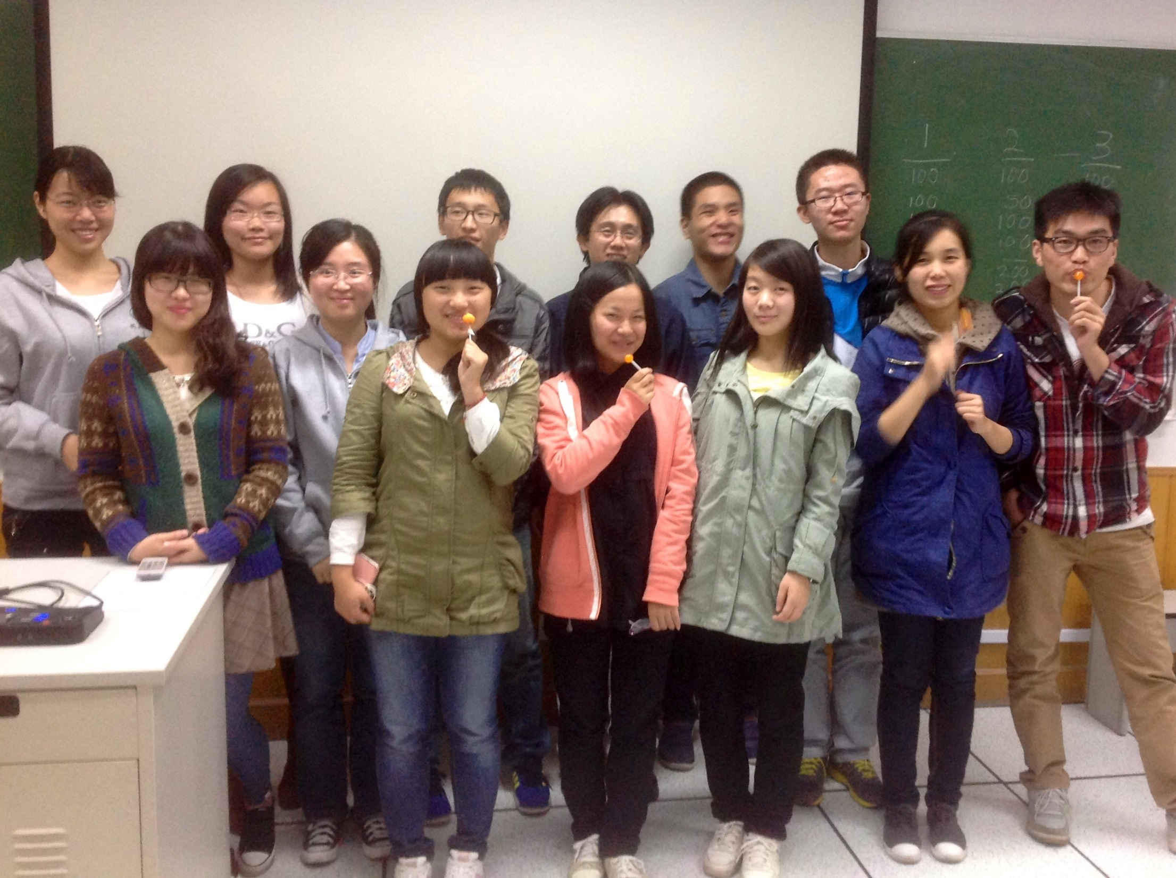
English Corner Friends

Slide 6


Veterans Day
November 11th
is an official United States holiday which honors people who have served in armed service also known as veterans. It is a federal holiday that is observed on November 11. It coincides with other holidays such as Armistice Day and Remembrance Day, which are celebrated in other parts of the world and also mark the anniversary of the end of World War I.
Most sources spell Veterans as a simple plural without a possessive apostrophe (Veteran's or Veterans')

Slide 8
Did anyone write a Limerick?
Limericks are short (sometimes serious; sometime silly) poems that are fun to recite.
A: What is a limerick, Mother? A: It's a form of verse, said brother B: In which lines one and two B: Rhyme with five when it's through A: And three and four rhyme with each other.

Slide 9

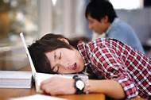
A great Invention by Madeleine Begun Kane
A fellow invented an app
That fills a technology gap:
It gives you some pinches,
When your teacher inches,
Near your desk, while you’re taking a nap.

Slide 10

Let’s Sing “Inventing”
Inventing is thinking of something that’s new.
Inventing takes hard work and energy too.
Each brand new contraption starts in somebody’s mind,
With problems to solve and solutions to find.
Inventors must work hard and overcome doubt,
But that’s what inventing is really about.

Slide 11
Your Discussion Topics
Instructions:
Form three groups so you can face each other.
In discussing your assigned topic: You will first have 3 minutes to define the topic / problem / issue. Second, you will have 5 minutes to discuss possible solutions. Third, we will select one person from each group to summarize the group’s discussion of your assigned topic.
Topics:
What are some of the modern inventions/discoveries you could not possibly live without?
What discoveries/inventions are the most amazing to you and why?
What new inventions/discoveries might be in our future?

Slide 12
List Chinese inventions
What are some of the great Chinese inventions?
Paper
Compass
Gun powder
Helicopter
Printing
China / Chinese writing / bank notes / USB Flash Drives
Mathematic Pie / Market Economy of Communities / silk / Medicines
Calculator / Abacus / Kung fun / Seismograph/ Whiskey /

Slide 13
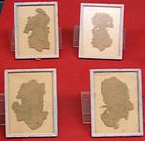
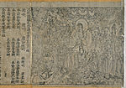
Paper
Fragments of hemp wrapping paper dated to the reign of Emperor Wu of Han (141-87 BC)
The Diamond Sutra, the oldest printed book, published in AD 868 during the Tang Dynasty (618–907)
Although it is recorded that the Han Dynasty (202 BC – AD 220) court eunuch Cai Lun (50 AD – AD 121) invented the pulp papermaking process and established the use of new raw materials used in making paper, ancient padding and wrapping paper artifacts dating to the 2nd century BC have been found in China, the oldest example of pulp papermaking being a map from Fangmatan, Tianshui;^{[9]} by the 3rd century, paper as a writing medium was in widespread use, replacing traditional but more expensive writing mediums such as strips of bamboo rolled into threaded scrolls, strips of silk, wet clay tablets hardened later in a furnace, and wooden tablets.

Slide 14
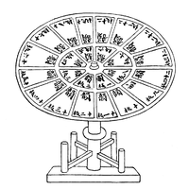
Printing
Woodblock printing: The earliest specimen of woodblock printing is a single-sheet dharani sutra in Sanskrit that was printed on hemp paper between 650 and 670 AD; it was unearthed in 1974 from a Tang tomb near Xi'an.

Slide 15
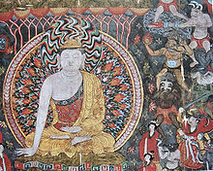
Gunpowder
The earliest artistic depiction of a fire lance gunpowder weapon, a painting at Dunhuang, dated Five Dynasties and Ten Kingdoms period (907–960 AD)
Evidence of gunpowder's first use in China comes from the Five Dynasties and Ten Kingdoms period (618–907).^{[27]} The earliest known recorded recipes for gunpowder were written by Zeng Gongliang, Ding Du and Yang Weide in the Wujing Zongyao, a military manuscript compiled in 1044 during the Song Dynasty (960–1279). Its gunpowder formulas describe the use of incendiary bombs.

Slide 16
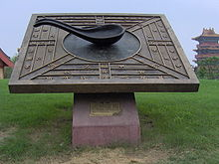
Compass
A model in Kaifeng of a Chinese ladle-and-bowl type compass used for geomancy in the Han Dynasty (202 BC – 220 AD); the historical authenticity of the model has been questioned by Li Shu-hua (1954).^{[32]}

Slide 17
Let’s finish
Playing
Jeopardy!

Slide 18

Break

Slide 19

Speaking Activity
Divide into groups of two
Roll the dice and answer the number of the question your rolled.
If you have already answered that question roll the dice again.

Slide 20
Describe your feelings about leaving your home and province for four years.
Try to describe your feelings as you return after successfully completing your B.S or B.A. degree in four years.
Try to describe the feelings of your parents as you return to your home as a college graduate.
Try your best to describe your first day on the job of your dreams.
Describe your future husband or wife.
What do you think your feelings will be when your first child leaves home to go to a school?
What do you think the purpose of life is?
Where do you think you will go when you or your parents die? Why do you believe that?
Do you believe you came from some where else when you were born? Why do you believe that?
Suppose you move to Australia which has a different form of government. How will that change the way you act in your life, Why?
What about living in Australia would make you nervous?
What do you think you will do to adjust to that concern?

Slide 21

ETHICAL DILEMMAS

Slide 22
Integrity
“Integrity without knowledge is weak and useless and knowledge without integrity is dangerous and dreadful.” (Samuel Johnson (1709-1784) English Poet, Critic and Writer)

Slide 23
VOCABULARY
ethics – the principles of conduct
governing an individual or a group, the
discipline dealing with what is good
and bad and moral duty and obligation
ethical – moral, conforming to accepted
standards of conduct
moral – principles of right and wrong
behavior
dilemma – a situation involving a choice
between alternatives

Slide 24
confided – to tell something in secret
welding - to unite (metallic parts) by
heating and allowing the metals to
flow together
barely hanging on – the business is
about to fail
pressures – try to get someone to do
what you want them to do
certify – to assure, to confirm
expelled – kicked out of school,
suspended from school

Slide 25

0 tolerance – no exceptions, no second
chances
full ride – a scholarship which pays
tuition, books, room and board

Slide 26
ETHICAL DILEMMA
(ENGINEER)
You are the only engineer in a small manufacturing company that makes steel trusses (roof support beams). The owner of the company has confided in you that the company is in financial trouble—barely hanging on.
The company has completed the manufacture of a large order of trusses, which you designed for a

Slide 27
shopping mall. They are about to be delivered to the builder when you inspect them and discover that they were welded incorrectly.
You go to the owner and tell him of the problem. The boss, of course, is very upset. He says it would be very expensive to remake them or even to break them apart and re-weld them correctly. He says the company will go broke and all of the employees (25), including yourself, will not have jobs.

Slide 28
Your wife is pregnant and you will also lose health insurance covering delivery of the baby. Your calculations show that the faulty trusses are not as strong as your original design and could result in a possibly dangerous structure for the mall roof. The boss thinks they will be okay and pressures you to certify them for delivery.
What will you do?

Slide 29
ETHICAL DILEMMA
(VICE PRINCIPAL)
You are the vice principal in charge of discipline of a high school. It is your responsibility to see that all students follow the rules and are treated fairly and equally. It is the policy of your school that students caught with alcohol, drugs or weapons on campus will be expelled—0 tolerance.

Slide 30
Your daughter is a senior at the high school. She is an outstanding basketball and volleyball player and is a top academic student. She has applied to several universities and for scholarships that would pay virtually all of her costs at any of these colleges. She is almost certain to be accepted and to receive a full ride at all schools to which she has applied.

Slide 31
One evening, you are supervising a school dance. You need to speak to your daughter and can’t find her. You finally go into the darkened girls’ locker room and hear voices. One is your daughter’s voice and as you listen, you realize they are drinking alcohol. They do not see you.
What will you do?

Slide 32

Life is full of choices and decisions and many of them will present us with moral and ethical dilemmas. Some of these choices and decisions will challenge
the very principles,
standards and values
we were taught by
our family. When
faced with these
moral dilemmas,
what will you do?

Slide 33
Vocabulary Builders
Instructions:
Form groups of three or four people.
Distribute the vocabulary card so each person in your group has one.
Taking turns, each person then pronounces each word on his/her card.
When everyone is finished, pass your card one person to the left and then each person pronounces the words on his/new card.
Repeat the process until everyone has had a chance to pronounce the words on each card.
Note: If someone needs help pronouncing a word, other group members should provide assistance.

Slide 34
Adjective Opposites Crossword Puzzle
Form groups of 3 or 4.
Working together complete the crossword puzzle; no technology please.
When completed come to the front and check your answers.

Slide 35
Talking Cards
Please form groups of 3-5 people.
You will be given a number of playing cards.
In turn, starting with the person whose birthday is closest to today’s date, draw a card from the top of the deck and answer the corresponding question.
Then take turns answering questions, until you have use up all of your cards.
Please speak loudly enough for your group to hear and understand you.

Slide 36
What are some of the topics you would like to discuss in class and/or English Corners?

Slide 37
Questions for and from
the Professors.

