Slide 1
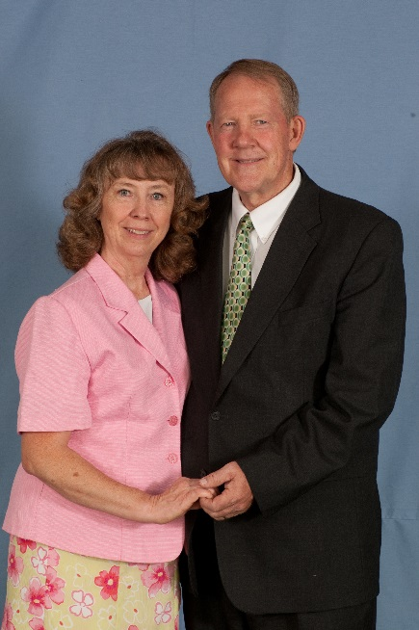
Professors John & Marie Murdoch
Welcome to English Corner

Slide 2
Introductions
Please stand and introduce yourself if this is your first English Corner.
What is your name?
Where are you from (hometown)?
What is one thing you did during this past summer?
Tell one thing you like to do in your free time?

Slide 3
English Corner’s Goals
To improve oral English skills—we speak only English.
To improve English listening skills.
To meet new friends.
To build social skills.
To learn about American and Chinese Cultures.
To share ideas and opinions.
Let’s have fun!

Slide 4

Next English Corner
November 12, 2013
7 PM
The next English Corner
will be in Room 218-this same room.

Slide 5
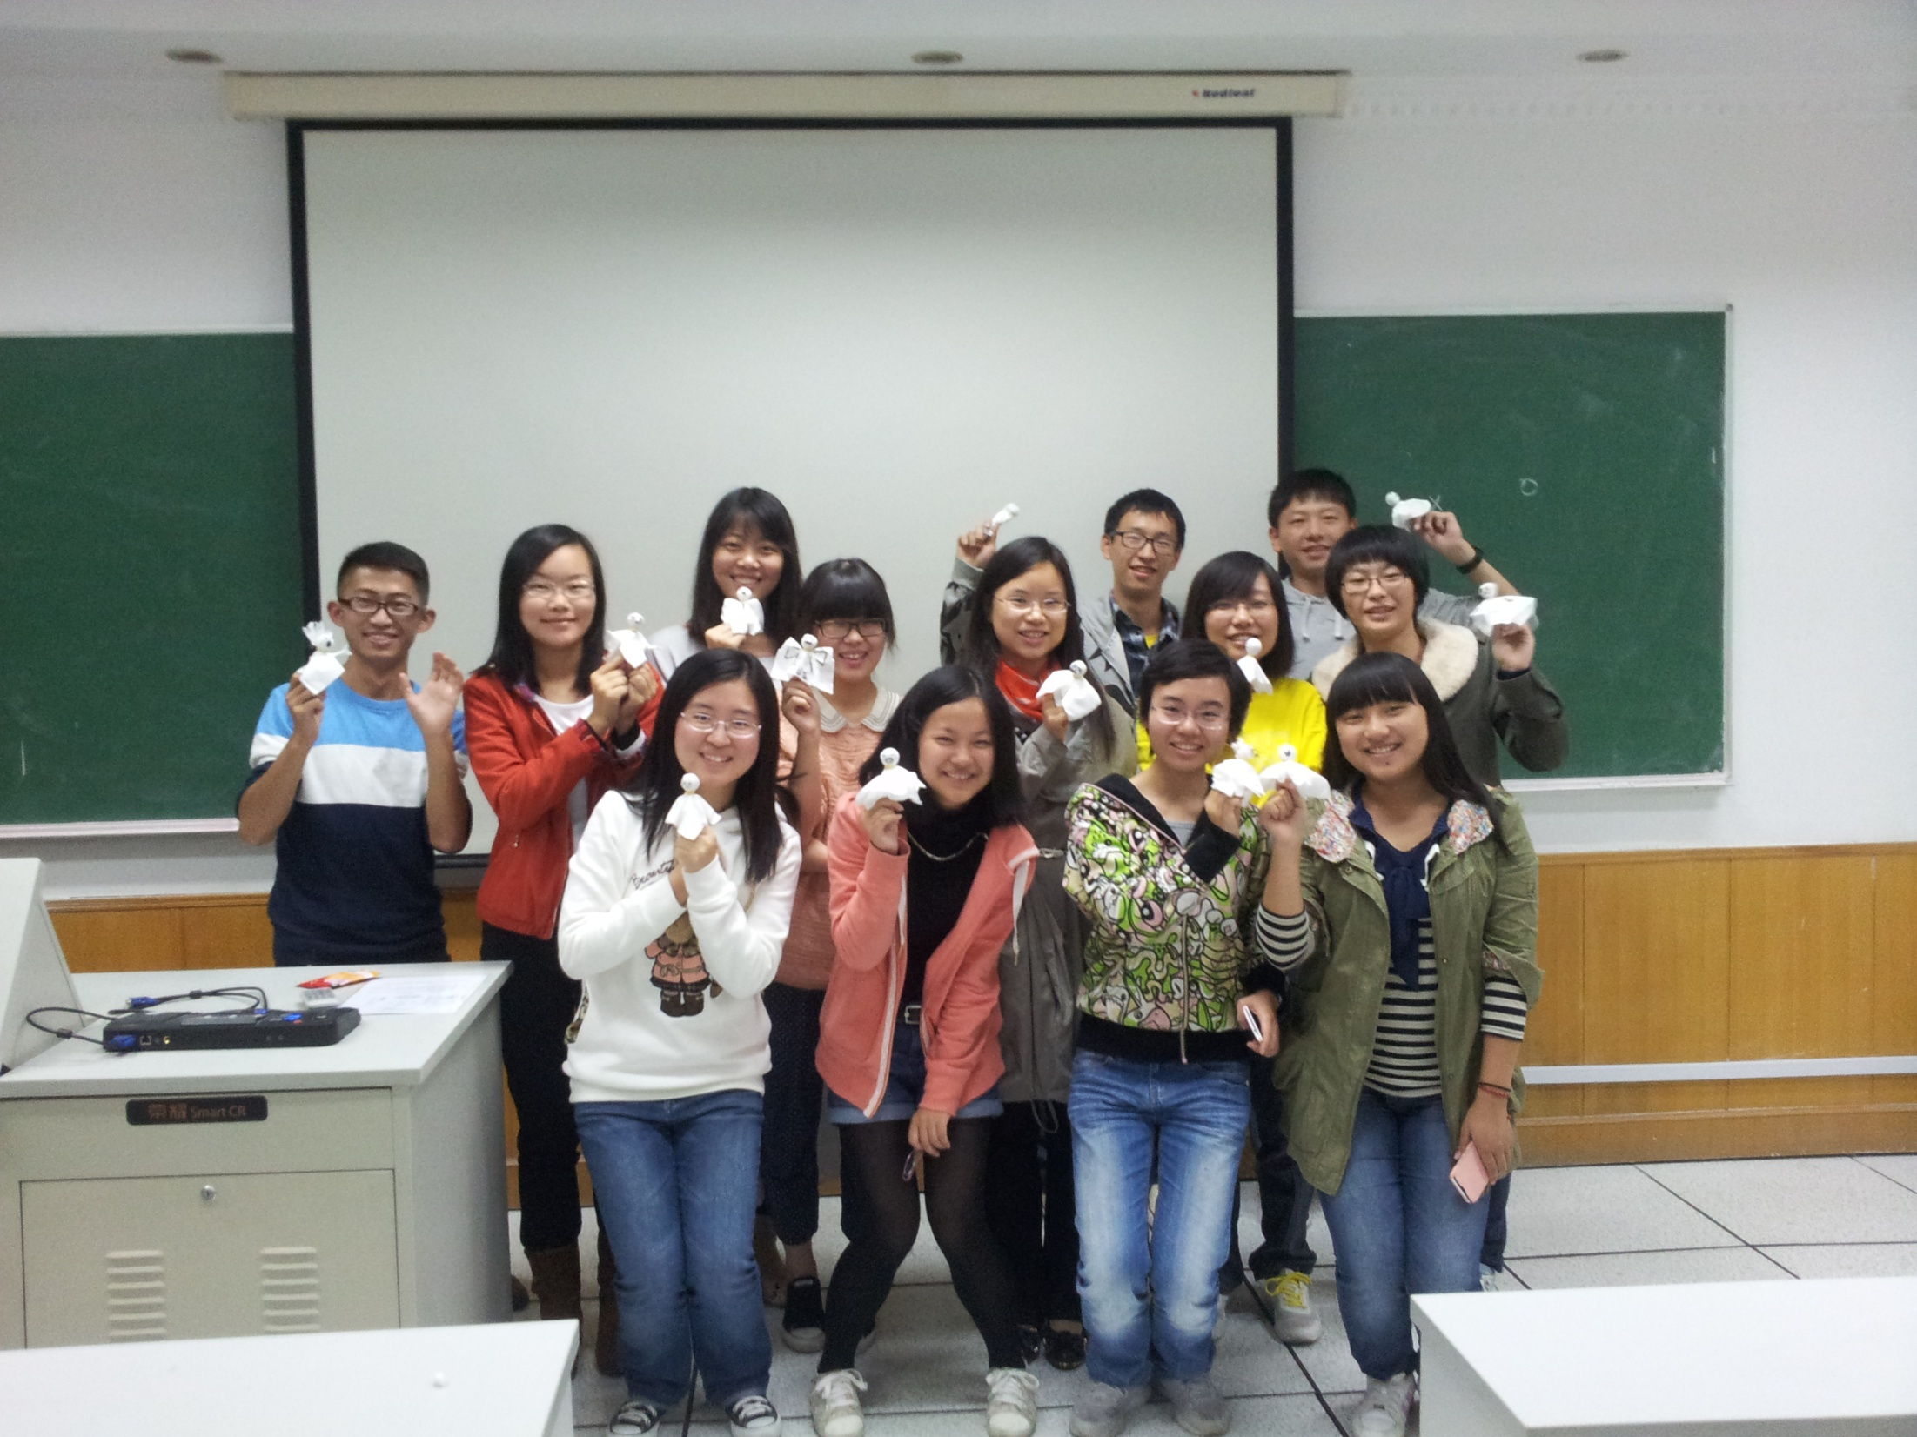
English Corner Spooks

Slide 6

Halloween Story

Slide 7
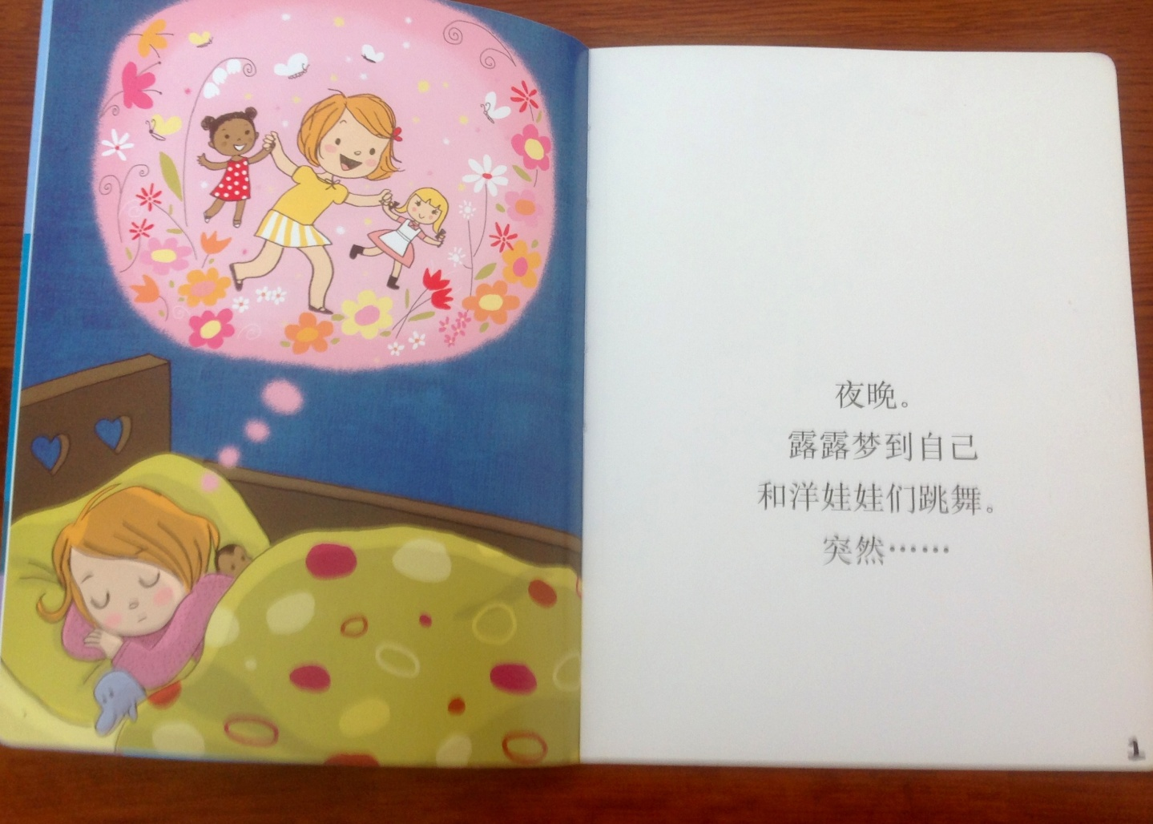
Halloween Story Page 1
One night, Lulu had a dream; she was dancing with her dolls. Suddenly…..

Slide 8
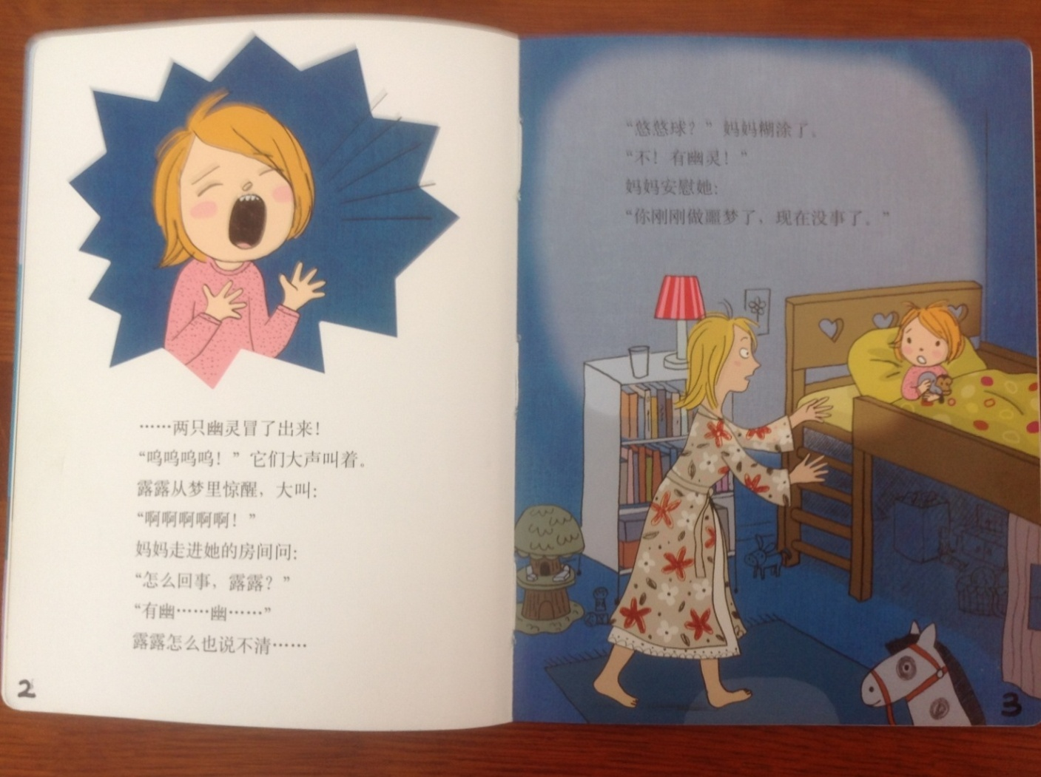
Halloween Story Pages 2 and 3
…two ghosts came out and shouted loudly, “Woo ooo ooo.”
Lulu woke up with a start and screamed, “Ahhhhhhh!”
Mother rushed into the room and asked, “What happened Lulu.”
“There’s a gho..gho..” as there was a twist to Lulu’s tongue—that is all she could say.
“A yo-yo?” Her mom was confused.
“No! There were two ghosts!” cried Lulu.
Her mom comforted her, “You’ve just had a nightmare, but it’s ok now.”

Slide 9
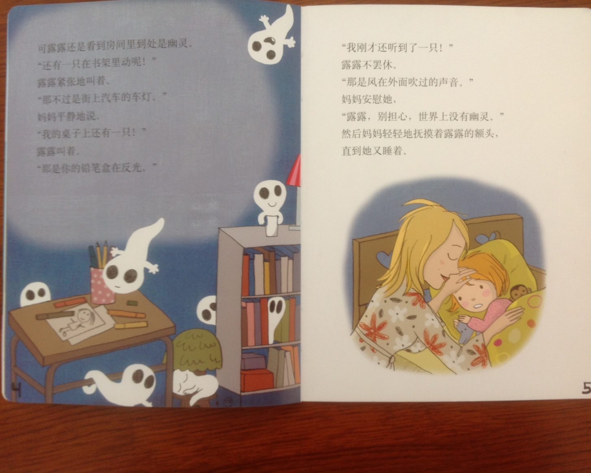
Halloween Story Page 4
However, Lulu still found that there were ghosts everywhere.
“There is one moving in the bookshelf!” Lulu shouted nervously.
“That’s just the lights of the cars on the street,” Mom replied peacefully.
“There is one on my desk!” Lulu shouted.
“That’s your pencil case reflecting the lights,” sighed Mother.

Slide 10

Halloween Story Page 5
“I just heard one,” Lulu didn’t give up.
“That was the wind blowing,” comforted Mother, “Don’t worry Lulu, there is no ghost in the whole world.”
Mom gently caressed Lulu’s forehead until she fell asleep.

Slide 11
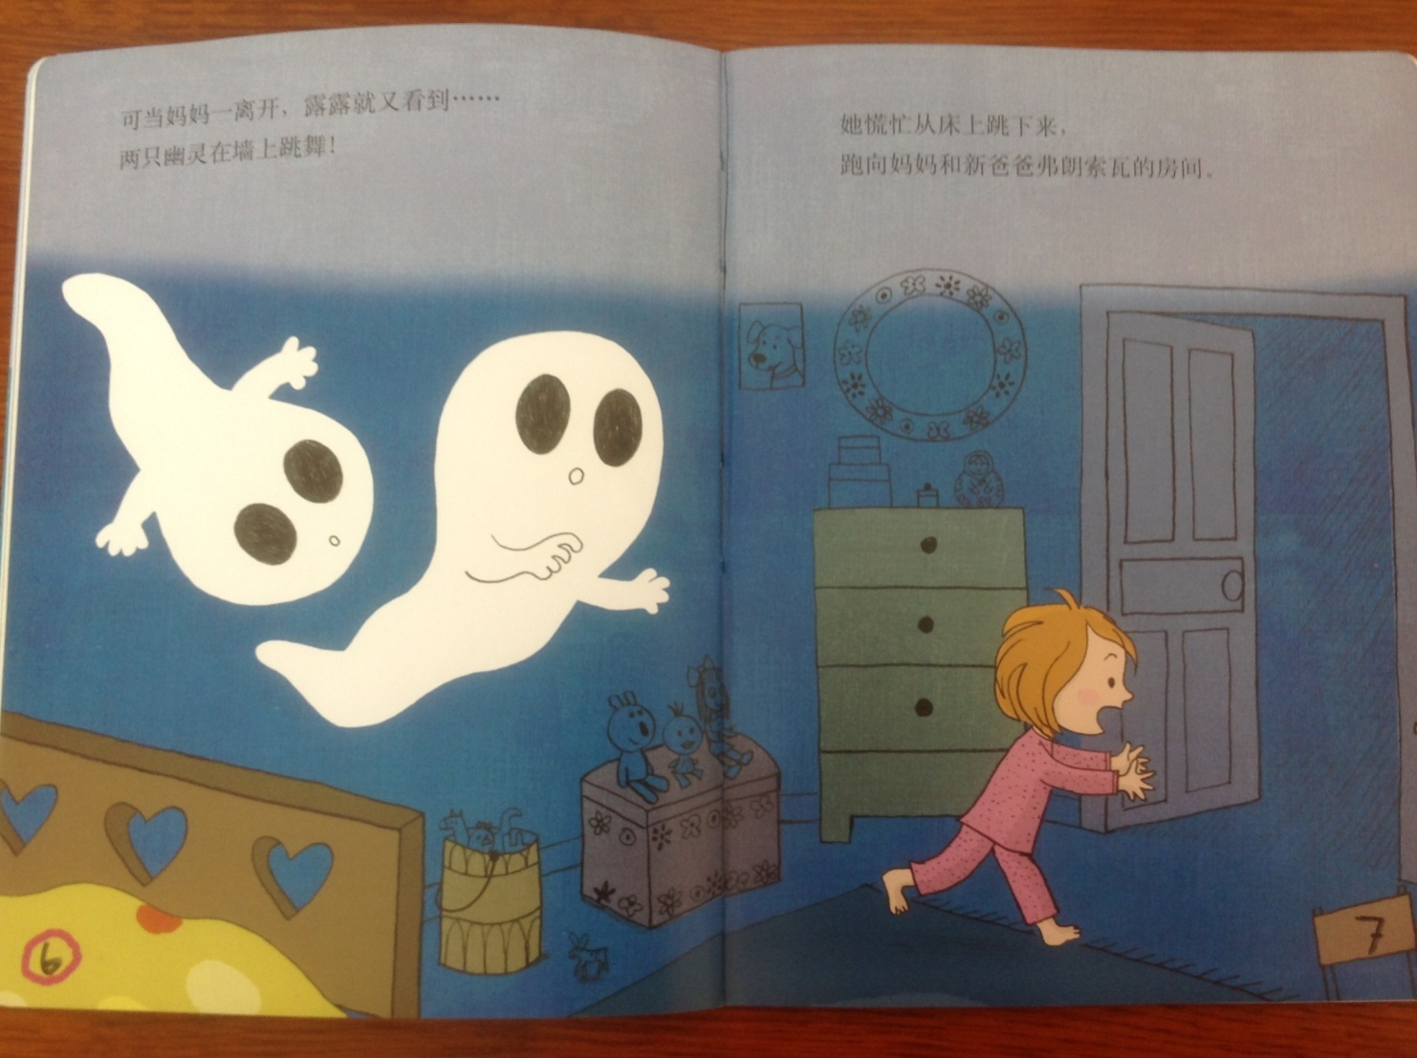
Halloween Story Pages 6 and 7
As soon as mom left, Lulu saw them again—two ghosts dancing on the wall! She jumped off her bed in a great panic and ran to her mother and stepfather’s room.

Slide 12
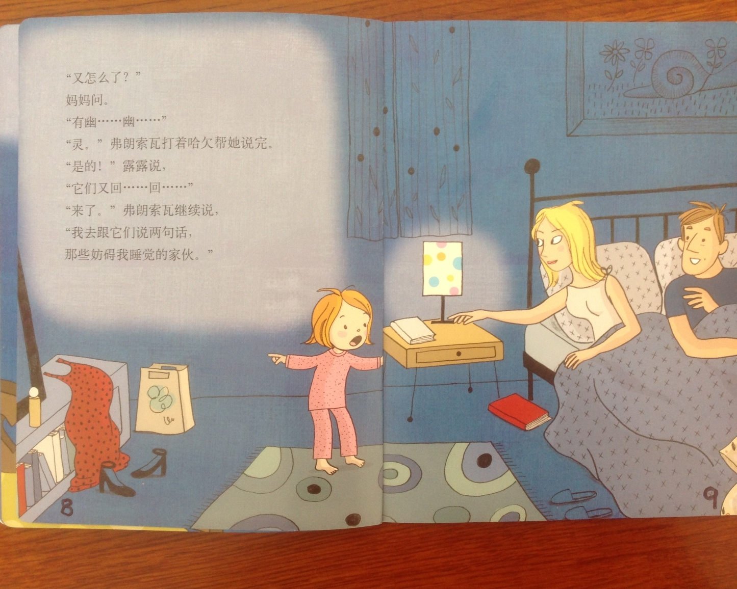
Halloween Story Pages 8 and 9
“What Happened--again?” asked Mother.
“G..G..G,” whimpered Lulu.
“Ghost,” Father helped her finish while yawning.
“Yes,” said Lulu, “They are b….back.”
Father continued, “I am going to talk to them; they are interrupting my sweet dreams.”

Slide 13
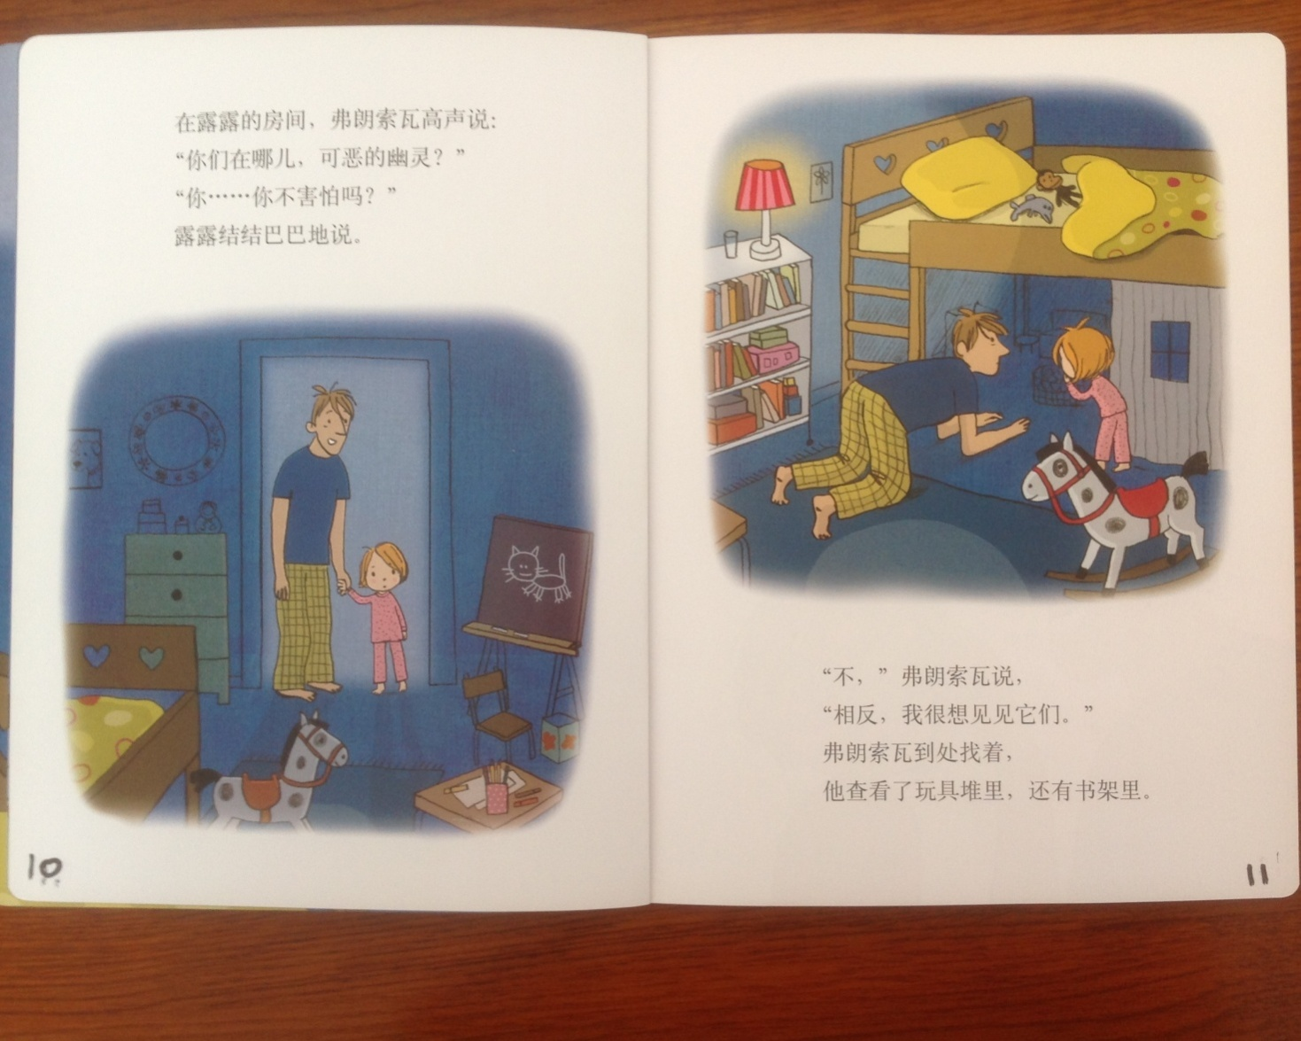
Halloween Story Pages 10 and 11
Back in Lulu’s room, Father speaks in a loud voice, “Where are you bad ghosts?”
“Don’t you feel scared?” Lulu said.
“No,” Father said, “just the opposite, I really want to see them.” He looked for them here and there; he looked through the piles of toys and in the bookshelf.

Slide 14
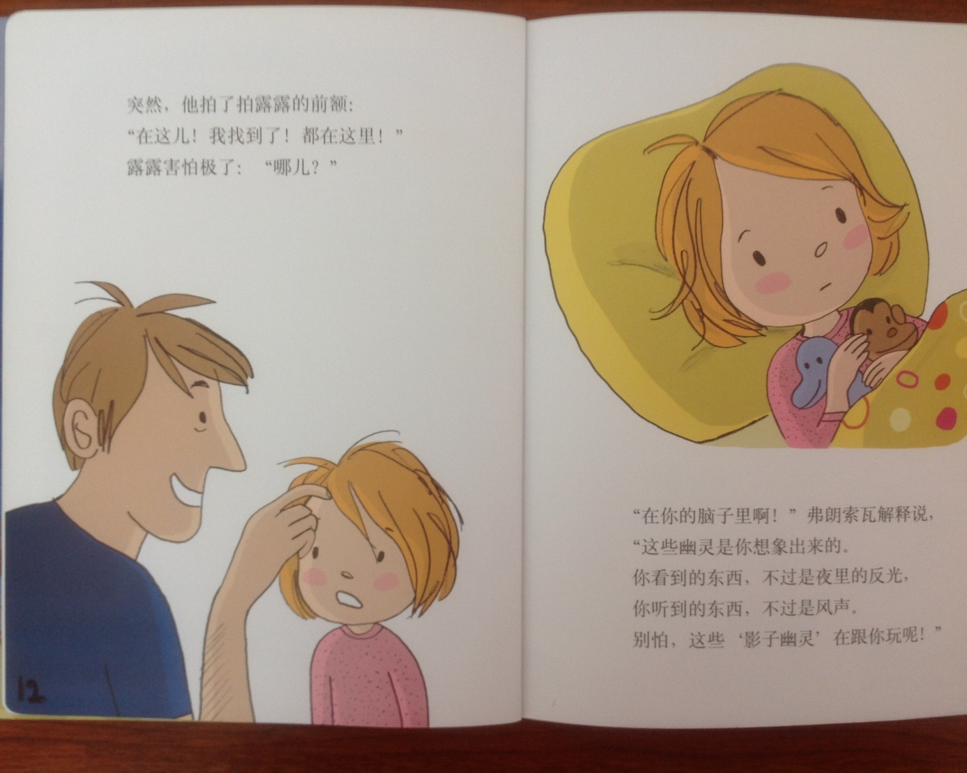
Halloween Story Pages 12 and 13
Abruptly, he patted Lulu’s forehead. “Here—I found it! All the ghosts are in here.”
Lulu, felt very scared, “Where?”
“In your brain,” explained Father, “From your imagination comes these ghosts! What you see is nothing, but a reflection in the night and what you heard is nothing but the wooo of the wind. So don’t be scared.”

Slide 15
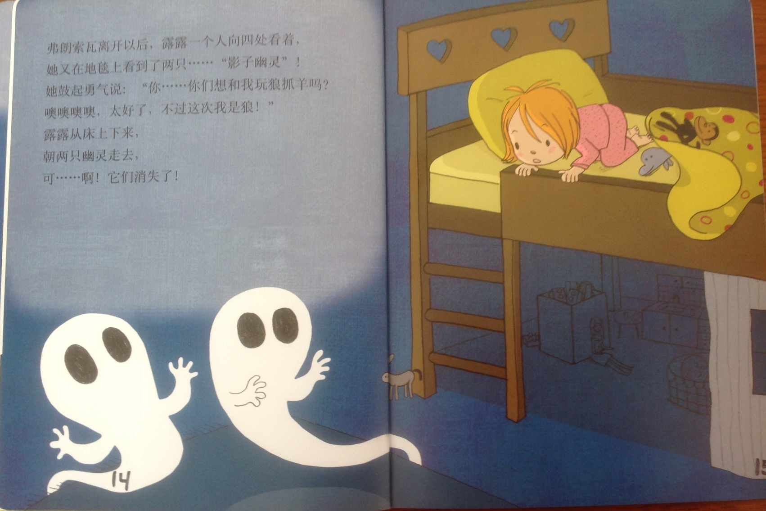
Halloween Story Pages 14 and 15
After father left, Lulu was alone; she looked around and saw two shadow ghosts on the carpet. She mustered up her courage and asked, “Do you want to play a game named wolf catches the sheep with me? Oh, great. I’m acting as the wolf this time!” Lulu slipped on the bed and walked towards the ghosts, but they vanished.

Slide 16
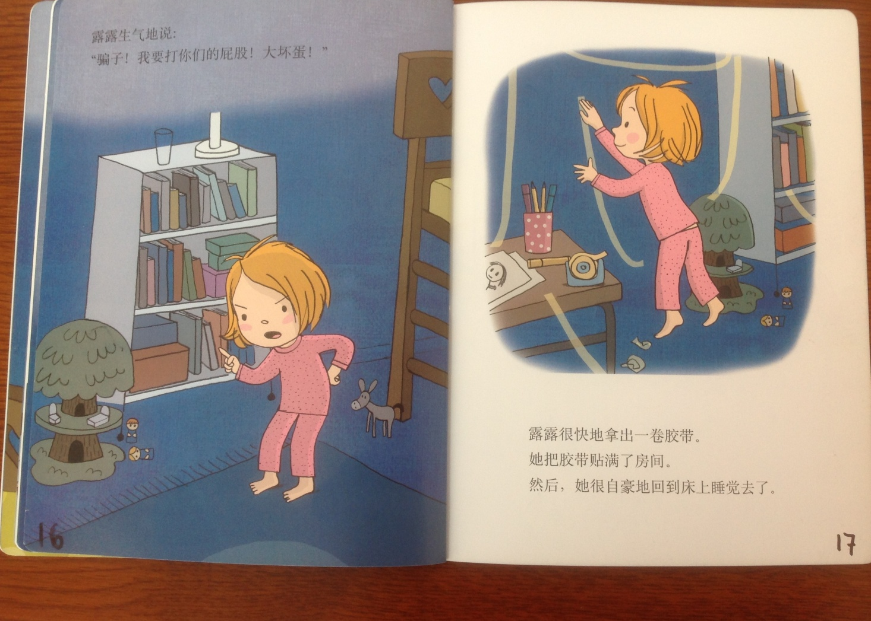
Halloween Story Pages 16 and 17
“I will bite your hip,” Lulu said angrily. She then took a roll of cello tap and put it around the room. Then she went to bed with pride.

Slide 17
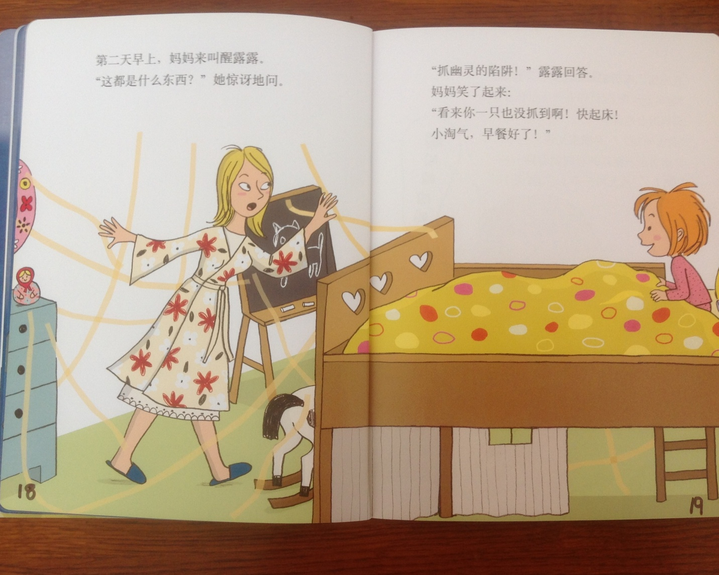
Halloween Story Pages 18 and 19
In the morning, Mom woke up Lulu. “What are these?” she asked with amazement.
“A trap to grab ghosts,” Lulu said.
“It seems that you didn’t catch anything; wake up quickly my naughty girl—breakfast is ready,” Mother replied.

Slide 18
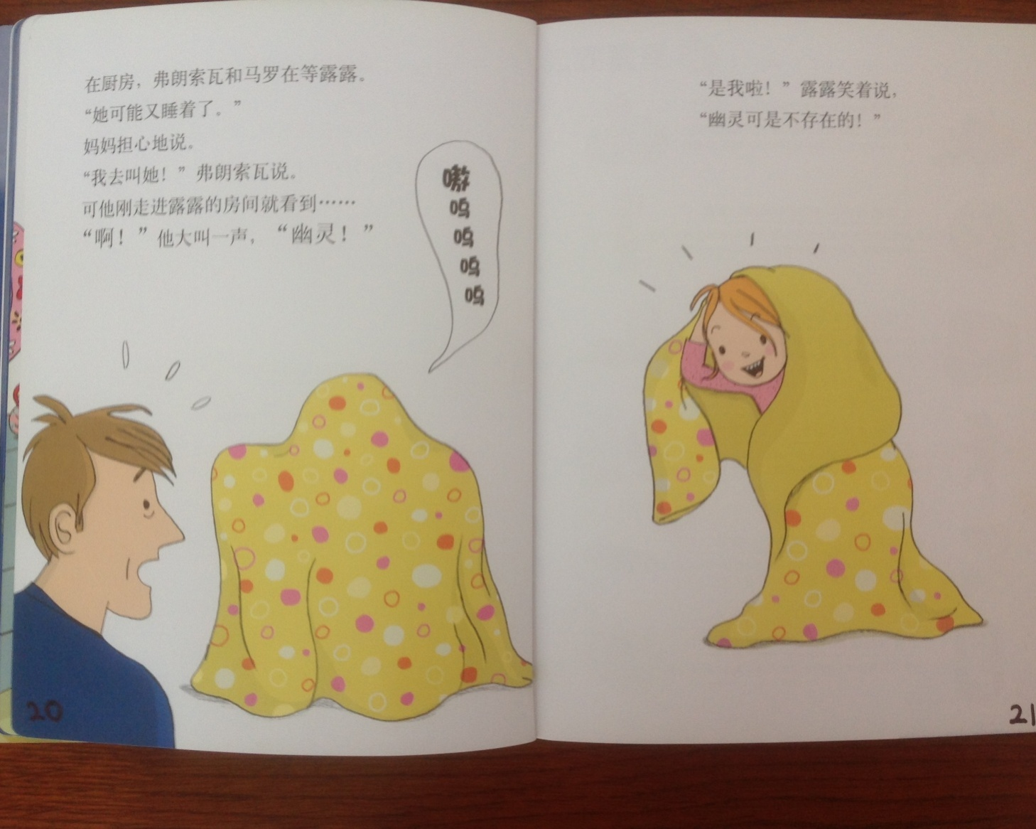
Halloween Story Pages 20 and 21
In the kitchen, father and mother were waiting for Lulu.
“Maybe she has fallen to sleep again,” said Mother.
“I’ll wake her up,” said Father, but the moment he entered the room he looked and then screamed loudly, “a ghost!”
“It’s me,” Lulu said smiling, “there is no ghost.”

Slide 19
Did anyone write a Limerick?
Limericks are short (sometimes serious; sometime silly) poems that are fun to recite.
A: What is a limerick, Mother?
A: It's a form of verse, said brother
B: In which lines one and two
B: Rhyme with five when it's through
A: And three and four rhyme with each other.

Slide 20

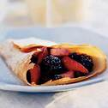
Oh to be Fit
Limericks are short (sometimes serious; sometime silly)
poems that are fun to recite.
A: I want to be in such great shape,
A: Like superman with his flowing cape,
B: But that takes so much work,
B: Which I am known to shirk,
A: I think I’ll eat another sweet crepe!

Slide 21

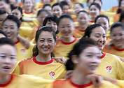

The Real Truth about Exercise
Exercise is easy, exercise is fun,
Exercise is great for everyone,
Run, jog, walk, run or skip,
Make sure you do at least a little bit.
Increase your exercise day by day,
Keep at it and you will find a way,
To be healthy, to be aware,
Exercise keeps you healthy,
Exercise takes care.
Exercise brings benefits,
Many benefits that are free,
Remember with exercise
You can live long and care free,
Free of all ailments, free of cholesterol,
Free from all aches and pains,
Be healthy and stand tall.
Get up from your couch,
And switch off the TV,
Put away your games and your PSP’s
Run out, play and celebrate,
The benefits of exercise
To be healthy and safe.
Exercise and be,
“A” OKAY.

Slide 22
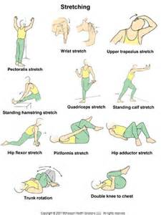

Let’s Sing
Head, Shoulders, Knees, and Toes
Knees and Toes; Knees and Toes
Head, Shoulders; Knees and Toes
Eyes, Ears, Mouth, and Nose.

Slide 23
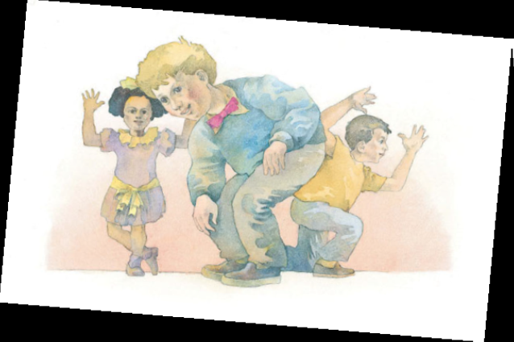
Hinges
I’m all made of hinges, cause everything bends. From the
Top of my neck way down to my ends. I’m hinges in front and I’m
Hinges in back; but I have to be hinges or else I would crack.

Slide 24
Your Discussion Topics
Instructions:
  Form three groups so you can face each other.
  In discussing your assigned topic: You will first have 3 minutes to define the topic / problem / issue. Second, you will have 5 minutes to discuss possible solutions. Third, we will select one person from each group to summarize the group’s discussion of your assigned topic.
    Topics:
      How can busy college students find time to stay fit?
      What are healthy food choices?
      What kind of foods/beverages/substances should we avoid?

Slide 25
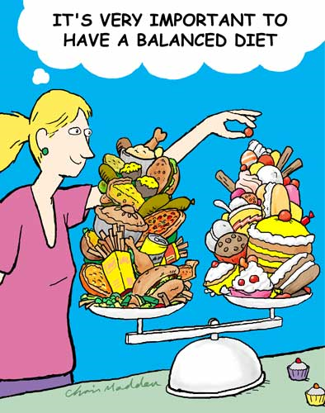
Cartoon of the Day
What is a
balanced diet?

Slide 26
Food/Drink Homonyms
Fly-swatter Game
Which word relates to food/drink?
Ate Eight
Bite Byte
Chews Choose
Chilly Chili
Doe Dough
Sweet Suite
Whine Wine
food, number
food, computer term
food, decide
cool-cold, food
female deer, food
food, large hotel room
complaining, drink

Slide 27
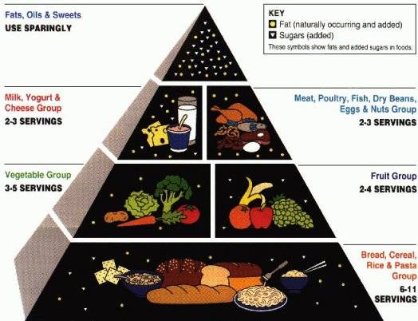
The Basic Food Groups

Slide 28

Break

Slide 29
Let’s Play
Jeopardy!

Slide 30
The Whisper Game
Instructions:
Divide into assigned teams.
Stand shoulder to shoulder.
The first person will be given a written statement.
This person will read the statement and then turns to the next person and whisper what was read.
In turn the second person turns and whispers what was heard into the ear of the third person.
This process continues until the last person in each group hears the whispered message. This person in turn states aloud what was heard.
The team whose final message most closely resembles the first message wins.

Slide 31

The bottom line….
“Take care of your body; it is the only place you have to live.”

Slide 32
Vocabulary Builders
Instructions:
  Form groups of three or four people.
  Distribute the vocabulary card so each person in your group has one.
  Taking turns, each person then pronounces each word on his/her card.
  When everyone is finished, pass your card one person to the left and then each person pronounces the words on his/new card.
  Repeat the process until everyone has had a chance to pronounce the words on each card.
  Note: If someone needs help pronouncing a word, other group members should provide assistance.

Slide 33
Talking Cards
Please form groups of 3-5 people.
You will be given a number of playing cards.
In turn, starting with the person whose birthday is closest to today’s date, draw a card from the top of the deck and answer the corresponding question.
Then take turns answering questions, until you have use up all of your cards.
Please speak loudly enough for your group to hear and understand you.

Slide 34
Adjective Opposites Crossword Puzzle
Form groups of 3 or 4.
Working together complete the crossword puzzle; no technology please.
When completed come to the front and check your answers.

Slide 35
What are some of the topics you would like to discuss in class and/or English Corners?

Slide 36
Questions for and from
the Professors.

