Slide 1

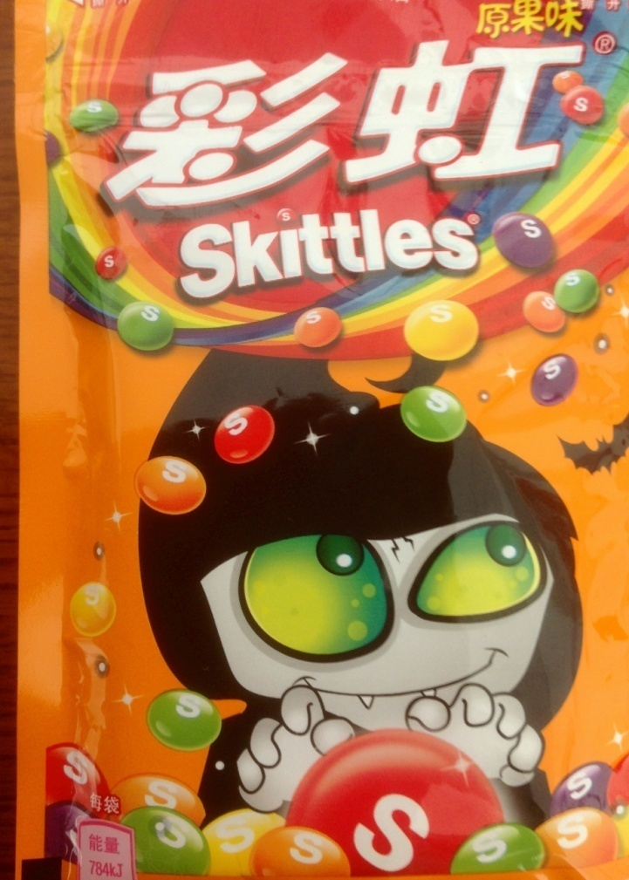
Professors John & Marie Murdoch
Welcome to English Corner

Slide 2
Introductions
Please stand and introduce yourself if this is your first English Corner.
What is your name?
Where are you from (hometown)?
What is one thing you did during this past summer?
Tell one thing you like to do in your free time?

Slide 3
English Corner’s Goals
To improve oral English skills—we speak only English.
To improve English listening skills.
To meet new friends.
To build social skills.
To learn about American and Chinese Cultures.
To share ideas and opinions.
Let’s have fun!

Slide 4

Next English Corner
November 5, 2013
7 PM
The next English Corner
will be in Room 218-this same room.

Slide 5
Did anyone write a Limerick?
Limericks are short (sometimes serious; sometime silly) poems that are fun to recite.
A: What is a limerick, Mother?
A: It's a form of verse, said brother
B: In which lines one and two
B: Rhyme with five when it's through
A: And three and four rhyme with each other.

Slide 6

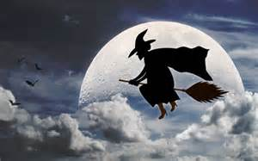
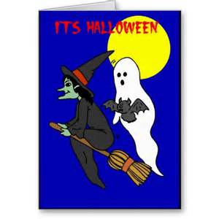
A Halloween Limerick
Limericks are short (sometimes serious; sometime silly) poems that are fun to recite.
A: I find some things to be scary,
A: So I warn you to be wary,
B: Of witches and ghosts,
B: Who hang out on fence posts,
A: And frighten children who tarry!

Slide 7
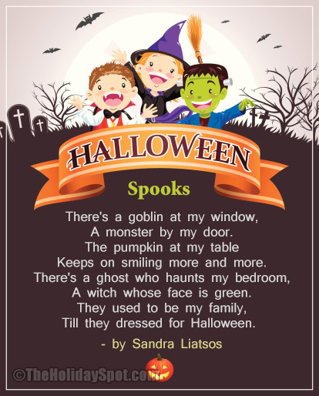

Slide 8
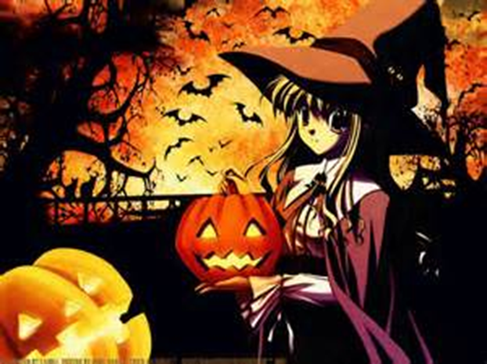
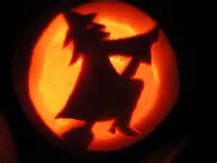


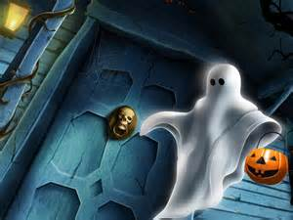
If You've Never
by Elsie Melchert Fowler
If you've never seen an old witch
Riding through the sky--
Or never felt big bat's wings
Flopping, as they fly--
If you've never touched a white thing
Gliding through the air,
And knew it was a ghost because
You got a dreadful scare--
If you've never heard the night owls,
Crying, "Whoo-whoo-whoo?"
And never jumped at pumpkin eyes
Gleaming out at you--
If all of these exciting things
You've never heard or seen,
Why then--you've missed a lot of fun,
Because--that's HALLOWEEN!

Slide 9

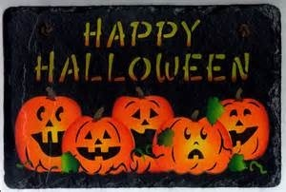
Five Little Pumpkins
Five little pumpkins sitting on a gate.
The first one said, “Oh, my it’s getting late!”
The second one said, “There are witches in the air.”
The third one said, “But we don’t care.”
The fourth one said, “Let’s run and run and run!”
The fifth one said, “We’re ready for some fun!”
Then Woooooo went the wind
And out went the lights
And the five little pumpkins rolled out of sight.

Slide 10
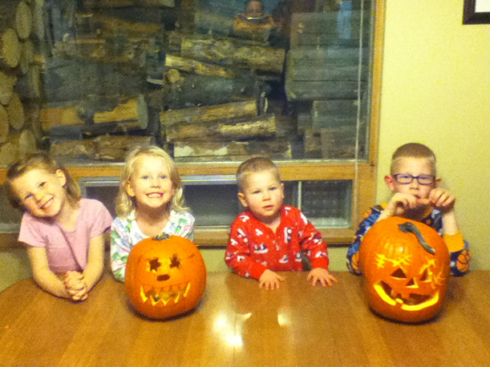
Plus Two More
Katie Maddie Ryan Ryker

Slide 11
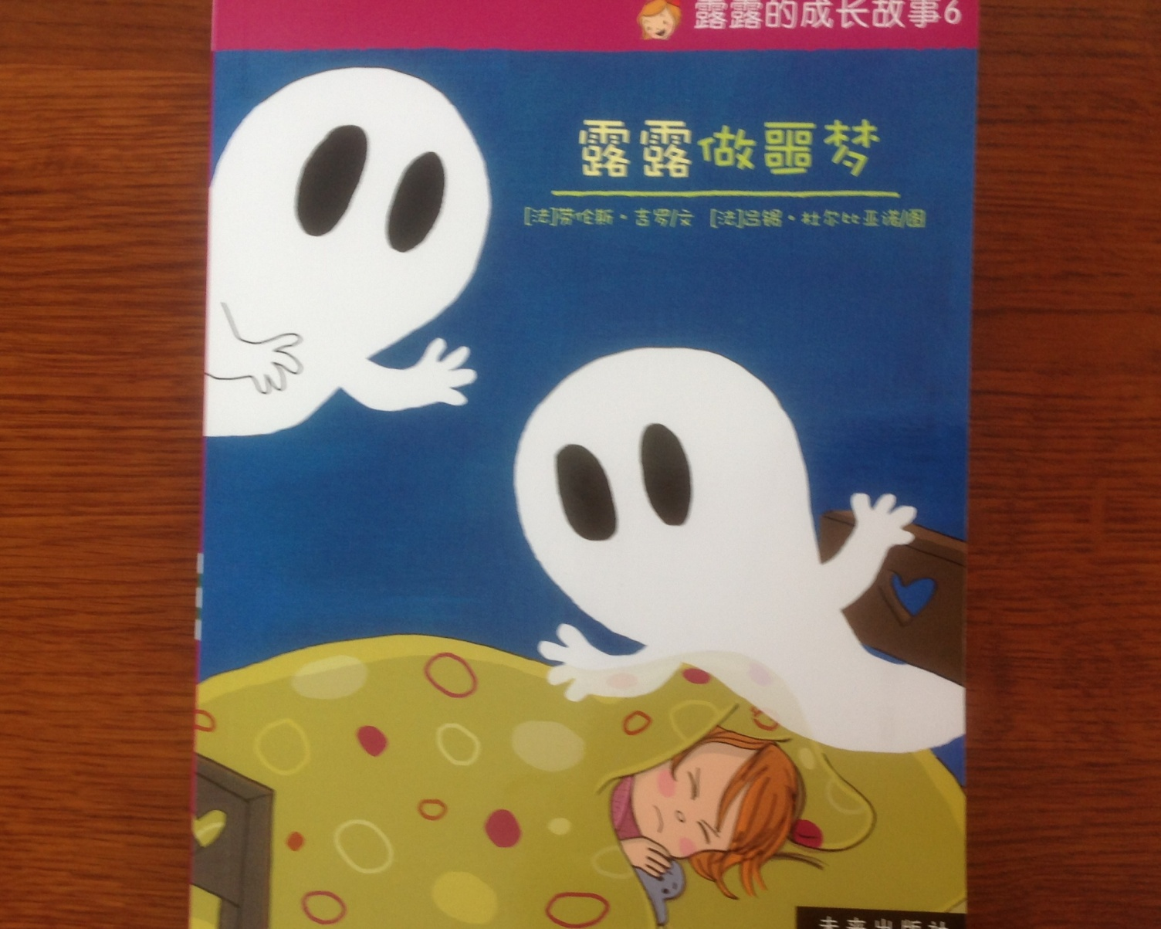
Halloween Story
Instructions:
With your partner(s), translate your assigned page(s) from Chinese into English (the best you can).
Once the translation is completed, please choose a person to read your assigned page(s) of the story to the class.

Slide 12
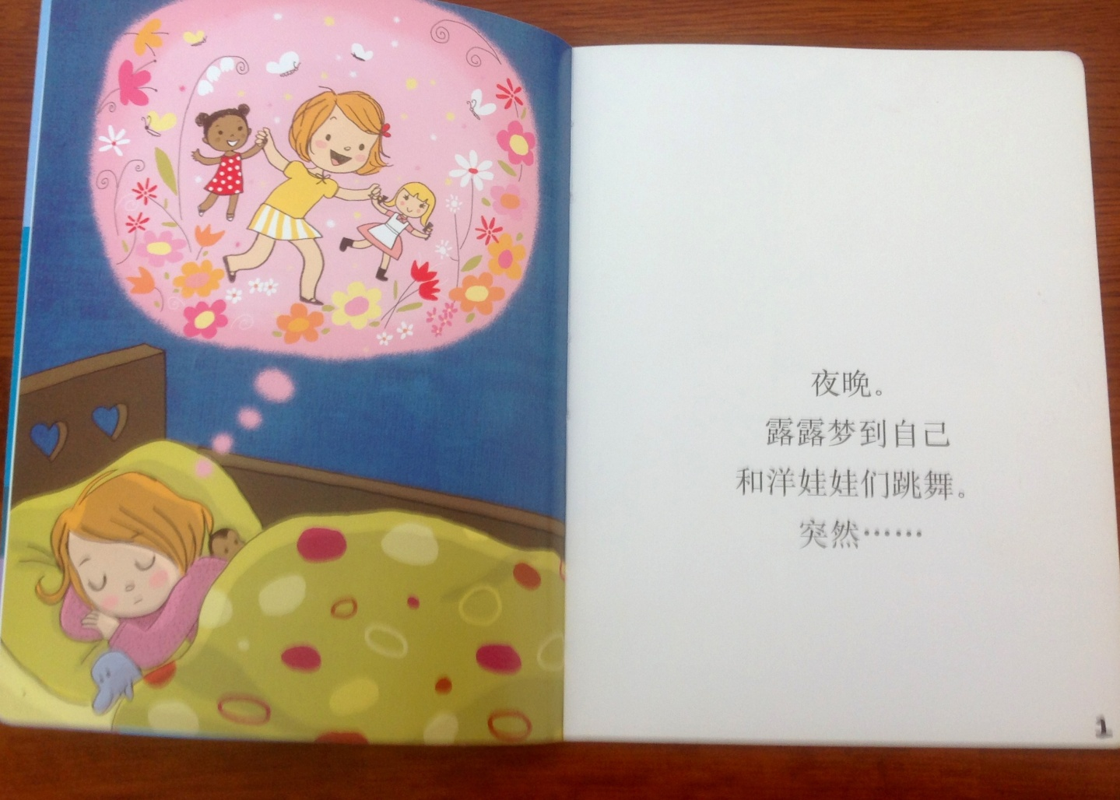
Halloween Story Page 1
At night, Lu Lu had a dream. In her dream she was dancing with her dolls. Suddenly….

Slide 13
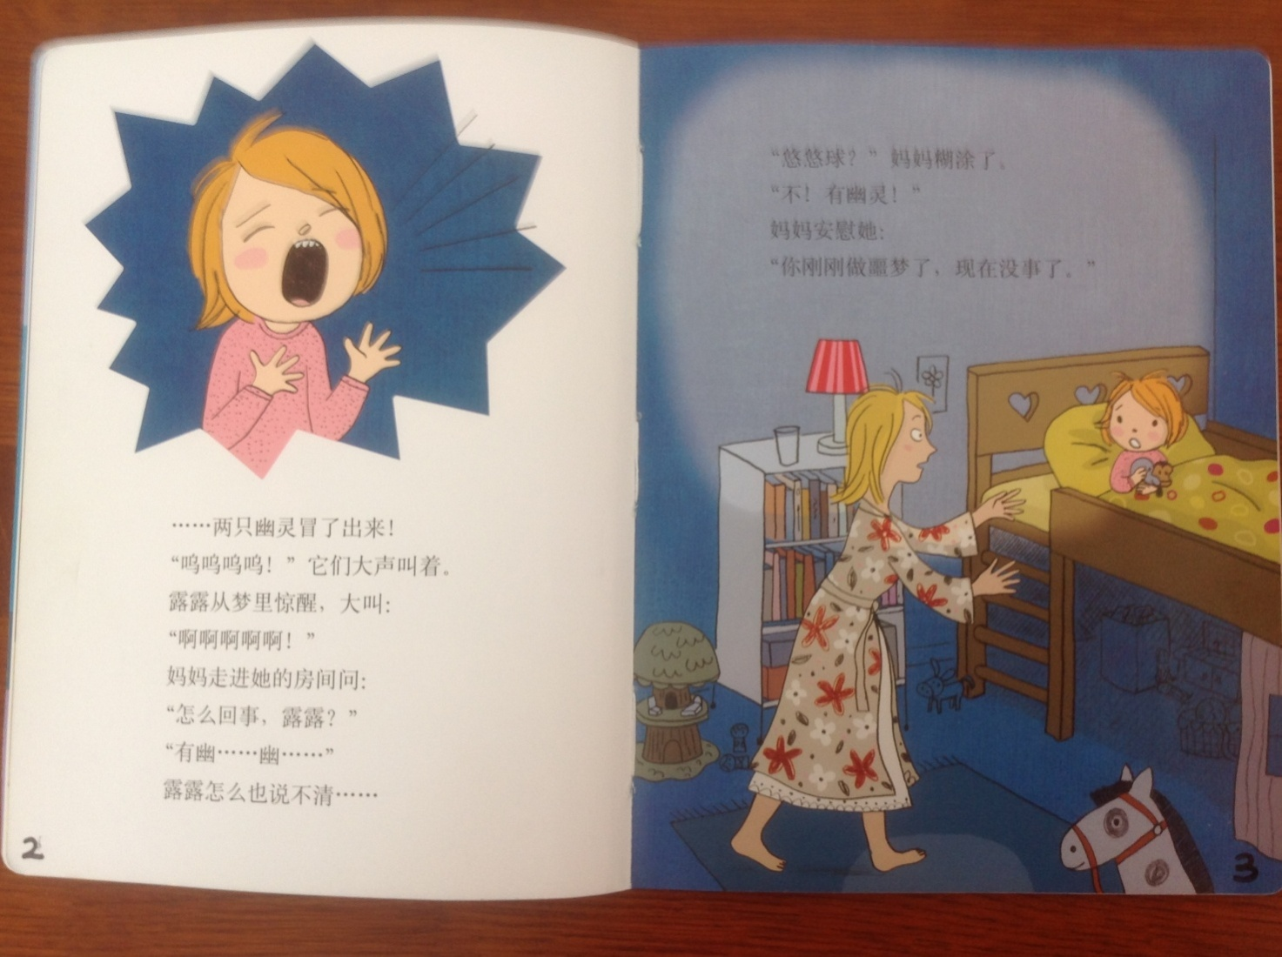
Halloween Story Pages 2 and 3

Slide 14
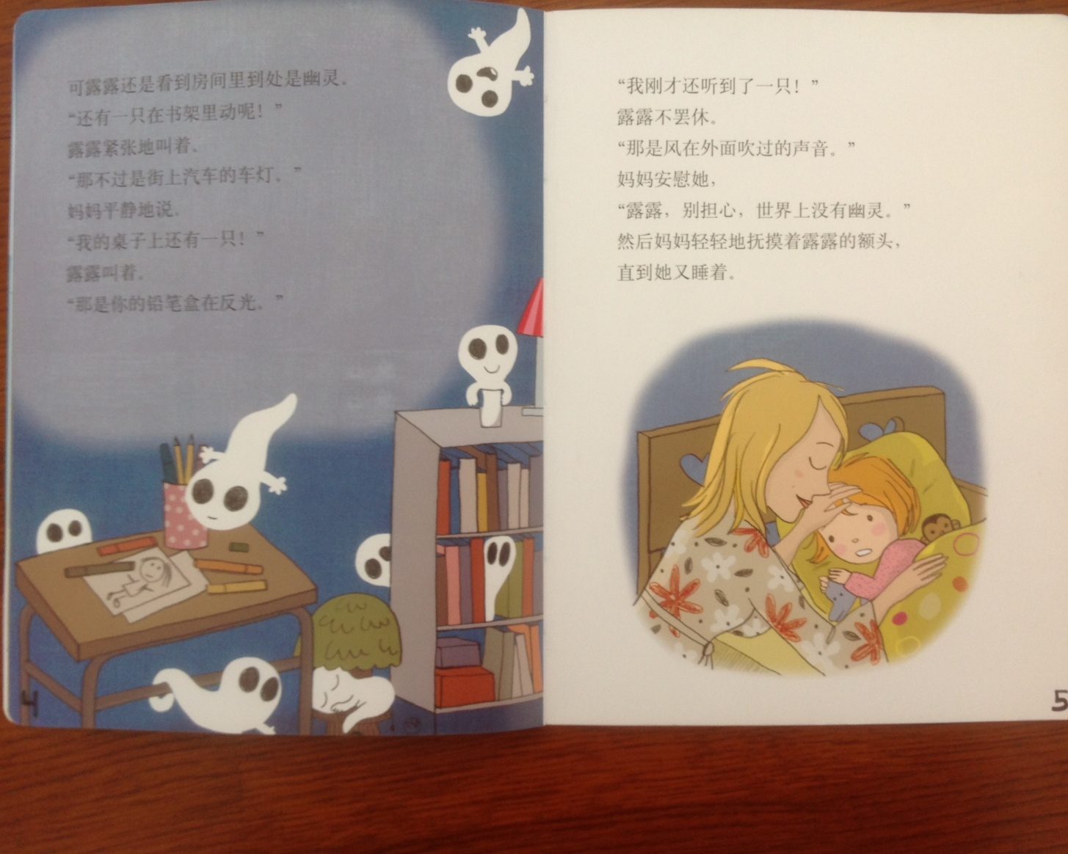
Halloween Story Pages 4 and 5

Slide 15
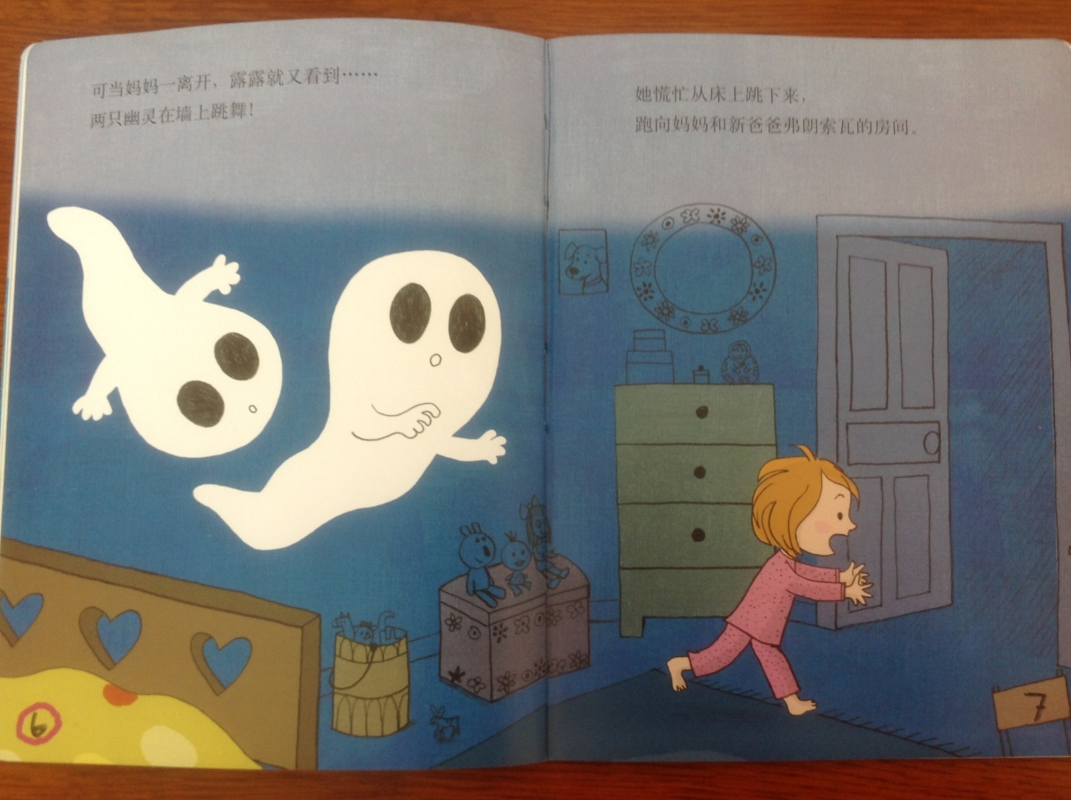
Halloween Story Pages 6 and 7

Slide 16
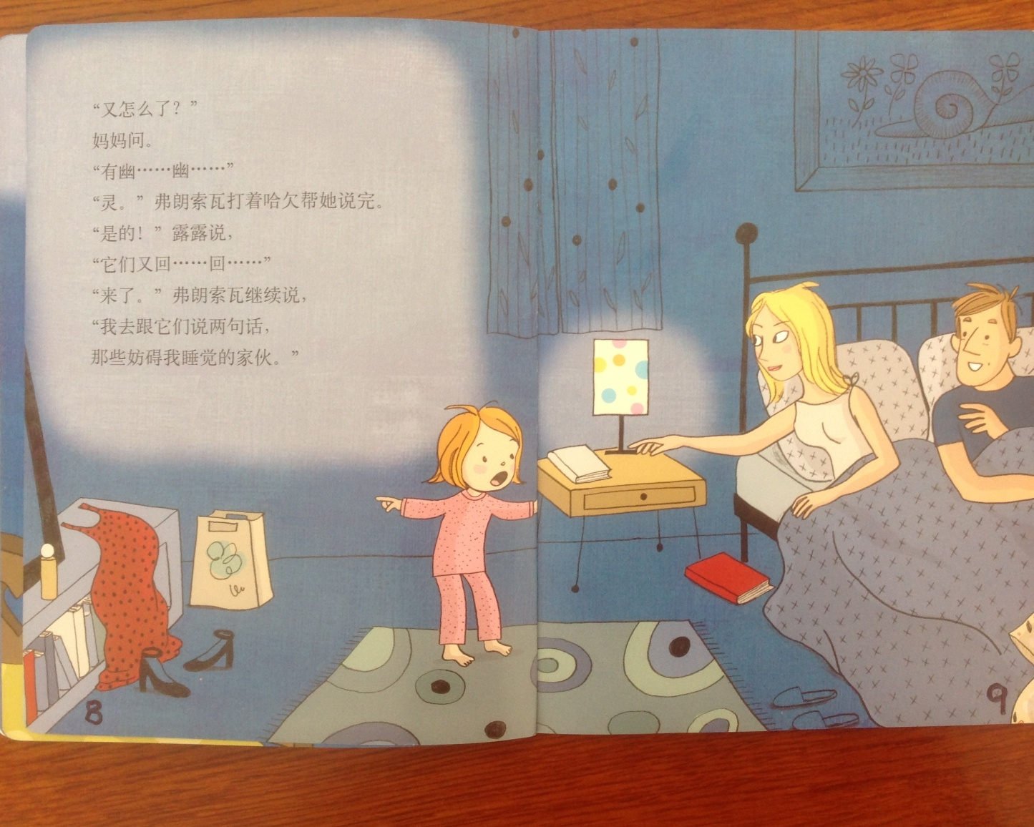
Halloween Story Pages 8 and 9

Slide 17
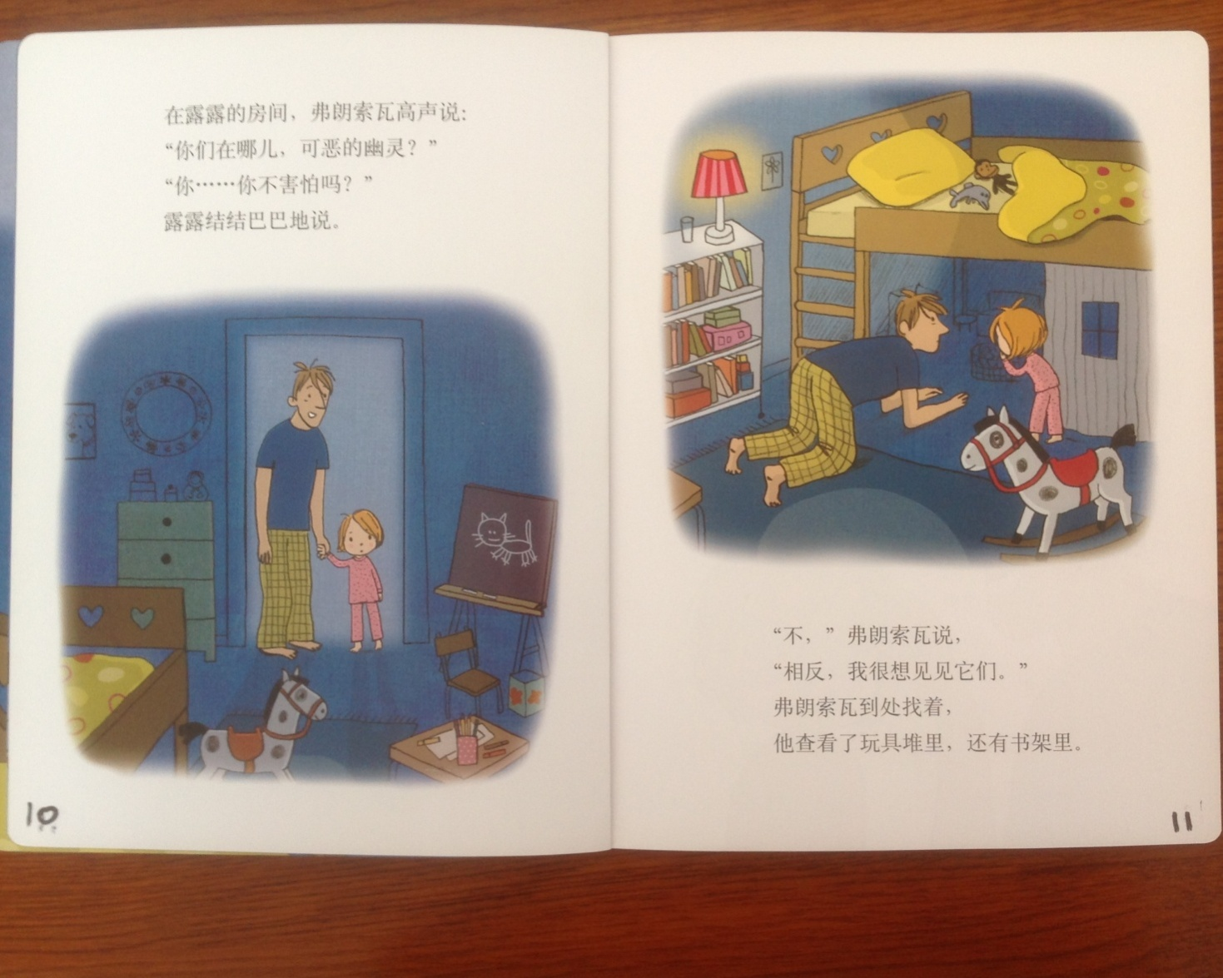
Halloween Story Pages 10 and 11
In Lu Lu’s room, Father speaks in a high voice, “ Where are you bad ghosts?” “Don’t you feel scared?” said Lu Lu.
“No,” Father said, “Just the opposite, I really want to see them!” Frank look here and there; he look through the piles of toys and on the book shelf.

Slide 18
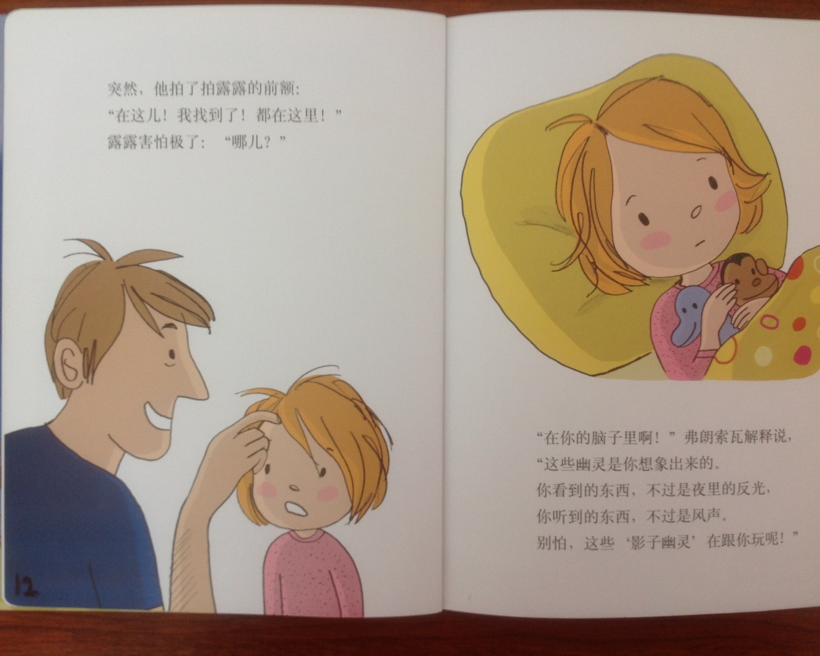
Halloween Story Pages 12 and 13
Abruptly, he patted Lu Lu’s forehead, “Here!! I found it!! All are here, but Lu Lu felt very scared. “ Where?”
“In your brain,” explained Frank, “From your imagination, comes these ghosts!” What you see is nothing but a reflection in the night. What you heard is nothing but the Wooo of the wind. So don’t be scared. The shadow ghosts are just playing with you.

Slide 19
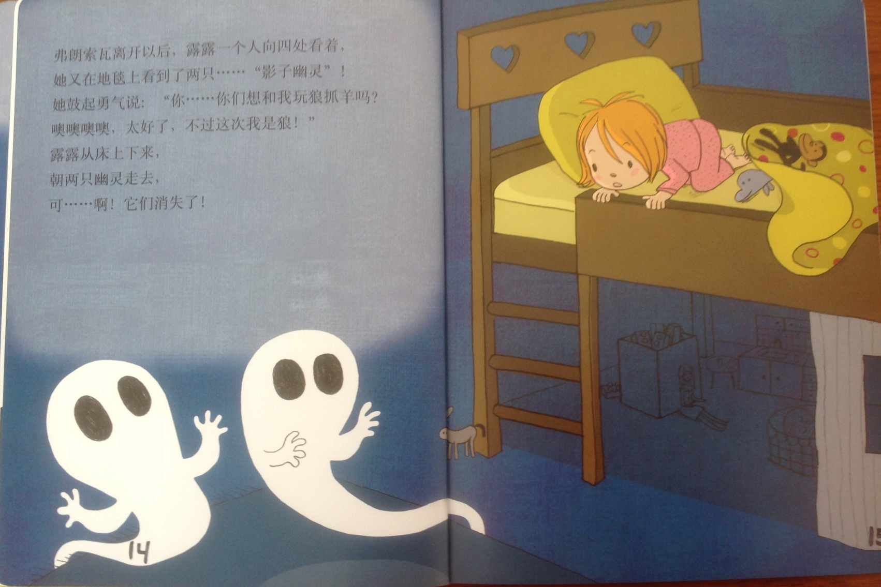
Halloween Story Pages 14 and 15
After Father left, Lu Lu was alone. She looked around and found two “shadow ghosts” on the carpet. She mustered up her courage, “will you two play a game with me? It’s ‘wolf catches the sheep.’ Oh great, this time let me act as the wolf.” Lu Lu left here bed waling towards the ghosts, but they just disappeared.

Slide 20
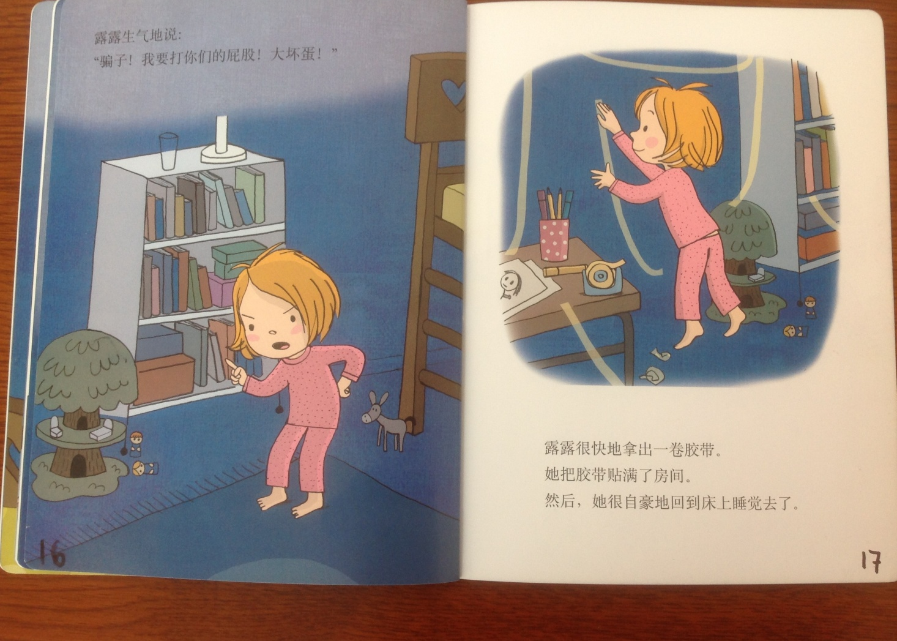
Halloween Story Pages 16 and 17
Lu Lu said angrily, “Lier; I will hit your hip hit—bad guy!”
Lu Lu took out a roll of cellotape and put it up around the room. Then she went to bed with pride.

Slide 21
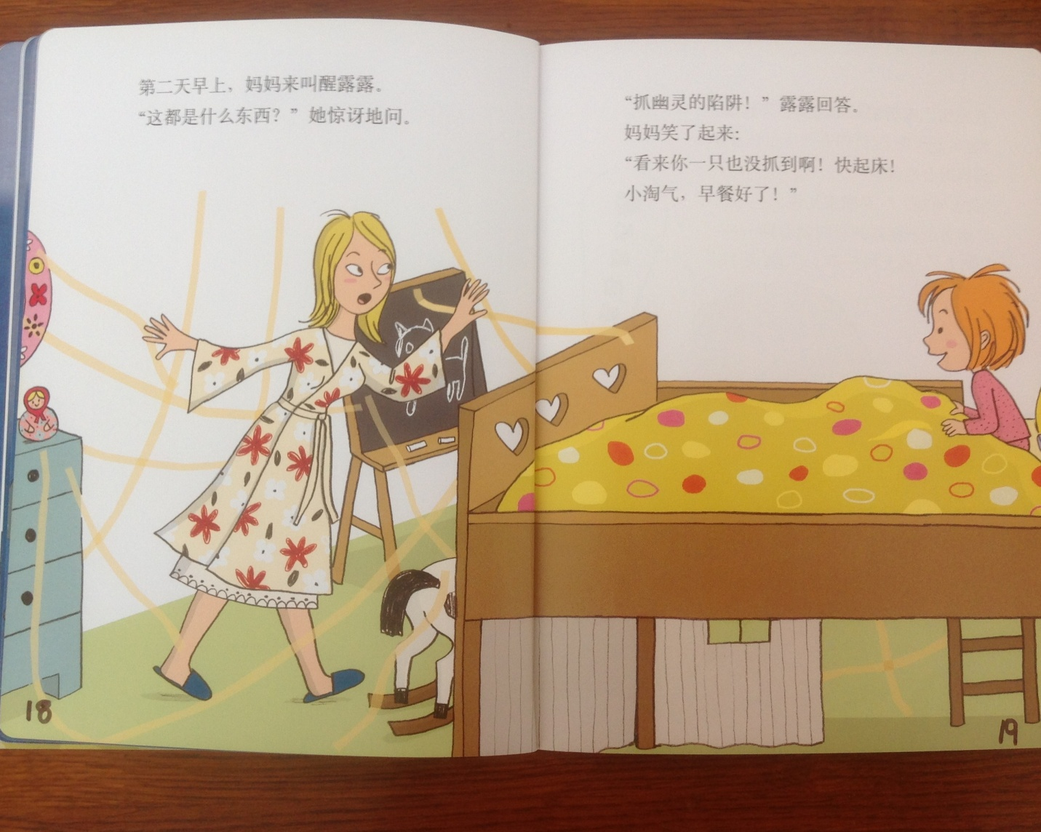
Halloween Story Pages 18 and 19
In the morning, Mother woke up Lu Lu. “What are these?” she asked in amazement.
“A trap for grabbing ghosts,” said Lu Lu.
Mother smiled, “It seemed that you didn’t catch anything; wake up quickly you naughty girl. Breakfast is ready.”

Slide 22
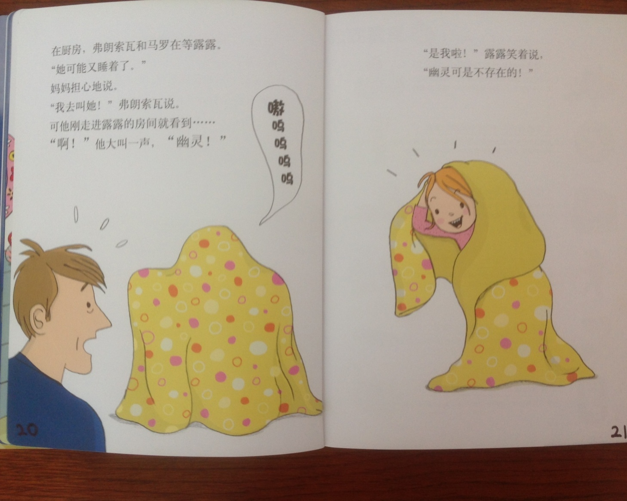
Halloween Story Pages 20 and 21
In the kitchen, Father and Mother were waiting for Lu Lu. “Maybe she fell asleep again,” said Mother. “I’ll wake her up,” said Father. At that moment, he entered the bedroom. He saw…”Oh, he screamed loudly—a ghost!”
“it’s me,” Lu Lu said smiling. There is no ghost.

Slide 23
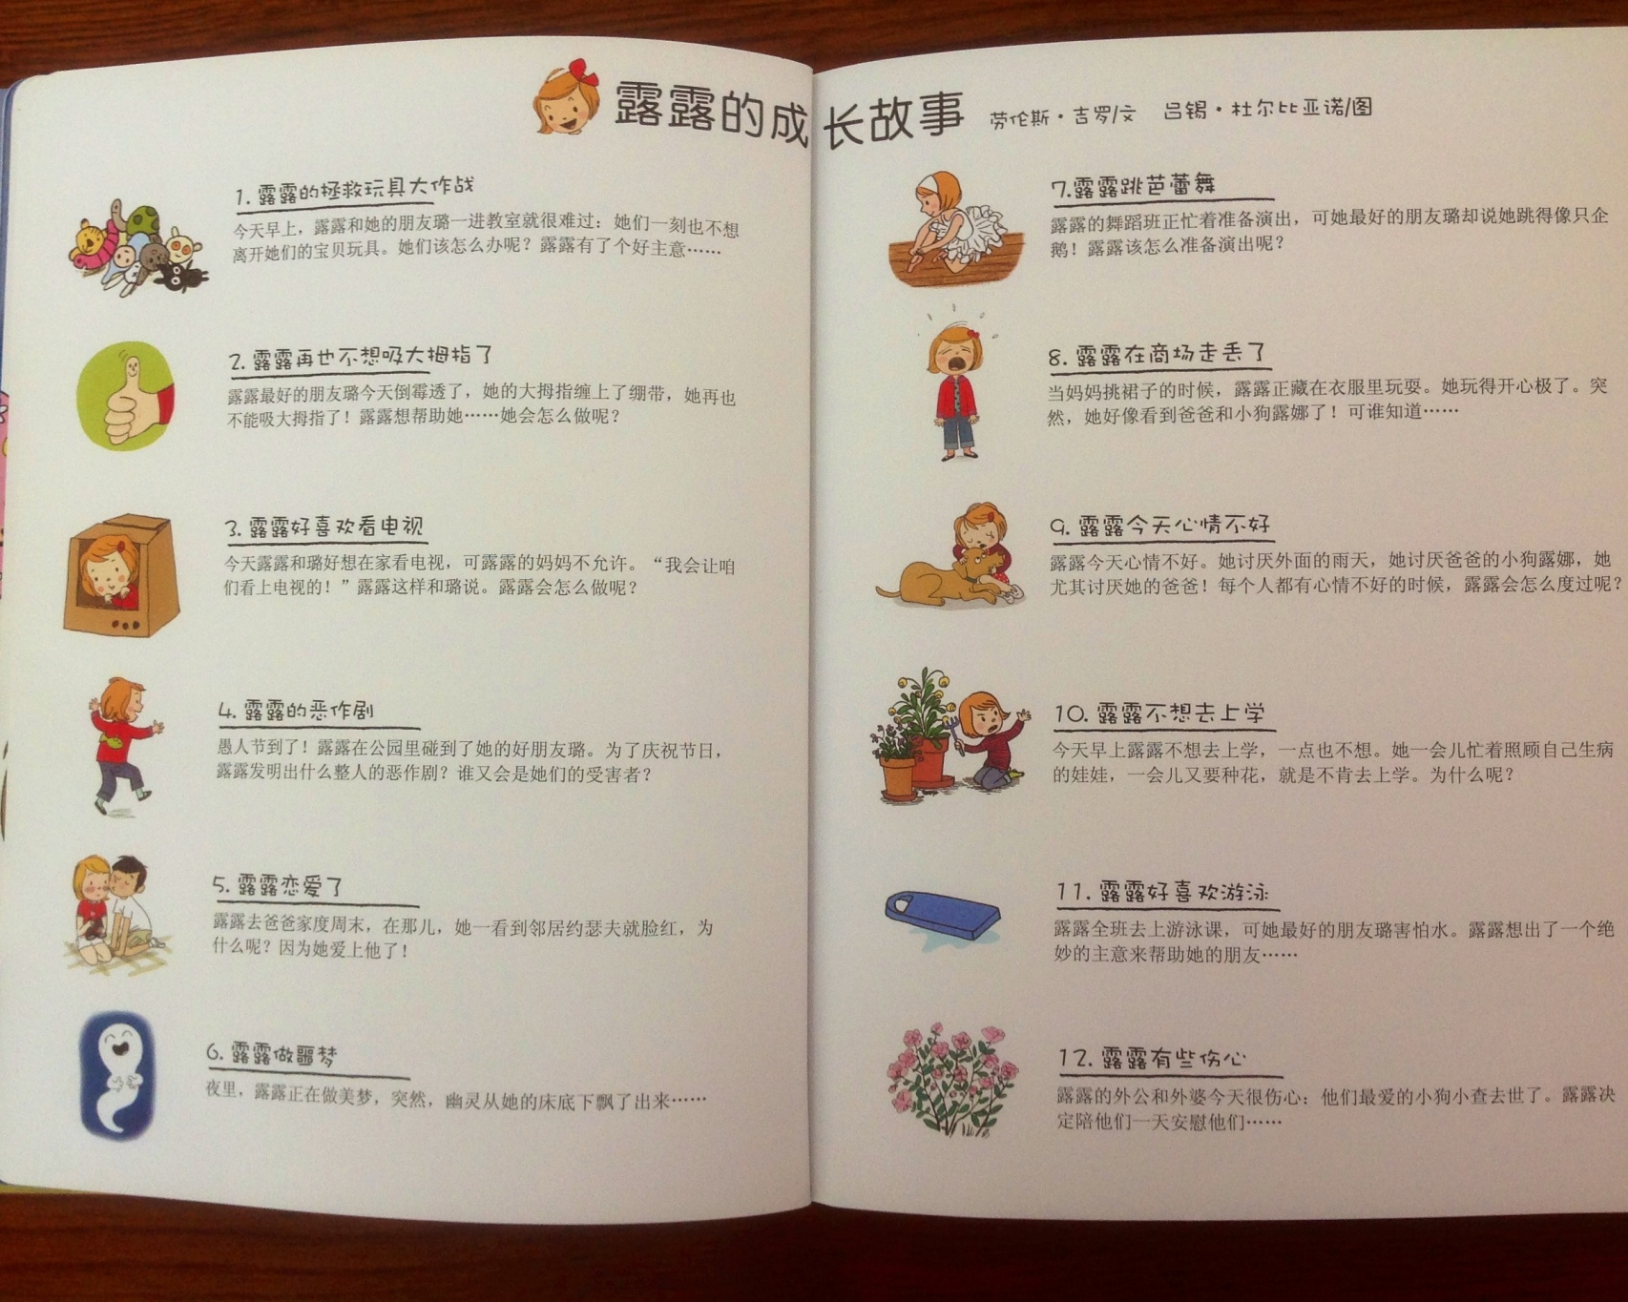
Halloween Story ???

Slide 24

Break

Slide 25
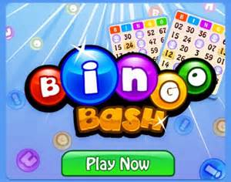
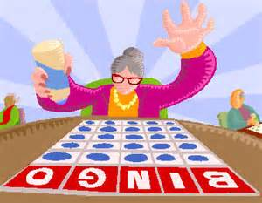
Halloween Bingo
Materials: Bingo Score Card and pen.
Instructions: Halloween related words will be drawn out of a jar. When a word is drawn that matches one of your words, place a X in the corner of that word’s square.
The first person to get five words in any straight line (up and down; across, or diagonal calls out “Bingo.” The person then reads his/her words to verify accuracy. If all are correct; he/she is declared the winner.
Play will then resume until a person has a X in all of his/her squares. If all are correct; he/she is declared the Grand Champion.

Slide 26
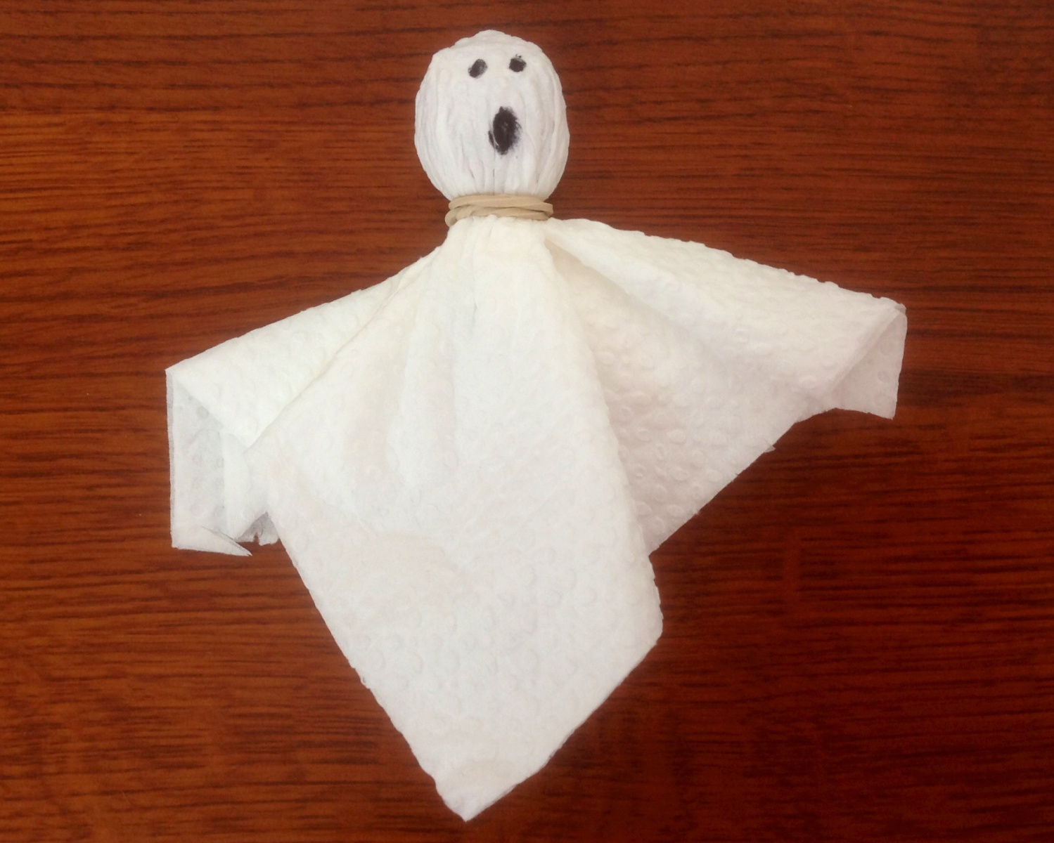
Make a Halloween Ghost
Materials: You will need two napkins, one elastic band, and one sucker. You will also need to share a black marker.
Instructions: Place the sucker inside the double layer of napkins and then wrap the elastic band around the neck. Finally, add eyes and a mouth as desired.
Enjoy eating your ghost!!!

Slide 27

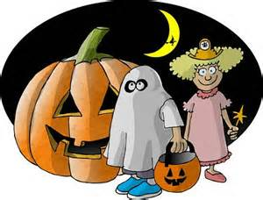
Tell a Scary Story
Instructions:
Share a story about a time that you were really scared. Never been scared? Then make a story up.

Slide 28
Your Discussion Topics
Instructions:
  Form groups of 3-6 so you can face each other.
  In discussing each topic: You will first have 3 minutes to define the topic / problem / issue. Second, you will have 5 minutes to discuss possible solutions. Third, we will select one person from each group to summarize the group’s discussion.
    Topic: Safety Problems—What are they and how can they be fixed?

Slide 29
Talking Cards
Please form groups of 3-5 people.
You will be given a number of playing cards.
In turn, starting with the person whose birthday is closest to today’s date, draw a card from the top of the deck and answer the corresponding question.
Then take turns answering questions, until you have use up all of your cards.
Please speak loudly enough for your group to hear and understand you.

Slide 30
Vocabulary Builders
Instructions:
  Form groups of three or four people.
  Distribute the vocabulary card so each person in your group has one.
  Taking turns, each person then pronounces each word on his/her card.
  When everyone is finished, pass your card one person to the left and then each person pronounces the words on his/new card.
  Repeat the process until everyone has had a chance to pronounce the words on each card.
  Note: If someone needs help pronouncing a word, other group members should provide assistance.

Slide 31
Adjective Opposites Crossword Puzzle
Form groups of 3 or 4.
Working together complete the crossword puzzle; no technology please.
When completed come to the front and check your answers.

Slide 32
What are some of the topics you would like to discuss in class and/or English Corners?

Slide 33
Questions for and from
the Professors.

