Slide 1

Professors John & Marie Murdoch
Welcome to English Corner

Slide 2
Introductions
Please stand and introduce yourself if this is your first English Corner.
What is your name?
Where are you from (hometown)?
What is one thing you did during this past summer?
Tell one thing you like to do in your free time?

Slide 3
English Corner’s Goals
To improve oral English skills—we speak only English.
To improve English listening skills.
To meet new friends.
To build social skills.
To learn about American and Chinese Cultures.
To share ideas and opinions.
Let’s have fun!

Slide 4

Next English Corner
October 29, 2013
7 PM
The next English Corner
will be in Room 218-this same room.

Slide 5
Your Discussion Topics
Instructions:
  Form groups of 3-6 so you can face each other.
  In discussing each topic: You will first have 3 minutes to define the topic / problem / issue. Second, you will have 5 minutes to discuss possible solutions. Third, we will select one person from each group to summarize the group’s discussion.
    Topic: Ways to be in harmony with the people with whom you share living quarters.

Slide 6
Did anyone write a Limerick?
Limericks are short (sometimes serious; sometime silly) poems that are fun to recite.
A: What is a limerick, Mother?
A: It's a form of verse, said brother
B: In which lines one and two
B: Rhyme with five when it's through
A: And three and four rhyme with each other.

Slide 7
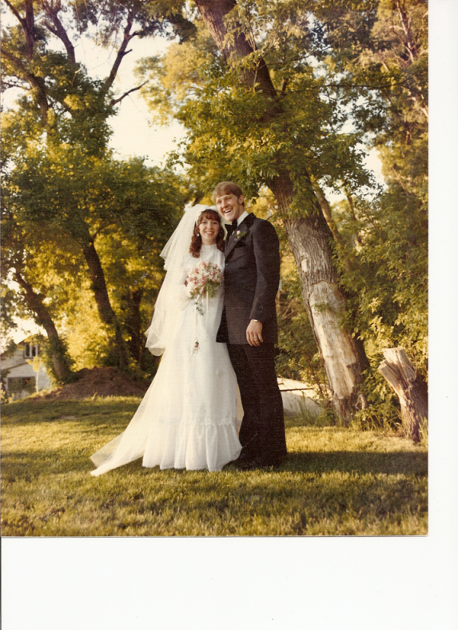
One More Limerick
Limericks are short (sometimes serious; sometime silly) poems that are fun to recite.
A: There was a pretty girl named Marie,
A: Who I hoped my attention she would see,
B: So, I asked her to dance,
B: Oh how we did prance,
A: And my love for her was the key!

Slide 8
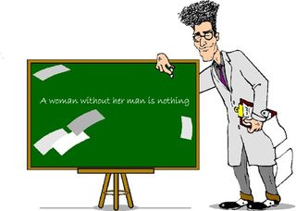
An English professor wrote the words, “woman without her man is nothing” on the blackboard and directed his students to punctuate it correctly.

Slide 9

woman without her man is nothing

Slide 10

Woman, without her man, is nothing.
Woman: without her, man is nothing.

Slide 11

Without each other, men and women would miss the most wonderful part of this life’s experience.

Slide 12
Dating Customs in China & America
China
America
Boy asks girl (few exceptions)
Boy pays for the date.
Dating doesn’t start until age 16
Double or group dating is most common.
Dates may consist of dancing, dinner, playing games, watching a movie, and performing service projects.

Slide 13
Dating Questions
In your groups, please discuss the following:
Polite ways for attracting the attention of someone (of the opposite gender) with whom you wish to become acquainted.
Polite ways for a young man to ask a young woman on a date.
Identify three activities / dates that would be fun, but costs little or no money.
Polite ways to tell someone no thank you when you do not want their attention.
What is the best strategy for dealing with someone who is too aggressive?
What is the role of intimacy in dating?
What is the right age to consider marriage?

Slide 14

JOHNNY LINGO

Slide 15
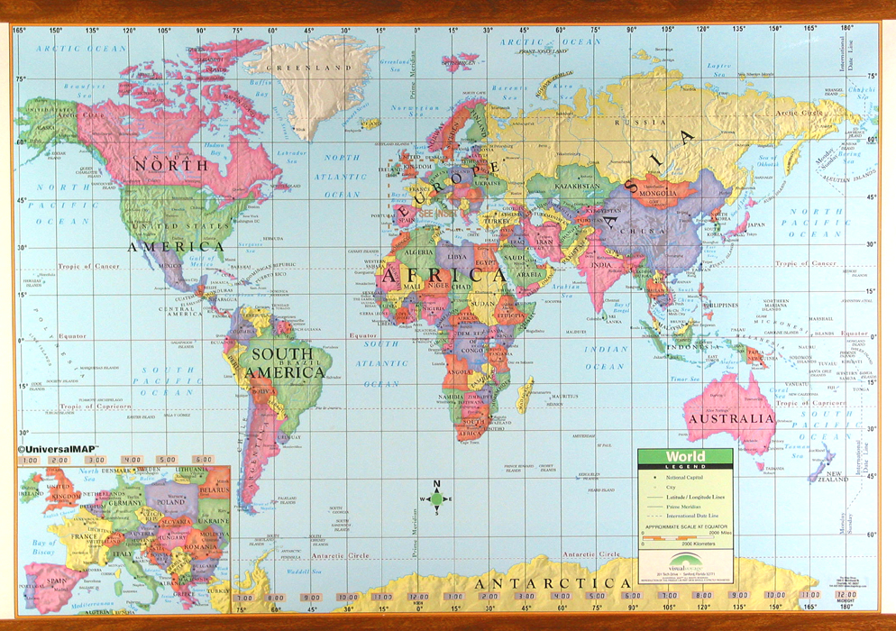

Slide 16
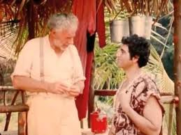
JOHNNY
LINGO
Story Line
In this true story, Johnny Lingo is a shrewd Polynesian trader.
shrewd – smart or wise in business matters
Polynesian - island people
trader – person who buys and sells merchandise
“He is the sharpest trader in all the islands.”
(very smart, bright, similar to shrewd)
The girls all flutter like birds (get excited) when he comes around.

Slide 17
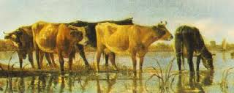
Johnny Lingo has come to the island to bargain for a wife. On this island a man must give cows to his future wife’s father as the marriage settlement.
bargain – make an agreement with future father-in-law on how many cows to give for his wife
settlement - business agreement
3 legged cow – an imperfect cow
A long time ago when this story happened, girls got married very young.

Slide 18
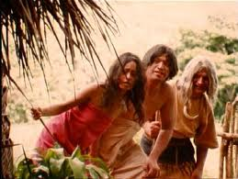
Mahana, the young woman he wants to marry is considered to be foolish and ugly.
foolish - lack of common sense, unwise
ugly – not good looking
She was said to have a face like a stone which would break a mirror if she looked in it.
“She looks like she’s missed too many meals.” (she is too thin).
“…the little shadow (ying zi) who comes in who comes in every once in a while for a spool of thread.”

Slide 19

Break

Slide 20
Why did Mahanna feel she was of so little
worth?
Why did the other people in the village
think Mahanna was of so little worth?
Why did Johnny Lingo pay more than
any other bridegroom had paid?
Why did payment of the 8 cows make
such a difference in the way Mahanna
thought of herself?
Did Johnny Lingo pay too much?
Have you known any Johnny Lingos
in your life?
7. Have you known any Mahannas in your
life that you could or have helped?

Slide 21

Treat a person as he is and
he will remain as he is.
Treat him as he could be and
he will become what he should be.

Slide 22
Talking Cards
Please form groups of 3-5 people.
You will be given a number of playing cards.
In turn, starting with the person whose birthday is closest to today’s date, draw a card from the top of the deck and answer the corresponding question.
Then take turns answering questions, until you have use up all of your cards.
Please speak loudly enough for your group to hear and understand you.

Slide 23
Vocabulary Builders
Instructions:
  Form groups of three or four people.
  Distribute the vocabulary card so each person in your group has one.
  Taking turns, each person then pronounces each word on his/her card.
  When everyone is finished, pass your card one person to the left and then each person pronounces the words on his/new card.
  Repeat the process until everyone has had a chance to pronounce the words on each card.
  Note: If someone needs help pronouncing a word, other group members should provide assistance.

Slide 24
Adjective Opposites Crossword Puzzle
Form groups of 3 or 4.
Working together complete the crossword puzzle; no technology please.
When completed come to the front and check your answers.

Slide 25
What are some of the topics you would like to discuss in class and/or English Corners?

Slide 26
Questions for and from
the Professors.

