Slide 1

Professors John & Marie Murdoch
Welcome to English Corner

Slide 2
Introductions
Please stand and introduce yourself if this is your first English Corner.
What is your name?
Where are you from (hometown)?
What is one thing you did during this past summer?
Tell one thing you like to do in your free time?

Slide 3
English Corner’s Goals
To improve oral English skills—we speak only English.
To improve English listening skills.
To meet new friends.
To build social skills.
To learn about American and Chinese Cultures.
To share ideas and opinions.
Let’s have fun!

Slide 4

Next English Corner
October 15, 2013
7 PM
The next English Corner
will be in Room 218-this same room.

Slide 5
Did anyone write a Limerick?
Limericks are short (sometimes serious; sometime silly) poems that are fun to recite.
A: What is a limerick, Mother?
A: It's a form of verse, said brother
B: In which lines one and two
B: Rhyme with five when it's through
A: And three and four rhyme with each other.

Slide 6
Now write your own limerick.
No technology please!
In your group write a limerick using the following pattern:
Limericks usual form consists of five lines with the rhyme scheme aabba;
lines 1, 2, and 5 contain 8 syllables and rhyme with each other;
lines 3 and 4 usually contain 6 syllables and rhyme with each other.

Slide 7
Your Discussion Topics
Instructions:
  Form groups of 3-6 so you can face each other.
  In discussing each topic: You will first have 3 minutes to define the topic / problem / issue. Second, you will have 5 minutes to discuss possible solutions. Third, we will select one person from each group to summarize the group’s discussion.
    First Topic: Strategies for securing a well pay job during college years and after graduation.
    Second Topic: Ways to be in harmony with the people with whom you share living quarters.

Slide 8

Break

Slide 9


Slide 10
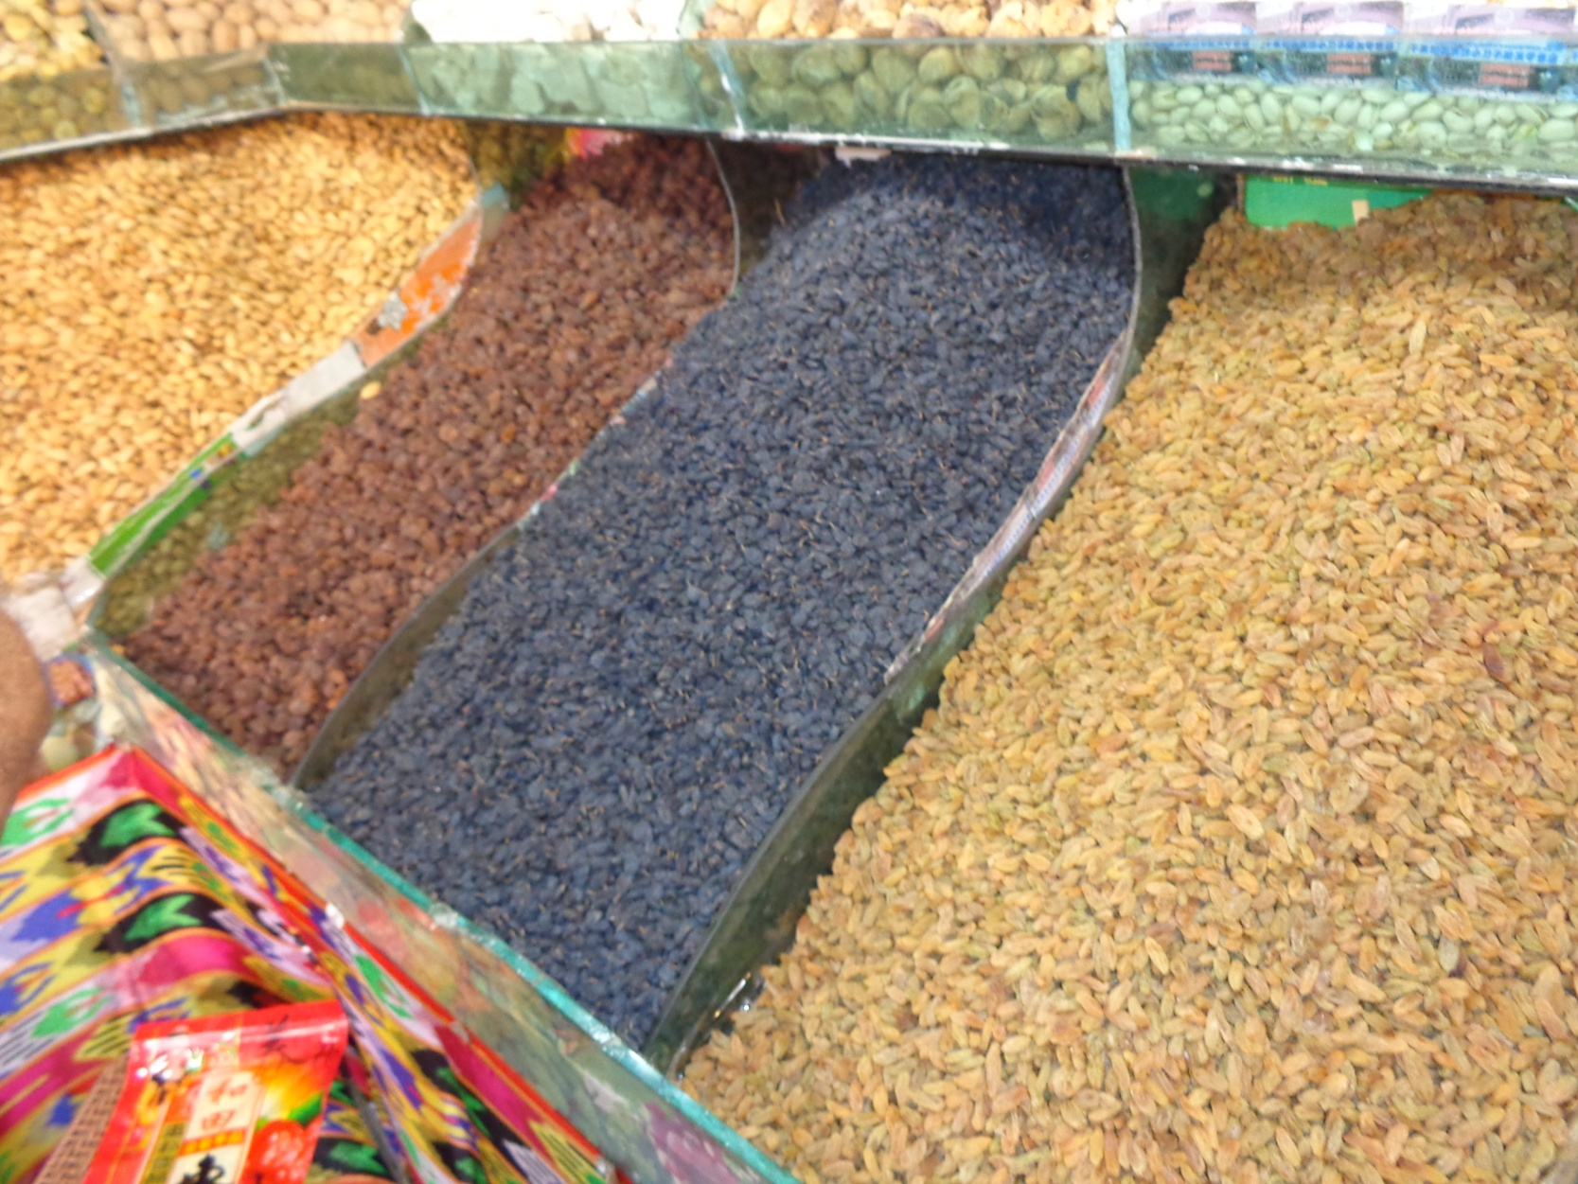
Famous Raisins

Slide 11
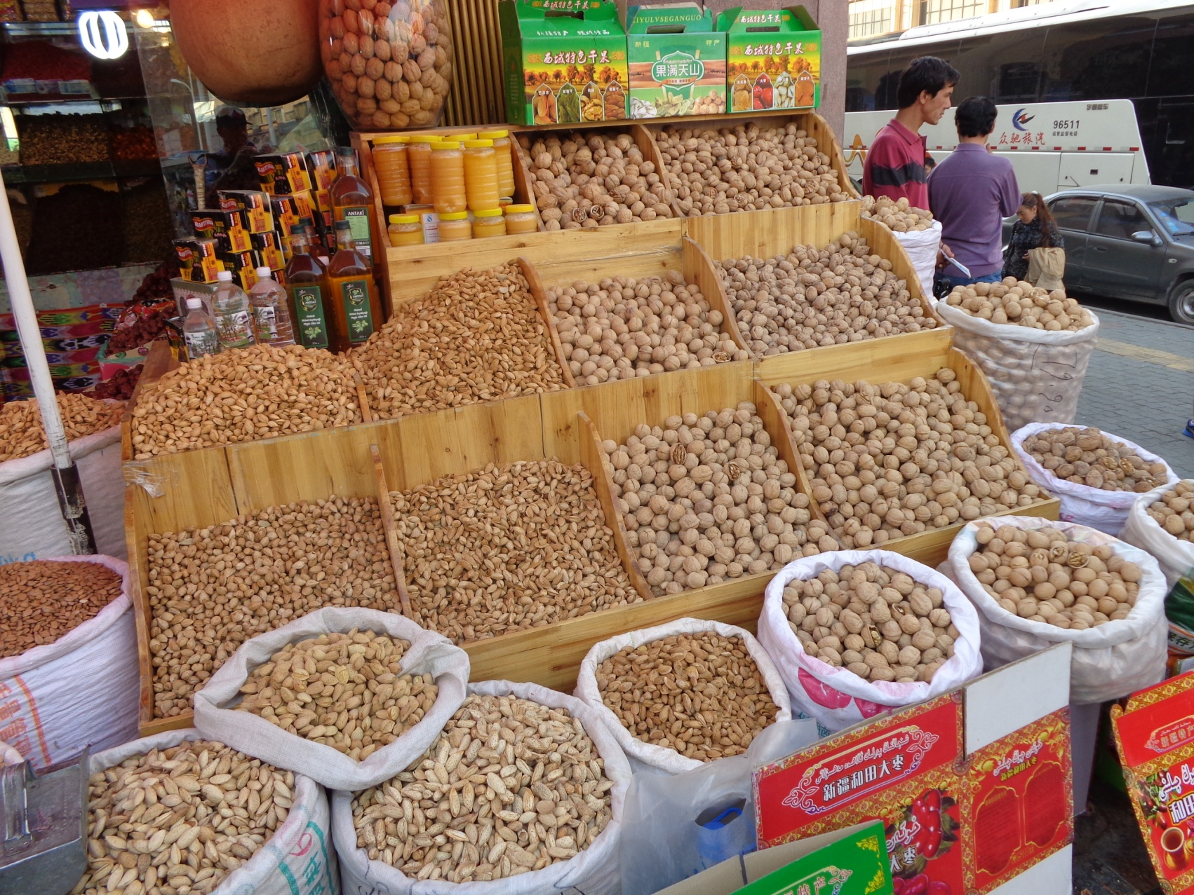
Famous Nuts

Slide 12
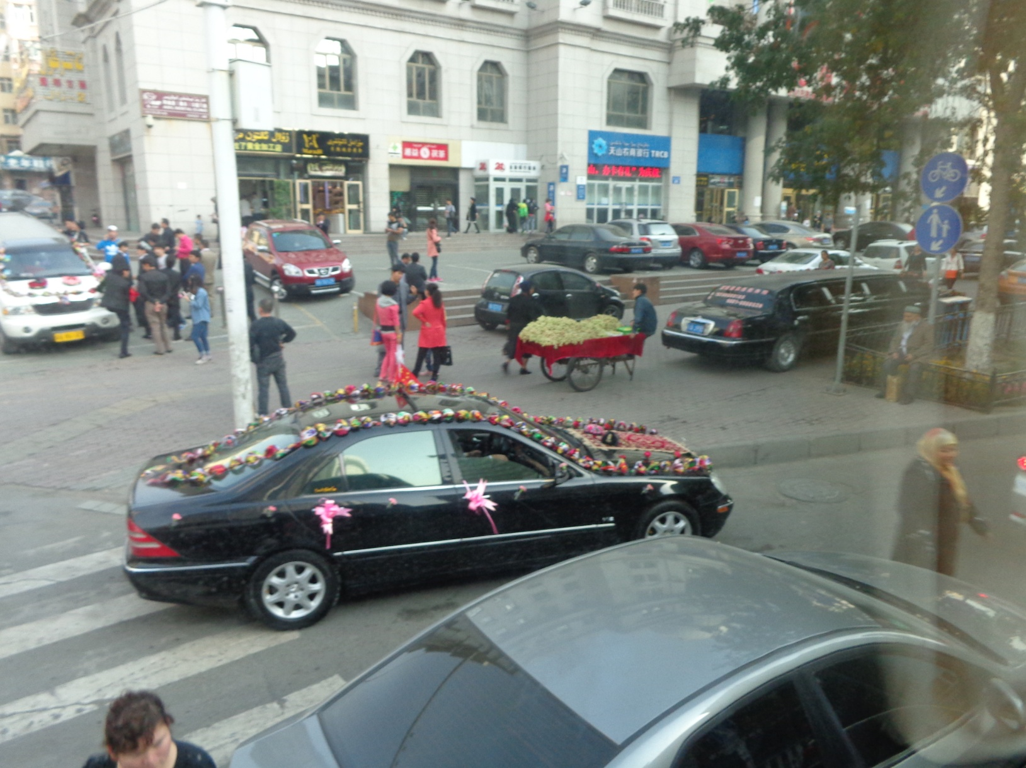
Wedding Celebrations

Slide 13
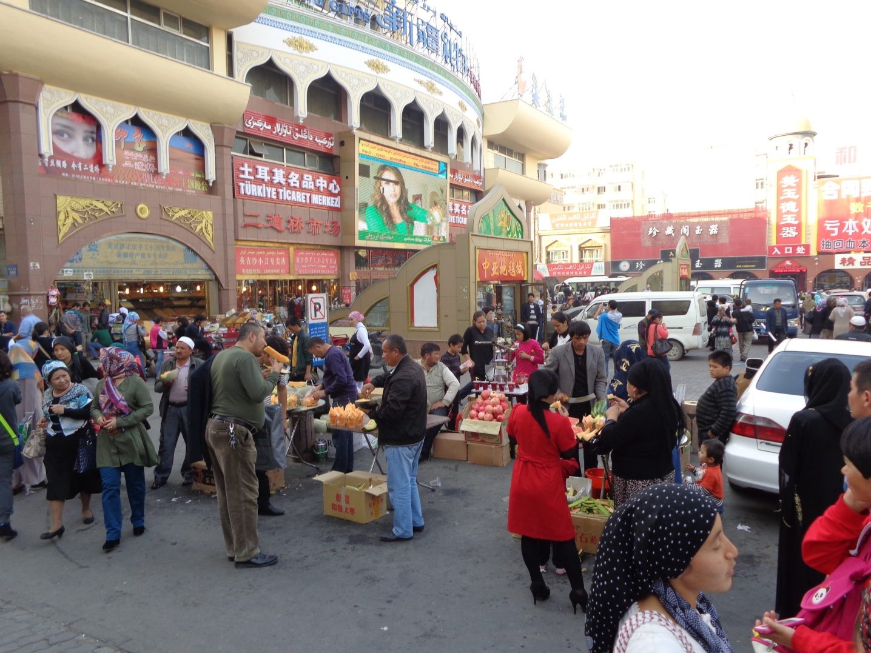
Bazaars

Slide 14
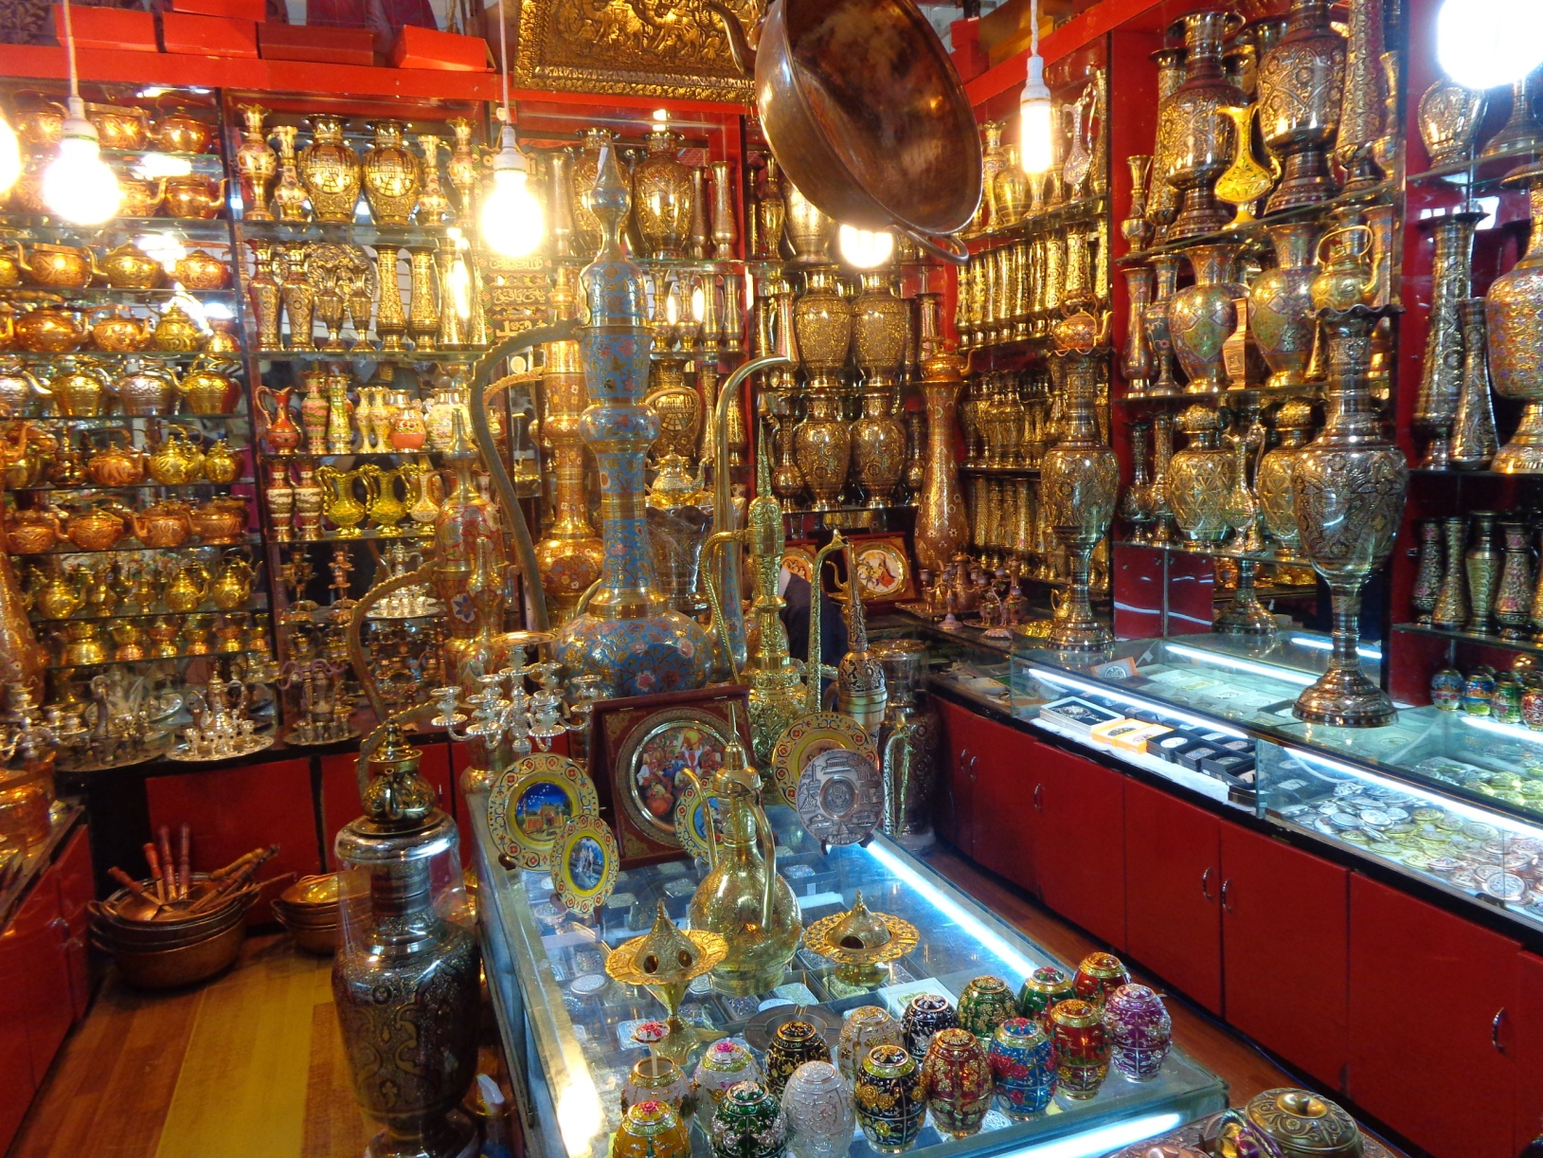
Beautiful Bronze

Slide 15

Beautiful Art Work

Slide 16
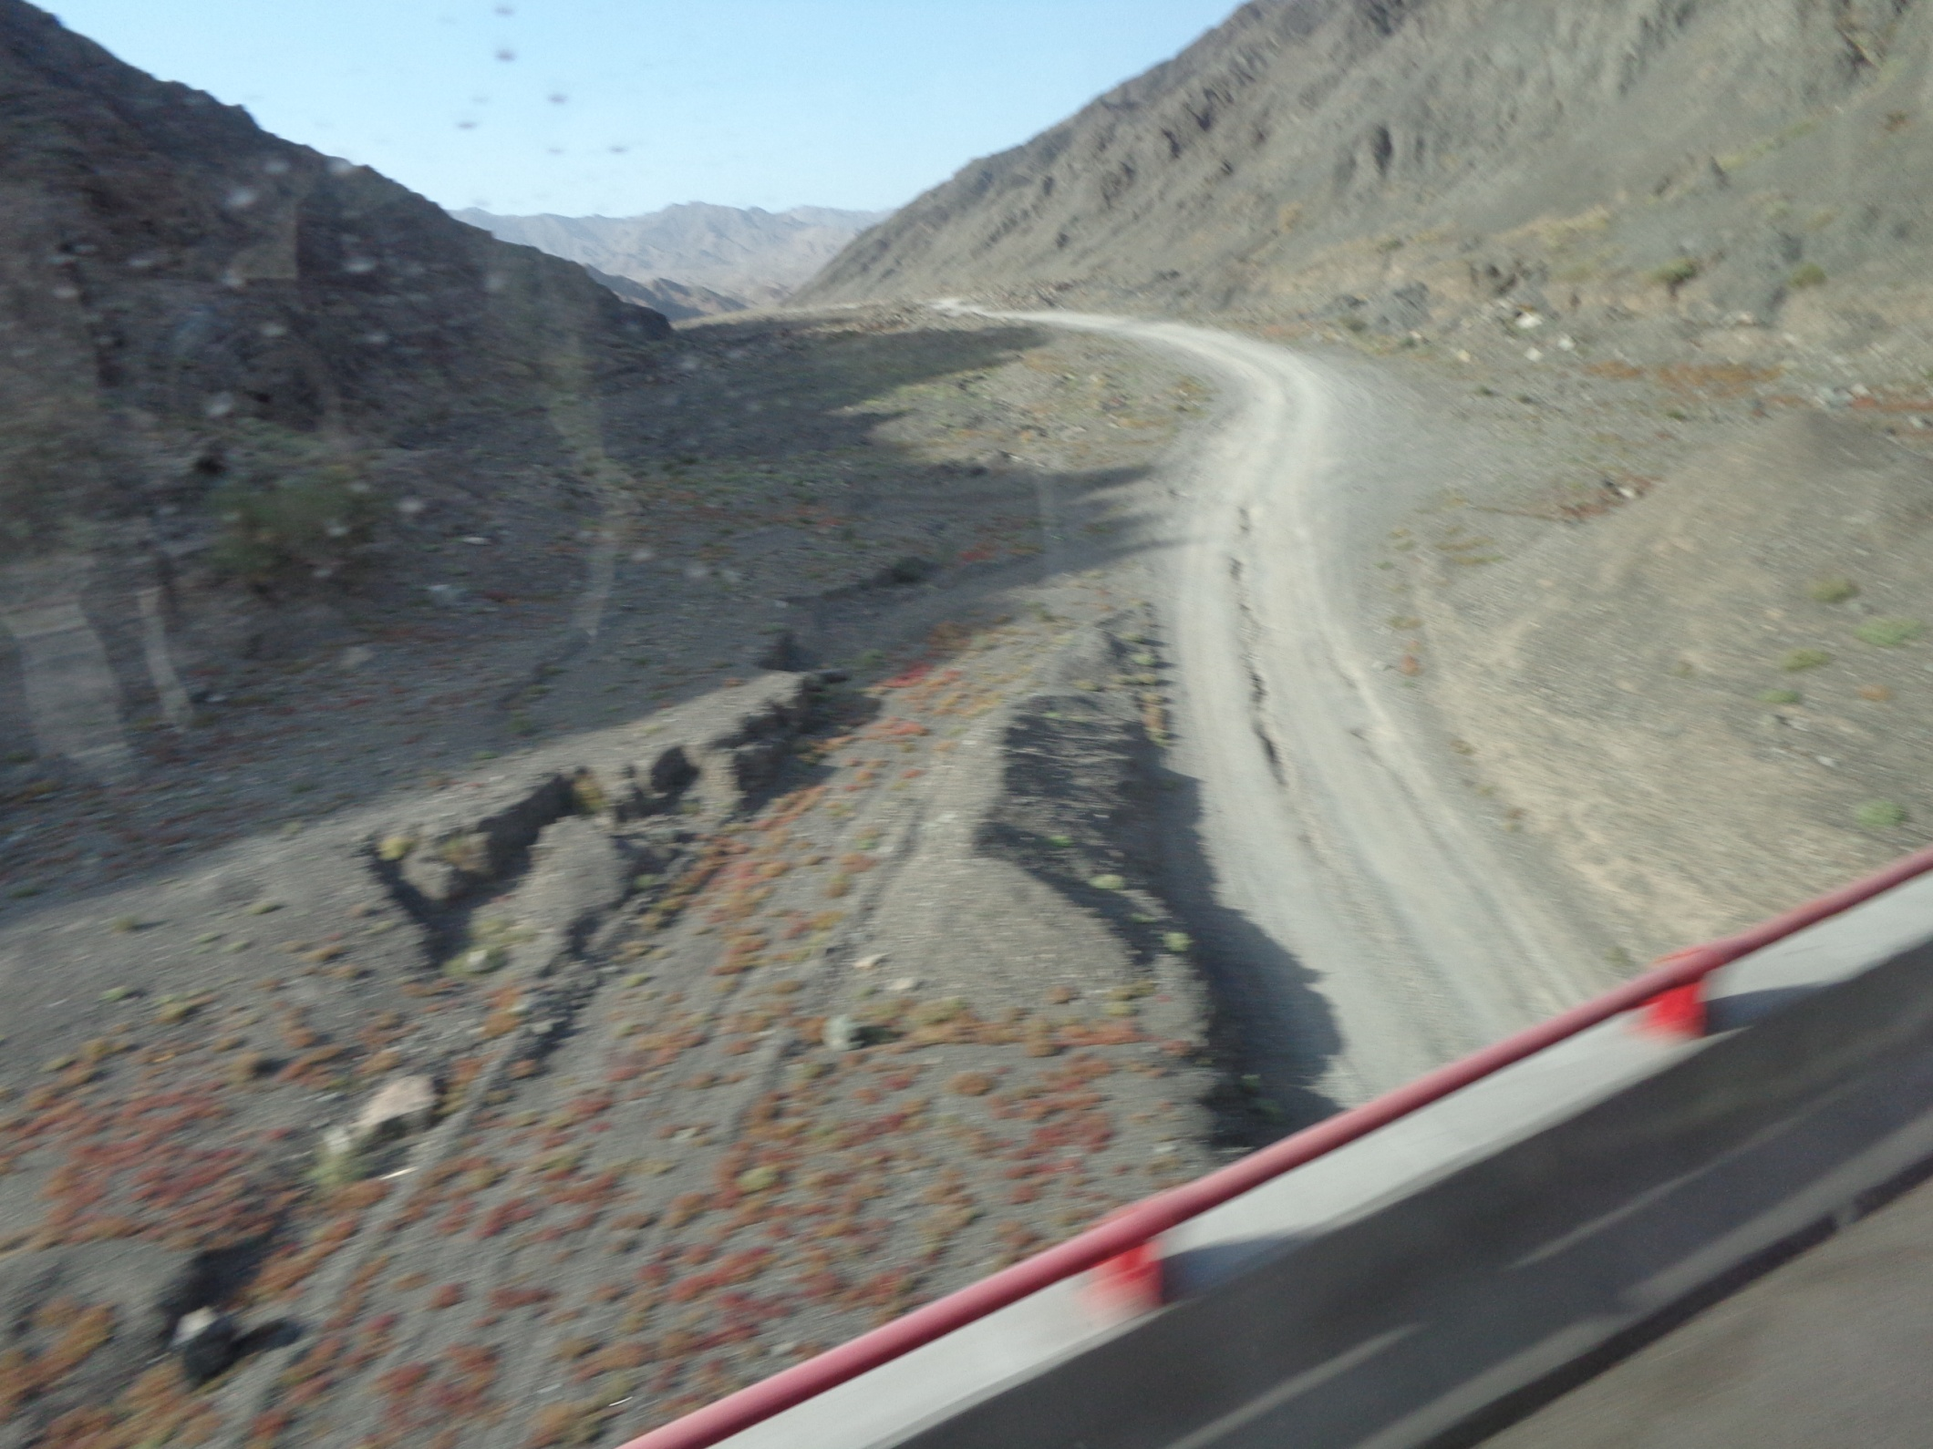
Remote Roads

Slide 17
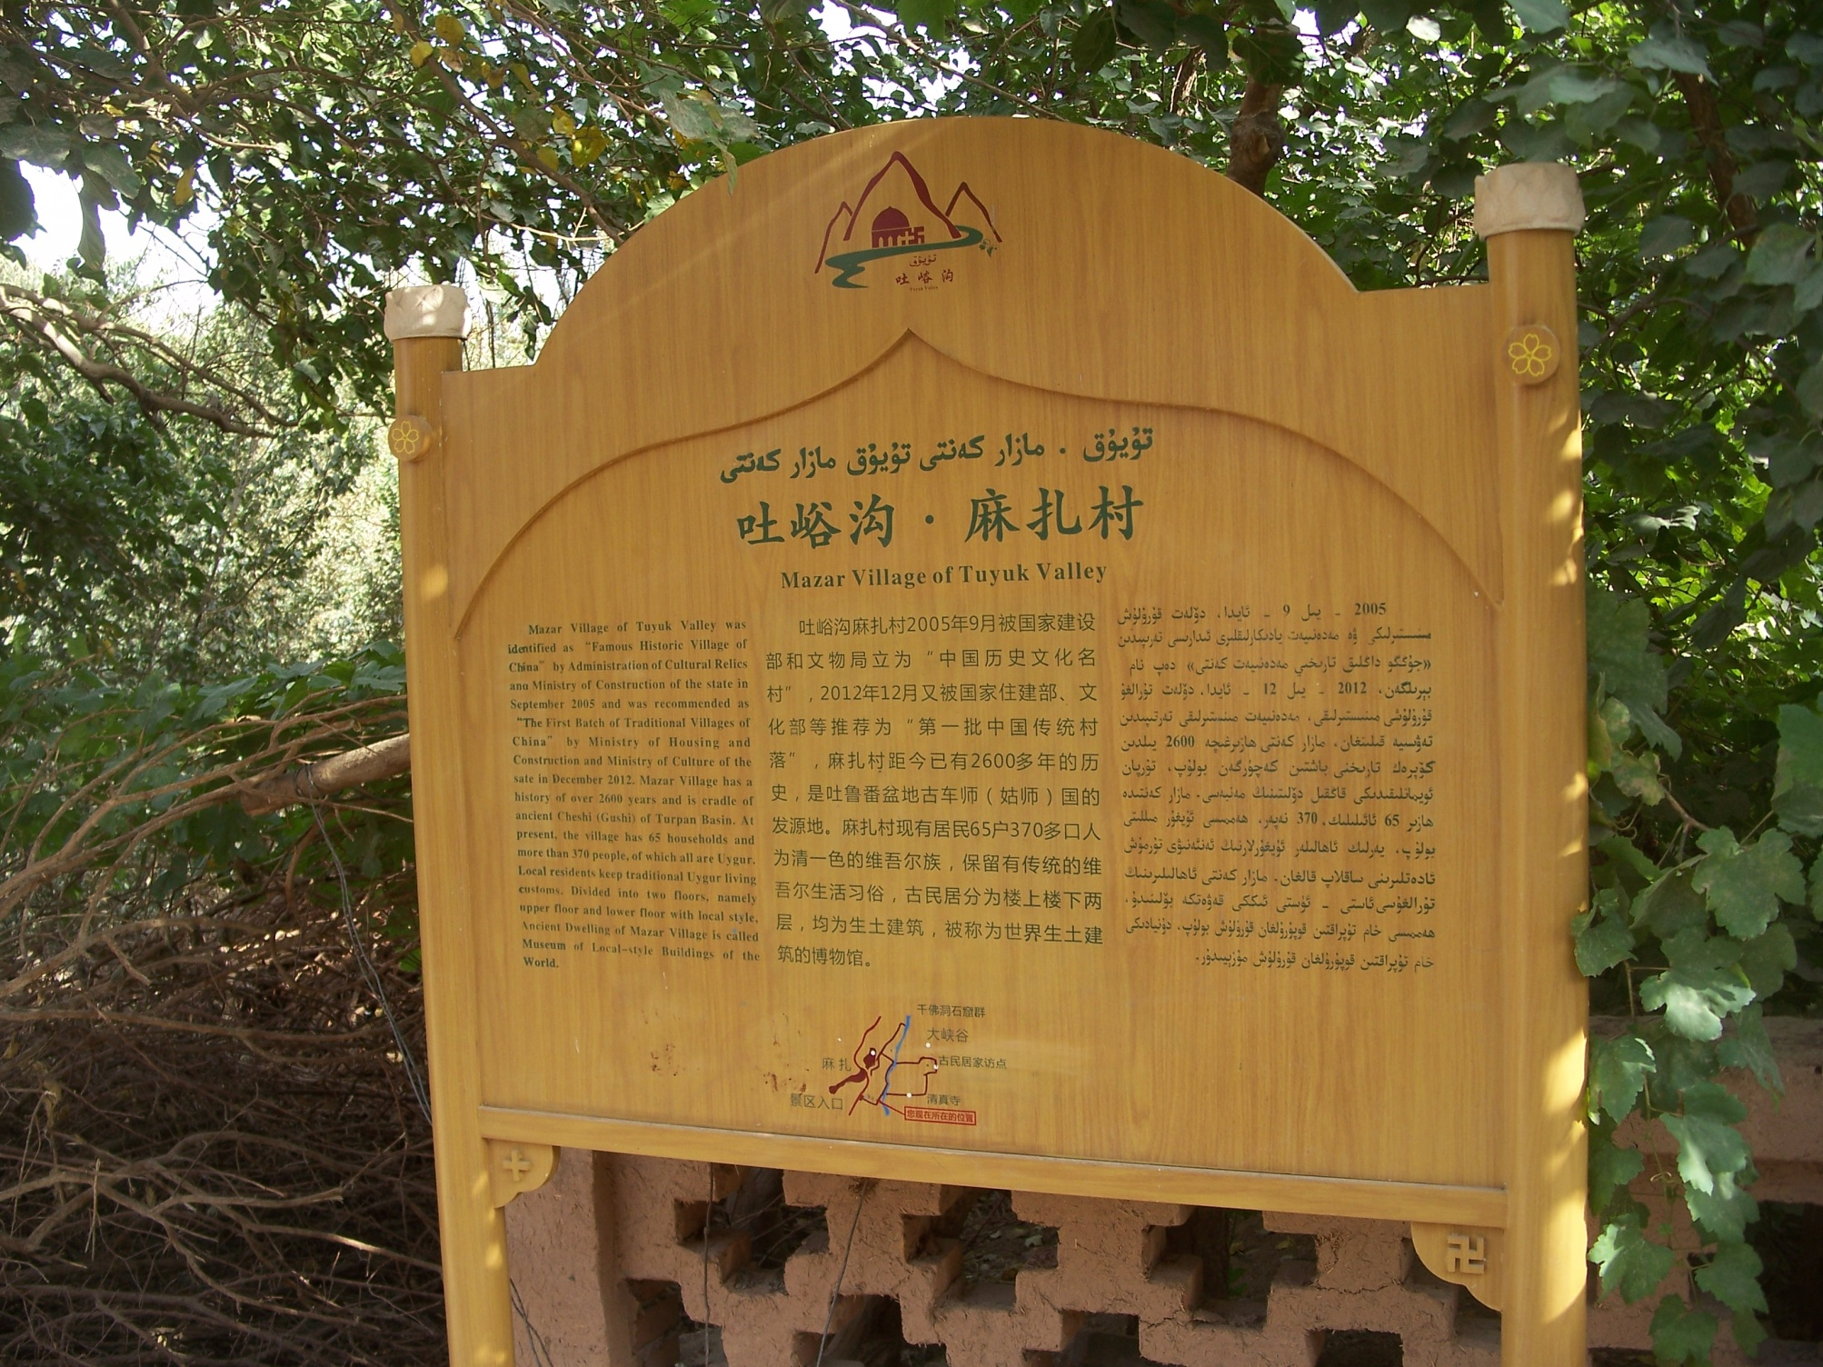
Mazar Village

Slide 18
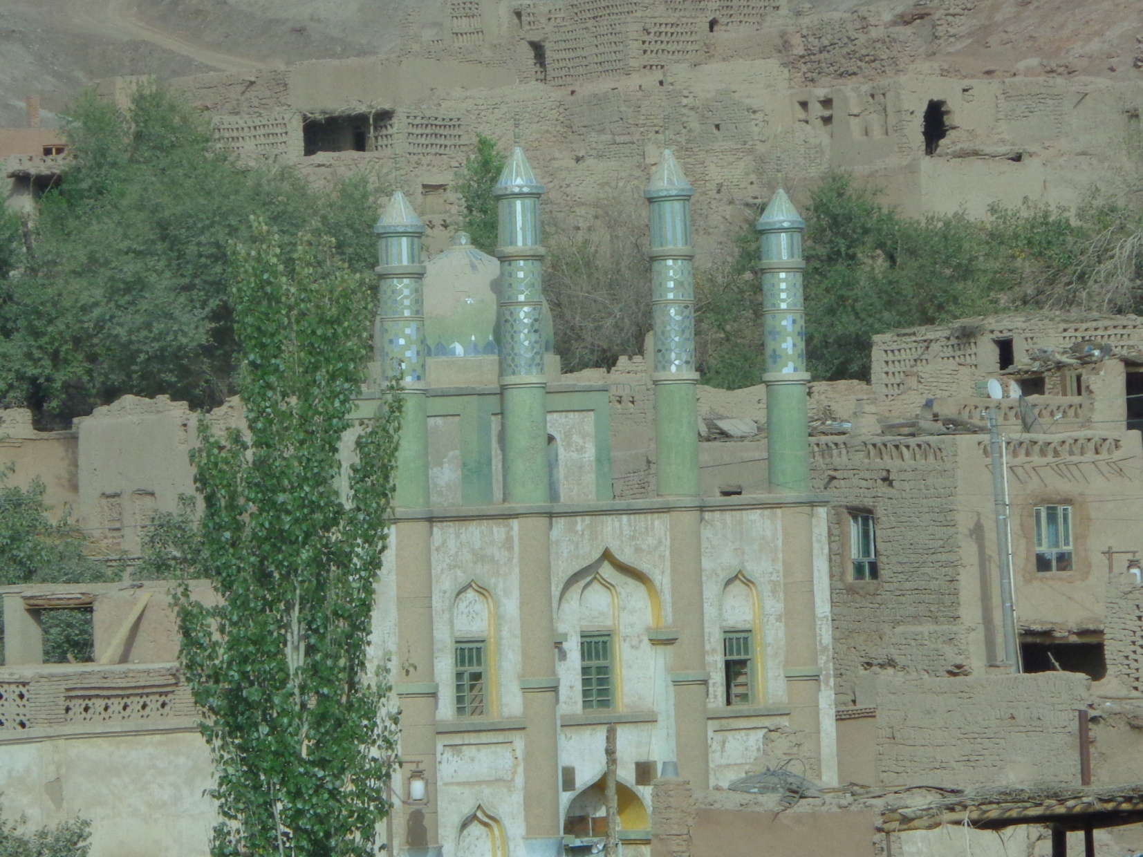
Ughur Village Sacred Shrine

Slide 19
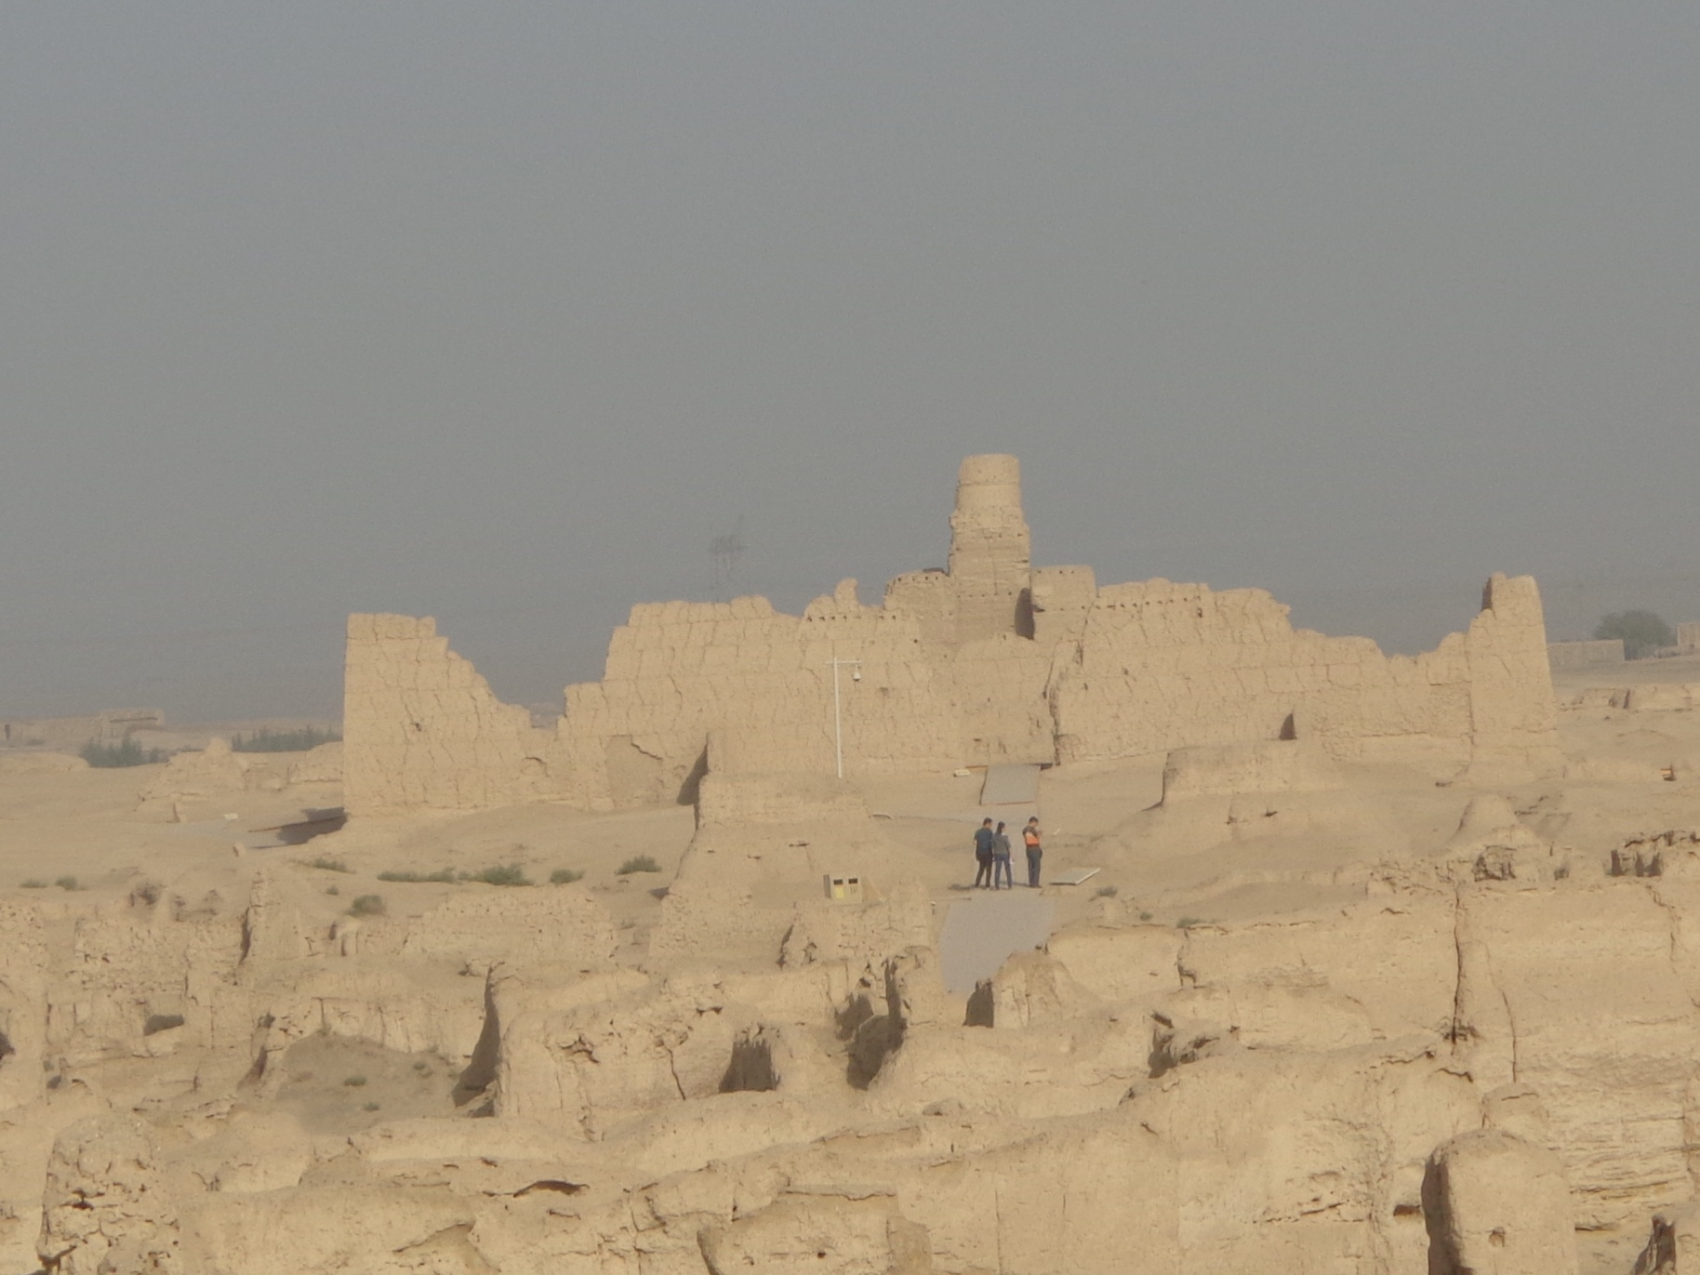
Yar City Sacred Shrine

Slide 20
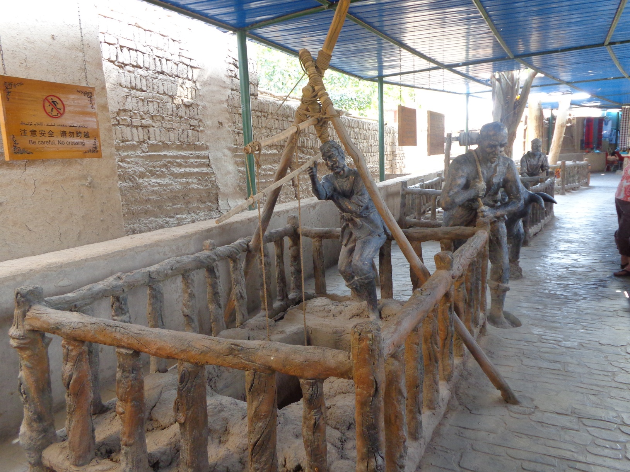
Karez Ancient Irrigation Project

Slide 21
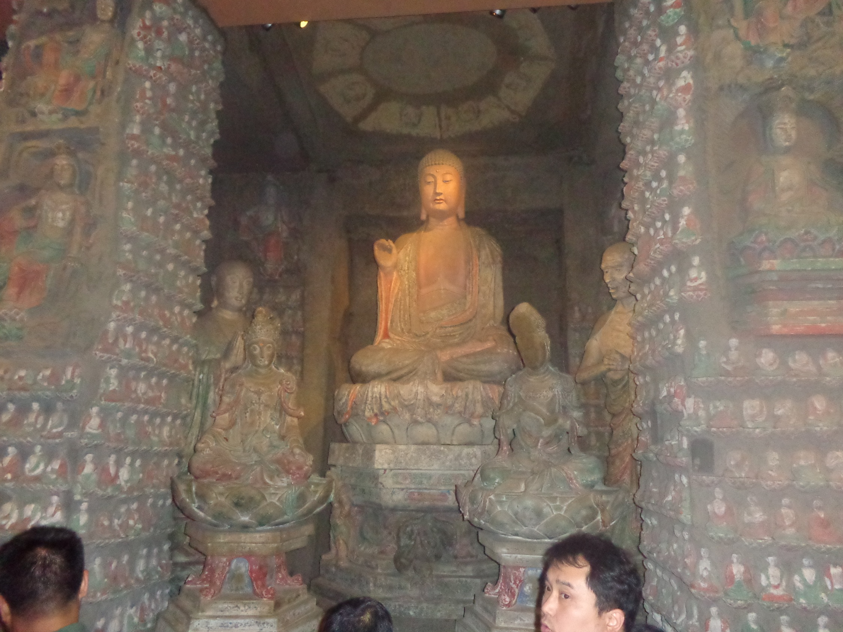
Mogao Grottos--Sacred Shrine

Slide 22
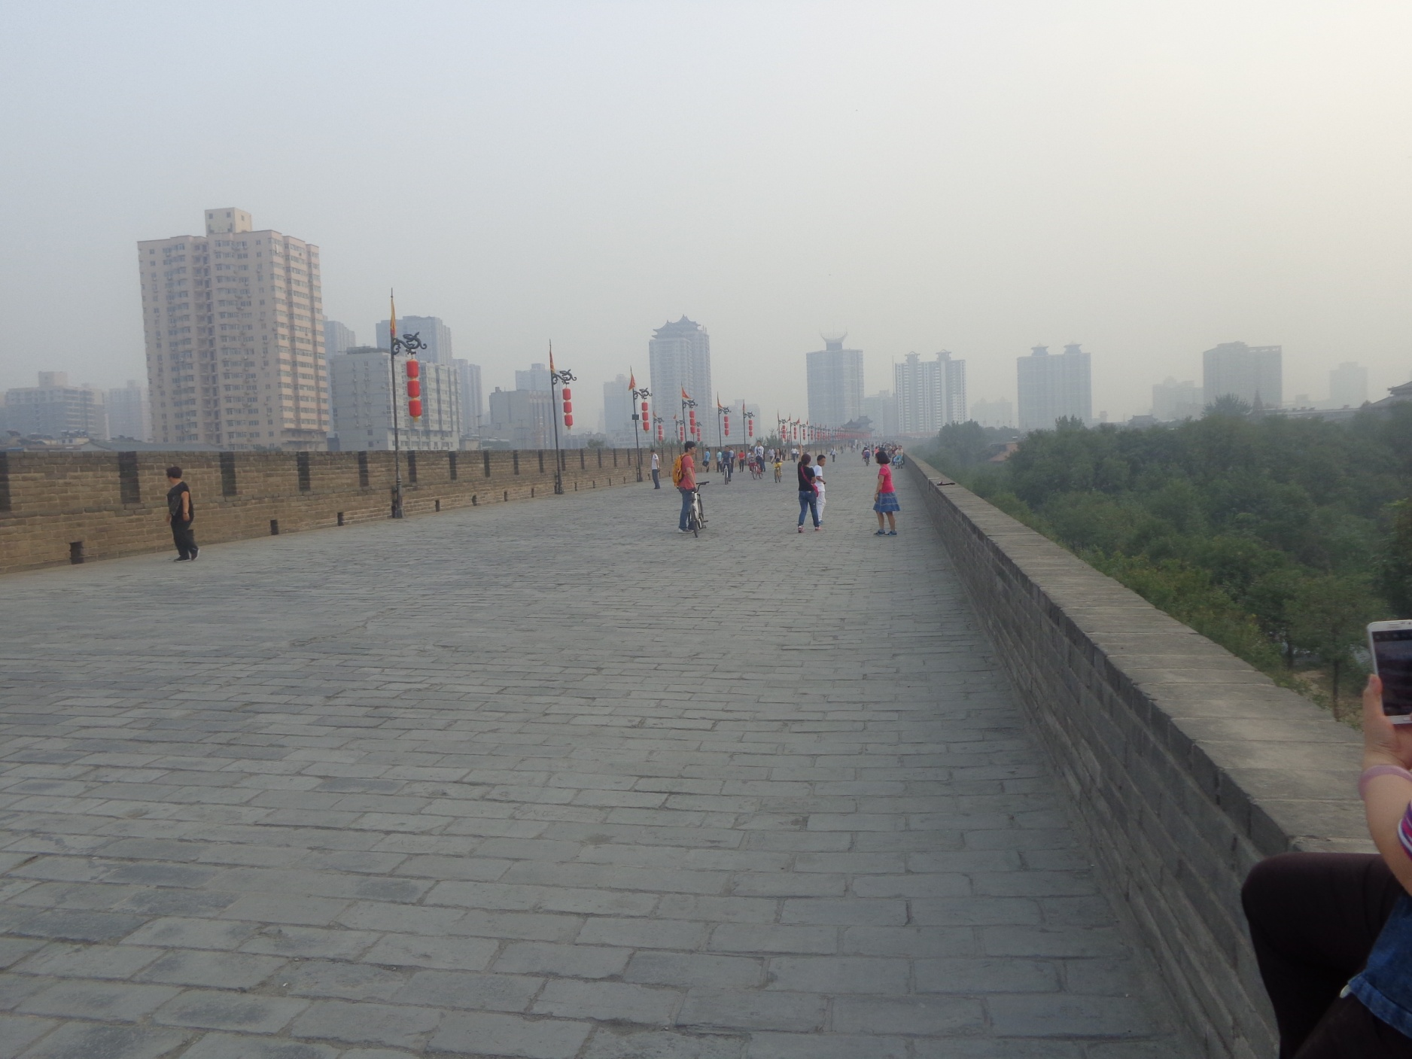
Xi’an City Wall

Slide 23
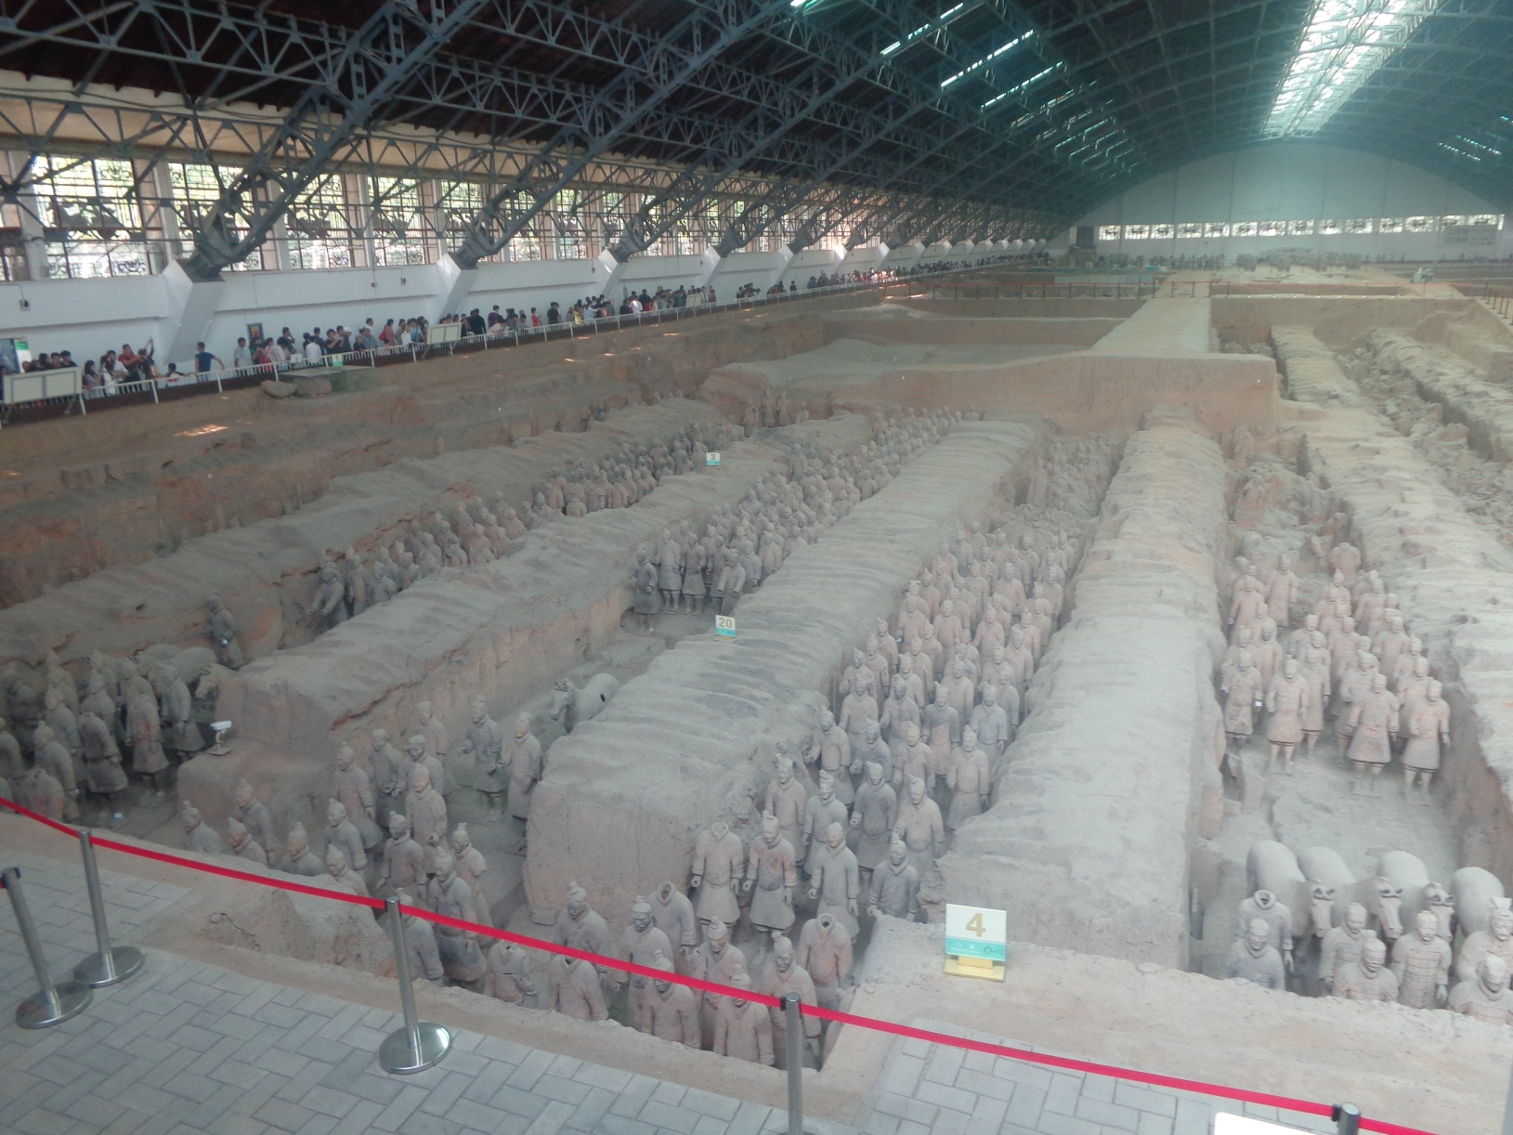
Terra-cotta Warriors
8th Wonder of the World

Slide 24
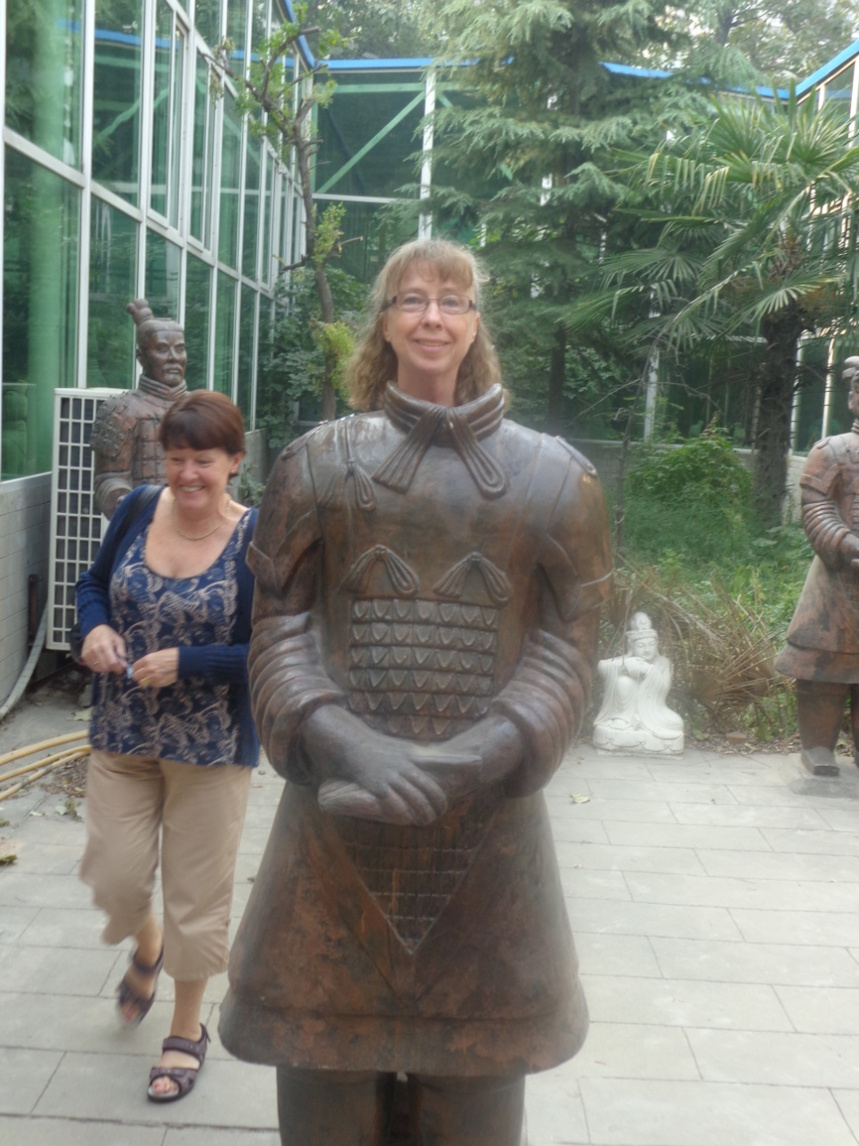
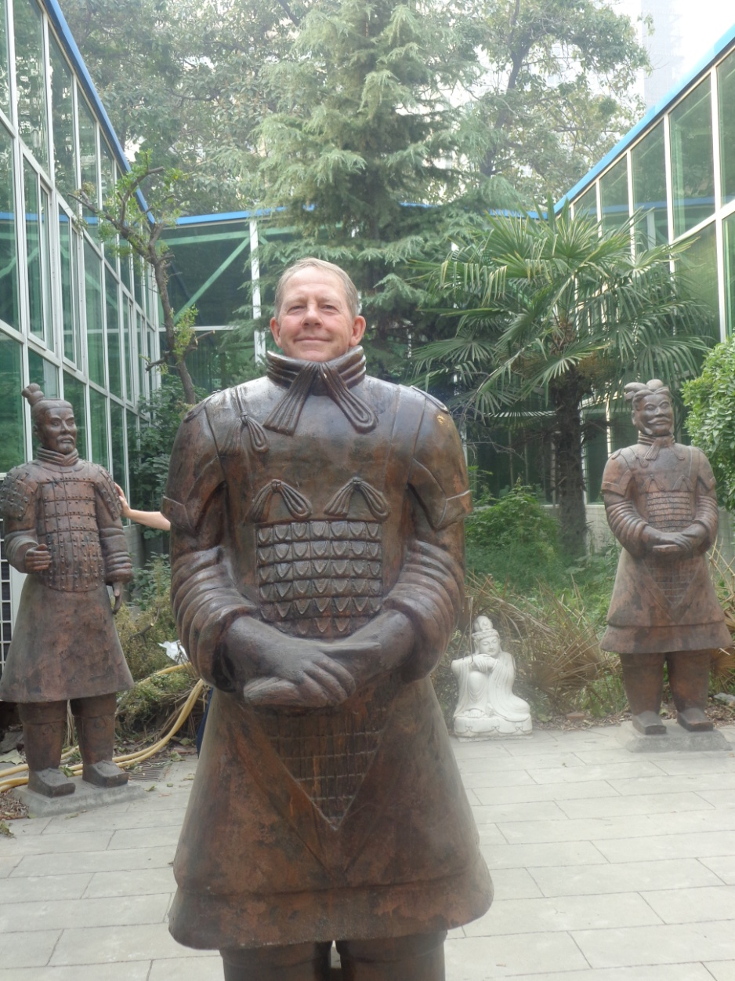
Modern Terra-cotta Professors
Professor Marie Murdoch
Professor John Murdoch

Slide 25
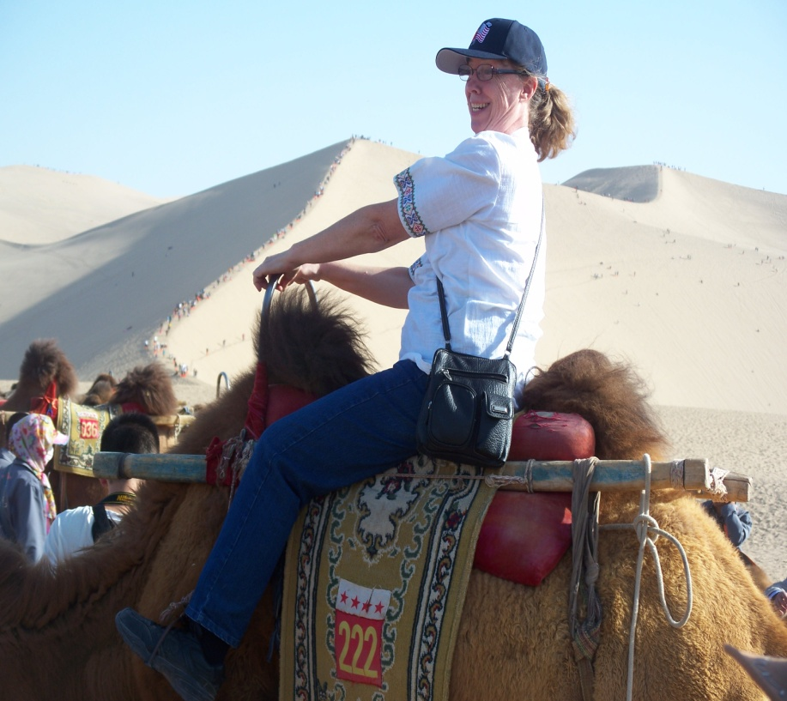
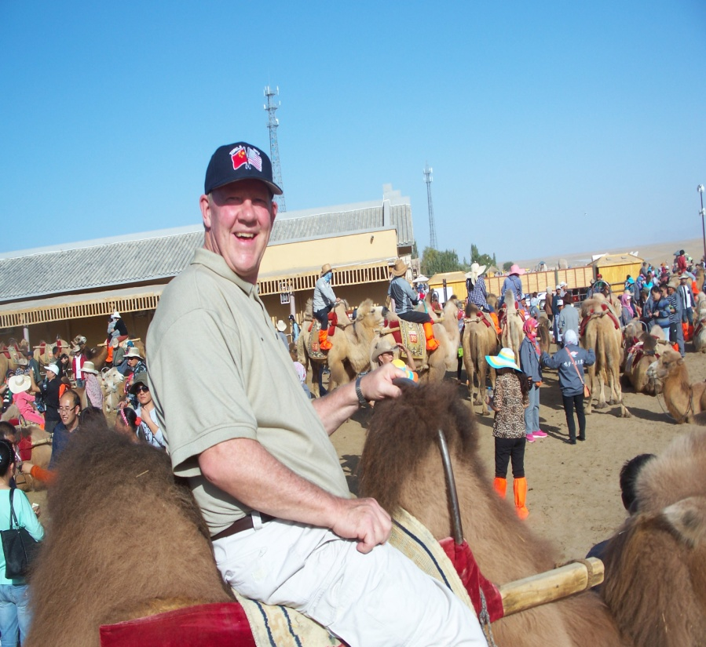
By Camel

Slide 26
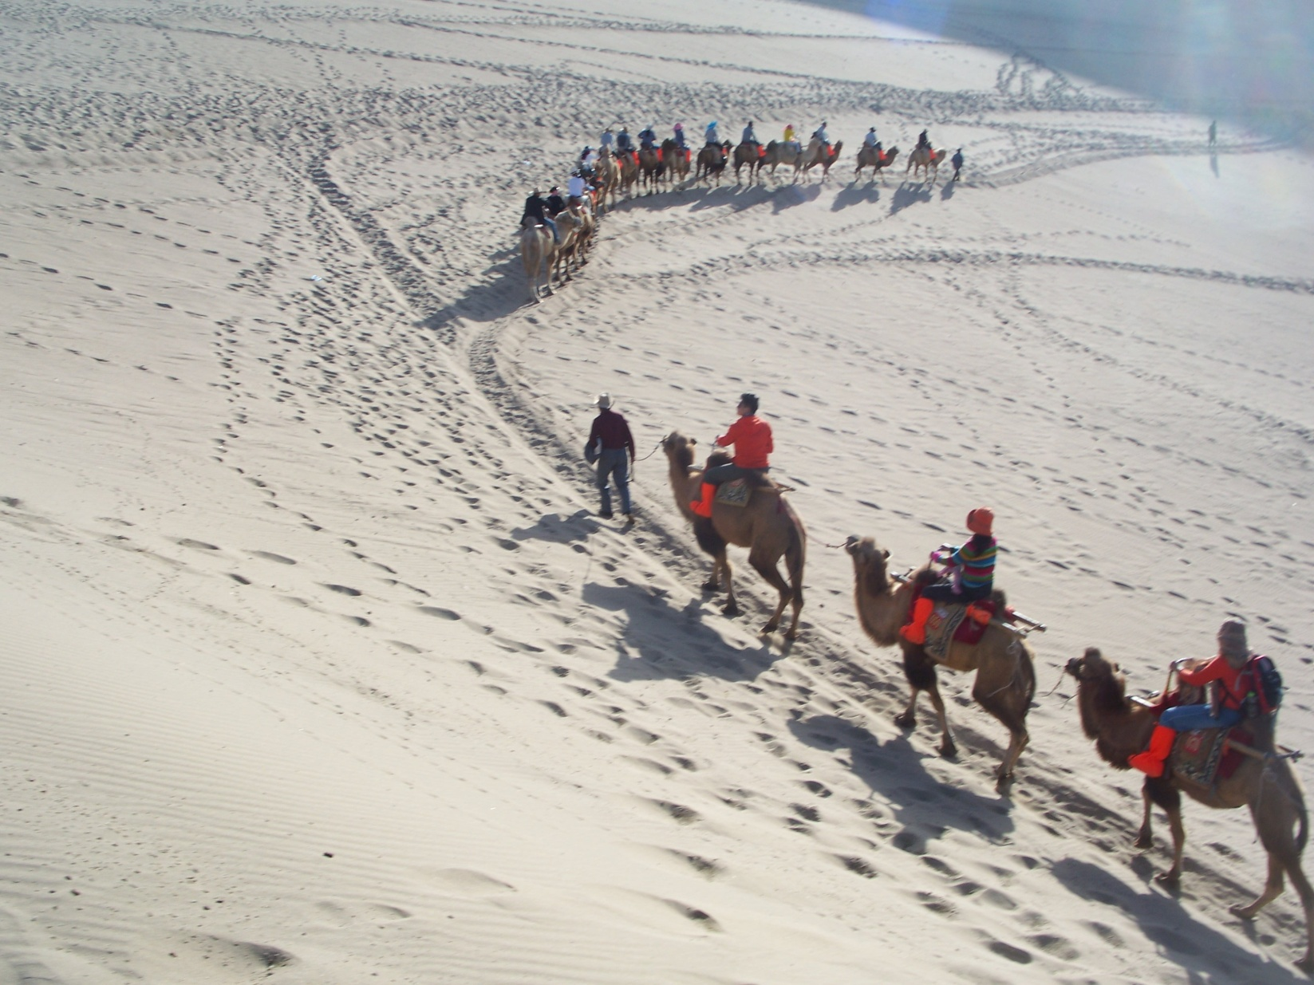
Camel Train

Slide 27
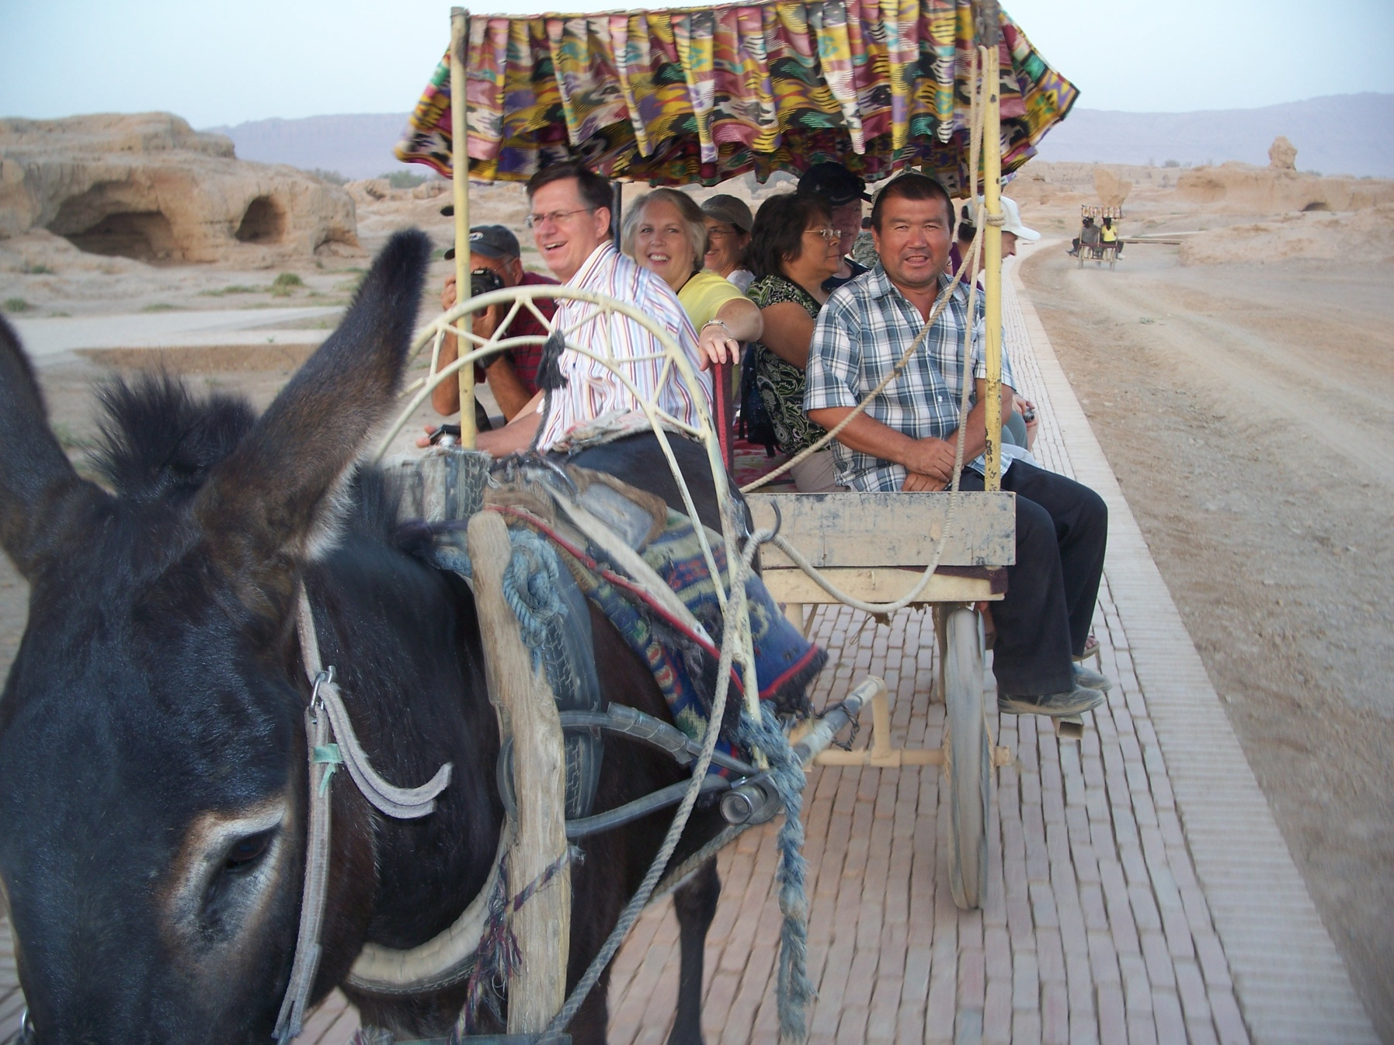
By Donkey

Slide 28
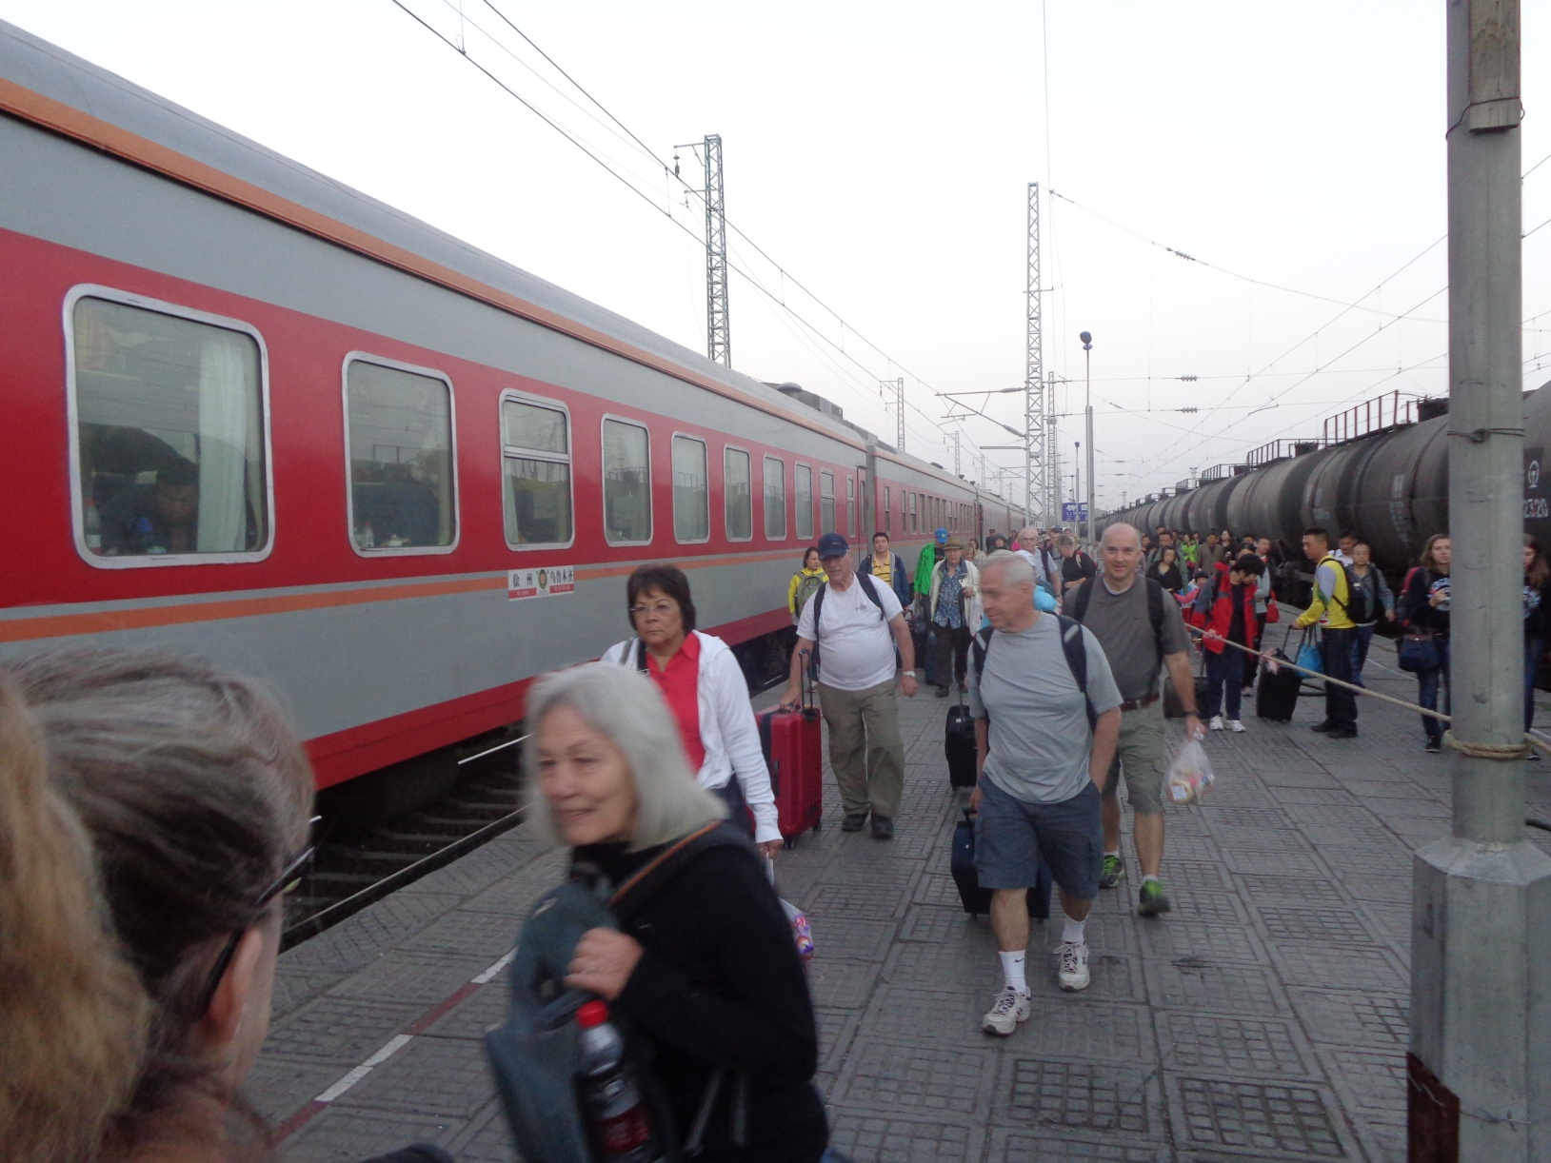
By Rail

Slide 29
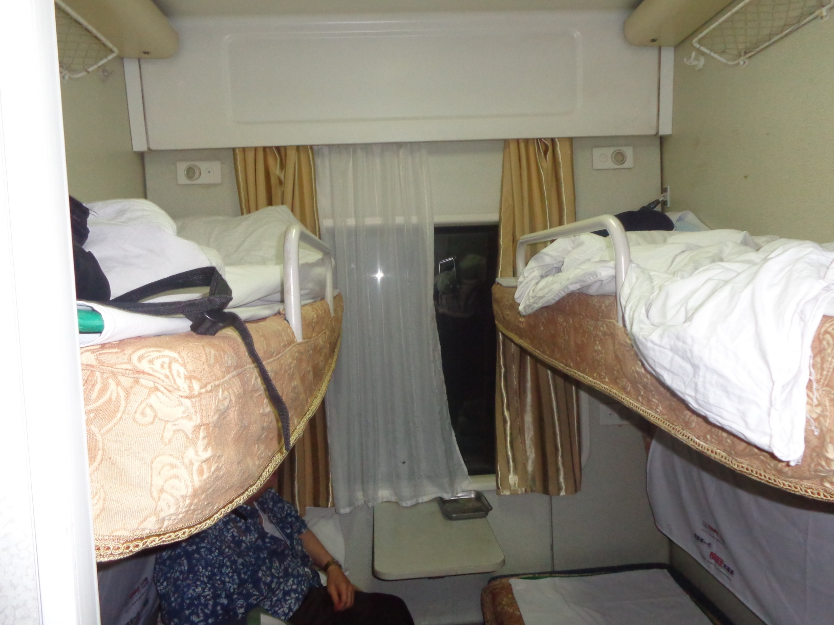
Our Soft Sleeper

Slide 31
Going Places
Instructions:
  Form Groups of 3 or 4.
  Take turns to share one Chinese city and/or province you have visited and give a fact or two about each one.
  Continue to take turns until time is up.
  Find out who has:
    Visited the most provinces.
    Traveled by airplane, train, automobile, boat, camel, donkey, or some other conveyance.
    Stand up and share with the full class one thing new you learned through this discussion with your classmates.

Slide 32
Vocabulary Builders
Instructions:
  Form groups of three or four people.
  Distribute the vocabulary card so each person in your group has one.
  Taking turns, each person then pronounces each word on his/her card.
  When everyone is finished, pass your card one person to the left and then each person pronounces the words on his/new card.
  Repeat the process until everyone has had a chance to pronounce the words on each card.
  Note: If someone needs help pronouncing a word, other group members should provide assistance.

Slide 33
Talking Cards
Please form groups of 3-5 people.
You will be given a number of playing cards.
In turn, starting with the person whose birthday is closest to today’s date, draw a card from the top of the deck and answer the corresponding question.
Then take turns answering questions, until you have use up all of your cards.
Please speak loudly enough for your group to hear and understand you.

Slide 34
Adjective Opposites Crossword Puzzle
Form groups of 3 or 4.
Working together complete the crossword puzzle; no technology please.
When completed come to the front and check your answers.

Slide 35
Questions for and from
the Professors.

