Slide 1
BYU china teachers program how to stay healthy in china August 11, 2021
Wendy Jones, RN
Director of Nursing – Brigham Young University Student Health Services/Missionary Training Center; Provo, Utah

Slide 2
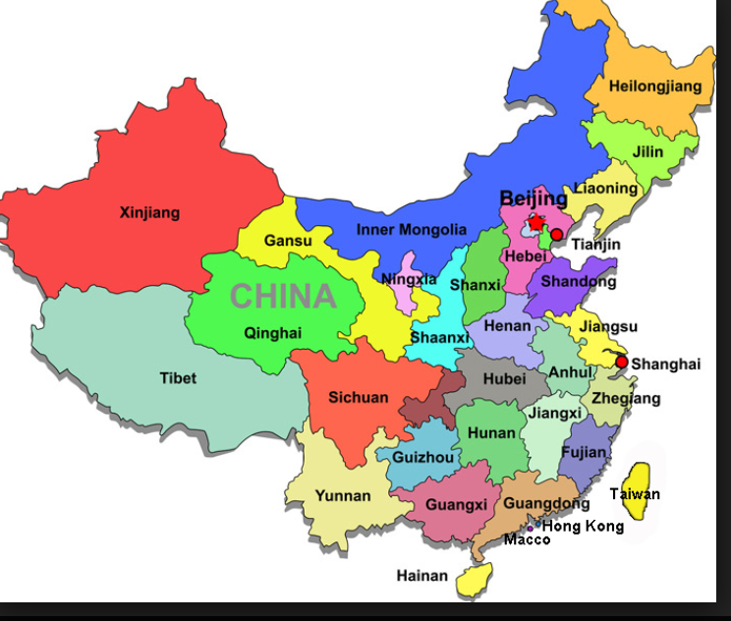

Slide 3
“Tell the people it was two of the best years of my life! You will not regret doing it. LOVED, lOVED, lOVED my students. They still keep in contact with me and I just adore them!”
“Honestly two of the best years of my life.”
Gloria Johnson China Foreign Affairs Univeristy, Beiijing

Slide 4
Vaccines needed for China
Tdap/ TD Tetanus-Diphtheria-Pertussis
Serious bacterial infection- TD
Whooping cough (Pertussis) Highly contagious disease that affects the lungs
Get a booster every 7-10 years

Slide 5
Hepatitis A
2 vaccines given 6 months apart for lifetime protection. If you only have time to receive one vaccine you will have 1-2 year protection.
A common travel vaccine.
Highly contagious liver infection.
Get from contaminated food and water or close contact with an infected person.

Slide 6
Hepatitis B
*A liver infection caused by Hepatitis B virus.
*Transmitted by blood or other body fluids
*3 doses given 0, 1 month, 6 months. Can be accelerated.
*Twinrix vaccine: combination Hepatitis A and Hepatitis B
accelerated schedule 0, 7, 21 day. Will need a 4th dose after 12 months. Excellent protection.

Slide 7
Typhoid (Two types – Typhim Vi, Oral)
*Contracted by drinking or eating food contaminated with the bacteria.
*Typhoid (Typhim Vi) needed every two years. 70% protection
*Oral typhoid needed every 5 years. 4 tablets taken by mouth. 78%-80% effective. (This oral vaccine is unavailable at this time)
*Use caution eating street food

Slide 8
Rabies
Not a problem unless you are bit! Easily treated with series if you are infected.
According to china’s Ministry of Health, China does have a high incidence of rabies due to consumption of rabid dog meat. Most people do not get the rabies vaccine because even if you get the series of shots, then you are bitten you will still need to have the series again.
It is very expensive to get the 3 series.
Prevention: Stay away from dogs. If bit you need a 4-5 series vaccine.

Slide 9
Pneumonia
*Exposure to high levels of air pollution significantly increases the risk of respiratory tract infections.
*There are two approved vaccines for prevention of pneumococcal disease. PCV13 and PPSV23. They are recommended for all seniors over 65, and for any age person with chronic heart or lung conditions, including asthmatics taking prevention or maintenance medications, those with sickle cell disease, diabetes, after splenectomy, or other immune challenged conditions.

Slide 10
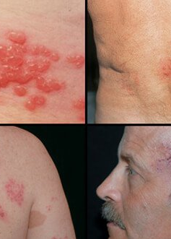
Shingles vaccine (Varicella Zoster Virus)
The CDC recommends adults ages 50 and older get the shingles vaccine.
Two vaccines are licensed:
Zostavax (2006) ages 60 and older
Shingrix (2017) Recommended inactive vaccine 2 doses ages 50 and older given 0 and 2- 6 months apart

Slide 11
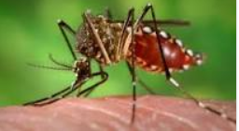
Japanese Encephalitis
Viral infection transmitted to humans through the bit of an infected mosquito
Transmission occurs in rural agricultural areas in Asia associated with rice production, rice fields, and pig farms.
Large cities have very little risk. (from 1973-2015 only 10 JE cases among U.S. travelers
JE transmission occurs mainly from June to October.
Protection: stay away from flood irrigation like rice paddies. Use repellant that contains 35%-50% deet.
Ixiario- 2 shot series. Can be given 7 days apart. Cost is approx. $300 each

Slide 12
DENGUE, CHIKUNGUNYA
Illness caused by a virus that is spread through mosquito bites. Mosquito prevention, DEET
Avian flu (H7N9)
Respiratory virus: fever, cough, muscle aches
Avoid contact with live poultry (including poultry markets and farms) birds and their droppings and to avoid eating undercooked poultry.

Slide 13
WATER
* Drinking water in China. DON’T
*Water pollution is a major health concern in China. Among the 200 major rivers in China the water quality was below grade.
*Tap water is not drinkable, even in major cities. Bottled water is easily available.
*Do not use contaminated water to wash dishes, brush your teeth, wash and prepare food, or make ice.
*Boiling water kills harmful bacteria and parasites. Rolling boil for 1 minute will kill most organisms.
*Chlorine bleach, 1/8 teaspoon of bleach per gallon of water if water is clear. ¼ teaspoon if water is cloudy. (See CDC for complete concentration guide)
*Wash all fresh food very carefully in either vinegar or bleach.

Slide 14
Pollution
*Air pollution in Chinese cities is a mixture of coal-combustion and motor-vehicle emissions. 16 of the 20 most polluted cities in the world are in China, and Beijing regularly tops the list.
*If you have asthma or chronic pulmonary disease, or congestive heart failure, take inhaler and use regularly especially during the winter months.
*When pollution is bad, many people were a mask, or try to just stay in your apartment. Properly fitted N95 masks can filter out particulates. Surgical style masks though popular provide no real protection.

Slide 15
TRAVELER’S DIARRHEA
*TRAVELER’S DIARRHEA (SUDDEN ONSET OF SYMPTOMS THAT CAN RANGE FROM MILD CRAMPS AND URGENT LOOSE STOOLS TO SEVERE ABDOMINAL PAIN, FEVER, VOMITING AND BLOODY DIARRHEA)
*30-70% of travelers get this
*Traditionally it was thought that TD could be prevented by following simple recommendations, such as:
*BOIL IT, COOK IT, PEEL IT OR FORGET IT. But studies have shown that people who follow these rules can still get sick. Poor hygiene practices in local restaurants is likely the biggest contributor. Bacteria is the most common cause.
*Zithromax- (Azithromycin) antibiotic : Contact your private physician for a prescription.
*Bismuth subsalicylate (BSS) active ingredient in Pepto-Bismol and Kaopectate. (Take daily as 2 oz. liquid or 2 chewable tablets 4 times per day reduces the incidence of TD by approximately 50%.
Note: BSS can cause blackening of the tongue and stool, nausea, constipation and rarely tinnitus. Has not been studies for longer than 3 weeks.

Slide 16
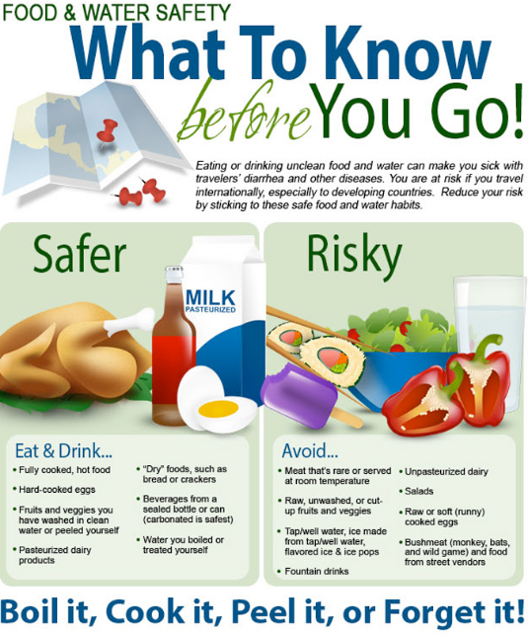

Slide 17
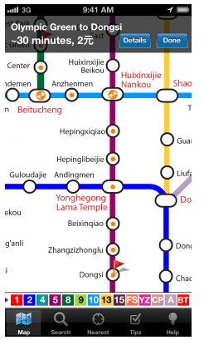
Safety
*People are kind. Subways are excellent.
*The apps are very user friendly. Carry a phone charger
at all times.

Slide 18
ACCIDENTS AND FALLS
*According to the CDC motor vehicle crashes are the number 1 killer of healthy U.S. citizens living, working or traveling in foreign countries.
*Pedestrians do not matter. You are fare game for drivers. They drive through stop lights and walk lights. They don’t look , slow, or stop.
*Crossing the street, a pedestrian must keep an eye on all four sides at all times.
*Electric motor bikes – You can’t hear them coming, and they drive on the sidewalks very fast. If you are hit they don’t stop. Be aware, not distracted.
*Walking and street hazards: Broken sidewalks, loose manhole covers, wires spread across sidewalks, construction.

Slide 19
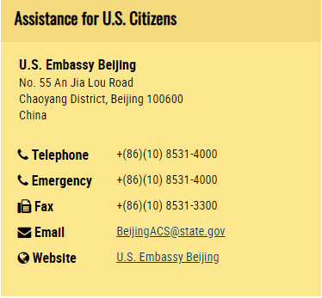

Finding a doctor
Go to the CDC site “Getting Health Care Abroad” they can give you help with where to find a doctor. There are many US, or British doctors practicing in China.
http://www.usembassy.gov/on
Do your homework. Check with Aetna or private insurance to see which medical organizations will accept your insurance.
Ie Beijing Family Medical. Located all over Beijing. Excellent services.
Prevention is better than treatment.
Keep in mind they love to treat Americans because they like our insurance. The more treatment for you the more money for them.

Slide 20
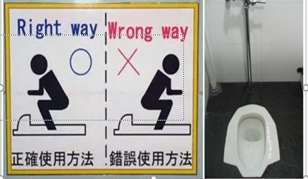
Hygiene
Use good hygiene to prevent infection and illness
Bring toilet paper (it is never in public restrooms)
Follow these tips to avoid getting sick or spreading illness while traveling.
*wash hands
*keep hands away from face. Don’t touch eyes, nose, or mouth
*Use hand sanitizer
Fish sucking pedicures, use caution

Slide 21
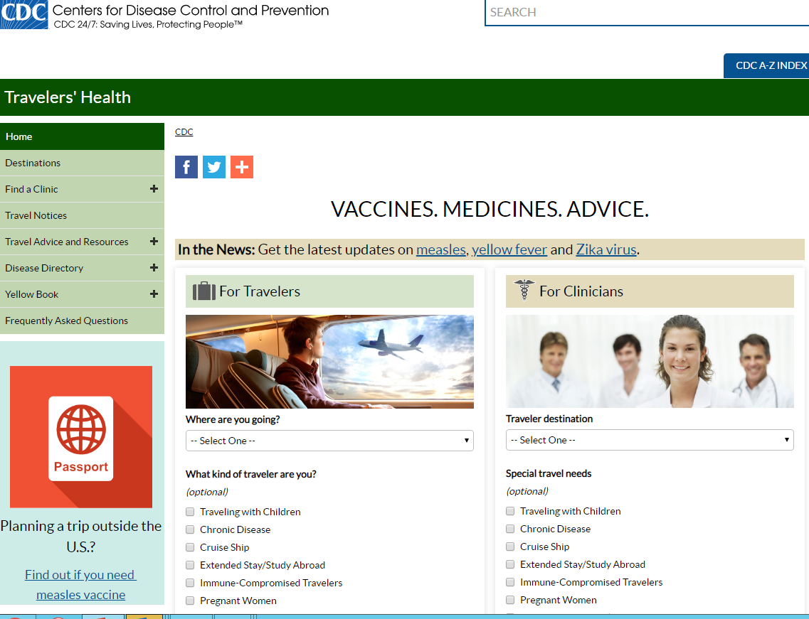

Slide 22
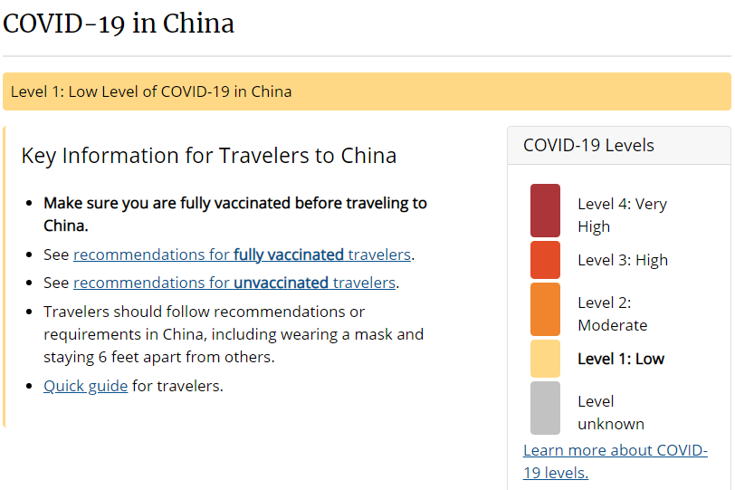

Slide 23
