Slide 1
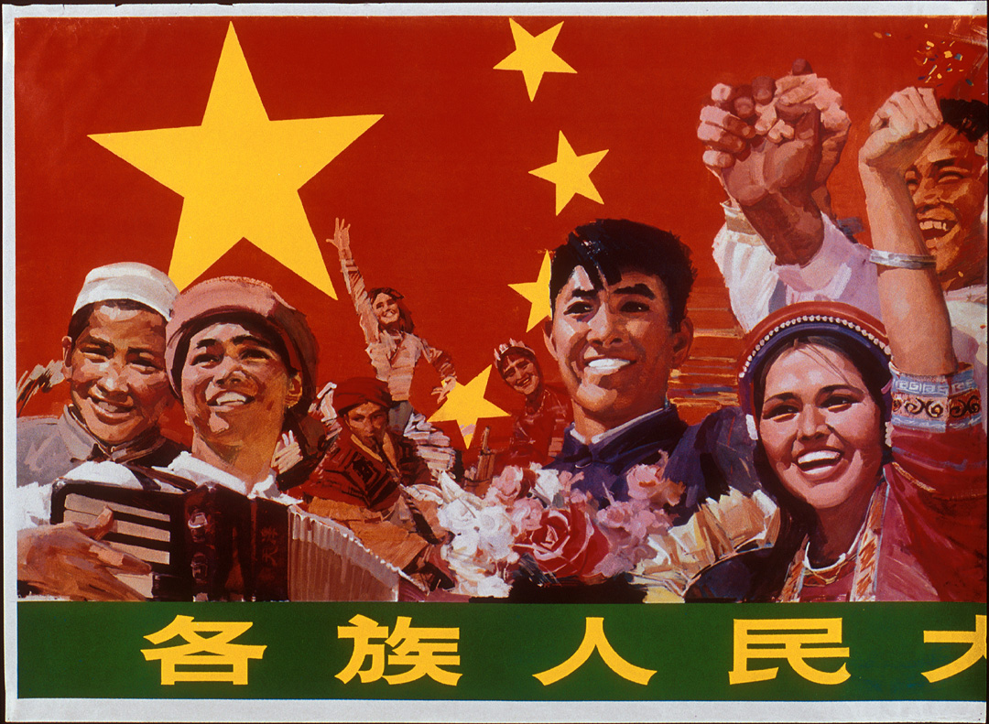
The People’s Republic of China (1949-

Slide 2
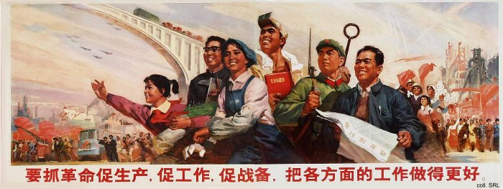
Revolution

Slide 3
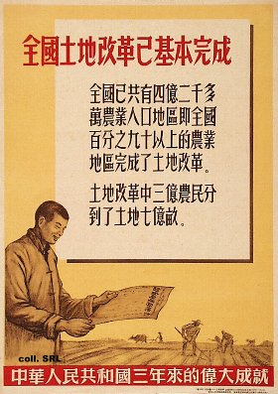
1) Land reform
--land to the tiller

Slide 4
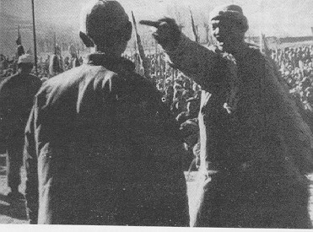
“Struggle sessions” (one million or more landlords killed)

Slide 5
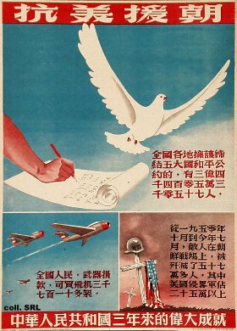
2) Korean War (1950-53)
--War to Resist U.S. Aggression and Aid Korea (抗美援朝戰爭)

Slide 6
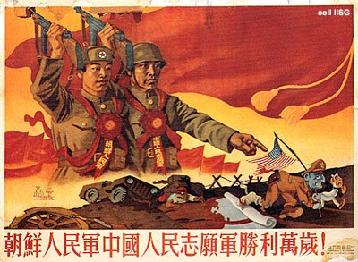

Slide 7
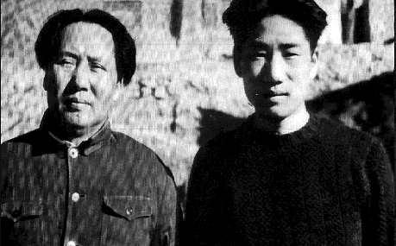
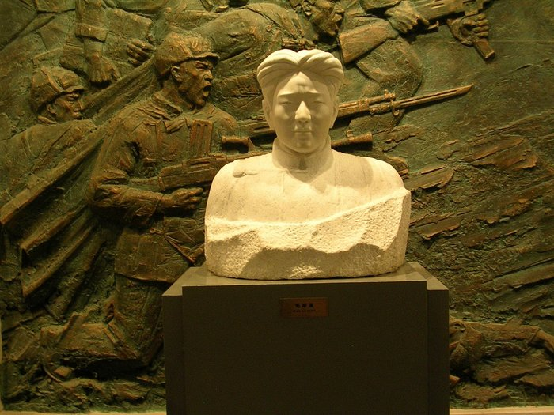

Slide 8
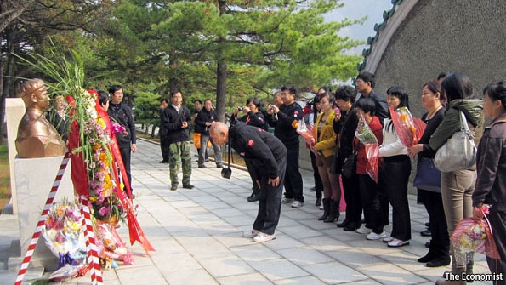

Slide 9
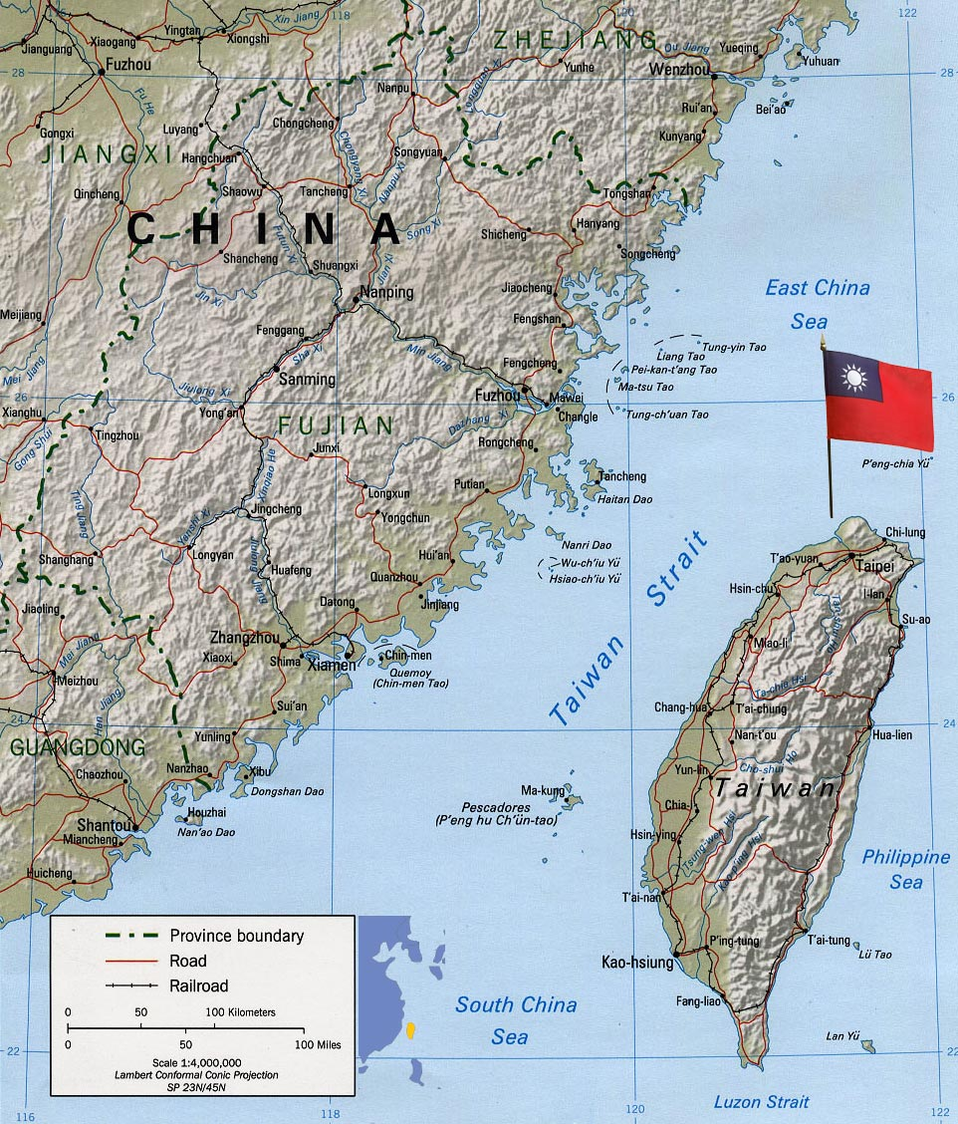

Slide 10
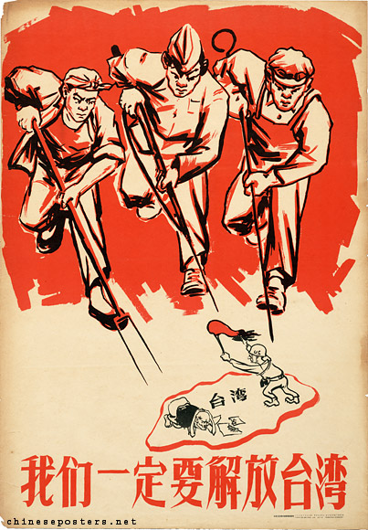

Slide 11
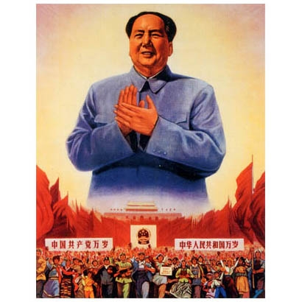
3) Great Leap Forward (dayuejin 大躍進) （1958-1961)

Slide 12
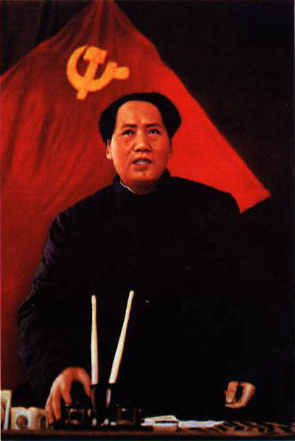
Quotations from Chairman Mao:
“I have witnessed the tremendous energy of the masses. On this foundation it is possible to accomplish any task whatsoever.”
“To read too many books is harmful.”
“A revolution is not a dinner party, or writing an essay, or painting a picture, or doing embroidery; it cannot be so refined, so leisurely and gentle, so temperate, kind, courteous, restrained and magnanimous. A revolution is an insurrection, an act of violence by which one class overthrows another.”
“Why brush? Does a tiger brush his teeth?”

Slide 13
Collectivization of agriculture
1955+ Collectivization (150-200 households)
1958+ People’s Communes (25,000+ people)

Slide 14
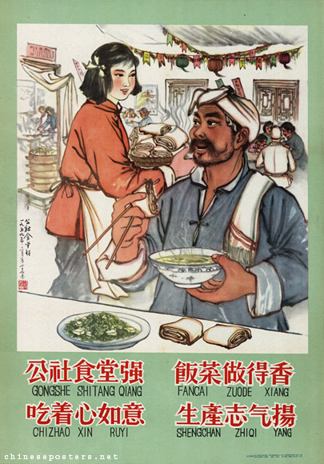

Slide 15
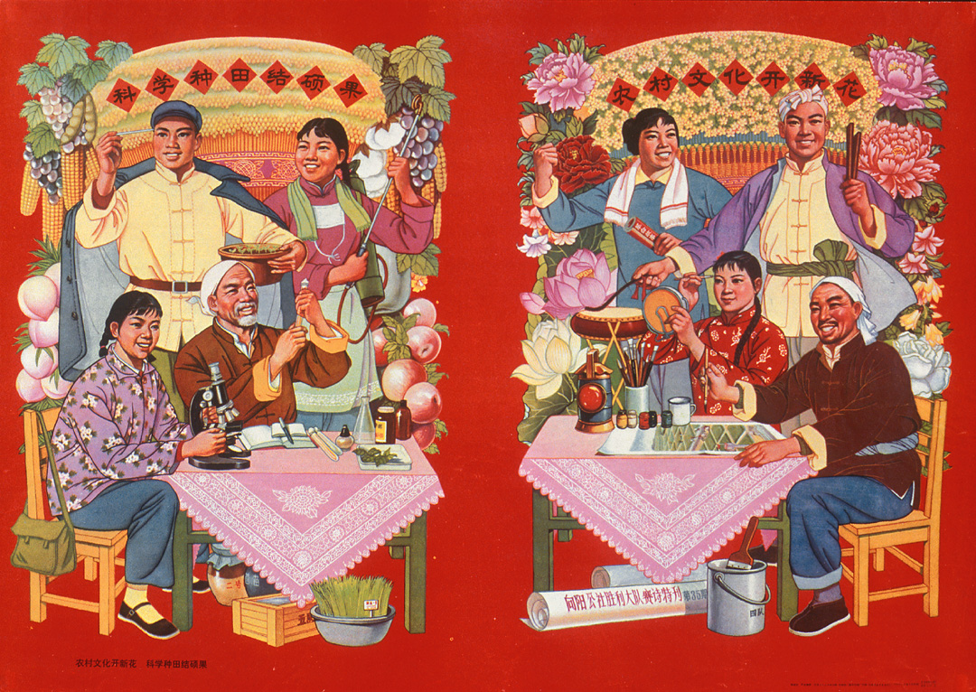

Slide 16
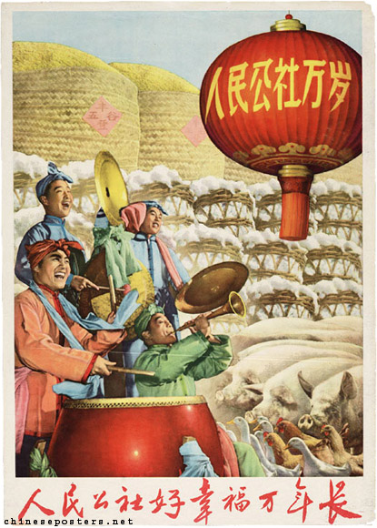

Slide 17
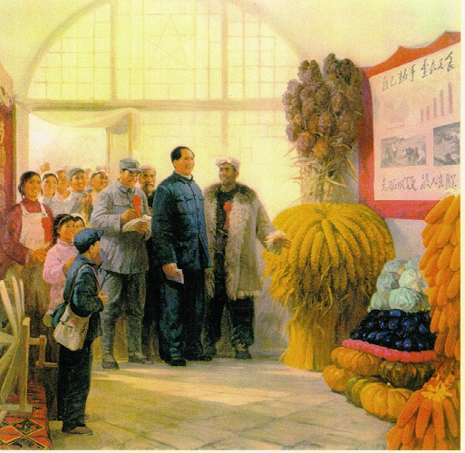

Slide 18
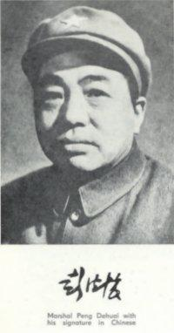
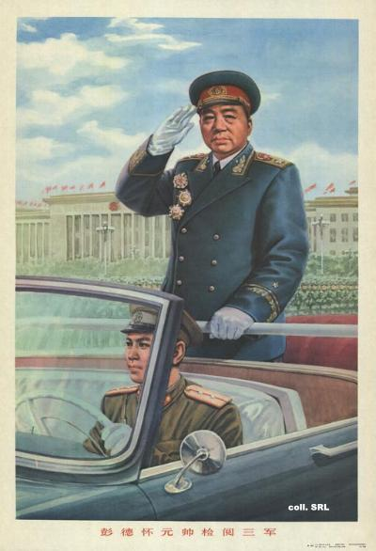
Ignoring and marginalizing critics
Peng Dehuai (彭德懷) 1898-1974

Slide 19
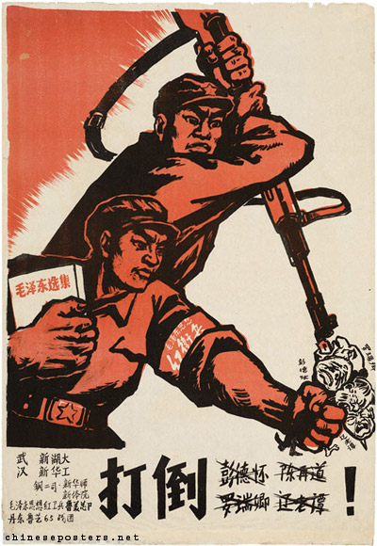

Slide 20
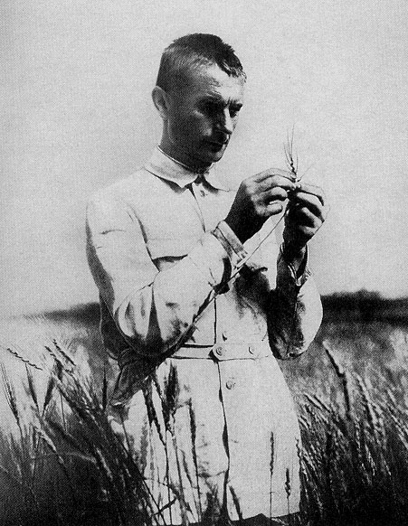
T.D. Lysenko (1898-1976)
--environmentally acquired inheritance
--”vernalization”

Slide 21
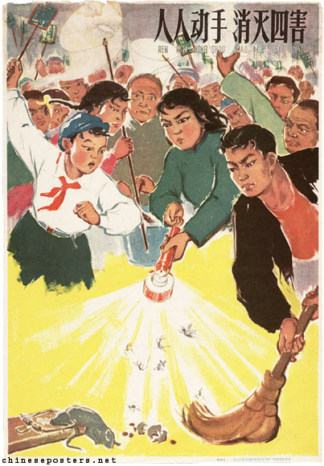
“Four Pests” campaigns:
--Rats, Mosquitoes, Flies, and Sparrows

Slide 22
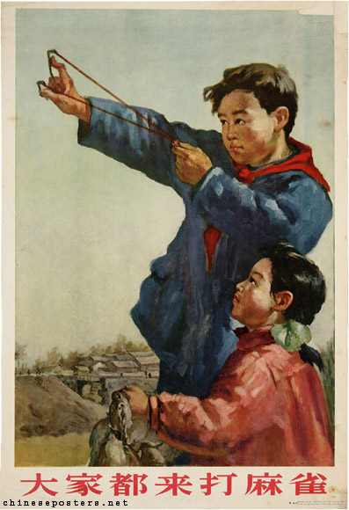

Slide 23
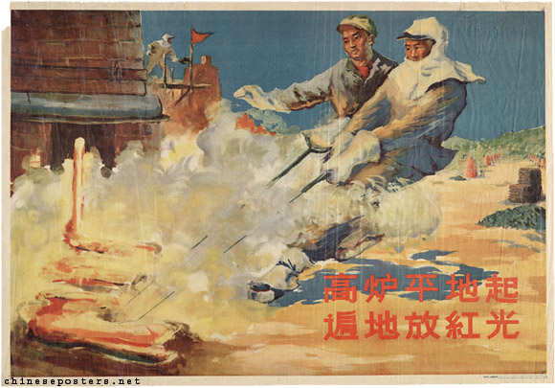
Backyard steel furnaces

Slide 24
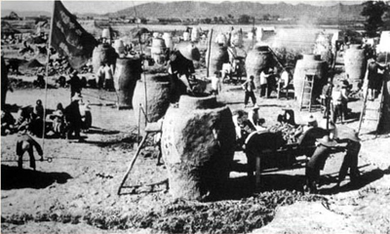

Slide 25
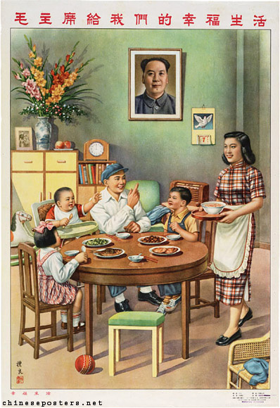

Slide 26
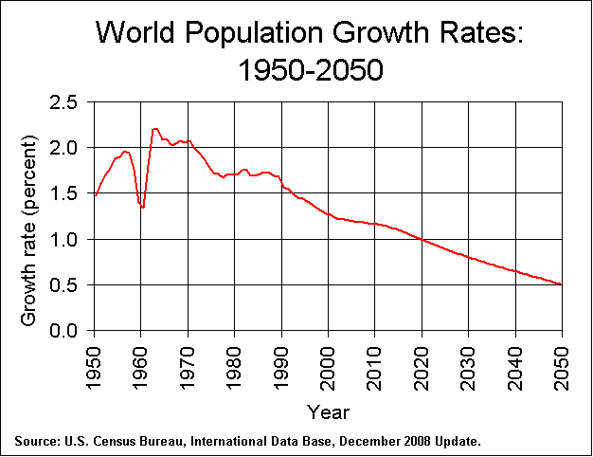

Slide 27
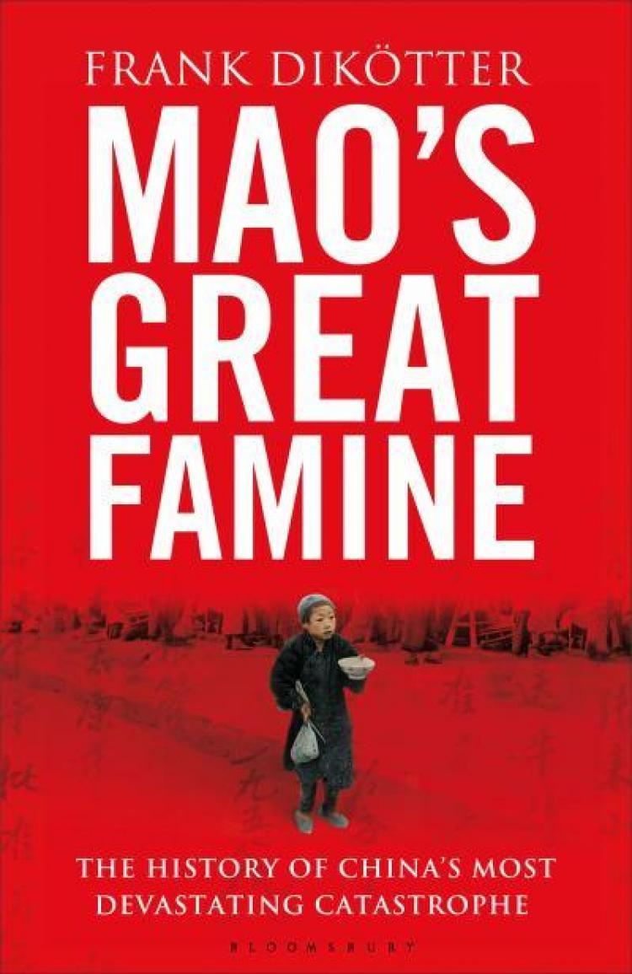

Slide 28
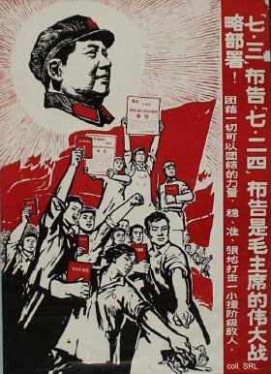
4) Cultural Revolution (1965-1969; 1965-1976)

Slide 29
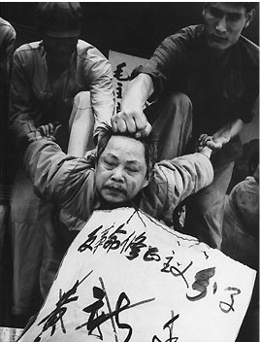
Red Guard
Torture (“airplane” technique)

Slide 30
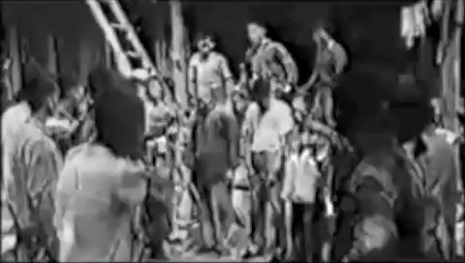

Slide 31
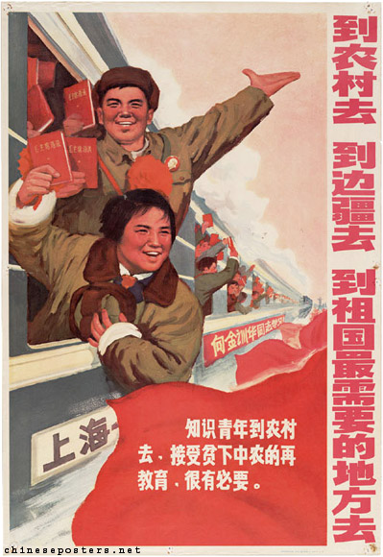

Slide 32
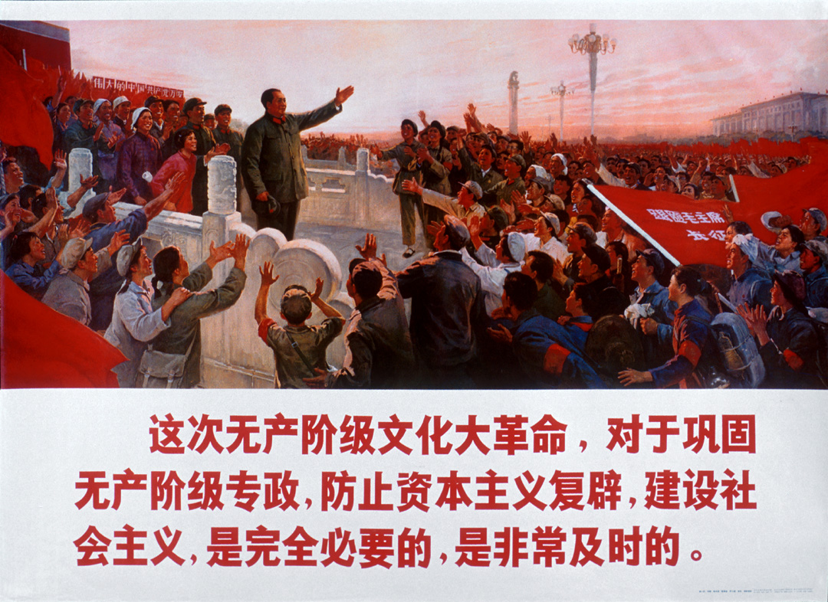
Cult of Mao

Slide 33
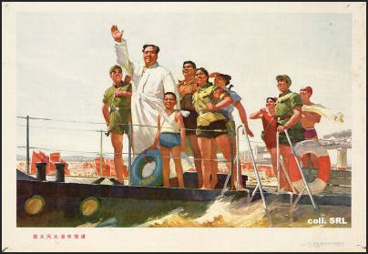

Slide 34


Slide 35

Revolutionary Culture

Slide 36
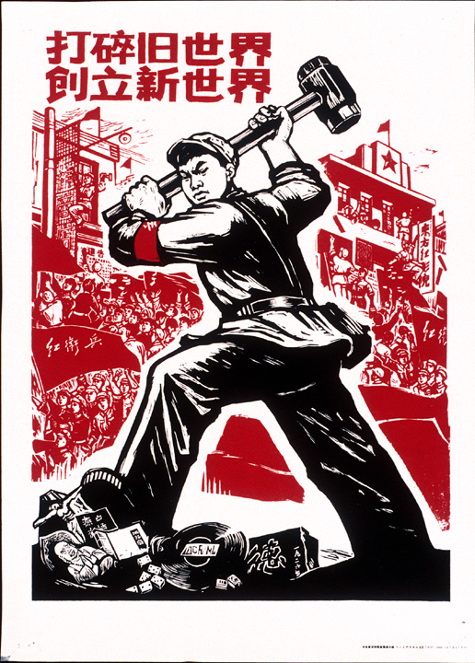
“Smash the Olds”

Slide 37
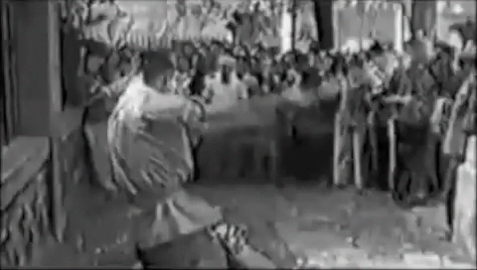

Slide 38
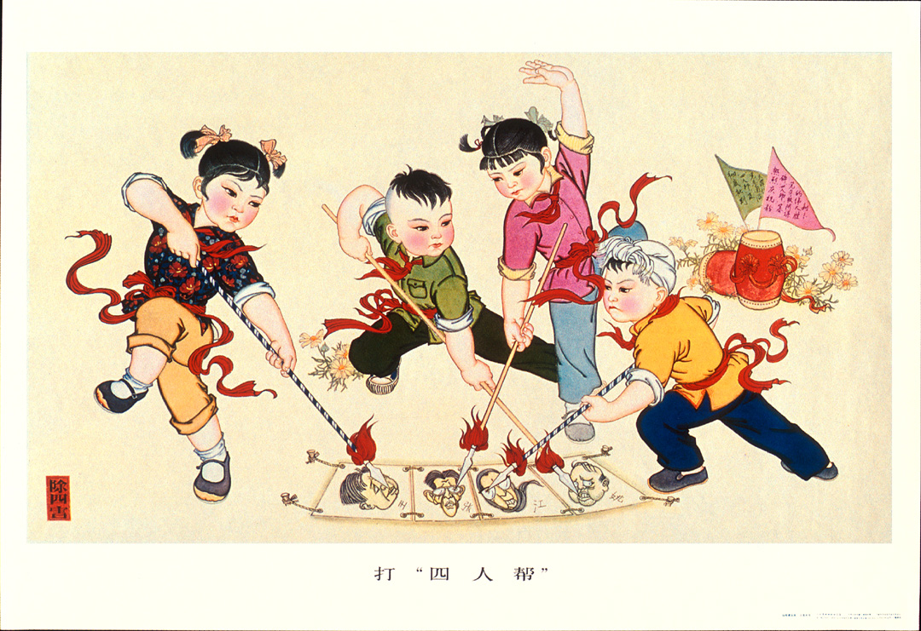

Slide 39
5) Post-Mao China
--Deng Xiaoping (1905-1997)
--economic liberalization
--“doesn’t matter what color the cat is as long as it can catch mice”
--“to get rich is glorious”

Slide 40
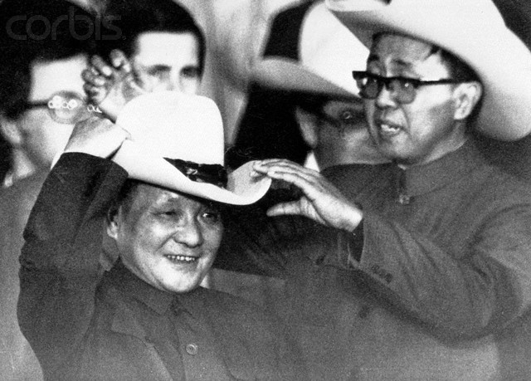

Slide 41
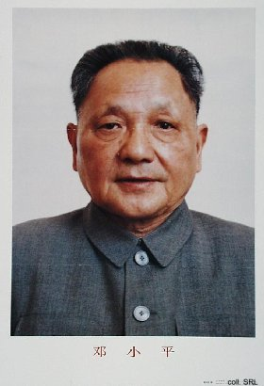
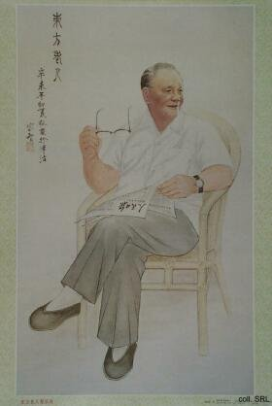

Slide 42
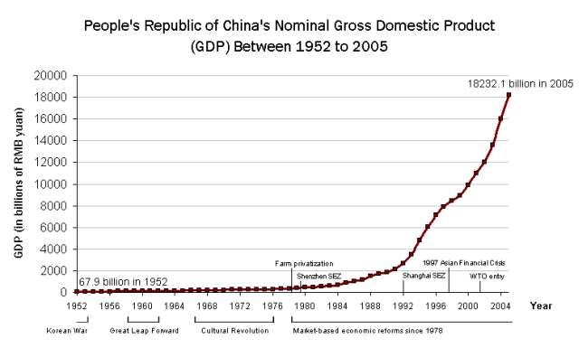

Slide 43
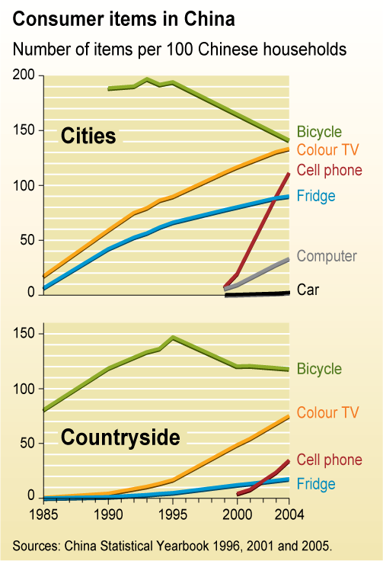
“Three Bigs” (三大件)
Bicycle, Radio, Gas Stove (Early PRC)
Bicycle, Wristwatch, Sewing Machine (Cultural Revolution)
TV, Refrigerator, Washing Machine (1980s, 1990s)
Cell Phone, House, Car (2000s)

Slide 44
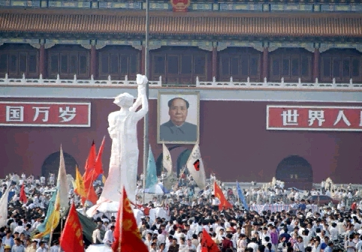
6) Tiananmen Square Incident (1989)

Slide 46
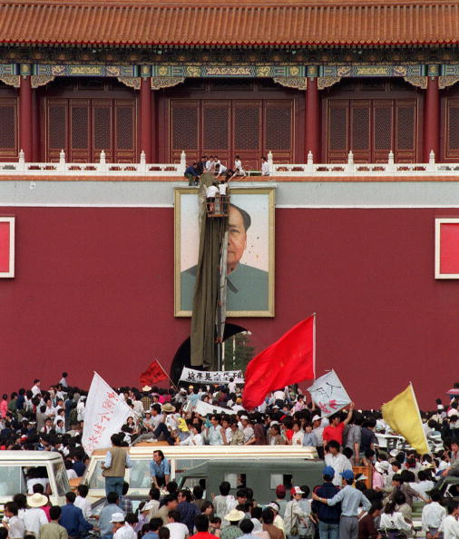

Slide 47
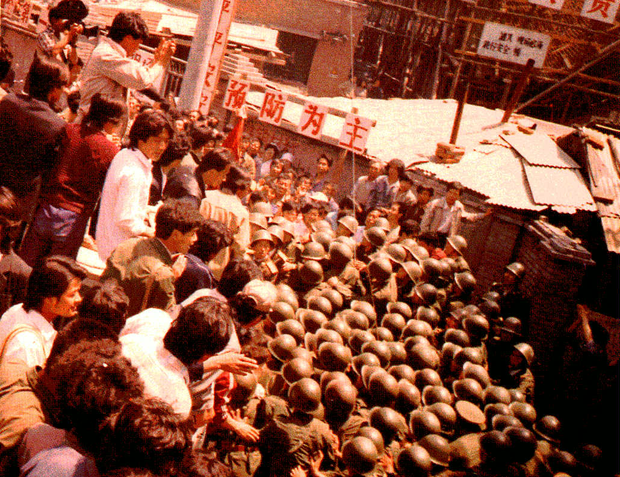

Slide 48
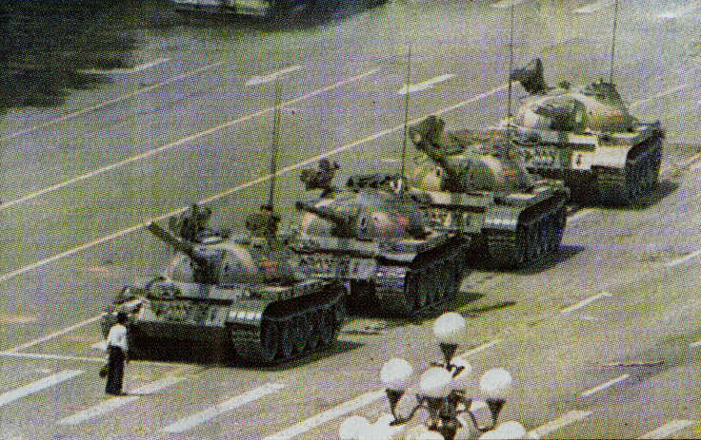

Slide 49
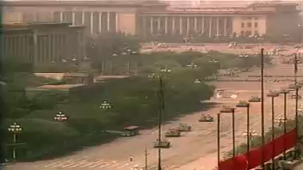

Slide 50
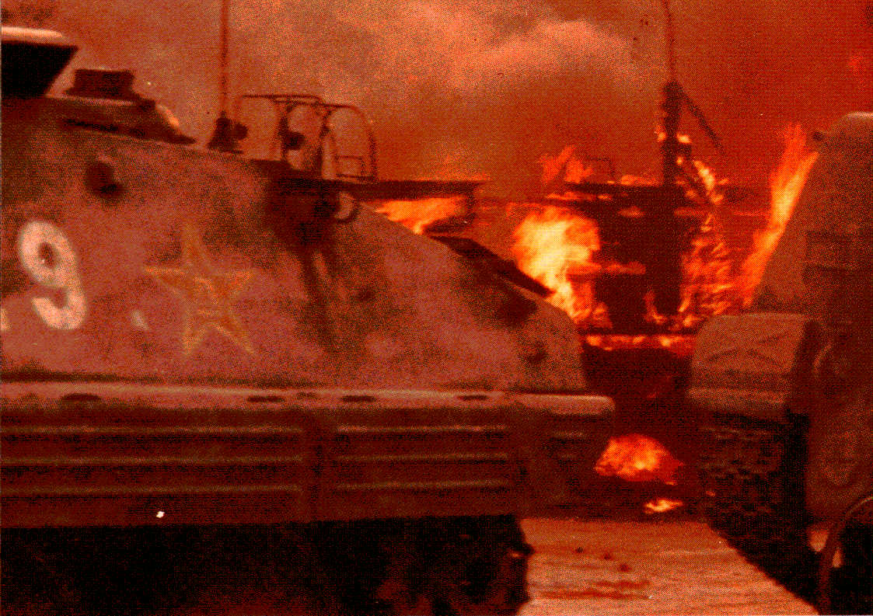

Slide 51
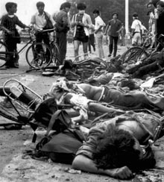

Slide 52

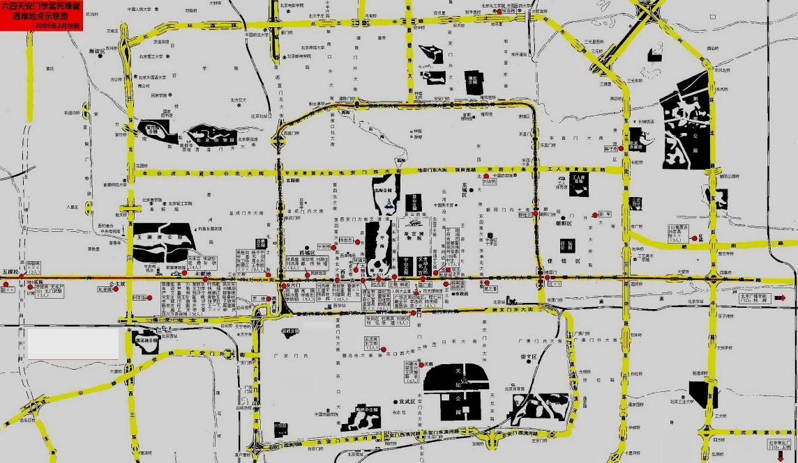
天安门母亲网站 > 真相与记忆 > 六四死难者资料
186 to 10,000 dead

Slide 53


Slide 54

Return of Hong Kong to Chinese control (1997)

Slide 55

Macao (Macau) handover (1999)

Slide 56

2008 Olympics

Slide 57


Slide 58


Whither China?

Slide 59

Challenges:
Rich-poor gap
Notes:
211 million internal migrants in China

Slide 60


Slide 61

Unrest

Slide 62


Slide 63


Slide 64

Corruption

Slide 65

Environment

Slide 66


Slide 67
Population
--One Child Policy
--”Bare branches”

Slide 68
Geopolitics
--Internal (Tibet, Xinjiang etc.)
--External
--North Korea
--Taiwan
--South China Sea
--Diaoyu/Senkaku

Slide 69


China as world hegemon

Slide 70


Slide 71

Chinese economy and trade imbalances

Slide 72

Military modernization

Slide 73


Slide 74
Convergence

Slide 75


Culture: Super Voice Girls (超級女聲)
--sponsored by Mengniu Yogurt (Mongolian Sour Yogurt)

Slide 76


Slide 77

Local elections (since the 1980s)
Judicial reform
But ….
Still no opposition parties
State control of press and media
Corruption

Slide 78
Challenge of the future?
Cold War
Authoritarian political system + state-run economic system
vs.
Democratic political system (in theory) + market economy
China = “market authoritarianism”

Slide 79

The Church in China

Slide 80

1853: Hosea Stout

Slide 81

1921: David O. McKay

Slide 82


Slide 83


Slide 84

1979: BYU Young Ambassadors’ first trip to China

Slide 85


Slide 86


“Greater China”
Taibei, Taiwan Temple
Hong Kong Temple

Slide 87


