Slide 1
Day 1
Introduction

Slide 2
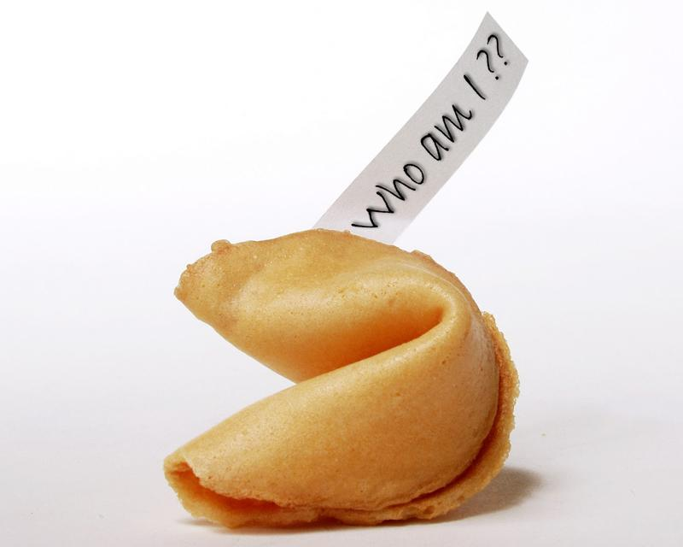
What kind of things can you associate with the word “Chinese”?

Slide 3
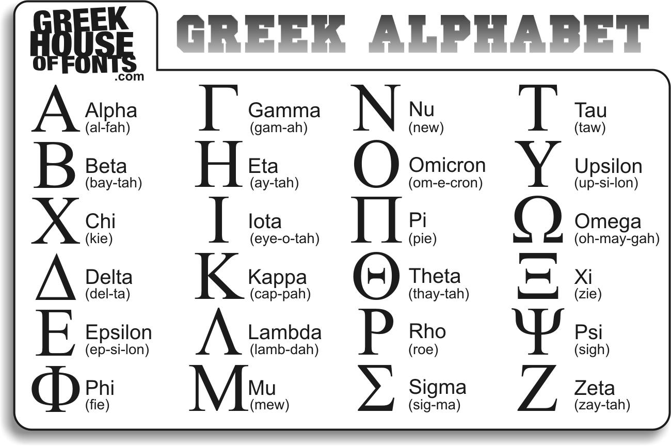
What do you know about the Chinese language?

Slide 4
What are some Chinese words you already know?
Chow mein
Feng shui
Kung fu
Tai chi
Tofu
Yin Yang

Slide 5
The Chinese language:
Sino-Tibetan language family
Tonal language
Several dialects (Cantonese, Hakka, Min)
Over 1.2 billion people speak one or more varieties of Chinese

Slide 6
Pinyin
Pinyin table
http://en.wikipedia.org/wiki/Pinyin_table

Slide 7
How to “read” Pinyin?
Initial (consonant) + Final (Vowel) + Tone

Slide 8
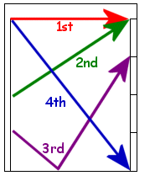
Tones

Slide 9
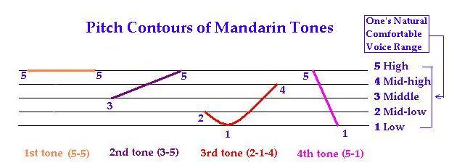
Tones

Slide 10

Practice time!

Slide 11
Chow mein = chǎo ​miàn
Feng shui = fēng​ shuǐ
Kung fu = gōng ​fu

Slide 12
Tai chi = Tài​ jí
Tofu = dòu ​fu
Yin Yang = yīn​yáng

Slide 13
Quiz

Slide 14
Question?

Slide 15
Day 2
Numbers

Slide 16
Tones

Slide 17
Tip:
Make connections with the sound/thing you are familiar with or things you already know.

Slide 18

1
One
yī

Slide 19

2
Two
èr

Slide 20

3
Three
sān

Slide 21
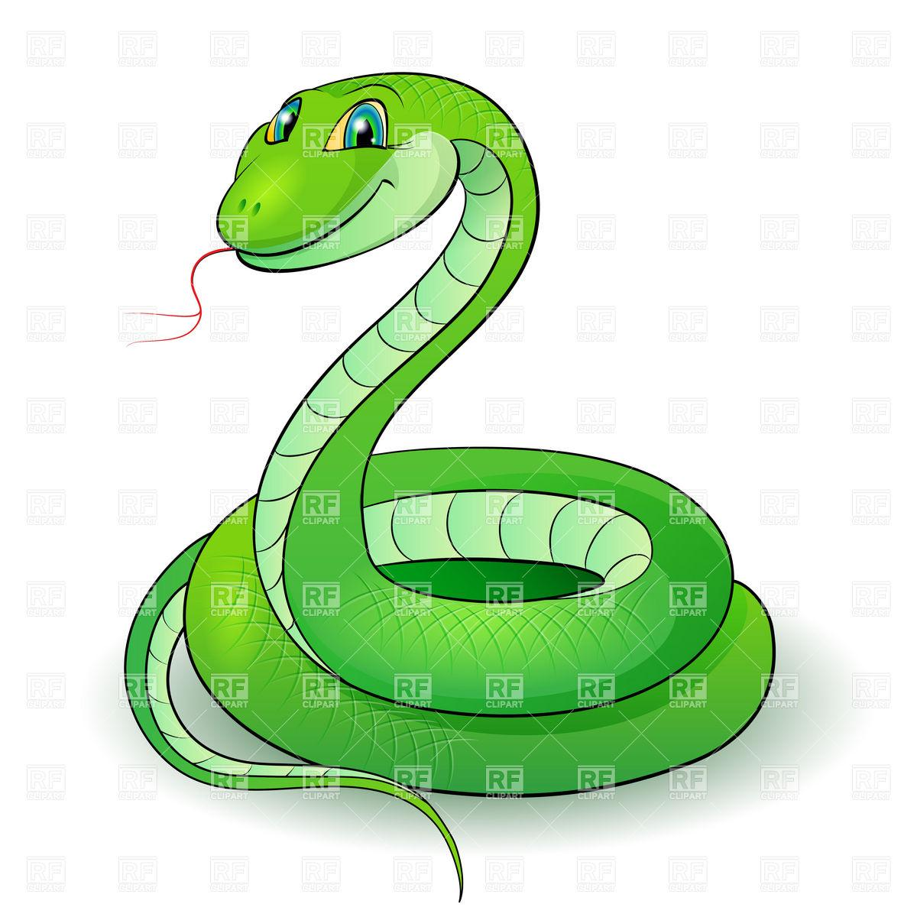
4
Four
sì

Slide 22

5
Five
wǔ

Slide 23
6
Six
liù

Slide 24
7
Seven
qī

Slide 25
8
Eight
bā

Slide 26
9
Nine
jiǔ

Slide 27
10
Ten
shí

