Slide 1
Test Orientation and Major English Tests in China
China Teachers Workshop
Lynn Henrichsen

Slide 2
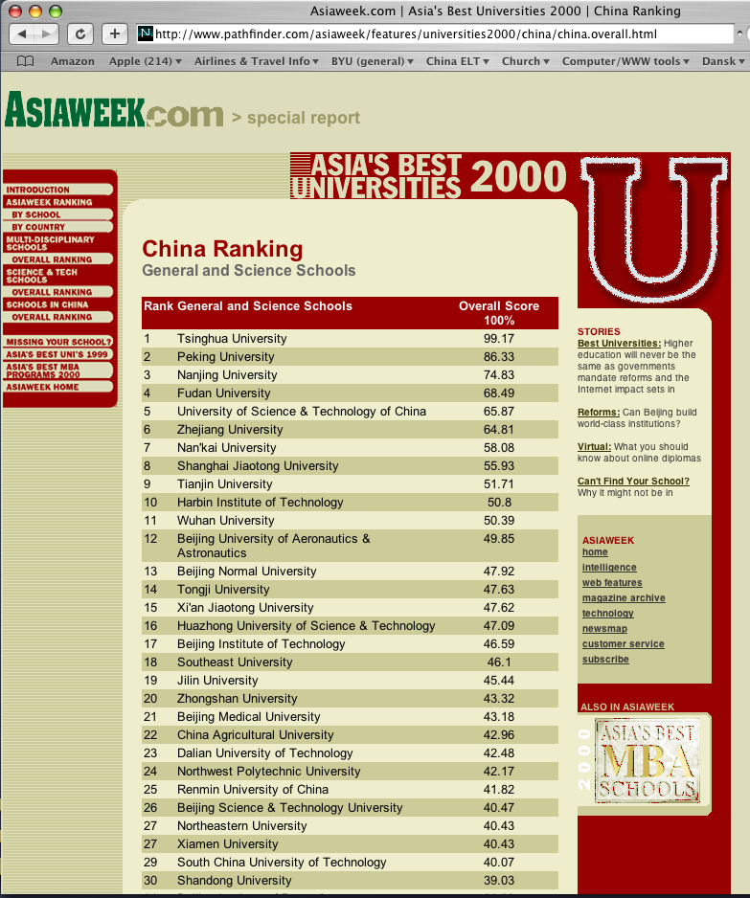
Rankings of Universities in China
Important to understand

Slide 3
Rankings of Universities in China
Important to understand
You are teaching at some of China’s top universities
  Your students are smart
  They prove themselves by taking examinations
(What is BYU’s ranking in the USA?)

Slide 4
My first experience in China
1985
Dalian Foreign Languages Institute
Course in TEFL methods for English teachers
Their gratitude
My challenge
My surprise!
What I hadn’t realized

Slide 5
Important English examinations in China
The National Higher Education Entrance Examination (NHEEE) Quánguó Pǔtōng Gāoděng Xuéxiào Zhāoshēng Tǒngyī Kǎoshì or Gāokǎo
  Major gateway through which Chinese students must pass to achieve higher education
  Multi-part academic examination held annually over a three-day period in early June throughout China
  All secondary students in their last year of high school who want to get into colleges and universities must pass the NHEEE (over 10 million take it each year)
  Includes the National Matriculation English Test (NMET)

Slide 6
Important English examinations in China
The Graduate School Entrance English Exam (GSEEE)
  National examination to determine which undergraduate students get to go on to graduate school
  Four components
  One of the compulsory ones is the Graduate School Entrance English Exam (GSEEE)

Slide 7
Important English examinations in China
The National Band 4/6 College English Test (CET-4, CET-6)
CET-4 is the most important certificate (or school-leaving) English test in the Chinese university system.
Over 10 million students take it each year now

Slide 8
Important English examinations in China
The National Band 4 College English Test
Administered biannually, in June and December/January
Created under the direction of the National College English Testing Committee (NCETC) on behalf of the Higher Education Department (HED) of the Chinese Ministry of Education (CET, 2009)

Slide 9
Important English examinations in China
The National Band 4 College English Test
Components
  Listening Comprehension (dialogs & passages)
  Reading Comprehension (in-depth & skim/scan)
  Integrated Test (cloze or error correction)
  Writing (short essay)
Samples coming soon
See Sun & Henrichsen (forthcoming) manuscript in your packet (B-10.A.1-19) for details

Slide 10
Important English examinations in China
The Test for English Majors (TEM)
Administered nationwide by the National Advisory Commission on Foreign Language Teaching in Higher Education
Aims to measure the English proficiency of university undergraduate English majors in accordance with the National College English Teaching Syllabus for English Majors
Fewer students take it (only English majors)

Slide 11
Important English examinations in China
The Test for English Majors (TEM)
Components
  Writing (essay & note-writing)
  Dictation (passage)
  Listening Comprehension (dialogues, passages, news broadcasts)
  Cloze (passage)
  Grammar & Vocabulary
  Reading Comprehension

Slide 12
Important English examinations in China
The Test of English as a Foreign Language (TOEFL)
Created and administered worldwide by Educational Testing Service (Princeton, New Jersey)
Used by US universities to determine admissibility of international students
Expensive by Chinese standards!

Slide 13
Important English examinations in China
The Test of English as a Foreign Language (TOEFL)
Three formats and scoring systems
  Paper (old)
  Computer
  Internet-based (TOEFL ibT)
http://www.toeflgoanywhere.org/
http://www.ets.org/toefl/

Slide 14
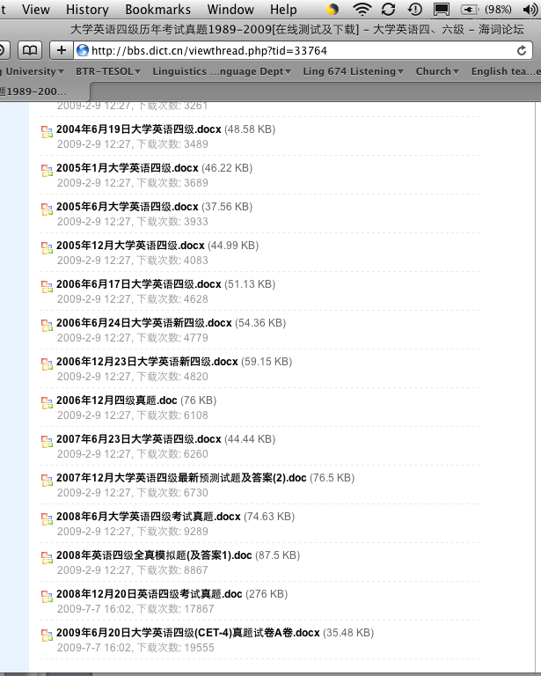
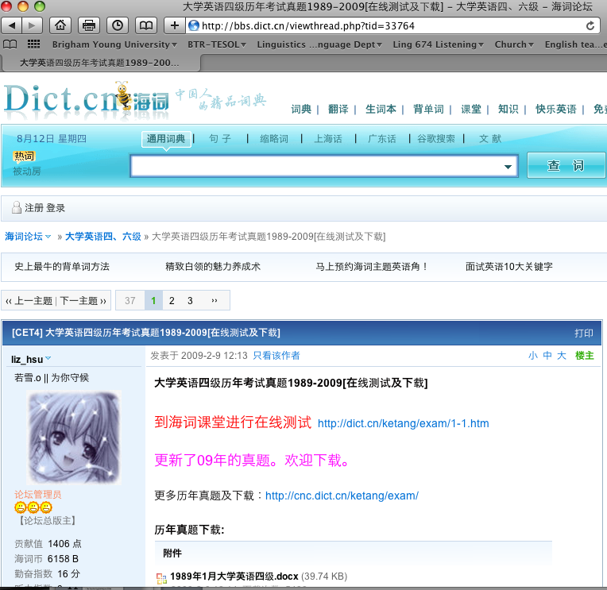
College English Test—Band 4
Sample tests for the last 20 years online athttp://bbs.dict.cn/viewthread.php?tid=33764

Slide 15
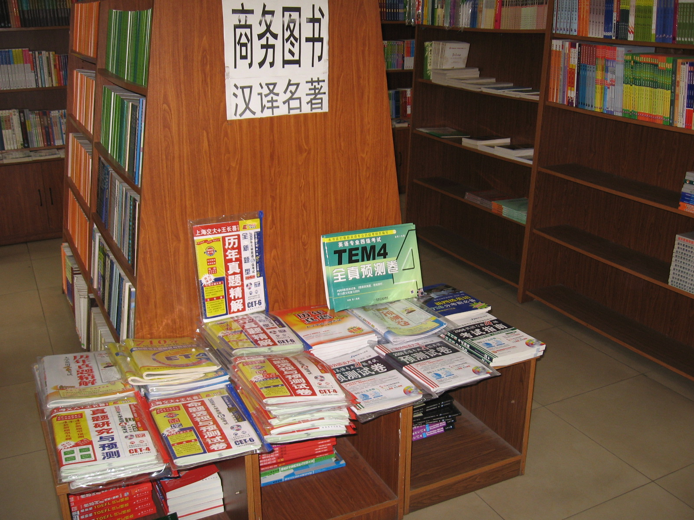


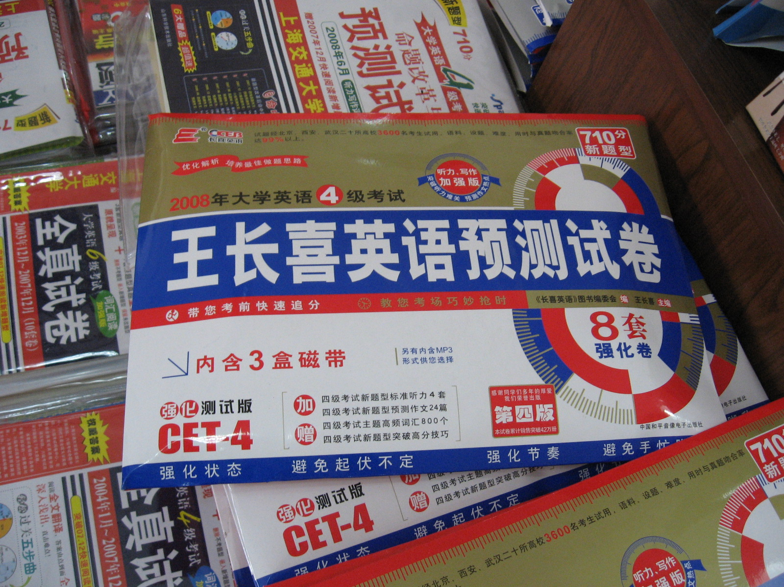
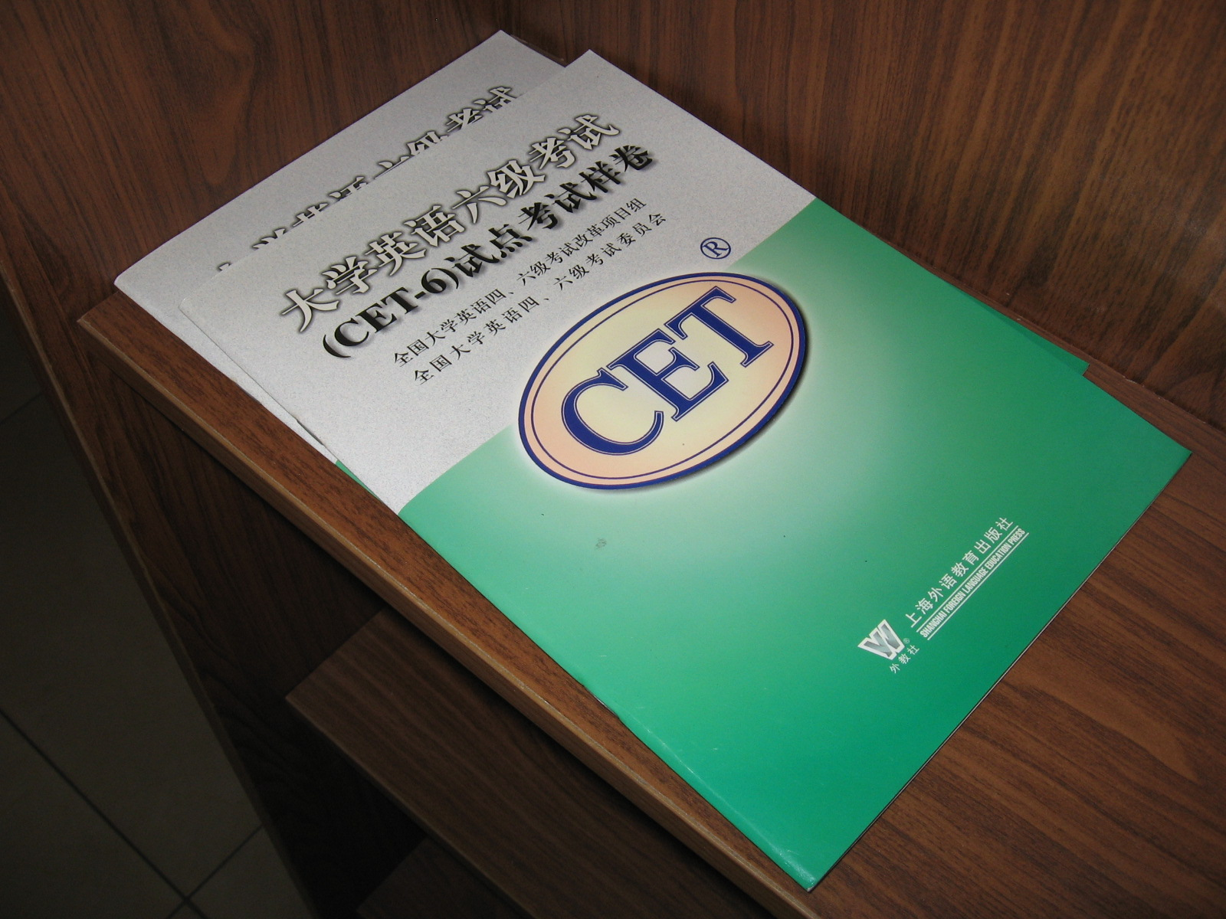
College English Test—Band 4
CET-4 practice (forecast) tests available in paper form in many university bookstores
My experience

Slide 16
College English Test—Band 4
Sample CET-4 test pages

